Slide 1

Project Title -
Seasonal Agriculture Performance Analysis
Manav verma
GNIOT (Greater Noida Institute of Technology)
AICTE STU ID : STU69e7d66a1817d1776801386

Slide 2

PROBLEM STATEMENT
Agricultural activities are influenced by seasonal variations in environmental conditions, farming practices, resource availability and market conditions. As a result, agricultural performance may differ from one season to another. However, raw agricultural data does not clearly explain how agricultural performance changes across seasons or what patterns can be observed in different seasonal conditions. The problem is to analyze the given agricultural dataset and investigate seasonal differences in agricultural performance by identifying meaningful patterns, trends, relationships and variations within the available data.

Slide 3
Project Description
This project analyzes a 4,000-record agricultural dataset covering Kharif, Rabi and Zaid seasons. The analysis examines environmental conditions, farming practices, resource usage, crop production and economic performance.
The workflow includes data understanding, missing-value/duplicate checking, exploratory data analysis, seasonal comparison, crop-wise and irrigation analysis, relationship analysis, interpretation and recommendations.
Main metrics: rainfall, temperature, soil moisture, fertilizer, yield, production, water use, water efficiency, revenue, cost, profit and disease/pest risk.

Slide 4

WHO ARE THE END USERS?
• Farmers – seasonal crop and resource planning
• Agricultural planners/departments – evidence-based planning
• Agribusinesses – production and economic planning
• Researchers & students – agricultural trend analysis
• Resource managers – water-use and input-efficiency monitoring

Slide 5

Technology Used
• Python
• Pandas & NumPy – data cleaning and analysis
• Matplotlib & Seaborn – visualization
• SciPy – statistical analysis
• Google Colab / Jupyter Notebook
• CSV dataset

Slide 6
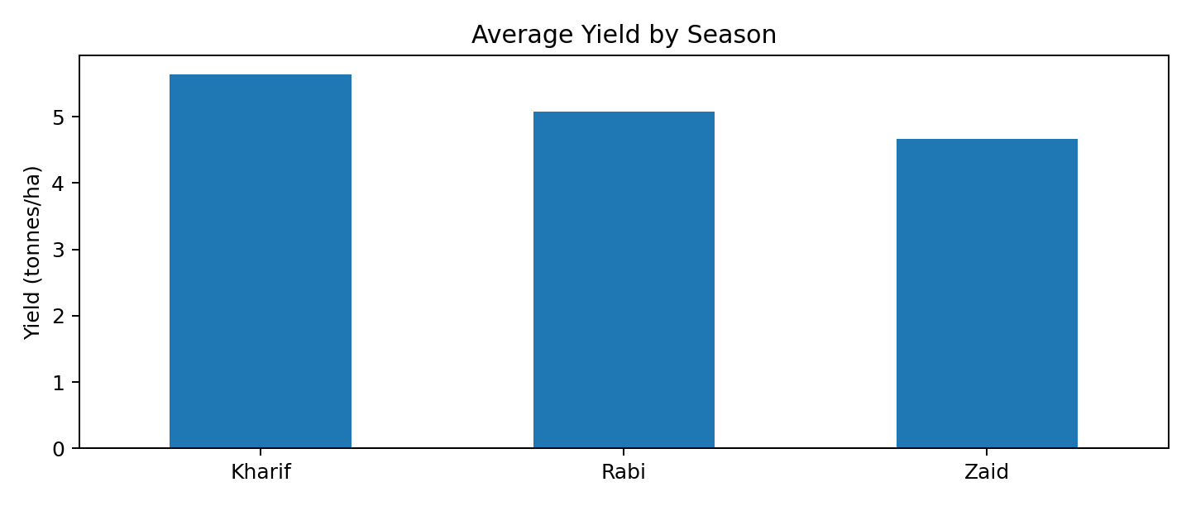
RESULTS
Kharif: 5.64 t/ha
Rabi: 5.08 | Zaid: 4.67 t/ha

Slide 7
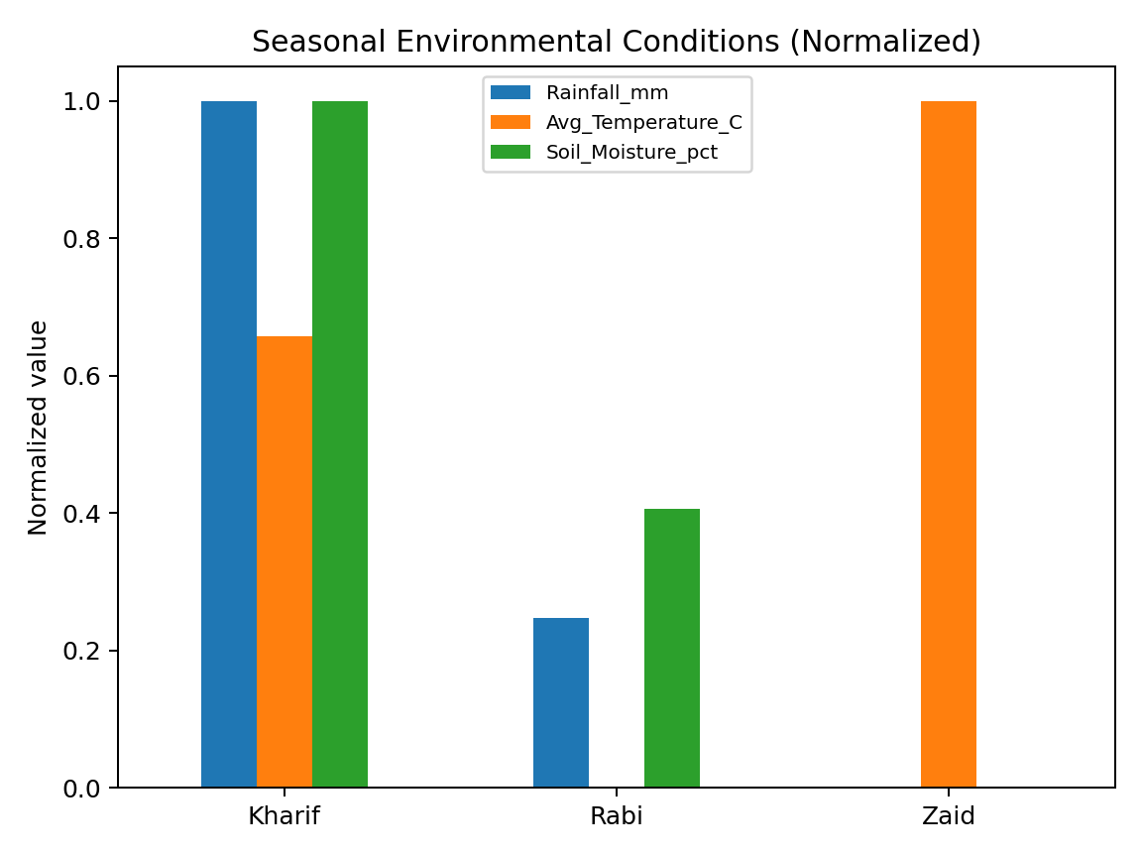
RESULTS
Kharif rainfall: 852 mm
Zaid temp: 31.04°C | soil moisture: 19.17%

Slide 8
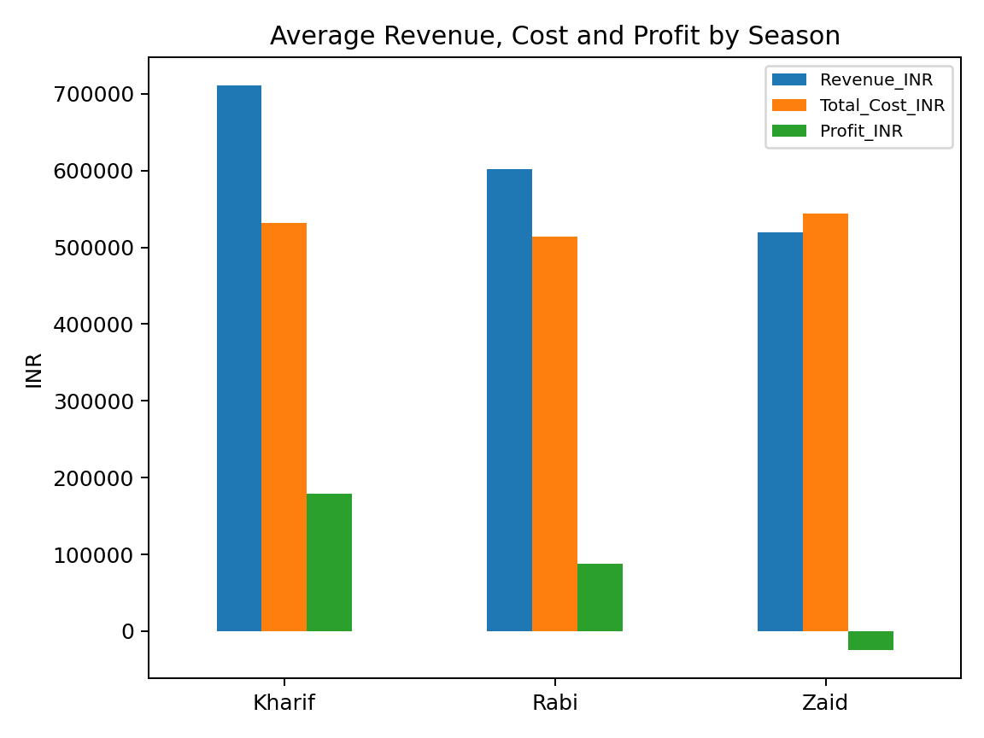
RESULTS
Kharif profit: ₹178,915
Zaid profit: ₹-24,805

Slide 9
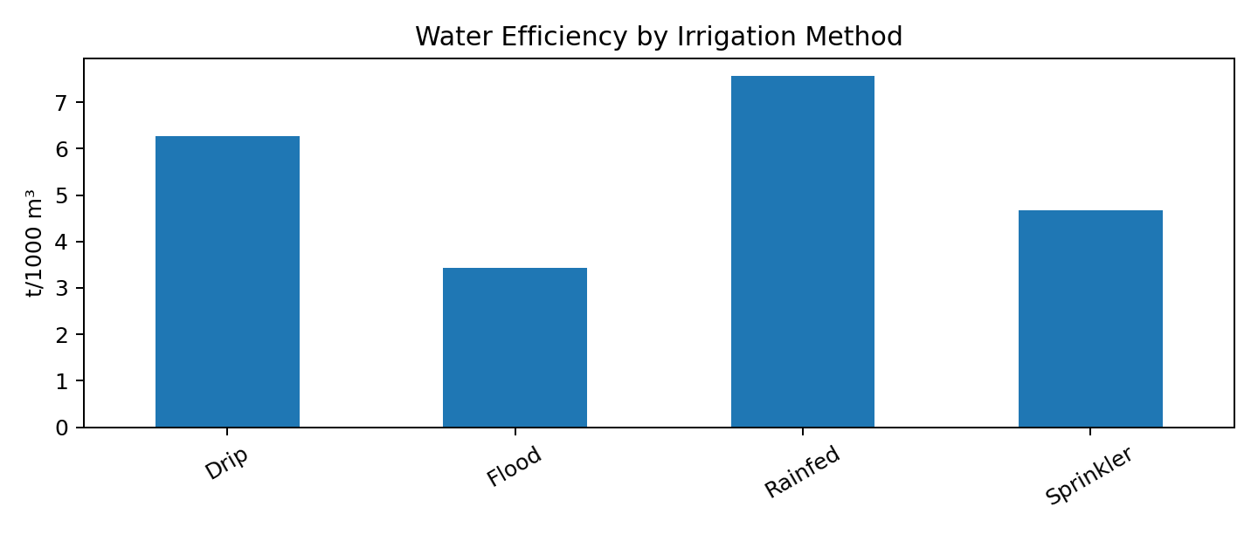
RESULTS
Drip efficiency: 6.27
Flood efficiency: 3.44

Slide 10
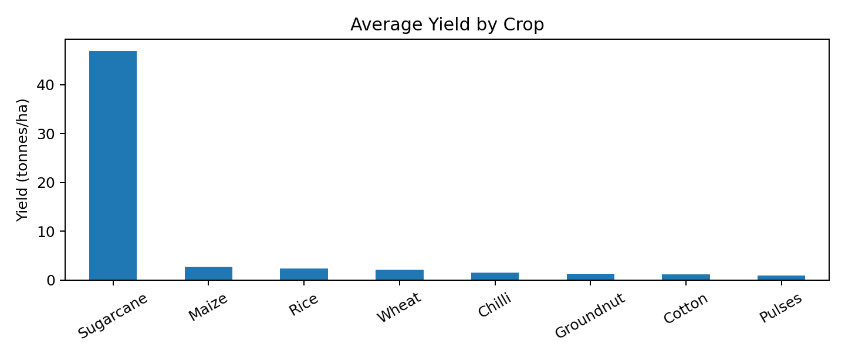
RESULTS
Highest average yield: Sugarcane (46.94 t/ha)
Lowest average yield: Pulses (0.92 t/ha)

Slide 11
Future scope
• Predict seasonal yield and profit using Machine Learning
• Integrate weather forecasts and real-time environmental data
• Build an interactive dashboard using Power BI or Streamlit
• Add crop recommendation and resource optimization
• Add district/state geospatial analysis
• Detect high-risk seasons and unusual patterns

Slide 12
GitHub Link
Project Repository:
https://github.com/AswiniKumar55/-Seasonal-Agriculture-Performance-Analysis-.git

Slide 13

VOIS Course completion certificate -
Course name- Data Visualization

Slide 14
Thank you

