Slide 1
Mealshare :
Sharable Economy
Abhijeet Limaye, Karuna Mehra, Manav Singh

Slide 2
Goals and Objectives
Provide a web and mobile platform to food enthusiasts who are looking for home cooked healthy food, no matter where they go
Provide web and mobile platform to anyone who loves cooking and wants to share their home cooked meals to generate some extra income
Encourage collaborative sharing so that communities come together
Sharing food to save food from wasting

Slide 3
Benefits
The application is beneficial to anyone who is looking for healthy food options around. For instance working professionals who want home cooked meal nearby available can easily get his meal
The application can help homemakers and chefs generate some income
The application can be help bringing communities together
Food wastage can be lowered to a greater extent

Slide 4
Food wastage – its what we don’t eat
is an immense problem that often gets buried in the 24-hour news cycle
according to a National Resources Defence Council report as much as 40 percent of all food produced in the United States never gets eaten, which amounts to Americans throwing away around $165 billion worth of food every year (or 730 football stadiums full).
Nearly 50 million Americans are food insecure
Not only do we pour wasted resources into producing that food, but the anaerobic conditions of landfills release METHANE, a powerful greenhouse gas

Slide 5
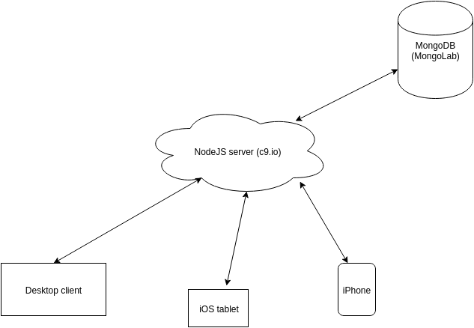
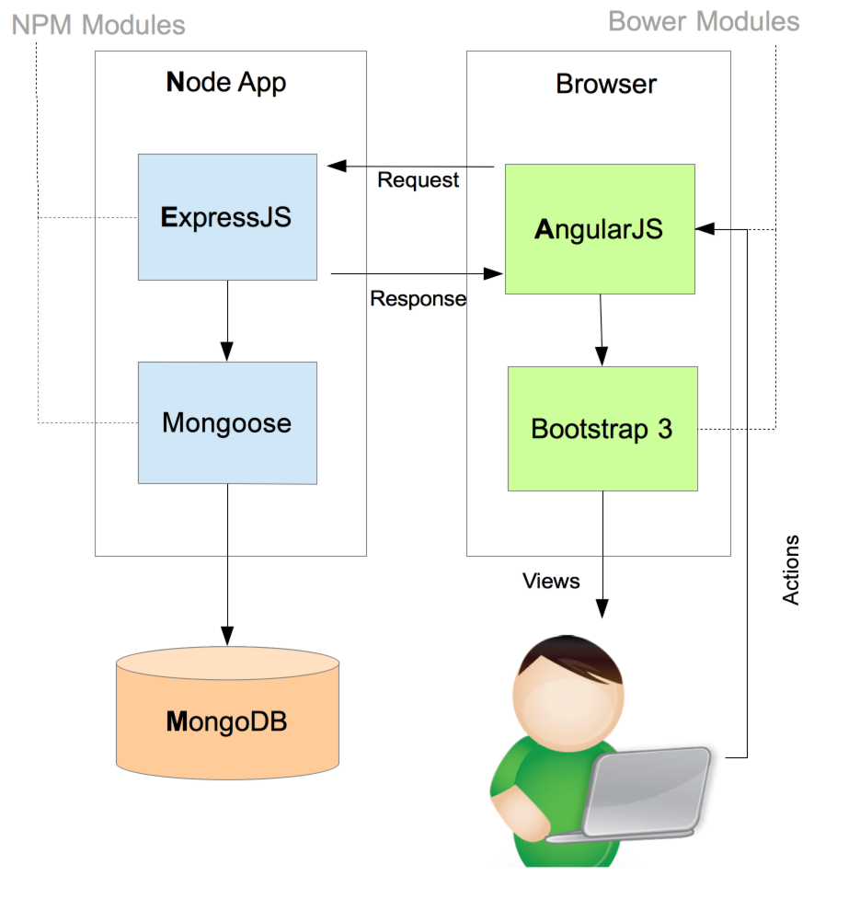
Web App Architecture

Slide 6
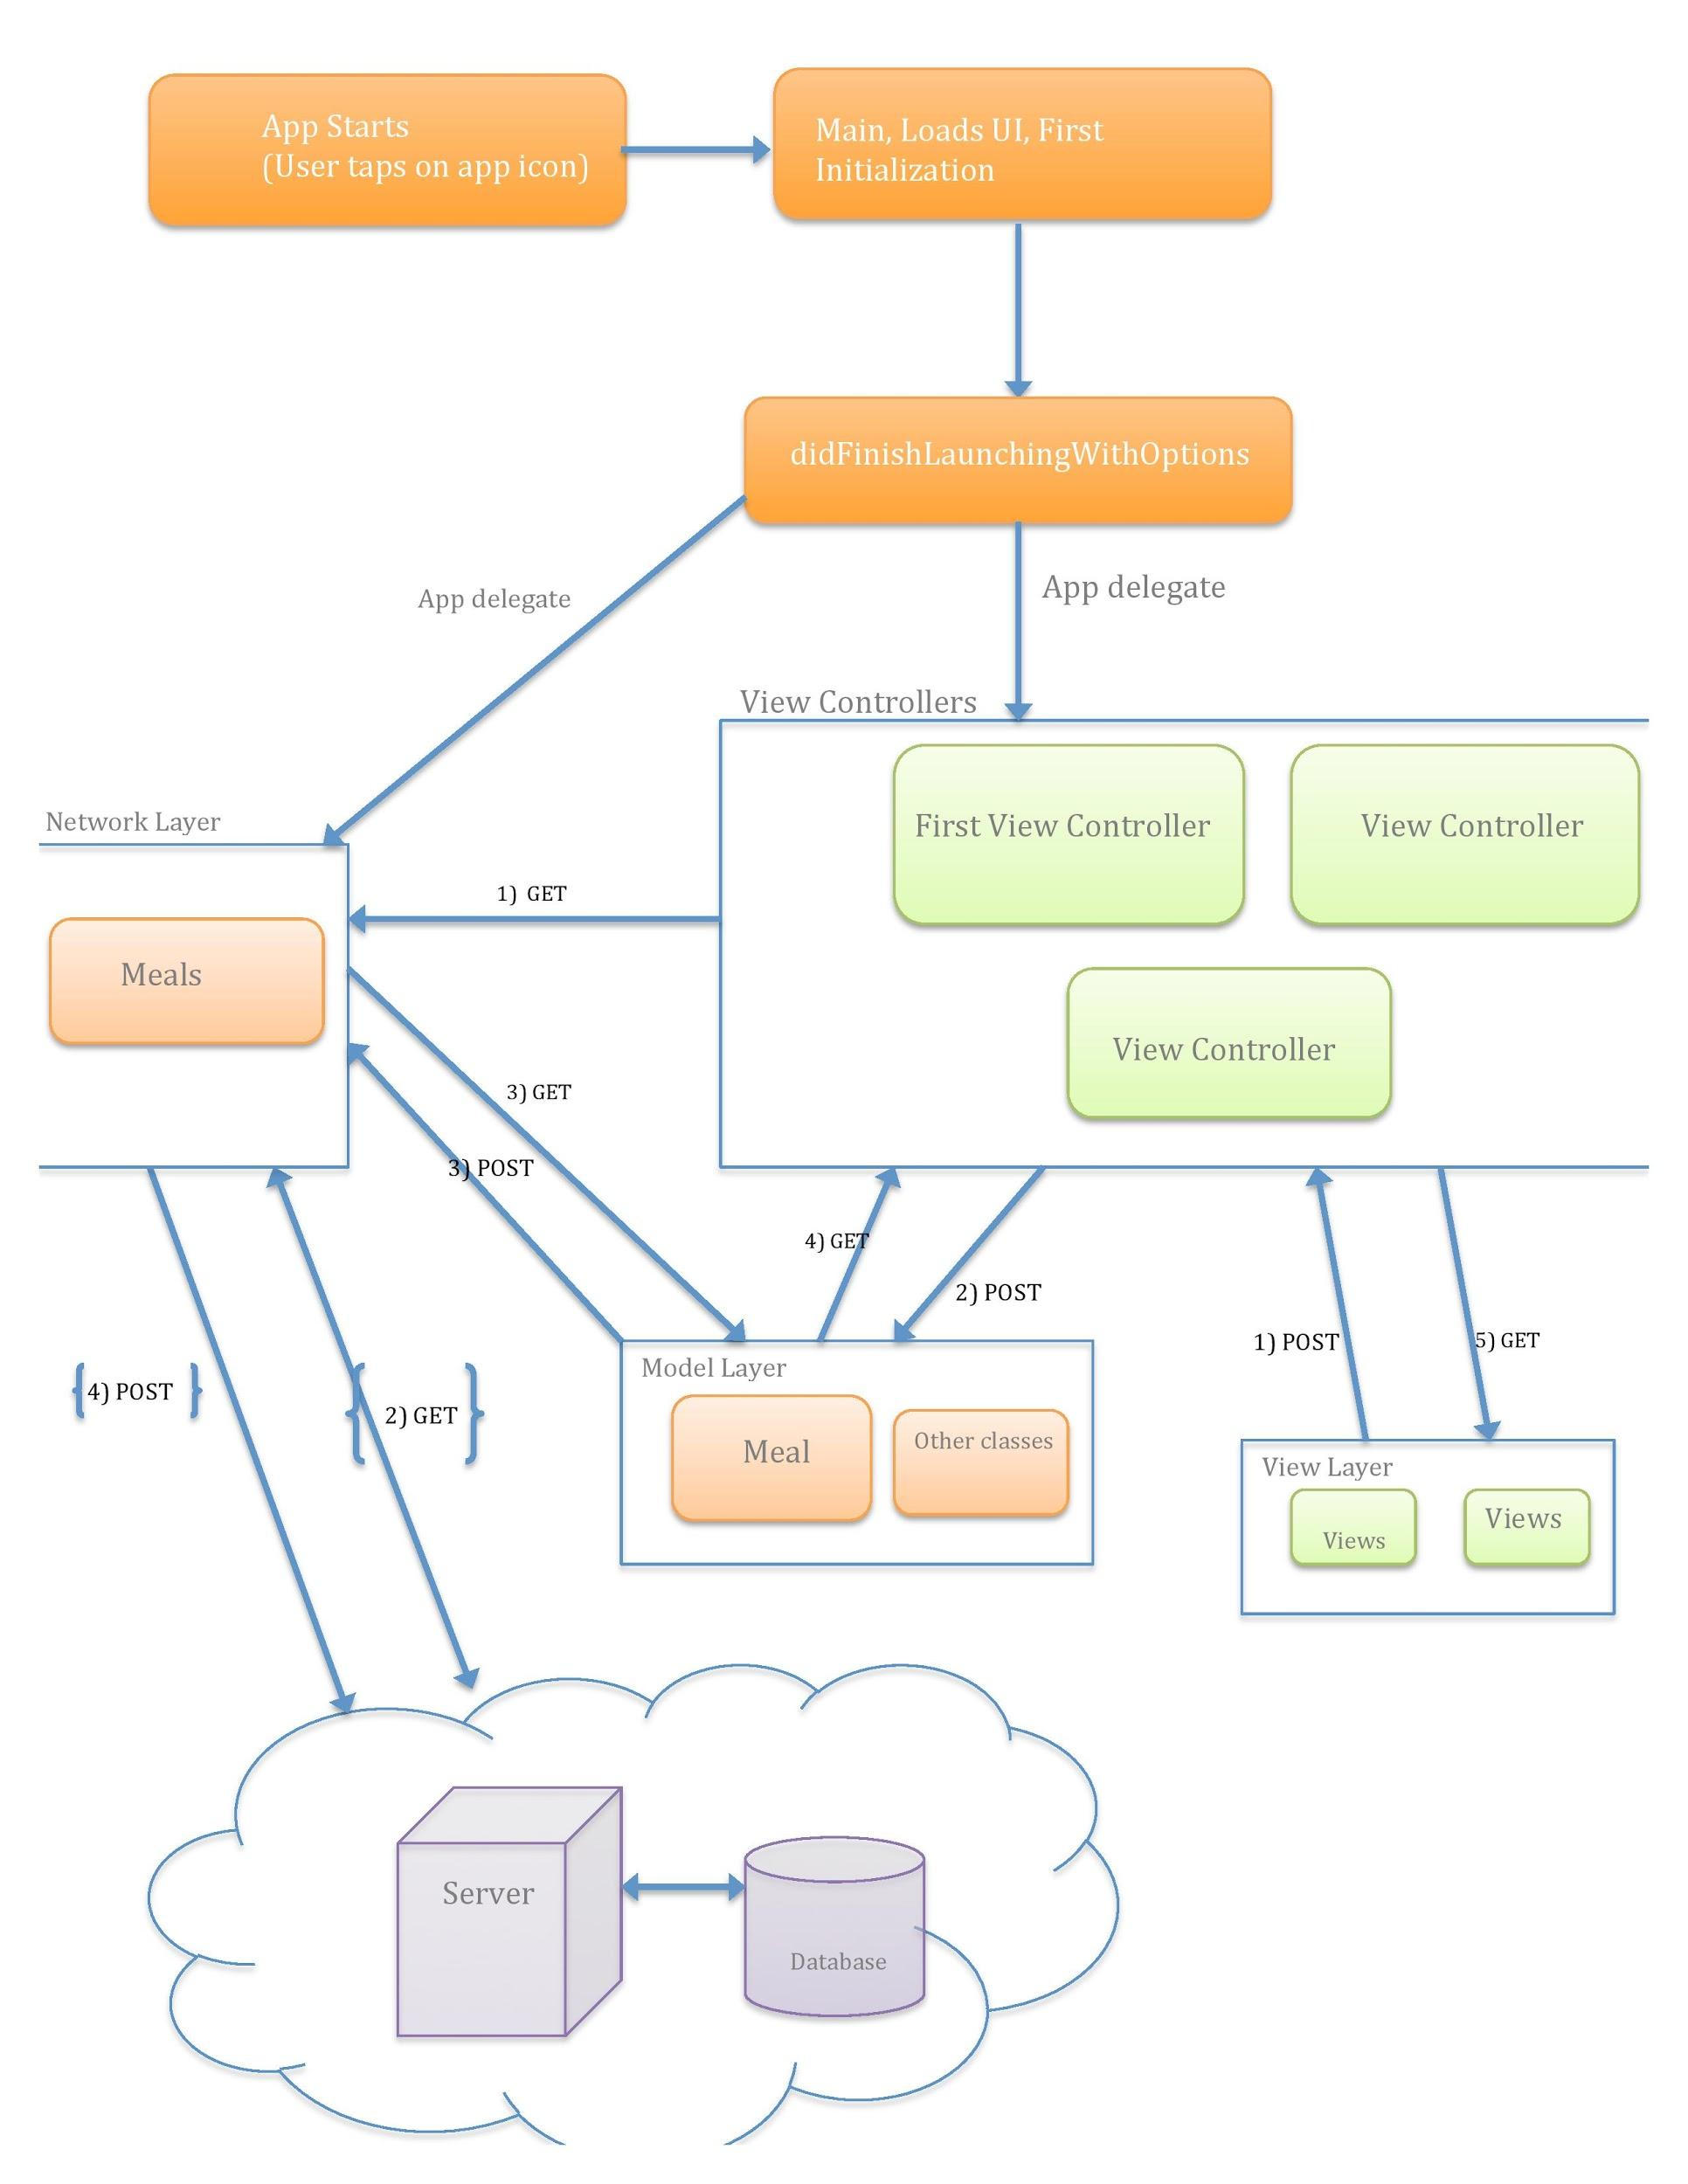
IOS App Architecture

Slide 7
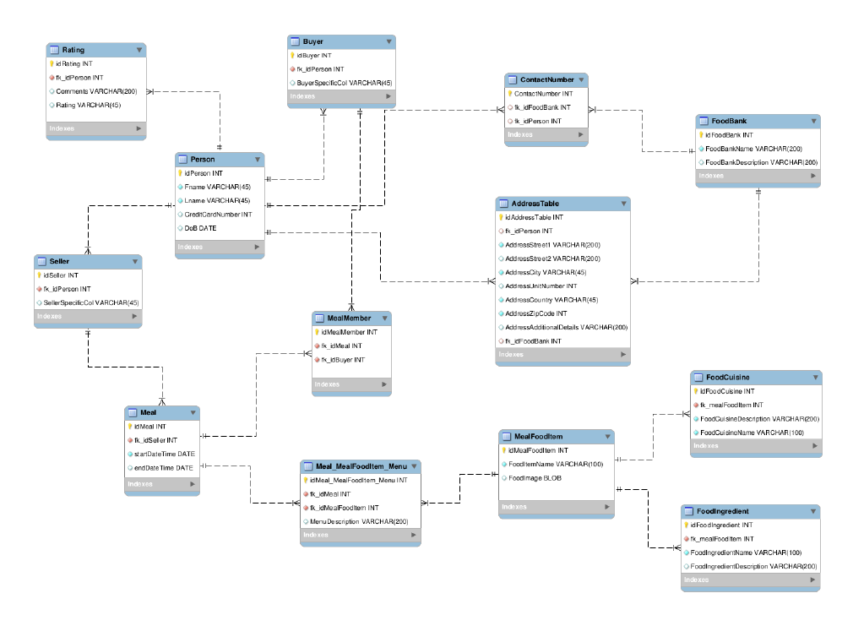
DB Schema

Slide 8



Services Provided
Buy home cooked meals through web and mobile application
Sell home cooked meals through web and mobile application
Donate home cooked meals through web and mobile application

Slide 9











Tools and Technologies

Slide 10
Recommendation
Recommendations for “trending” meals, optimum prices for a particular meal, etc.
Technologies to be used:
Apache Mahhout, Apache Kafka, Python
Collaborative filtering algorithms such as item-based, user bsed, etc.

Slide 11
Thank You!!!

