Slide 1
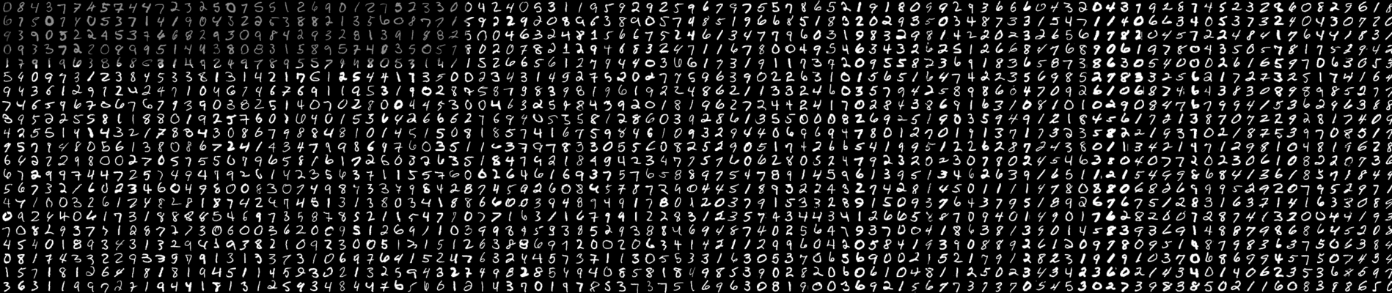

Digit Recognizer

Slide 2
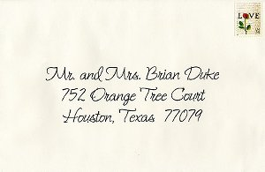

INTRODUCTION
The subject of “Handwritten digit recognition” is of great concern and has many applications in various fields like zip code recognition.

Slide 3
Misclassification:

Slide 4
Handwritten Digit data
28 x28 (= 784 pixel) Grey Scale images of digits in range 0-9
X_{i}=[x_{i1}, x_{i2}, ……. x_{i256}]
y_{i} { 0,1,2,3,4,5,6,7,8,9}
42000 labelled samples
Training set ~ 33600 images
Test set ~ 8400 images
Randomly selected from the full data base
Basic idea
– Correctly identify the digit given an image
x_{ij}
28
28

Slide 5
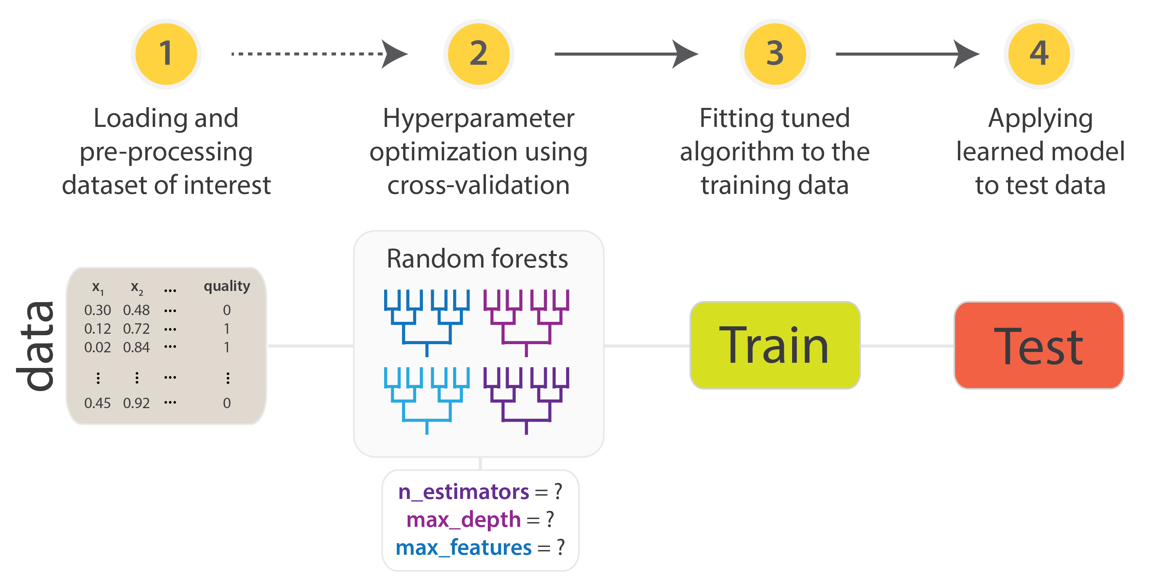
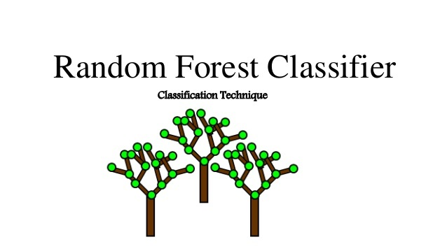

Slide 6


Slide 7
