Slide 1
Bechdel Test: Prediction and Revenues
Manav Dutta

Slide 2
The Problem
Problem is that there is an issue with representation of female characters in films
The Bechdel test asks whether a film contains a scene with two female characters talking about something other than men

Slide 3
Client and Motivation
The client is the film industry, especially Hollywood studios and directors
They have come under fire for their portrayals of female characters
The Bechdel test is a common metric used to measure this disparity
Want to examine how films pass the test and how the test affects revenue

Slide 4
Data Wrangling
Used data from data.world and bechdeltest.net
Augmented with gender data from behindthename API and box office revenue data from omdb
Used Pandas to combine them together
Filtered missing data and performed steps to transform data into a usable form

Slide 5
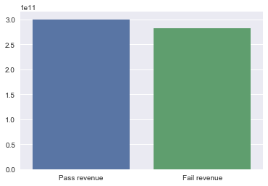
Exploratory Analysis: Mean Revenue

Slide 6
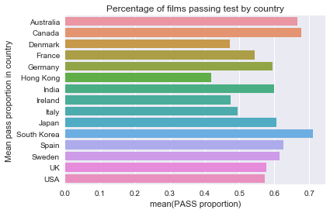
Exploratory Analysis: Pass rates by country

Slide 7
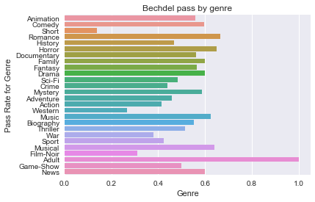
Pass rates by genre

Slide 8
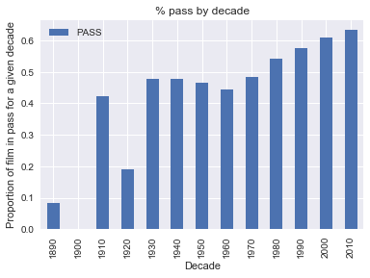
Pass rate by decade

Slide 9
Machine Learning: Choice of Method
Most features are categorical
Decided to use boosting with decision trees
This is an ensemble method consisting of weighting the results of multiple decision trees

Slide 10
Framework used
Decided to use the CatBoost library
Has built-in Python wrapper
Does conversion of categorical features into suitable forms like one hot encodings, integer labels, etc.
Robust performance and variety of metrics available for analysis

Slide 11
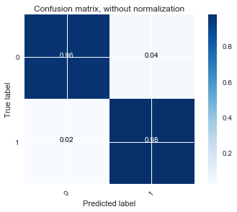
Results for binary pass/fail
Accuracy: 96.78%
Confusion Matrix:

Slide 12
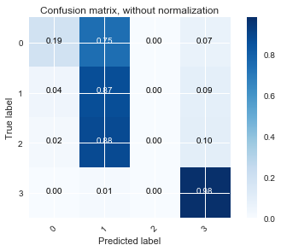
Results for multiclass classification
Includes particular reasons why film failed Bechdel test
Accuracy: 77.65%

Slide 13
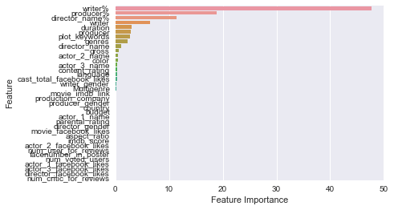
Feature Importance
It appears that the writer and producer’s past records are important
for classification purposes.

Slide 14
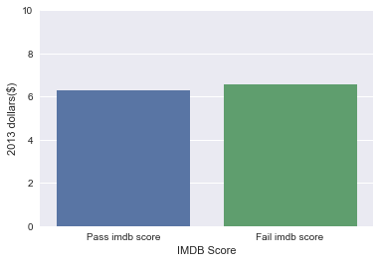
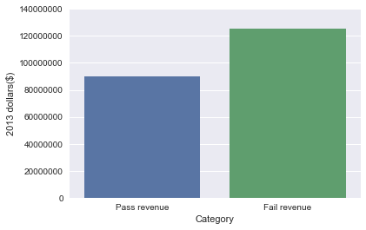
Box office revenue/Popularity analysis
Focused on films made in the US from 1990-present

Slide 15
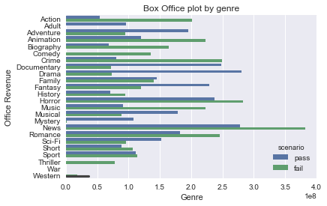
Box Office Revenues

Slide 16
Recommendations
Focus on selecting writers and producers with a good past record of passing the Bechdel test
Focus on creating films that pass in the Sci-Fi, Musical, Adventure, Drama, and Fantasy genres
Overall trend is an increase in films passing the Bechdel test

Slide 17
Further Research
Focus on personal and artistic attributes of writers and producers when predicting which films by new writers/producers will pass the test
Focus on how Bechdel test works in other countries
Data on Netflix views and VHS/DVD revenue for these films would be nice to look into

