Slide 1

SpeedAhead.com
Submitted as Minor Project
Project Supervisor:
Ms. Priyanka

Slide 2
Team Introduction
Manav Bagai (12PEB338) manav@gmail.com
I am a Btech 3rd year student.
Expertise: Web Development with PHP, JavaScript, CSS.
Siddharth Gupta (12PEB576)sidg@gmail.com
I am a Btech 3rd year student.
Expertise: Online Shopping Scheme, Free ke recharge , Fifa

Slide 3
Technology Used:
HTML
PHP
JAVASCRIPT
CSS
JQUERY
MYSQL
GOOGLE CUSTOM SEARCH

Slide 4
Project Summary
The idea behind the project is to develop a web application which displays & manages car catalogue and provides various information for the cars and car dealers of various cities. This is a set of useful features that helps you in planning, finding and booking cars. Wishlist feature is also available to save your interested cars.

Slide 5
Want to buy car?? We are here.
Until today car buying is a very time taking process, going to various showrooms, asking price, specs of cars. Then making a wish list of cars in which you are interested, then choosing one and again going to showroom to book it.
But from today by our web application this can be done from one place, your own computer. Only you need an internet connection then all car showroom will be one click away.

Slide 6
Business Concept
SpeedAhead.com website allows you to check various cars, car dealers in Aligarh, Delhi, Kolkata, Mumbai with brands like Maruti Suzuki, Audi, Hyundai, Toyota, BMW, Tata, Honda, Chevrolet . Wish list, Car Booking and separate login & registration system are also available to make it user friendly. It is online event management system, runs on web browsers worldwide and has virtually no installation costs. Instant availability and 24X7 Booking options make you buy car instantly. Several user reviews also help people to choose vehicle wisely.

Slide 7
Ok, Buying.. Fine! How to sell vehicles???
For selling vehicles on our website you only have to register on our website and contact us to give your details and cars to be sold. For security purpose we have not added sellers by simple registration only. After giving details complete verification of seller will be done by our team. Then cars will be uploaded on website by us as per seller.

Slide 8
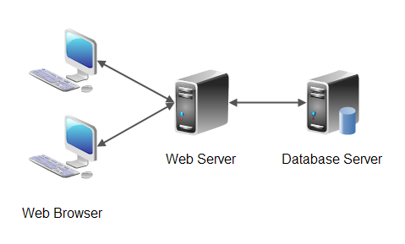
How about the System Architecture?

Slide 9
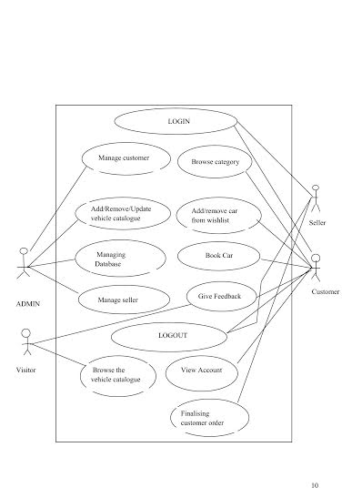
And the Conceptual Use-Case?

Slide 10
Makes Sense, Straight to the preview!

Slide 11
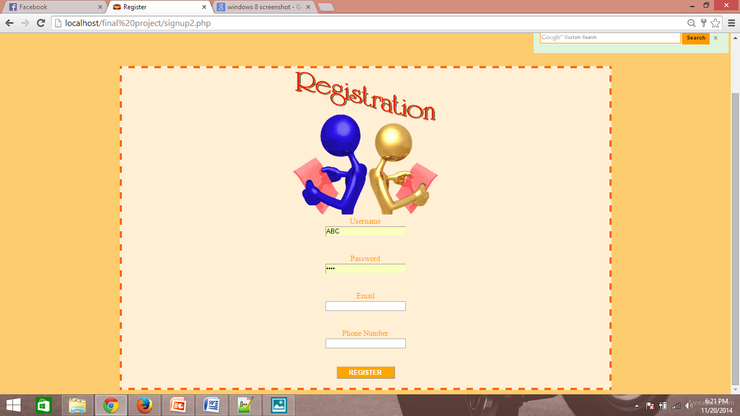
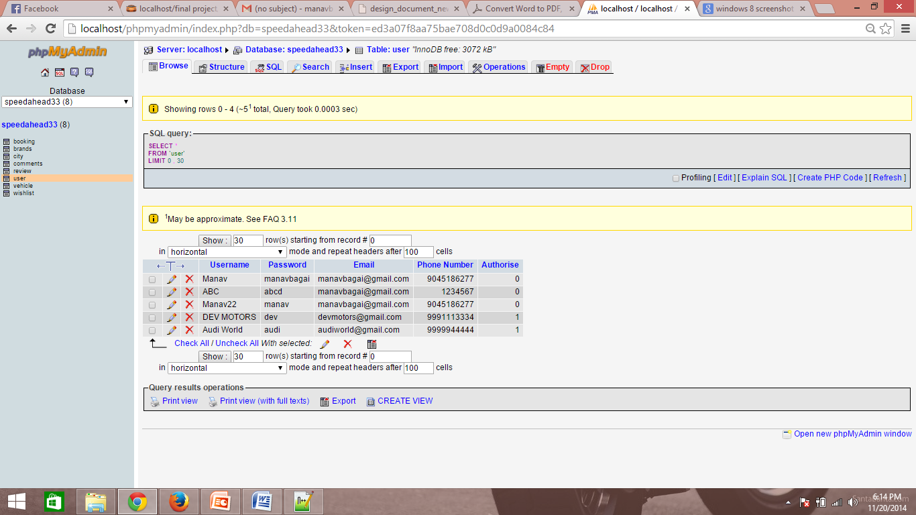
Our Functionalities..
Register- signup2.php

Slide 12
<?php
if(isset($_POST['submit']))
{
$username=$_POST['username'];
$pass=$_POST['password'];
$email=$_POST['email'];
$phone=$_POST['Phone'];
$query="INSERT INTO `user` (`Username`, `Password`, `Email`, `Phone Number`) VALUES ('".$username."', '".$pass."', '".$email."', '".$phone."')";
if(mysql_query($query))
{
echo '<br><br>Account added Successfully!';
}
else
echo "Duplicate entry!";
}
?>

Slide 13
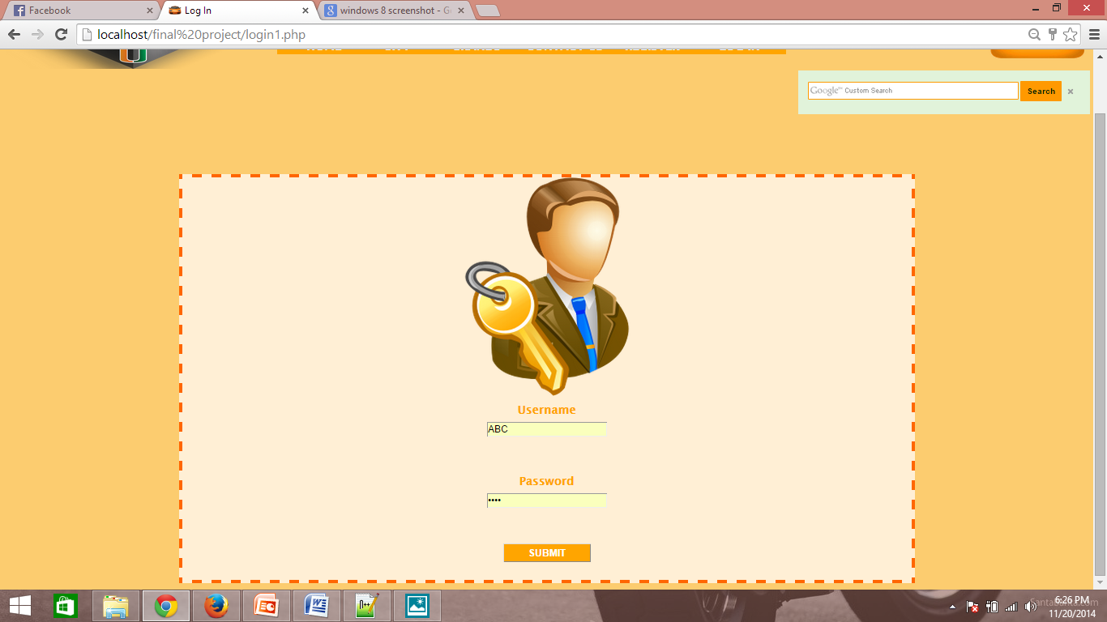
2. Login: login1.php

Slide 14
<?php
function check_for_existence($query){
if($query_run = mysql_query($query)){
$row=mysql_fetch_assoc($query_run);
$query_num_rows = mysql_num_rows($query_run);
return $query_num_rows;
}else{
return die('error');
}
}
if(isset($_POST['username']) && !empty($_POST['username']) && isset($_POST['password']) && !empty($_POST['password'])){
$user_name = $_POST['username'];
$pass_word = $_POST['password'];
$query12 = "SELECT username FROM `user` WHERE `username` ='".$user_name."' AND `password` = '".$pass_word."'";
if(check_for_existence($query12) == 1){
session_start();
$_SESSION["username"]=$user_name;
echo '<script type="text/javascript">
goBack();</script>';
}else{
echo '<strong>Please enter valid username and password combination!</strong>';
}
}
?>

Slide 15
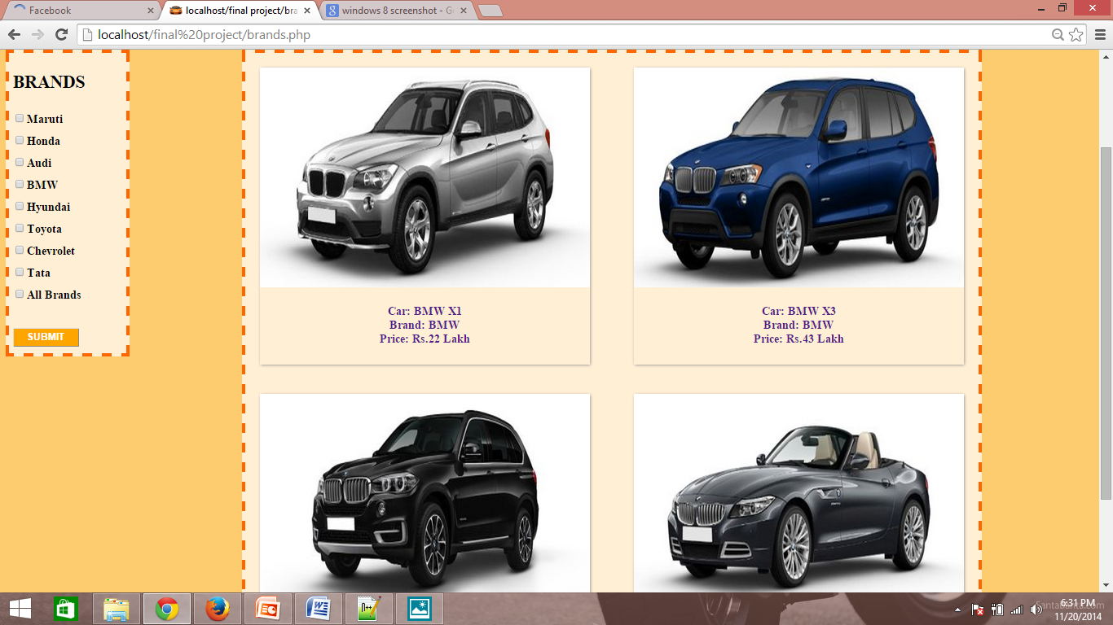
3. Catalogue: brands.php

Slide 16
<?php
echo'<span class="layout">';
if($query1_run=mysql_query($query1)){
while($row=mysql_fetch_assoc($query1_run)){
$bun=$row['Car Name'];
$bun2=$row['Brand'];
$bun3=$row['Price'];
$bun4=$row['Photo'];
echo'<a href="vehicle.php?value='.$bun.'">';
if($count%2==1)
{
echo '<div class="img1">';
}
else{
echo'<div class="img">';
}
echo'<img src="'.$bun4.'" width="450" height="300"><br>';
echo "<center><strong><br> Car: ".$bun."<br> Brand: ".$bun2."<br> Price: Rs.".$bun3." Lakh</strong></div></center>";
$count++;
}
echo'</a></span>';
}
?>

Slide 17
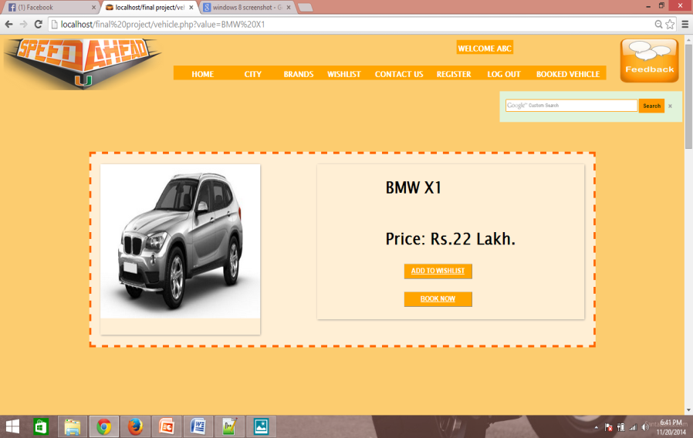
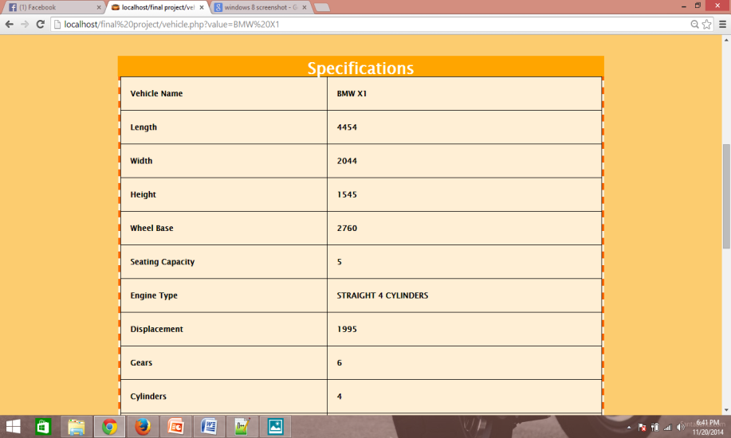
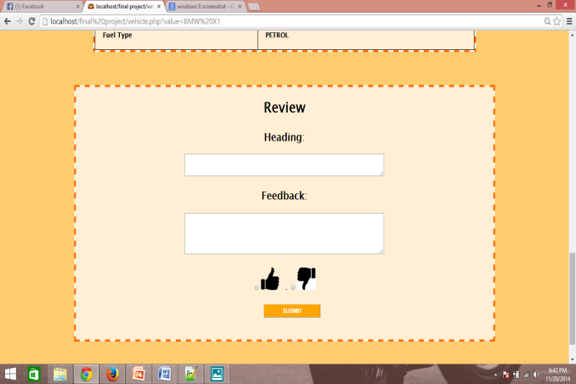
4.Vehicle: vehicles.php

Slide 18
<?php
$abcd=$_GET['value']; //fetch car name from brands.php
$query1="SELECT * FROM `vehicle` WHERE `Vehicle Name` ='".$abcd."' ";
$query2="SELECT `Price` FROM `brands` WHERE `Car Name` ='".$abcd."' ";
if($query2_run=mysql_query($query2)){
$row2=mysql_fetch_assoc($query2_run);
$un1=$row2['Price'];
}
if($query1_run=mysql_query($query1)){
$row=mysql_fetch_assoc($query1_run);
$un=$row['Vehicle Name'];
$un2=$row['Photo'];
$un3=$row['Length'];
$un4=$row['Width'];
$un5=$row['Height'];
$un6=$row['Wheelbase'];
$un7=$row['Seating Capacity'];
$un8=$row['Engine'];
$un9=$row['Displacement'];
$un10=$row['Gears'];
$un11=$row['Cylinders'];
$un12=$row['Power'];
$un13=$row['Torque'];
$un14=$row['Fuel'];
$un15=$row['Milage'];
$un16=$row['Fuel Type'];
echo'<div class="layout">';
echo'<div class="img"><img src="'.$un2.'" width="350" height="300"></div><div class="img1"><h1>'.$un.'<br><br><center> Price: Rs.'.$un1.' Lakh.</h1></center>
<u><a href="wishlist1.php?value1='.$un.'">
<input type="button" name="submit" value="Add to wishlist" class="submit">
</a><br><a href="book.php?value2='.$un.'"><input type="button" name="submit" class="submit" value="Book Now"/></u> </div></a><br><br><br>';

Slide 19
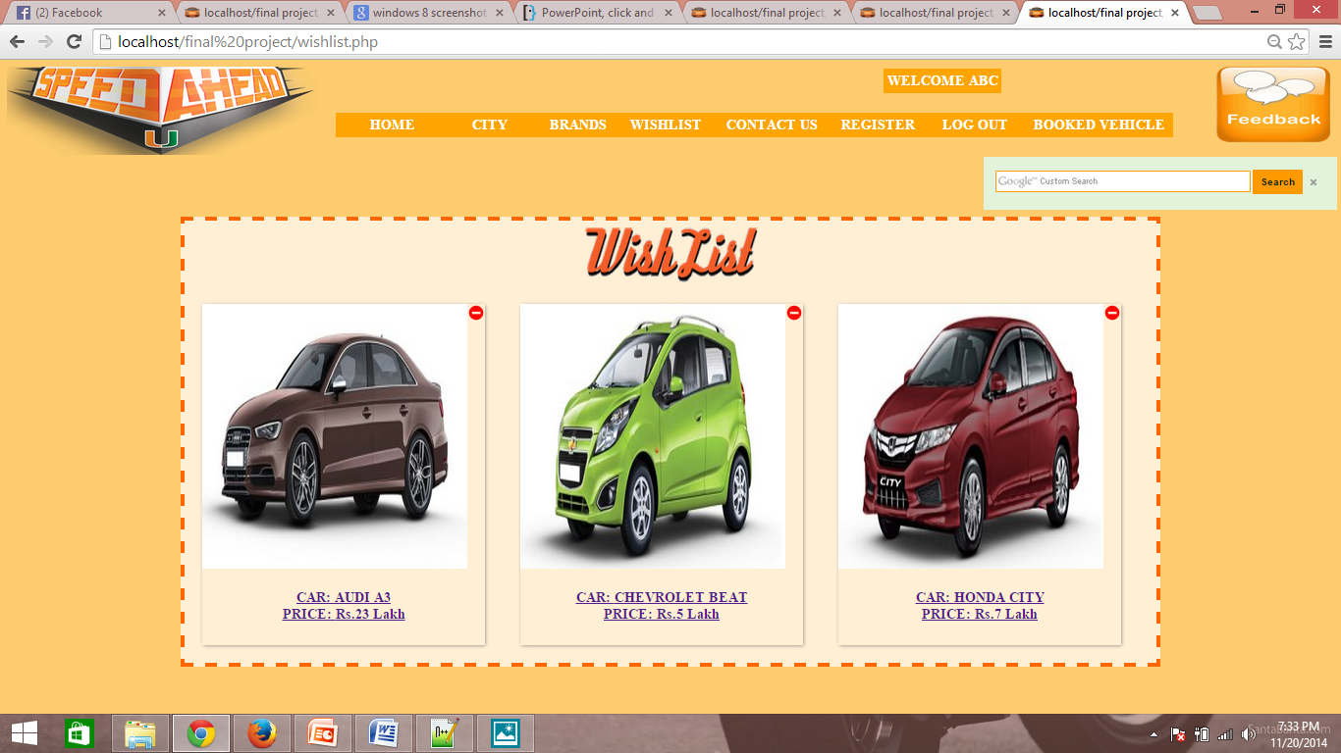
5. Wishlist
Addition and Removal from Wishlist

Slide 20
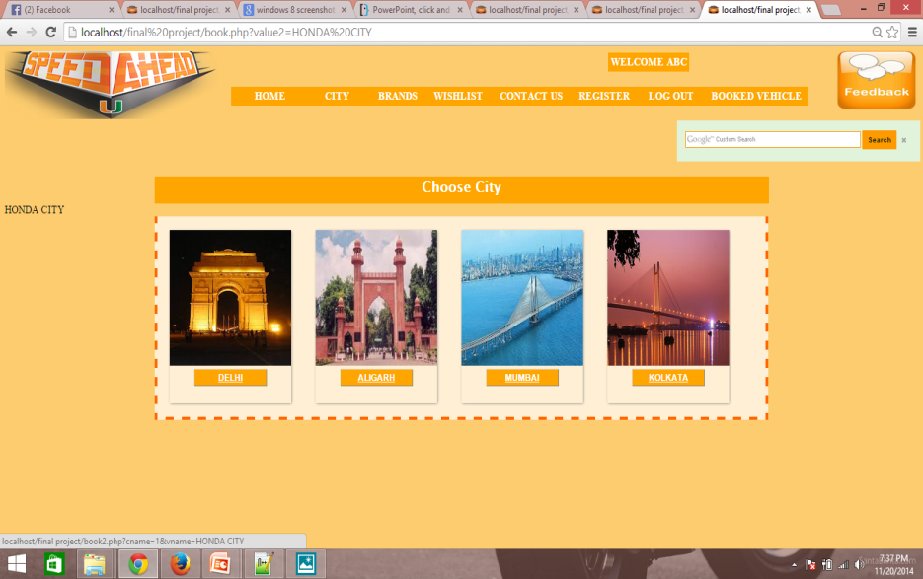
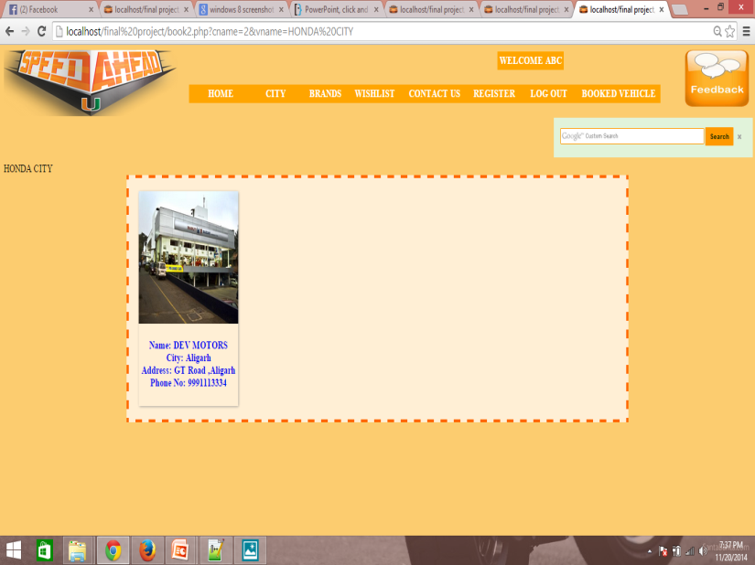
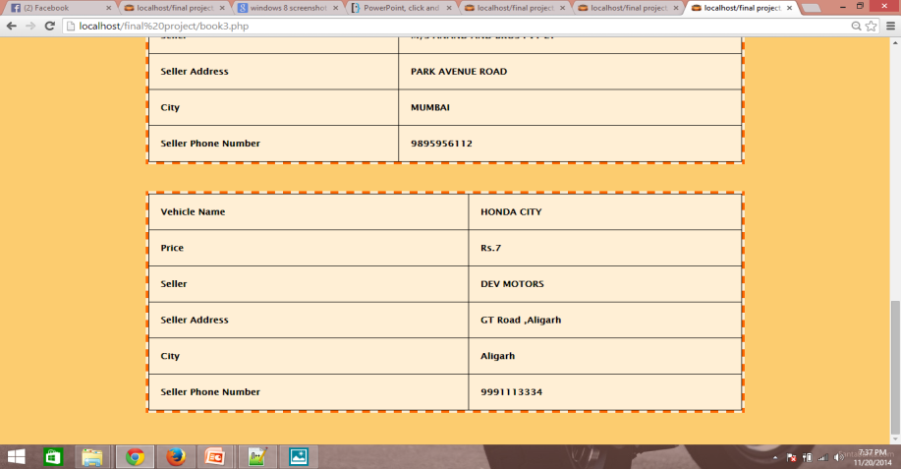
6: Booked Vehicle Choose City->Choose Dealer->Booked!!!

Slide 21
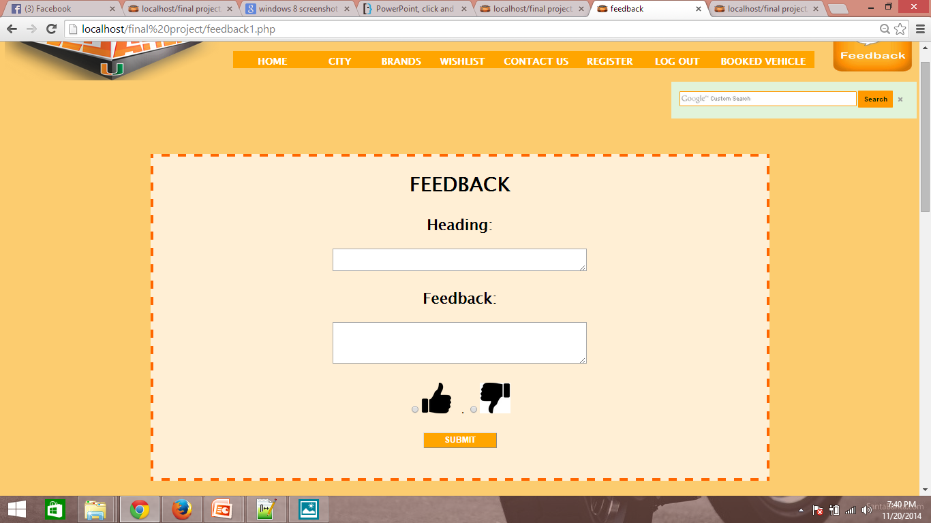
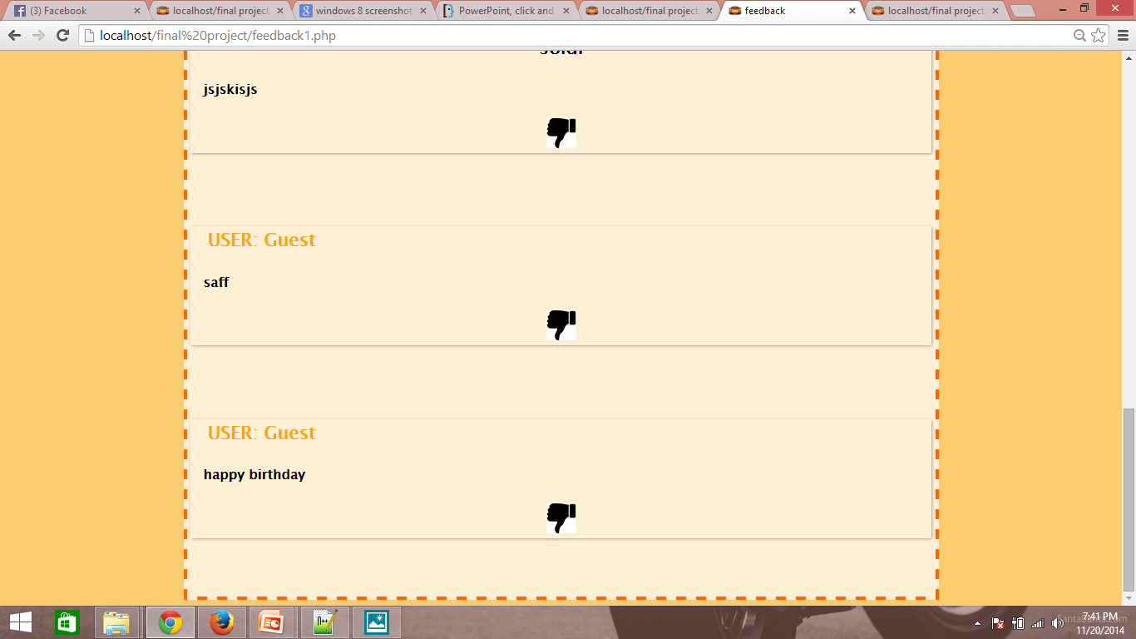
7. Feedback!!!

Slide 22
Ofcourse, few snaps cannot explain it all..
Please bear with me for a few moments & let me expose more of the system’s potential!!

Slide 23
Still Assertive? Let us explain..
How we are different from the already existing similar services..
All event management systems are not created equal. These are created with some purposes in mind. Our main purpose was to integrate several car dealers of various city to give user friendly experience. Any further suggestion can be given on our Feedback page of our website so that we could improve our services.

Slide 24
Future Potential Of Such Concept?
This project can further be taken to new level in future like increasing more cities, more seller and also increasing more functionalities. Also payment portal can be added in future for vehicle booking.
Also several security features like SMS and Email confirmation can be added.

Slide 25
Conclusions
We want to thank our mentor Ms. Priyanka for helping us to work on this project and mentoring us to complete this project.
Thank You everybody for giving us some time to show our work.We wish good luck to everybody for their presentations.

Slide 26
The end is no where
Becaz
This is just a begining

Slide 27
THANK YOU

