Slide 1

IntelliJ Idea Plugin
Group 2

Slide 2
What are we trying to achieve?
Designite as an IntelliJ plugin is responsible for detecting code smells.
Display Code Smells and Code Metrics in the Tool Window.
Display the Smells in Line Markers.
Create a Project Level User-Interface for smells.

Slide 3
Meeting Statistics
Meetings with the client team: 8
Meetings with the TA: 5
Internal meetings: 25

Slide 4
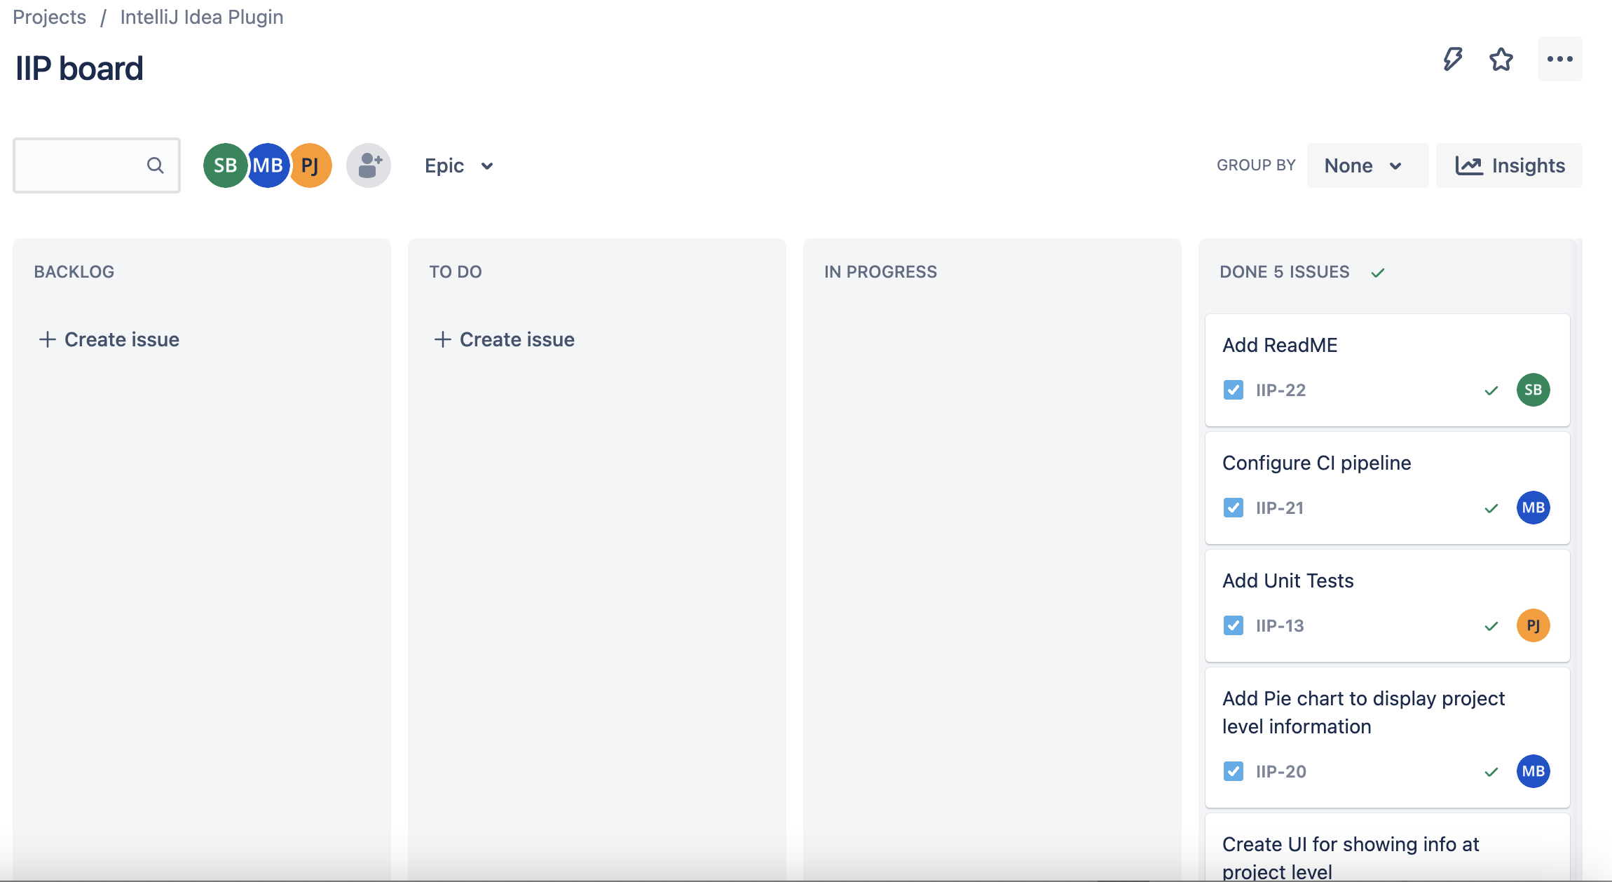
Dashboard

Slide 5
Milestones
Achieved:
Display Test Smells.
Display Architectural Smells
Displaying Progress Bar.
Providing Links to Class/Methods/Package having Smells.
Displaying Testability smells
Creating the Project Level User-interface

Slide 6
DEMO

Slide 7
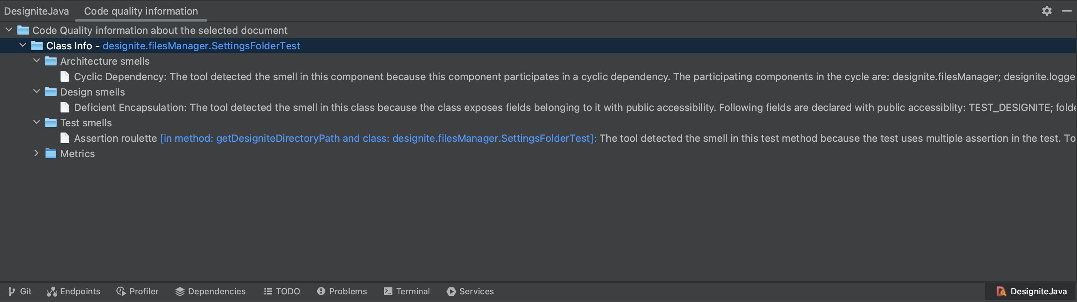
Screenshots
Architecture and Test Smells.

Slide 8
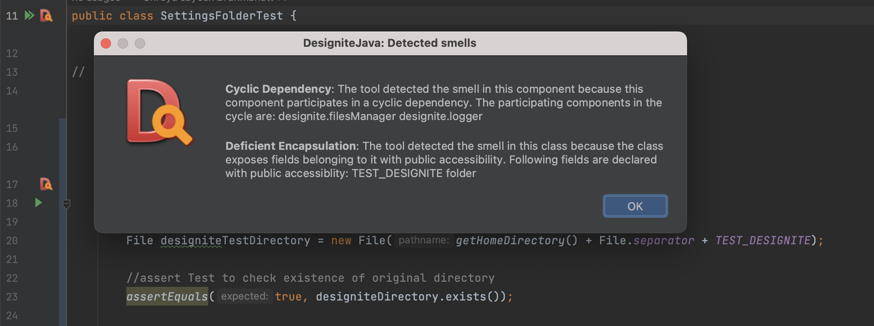
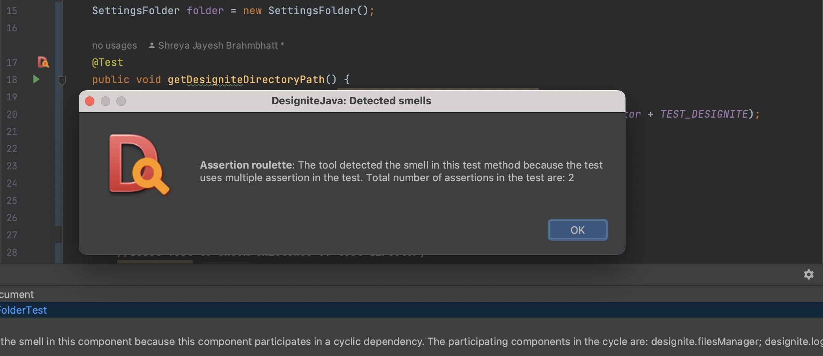
Architecture and Test Smells in Line Marker

Slide 9
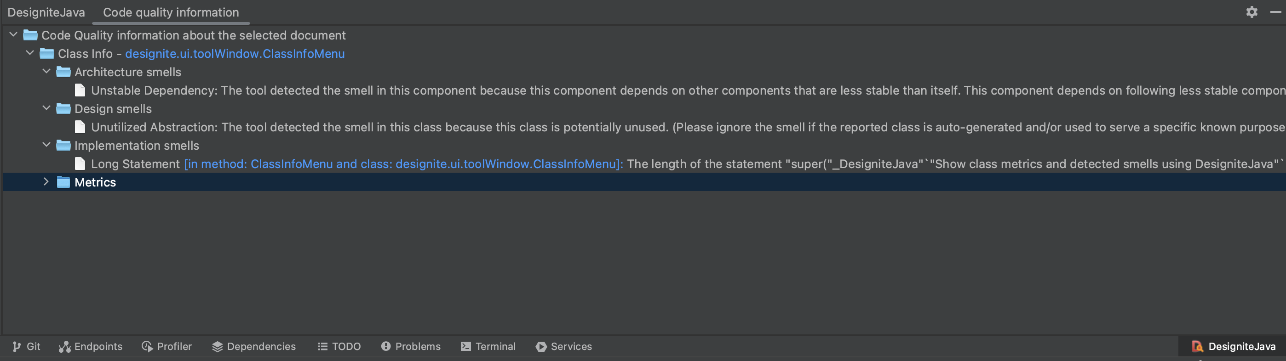
Links in the Tool Window

Slide 10
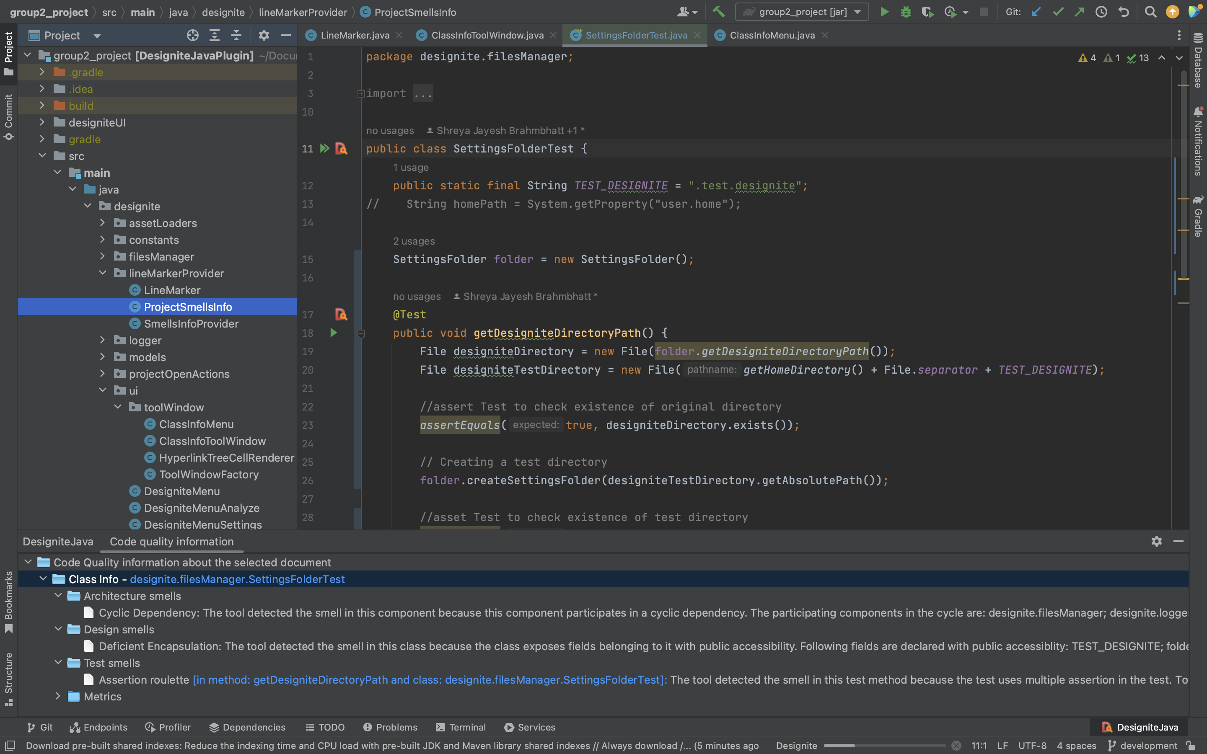
Progress Bar

Slide 11
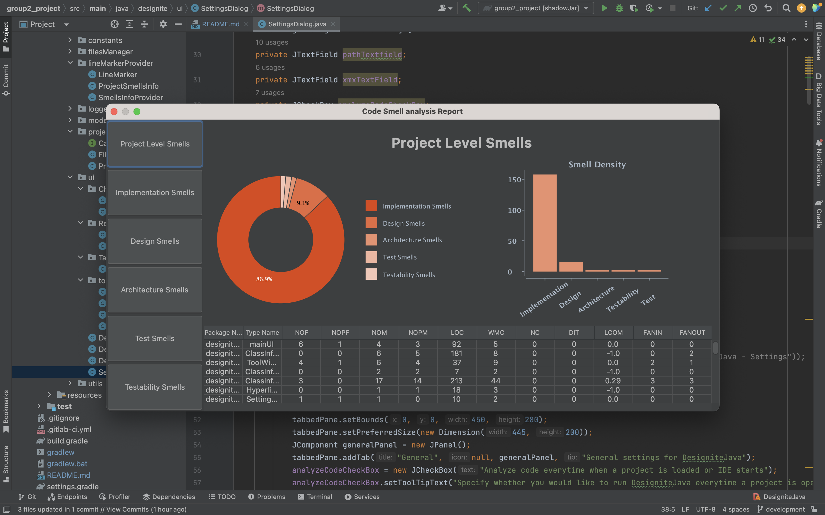
Project Level User-Interface

Slide 12
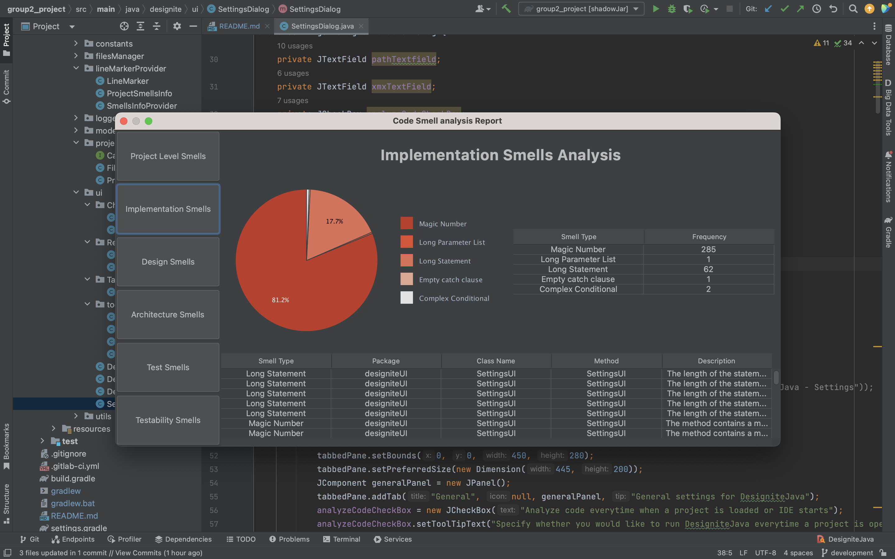
Specific Smell

Slide 13
Challenges faced
Learning IntelliJ Plugin SDK
Understanding Existing Code
Understanding IntelliJ UI elements
Understanding Runners and integrating external tools in CI Pipeline

Slide 14
Thank You
Group: 2
Parth Jindal
Manav Bhikadiya
Shreya Brahmbhatt
Nilesh Kopparty

