Slide 1


ATLIQO TELECOM ANALYSIC
After launching 5G plan: Average revenue has decreased by 0.50% .
The active users are decreased by 8.25% after 5 G.
Smart recharge (pack 2g combo),super saviour pack(1.5 gb) ,elite savier pack (1gb) and mini data saver (500mb) they contribute half of the revenue.
Top unsubscribing users are from Delhi, Kolkata, Bangalore, Chennai and Pune, they are having unsubscription rate more than 6.5%.
Suggestions:
The cost of the internet plans need to think again, as it is observed that the ARPU is more after launching 5G, even when the numbers of unsubscribed users is going up. Cost might be the major reason for decreased active users.
Internet plans has to be optimized as only 3 plans are contributing half of the revenue, where as other 7 plans combine share other half.
Need to check proper network connectivity on low performing cities.

Slide 2
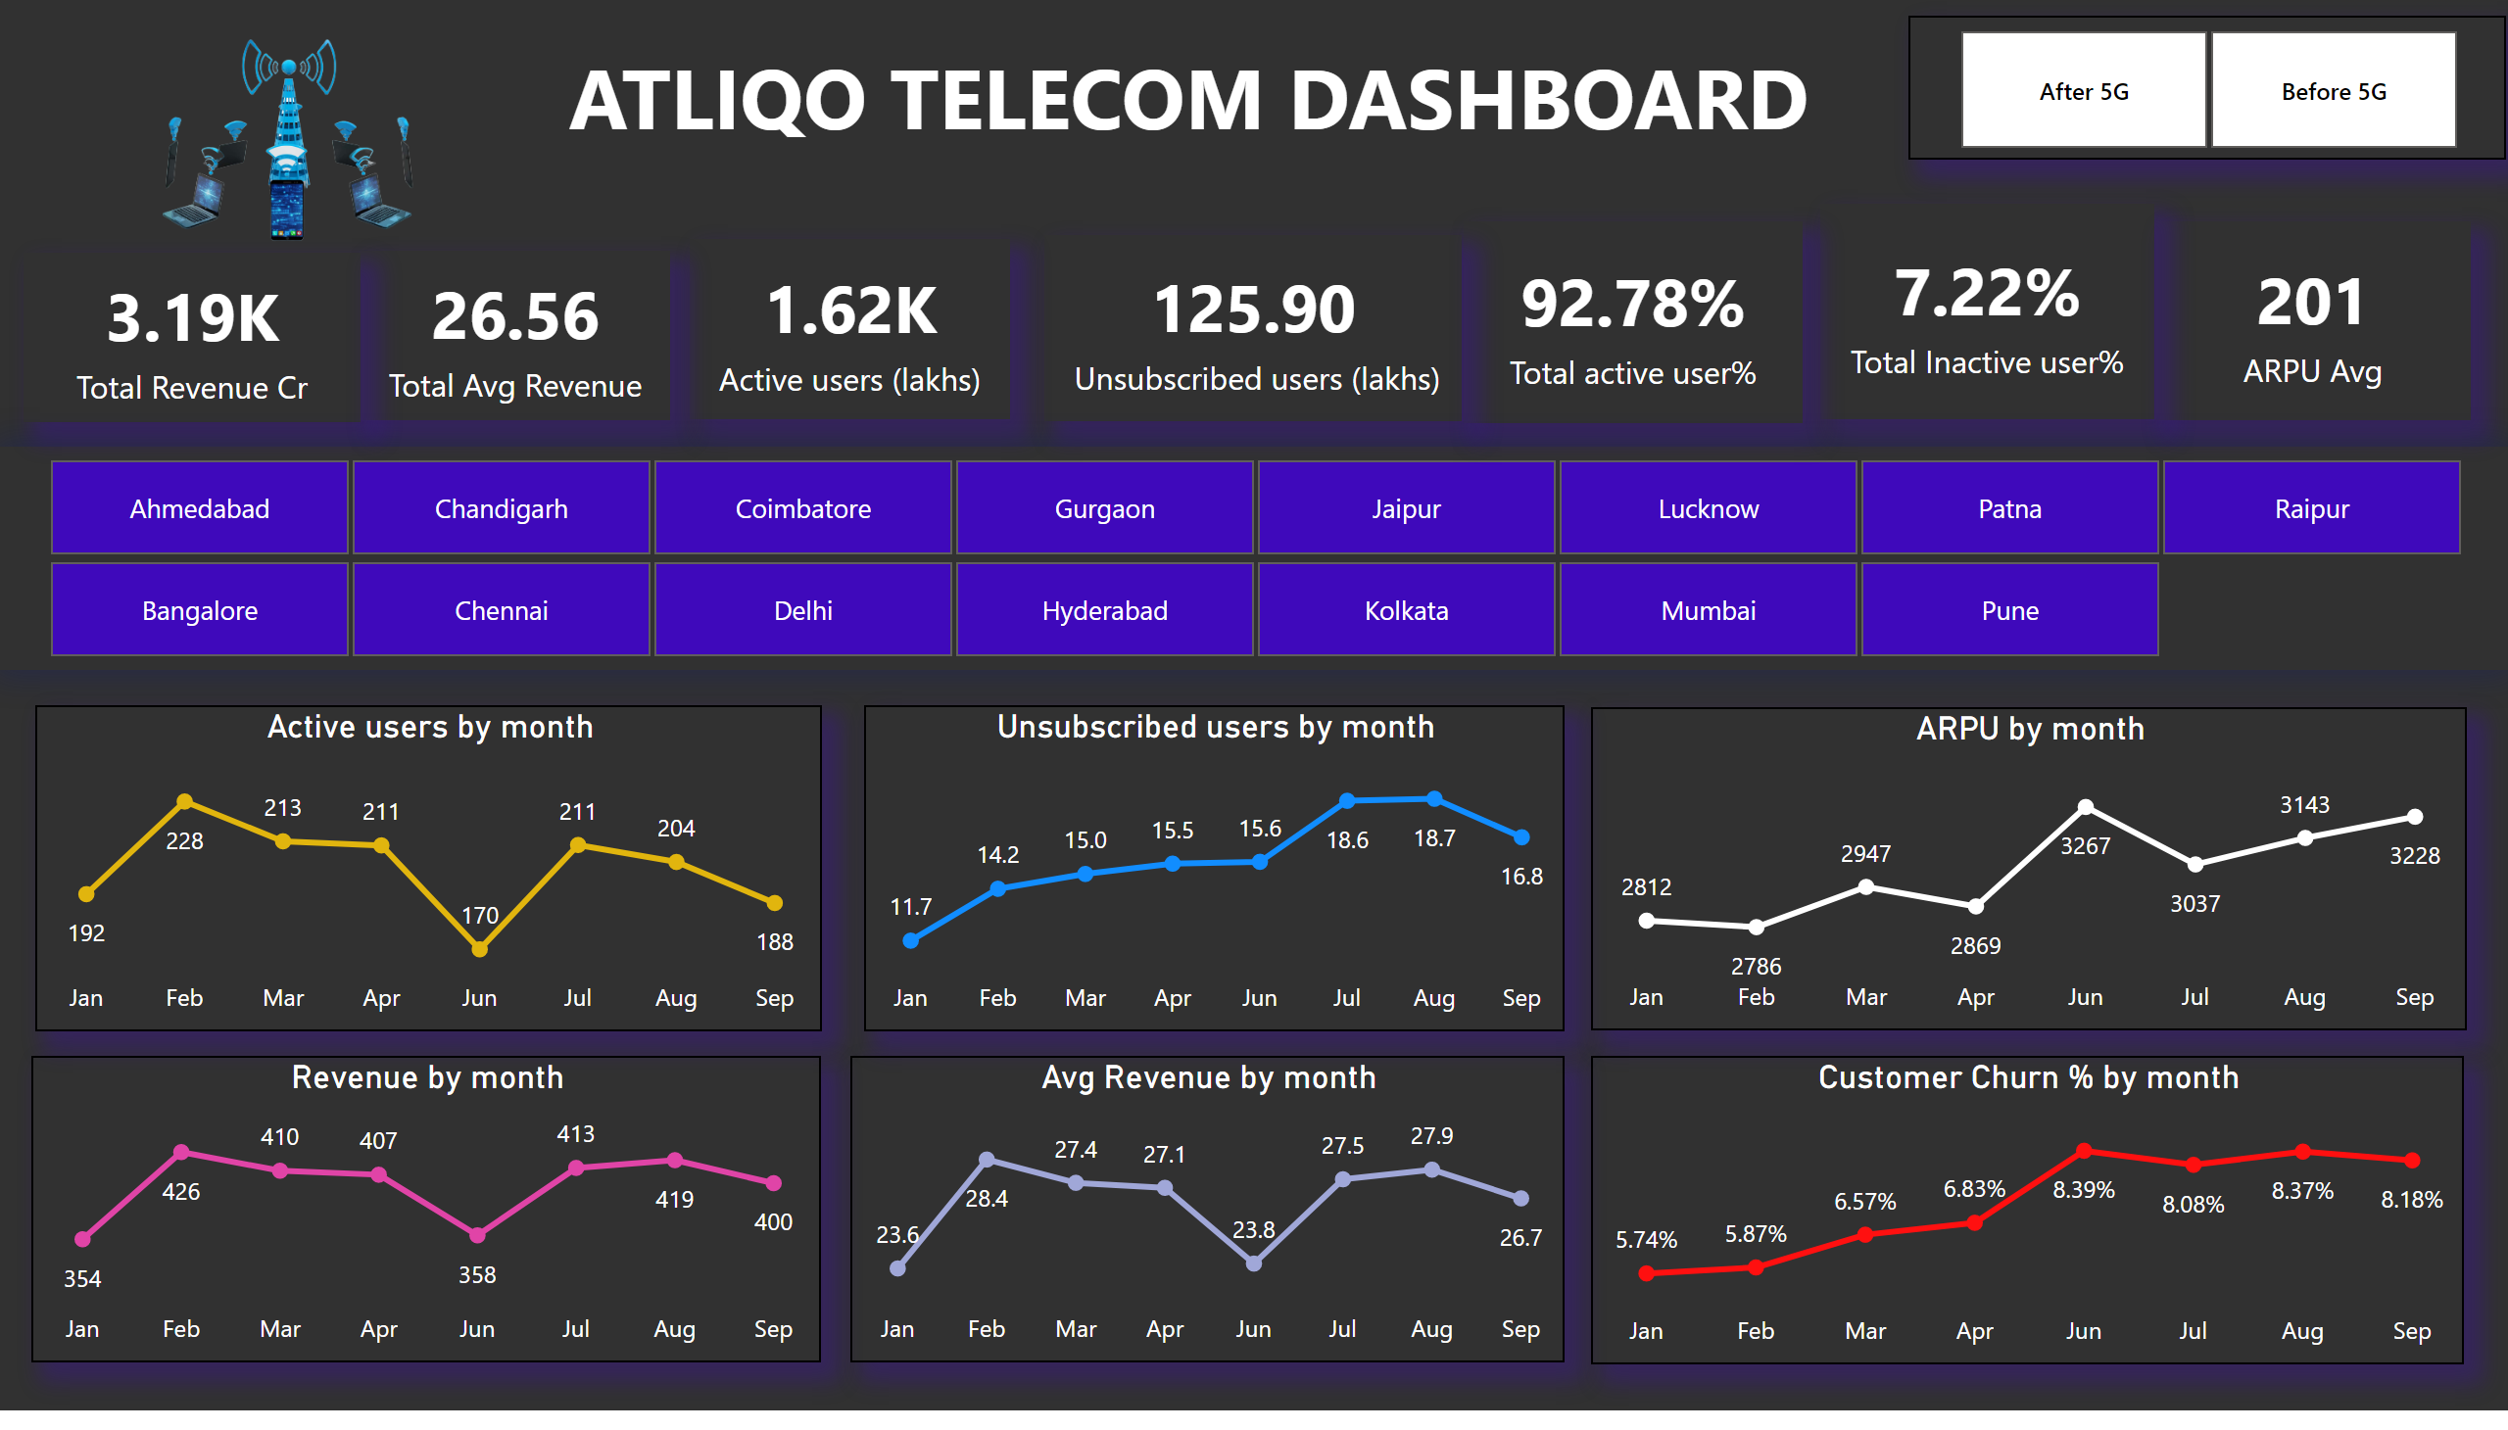
Overview
Notes:
slicer
No alt text provided
slicer
No alt text provided
textbox
No alt text provided
card
No alt text provided
card
No alt text provided
card
No alt text provided
card
No alt text provided
card
No alt text provided
card
No alt text provided
Active users by month
No alt text provided
Unsubscribed users by month
No alt text provided
Revenue by month
No alt text provided
Avg Revenue by month
No alt text provided
card
No alt text provided
ARPU by month
No alt text provided
image
No alt text provided
Customer Churn % by month
No alt text provided

Slide 3
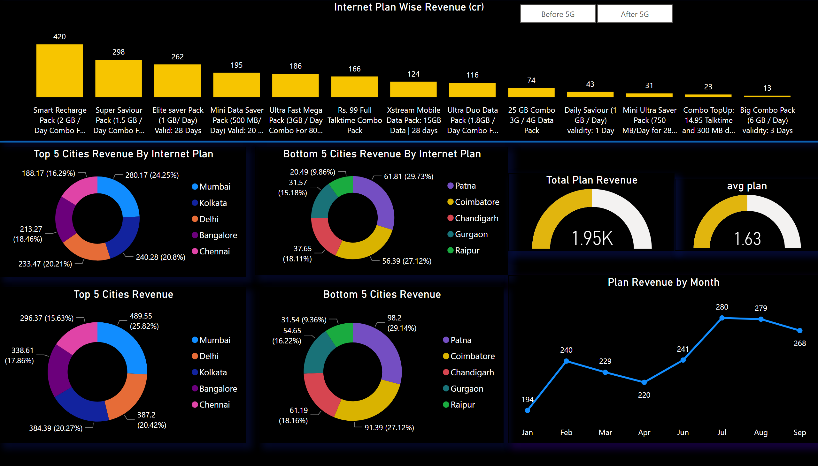
Data Plan
Notes:
Internet Plan Wise Revenue (cr)
No alt text provided
Top 5 Cities Revenue By Internet Plan
No alt text provided
slicer
No alt text provided
Bottom 5 Cities Revenue By Internet Plan
No alt text provided
Bottom 5 Cities Revenue
No alt text provided
Top 5 Cities Revenue
No alt text provided
shape
No alt text provided
Plan Revenue by Month
No alt text provided
Total Plan Revenue
No alt text provided
gauge
No alt text provided

Slide 4
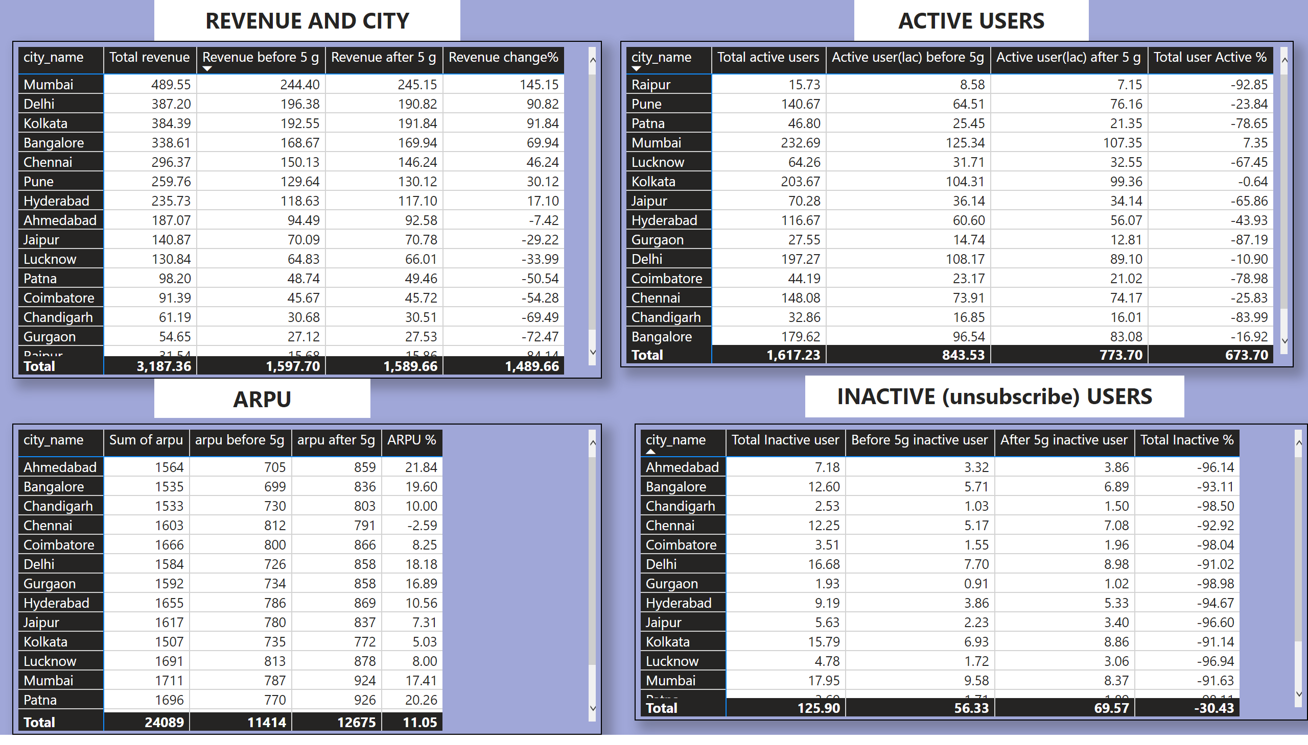
City wise
Notes:
pivotTable
No alt text provided
pivotTable
No alt text provided
pivotTable
No alt text provided
textbox
No alt text provided
textbox
No alt text provided
pivotTable
No alt text provided
textbox
No alt text provided
textbox
No alt text provided

