Slide 1
A FIELD GUIDE · V1.0 · 2026 | HALF-DAY · LECTURE + HANDS-ON
VOLUME ONE — FOUNDATIONS
Data Architecture for the AI Era.
A field guide for sellers, architects, and SSRs — six patterns, one BFSI scenario, six runnable notebooks.
MAPLE TRUST BANK · CASE STUDY | MANAV GUPTA | VP & CTO, TECHNICAL SALES
Notes:
Welcome everyone. This is a working session, not a PowerPoint marathon. You have six Jupyter notebooks in front of you. By the end of today, you'll know which data architecture pattern to propose for any customer conversation — and you'll have run the code to prove it.

Slide 2
“
The data architecture you designed in 2019 is what’s breaking your AI strategy in 2026.
Opening
2 / 58
Notes:
This is the thesis. Not "your architecture is bad" — it was right for 2019. But AI changed the read patterns, the latency budgets, and what counts as data. Today we fix the gap.

Slide 3
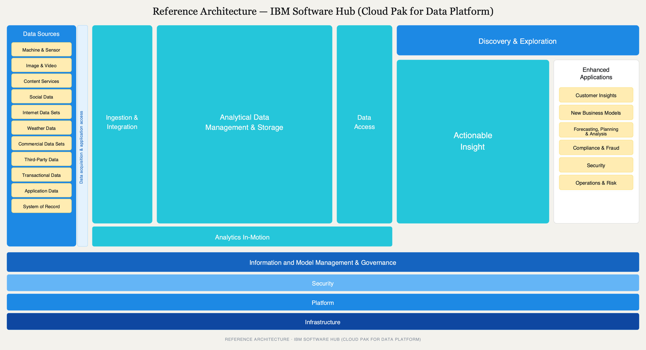
Opening
3 / 58
Notes:
This is the slide everyone has seen 400 times. Today is the day someone explains it to you. Every block of this lecture will light up different swimlanes. By the end, you'll have the whole diagram populated in your head — and you'll know which swimlane to point at for any customer conversation. Let me walk you through it at 30,000 feet.

Slide 4
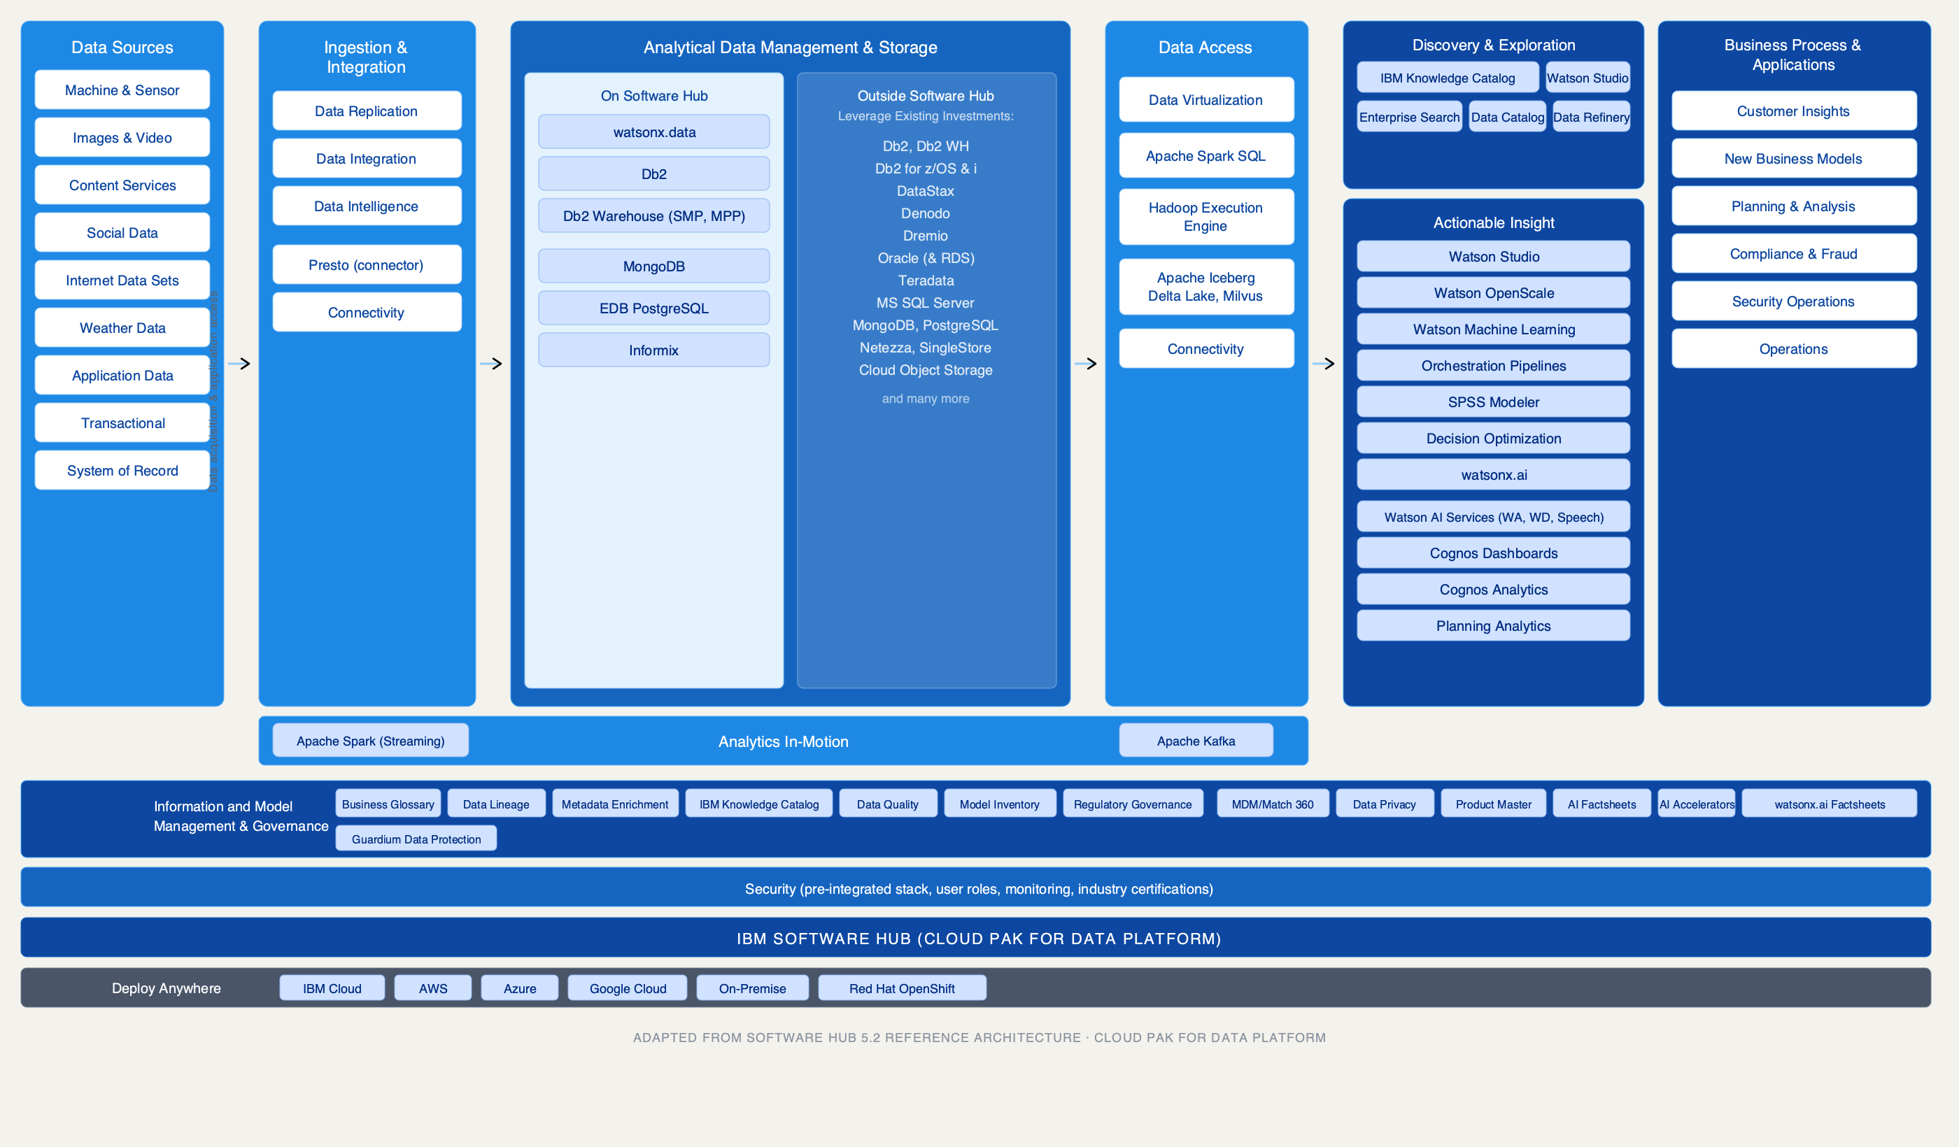
Opening
4 / 58
Notes:
Same diagram, now with the actual IBM products named. watsonx.data is in the center — the analytical storage lane. Presto, Spark, Db2 are query engines. Knowledge Catalog is the governance rail on the left. The right rail shows this deploys on IBM Cloud, on-premise, or a hyper-converged single-node stack for teaching. Every product maps to one lane.

Slide 5
OPENING
Why each role cares.
SELLERS
ARCHITECTS
SSRs
Stop selling “AI.” Start selling the data plane that makes AI work.
The integration contract between your enterprise and your agents — get it wrong and nothing else matters.
Every incident is now a governance incident. You need to know which swimlane broke.
Opening
5 / 58
Notes:
Ground rules: interrupt freely. We have two live notebooks in Block 4, two notebook cameos in Block 1, and one architecture critique exercise. If I'm boring you, say so — this is a working session.

Slide 6
BLOCK 1 OF 5
Foundations.
Storage, compute, catalog, governance, observability — the five primitives. Then the six patterns.
45 MIN
Foundations
6 / 58
Notes:
Block 1 is the foundation. If you already know what a lakehouse is, stay with me anyway — I'm going to reframe it. If you don't know what a lakehouse is, you will in 45 minutes.

Slide 7
§ 1.1 — WHY WE KEEP REINVENTING DATA ARCHITECTURE
The 30-year arc.
OLTP
→
Warehouse
→
Lake
→
Lakehouse
→
Mesh
→
Fabric
Each generation solved the previous generation’s scaling problem and created a new governance problem. The pendulum: centralize → decentralize → federate.
Block 1 — Foundations
7 / 58
Notes:
Every generation solved the previous generation's scaling problem and created a new governance problem. Warehouses solved OLTP reporting but couldn't handle unstructured data. Lakes solved storage cost but created swamps. Lakehouses added ACID but didn't solve org design. Mesh solved org design but assumed product thinking maturity nobody had. Fabric tries to automate the governance layer. The cycle continues.

Slide 8
§ 1.2 — THE FIVE PRIMITIVES
Not four. Five.
PRIMITIVE | WHAT IT COVERS
Storage | Object stores, columnar formats (Parquet, ORC), open table formats (Iceberg, Delta, Hudi)
Compute | Query engines (Presto/Trino, Spark, DuckDB), separation of storage and compute
Catalog | Hive, Unity, Polaris, Nessie — catalog wars are the new format wars
Governance | Lineage, access, classification, lifecycle
Observability | Quality, freshness, schema drift, pipeline SLOs, lineage-driven impact analysis
Block 1 — Foundations
8 / 58
Notes:
Most people teach four primitives and leave out observability. That was fine when data pipelines ran overnight and you checked them in the morning. It's not fine when an agent loop needs fresh data in milliseconds. Observability is now first-class — quality monitoring, freshness SLOs, schema drift detection. Three layers: data observability, model observability, agent trace observability. Most orgs have one of the three. Almost nobody has all three.

Slide 9
§ 1.3 — PATTERN DECODER RING
Six patterns. When to use. When each is actively wrong.
PATTERN | BEST FOR | ANTI-PATTERN
Data Warehouse | Stable schemas, BI, regulatory reporting | Unstructured/AI workloads
Data Lake | Cheap raw storage, ML training sets | Anything needing ACID or governance
Lakehouse | Unified analytics + ML on open formats | Sub-second OLTP
Data Virtualization | Federated queries, data residency | High-volume scans, latency-sensitive
Data Mesh | Large orgs with strong domain teams | Orgs without product thinking
Data Fabric | Heterogeneous estates, federation | Greenfield single-cloud
Block 1 — Foundations
9 / 58
Notes:
Memorize this table. When a customer describes their problem, you should be able to point at the right row in under 10 seconds. The anti-pattern column is more important than the "best for" column — knowing when NOT to propose a pattern is what separates a seller from a consultant.

Slide 10
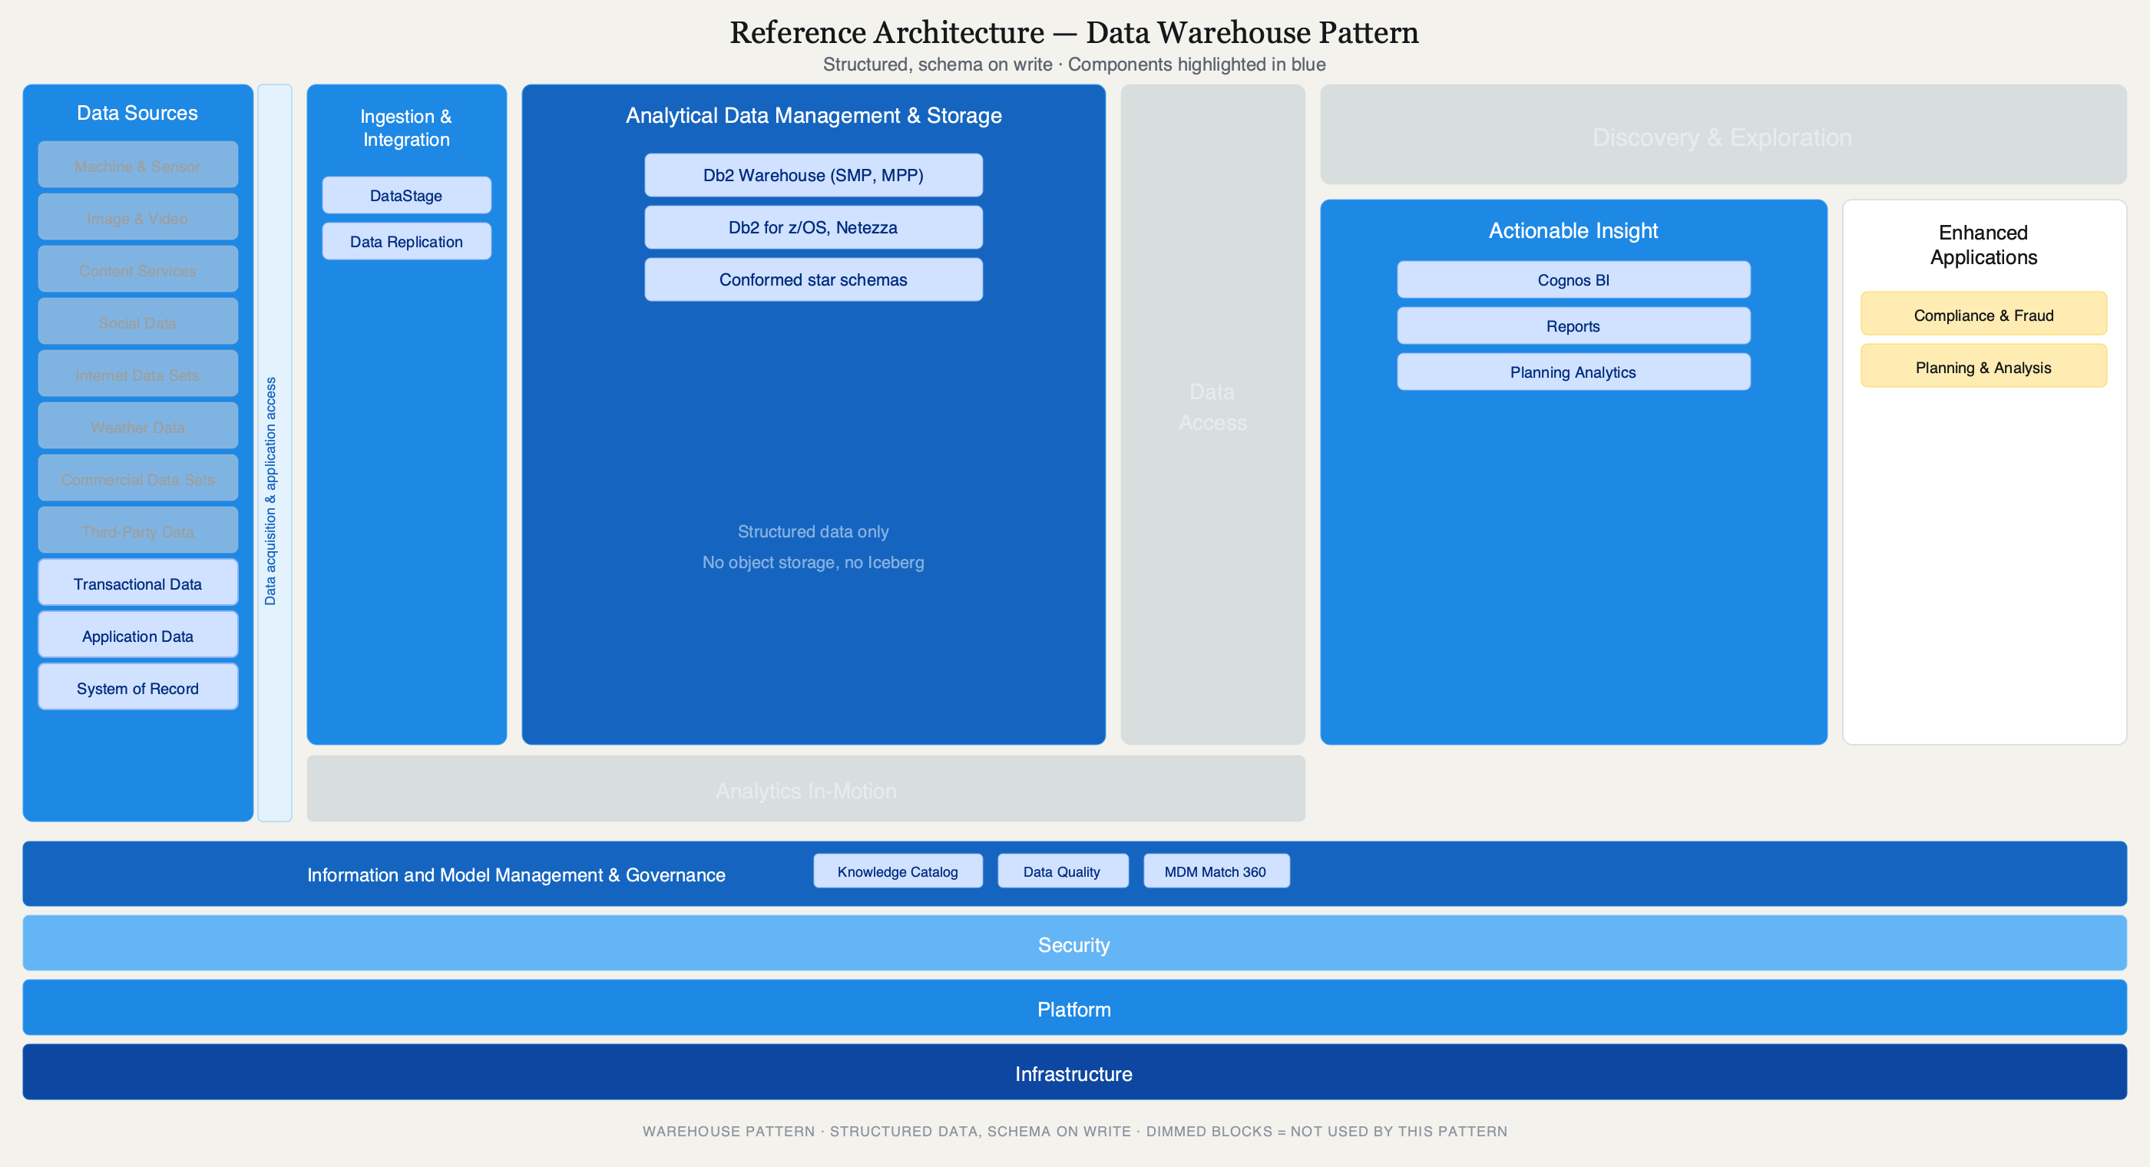
Opening
10 / 58
Notes:
Here is what the warehouse pattern looks like on the reference architecture. Only the structured sources light up. Ingestion is DataStage and replication. Storage is Db2 Warehouse with star schemas — no object storage, no Iceberg. Data Access and Analytics In-Motion are dimmed — warehouse is batch SQL. The consumption layer is narrow: Cognos BI, reports, planning.

Slide 11
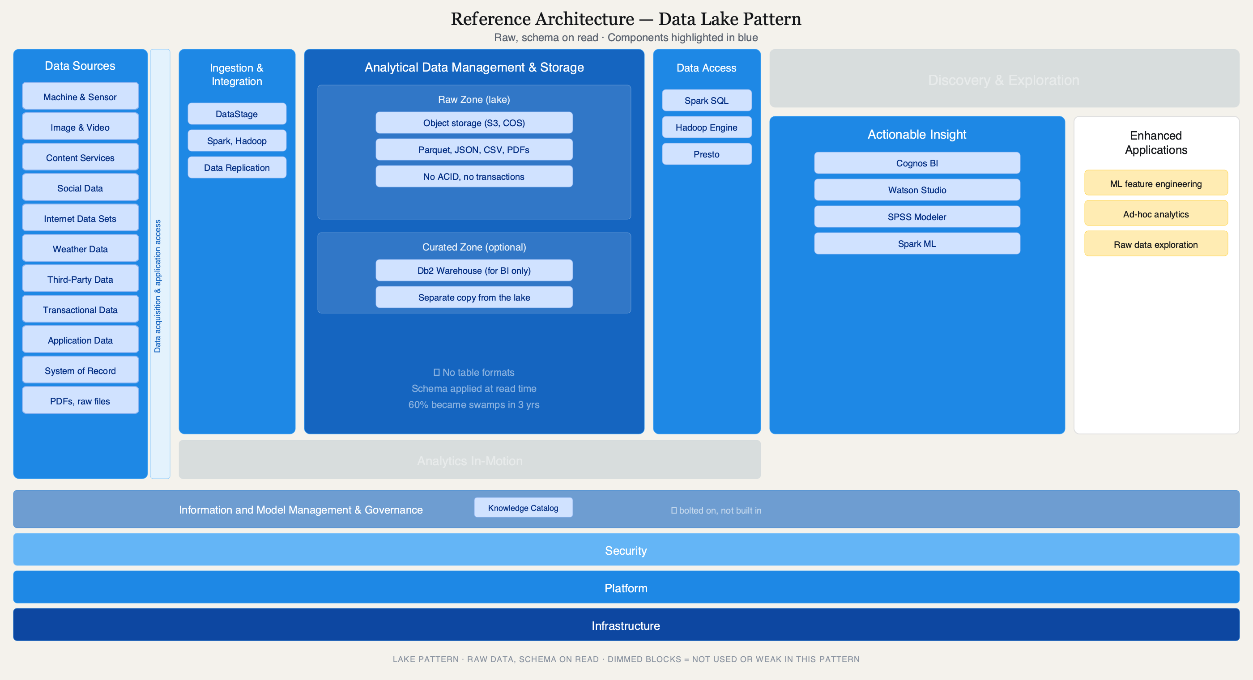
Block 1 — Foundations
11 / 58
Notes:
The lake. Cheap storage for everything. Parquet, JSON, CSV, PDFs — dump it all in and figure out the schema later. No ACID means no rollback, no isolation, no history. That is why 60% of bank-built lakes became swamps within three years.

Slide 12
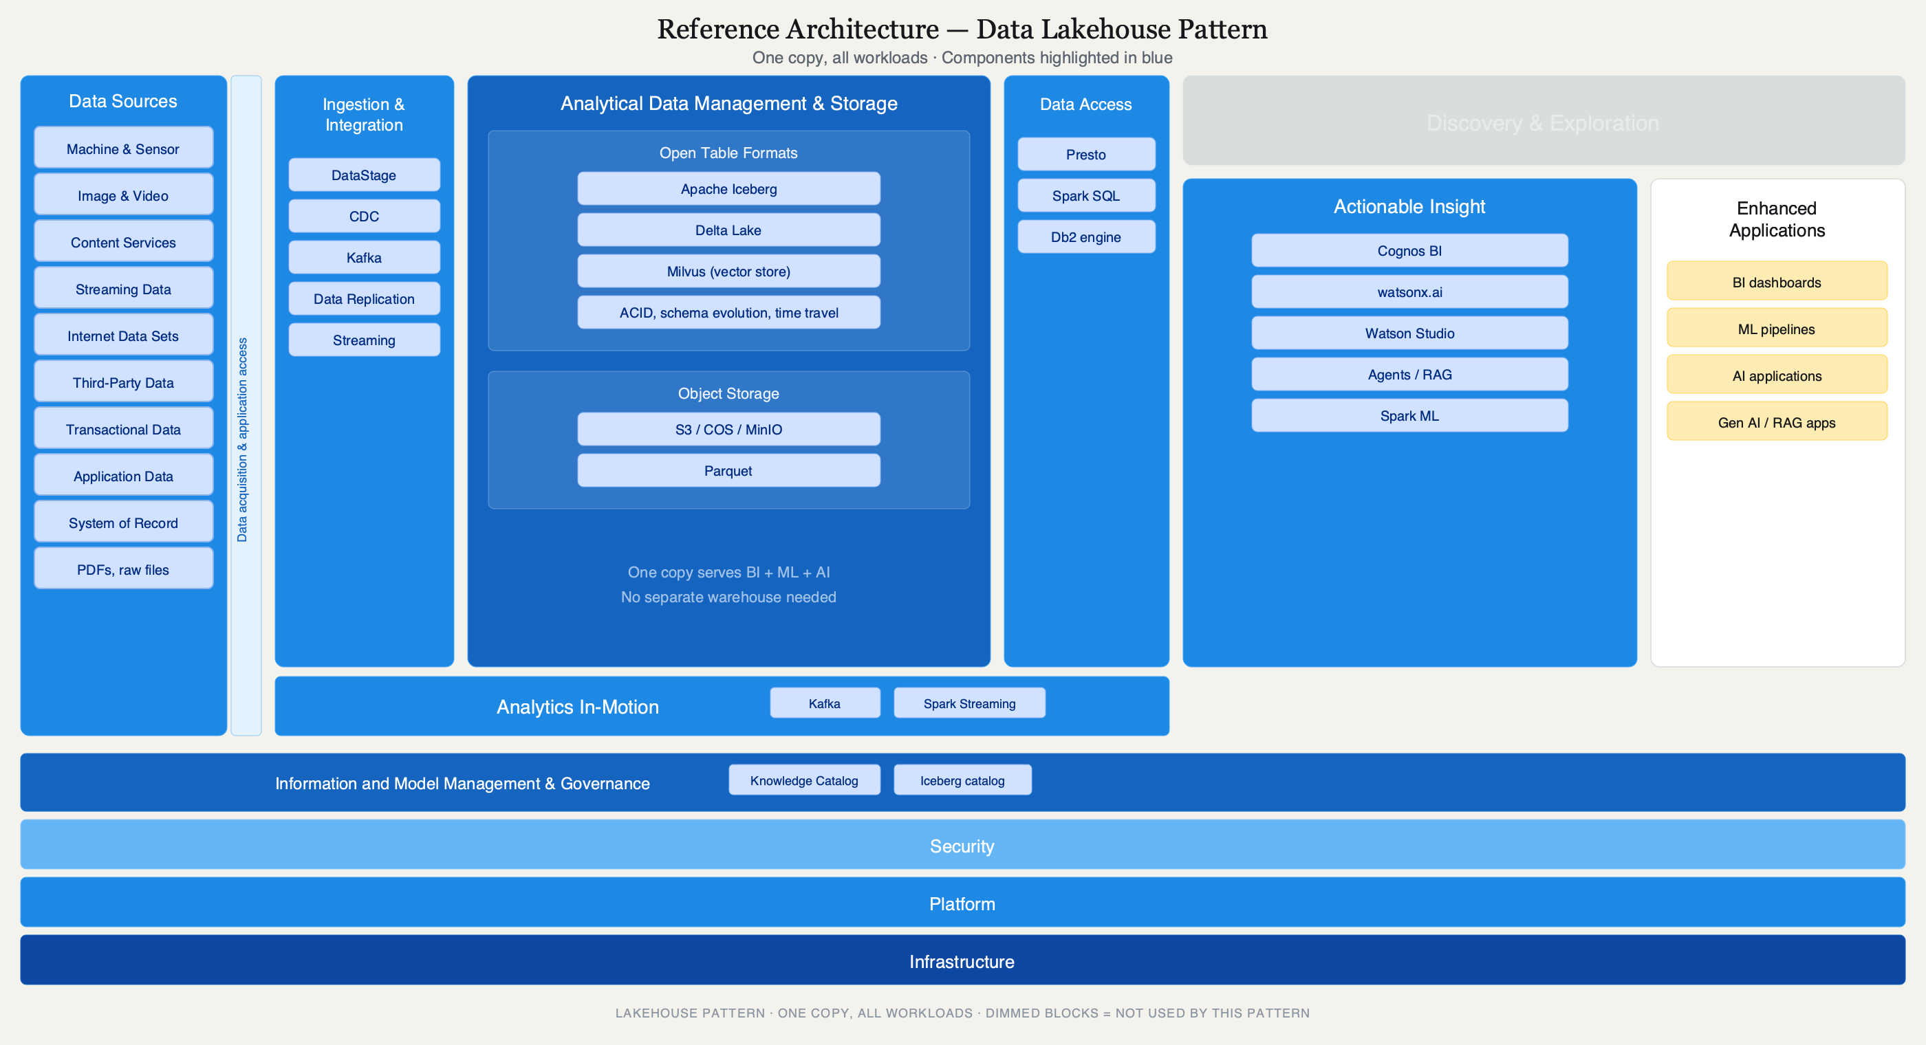
Block 1 — Foundations
12 / 58
Notes:
Same cheap storage, but now with Iceberg on top. ACID means two writers cannot corrupt each other. Schema evolution means adding a column is not a two-week project. Time travel means the regulator asks what did it look like on March 15th and you answer in one query.

Slide 13
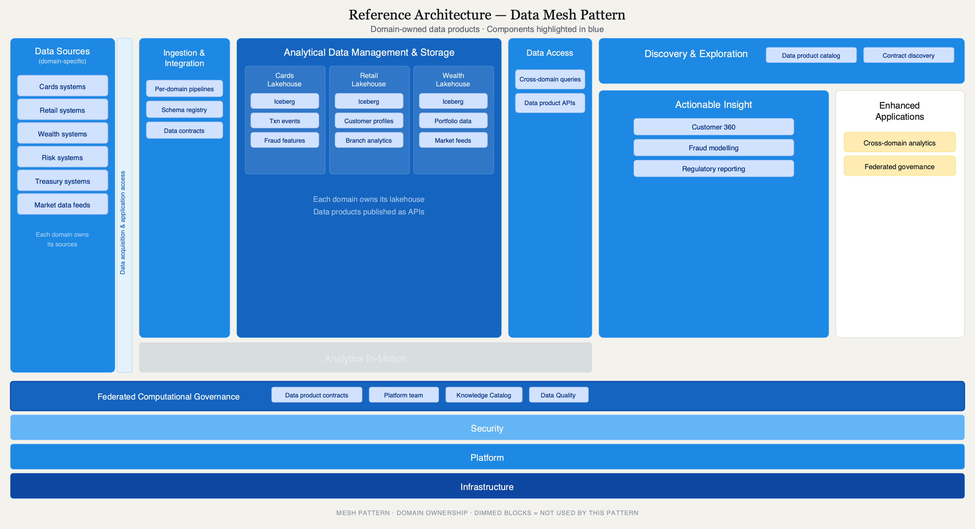
Block 1 — Foundations
13 / 58
Notes:
Mesh is not a technology — it is an org chart expressed in storage. Each domain owns its lakehouse and publishes data products with contracts. The platform team provides the runway.

Slide 14
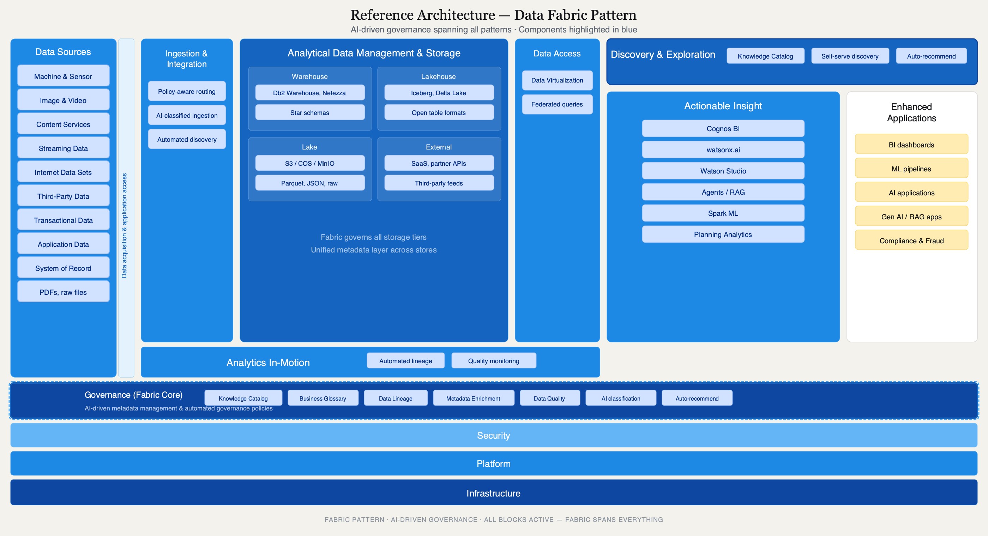
Block 1 — Foundations
14 / 58
Notes:
Fabric is the meta-pattern. It does not replace the others — it automates the governance layer across all of them. AI-assisted classification, automated lineage, self-serve discovery. This is where IBM Knowledge Catalog plays.

Slide 15
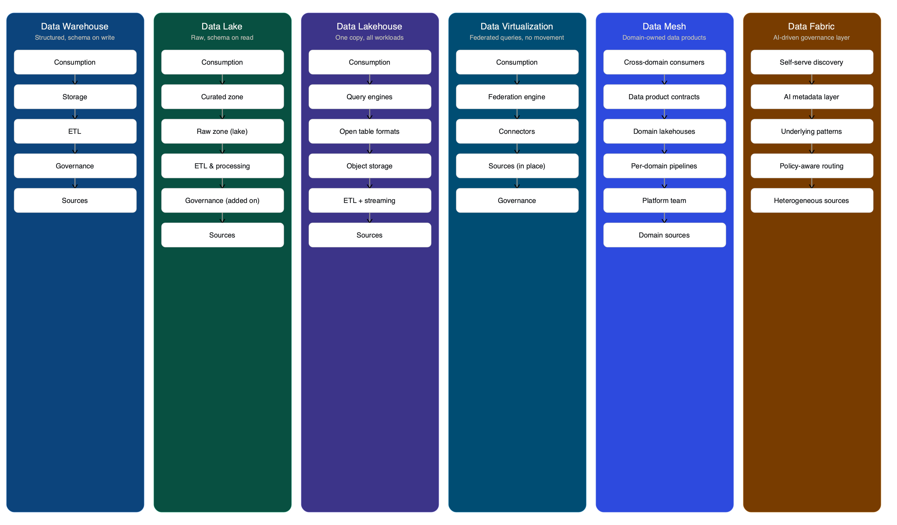
Block 1 — Foundations
15 / 58
Notes:
Six patterns, one slide. Warehouse is structured, schema-on-write. Lake is cheap and raw, schema-on-read. Lakehouse adds ACID and time travel. Virtualization federates without moving data. Mesh is domain ownership with contracts. Fabric is the AI governance meta-layer.

Slide 16
§ 1.3 — CHOOSING BETWEEN THE SIX
The matrix you can draw on a napkin.
WORKLOAD | WH | DL | LH | V | M | F
Regulatory BI | ● | ○ | ● | ◐ | ◐ | ◐
Ad-hoc ML feature eng. | ○ | ◐ | ● | ◐ | ● | ◐
Unstructured / RAG | ○ | ● | ● | ◐ | ● | ●
Cross-system join | ◐ | ○ | ◐ | ● | ● | ●
Schema evolves weekly | ○ | ◐ | ● | ◐ | ● | ◐
Data residency hard-line | ○ | ○ | ○ | ● | ● | ●
● Strong fit ◐ Possible ○ Wrong tool
Block 1 — Foundations
16 / 58
Notes:
This is the napkin matrix. When a customer describes their workload, find the row. The columns tell you which pattern to propose. Most banks need at least three of these running simultaneously. The question is never which one — it's which combination.

Slide 17
§ 1.3 — PATTERN TRADE-OFFS
What you gain, what you give up.
Warehouse
Data Lake
Lakehouse
✓ Strong consistency ✓ Audit trails ✓ Mature tooling
✗ No unstructured data ✗ Expensive to scale ✗ Schema changes are projects
✓ Cheapest storage ✓ All data types ✓ ML feature eng.
✗ No ACID / governance ✗ 60% become swamps ✗ Schema debt accumulates
✓ ACID + time travel ✓ One copy for all ✓ Open formats (Iceberg)
✗ Needs Spark/Iceberg skill ✗ Not sub-ms OLTP ✗ Newer, less battle-tested
Virtualization
Data Mesh
Data Fabric
✓ Zero data movement ✓ Residency compliance ✓ Fast prototyping
✗ No pushdown = slow ✗ Source overload risk ✗ Not for heavy scans
✓ Domain ownership ✓ Scales with org ✓ Quality at boundaries
✗ 18-month minimum ✗ Needs product thinking ✗ Governance is hard
✓ Governs everything ✓ AI-driven metadata ✓ Self-serve discovery
✗ Overkill if single-cloud ✗ Complex to implement ✗ Requires mature catalog
Block 1 — Foundations
17 / 58
Notes:
Every pattern has trade-offs. Warehouse gives you consistency but can't handle unstructured data. Lake is cheap but ungoverned. Lakehouse is the pragmatic middle but needs Iceberg skill. Virtualization is elegant but breaks on heavy scans. Mesh is powerful but takes 18 months. Fabric governs everything but is overkill for simple estates. Know the trade-offs before you pitch.

Slide 18
§ 1.3 — PATTERN DECODER RING (DEMO)
Let’s see one running.
NOTEBOOK CAMEO #1
• Open notebooks/01-warehouse.ipynb
• Run one canonical query against the synthetic BFSI star schema
• Show the output: branch transaction volume for Q3 2024
• Then try Q2 — finding customers whose policy documents reference an AML procedure
• The warehouse stores the PDF as a BLOB. It cannot read it.
Block 1 — Foundations
18 / 58
Notes:
We have notebooks. They're real. They run. This is the warehouse query — branch transaction volume for Q3 2024. Clean SQL, fast results, no surprises. This is what the warehouse does well. Now watch what happens when we try Q2 — finding customers whose policy documents reference an AML procedure. The warehouse stores the PDF as a BLOB. It cannot read it.

Slide 19
§ 1.3 — PATTERN DECODER RING (DEMO)
No data moved.
NOTEBOOK CAMEO #2
• Open notebooks/04-virtualization.ipynb
• Run one federated query joining two sources without moving data
• Joining Postgres and Iceberg data through Trino — no ETL, no copies, one SQL query
• Read the EXPLAIN plan — that’s where the truth lives
Block 1 — Foundations
19 / 58
Notes:
This is the most misunderstood pattern. Everyone nods at "federated queries" in the reference architecture. Nobody believes it actually works until they see it. Watch: we're joining Postgres and Iceberg data through Trino. No ETL. No copies. One SQL query. Now — before you sell this to every customer — read the EXPLAIN plan. That's where the truth lives.

Slide 20
§ 1.4 — MASTER DATA MANAGEMENT
The unsexy foundation.
• Why MDM became cool again: agents need authoritative entities to reason over
• Four MDM patterns: registry, consolidation, coexistence, centralized
• IBM MDM / InfoSphere MDM / Match 360 positioning
• Graph + MDM: the entity resolution play (foreshadows Block 2 Graph RAG)
• Every Canadian bank has a 10-year MDM program that’s “almost done.” Agentic AI just made it urgent again.
Block 1 — Foundations
20 / 58
Notes:
Every Canadian bank has a 10-year MDM program that's "almost done." Agentic AI just made it urgent again. When your agent needs to answer "who is this customer?" across four systems — core banking, CRM, AML, branch records — it needs entity resolution. That's MDM. Not glamorous. Absolutely foundational. If your customer's MDM is broken, don't sell them RAG. Sell them MDM first.

Slide 21
§ 1.5 — IBM STACK MAPPED TO THE REFERENCE ARCHITECTURE
Where the storage and access patterns live.
LAYER | IBM PRODUCTS
Storage | watsonx.data, Db2, Db2 Warehouse, Informix, EDB Postgres
Compute | Presto via watsonx.data, Spark, DuckDB
Catalog | Iceberg REST catalog, Knowledge Catalog
Federation | Data Virtualization, Presto connectors
Open formats | Iceberg, Delta Lake, Milvus
Block 1 — Foundations
21 / 58
Notes:
When you're positioning this with a customer, point at the Analytical Data Management & Storage lane. watsonx.data is the anchor. If they're on z/OS, it's Db2 for z/OS. If they want modern open formats, it's Iceberg on watsonx.data with Presto. The federation story is Data Virtualization or Presto connectors joining sources without copying.

Slide 22
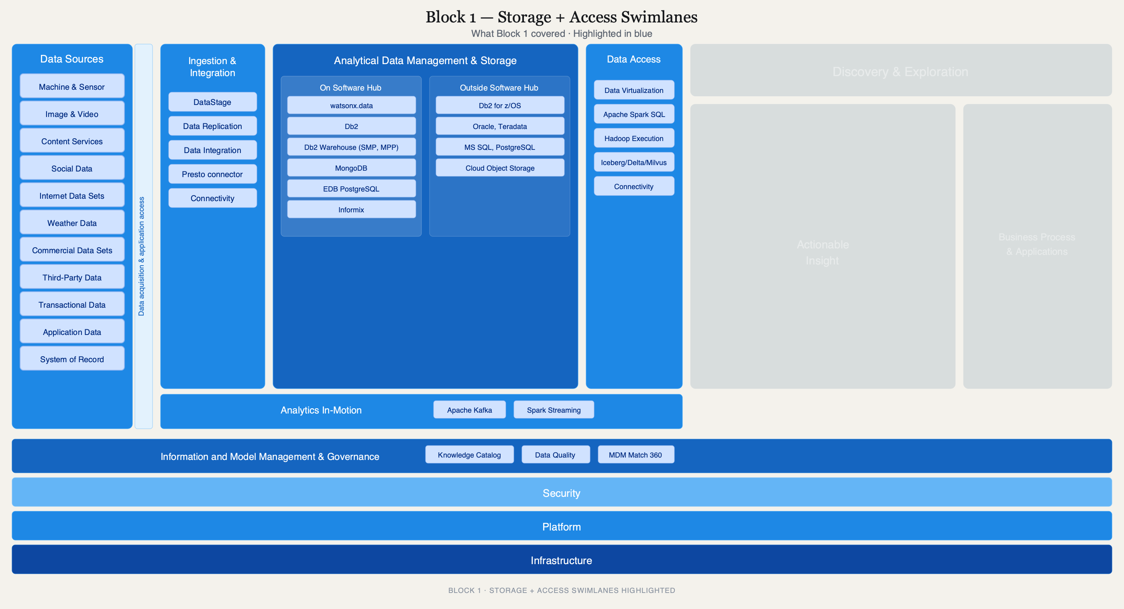
Block 1 — Foundations
22 / 58
Notes:
Here's the reference architecture again, but now with only the storage and access lanes lit. This is what Block 1 was about. watsonx.data sits in the big blue box in the center. The connectors reach left to the sources and right to the query engines. The governance band at the bottom — we'll light that up in Block 3.

Slide 23
“
The warehouse works. The lake stores everything. The lakehouse adds ACID. Virtualization federates. Mesh organizes. None of them can read a PDF.
Block 1 — Foundations
23 / 58
Notes:
That's the setup. Five patterns, each solving a real problem, each with a clear failure mode. Now let's talk about what AI changed — and what the reference architecture needs that isn't on the diagram yet.

Slide 24
BLOCK 2 OF 5
AI-Era Architecture.
What changed when AI ate the stack. RAG, Docling, context engineering, and the agent control plane.
60 MIN
AI-Era Architecture
24 / 58
Notes:
If Block 1 was the foundation, Block 2 is why we're all here. AI changed what data architecture means. New data types, new latency requirements, new governance problems. Let me show you what changed and what the reference architecture needs that isn't on the diagram yet.

Slide 25
§ 2.1 — WHAT CHANGED
Old vs. new.
BEFORE (BI ERA) | AFTER (AI ERA)
Scan tables | Retrieve passages
Minutes (batch) | Milliseconds (agent loops)
Structured only | Unstructured is primary fuel
Tables, views | Embeddings, chunks, traces, prompts, tool-call logs
Report-time governance | Real-time policy enforcement
Block 2 — AI-Era
25 / 58
Notes:
Read patterns flipped. In the BI era, you scanned tables and aggregated. In the AI era, you retrieve passages and assemble context. Latency budgets collapsed from minutes to milliseconds. And 80% of enterprise data — the PDFs, the emails, the contracts — went from "unusable for analytics" to "primary fuel for AI." That's the unstructured data tax. Every bank has it. Most haven't paid it yet.

Slide 26
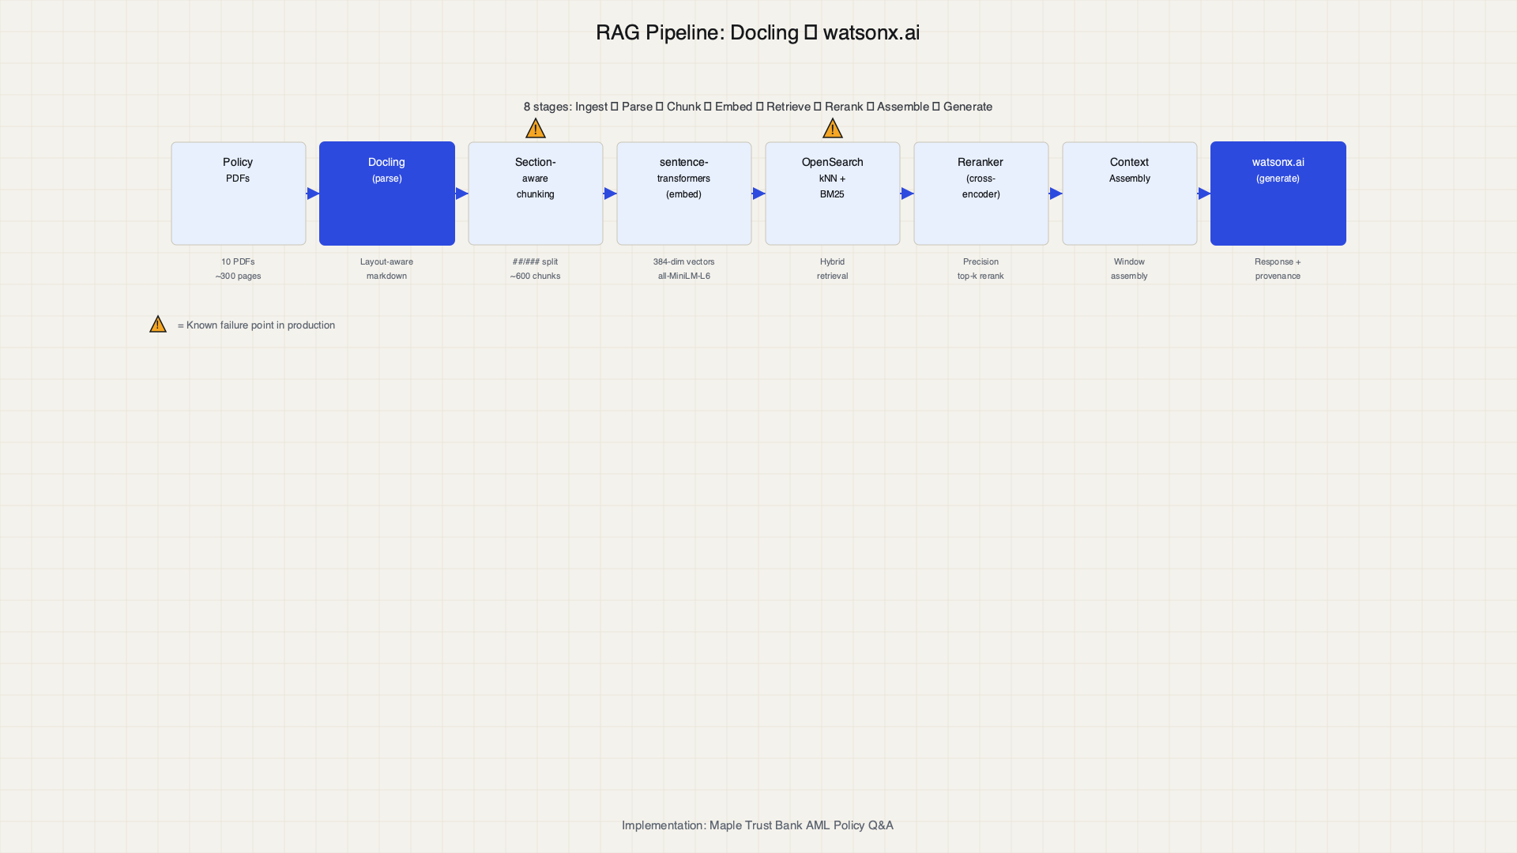
§ 2.2 — THE RAG REFERENCE ARCHITECTURE
The pipeline that actually ships.
Block 2 — AI-Era
26 / 58
Notes:
This is the pipeline. Every step can fail. Chunking is where dreams die — split too aggressively and you lose context, split too conservatively and you drown the model in noise. Pure vector retrieval is what consultants sell. Hybrid retrieval — BM25 plus vector plus reranker — is what works. Let me show you each layer.

Slide 27
§ 2.2 — DOCLING DEEP-DIVE
The ingestion-side fix.
• Open-source, Apache 2.0, IBM Research Zurich, now in Linux Foundation’s Agentic AI Foundation
• Replaces naive OCR with layout-aware extraction (~30x speedup, preserves structure)
• DoclingDocument representation: bounding boxes, reading order, structure-aware chunking
• Integrates with LangChain, LlamaIndex, spaCy
• Granite-Docling-258M VLM under Apache 2.0
• Docling OpenShift Operator with Red Hat — banks named as deployment segment
Block 2 — AI-Era
27 / 58
Notes:
Docling is the answer to "how do I get PDFs into my RAG pipeline without losing the table structure?" Naive OCR reads left to right and destroys multi-column layouts. Docling understands the visual structure — it knows that the table on page 7 has four columns, not eight. The OpenShift Operator means your bank can run it on-prem, air-gapped, with no data leaving the building. That's the pitch.

Slide 28
§ 2.2 — HYBRID RETRIEVAL
BM25 + vector + reranker. In one engine.
• Why pure vector search fails: semantic similarity is not semantic correctness
• BM25 for exact matches (regulatory terms, policy numbers)
• Vector for conceptual similarity
• Reranker for precision (cross-encoder on top-k)
• OpenSearch does all three in one engine — no stitching
Block 2 — AI-Era
28 / 58
Notes:
Pure vector RAG is a myth. I've never seen it work in production at a bank. The compliance officer searches for "PCMLTFA Section 7 obligation for EFTs over $1000" — that's a keyword search, not a semantic one. You need BM25 for exact terms AND vector for conceptual similarity AND a reranker to sort the results. OpenSearch does all three. That's why it's in the reference architecture.

Slide 29
§ 2.2 — CHOOSING A VECTOR STORE
Pick based on ops maturity, not benchmarks.
STORE | BEST FOR | WATCH OUT FOR
Milvus | Scale, GPU-accelerated search | Ops complexity
OpenSearch | Hybrid (BM25 + vector + reranker) | Memory footprint
Elastic | Existing ELK stack shops | License changes
Pinecone | Managed, zero-ops | Vendor lock-in, no hybrid
pgvector | Already on Postgres | Not built for scale
Chroma | Prototyping | Not production-grade
Block 2 — AI-Era
29 / 58
Notes:
Stop benchmarking vector stores. Start asking: does my team know how to operate this in production? Pinecone is zero-ops but vendor-locked. OpenSearch is self-managed but does hybrid. pgvector is free but not built for scale. Pick based on your ops maturity, not someone else's benchmark.

Slide 30
§ 2.3 — CONTEXT ENGINEERING AND THE AGENT DATA PLANE
RAG vs. fine-tuning is the wrong question.
• Context engineering: what goes in the window, in what order, with what provenance
• Agent data plane: tool registries, memory stores, trace logs, evaluation sets — these are data architecture now
• Graph RAG and when it beats vector (entity-heavy, multi-hop reasoning)
• Open RAG positioning: open standards, open formats, swappable components
Block 2 — AI-Era
30 / 58
Notes:
"Should we RAG or fine-tune?" is the question every customer asks. The answer is: neither, both, and it depends. The real question is context engineering — what goes in the context window, in what order, with what provenance. That's a data architecture problem. Tool registries, memory stores, trace logs, eval sets — these are the new data products. If you're an architect, this is your job now.

Slide 31
§ 2.3 — THE AGENT DATA PLANE
These are data architecture now.
COMPONENT | WHAT IT STORES | WHY IT MATTERS
Tool registry | Available tools, permissions, schemas | Agent needs to know what it can call
Memory store | Conversation history, entity state | Agents need context across sessions
Trace logs | Every tool call, every generation | Audit, debugging, compliance
Evaluation sets | Ground-truth Q&A pairs, human ratings | Only way to know if it works
Prompt templates | Versioned prompts, system messages | Prompt is code; version it like code
Block 2 — AI-Era
31 / 58
Notes:
Five new data products that didn't exist three years ago. Every one of these needs storage, versioning, access control, and lineage. If you're a data architect, this is your new backlog. If you're a seller, this is the expansion play after the initial RAG deployment.

Slide 32
§ 2.3 — OPEN RAG
Open standards, open formats, swappable components.
• Enterprise buyers are demanding component swappability
• No lock-in to one embedding model, one vector store, one reranker
• Open formats: Parquet for structured, Docling for unstructured, OpenSearch for retrieval
• IBM’s position: watsonx.ai + watsonx.data + OpenSearch is the open stack
• Contrast with closed alternatives (Azure AI Search + Azure OpenAI, Bedrock + Kendra)
Block 2 — AI-Era
32 / 58
Notes:
Enterprise buyers are done with lock-in. They want to swap the embedding model without rewriting the pipeline. They want to change the vector store without losing the index. Open RAG means: Parquet for structured data, Docling for document extraction, OpenSearch for hybrid retrieval, and any LLM behind the generation step. IBM's play is the open stack. Position it against the closed alternatives where every component is vendor-locked.

Slide 33
§ 2.4 — MCP AND THE AGENT CONTROL PLANE
The integration contract between agents and your enterprise.
• Why MCP matters for data architects: standardized tool interface for agents
• The problem it solves: every agent framework has its own tool-calling convention
• MCP as the “JDBC of agents” — one contract, many implementations
Block 2 — AI-Era
33 / 58
Notes:
MCP — Model Context Protocol — is what JDBC was for databases. One standard interface so agents can call tools without caring about the implementation. Before JDBC, every database had its own wire protocol and every app was hardcoded to one vendor. Before MCP, every agent framework had its own tool-calling convention. MCP standardizes it. If you're selling data architecture, MCP is how your customer's data becomes accessible to agents.

Slide 34
§ 2.4 — CONTEXT FORGE
The missing layer between AI agents and your enterprise.
• NHI attribution (non-human identity — which agent, which tool, which user delegated)
• Blast radius control (what can this agent touch?)
• HITL gate (human-in-the-loop for high-risk actions)
• DLP (data loss prevention — PII doesn’t leave the perimeter)
• Immutable audit (every tool call logged, tamper-evident)
• Anomaly detection (agent doing something unusual? flag it)
• This is a gap in the published reference architecture — call it out explicitly
Block 2 — AI-Era
34 / 58
Notes:
Full disclosure: I'm a contributor to Context Forge. This is the missing layer in the reference architecture — and I say that knowing the published diagram doesn't have it yet. When your agent calls a tool that queries customer data, who approved it? What's the blast radius? Where's the audit trail? Context Forge answers these questions. The plugin model means you can add governance capabilities without rewriting your agent.

Slide 35
§ 2.2 — DOCLING LIVE DEMO
Structure-aware extraction in action.
NOTEBOOK TEASER #3
• Open notebooks/06-rag-mdm.ipynb to the Docling cell
• Parse a real PDF live — watch the structured output with section headings preserved
• This is what goes into the chunking step
• Compare with naive 512-character window splitting — this is the fix
Block 2 — AI-Era
35 / 58
Notes:
Let me show you Docling in action. This is one of our 10 synthetic AML policy PDFs. Watch the output — it preserves the section headings, the table structure, the reading order. This is what goes into the chunking step. If you've ever seen a RAG pipeline that chops documents into 512-character windows regardless of structure — this is the fix.

Slide 36
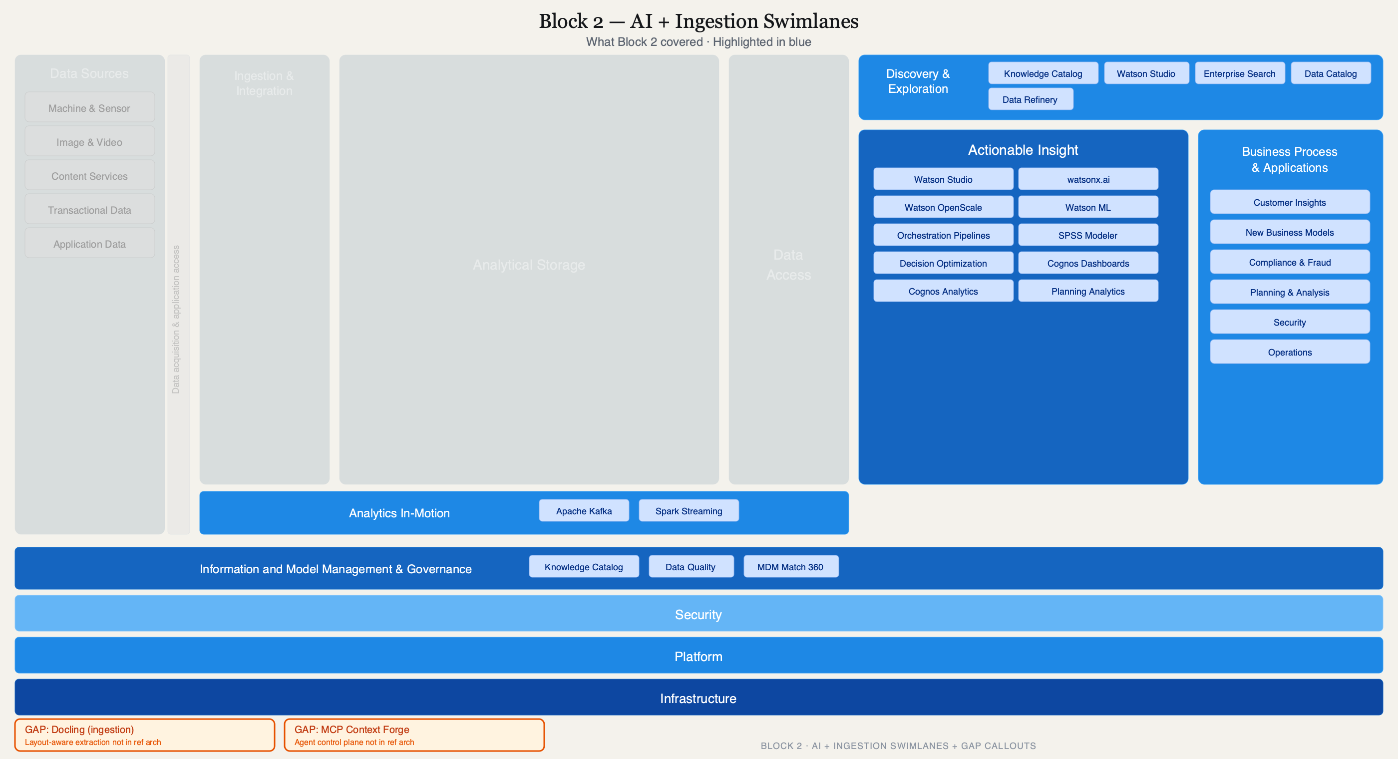
Block 2 — AI-Era
36 / 58
Notes:
Here's the diagram again. Now we've lit up the AI and analytics lanes — Watson Studio, watsonx.ai, the ML pipelines. Notice two annotations I've added. First: Docling, sitting in the Ingestion & Integration lane — it's how unstructured documents enter the pipeline. Second: Context Forge, below the governance band — it's the agent control plane that the published diagram doesn't include yet. You're ahead of the published material. Use that in customer conversations.

Slide 37
“
Every bank has data governance. Almost none have AI governance. Zero have agent governance. Those are three different problems.
Block 2 — AI-Era
37 / 58
Notes:
Let that sink in. Three different problems, three different toolchains, three different teams. After the break, we're going to light up the bottom three bands of the reference architecture and talk about what "governed" actually means in Canada.

Slide 38
BLOCK 3 OF 5
Governance.
Data governance. AI governance. Agent governance. Three problems, not one.
45 MIN
Governance
38 / 58
Notes:
Welcome back. This block is the one that makes the compliance team lean forward. We're going to talk about what "regulated" actually means, why every reference architecture you see online is wrong for a Canadian bank, and why agents just made the threat model worse.

Slide 39
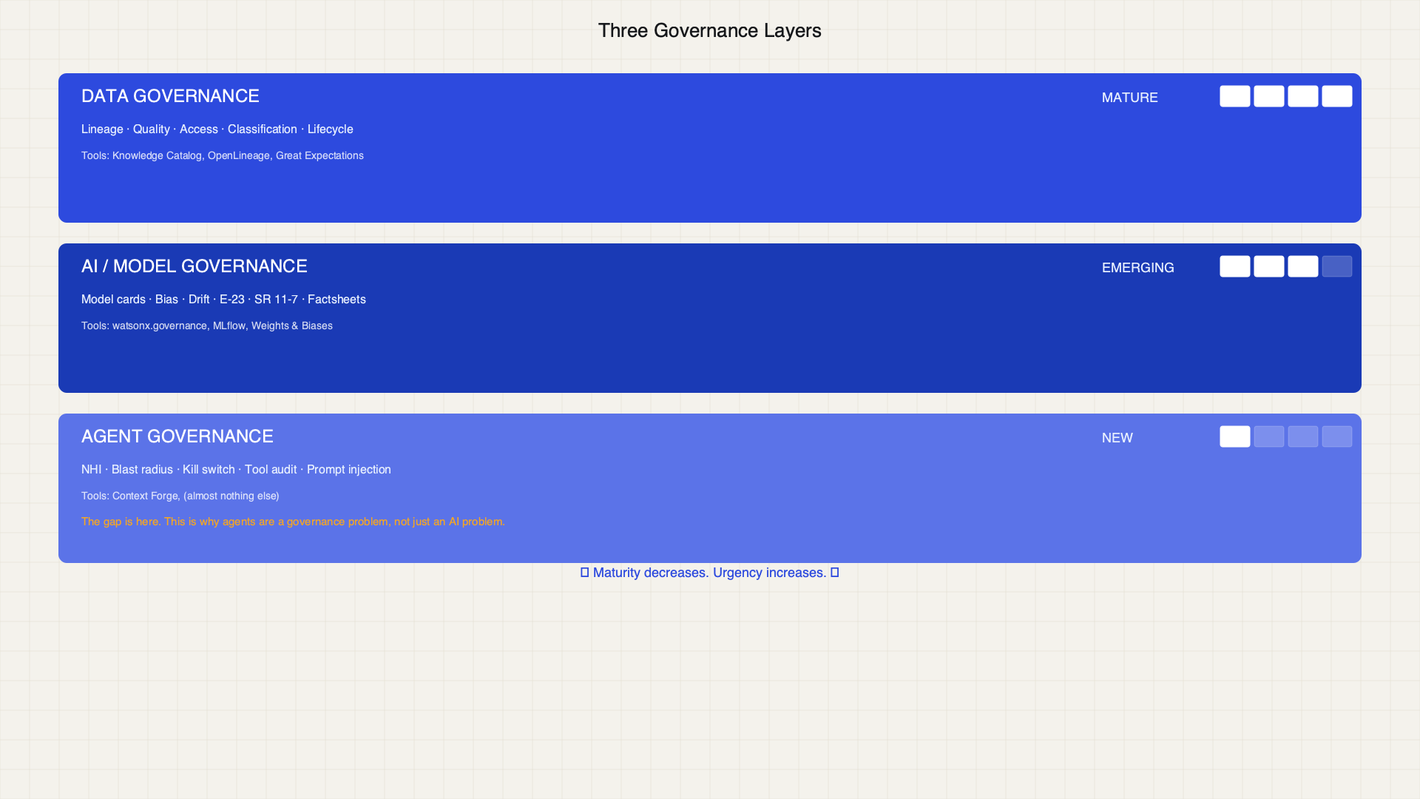
§ 3.1 — THREE GOVERNANCE PROBLEMS
Treating these as one thing is how enterprises get burned.
Block 3 — Governance
39 / 58
Notes:
Data governance is table-stakes — every bank has Knowledge Catalog, lineage, quality rules. AI governance is emerging — model risk management, OSFI E-23, bias detection, drift monitoring. Agent governance is brand new — who authorized this agent to call this tool? What's the blast radius? Where's the kill switch? Treating these as one problem is how you end up with a governance framework that covers data lineage perfectly but has no idea an agent just exfiltrated PII via a tool call.

Slide 40
§ 3.2 — REGULATED REALITY
Why every reference architecture you see online is wrong for a Canadian bank.
• OSFI B-13 (technology and cyber risk)
• PIPEDA (privacy)
• E-23 (model risk management)
• SR 11-7 (US model risk, but Canadian banks follow it too)
• Lineage-to-audit-trail requirements
Block 3 — Governance
40 / 58
Notes:
When I show a reference architecture at a US tech conference, everyone nods. When I show it at a Canadian bank, the CISO asks "where's the data residency boundary?" and the model risk officer asks "where's the E-23 mapping?" and the privacy officer asks "where's the PIPEDA consent flow?" Every reference architecture you see online is wrong for a Canadian bank. Today we fix that.

Slide 41
§ 3.2 — SOVEREIGNTY
Three different things, frequently confused.
TERM | DEFINITION
Data Residency | Data physically stays in Canada
Data Sovereignty | Canadian law governs the data
Operational Sovereignty | Canadian operators control the infrastructure
“Sovereignty, not solitude.” — Sovereignty doesn’t mean isolation.
Block 3 — Governance
41 / 58
Notes:
Three different things, frequently confused. A Canadian bank can use AWS in Montreal (residency) but the data is still subject to the US CLOUD Act (sovereignty gap). Operational sovereignty means a Canadian team runs the infrastructure — not an offshore NOC. "Sovereignty, not solitude" — you can use public cloud, but you need to know which of these three you're actually getting.

Slide 42
§ 3.3 — DATA OBSERVABILITY
The triad nobody has all three of.
• Data observability: quality, freshness, schema drift, pipeline SLOs
• Model observability: bias, drift, performance degradation
• Agent trace observability: tool call logs, latency, error rates, anomaly detection
• Tools: Monte Carlo, Bigeye, IBM Databand, OpenLineage
Block 3 — Governance
42 / 58
Notes:
The triad: data observability, model observability, agent trace observability. Three layers, frequently confused, rarely all instrumented. Most banks have data observability (at least for their warehouse pipelines). Some have model observability (watsonx.governance does this). Almost none have agent trace observability — logging every tool call, every context assembly, every generation. That's the gap.

Slide 43
§ 3.4 — GOVERNANCE AS ARCHITECTURE
75 sub-capabilities, 10 domains. Overview only — we’ll go deep another day.
Identity
Authorization
Audit
Evaluation
Safety
Privacy
Quality
Observability
Lifecycle
Compliance
Block 3 — Governance
43 / 58
Notes:
The full framework has 75 sub-capabilities across 10 domains. We don't have time to go through all of them today, but I want you to know it exists. When a customer asks "how do we govern our agents?" — this is the answer. It maps to a real bank's 80-domain questionnaire. Context Forge implements it as plugins.

Slide 44
§ 3.4 — BANK QUESTIONNAIRE MAPPING
How RBC, CIBC, and Scotia approach this differently.
• Real bank governance questionnaires have 60–80 domains
• The 10-domain agentic governance framework maps to the top 15–20
• Anonymized patterns: one bank leads with privacy, another with model risk, a third with operational risk
• “Sovereignty, not solitude” applied to governance: federate where you can, centralize where you must
Block 3 — Governance
44 / 58
Notes:
I can't name the banks. But I can tell you the pattern. One Big Five bank builds governance from privacy outward. Another starts from model risk (E-23 compliance). A third starts from operational risk. They all end up in the same place — a framework that covers data, AI, and agent governance — but they get there from different starting points. When you're in front of the customer, ask which door they came through. That tells you how to position.

Slide 45
§ 3.4 — WATSONX.GOVERNANCE
Where HITL and BPM integration fits.
• watsonx.governance: model inventory, AI Factsheets, bias/drift monitoring
• Orchestrate: where human-in-the-loop and BPM integration happens
• Plugin-based governance: how Context Forge extends the framework
Block 3 — Governance
45 / 58
Notes:
watsonx.governance is where model risk management lives. AI Factsheets document what the model does, who trained it, what data it saw, and what its known failure modes are. Orchestrate handles the human-in-the-loop workflows — when the model says "I'm not sure," Orchestrate routes it to a human. Context Forge extends this to agents — same idea, but for autonomous tool calls instead of model predictions.

Slide 46
§ 3.5 — AGENT THREAT MODEL
Autonomous tool use is a new attack surface.
• Lateral movement via tool chains
• Prompt injection as exfiltration vector
• Control plane requirements: identity, authorization, audit, kill switch, eval harness
• Where the partner ecosystem (AWS, Google, Microsoft, JPMC, Palo Alto) is converging
• Where IBM is differentiated — and where we’re catching up
Block 3 — Governance
46 / 58
Notes:
When an agent calls a tool, it's executing code with privileges. If the agent is compromised via prompt injection, the attacker inherits those privileges. That's lateral movement via tool chain — the agent becomes the attack vector. This is why the control plane needs identity (who is this agent acting for?), authorization (what tools can it call?), audit (what did it actually call?), and a kill switch (stop everything, now). The named-partner ecosystem is converging on these requirements. We're not ahead of everyone, but we're not behind either.

Slide 47
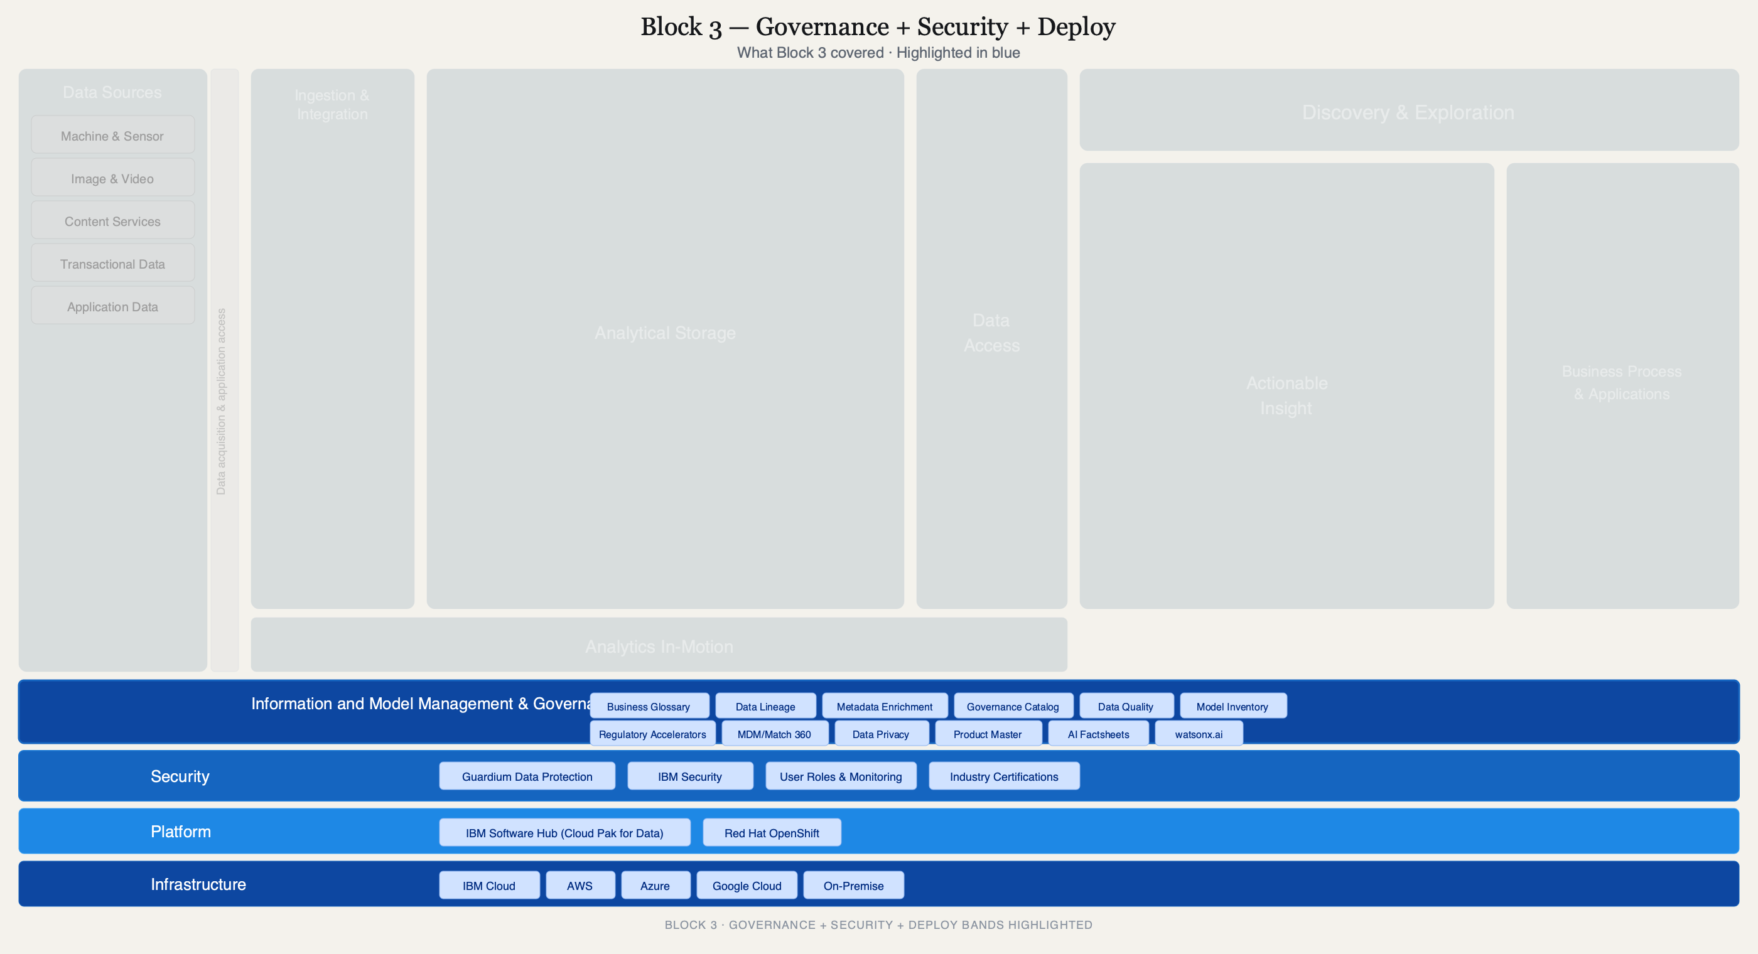
Block 3 — Governance
47 / 58
Notes:
Last time with the diagram. Now we've lit up the bottom three bands — governance, security, and deployment. This is where IBM's differentiation is strongest. Knowledge Catalog, Data Lineage, MDM/Match 360, AI Factsheets, Guardium, OpenShift. When the CISO asks "who controls this?" — point here.

Slide 48
§ 3.5 — IBM DIFFERENTIATION
Where we lead and where we’re catching up.
STRENGTH | GAP
Knowledge Catalog + lineage | Agent control plane (Context Forge fills this)
watsonx.governance + AI Factsheets | Agent trace observability
OpenShift everywhere | Competitive vector store (Milvus vs. managed options)
MDM/Match 360 | Open RAG standardization
Block 3 — Governance
48 / 58
Notes:
I'm going to be honest about where we're strong and where we're catching up. Knowledge Catalog is best-in-class for data governance. watsonx.governance is strong for model risk. MDM/Match 360 is the entity resolution play nobody else has. Where we're catching up: agent control plane (Context Forge is the answer, but it's early), agent trace observability, and the competitive vector store landscape. When you're in a customer conversation, lead with governance — that's where we win.

Slide 49
BLOCK 4 OF 5
Hands-on.
Two notebooks. One critique. Your turn.
60 MIN
Hands-on
49 / 58
Notes:
Your turn. We're going to run two notebooks live — the lakehouse and the AI-era capstone. Then you're going to critique an architecture that someone actually shipped to a healthcare customer. Buckle up.

Slide 50
§ 4.1 — SETUP AND ARCHITECTURE MAP
Maple Trust Bank: an AML policy Q&A system with full lineage and audit.
• Recap the reference architecture one more time
• You’ve now seen all five swimlane groups lit up
• Now we exercise them in code
• The scenario: Maple Trust Bank needs an AML policy Q&A system with full lineage and audit
• Two notebooks, two patterns, one story
Block 4 — Hands-on
50 / 58
Notes:
One more look at the diagram. You've now seen all five swimlane groups lit up. Now we're going to exercise them in code. The scenario: Maple Trust Bank needs an AML policy Q&A system with full lineage and audit. Two notebooks, two patterns, one story.

Slide 51
§ 4.1 — NOTEBOOK MAP
Which notebook lights which swimlane.
NOTEBOOK | SWIMLANE | MODE
01 Warehouse | Analytical Storage | Take-home (cameo in Block 1)
02 Data Lake | Raw Storage | Take-home
03 Lakehouse | Analytical Storage + Catalog | Live now
04 Virtualization | Data Access | Take-home (cameo in Block 1)
05 Data Mesh | Data Products + Governance | Take-home
06 MDM + RAG | AI + Governance + Storage | Live now
Block 4 — Hands-on
51 / 58
Notes:
Here's the map. Each notebook lights up different swimlanes. We're going to run Notebook 3 (Lakehouse) and Notebook 6 (MDM + RAG) live. The other four are take-home — run them tonight, break them deliberately, build intuition.

Slide 52
Live: Notebook 3
Lakehouse Pattern — 15 minutes
notebooks/03-lakehouse.ipynb
Block 4 — Hands-on
52 / 58
Notes:
Run cells top to bottom. Narrate the Iceberg schema evolution and time travel cells. Pause for questions after the partition pruning demo. If a cell fails, skip to pre-recorded output. (Full choreography will be in facilitator-guide.md — see Issue #16.)

Slide 53
Live: Notebook 6
MDM + RAG — 25 minutes
notebooks/06-rag-mdm.ipynb
Block 4 — Hands-on
53 / 58
Notes:
The payoff of the whole day. Run the Docling PDF parsing cell first (takes 30-60s). Then the OpenSearch indexing. Then Q2 — the question every previous notebook deferred. Let the room see it work. Then show Break 2 (the eval scoring) to prove we're honest about the limits. (Full choreography will be in facilitator-guide.md — see Issue #16.)

Slide 54
§ 4.4 — ARCHITECTURE CRITIQUE
Find the failures.
• Distribute handouts/critique.md — HealthFirst Insights scenario
• Simple RAG sold as “agentic,” tightly coupled .NET/C#, vibes-based eval
• PHI sent to a hyperscaler API with no guardrail, multi-tenancy “planned” at DB level
• Small groups (3–4 people), 10 min to find failures, 5 min readout
• Severity: Critical / High / Medium Category: Data / AI / Governance / Security / Ops
Block 4 — Hands-on
54 / 58
Notes:
Names and details are anonymized. The pattern is real. Welcome to enterprise AI. You have 10 minutes with your group. Use the worksheet. Severity: critical, high, medium. Category: data, AI, governance, security, ops. Go.

Slide 55
“
Data architecture in 2026 is the integration contract between your enterprise and your agents. Get it wrong and nothing else matters.
Block 5 — Close
55 / 58
Notes:
One slide. One sentence. This is the thing you take back to your customer. Not "buy watsonx" — that's the how. The what is: your data architecture IS the integration contract between your enterprise and your agents. If the contract is broken, nothing else works. If the contract is solid, everything else follows.

Slide 56
BLOCK 5 — CLOSE
Three things to do Monday morning.
ROLE | ACTION
Sellers | Stop selling “AI.” Start selling the data plane that makes AI work.
Architects | Audit your context engineering and your control plane, not just your RAG pipeline.
SSRs | Every incident is now a governance incident.
Block 5 — Close
56 / 58
Notes:
Three things. Do them Monday. Sellers: the next time you're about to say "AI" in a pitch, replace it with "data plane." Architects: audit your context engineering, not just your RAG pipeline. SSRs: every outage is a governance question now — which swimlane broke, and who owns it?

Slide 57
BLOCK 5 — CLOSE
Pointers.
• MCP Context Forge: github.com/IBM/mcp-context-forge
• factor10.ai — 10 Principles of Enterprise AI
• Docling: github.com/DS4SD/docling
• OpenSearch hybrid retrieval guide
• Internal IBM governance framework doc
Block 5 — Close
57 / 58
Notes:
All of these are live links. The notebooks are on GitHub. Context Forge is open source. Docling is open source. factor10.ai is the 10 Principles of Enterprise AI. Bookmark them, share them with your customer's architect. These are the resources that make you credible.

Slide 58
END OF VOLUME ONE
Six patterns. One conversation.
Walk into the next customer with the pattern decoder ring. Listen for which row their problem sits on. Propose the pattern, not the product.
QUESTIONS? | MANAV.GUPTA@IBM.COM | NOTEBOOKS · GITHUB.COM/...
Close
58 / 58
Notes:
Thank you. The notebooks are on GitHub. The pattern decoder ring is your cheat sheet. When the customer says "we need to query across three systems without moving data," you know the answer is virtualization. When they say "we need ACID on the lake," it's lakehouse. When they say "our domains need autonomy," it's mesh — but only if they have the org maturity. Propose the pattern. Then back it with the product.

