Slide 1
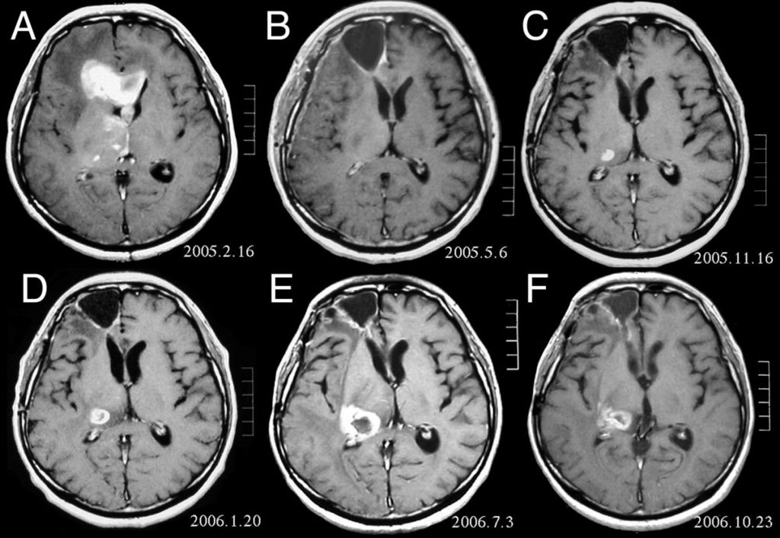
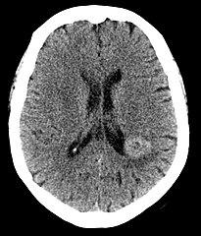
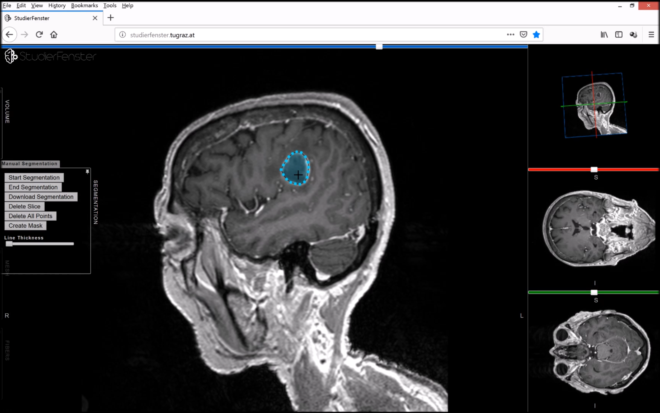
Brain Tumor Detection
Jacob Ohlin
Nandita Patil
Rishi Parpyani
Swaroop Giri

Slide 2
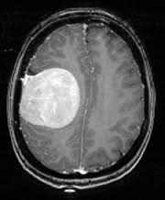
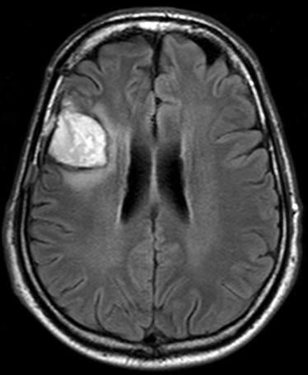
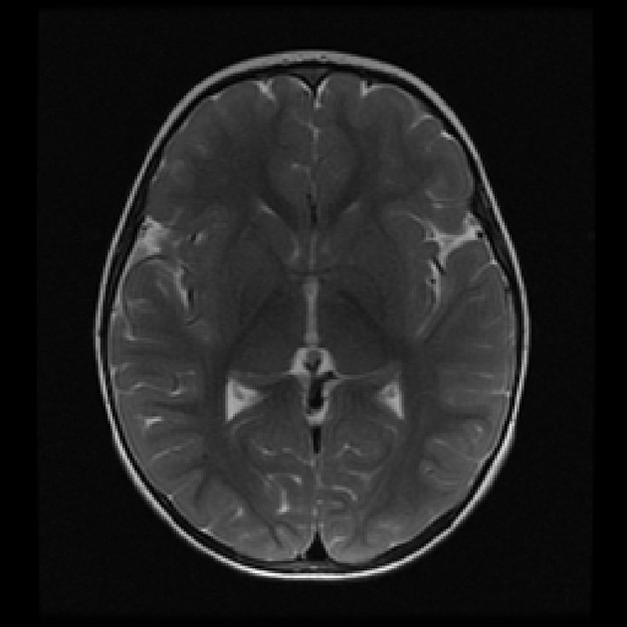
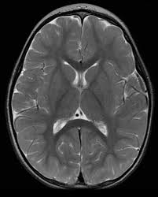
Problem Statement
To identify if a person has brain cancer using the MRI brain scan Images
YES
YES
NO
NO

Slide 3
Algorithm Used
Convolutional Neural Network (CNN or convnet) is a subset of machine learning. It is one of the various types of artificial neural networks which are used for different applications and data types. A CNN is a kind of network architecture for deep learning algorithms and is specifically used for image recognition and tasks that involve the processing of pixel data.
ResNet-50 is a convolutional neural network that is 50 layers deep. You can load a pre trained version of the network trained on more than a million images from the ImageNet database . The pretrained network can classifies images into Yes and No.
MobileNet is a type of convolutional neural network designed for mobile and embedded vision applications. They are based on a streamlined architecture that uses depth wise separable convolutions to build lightweight deep neural networks that can have low latency for mobile and embedded devices.
Support Vector Machine (SVM) is a classification technique used for the classification of linear as well as non-linear data. SVM is the margin based classifier. It selects the maximum margin.

Slide 4
Approach Used
Classify dataset into two classes.
Performed data amputation by resizing and rotating images.
Normalized the data to make it look consistent.
Split data into train and test.
Train Model
- For SVM, classified the data into linear model.
- For CNN, defined layers of Neural network using keras library of tensorflow and used Relu Activation function.
- ForResNet-50, defined 50layer using resnet library and used Sigmoid Activation function.
- For MobileNet, used keras library of tensorflow to train the model.
Accuracy test.

Slide 5
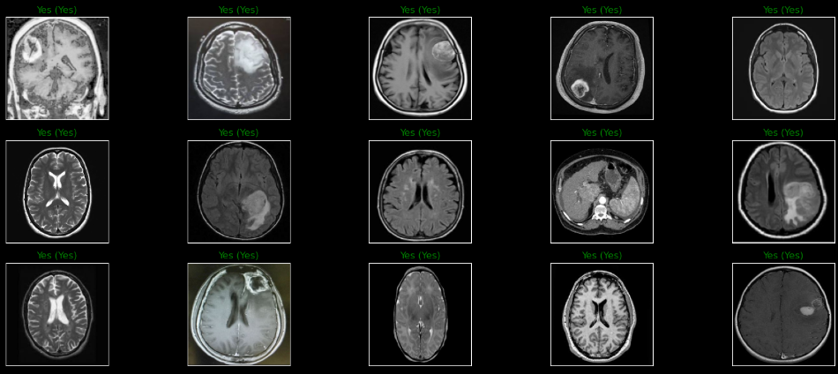
Brain Tumor Predictions

Slide 6
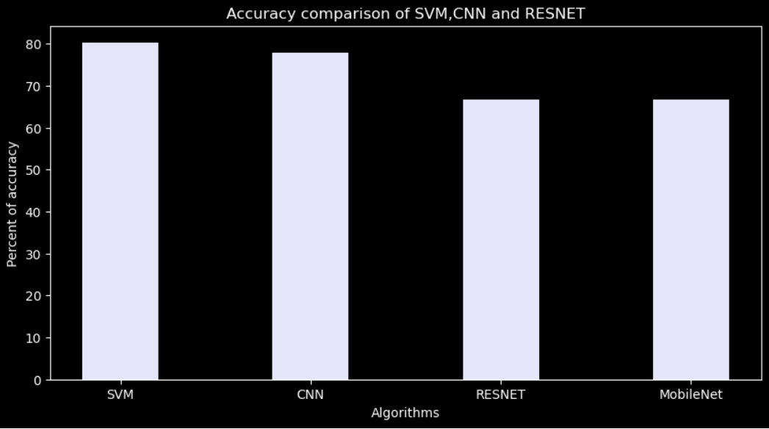
Accuracy Comparison

Slide 7
Conclusion
We tried and tested the following Algorithms:
SVM Classifier
Convolutional Neural Network
Resnet-50
Mobilenet
Following were the observations after testing the above algorithms:
CNN with ReLu has the highest number of accuracy and the accuracy goes on increasing as we increase the number of epochs.
Major drawback for deep learning algorithms is that the time complexity increases if we increase the epochs.
From the observation we can conclude that images with more pixel/clarity increase the accuracy

