Slide 1
Dot Net Full Stack Training Project
LOAN MANAGEMENT SYSTEM
Presented by: Batch 9 (Team 3)
Instructor: Shrivalli Maheshwaran

Slide 2
Contributions
Ashwin Menon - Frontend Alerts, Exception Handling, (UI - Customer management, Item Purchased, View Loans, Navbar, Dashboard) & (APIs - Edit/Delete Employee, Get Purchased Items, Get Loan Cards, Role Based Auth), Test cases for GetLoanCards API.
Agastya Varma - Frontend Login/Register page, Setting up AuthContext, Password hashing, APIs - Delete loan, Login, Register, Database Schema, DDL commands.
Soumil Kamat - (UI- Apply for Loan, Edit loan, Add item, Bootstrap setup, UI for Tables, adding session storage), (APIs- Delete Item, Add loan card), (API connection from frontend - delete item, delete loan)
Hardik Sharma- Frontend: Reusable TableComponent, UI enhancement of master tables and edit form, helper filter function, Backend: Unit tests for GetItems() API, APIs: IssueItem,UpdateItem,UpdateLoan, DeleteItem, exception for repos, DML commands
Manav Munjal - (Ui tasks- User & Admin Dashboards, ApplyForLoan, Add Employee, Dates validation), (Backend tasks- Apis - (Login, Register, GetEmployeeById), Dates validation), DDL commands, Tables creation and population sql.

Slide 3
Code Structure

Slide 4
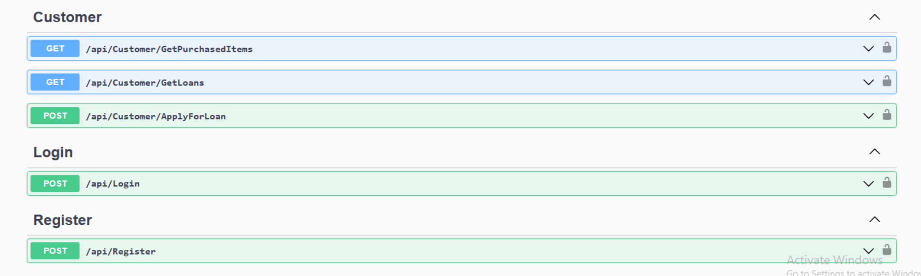
API Specification (Swagger)

Slide 5
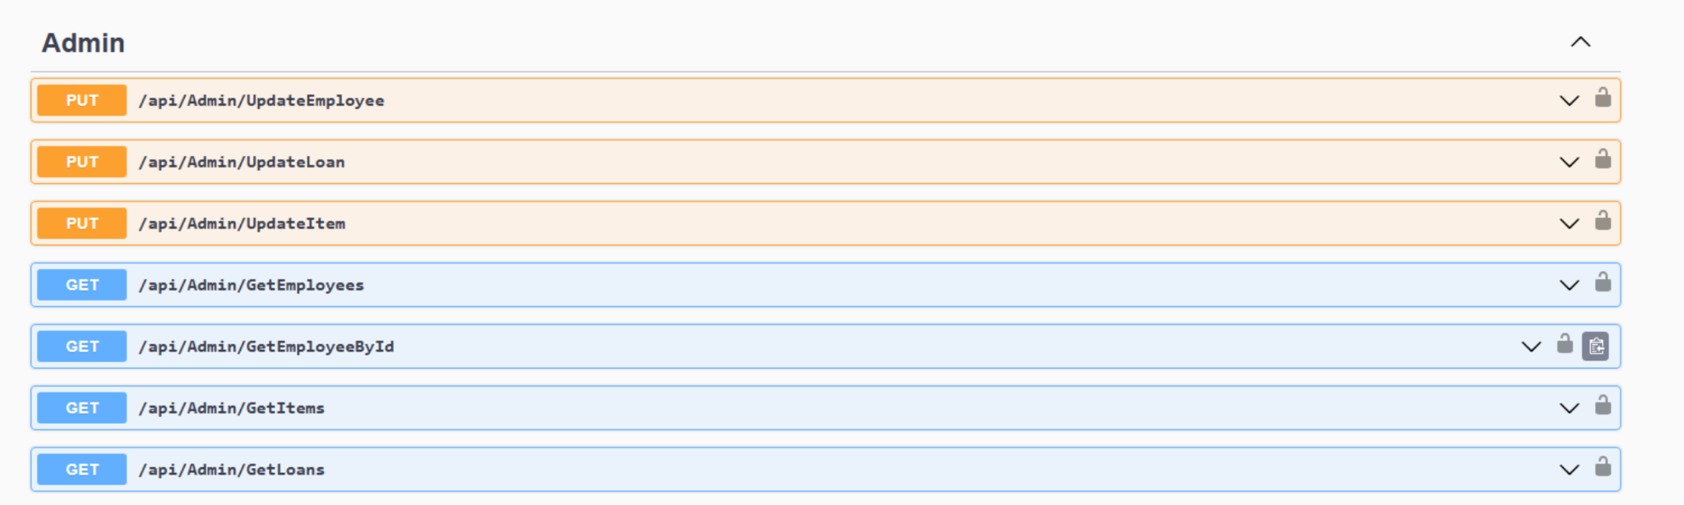
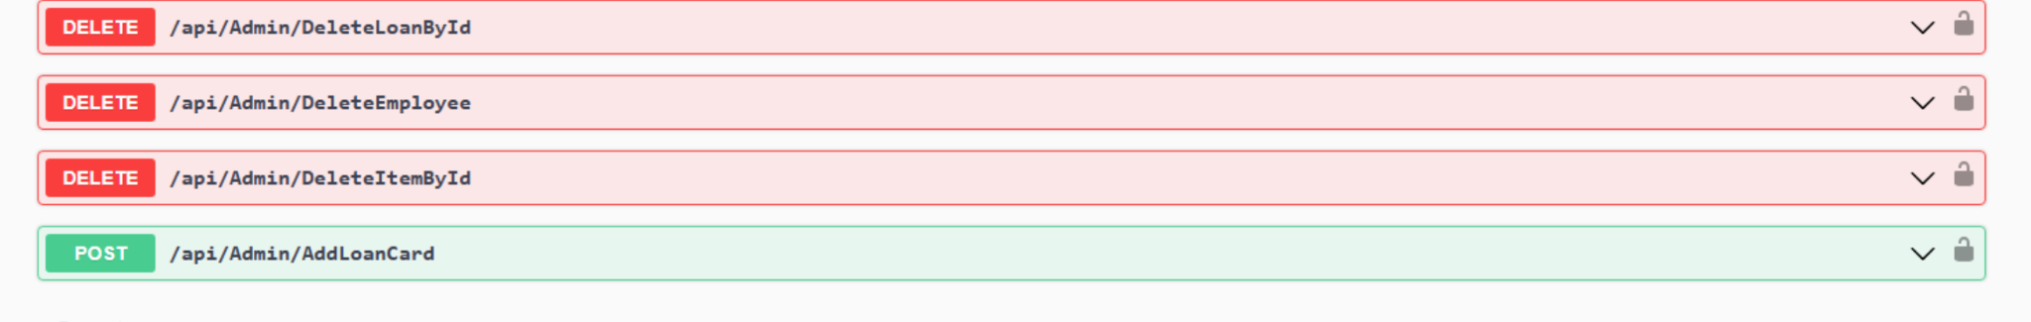
API Specification (Swagger)

Slide 6
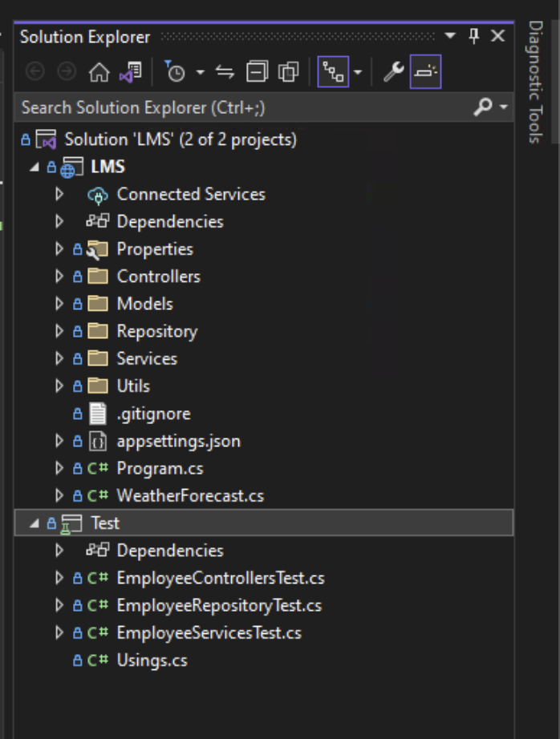
Backend Structure

Slide 7
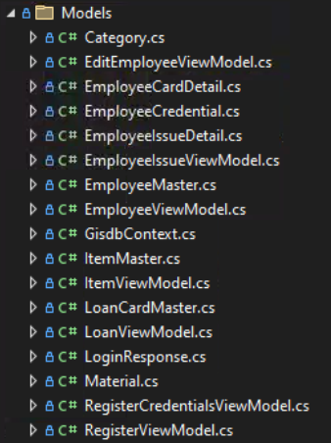
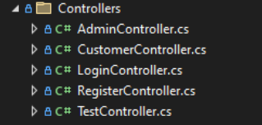
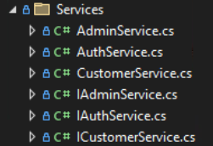

Backend Structure

Slide 8
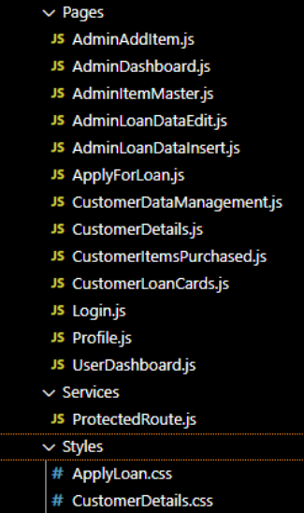
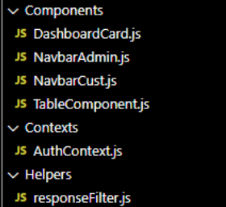
Frontend File Structure

Slide 9
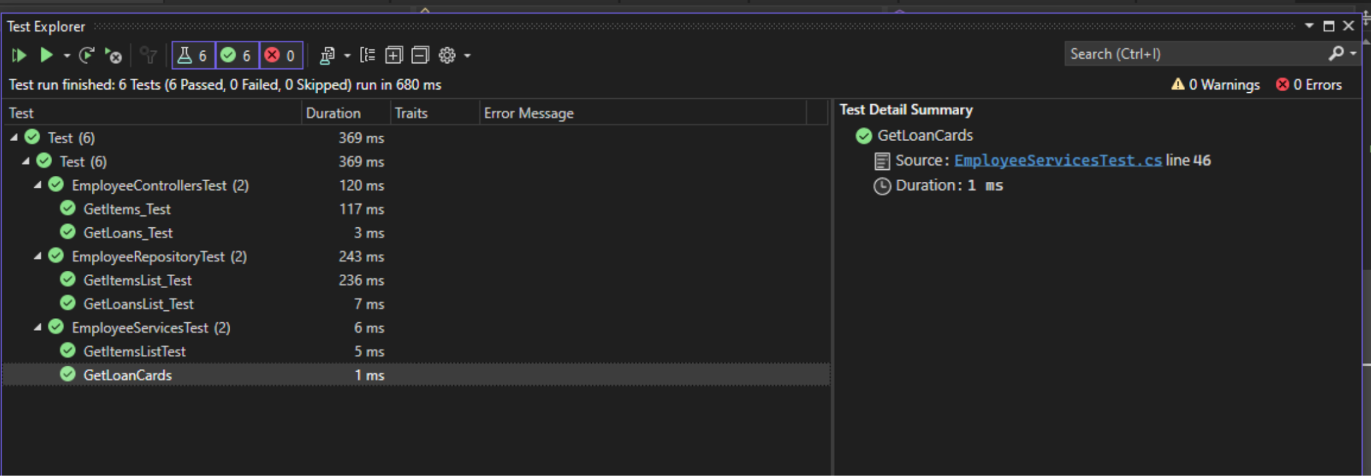
Unit Testing Results

Slide 10
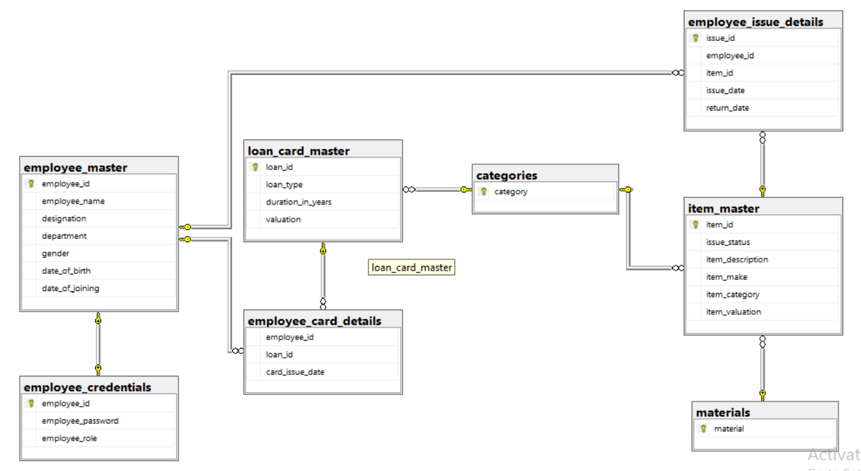
Database Schema

Slide 11
Special Features

Slide 12
Special Features
Appropriate error handling like validation error is shown in case employee enters date of birth > date of joining
User is shown appropriate status, e.g. when tables do not have any data, proper message is displayed instead of blank screen
Data consistency has been taken care of, e.g. when deleting a loan card, associated items will be deleted as well
Navbar has been added with user greeting on right side
Loan card valuation is displayed which is the sum of all items purchased with it
Displaying return date for items purchased

Slide 13
Reusable Table Component
The TableComponent takes various table header names, the corresponding row data and messages to display when no data is present in the table as prop arguments. All view table pages make use of this component. It also uses a helper function responseFilter(), which filters requisite columns from backend response.

Slide 14
Application Walkthrough

Slide 15
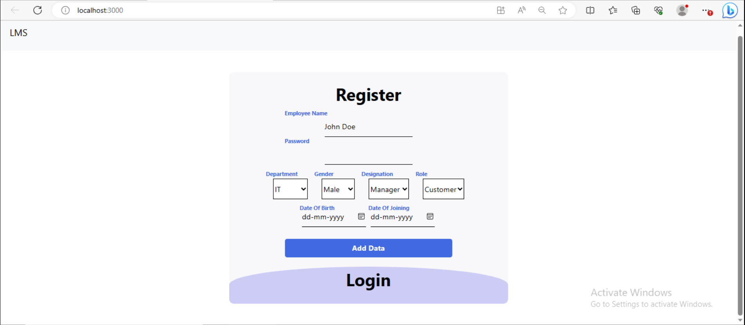
Register Screen

Slide 16
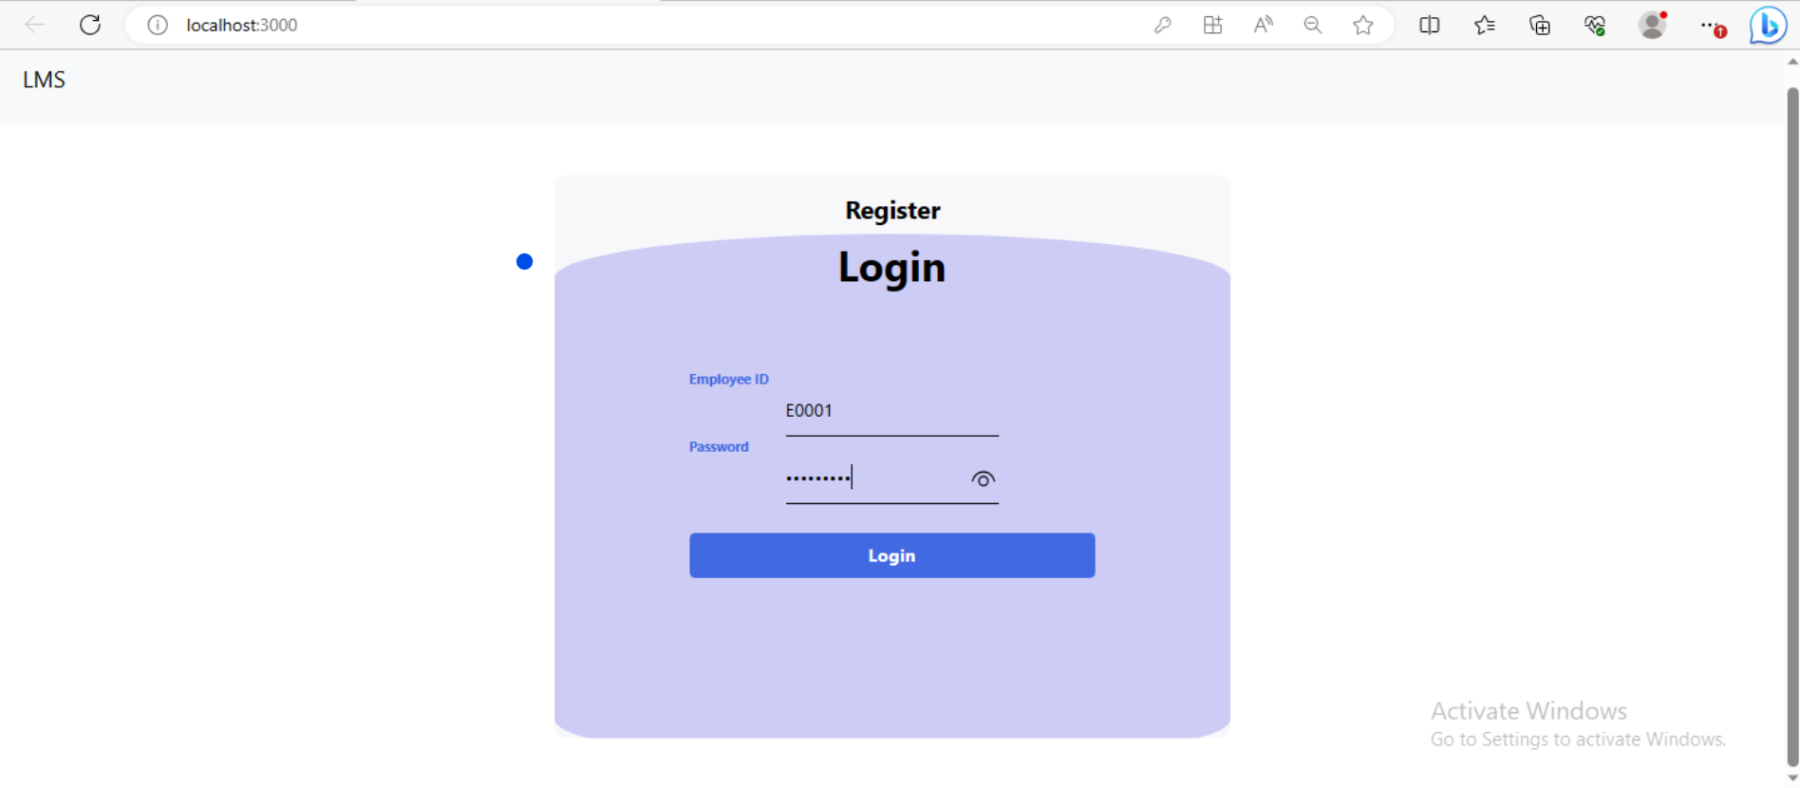
Login Screen

Slide 17
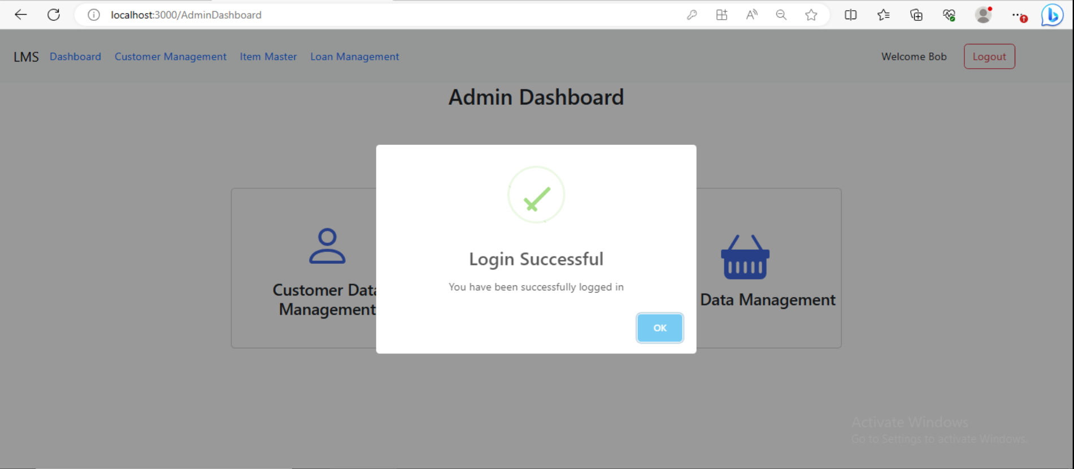
Successful Login

Slide 18
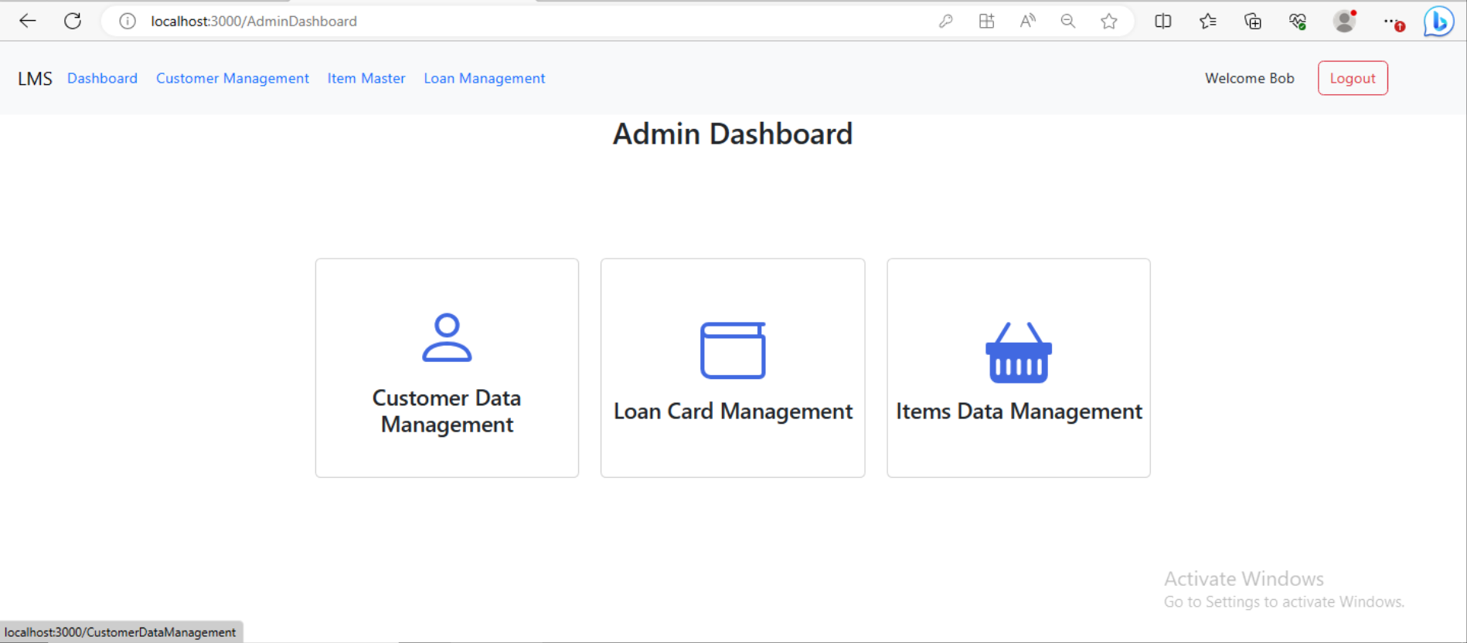
Admin Dashboard

Slide 19
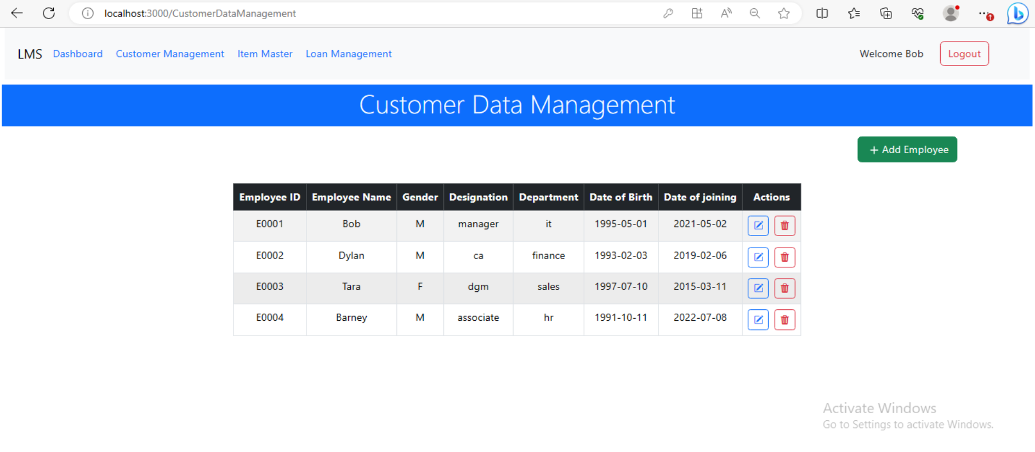
Admin > Customer Data Management

Slide 20
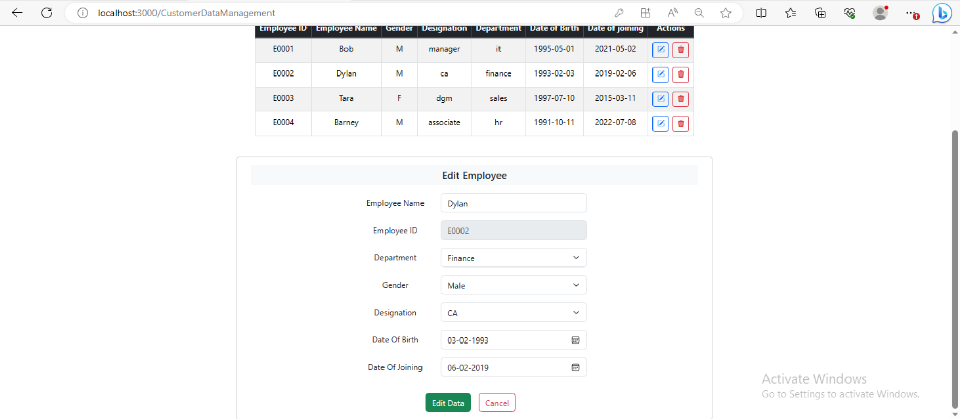
Admin > Customer Data Management > Edit Customer

Slide 21
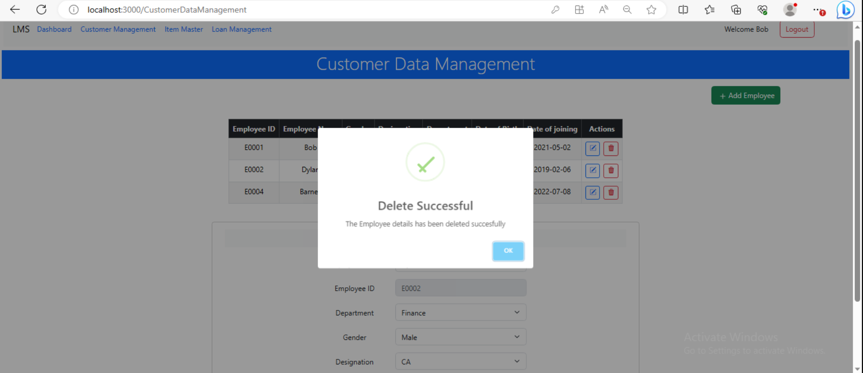
Admin > Customer Data Management > Delete Customer

Slide 22
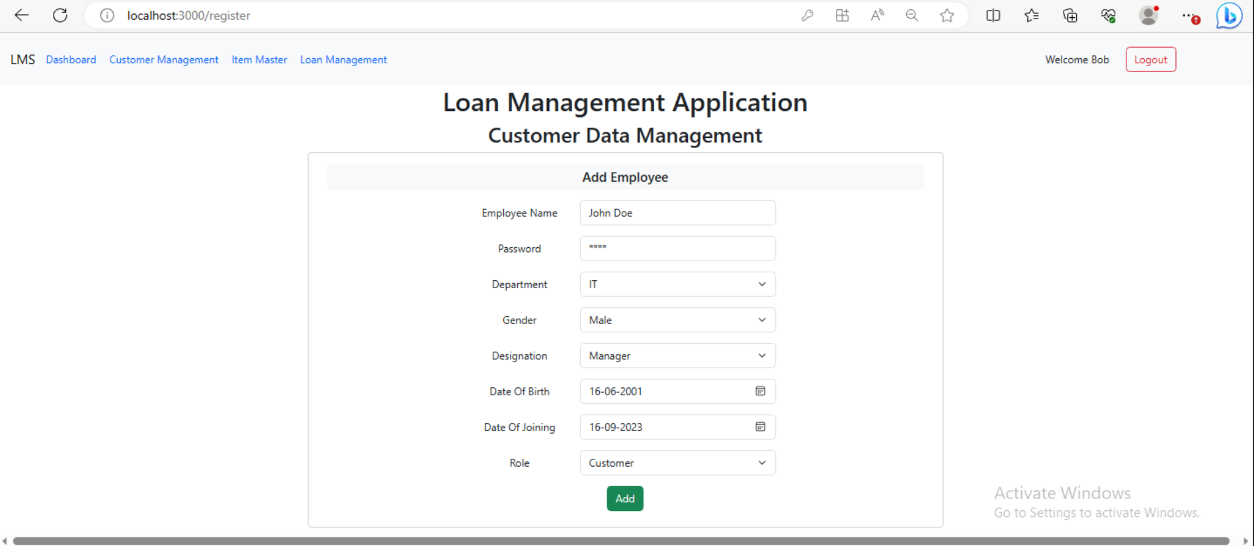
Admin > Customer Data Management > Add Employee

Slide 23
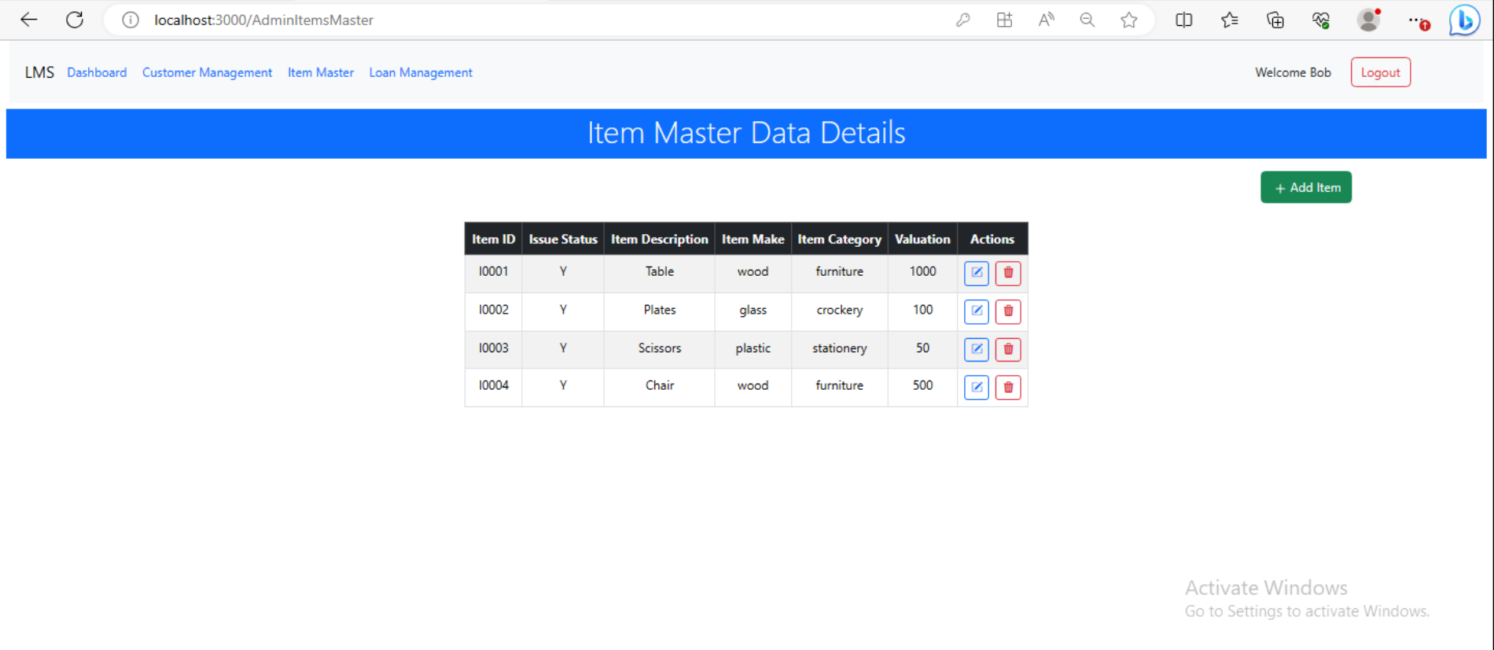
Admin > Item Master View

Slide 24
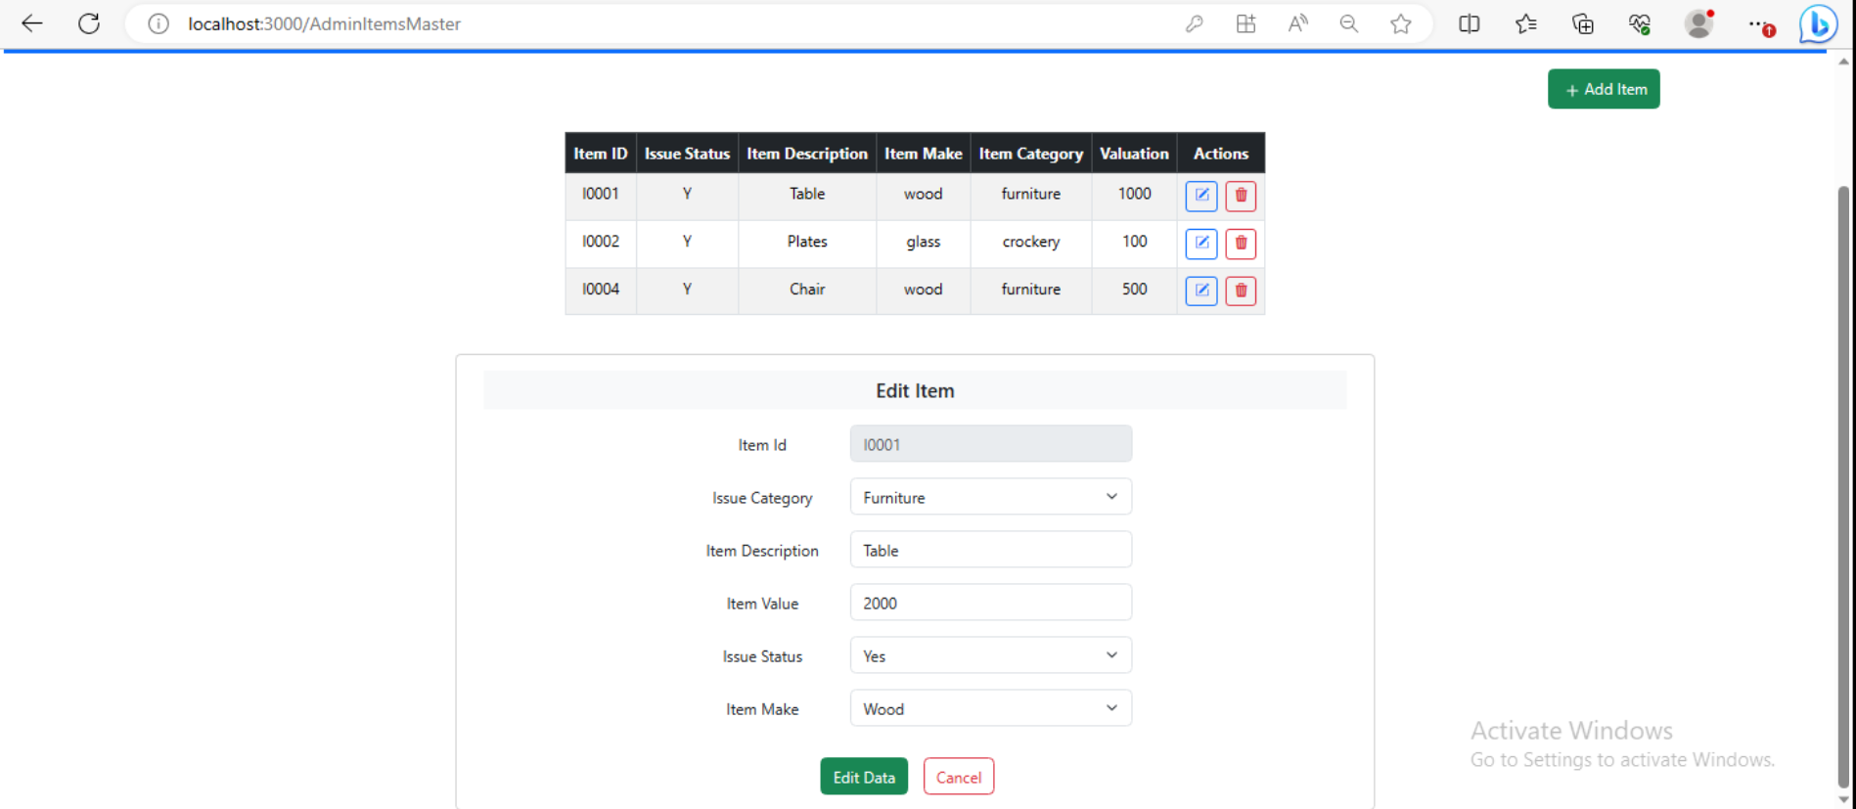
Admin > Item Master View > Edit Item

Slide 25
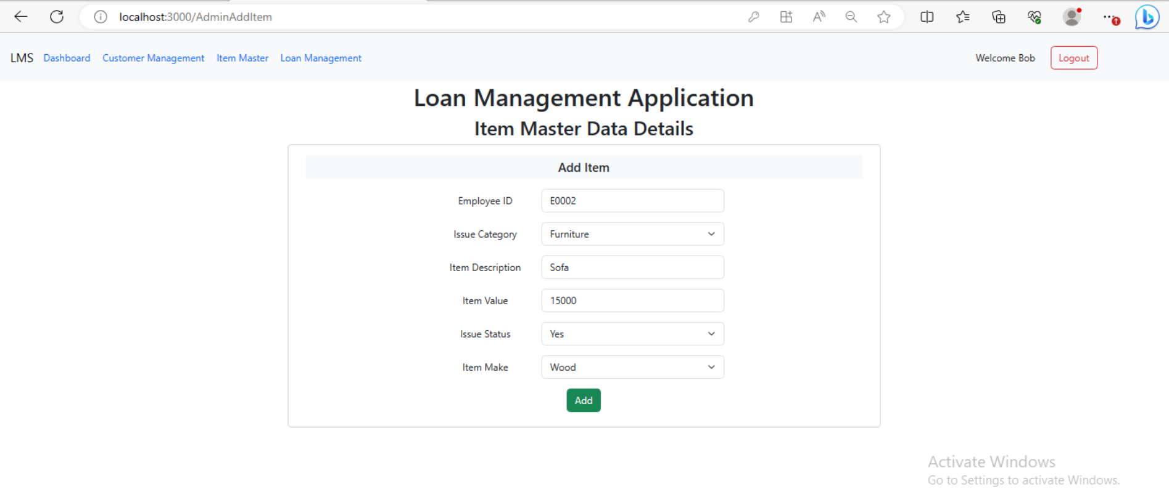
Admin > Add Item Form

Slide 26
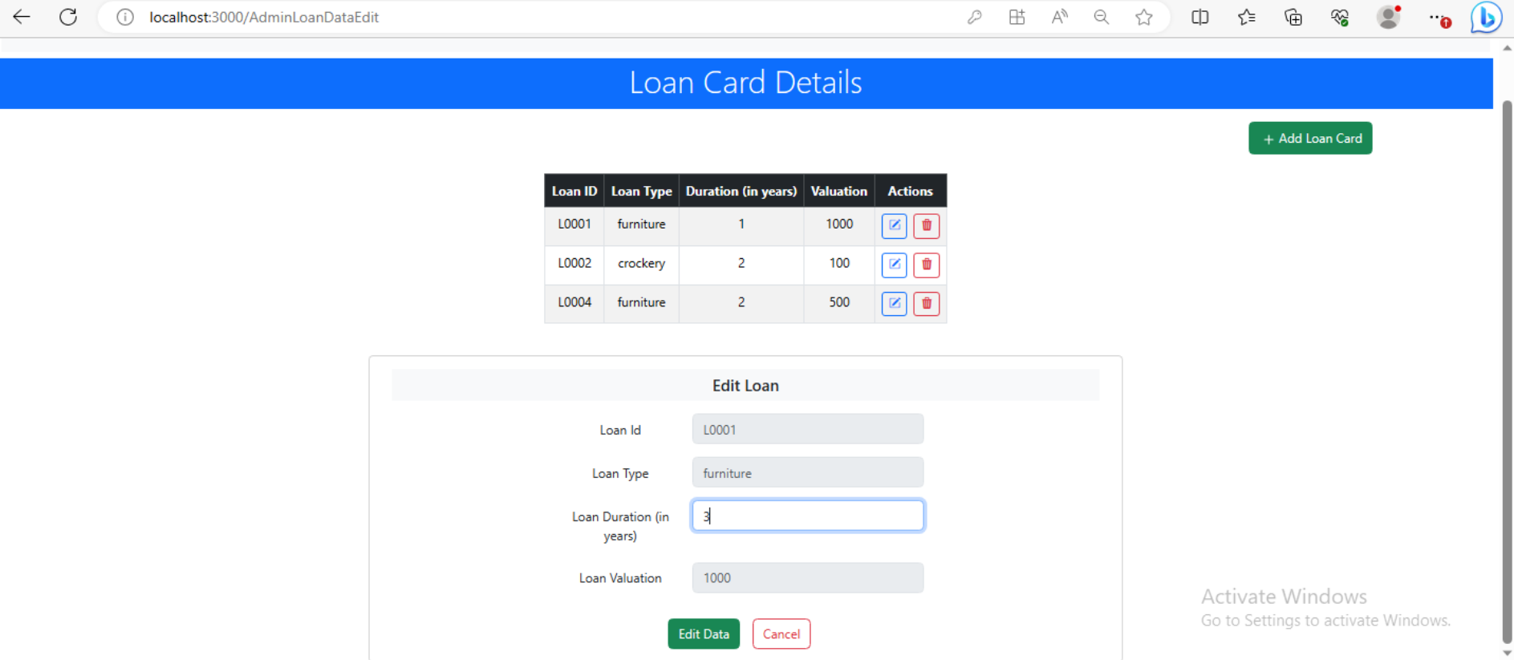
Admin > Loan Card Master and Edit Loan

Slide 27
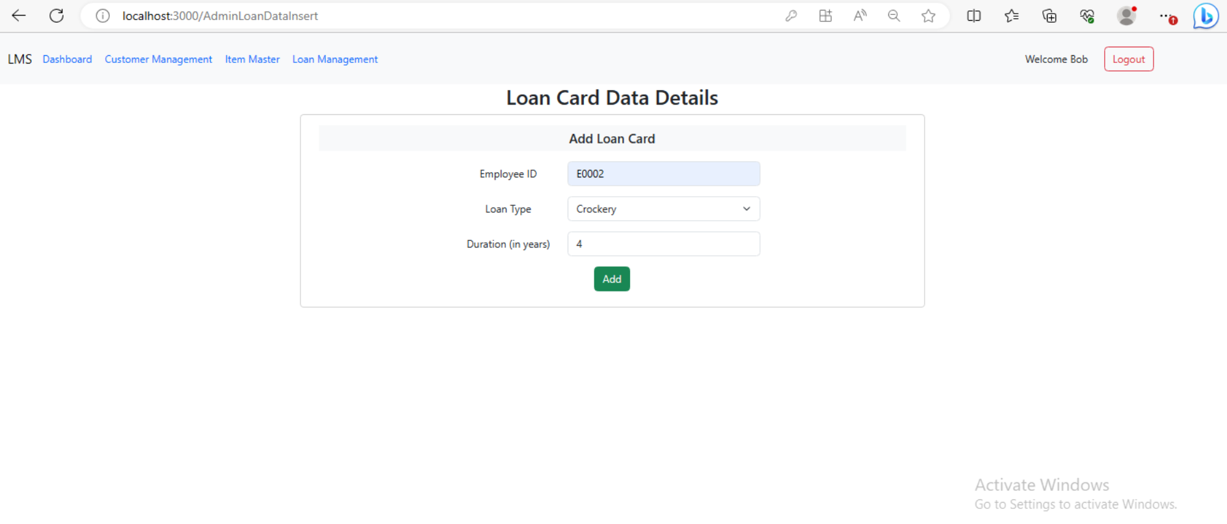
Admin > Add Loan Card

Slide 28
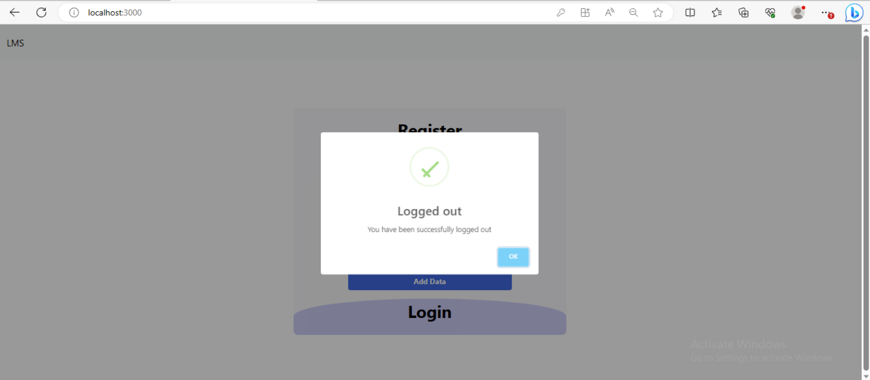
Logout Screen

Slide 29
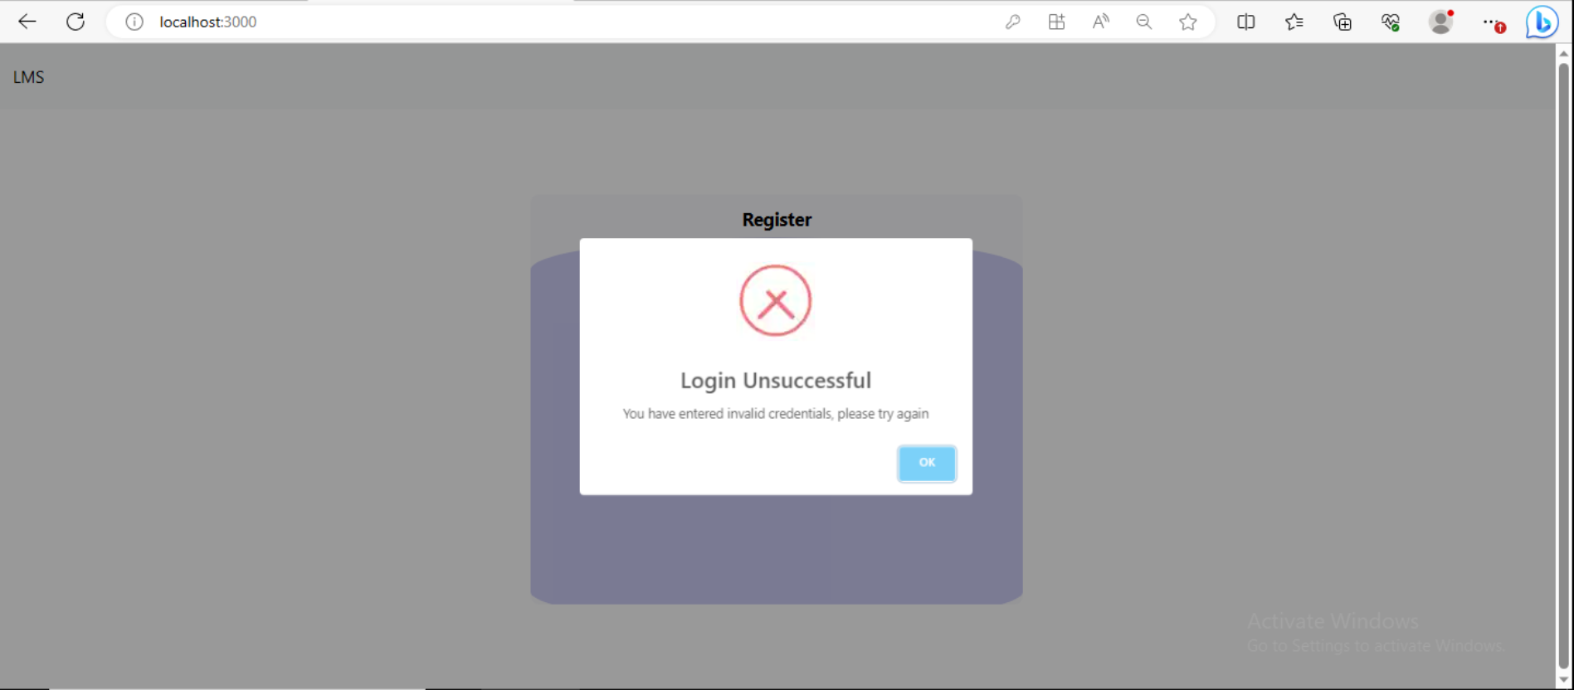
Error screen on entering invalid credentials

Slide 30
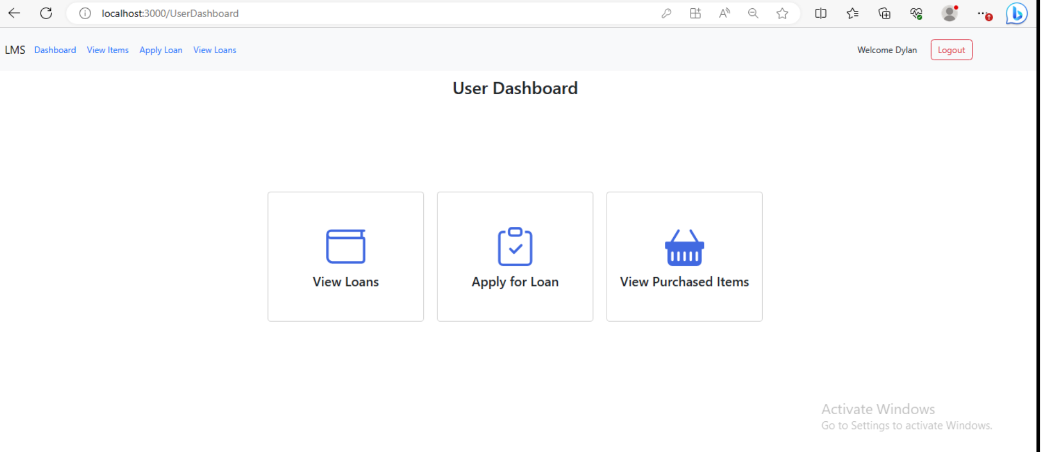
Customer Dashboard

Slide 31
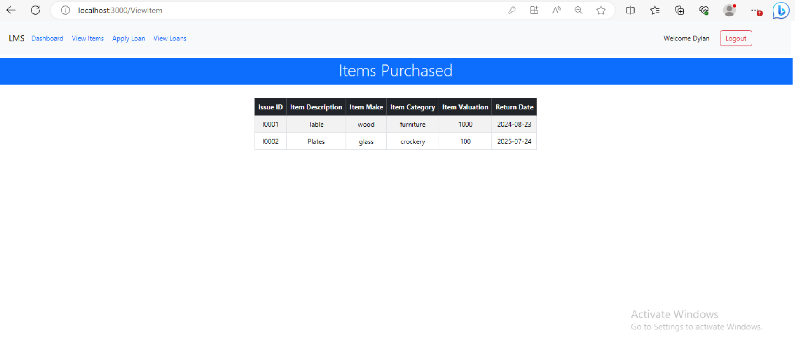
Customer > View Items Purchased

Slide 32
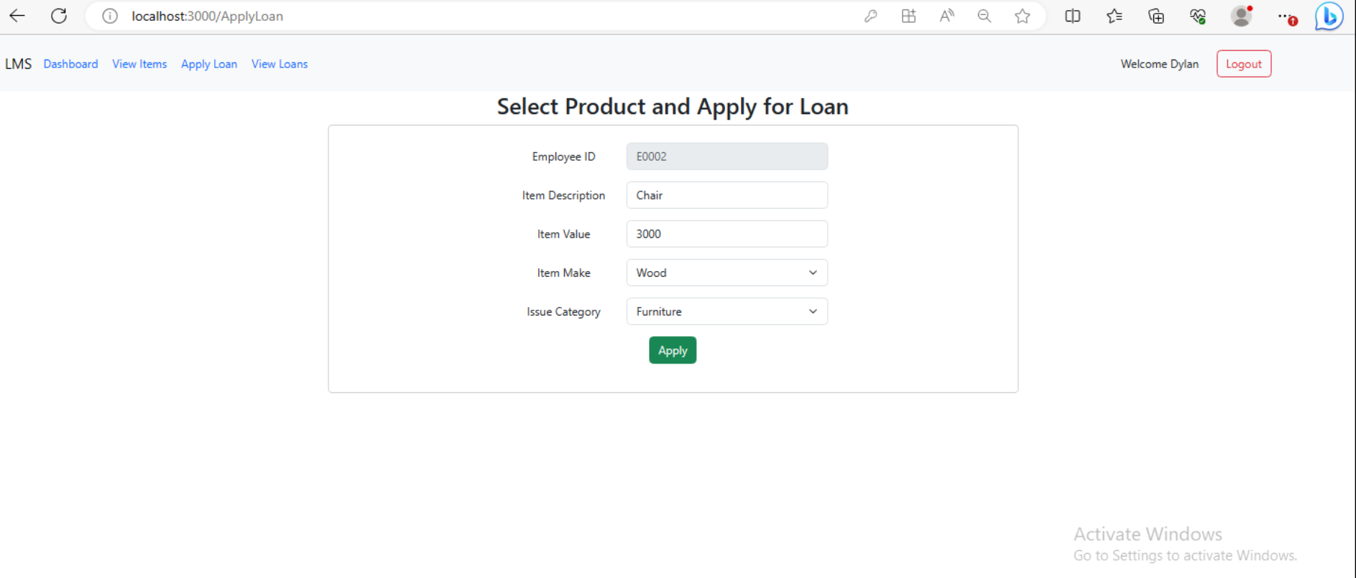
Customer > Apply for Loan

Slide 33
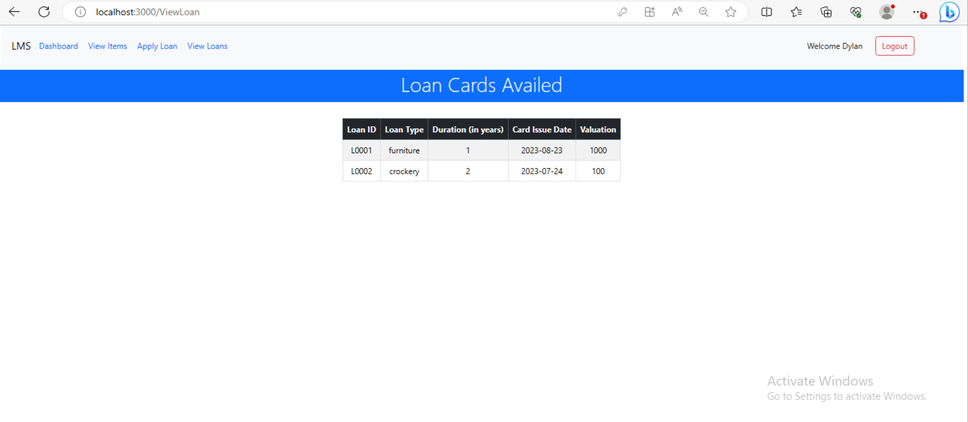
Customer > View Loans

Slide 34
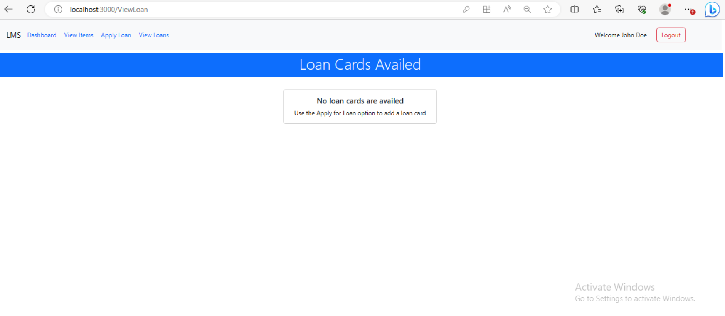
Customer > View Loans (No Loan Cards Availed)

