Slide 1
Image Caption Generator using Machine Learning
The basis of our brains is annotating or classifying any images that are demonstrated to us. What about computers, though? How can a device comprehend an image and place a caption that is highly accurate and has appropriate context terms? To say that it was hard to believe was absolutely true only a few years ago. However, there is a continuous advancement in the general-purpose image captions generator because of the progress in Computer Vision and Deep Learning algorithms, also relevant data sets and AI models are now available. The circle of captioning around the world is constantly widening, with many data annotation companies increasing their profit margins every year.
By the aid of datasets, we will build a specimen with such properties as to give a useful description of the image in this tutorial. LSTM and CNN technologies will be discussed briefly and also covers a general description about the concepts of Deep learning approaches.

Slide 2
Table of Contents
Image Caption Generator using Machine Learning
What is Image to Caption Generator?
What is CNN?
What is LSTM?
Dataset for Image Caption Generator
Building the Image Caption Generator
Import all the Required Packages
Perform Data Cleaning
Extract the Feature Vector
Loading dataset for model training
Create a Data generator
Define the CNN-RNN model
Training the Image Caption Generator model
Testing the Image Caption Generator model
End Note

Slide 3
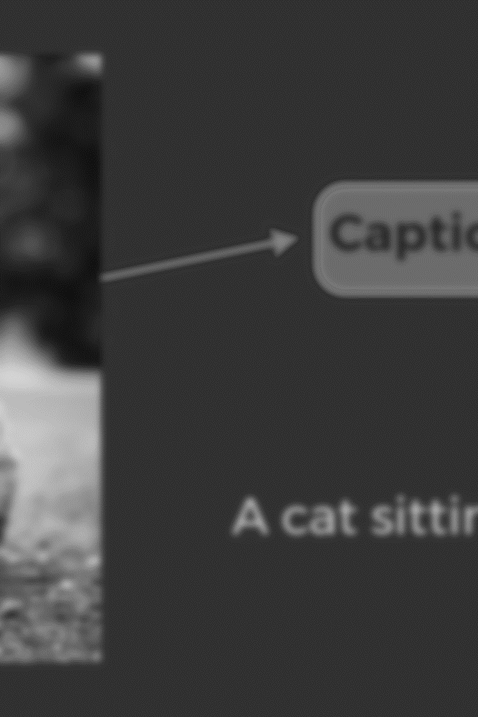
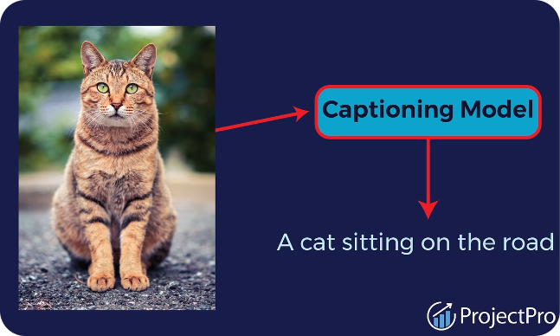
What is Image to Caption Generator?
With the aid of deep learning and computer vision, an image caption generator will be able to interpret the image and provide relevant captions. It utilizes an image set provided during the model-training to assign these keywords in English. The CNN model Xception is trained using the imagenet dataset. Xception does the features extraction of images. The LSTM model in charge of the image description will receive these feature vectors as the input.

Slide 4
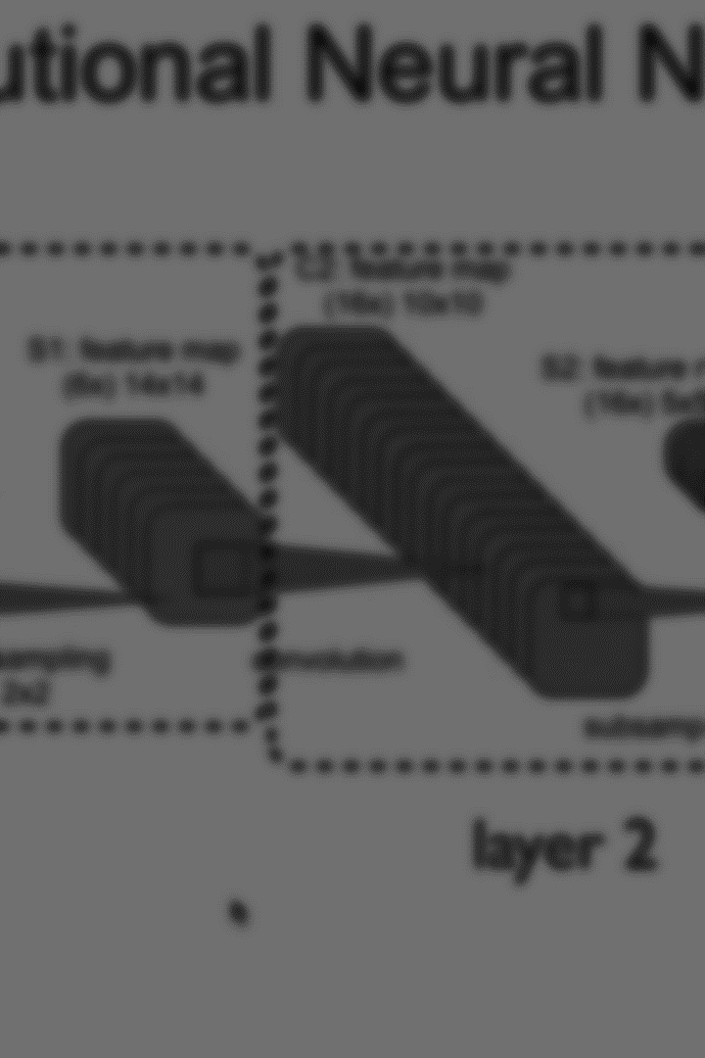
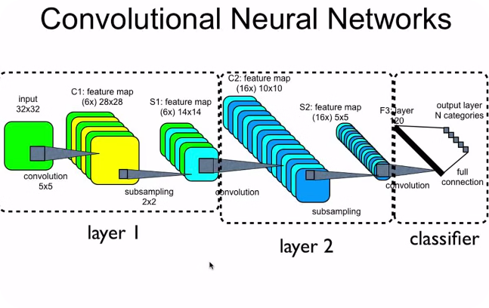
What is CNN?
CNN, which is a sub-discipline of deep learning, is an approach used to detect and classify images. It deals with the raw data in the form of matrices that looks like two dimensional pictures. CNN is able to deal with images that are translated, rotated or scaled. It locates important features of the image by looking from top to bottom and from left to right. Therefore, it unites all the components of image categorization in the end.

Slide 5
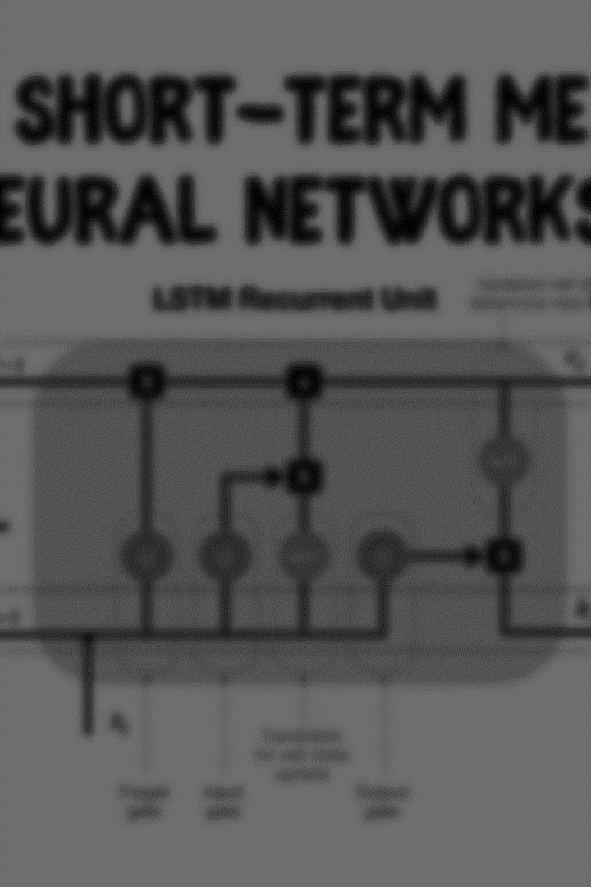
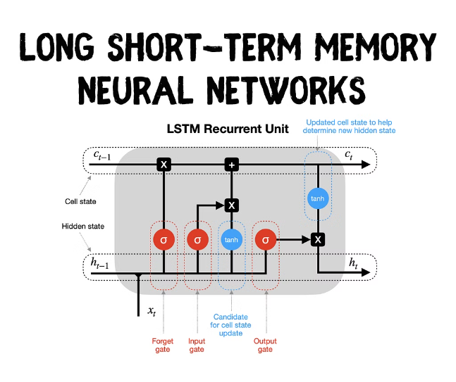
What is LSTM?
Sequence prediction problems can be tackled via the use of LSTM (Long Short-Term Memory), which is a type of RNN (Recurrent Neural Network). The main purpose of that model is predicting the next word, as our system takes into account the Google search results determined by the previous text. LSTM has been designed to filter the significant data and eradicate the redundant data as the inputs are processed. Consequently, CNN and LSTM has to be incorporated for building image caption generator model.
CNN + RNN make the CNN-RNN model for image caption generators. CNN: The first stage involves the description of the image. Therefore, an Xception model that is already trained will be involved. LSTM: To build a description based on information that was disentangled from the image.

Slide 6
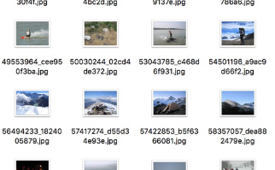
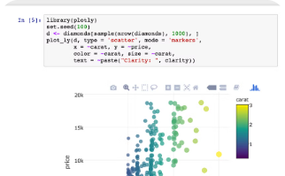
## Dataset for Image Caption Generator
Flickr8K Dataset
Downloading the Dataset
Implementing in Jupyter Notebooks
Flickr8K is the model training dataset setting of the caption generators. These datasets can be retrieved through links given below. As the dataset is big (1GB in size), the downloading being slow takes some time to complete. Flickr 8k.token, which contains all image titles and captions, is the dominant file in the provided files. The Flickr_8k_text folder has text files with image captions, whereas the image dataset of 8091 photos is stored inside the Flickr_8k_Dataset folder.
To access the Flickr8K dataset, you can download the Flicker8k_Dataset.zip and Flickr_8k_text.zip files from the provided links. These links will take you to the GitHub repository where the dataset is hosted. Keep in mind that the dataset is quite large, around 1GB in size, so the download may take some time to complete.
The implementation of the caption generator will be done through the utilization of Jupyter notebooks. The Jupyter notebooks described in the article can be found in the above page. The development of these skills will be vital to the understanding, on a deeper level, of Python, Deep Learning and NLP. If this is new to you, I would recommend first exploring the provided links for Python, Deep Learning, and NLP to build a strong foundation before diving into the image caption generator project.

Slide 7
Building the Image Caption Generator
Perform Data Cleaning
Extract the Feature Vector
Loading dataset for model training
All image captions are available in the Flickr 8k.token file of the Flickr_8k_text folder. If you analyze this file carefully, you can drive the format of image storing, each image and caption separated by a new line and carry 5 captions numbered from 0 to 4 along with.
The model used is called Xception and it has been through massive datasets for training. To classify the photos, Xception's training was carried out on the imagenet dataset, which included 1,000 diverse classes. In a rather straightforward manner, the model in use can be imported by using keras.applications. It becomes necessary to make a few alterations to the Xception model to integrate it with our framework. As the Xception model demands an image size of 299*299*3 in input, we need to take away the last classifier layer and then extract a 2048-feature vector from it.
Our Flickr_8k_test folder contains the file "Flickr_8k.trainImages.txt". In this file, there are 6000 names of pictures which mostly serve for training purposes. The function load_photos(fname) considers a text file as an input, reads from a file name, and returns it as a list of image names. The function load_clean_descriptions(fname, images) creates a dictionary with captions for each picture in a list. To define when the caption starts and ends, we add and to every caption that will be presented to the LSTM network. The function load_features(photos) returns the record of photos together with the features vectors calculated by the Xception model.

Slide 8




Create a Data Generator and Define the CNN-RNN Model
Data Generator
For training the model as a supervised learning task, we need to feed it with input and output sequences. There are 6000 images in the training set, each with a 2048-length feature vector and captions represented as numbers. However, it's not possible to hold such a large amount of data in memory, so we will use a generator method that yields batches. The generator will provide the model with [x1, x2] as input, where x1 represents the 2048 feature vectors of the image and x2 represents the input text sequence, and y as the output, which is the output text sequence predicted by the model.
CNN-RNN Model Definition
We will use the Keras Functional API to define the structure of the model. The model includes three main components: a Feature Extractor, a Sequence Processor, and a Decoder. The Feature Extractor will use a dense layer to extract features from the 2048-dimensional image vectors and reduce the dimensions to 256 nodes. The Sequence Processor will handle the textual input using an embedded LSTM layer. Finally, the Decoder will merge the outputs of the Feature Extractor and Sequence Processor and process them through a dense layer to make the final prediction.
Model Training
To train the model, we will generate the input and output sequences for the 6000 training images. We will create a function called model.fit_generator() to fit the batches to the model. This will allow us to efficiently train the model without having to load the entire dataset into memory at once. After the training is complete, we will save the model to the models folder for future use.

Slide 9

End Note
The successful development of the image caption generator using the combined power of convolutional neural networks (CNNs) and long short-term memory (LSTMs) is a testament to the remarkable progress in deep learning and computer vision. By leveraging the image processing capabilities of CNNs and the sequence prediction prowess of LSTMs, the team was able to create a model that can generate linguistically coherent, contextually-relevant, and varied captions for images. The journey began with a deep understanding of these foundational techniques and a vision to unite them into a synergistic CNN-RNN architecture, the fundamental building block of the image captioning system.
Preparing and preprocessing the data was a crucial step, as the team carefully cleaned, extracted, and tokenized the information to provide a solid foundation for model training. The design and refinement of the neural network architecture was a complex and iterative process, requiring multiple training sessions and parameter adjustments to achieve the desired performance. The team's dedication and perseverance in this phase ultimately led to the creation of an image caption generator that excelled in its ability to generate high-quality captions.
The final phase of testing and validation on unseen data confirmed the model's remarkable capabilities, demonstrating its potential for a wide range of computer vision and natural language processing tasks. This empirical evidence not only validates the reliability of the approach but also paves the way for further advancements in the field of image understanding and generation. The successful development of this image caption generator stands as a testament to the power of deep learning and the team's commitment to pushing the boundaries of what is possible in the realm of artificial intelligence.

