Slide 1



PREPARED BY :-
NAME : MANAV SHAH
BATCH : B-10
BRANCH : CSE
ENRLLMENT NO. : 2021002171210160
SCIENTIFIC
CALCULATOR
01

Slide 2
INTRODUCTION
I have made a scientific calculator using C Programming.
With this simple programming user can easily calculate the scientific operation according to their choice.
In this calculator we can do following mathematical operations(i.e. squareroot, cuberoot, ncr, npr, sinx, cosx, tanx….etc.).
1-Addition 8-Cube Root 15-Trigonometry Functions
2-Subtraction 9-Factorial
3-Multiplication 10-nCr
4-Division 11-nPr
5-Square 12-Addition of two Matrix
6-Power-n 13-Subtraction of two Matrix
7-Square Root 14-Multiplication of two Matrix

Slide 3
MAIN POINTS
Here I mainly used 4 Things.
1) stdio.h : Standerd input & output library.
2) math.h : Mathamatics library.
3) stdlib.h : Memory Allocation, Process Control, Conversions & etc. Library.
4) All 4 types of Functions.

Slide 4
FLOW CHART :-
START
INPUT CHOICE OF SWITCH
CASE-1 ADDITION
YES
ADD( )
NO
YES
CASE-2 SUBTRACT
SUB( )
NO
CASE-3 MULTIPLICATION
YES
MULTI( )
NO
CASE-4 DIVISION
YES
DIV( )
NO
YES
CASE-5 SQUARE ROOT
SROOT( )
NO
CASE-6 CUBE ROOT
YES
CROOT( )
NO
CASE-7 nCr & nPr
YES
nCr & nPr( )
NO
YES
CASE-8xxxxxxxxxxxxxxx TIGONOMETRY
TRIGONOMETRY( )
OUTPUT ACCORDING TO SWITCH CASE
STOP

Slide 5
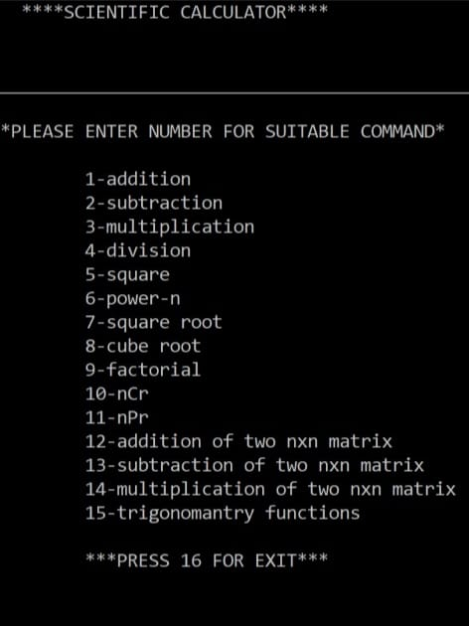
FUNCTIONALITY
Run the program & you can see the output as shown in the picture.
Enter number between 1-16.
Enter 1-15 for Appropriate operation.
The trigonometry function have another nested switch statement for sinx, cosx, tanx, secx, cosecx & tanx (in 15).
Now enter trigo function after pressing 15.
Then you can get your answer.
Enter 16 for exit (because this program done in the do while loop).
It’s Done;

Slide 6
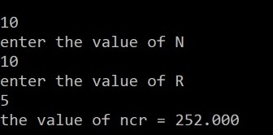
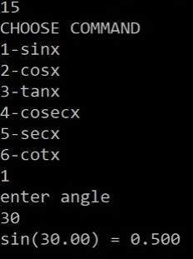
Example : 1(fun.10 nCr)
Enter the 10 for nCr.
Enter the value of N (e.g.10).
Enter the value of R (e.g.5).
You get the answer (252.00).
explanation
Example : 2(fun.15 Trigonometry)
Enter 15 for Trigonometry function.
Enter any function( e.g. 1-sinx).
Enter angle. (e.g. 30)
Program calculate angle x in radian.
You get the answer (sin(30)=0.5)
explanation

Slide 7
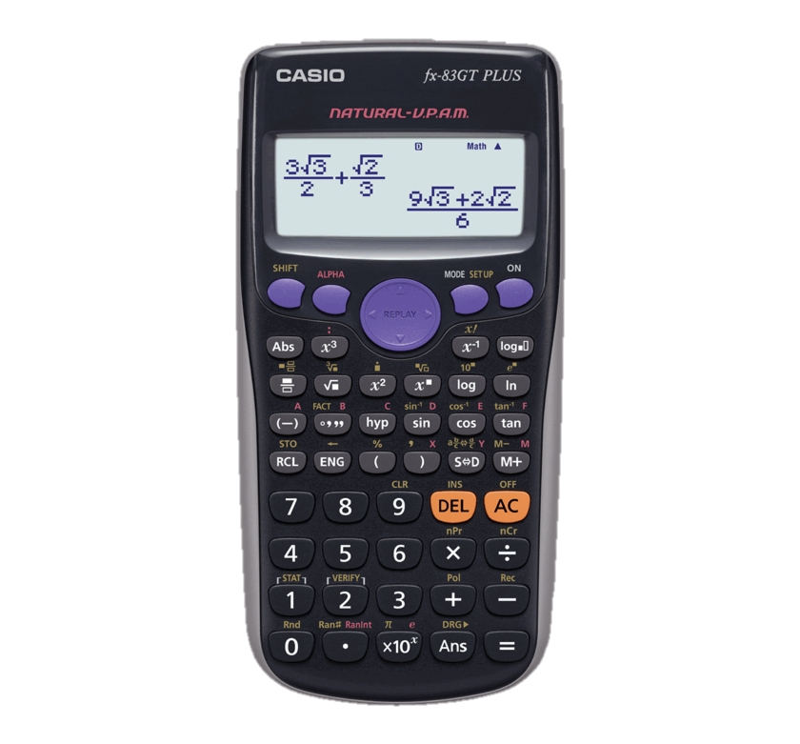
Merits &Demerits
Merits
Easy to use.
Portable.
Light weight.
Long battery life.
Demerits
In trigo function, calc does not show infinite answer.
Cheating during exams.
High cost.

Slide 8
Thank you

