Slide 1

Project Presentation
On
Adaptive Bitrate HLS Video Streaming Platform with Asynchronous Background Transcoding
Project Group No: 43
Under the Supervision of
Akshay Meena (2311401161)
Gaurav Bhaisare (2311401162)
Dhruv Kumar (2311401248)
Manav Sharma (2311401271)
Dr. Vivek Pratap Singh
Department of Electronics and Communication Engineering
Maulana Azad National Institute of Technology Bhopal
Date
Slide No
Notes:
Good morning everyone. Our project is an adaptive video streaming platform. The key idea is that every video gets processed in the background and served in multiple qualities, so playback never buffers. We are four of us in group 43, guided by Dr. Vivek Pratap Singh.

Slide 2
Introduction
• Video streaming needs high internet bandwidth.
• Users face buffering when network is slow.
• HLS (HTTP Live Streaming) solves this issue.
• It changes video quality based on internet speed.
• Our project implements this for an Anime platform.
Slide No: 2
Notes:
Video streaming needs a lot of bandwidth, and network speeds keep changing. HLS handles this by keeping the video in small segments at multiple qualities, and the player switches between them on the fly. That is basically what we built.

Slide 3
Problem Statement
• Large video files take too long to load.
• Converting videos synchronously blocks our Node.js server.
• This causes the website to freeze for other users.
Slide No: 3
Notes:
The problem with a naive build is simple. Large videos take long to load, and if you convert them inside the main server, the whole site freezes for everyone else. That is exactly what we wanted to avoid.

Slide 4
Objectives
• Build an adaptive HLS streaming service.
• Process videos in the background (asynchronously).
• Support multiple audio tracks and subtitles.
• Keep the main server free to handle user requests.
Slide No: 4
Notes:
So our objectives were: adaptive HLS streaming, background transcoding, multi audio and subtitle support, and a main server that stays free to serve users.

Slide 5
Literature Survey
• Most student projects use simple MP4 files (causes buffering).
• Cloud services like AWS MediaConvert are very expensive.
• We needed a free, scalable local solution.
• Decided to use FFmpeg with job queues in Node.js.
Slide No: 5
Notes:
Most student projects just serve MP4 files directly, which buffers badly. Cloud solutions like AWS MediaConvert solve it but cost a lot. We wanted something free and scalable, so we went with FFmpeg plus job queues in Node.js.

Slide 6
Methodology - How it Works
• User uploads video from React frontend.
• Express server saves raw file and adds a job to the queue.
• Background worker picks up the job.
• FFmpeg converts video into small HLS segments.
• Thumbnails are generated at the same time.
Slide No: 6
Notes:
This is how it works. The user uploads from the React frontend, Express saves the raw file and adds a job to the queue, a background worker picks it up, FFmpeg converts the video into small HLS segments, and thumbnails get generated at the same time. If the panel asks for specifics: FFprobe scans the file first to count the audio and subtitle tracks. Subtitles come out as VTT, and we strip the styling tags, otherwise web players show raw code on screen. Audio becomes AAC at 128 kbps and 48 kilohertz, and languages are detected from the filename, like naruto_hindi becomes Hindi. Video is encoded with libx264, Main profile, yuv420p, preset ultrafast, single thread so the server RAM does not overload. Segments are 6 seconds, with a keyframe every 48 frames so seeking does not freeze the player. And the MP4 downloads are not re-encoded, just repackaged from the HLS segments, so they are instant.

Slide 7
Implementation Details
Audio & Subtitles
Video Encoding
• FFprobe scans the file for tracks first.
• Subtitles extracted to clean VTT, styling stripped.
• Audio encoded to AAC, 128 kbps, 48 kHz.
• Languages detected from filenames (hindi, english, japanese).
• libx264, Main profile, yuv420p, ultrafast.
• One decode, 1080p / 720p / 480p encoded together.
• 6-second HLS segments, keyframe every 48 frames.
• Single thread (-threads 1) protects server RAM.
• MP4 downloads repackaged, not re-encoded.
Every upload goes through the same pipeline - the admin never touches FFmpeg by hand.
Slide No: 7
Notes:
This slide is basically what is inside our FFmpeg service, in case anyone asks how deep our implementation goes. FFprobe scans the file first, so the pipeline knows exactly how many audio and subtitle tracks are inside before it starts. Subtitles are extracted and cleaned, otherwise browsers show raw styling code. Audio goes to AAC at 128 kbps, and we detect the language from the filename. Video is libx264 with the Main profile so even old phones can play it. We decode once and encode all three resolutions in a single pass, segments are 6 seconds with a keyframe every 48 frames for smooth seeking, and everything runs on a single thread so the shared server does not run out of RAM. The MP4 downloads are just repackaged from the segments, so they are instant.

Slide 8
System Architecture
React Frontend
upload
Node.js Backend API
Express
Job Queue
Redis / Bull
HLS Player
adaptive quality
File Storage
segments and playlists
FFmpeg Transcode Workers
background processing
Fig. 1: System architecture
Slide No: 8
Notes:
The whole flow in one picture. React frontend on the left, the Node API, the Redis job queue, the FFmpeg workers, file storage, and finally the HLS player. The main API never touches the heavy transcoding work. One thing worth mentioning: we decode the source video only once and split it into 1080p, 720p and 480p in the same pass, which saves a lot of CPU compared to encoding three times. The master playlist is generated by hand, it lists every video variant and audio track, so the player can switch quality and language on its own. And if a source is only 720p, we skip the 1080p variant rather than upscale it.

Slide 9
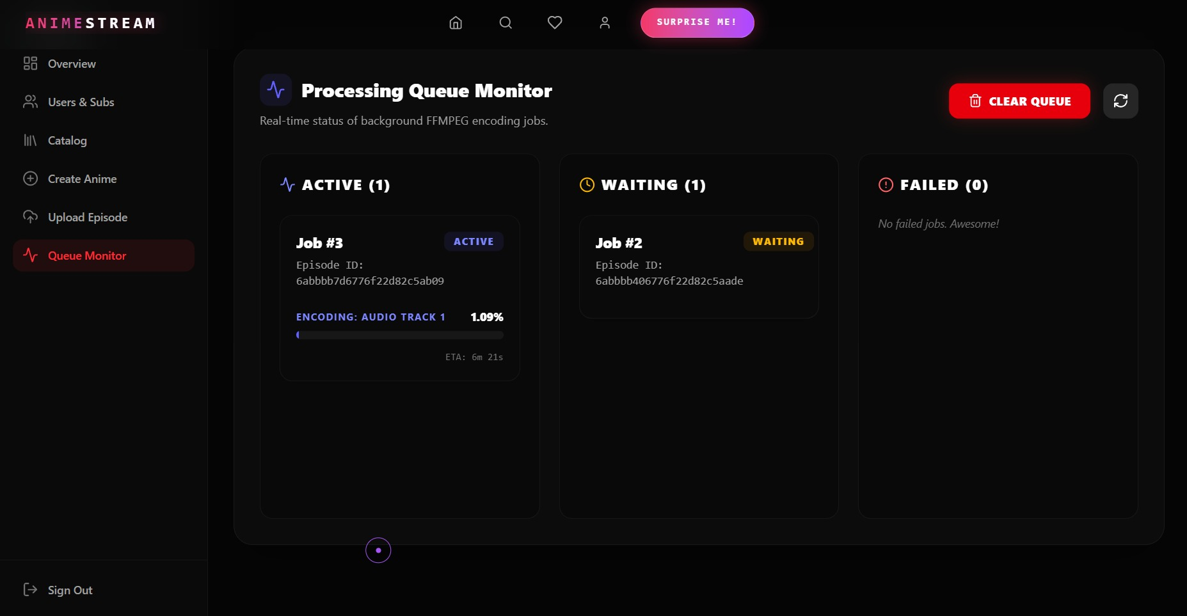
Results
• Server doesn't crash during heavy video uploads anymore.
• Videos play smoothly even on slow networks.
• Users can switch audio and subtitles seamlessly.
• Failed transcoding jobs can now auto-retry.
Fig. 2: The queue monitor - background FFmpeg jobs in real time
Slide No: 9
Notes:
And it actually works. The server does not crash during heavy uploads anymore, videos play smoothly even on slow networks, audio and subtitles switch seamlessly, and failed jobs can auto retry. We also load tested the backend. Artillery simulated 650 users making about 2,000 requests, and 99.89 percent succeeded. In the k6 stress test it scaled to 1,000 users and did not drop a single request.

Slide 10
Conclusion
• Background processing is crucial for video platforms.
• HLS provides a much better user experience than direct MP4.
• Custom FFmpeg integration is complex but highly cost-effective.
Slide No: 10
Notes:
To conclude. Background processing is crucial for video platforms. HLS is a much better experience than direct MP4. And the custom FFmpeg integration was complex, but it is very cost effective compared to paid cloud services.

Slide 11
Future Work
• Move file storage to cloud (e.g., AWS S3).
• Add low-latency live streaming support.
• Setup multiple transcode workers on different servers.
Slide No: 11
Notes:
Next steps. Move storage to the cloud, add low latency live streaming, and run multiple transcode workers on different servers.

Slide 12
References
• Apple Developer Documentation - HLS Specification.
• FFmpeg Documentation (ffmpeg.org/ffmpeg-all.html).
• Node.js Child Process API (nodejs.org/api/child_process.html).
• hls.js API Documentation (github.com/video-dev/hls.js).
Thank you! Questions are welcome
Slide No: 12
Notes:
These are our main sources. Thank you, we are happy to take questions.

