Slide 1


Minor Project Title: Public Transportation Efficiency Enhancement System
Presented by:
Aryan Singh Panwar
Manav Verma
Ayush Deep
Tushar Rawat
Atharv Ranjan
Guided by:
Dr Keshav Sinna
Assistant Professor
School of Computer Science

Slide 2
Introduction.
Welcome to the Public Transport Efficiency System, your multi-destination trip planner for optimizing public transportation routes. Our web application is designed to assist you in planning your journeys with ease. Whether you need to visit multiple destinations, find the quickest routes, or minimize your travel time, we've got you covered.
Challenges: We identify transportation obstacles in unexplored territory, including environmental, engineering, and congestion issues.
Algorithmic Solutions: We use powerful algorithm (brute force approach) and to efficiently optimize road routing in these areas.
Transportation Improvement: Through algorithmic solutions, we hope to create a more sustainable, efficient, and accessible transportation system that benefits communities and the environment in unexplored areas.

Slide 3
Problem Statement.
Dissatisfaction with inadequate public transportation in less developed regions and congested travel plans can be addressed, aligning with the smart city objective of enhancing living standards and promoting economic growth.
Create an innovative and effective solution to address inefficiencies in public transportation systems, with a focus on improving route planning to increase overall system efficiency, decrease travel times, and improve the customer experience.

Slide 4
Motivation.
Congestion in Cities: Many cities throughout the world are grappling with transportation challenges, including longer travel times and a lower quality of life due to limited and inefficient public transportation options. A well-optimized static route system can significantly enhance urban mobility and improve the overall commuting experience.
Environmental Sustainability: Reducing the number of private vehicles on the road through improved public transportation efficiency is an important step toward reducing carbon emissions.
Economic Advantages: Efficient public transportation networks can attract businesses, visitors, and residents, boosting local economies and expanding job opportunities.
Passenger Satisfaction: Improving the passenger experience by shortening wait times, offering dependable services, and streamlining routes might attract more people to use public transit, resulting in a more sustainable method of transportation

Slide 5
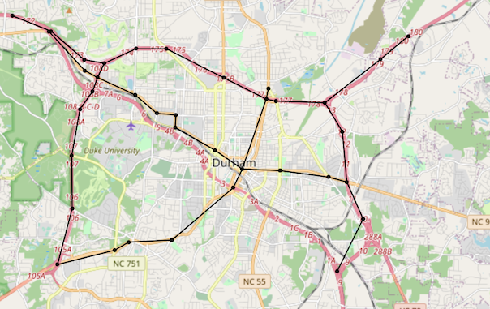
Objectives.
Brute Force Algorithm:
Develop and implement a static route calculation algorithm suitable for public transportation networks, ensuring efficient route planning without considering real-time traffic data.
Network Representation:
Create a comprehensive representation of the static public transportation network as a graph, with nodes representing stops or stations and edges representing routes between them.
3. User-Friendly Interface:
Design an intuitive user interface that enables users to input their origin and multiple destinations, selecting from static routes, and receive optimized route suggestions within the public transportation network.
4. Efficiency Enhancement:
Enhance public transportation efficiency by providing commuters with accurate, static route recommendations, reducing travel time, and improving the overall reliability of the transportation system.

Slide 6
Tech Stack.
Version Control:
Git, GitHub/GitLab
Programming Language:
Java
Integrated Development Environment (IDE):
VS-code
Frontend:
Springboot, HTML, CSS
Deployment and automation:
Maven
Google maps API integration

Slide 7
Methodology.
Google Maps API Data: Access data from Google Maps APIs, including the Distance Matrix API and Route API, to obtain information about locations, distances between places, and route conditions.
Graph Representation: Create a graph data structure to represent the highway network based on the static dataset. Vertices represent cities or intersections, and edges represent roads connecting them.
Route Calculation Algorithm: Implement a routing algorithm (Brute Force Approach) to calculate the shortest route between two cities based on the graph representation.
User Interface Development: Choose a user interface development framework (GUI: Apache Maven).
Design and create a user interface that includes: Input fields for specifying the start and multiple end cities, routes and the total distance and total duration.

Slide 8
Methodology (contd).
6. Google Maps API Integration: Load the Google Maps API into the application and ensure that the graph data structure is initialized with this dynamic data source.
7. User Interaction: Allow users to input start and multiple end cities through the user interface. Trigger the routing algorithm to calculate the shortest route when the user requests it.
8. Route Display: Display the calculated route on the map in the user interface. Show route information, including the list of cities on the route and the total distance and total duration.
9. Testing: Test the routing algorithm for accuracy by comparing results with a known static dataset. Conduct user testing to ensure the interface is intuitive and functional.
10. Documentation: Create user documentation explaining how to use the application. Document the code and algorithms for future reference.

Slide 9
c
Implementation.
Google API Data Representation: Utilize data obtained from Google Maps APIs to represent information about the highway network and real-time traffic conditions, including details about vertices and edges in the network.
Interface Design Develop a user-friendly CLI/GUI for interacting with the routing service.
Route Calculation Logic: Implement Brute Force algorithm considering API data.
Implement the Interface: Define flexible interface methods for route calculation.
Implement the Routing Service: Develop a class (Path.java) with route calculation logic using the API.
Demonstration: Showcase the routing service with the chosen interface.

Slide 10
Application of the Project.
Emergency Services: Improved routing efficiency can be crucial for emergency response teams, allowing them to arrive at accident or catastrophe sites sooner and more effectively, potentially saving lives.
Tourism and Navigation: Tourism and navigation apps can use efficient routing algorithms to give tourists and travellers with the best routes to their destinations, thereby encouraging tourism and improving user experience.
Trip Planner: A trip planner can be used to optimize public transportation routes in urban areas. By providing efficient routes and schedules for buses, trams, and trains, it can encourage more people to use public transport, reduce traffic congestion, and minimize the environmental impact of commuting.
Rural and Remote Areas: Rural and isolated locations deal with particular transportation issues; this project can improve accessibility and connectivity for these places, potentially increasing their economic development and quality of life.

Slide 11
Coding the Algorithm.
Node.java:
The Node class represents nodes in a graph.
It has a generic type T for the node's label.
It can have outgoing edges that connect to other nodes.
Provides methods to get the label, edges, and find an edge to a specific target node.
Overrides hashCode, equals, and toString methods for customized behavior.
Edge.java:
The Edge class represents edges in a graph.
It connects two nodes (source and target) with a weight (e.g., distance or duration).
It has a generic type T for the source and target node types.
Provides methods to access source, target, and weight information.
Overrides hashCode, equals, and toString methods for customized behavior.
Graph (Brute_Force_Algorithm.Graph.java):

Slide 12
Coding the Algorithm(contd).
Graph.java:
The Graph class represents a graph where nodes are connected by edges.
It stores a list of nodes and calculates the shortest path using a brute-force algorithm.
The graph can be created by providing places (nodes), distance information, and a weight method (distance or duration).
It can find the shortest path for any starting node or a specific starting node.
It uses recursive methods to explore all possible paths and find the one with the lowest cost.
Path.java:
The Path class represents a path in the graph, which is a sequence of nodes with associated costs.
It stores the total cost of the path and a list of costs for each edge in the path.
It can be converted to an array of strings, and the costs can be converted to a human-readable format based on a weight method (distance or duration).
Provides methods to get the cost, the list of costs, and the human-readable cost.
It can be printed to the standard output.

Slide 13
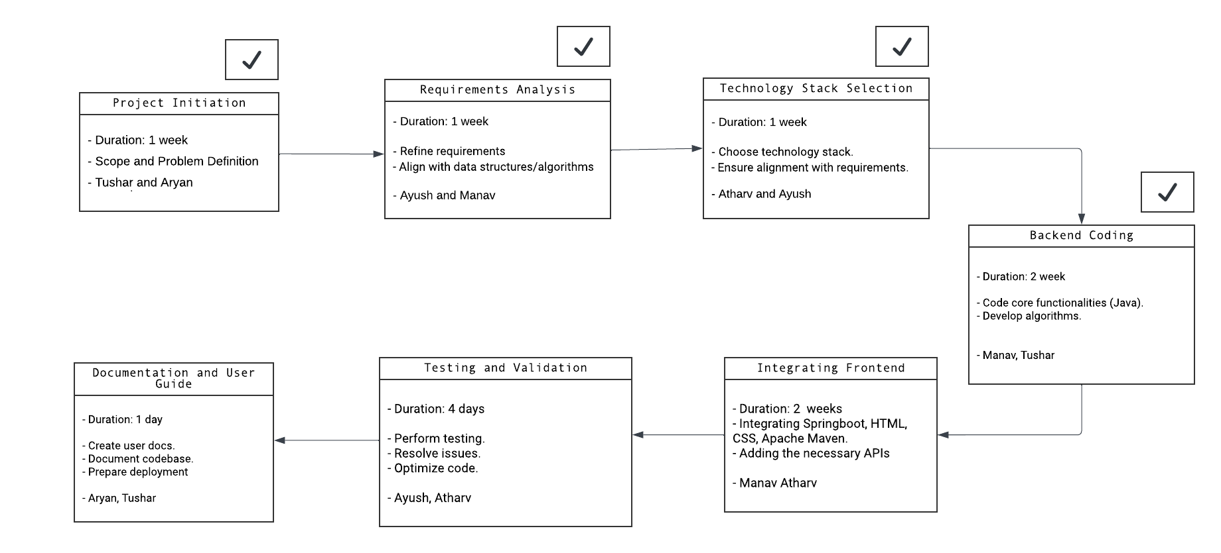
PERT Chart.

Slide 14
SWOT Analysis.
Strengths | Weaknesses
Efficient Route Planning | Resistance to Change: Users may prefer familiar platforms
User-Friendly Interface | Technological Vulnerability: Prone to glitches or crashes
Multi-Modal Integration | Data Privacy Concerns: Handling personal data securely
Real-Time Updates | Complexity in Handling Multiple Transport Providers
Opportunities | Threats
Enhanced User Engagement | Competitor Advances: New trip planners with better features
Integration with Emerging Technologies | Budget Constraints: Funding cuts impacting development
Personalized Recommendations | Dependence on Third-Party Services & APIs
Expansion to New Geographical Areas | Legal & Regulatory Changes affecting data sharing

Slide 15
References.
Mu, H., Yu, J., & Liu, L. (2009). Shortest path algorithm for road network with traffic restriction. IEEE 2nd International Conference on Power Electronics and Intelligent Transportation System, China.
https://www.geeksforgeeks.org/brute-force-approach-and-its-pros-and-cons/
https://en.wikipedia.org/wiki/Brute-force_search
https://www.srividyaengg.ac.in/coursematerial/CSE/104442.pdf
Nha, V., Djahel, S., & Murphy, J. (2012). A comparative study of vehicles' routing algorithms for route planning in smart cities. IEEE First International Workshop on Vehicular Traffic Management for Smart Cities, Ireland.

