Slide 1












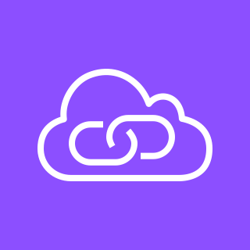
Amazon Elastic Container Registry (Amazon ECR)
Virtual private cloud (VPC)
Public subnet
Fargate
Registry
Traffic
Internet gateway
Application Load Balancer
Amazon Elastic Container Service
Container
Image
Endpoints
Amazon Bedrock
AWS PrivateLink

Slide 2
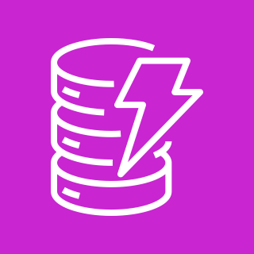
Local Docker
Container
Traffic
Local Image
ngrok
Amazon Bedrock
Amazon DynamoDB

Slide 3





Twilio
AWS Cloud
1
3
6
2
Twilio Phone #
Twilio Programmable
Voice
Amazon DynamoDB
Application Load Balancer
5
Amazon Elastic Container Service
4
7
Twilio Conversation
Relay
Amazon Bedrock

Slide 4
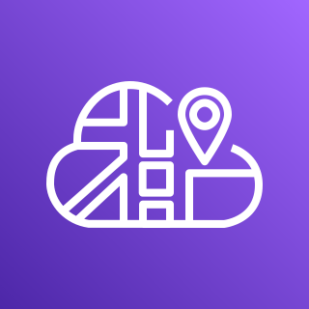

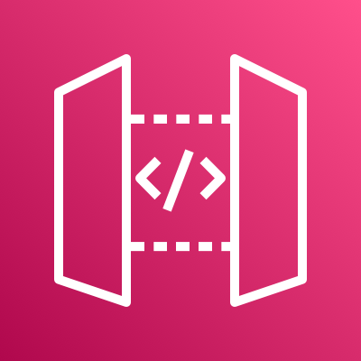
ECS registers tasks in Cloud Map
AWS Cloud Map
Amazon Elastic Container Service (Amazon ECS)
API Gateway uses a VPC link to access private task IP’s
AWS Fargate
API Gateway looks up task IP addresses using Cloud Map
Public subnet
Container
Container
Traffic
Public subnet
Amazon API Gateway
Container
Container

Slide 5
Amazon Elastic Container Registry (Amazon ECR)
Virtual private cloud (VPC)
Public subnet
AWS Fargate
Registry
Traffic
Internet gateway
Application Load Balancer
Amazon Elastic Container Service (Amazon ECS)
Container
Image

