Slide 1
Seedling Classification
Cloud Computing Fall 2022
Group 6
Ruiqi Li, He Huang, Yixi Liang

Slide 2
Table of Contents
Definition:
Scope
Data sources
Architecture:
AWS Applications
Data flow
Demonstration:
Demo
Results

Slide 3
Scope of the Project
Machine Learning Topic:
Image Classification
Cloud Computing:
AWS
Goal:
Apply different Convolutional Neural Networks to identify the images of weed seedlings/crop seedlings and compare the performances in the AWS environment

Slide 4
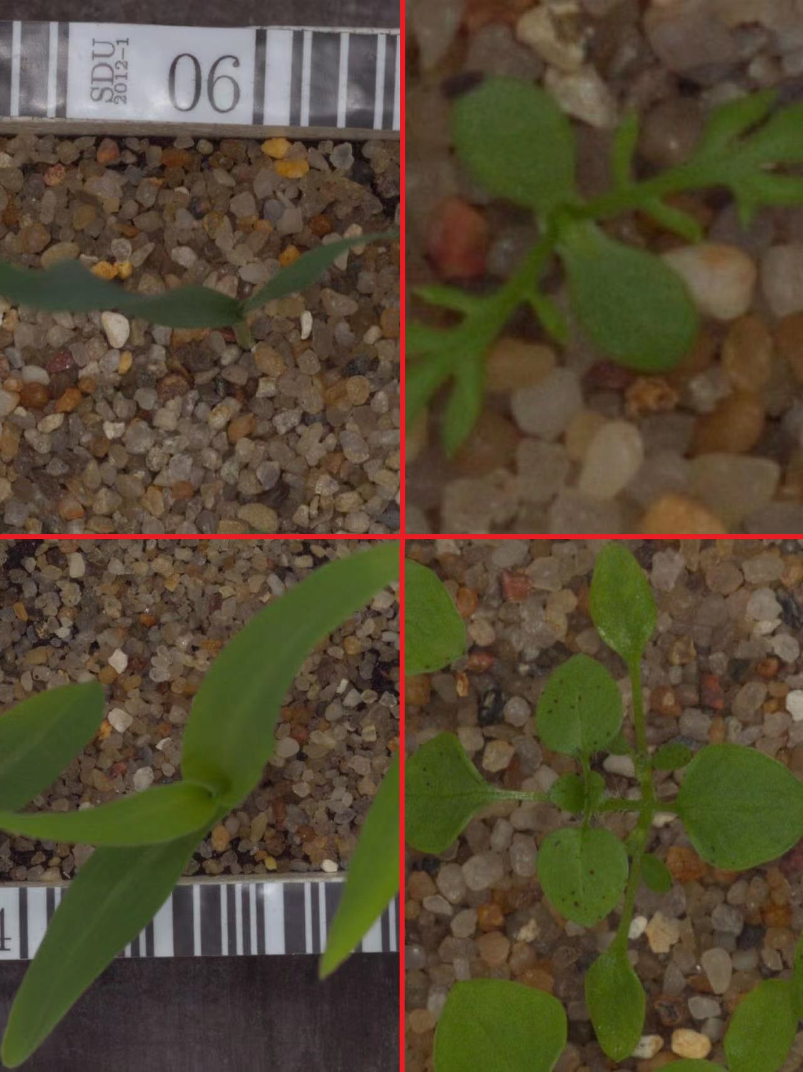
Data Sources
Dataset
Plant Seedling Classification from Kaggle
Features: 12 species, 960 plants, 4750 images
https://www.kaggle.com/competitions/plant-seedlings-classification/data
CNNs (Convolutional Neural Networks)
7 models: EfficientNetV2S, ResNet50V2, VGG16, etc
Wheat (Up Left)
Mayweed (Top Right)
Maize (Down Left)
Chickenweed (Down Right)

Slide 5
AWS Applications
S3
Preserve all data (images) in an S3 bucket
Save the output file of test data prediction
EC2
Create an instance with python environment
Use Jupyter Notebook and PyCharm to deploy and run the pipeline
VPC
Use private and public subnet to protect data

Slide 6







Data Flow
Initialize
Train and Test
Input
Output
Save

Slide 7
Demo

Slide 8
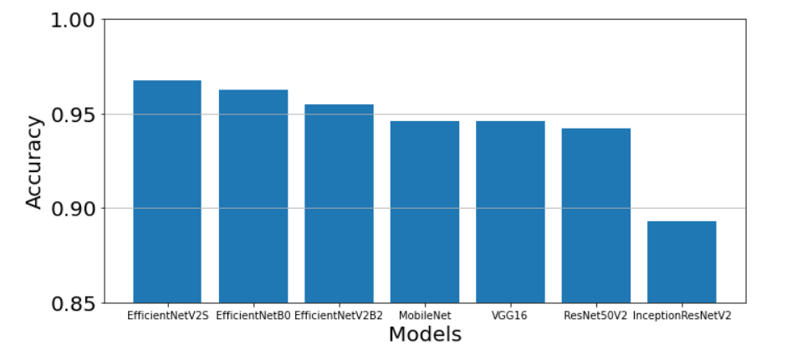
Conclusion
The family of EfficientNet models performs so well
Different pre-trained models need different optimizers
Complex head layers are needed

Slide 9
Results
Successful utilization of S3 Bucket and EC2 Instance
Train and test the various CNN models
Produce meaningful visualizations to show the performances of the models
Rank the accuracies of models based on their predictions of test data

Slide 10
Reference
Data Source: https://www.kaggle.com/competitions/plant-seedlings-classification/data
AWS S3: https://aws.amazon.com/s3/
AWS EC2: https://aws.amazon.com/ec2
Project File + Presentation PPT can be found at the following GitHub Repository:
https://github.com/mancai111/Seedling-Classification-AWS

Slide 11
Thank You

