Slide 1
Sales Performance Review
July 2024 – June 2025

Slide 2
Total Revenue, FY24–25
$822,037
across 4,614 orders · $178.16 average order value
• Best month: 2024-12 ($97,138.60)
• 6 product categories, 60 products, 1,093 customers

Slide 3
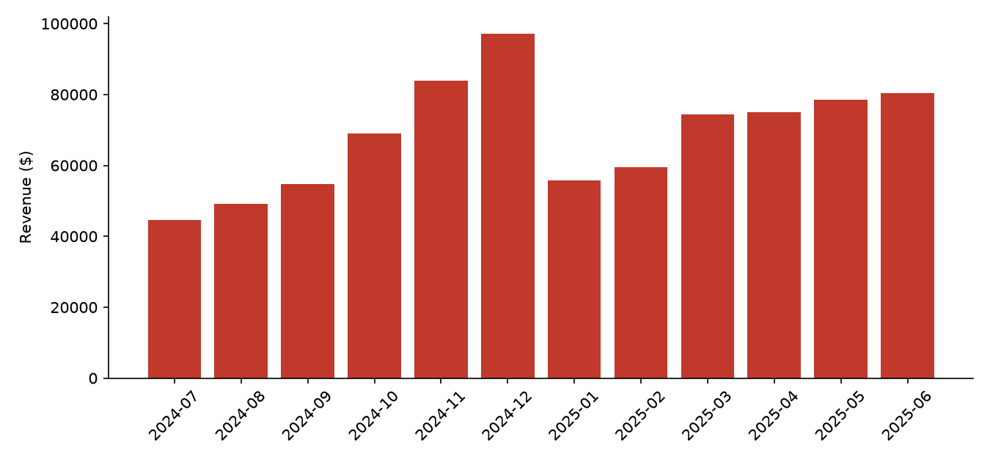
Revenue Trend by Month

Slide 4
Seasonality, Not Pricing, Drives the Peak
• December 2024 set the revenue record ($97,138.60), driven by order volume, not higher spending per order
• Average order value stays in a narrow band all year — the swing is in how many orders are placed
• Revenue fell 42.7% from December to January — the only double-digit month-over-month decline in the period
• Order volume and revenue both recovered steadily over the following five months

Slide 5
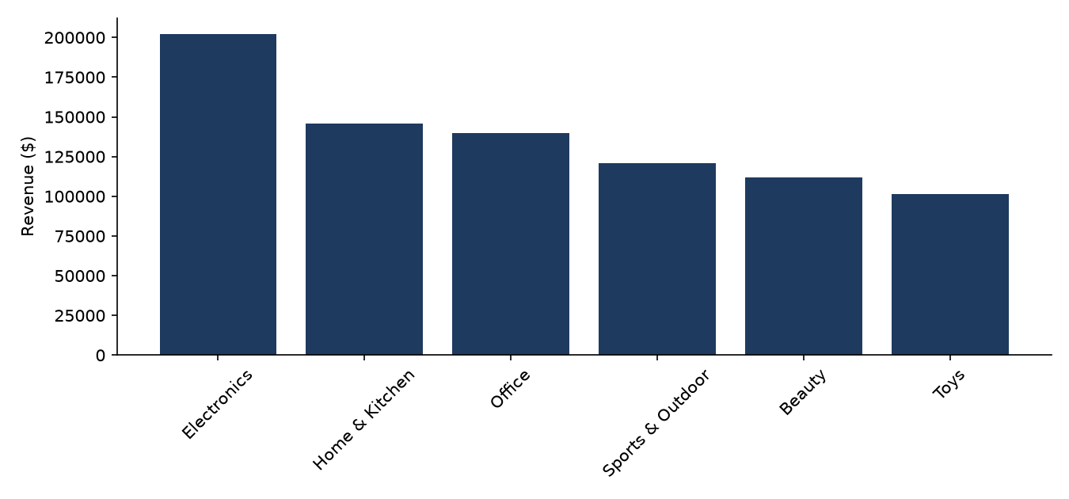
Revenue by Category

Slide 6
Category Detail — Orders & AOV
Category | Revenue | Orders | AOV
Electronics | $202,226.76 | 925 | $218.62
Home & Kitchen | $145,521.73 | 917 | $158.69
Office | $139,996.79 | 770 | $181.81
Sports & Outdoor | $120,659.69 | 797 | $151.39
Beauty | $112,022.16 | 580 | $193.14
Toys | $101,609.91 | 625 | $162.58

Slide 7
Underlying Growth Across Halves
• H2 2024 (Jul–Dec) revenue: $398,662.45
• H1 2025 (Jan–Jun) revenue: $423,374.59
• +6.2% versus the prior half, despite H1 2025 having no equivalent holiday spike
• Indicates the business is growing its baseline (non-holiday) demand, not just riding a one-time seasonal event

Slide 8
Takeaways
• Revenue grew steadily over the period, with a clear seasonal peak in December 2024
• The peak and the January pullback are both volume-driven, not pricing-driven
• Underlying (non-holiday) demand is trending up across halves
• Limitation: figures are gross revenue with no adjustment for returns, discounts, or refunds; only 12 months are available, so the seasonal read cannot yet be confirmed against a second holiday cycle

