Slide 1
Sales Prediction Model
Results, Commentary & Recommendations

Slide 2
Model Performance
88%
of order-revenue variance explained, using only category, quantity, product, and timing — without seeing price
• Typical prediction error: $19.61 per order (11.1% of the $177.01 average order)
• Beats a simple baseline model (R² 0.42 → 0.88)
• Overall assessment: GOOD

Slide 3
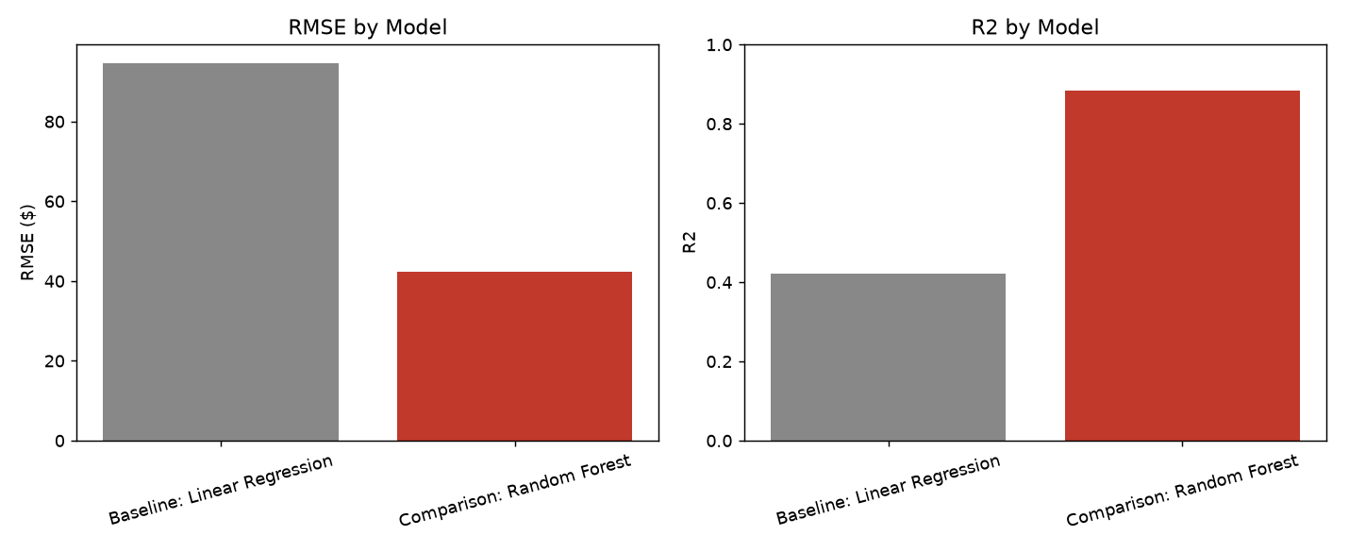
Model Comparison

Slide 4
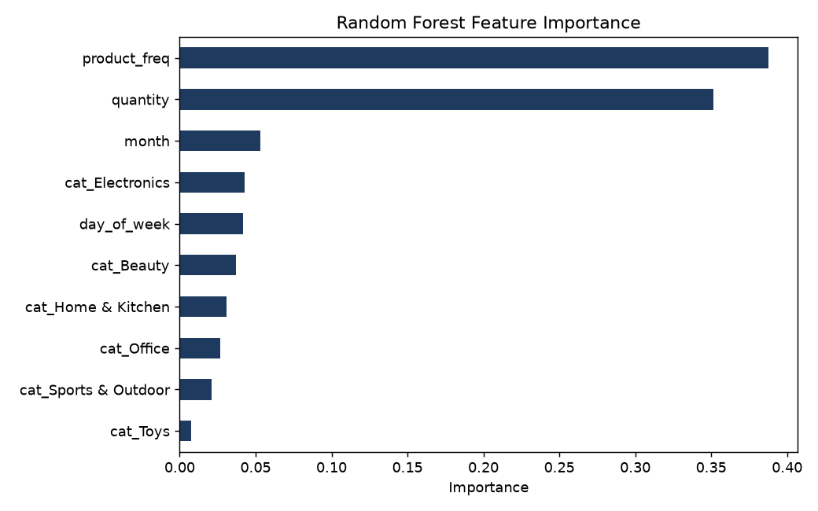
What Drives Order Revenue

Slide 5
What This Means for the Business
• Which product is ordered (product_freq) and how many units (quantity) explain most of the variation in revenue — product mix and basket size matter more than category or timing
• Category and seasonality features contribute, but far less — revenue is driven primarily at the product level, not the category level
• Because the model never sees price and still predicts revenue well, product identity is acting as a reliable stand-in for price tier — a sign that pricing by product is fairly consistent and predictable today
• Electronics remains the strongest category ($202,227 revenue), while Toys lags furthest behind ($101,610)

Slide 6
Recommendations to Increase Sales
• Prioritize inventory and marketing spend on proven top sellers — product identity is the single biggest revenue driver, so doubling down on what already sells beats spreading effort evenly across the catalog
• Increase basket size — quantity is the #2 driver. Bundle offers, volume discounts, and checkout cross-sells directly target the lever with the most leverage
• Grow Toys toward Electronics-level performance with targeted promotions or bundling — it's the clearest underperforming category in the data
• Replicate the December holiday volume surge earlier in Q4 with proactive campaigns, and run a post-holiday promotion in January to soften the seasonal pullback
• Sustain H1 2025's underlying (non-holiday) growth with retention and loyalty programs, since that growth is organic rather than seasonal

Slide 7
Limitations & Next Steps
• Model is trained on 12 months of data from a single year — no second holiday cycle to confirm seasonality patterns repeat
• Price itself was deliberately excluded as a feature, so this model explains revenue drivers, not price sensitivity or elasticity
• Next step: track whether the top-seller and basket-size strategies move actual revenue, then retrain the model on a second year of data to validate seasonality

