Slide 1
The Political Economy of Upgrading Regimes
By Michael Schedelik
(Goethe-Universität Frankfurt)
Book Review by Tales Mançano
For Latin American Politics and Society

Slide 2
Part 01
Part 02
Part 03
Theory and Frames
Technological Upgrading in Brazil
Conclusions

Slide 3
Middle-income trap
How can emerging economies overcome middle-income barriers?z

Slide 4
“Empirically, this notion refers to growth slowdowns at certain income levels that persist over time”
— Michael Schedelik
Notes:
Middle-income countries are, accordingly, unable to compete with lower-cost economies in simple manufacturing. However, they still lack the capacity to manufacture more sophisticated high-technology products to compete with advanced economies

Slide 5
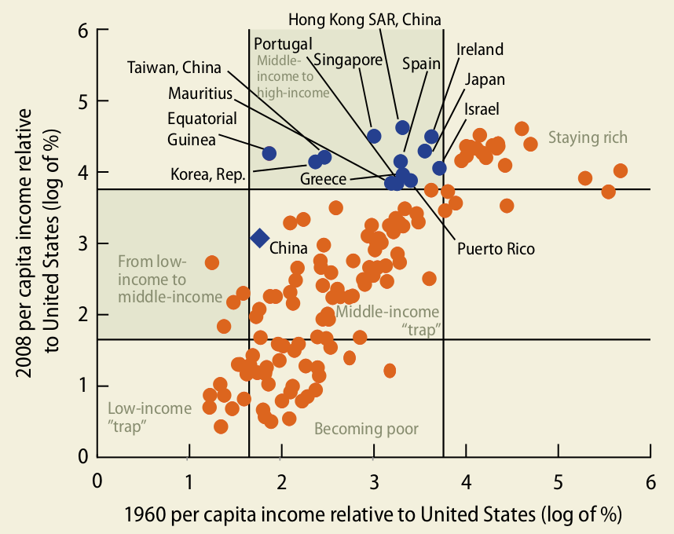

Slide 6
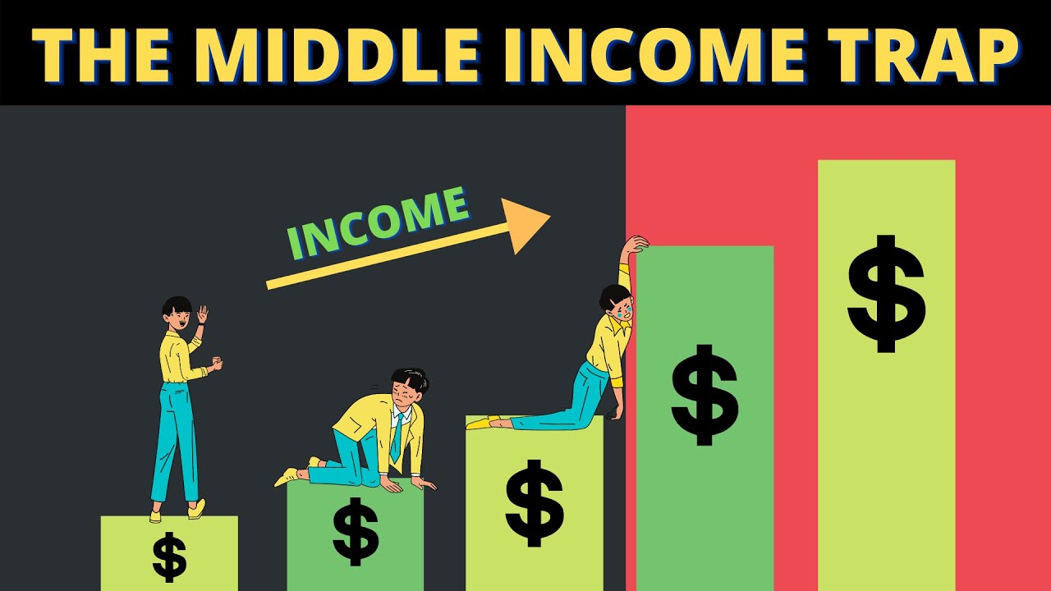

Slide 7
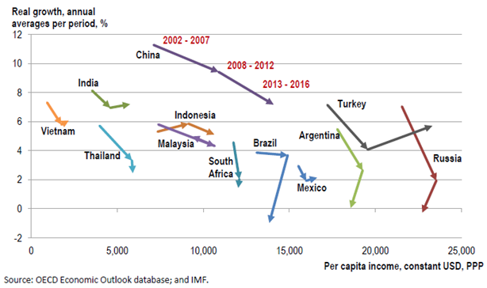

Slide 8
Technological upgrading is a pivotal solution for emerging economies to escape the middle-income trap since it can develop higher technology to boost economic growth
Notes:
Middle-income countries are, accordingly, unable to compete with lower-cost economies in simple manufacturing. However, they still lack the capacity to manufacture more sophisticated high-technology products to compete with advanced economies

Slide 9
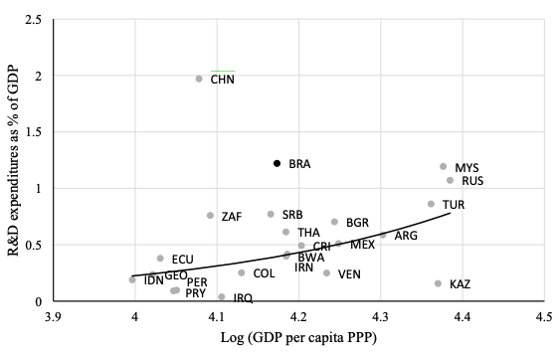
Notes:
R&D expenditures of upper middle-income countries in relation to GDP per capita, 2010–2017 (Note For all upper middle-income countries as defined by the World Bank with available data. Source World Development Indicators

Slide 10
Why don't Brazil grow since it's one of the countries that invest the most in R&D?
Period: Workers Party government (2003-2016)

Slide 11
Theory and Frames
01
The Quest for Technological Upgrading
in Emerging Economies: Understanding the research question

Slide 12

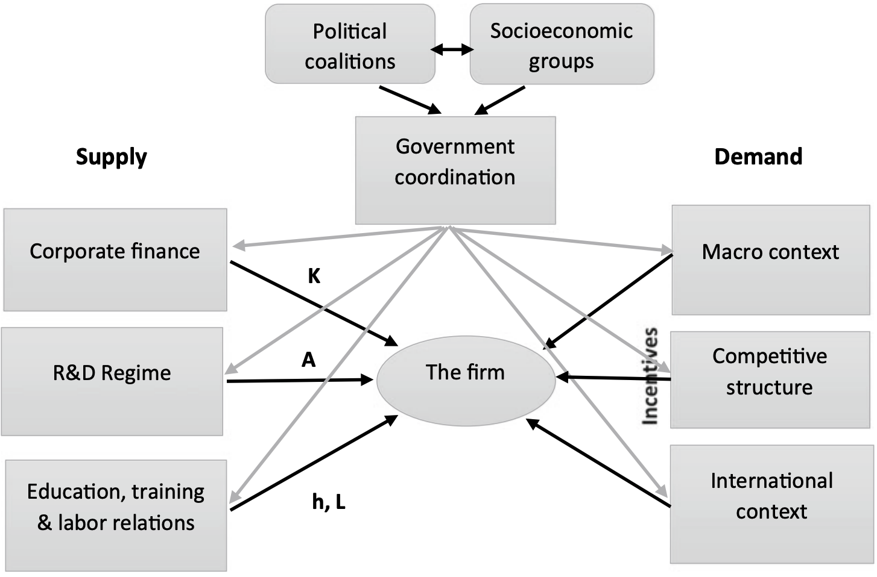

Slide 13
02
Technological Upgrading in Brazil:
Achievements and Challenges

Slide 14
Book Chapters
Part I
The Quest for Technological Upgrading in Emerging Economies
Theoretical Framework: The Political Economy of Upgrading Regimes
Part II
(i) innovation capacity building;
(ii) political coordination and socioeconomic coalition;
(iii) research and development and competition policy;
(iv) finance;
(v) education, training, and labor;
(vi) international integration;
(vii) macroeconomic management and domestic demand.
Part III
Complementarities and Comparisons
Conclusions

Slide 15
03
Conclusions

Slide 16
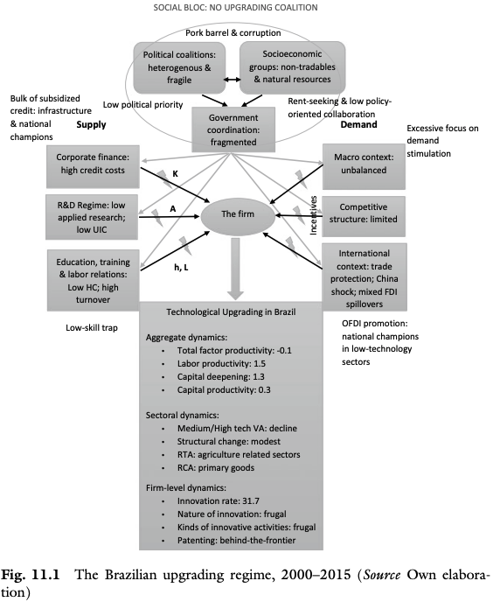
The Brazilian upgrading regime, 2000–2015

Slide 17
Thank You!

