Slide 1
Antitrust as industrial policy: Government-Sponsored Mergers as Passive Industrial Policy in Brazil, 1995-2002
André Vereta-Nahoum and Tales Mançano
andre.nahoum@usp.br

Slide 2
Argument
Antitrust can serve as a passive industrial policy by fiscally conservative, liberal governments to forge competitive large firms
Case Evidence (Brazil 1990s-2000s): Gerdau (steel) acquisition of Pains and Antarctica-Brahma (beer/beverages) merger into Ambev
Notes:
Despite explicit denial of industrial policy, Brazil’s flexible antitrust enforcement in the 1990s functioned as de facto industrial policy, fostering ‘national champions’ like Gerdau and AmBev.
Evidenced by a study of two cases of mergers and acquisitions in the 1990s-2000s : Gerdau and Ambev
Firms and state agents leveraged ambiguities in newly enacted competition legislation - against its original intent - to justify efficiencies and promote national conglomerates amid heightened international competition following economic liberalization, through a strategy of institutional conversion (Mahoney & Thelen, 2009).

Slide 3
Key mechanism
State and corporate actors strategically reinterpreted Brazil's competition framework to legitimize M&As that consolidated national champions:
As adaptive response to post-liberalization competition pressures Despite official rejection of industrial policy interventions
Through institutional conversion (Mahoney & Thelen 2009) of:
Ambiguous "efficiency" standards
Flexible "relevant market" definitions Subverting pro-competition legal intent to construct strategic market power
Notes:
Despite explicit denial of industrial policy, Brazil’s flexible antitrust enforcement in the 1990s functioned as de facto industrial policy, fostering ‘national champions’ like Gerdau and AmBev.
Firms and state agents leveraged ambiguities in newly enacted competition legislation - against its original intent - to justify efficiencies and promote national conglomerates amid heightened international competition following economic liberalization, through a strategy of institutional conversion (Mahoney & Thelen, 2009).

Slide 4
Industrial policy: a working definition
“industrial policy is a concerted, focused, conscious effort on the part of a government to encourage and promote a specific industry or sector with an array of policy tools that include subsidies or reduced taxes, trade protection, favorable regulation, forced mergers, protection from foreign takeovers” (White 2008: 8).
Notes:
Why is this interesting?

Slide 5
Industrial policy and antitrust
Antitrust scholarship (spanning Brandeisian and Williamsonian approaches) rejects state-led industrial policy as market-distorting
But scholars recognize that early-20th century U.S. market regulation functioned as de facto industrial policy to protect local business without direct state intervention (Dobbin 1994; Prasad 2012)
Notes:
– in the first case, because it forges big business; in the latter, because protecting local competition can actually harm consumers (decreases consumer welfare - smaller prices)
Although cost-transaction economists decry market regulation of the Brandeisian type as an inefficient industrial policy itself
"Antitrust legislation emerged not as a mechanism for market efficiency, but as an institutional reflection of the agrarian-populist/progressive alliance's dual distrust of concentrated state and corporate power. Rather than pursuing consumer welfare through price competition, it functioned as protectionist regulation against market forces themselves."

Slide 6
What makes the cases interesting?
Brazil’s post-liberalization approach repurposed competition policy to create large, internationally competitive firms. Not to protect small businesses and limit corporate power
Despite a political climate in which officials denied industrial policy and aimed at curtail state intervention in markets
Notes:
- market antitrust regulation was not used as an industrial policy to foster competition and protect small business, like in the US - against big business and big government. In the context of liberalization, privatization, and the demise of direct state intervention, it was used to foster large internationally competitive firms.
-Context of denial of industrial policy and liberalization movement (despite disputes and ambiguities, after all state is no monolith, overall spirit at first was protecting competition with consumers welfare in mind) – general expertise in the service of keeping state power and intervention in the market at check (controlling the state) (Miola & Onto 2024).

Slide 7
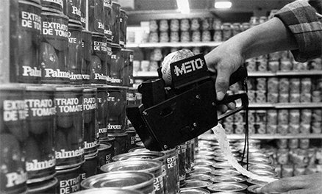
The context
Liberalization followed decades of direct state intervention via state-owned firms, protectionism, and weakened corporatism (sanctioned price controls and trusts)

Slide 8
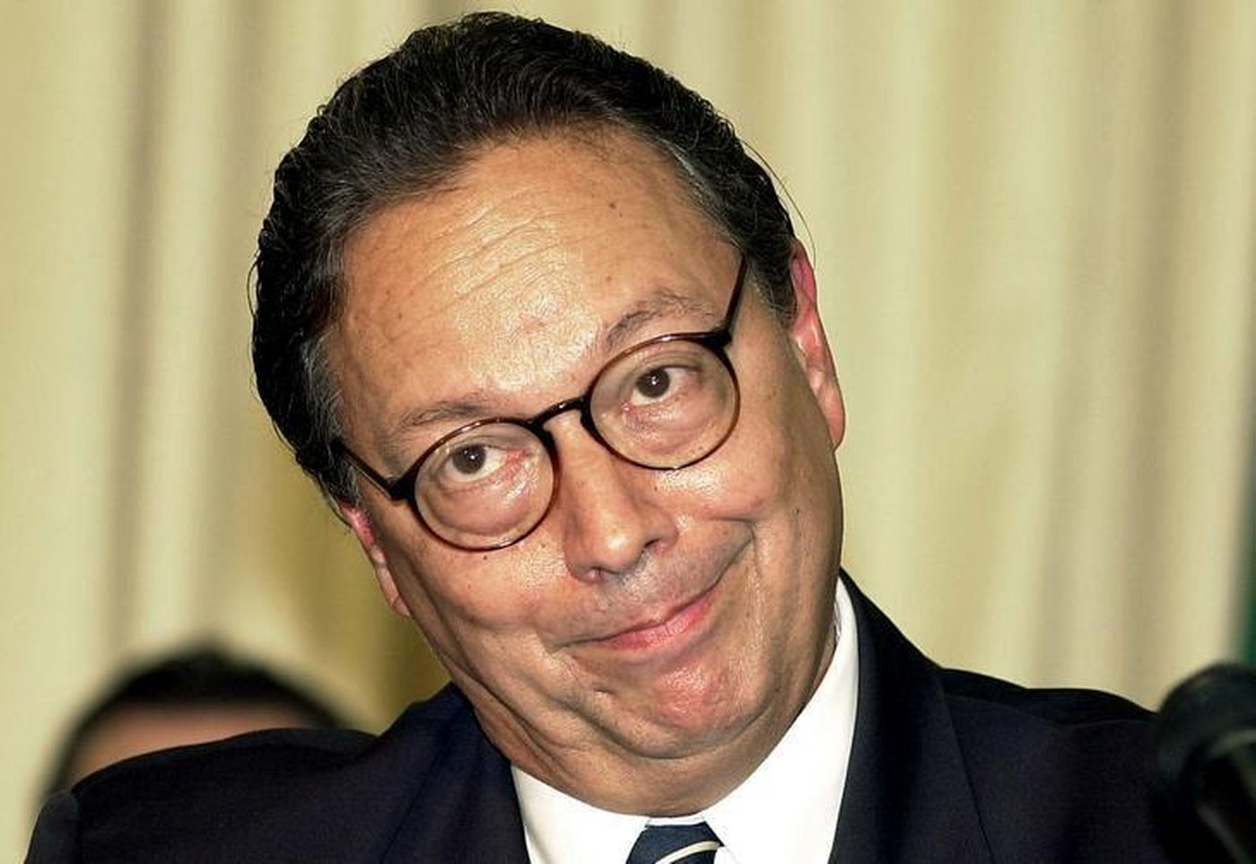
The context
New competition legislation (1994) granting autonomy to the antitrust authority "Administrative Council for Economic Defense”(CADE) – members appointed by the President
Aims at “strengthening the competition culture”: promoting market competition as part of inflation control
"The best industrial policy is to have no industrial policy.” (Malan, Minister of Finance)
Notes:
The challenge of CADE is to legitimate and politically consolidate its new mandate.

Slide 9

The rebars of discord
Acquisition of Korf GmbH by Brazil's Gerdau Group: vertical and horizontal integration
The vertical integration merger involving technology, commercial, and pig iron production companies was unanimously approved
The primary contention centered on the steel rebar market - Korf’s core business in Brazil - where Gerdau's acquisition would give it nearly 50% market share
Notes:
Nine mergers submitted to CADE in 1994-6 period: 7 were granted partial authorization; 2 denied
This was about to change with two emblematic cases: the first involving two toothpaste brands and the second two steel companies

Slide 10
Gerdau/Pains Case timeline
March 1995
October 1995
November 1995
November 1996
December 1996
CADE ruled 4-2 a partial approval, ordering deconstitution of the incorporation of Korf-owned Pains steel mill
Parties filed for reconsideration CADE upheld its original decision and reaffirmed the deconstitution order
Parties refused compliance and appealed to the Minister of Justice Challenged constitutionality of antitrust law granting CADE final executive authority (allowing only judicial review) Minister accepted the hierarchical appeal, suspending enforcement
With a renewed composition, CADE deliberated on enforcement options President proposed remedies to mitigate anti-competitive effects of Gerdau's acquisition
Gerdau agreed to divest a lamination unit and guarantee raw material supply to buyer

Slide 11
Key Arguments in the Gerdau-Pains Case
Relevant Market Debate
Gerdau/Government Position: Steel as a global commodity with low import barriers in liberalized markets
CADE's Finding: Domestic prices remained decoupled from international benchmarks
Efficiency Claims (Art. 54 of the new antitrust law)
Corporate Argument: Acquisition provided access to Korf's proprietary technologies (EOF, Korf Arc) and was necessary to rescue financially distressed Korf/Pains operations
CADE's Rejection:
Alternative paths to efficiency other than integration existed Consumer welfare gains unsubstantiated despite long steel market dominance
Notes:
Arguments centered around the “relevant market”: is steel a global commodity and thus easily imported?
Low barriers to entry in a liberalized market
Gerdau, Minister of Justice, and even President Cardoso state that fusões e incorporações de empresas representam o caminho para a competitividade e eficiência na era da globalização econômica.
Cade’s original decision: local prices do not follow international prices and
And efficiencies: Access to alternative production technologies that Korf detained
The acquisition was crucial for the survival of Korf GmbH and its affiliates, including Pains, which faced difficult financial situations
Cade’s original decision: efficiencies can be achieved through means other than integration
integration generates significant market power on long steel products without gains for the consumer

Slide 12
Political Dimensions
Executive Branch Advocacy:
"Mergers represent the path to competitiveness in the globalization era" (MoJ/FHC)
The Minister of Justice intervened directly—contravening the spirit of the newly enacted legislation
Institutional Consequences:
Post-ruling "rationalization" of antitrust policy after threat of reform
Replacement of CADE councilors with transaction-cost economists (“do not cause me trouble!” Cardoso)
Reduction of state regulatory power over market structures
Notes:
Post-ruling "rationalization" of antitrust policy after threat of reform – just a year after passing the new legislation

Slide 13
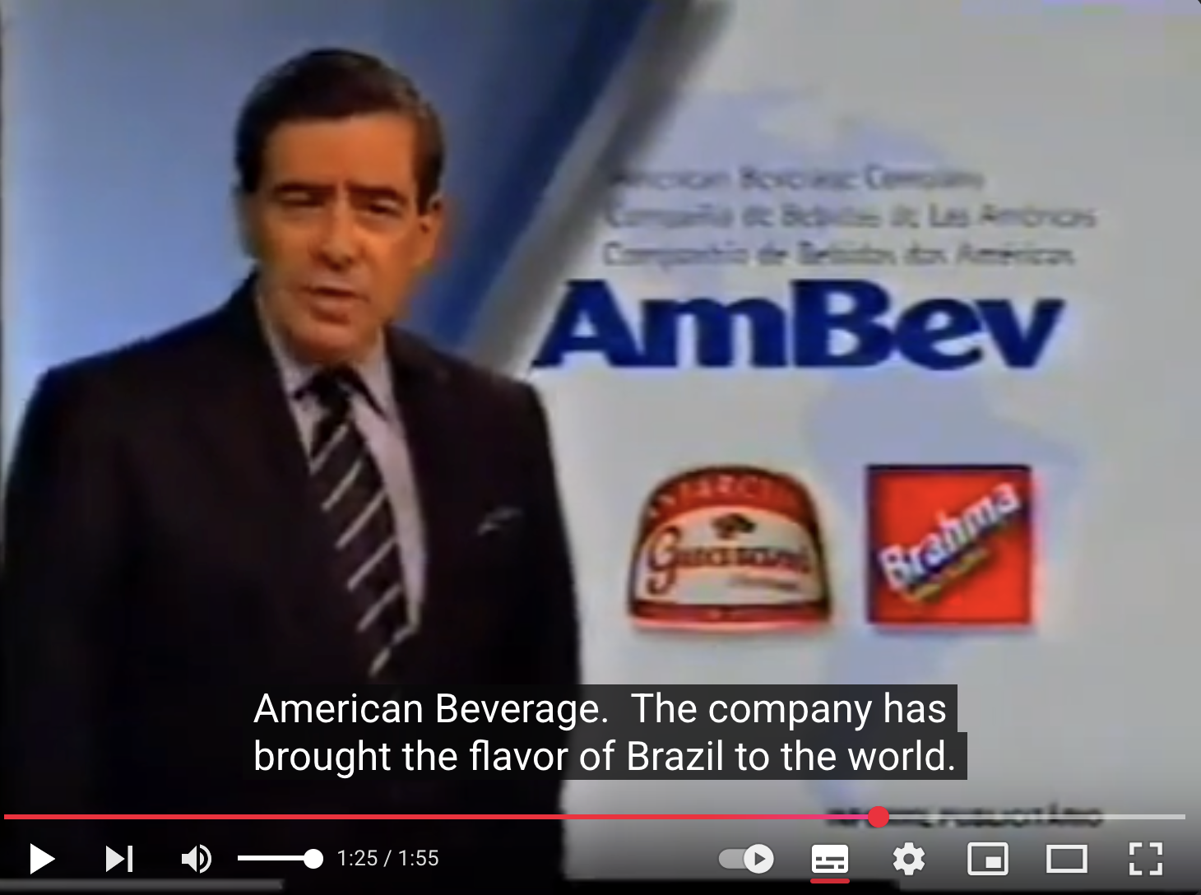
A national champion in the land of no industrial policy: Ambev, the “green-and-yellow multinational”
Notes:
After many attempts to team up with foreign firms, with joint-ventures, distribution agreements and sales to foreign groups, the two main beer firms (Antarctica and Brahma) decide to merge.
The term "verde-e-amarela" (green and yellow), referring to the colors of the Brazilian flag, was primarily used in the AmBev case to frame the newly formed company as a national champion and a Brazilian multinational. This branding was employed by AmBev and its supporters to evoke a sense of national pride and strategic importance for the merger, particularly in the context of global competition.

Slide 14
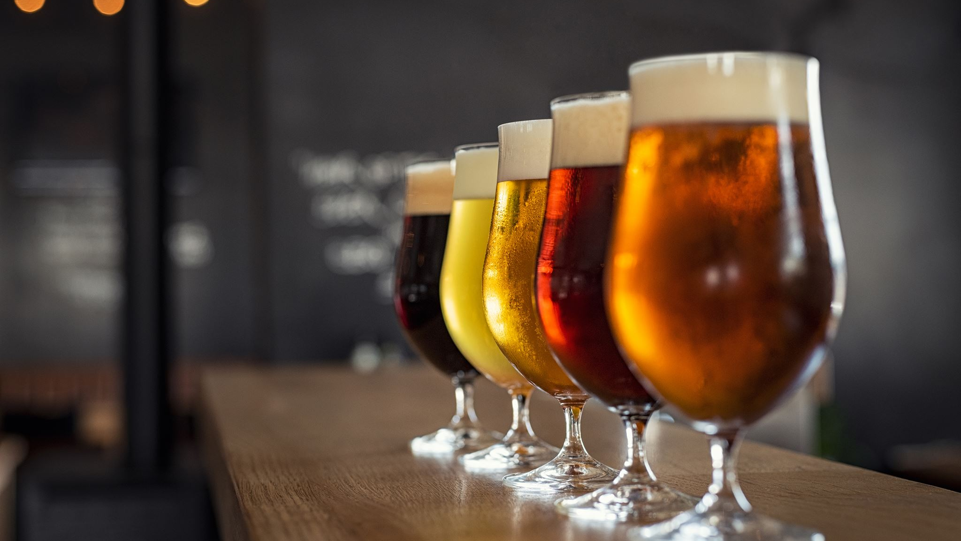
The green-and-yellow multinational
Merger of Antarctica and Brahma into American Beverage Company (Ambev) in 1999: two largest national beer firms with the three main brands (70% of market) and 39% of all beverages
Controlled a significant part of the distribution infrastructure and retail points (up to 99% in some states)
Ambev’s executives mobilized fears of denationalization: framed the merger as essential to compete internationally against industry giants and to serve as a stepping stone for internationalization (a “green-and-yellow” champion)
Notes:
AmBev's executives, such as Marcel Telles, emphasized that the company was meant to be a "multinational" to gain scale and compete internationally, indicating that if the company did not have the size to grow, it would be "denationalized"
The merger was framed as essential to enhance international competitiveness against industry giants and to serve as a strategic stepping stone for global expansion.

Slide 15
Ambev Case timeline
Merger finalized, announced at Palácio da Alvorada with President Cardoso’s endorsement
CADE's Plenary unanimously endorsed Counselor Hebe Romano's pioneering precautionary measure suspends merger pending review to protect market/public interest
Reports of CADE’s advisory bodies at the Ministries of Justice and Finance opposed unconditional approval, citing overstated efficiencies (6.9% vs. AmBev’s claimed 14.1% cost reductions). Recommended alienating one beer brand
Federal Police investigates bribery allegations against CADE’s councilors. Case proceeds
Upon CADE’s inquiry, Ministry of Development affirmed merger aligns with national interest
CADE approved the merger with restrictions, requiring a Performance Commitment Term (TCD) that includes asset divestments, shared distribution networks to mitigate antitrust risks and maintenance of employment levels
July 1999
14th July 1999
November 1999-January 2000
December 1999
February 2000
March 2000

Slide 16
Key Arguments in the Ambev Case
Relevant Market Debate
Ambev: pushed to define the market broadly as "beverages" (including sodas, juices), diluting its beer dominance (70% share) and framed competition as international (vs. Coca-Cola)
Critics, competitors, CADE’s advisory bodies: insisted the market was beer and highlighted minimal exports (<1%)
Efficiency Claims
AmBev’s Claims: Promised 14.1% cost cuts from optimized production, logistics, and scale to compete globally
Critics, competitors, CADE’s advisory bodies: found efficiencies overstated (just 6.9%), speculative, and unlikely to benefit consumers
CADE’s Stance: Gesner Oliveira prioritized regulating conduct over blocking mergers for structure, aligning with modern antitrust trends
Notes:
Relevant Market
Disputed Definition: AmBev Critics, like CADE’s SEAE, insisted the focus should be solely on beer, where concentration was extreme.
Global vs. Local: The company framed competition as international (vs. Coca-Cola), but critics highlighted minimal exports (<1%), undermining claims of global rivalry.
Efficiency
AmBev’s Claims: Promised 14.1% cost cuts from optimized production, logistics, and scale to compete globally.
Critics’ Rebuttal: SEAE found efficiencies overstated (just 6.9%), speculative, and unlikely to benefit consumers.
CADE’s Stance: Gesner Oliveira prioritized regulating conduct over blocking mergers for structure, aligning with modern antitrust trends.

Slide 17
Political Dimensions
Stronger Executive Branch Advocacy:
Merger was publicly announced at the Presidential Palace
President Cardoso defended the deal: “The world operates in oligopolies”
Development Minister Clovis Carvalho embraced mergers in strategic industries to resist foreign acquisitions and build Brazilian multinationals and supported Ambev’s merger
Result of antitrust policy “rationalization”: CADE yields to pressure
Notes:
The merger was publicly announced at the Presidential Palace, signaling high-level political endorsement.
President Cardoso defended the deal, stating: "The world operates in oligopolies", dismissing monopoly concerns.
Development Minister Clovis Carvalho actively promoted mergers in key industries (e.g., steel, paper) to create "national champions" and resist foreign takeovers.
Impact on CADE: Faced with executive pressure, the antitrust authority balanced competition concerns with political realities, approving the merger with conditions to retain legitimacy.
Cardoso publicly dismissed monopoly concerns, stating, "The world operates in oligopolies."
Development Minister Clovis Carvalho actively promoted mergers in key industries (e.g., steel, paper) to create "national champions" and resist foreign takeovers. A true industrial policy.
Impact on CADE: Faced with executive pressure, the antitrust authority balanced competition concerns with political realities, approving the merger with conditions to retain legitimacy.

Slide 18
Thank you

