Slide 1
Unredact the Mueller Report?
Portland Python User Group
Hobson Lane @hobsonlane
Al Kari @alkari
May 30, 2019

Slide 2
Agenda
Natural Language Processing
NLP Problem: Unredaction
LSTM (RNN):
Pretrained BERT:
Fine-tuned BERT:

Slide 3
NLP = Sequence Learning
Language Model
Predictive Text
Middle Button Game
Autocomplete
Time Series Model

Slide 4
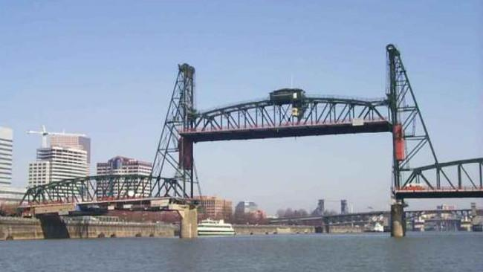
Portlandian Learning
Rain/Sun
Hawthorne Bridge
Cloudy
Traffic
Roses

Slide 5
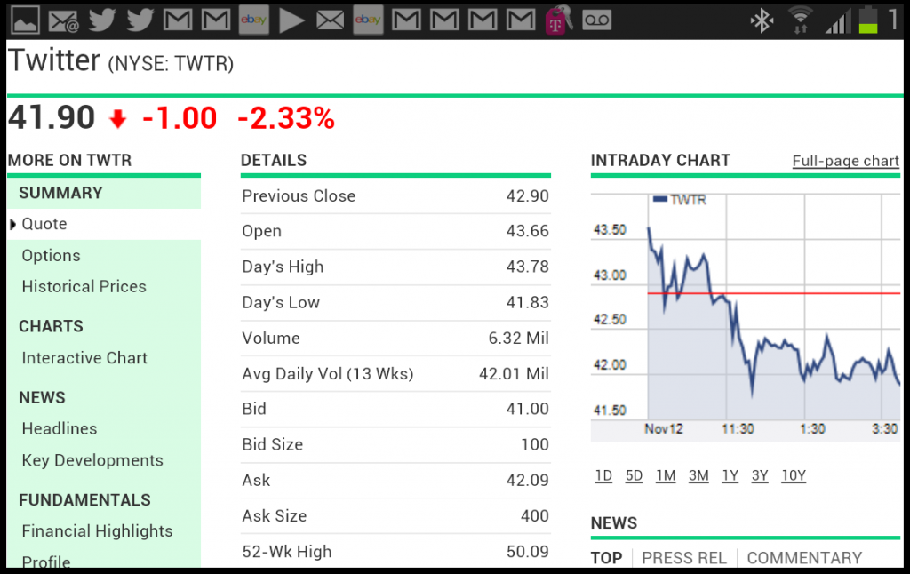
Californian’s Learn Too
Smog
Email inbox
Web traffic
Stock price
Traffic jams
Dodgers

Slide 6
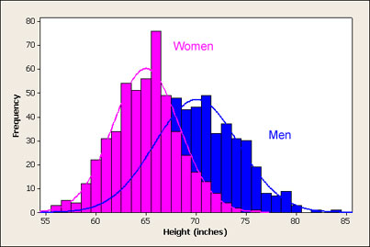
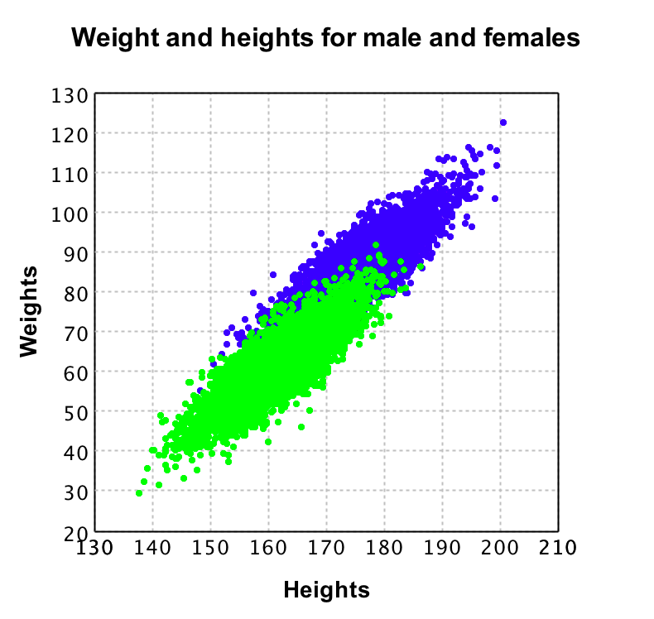
Machine Learning
Average (MLE)
Linear Regression
Moving Average
ARMA
Decision Tree
Many Decision Trees (Forest)
Voting (XGBoost)

Slide 7
Chatbot
“a”
“b”
“Cohen”
“;-)”
“LOL”
“!”

Slide 8
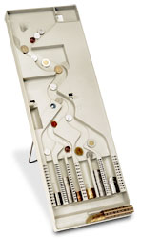
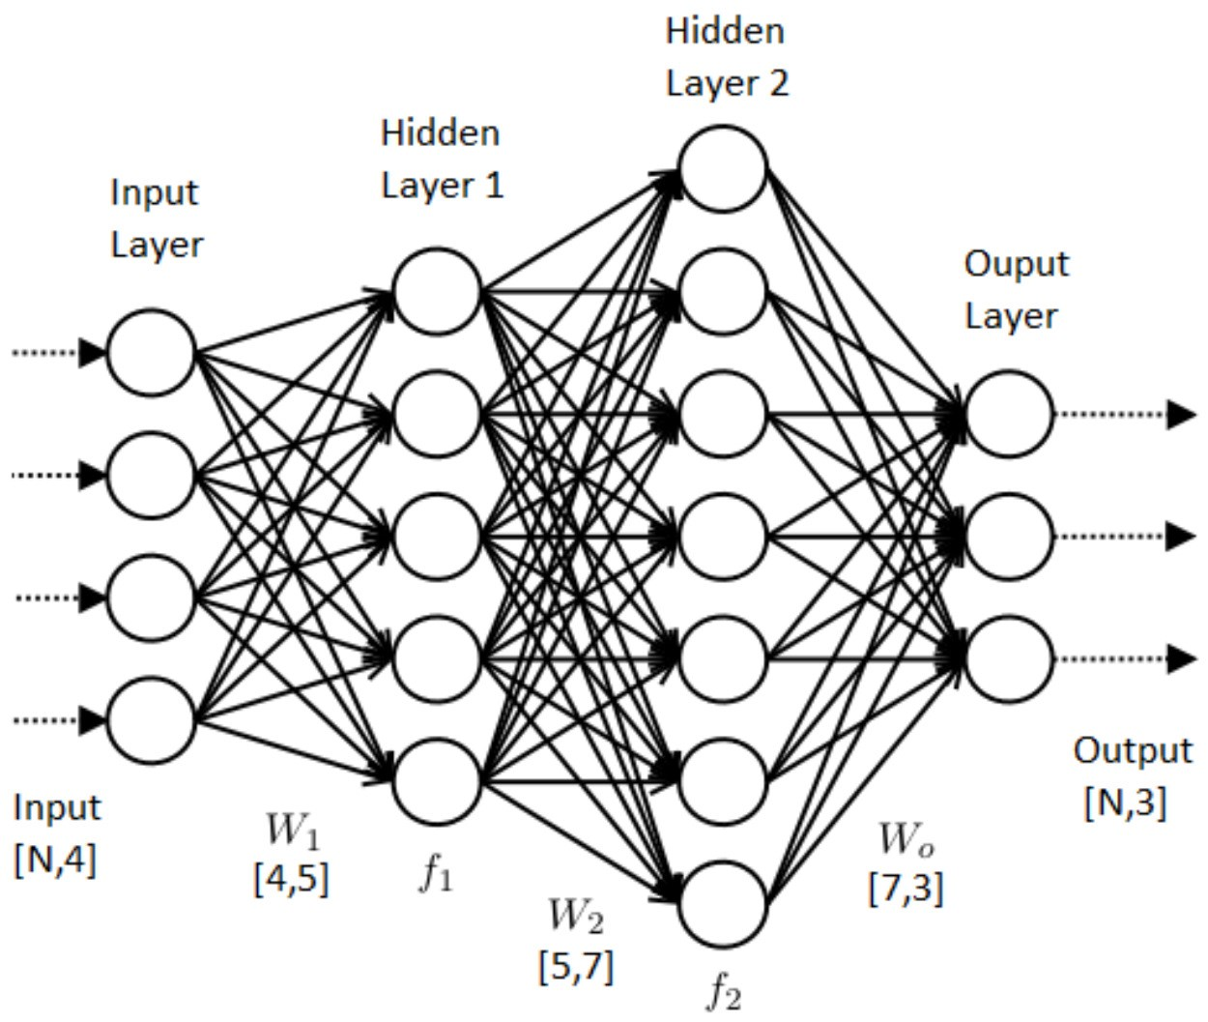
NLP Pipeline
Prediction (forward propagation)
“The quick brown ...”
“The” “quick” “brown”
“...”
“fox” “jumped” “over” ...
Learning/Training
(back propagation)
The
brown
quick

Slide 9
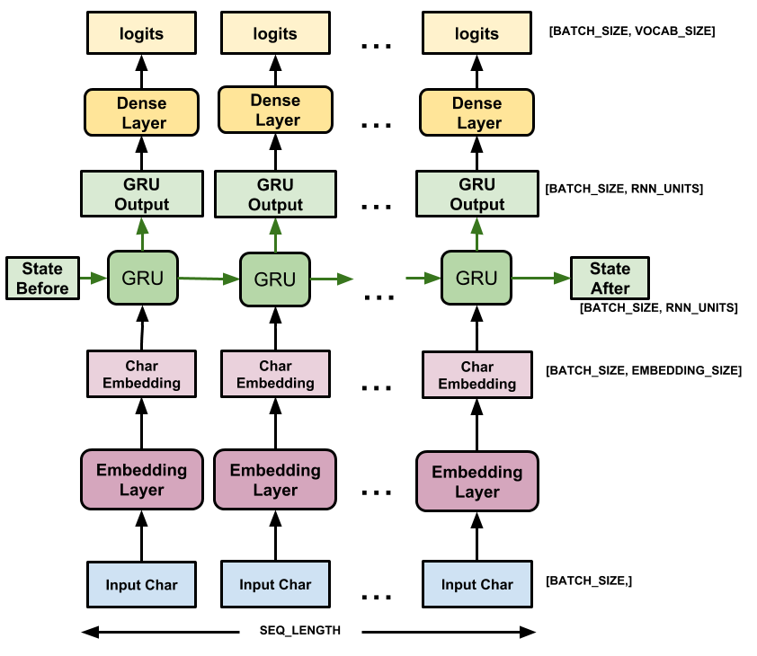
RNN (Recurrence)
Recurrence
1.2
2.0
.25
Gate
.3
.6
“a”

Slide 10
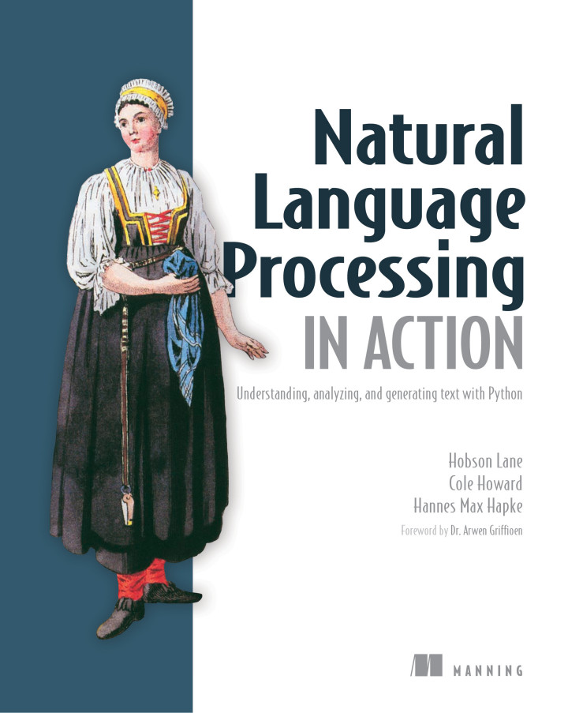
What’s NLP Good For?
Classification & Filtering
Translation (style too!)
Question Answering
Search & Extractive summary
Weather & finance
Law
Novels & Movie scripts
IA! (Assistants)

Slide 11
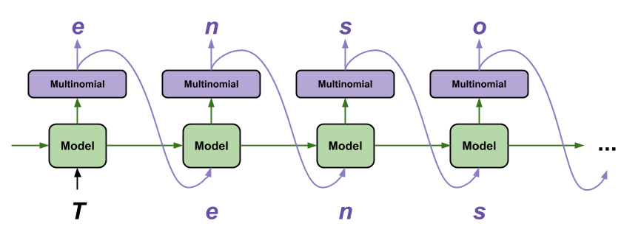
The Prediction Loop

Slide 12
RNN Demo

Slide 13
Data Pre-processing
Training with the document data
OCR the Mueller Report
Identifying redacted areas
Text Extraction & Tokenization

Slide 14
BERT – The Model
Bidirectional Encoder Representation from Transformers (BERT)
Transfer Learning – Fine Tuning BERT
  Training Set
  Challenges
Training
Prediction

Slide 15
What’s NLP Good For?
Classification & Filtering
Translation (style too!)
Question Answering
Search & Extractive summary
Weather & finance
Law
Novels & Movie scripts
IA! (Assistants)
http://bit.ly/nlpia-py

Slide 16
Intelligence Augmentation

Slide 17
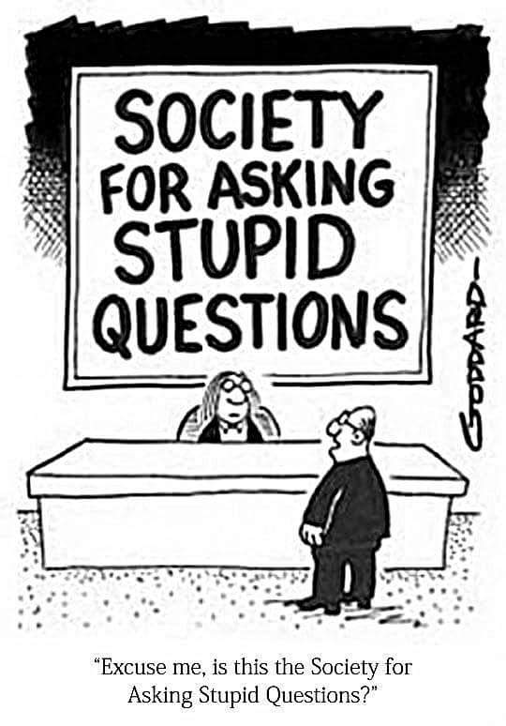
QUESTIONS

