Slide 1
“Nessvectors”
Portland Python User Group
Hobson Lane
Twitter: @hobsonlane
June 27, 2019

Slide 2
Agenda
Thank you
NLP: Natural Language Processing

Slide 3
Language Model
Sequence Learning => Predict the next word
Predictive Text
Middle Button Game
Autocomplete
Time Series Model

Slide 4
Language Model = Mad Libs
Excuse me sir, you __[verb]__ your wallet.
I’m __[adjective]__ for being too late.
Could we have _[noun]_ at 6, and then go to a movie?
My mom _________ some cookies if you want some.
I don’t understand. Could you please ______ that?
I was born in Damascus. Where are ___ from?

Slide 5
Chatbot
“a”, “b”, “c”, ...
“!”, “?”, …
“Cohen”, “Harari”
“Leonard_Cohen”, “Yuval Harari”
“:)”, “:-)”, “;-)”, “:-/”
“POTUS”, “LOL”, “WAT”, ...

Slide 6
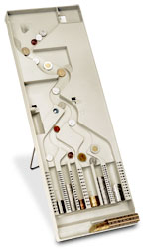
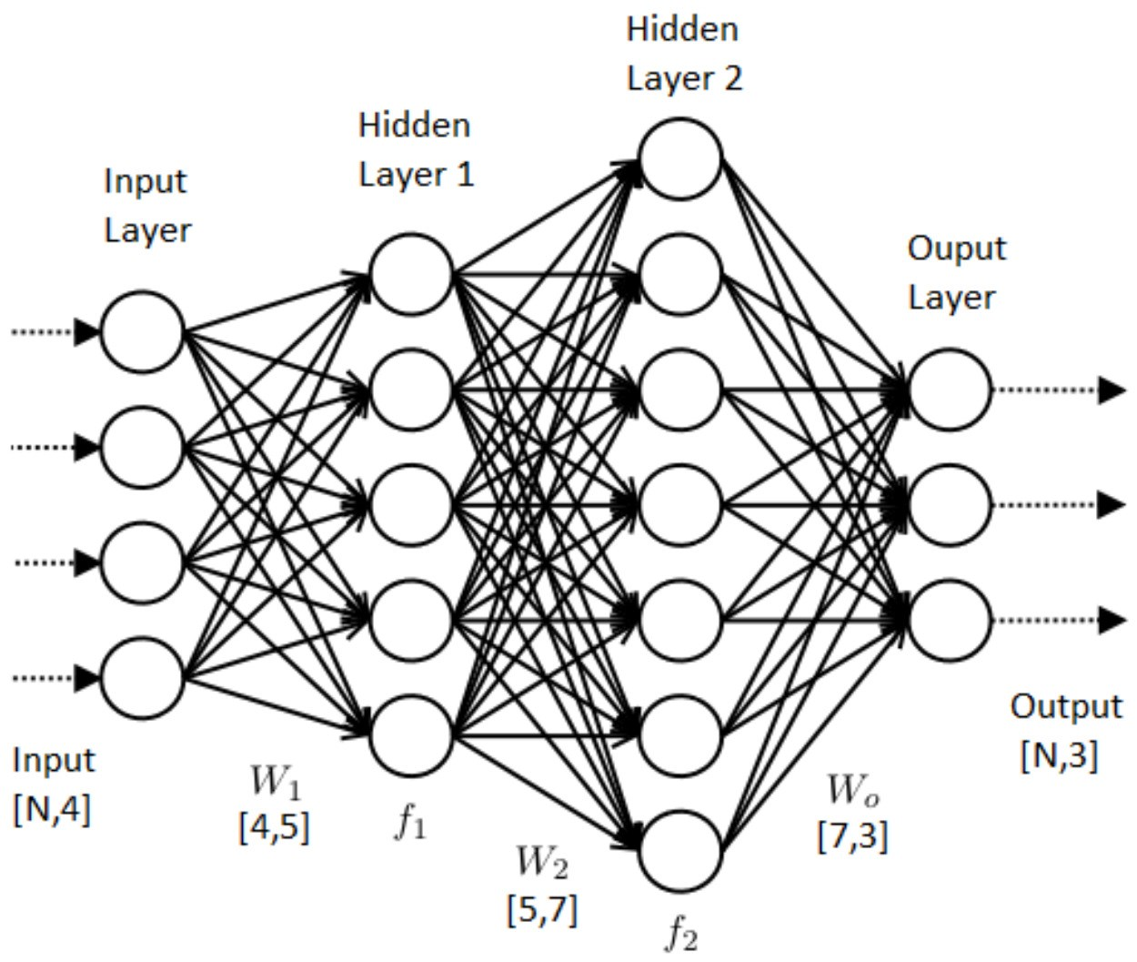
NLP Pipeline
Prediction (forward propagation)
“The quick brown ...”
“The” “quick” “brown”
“...”
“fox” “jumped” “over” ...
Learning/Training
(back propagation)
The
brown
quick

Slide 7
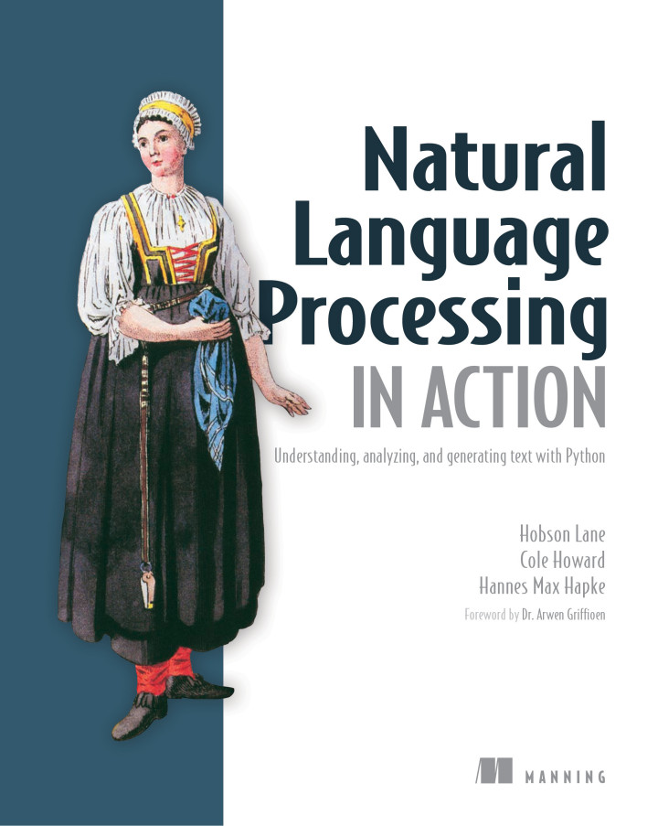
What’s NLP Good For?
Classification & Filtering
Translation (style too!)
Question Answering
Search & Extractive summary
Weather, Finance & Law
Novels & Movie scripts
IA! (Assistants)
http://bit.ly/nlpia-py

