Slide 1
Prompt Iteration Platform
Adrian Manchado

Slide 2
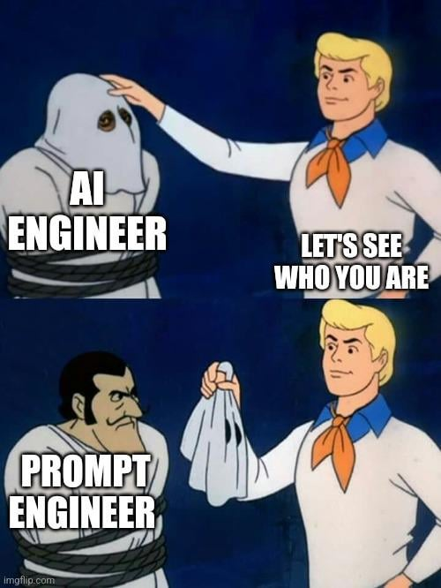

Slide 3
It is not that easy in production…

Slide 4
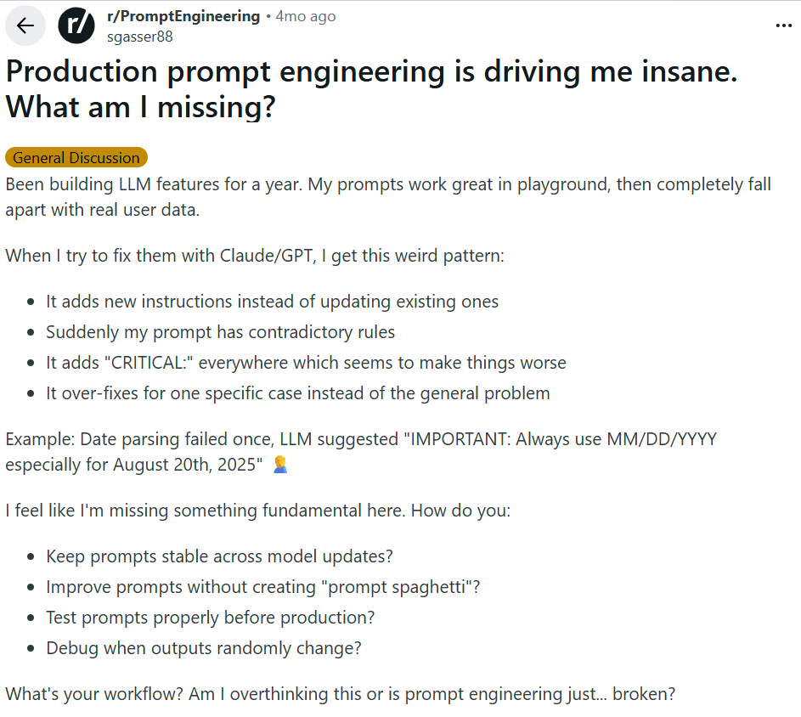
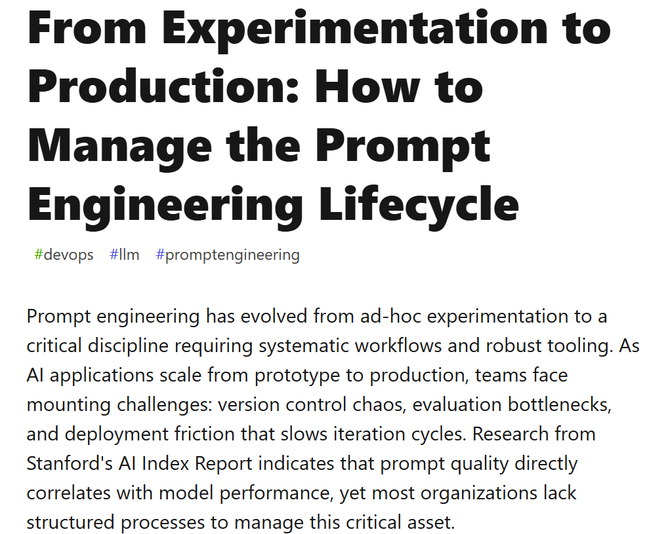
It is not that easy in production…

Slide 5

What did you do?

Slide 6
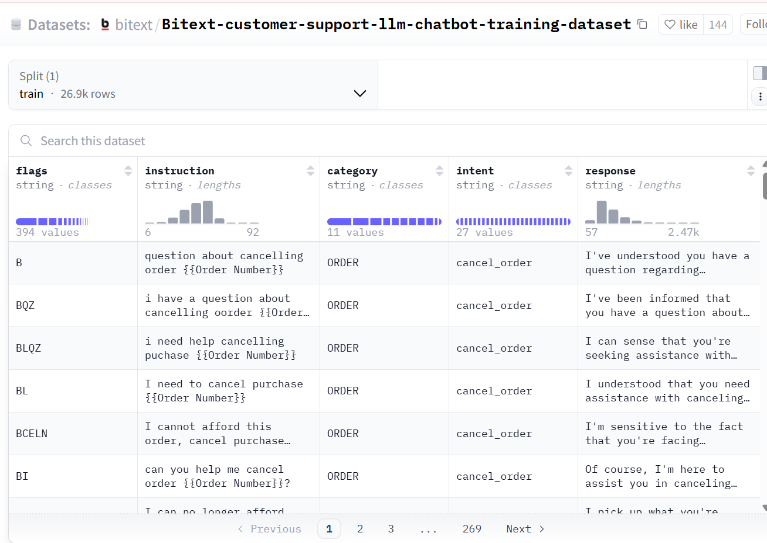
What did you do?
Dataset

Slide 7
What did you do?
Dataset

Slide 9
What would I have done if I had more time?
Deploy it to an actual site instead of localhost
Integration for loading your own data
Deploying it with an actual backend and database
More metrics: recall, categories harder to predict, etc

Slide 10
Thank you!

