Slide 1
Polygon Mesh
Computer Graphics
Unit : 4
By : Kapil Manchandani

Slide 2
What does Polygon Mesh mean?
A polygon mesh is a collection of edges, faces and connecting points that is used to provide a polygon model for 3-D modeling and computer animation. Its geometric makeup can be stored in order to facilitate various kinds of simulation of three-dimensional renderings.
OR
Polygon is a representation of the surface. It is primitive which is closed in nature. It is formed using a collection of lines. It is also called as many-sided figure. The lines combined to form polygon are called sides or edges. The lines are obtained by combining two vertices.

Slide 3
Polygon Mesh
In a polygon mesh, each surface joins together through its boundaries and common edges. One example is a three-dimensional sphere made up of identical faces, like a soccer ball in which the faces themselves can be flat or curved. More complex polygon meshes render people, animals, and other complex shapes. Computer engineers use specific digital tools to build and store these models for animation.

Slide 4
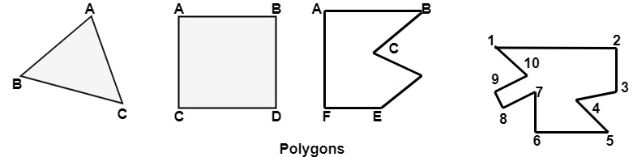
Example of Polygon
Triangle
Rectangle
Hexagon
Pentagon

Slide 5
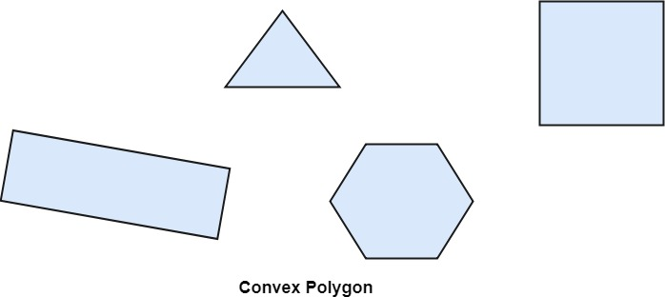
Types of Polygons
Concave
Convex
Convex : A polygon is called convex of line joining any two interior points of the polygon lies inside the polygon.

Slide 6
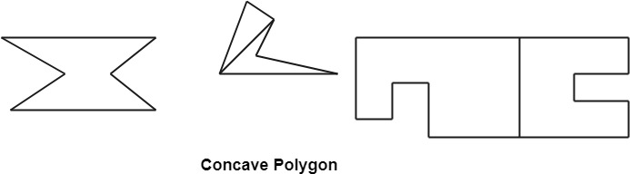
Concave Polygons
Concave : A non-convex polygon is said to be concave. A concave polygon has one interior angle greater than 180°. So that it can be clipped into similar polygons.

Slide 7
Advantages / Disadvantages of Polygons
Advantages
It can be used to model almost any object.
They are easy to represent as a collection of vertices.
They are easy to transform.
They are easy to draw on computer screen.
Disadvantages
Curved surfaces can only be approximately described.
It is difficult to simulate some type of objects like hair or liquid.

