Slide 1
Monte Carlo Methods

Slide 2
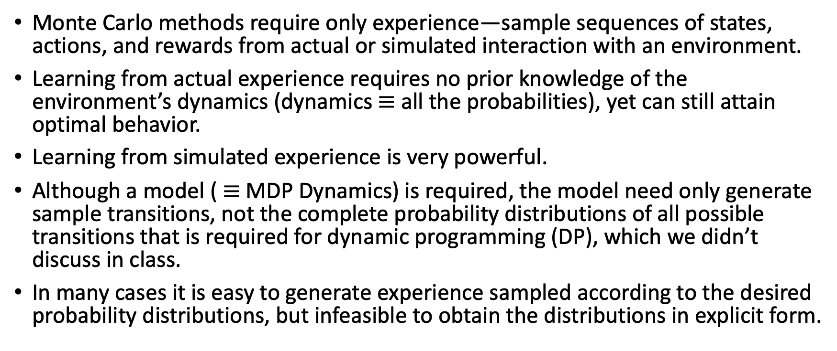
Monte Carlo methods
Monte Carlo methods require only experience—sample sequences of states, actions, and rewards from actual or simulated interaction with an environment.
Learning from actual experience requires no prior knowledge of the environment’s dynamics (dynamics $≡$all the probabilities), yet can still attain optimal behavior.
Learning from simulated experience is very powerful.
Although a model ( $≡$MDP Dynamics) is required, the model need only generate sample transitions, not the complete probability distributions of all possible transitions that is required for dynamic programming (DP), which we didn’t discuss in class.
In many cases it is easy to generate experience sampled according to the desired probability distributions, but infeasible to obtain the distributions in explicit form.

Slide 3
Monte Carlo methods
Monte Carlo methods solve the reinforcement learning problem based on averaging sample returns.
Monte Carlo methods are used only for episodic tasks.
Experience is divided into episodes, and that all episodes eventually terminate no matter what action sequences are selected. Some episodes may be short, some others may be long.
Only on the completion of an episode are value estimates and policies changed.
Monte Carlo methods are incremental in an episode-by-episode sense.

Slide 4
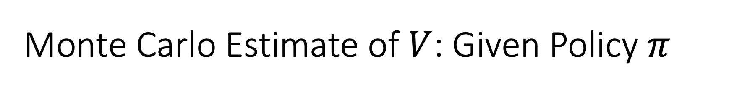
Monte Carlo Estimate of $V$: Given Policy $π$
Want to estimate V^{π}(s)
expected return starting from s and following π
estimate as average of observed returns in state s
First-visit MC
average returns following the first visit to state s
s
s
s₀
G₁(s) = +2
+1
-2
0
+1
-3
+5
s₀
s₀
G₂(s) = +1
s₀
G₃(s) = -5
s₀
s₀
G₄(s) = +4
V^{π}(s) ≈ (2 + 1 – 5 + 4)/4 = 0.5

Slide 5
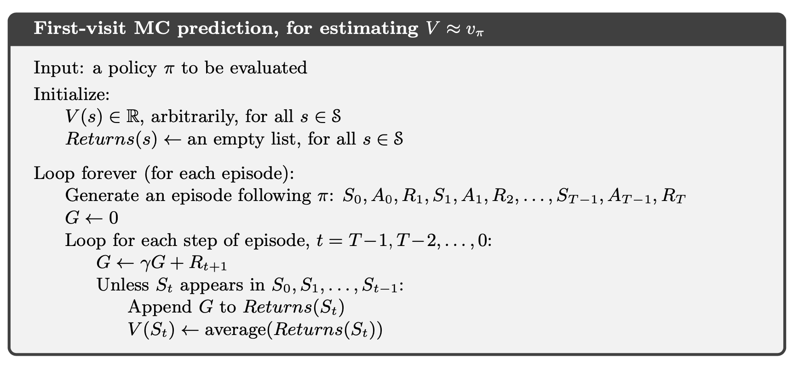
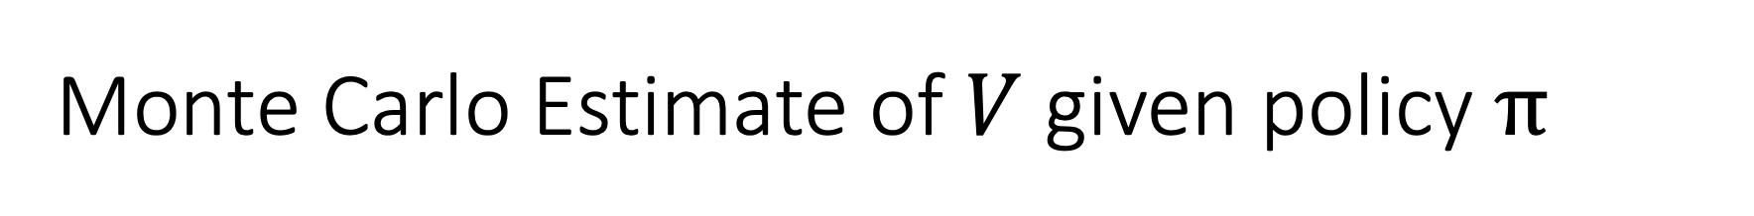
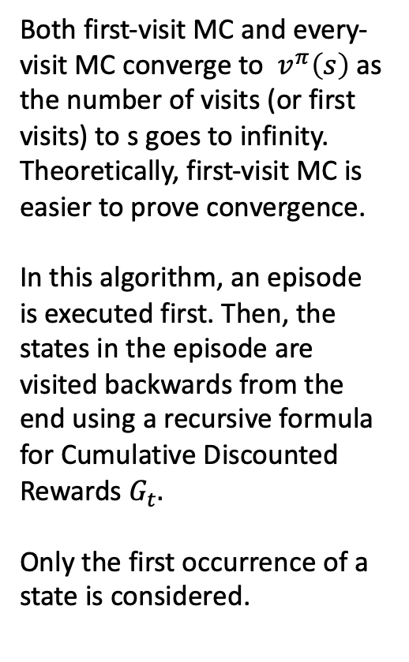
Monte Carlo Estimate of $V$ given policy $π$
Both first-visit MC and every-visit MC converge to $v^{π}\left(s\right)$ as the number of visits (or first visits) to s goes to infinity. Theoretically, first-visit MC is easier to prove convergence.
In this algorithm, an episode is executed first. Then, the states in the episode are visited backwards from the end using a recursive formula for Cumulative Discounted Rewards $G_{t}.$
Only the first occurrence of a state is considered.
From Sutton and Barto, 2020

Slide 6
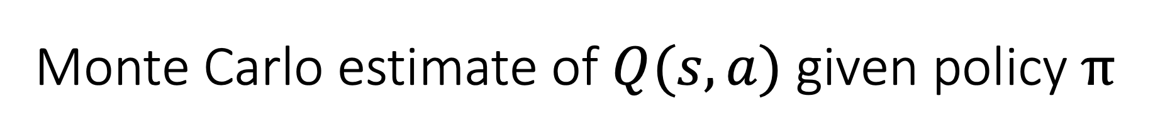
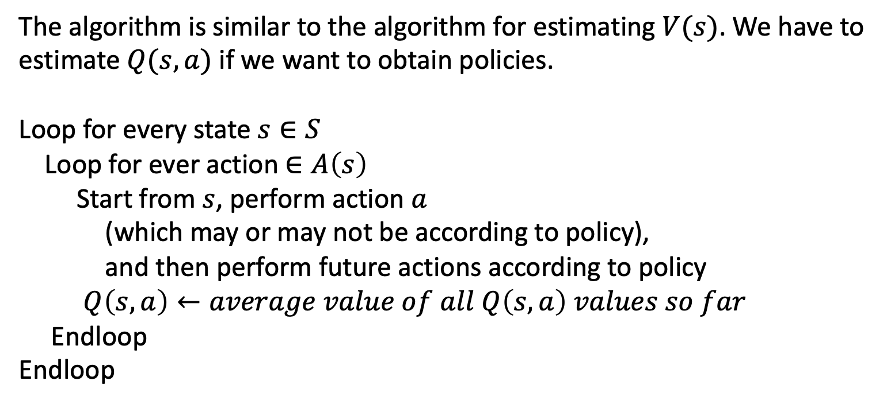
Monte Carlo estimate of $Q(s,a)$ given policy $π$
The algorithm is similar to the algorithm for estimating $V(s)$. We have to estimate $Q(s,a)$ if we want to obtain policies.
Loop for every state $s∈S$
Loop for ever action $∈A\left(s\right)$
Start from $s$, perform action $a$
(which may or may not be according to policy),
and then perform future actions according to policy
$Q\left(s,a\right)←average value of all Q\left(s,a\right) values so far$
Endloop
Endloop

Slide 7
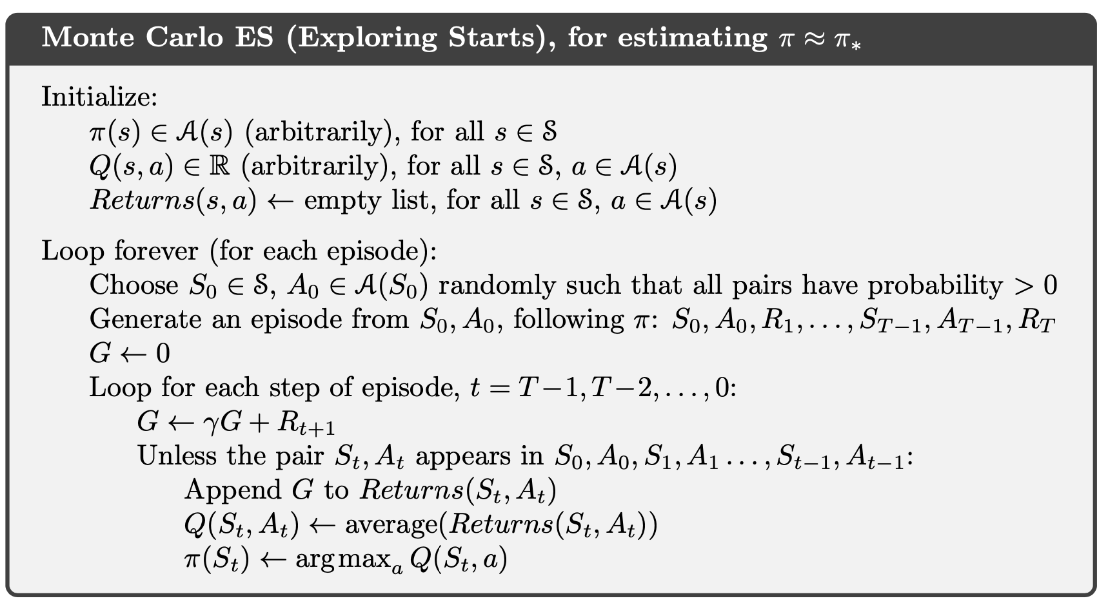
Monte Carlo estimate of $Q(s,a)$ given policy $π$
This is a special version of Monte Carlo $Q(s,a)$ learning: With exploring starts assumption.
Exploring Starts Assumption:
The episodes start in a state–action pair
Every pair has a nonzero probability of being selected as the start.
This guarantees that all state–action pairs are visited an infinite number of times in the limit of an infinite number of episodes.
Note: Pick the max Q(s,a) as we update the policy for state $π\left(s\right)$

Slide 8
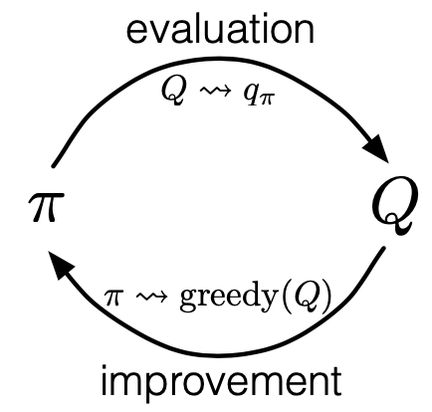
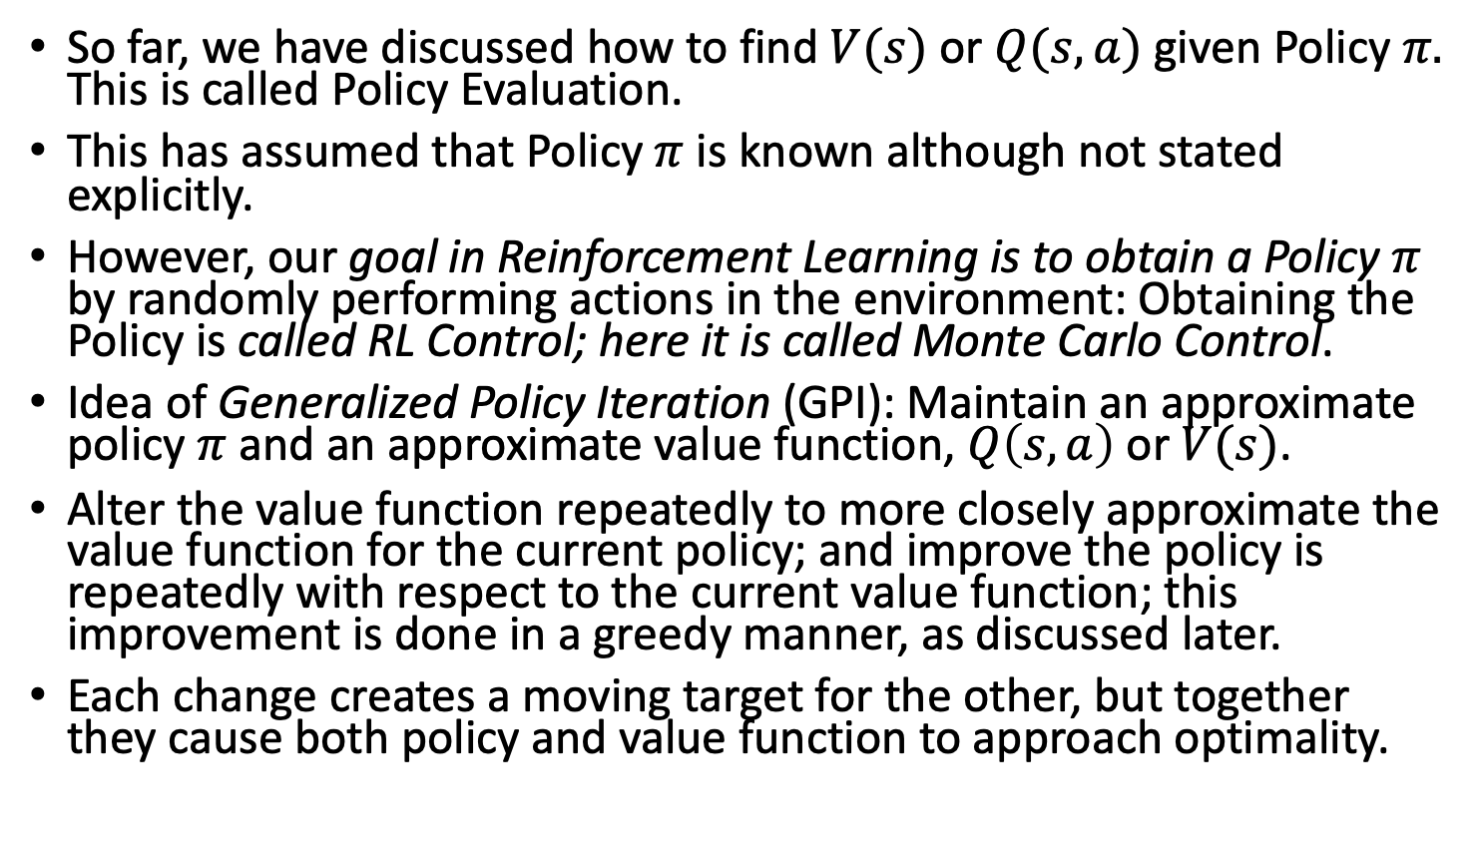
Monte Carlo Control: Find Optimal Policy
So far, we have discussed how to find $V(s)$ or $Q(s,a)$ given Policy $π.$ This is called Policy Evaluation.
This has assumed that Policy $π$ is known although not stated explicitly.
However, our goal in Reinforcement Learning is to obtain a Policy $π$ by randomly performing actions in the environment: Obtaining the Policy is called RL Control; here it is called Monte Carlo Control.
Idea of Generalized Policy Iteration (GPI): Maintain an approximate policy $π$and an approximate value function, $Q\left(s,a\right)$ or $V(s)$.
Alter the value function repeatedly to more closely approximate the value function for the current policy; and improve the policy is repeatedly with respect to the current value function; this improvement is done in a greedy manner, as discussed later.
Each change creates a moving target for the other, but together they cause both policy and value function to approach optimality.

Slide 9
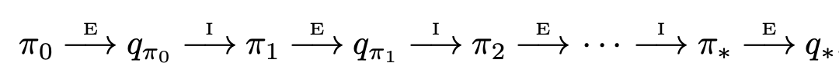


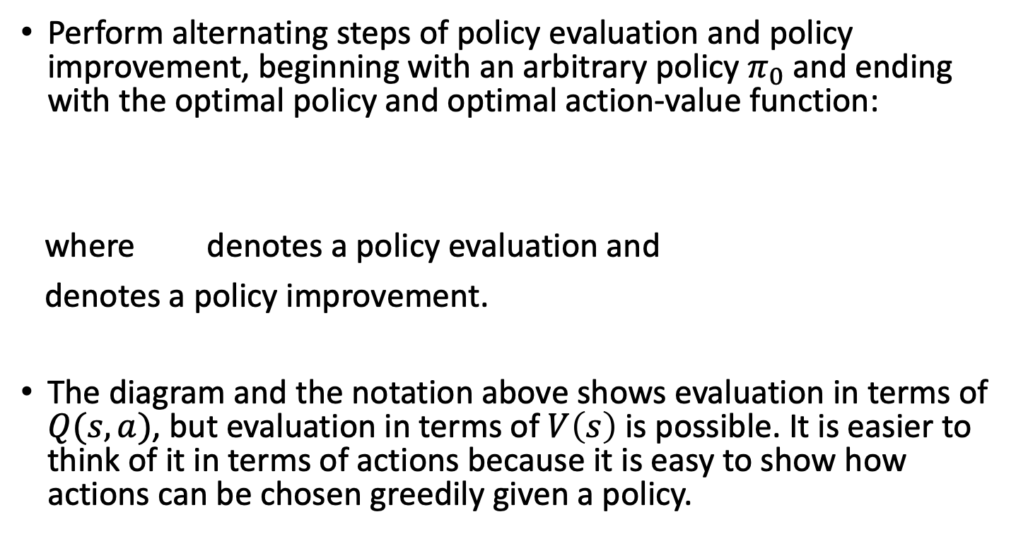
Monte Carlo Control: Find Optimal Policy
Perform alternating steps of policy evaluation and policy improvement, beginning with an arbitrary policy $π_{0}$ and ending with the optimal policy and optimal action-value function:
where denotes a policy evaluation and
denotes a policy improvement.
The diagram and the notation above shows evaluation in terms of $Q(s,a)$, but evaluation in terms of $V\left(s\right)$ is possible. It is easier to think of it in terms of actions because it is easy to show how actions can be chosen greedily given a policy.

Slide 10

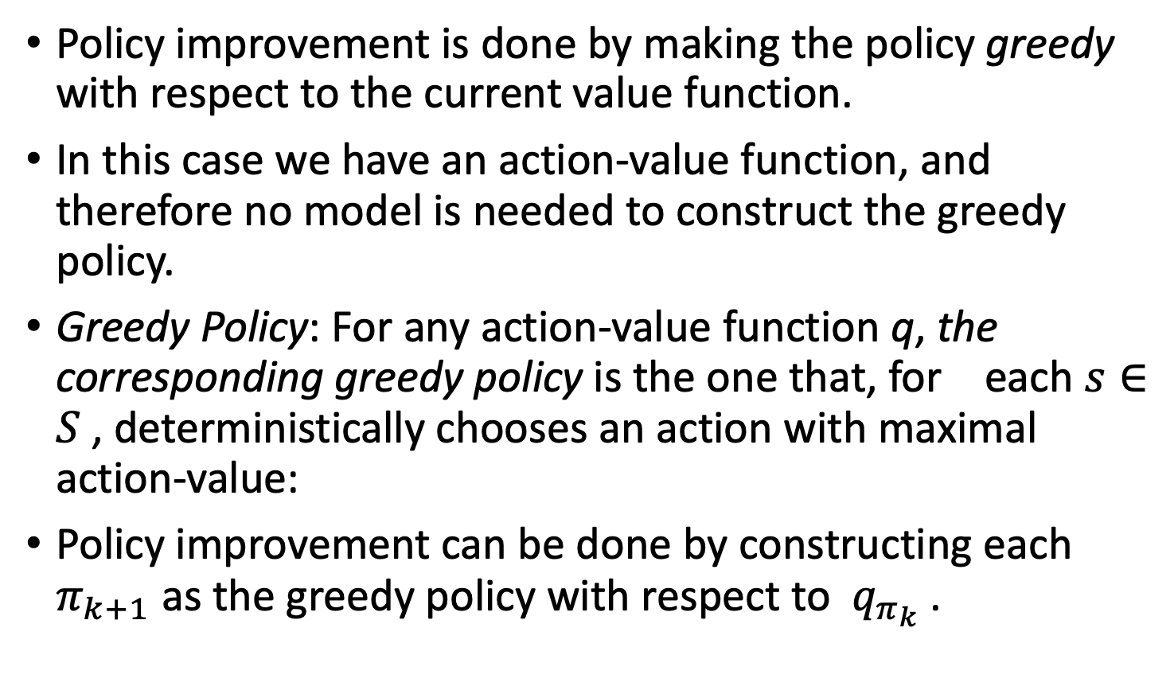
Monte Carlo Control: Find Optimal Policy
Policy improvement is done by making the policy greedy with respect to the current value function.
In this case we have an action-value function, and therefore no model is needed to construct the greedy policy.
Greedy Policy: For any action-value function q, the corresponding greedy policy is the one that, for each $s∈S$, deterministically chooses an action with maximal action-value:
Policy improvement can be done by constructing each $π_{k+1}$ as the greedy policy with respect to $q_{π_{k}}$ .

Slide 11
Exploration vs. Exploitation
The dichotomy between exploration and exploitation is a key ingredient of RL.
The idea of a Greedy Policy needed for RL Control requires us to think of exploration and exploitation.
Deterministic policy will not explore all actions
A deterministic policy will perform the same designated action in a state every time.
This does not lead to any learning to do things better or a new policy.
We are trying to learn a policy from scratch or nothing.
Don’t know anything about the environment at the beginning
Need to try all actions to find the optimal one since we know nothing to start

Slide 12
Exploration vs. Exploitation
Performing the same action known to be the best in a state is called Exploitation.
Exploitation is good because it leads to high cumulative reward based on what is known at the time.
However, since we start from no knowledge (e.g., a equi-random dynamics), the knowledge may not be the best a certain time.
This calls for Exploration, which means not doing the current best action at a state from time to time, i.e., taking a chance with lower valued actions.

Slide 13
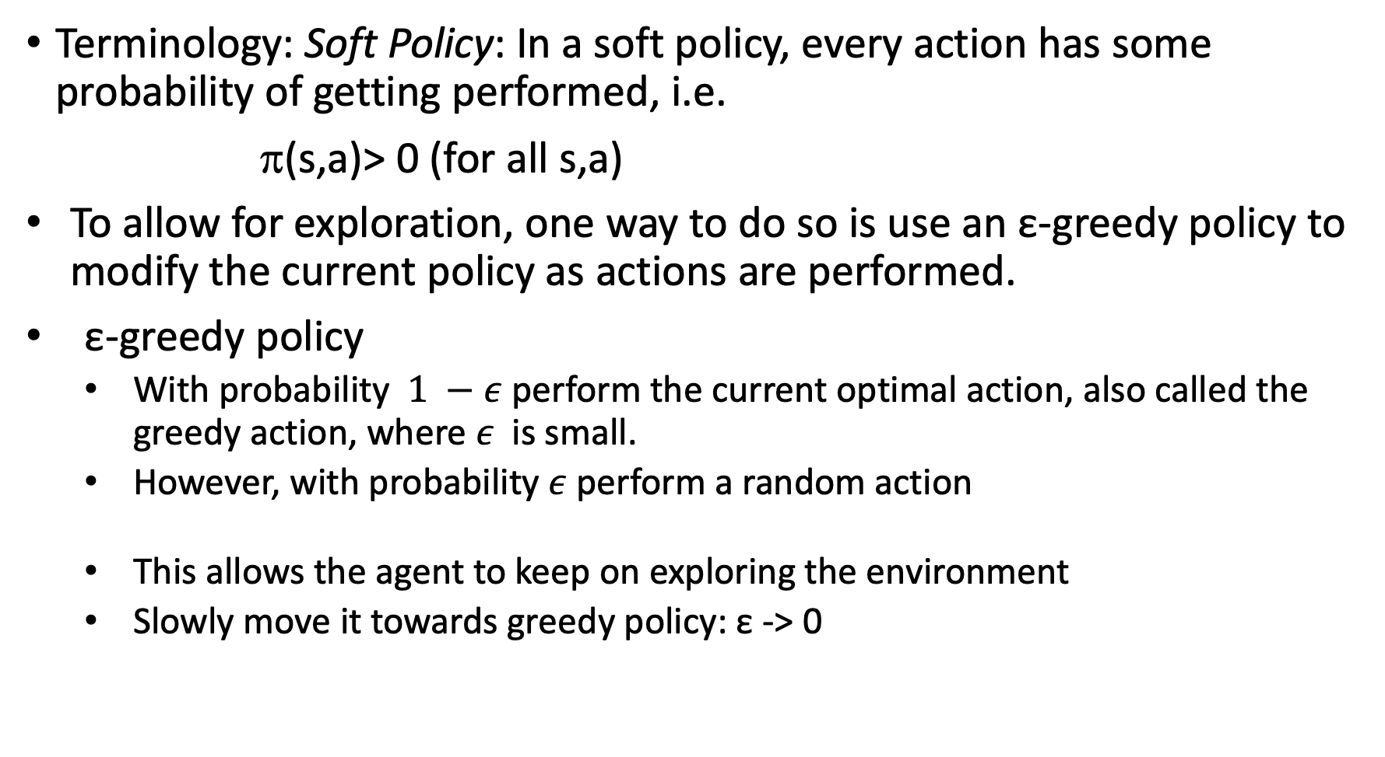
Exploration vs. Exploitation
Terminology: Soft Policy: In a soft policy, every action has some probability of getting performed, i.e.
π(s,a)> 0 (for all s,a)
To allow for exploration, one way to do so is use an ε-greedy policy to modify the current policy as actions are performed.
ε-greedy policy
With probability $1 −ε$ perform the current optimal action, also called the greedy action, where $ε$is small.
However, with probability $ε$ perform a random action
This allows the agent to keep on exploring the environment
Slowly move it towards greedy policy: ε -> 0

Slide 14
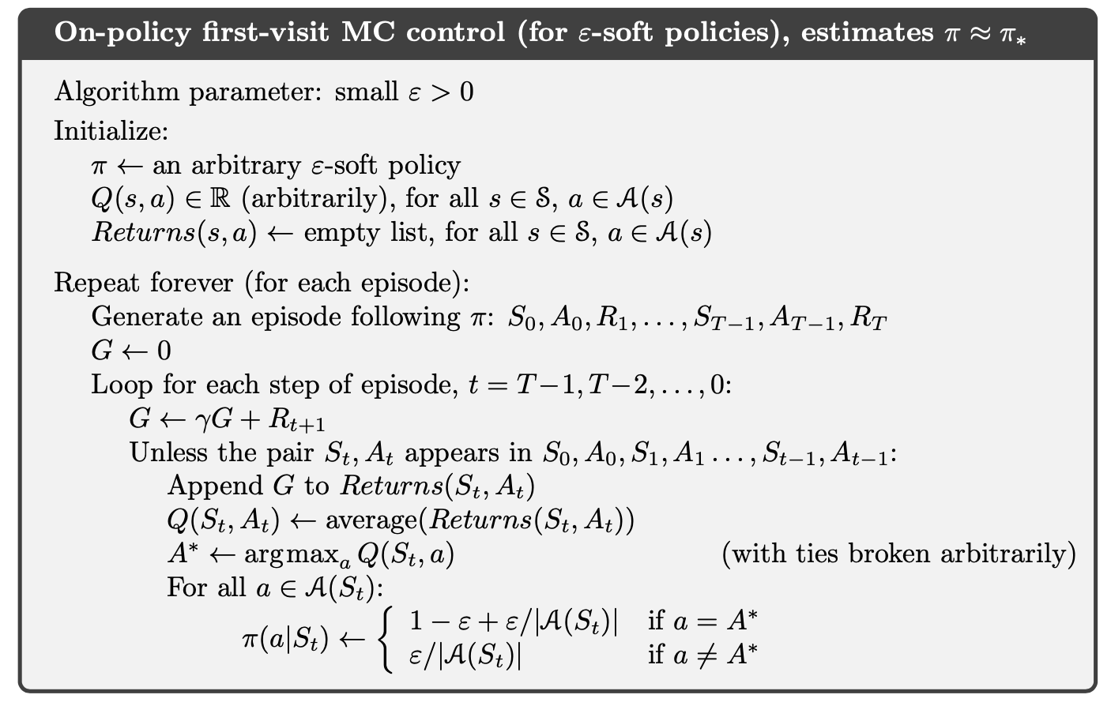
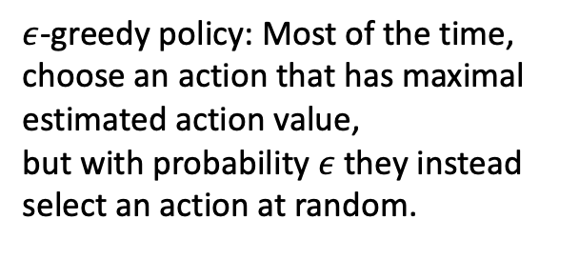
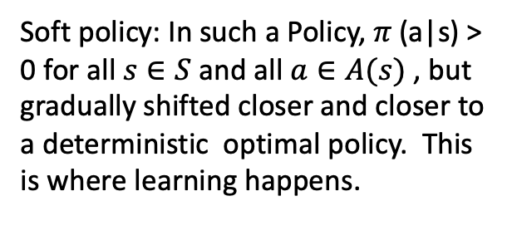
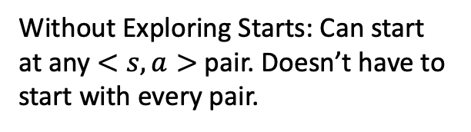
Monte Carlo Control without Exploring Starts
Without Exploring Starts: Can start at any $<s,a>$ pair. Doesn’t have to start with every pair.
Soft policy: In such a Policy, $π$(a|s) > 0 for all $s∈S$ and all $a∈A(s)$ , but gradually shifted closer and closer to a deterministic optimal policy. This is where learning happens.
$ε$-greedy policy: Most of the time, choose an action that has maximal estimated action value,
but with probability $ε$ they instead select an action at random.

Slide 15
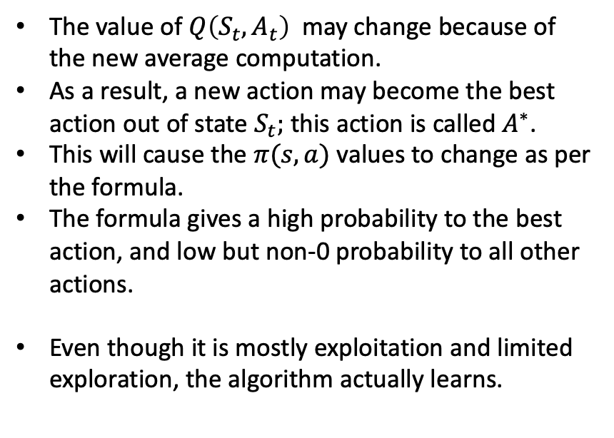
MC Control: Limited Exploration, Mostly Exploitation
The value of $Q\left(S_{t}, A_{t}\right)$may change because of the new average computation.
As a result, a new action may become the best action out of state $S_{t};$ this action is called $A^{∗}$.
This will cause the $π(s,a)$ values to change as per the formula.
The formula gives a high probability to the best action, and low but non-0 probability to all other actions.
Even though it is mostly exploitation and limited exploration, the algorithm actually learns.

Slide 16



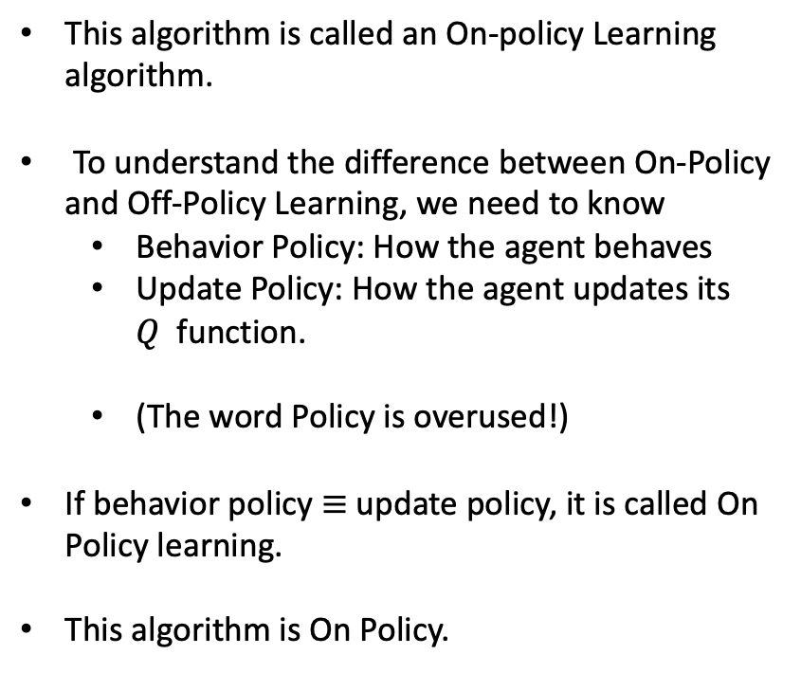
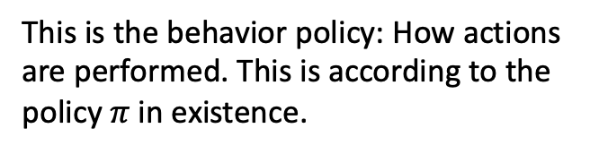
MC Control: On Policy Learning
This algorithm is called an On-policy Learning algorithm.
To understand the difference between On-Policy and Off-Policy Learning, we need to know
Behavior Policy: How the agent behaves
Update Policy: How the agent updates its $Q$function.
(The word Policy is overused!)
If behavior policy $≡$ update policy, it is called On Policy learning.
This algorithm is On Policy.
This is the behavior policy: How actions are performed. This is according to the policy $π$in existence.
This is the update policy. The policy being updated is the one being used to behave, not something else.

Slide 17
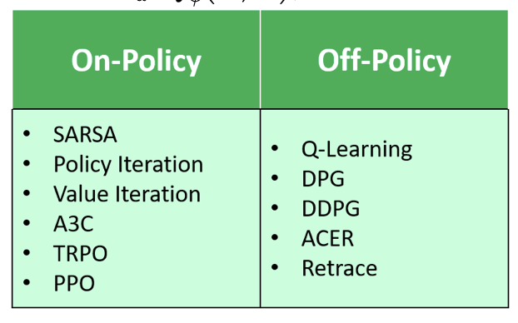
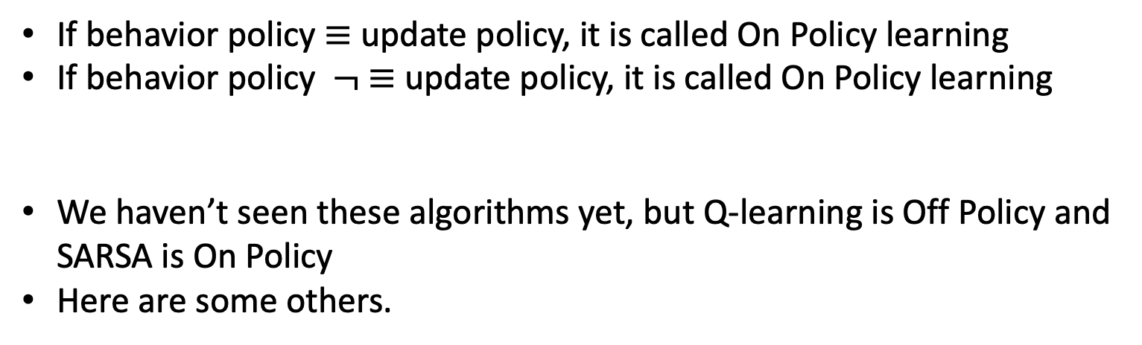
On Policy Vs. Off Policy Learning
If behavior policy $≡$ update policy, it is called On Policy learning
If behavior policy $¬ ≡$ update policy, it is called On Policy learning
We haven’t seen these algorithms yet, but Q-learning is Off Policy and SARSA is On Policy
Here are some others.
core-robotics.gatech.edu

Slide 18
On Policy vs. Off Policy Learning
On-policy algorithms attempt to improve upon the current behavior policy that is used to make decisions and therefore these algorithms learn the value of the policy carried out by the agent.
Off-policy algorithms learn the value of the optimal policy, , and can improve upon a policy that is different from the behavior policy
What are the implications of these differences? In the end does the type of learning matter? When should we use which algorithm?

Slide 19
On Policy vs. Off Policy Learning
An Off-Policy Method’s (e.g., Q-learning) update policy follows a greedy policy, assuming that the agent will act optimally in the future and therefore, the algorithm will learn the optimal policy as long as all states and actions are sufficiently experienced.
Sometimes, this means that the an agent (e.g., a cliff walking agent) will learn to take the optimal path from the start to goal even though this path may be dangerous if the agent’s actions are stochastic.
An On Policy Method (e.g. SARSA), on the other hand, assumes that the agent will follow the current policy in the future.
This means that when updating the Q-function, an agent (e.g., a cliff walking agent) will perform actions that are not so terrible (e.g., at times jump over the cliff if it travels too close to the edge because it’s an acceptable action).
Therefore, an Off Policy learner learns a policy which is usually safer.
On Policy learning only learns a near-optimal policy that depends on the behavior strategy. Only if the behavior strategy in Greedy, On Policy learning will learn optimal policy.

