Slide 1
Temporal Difference Learning

Slide 2
Temporal Difference Learning Vs. Monte Carlo Learning
Monte Carlo learning (estimates of values or learning a policy) requires that an episode is complete before learning takes place.
However, if the episode is long, it may make sense to try to learn before the episode complete.

Slide 3
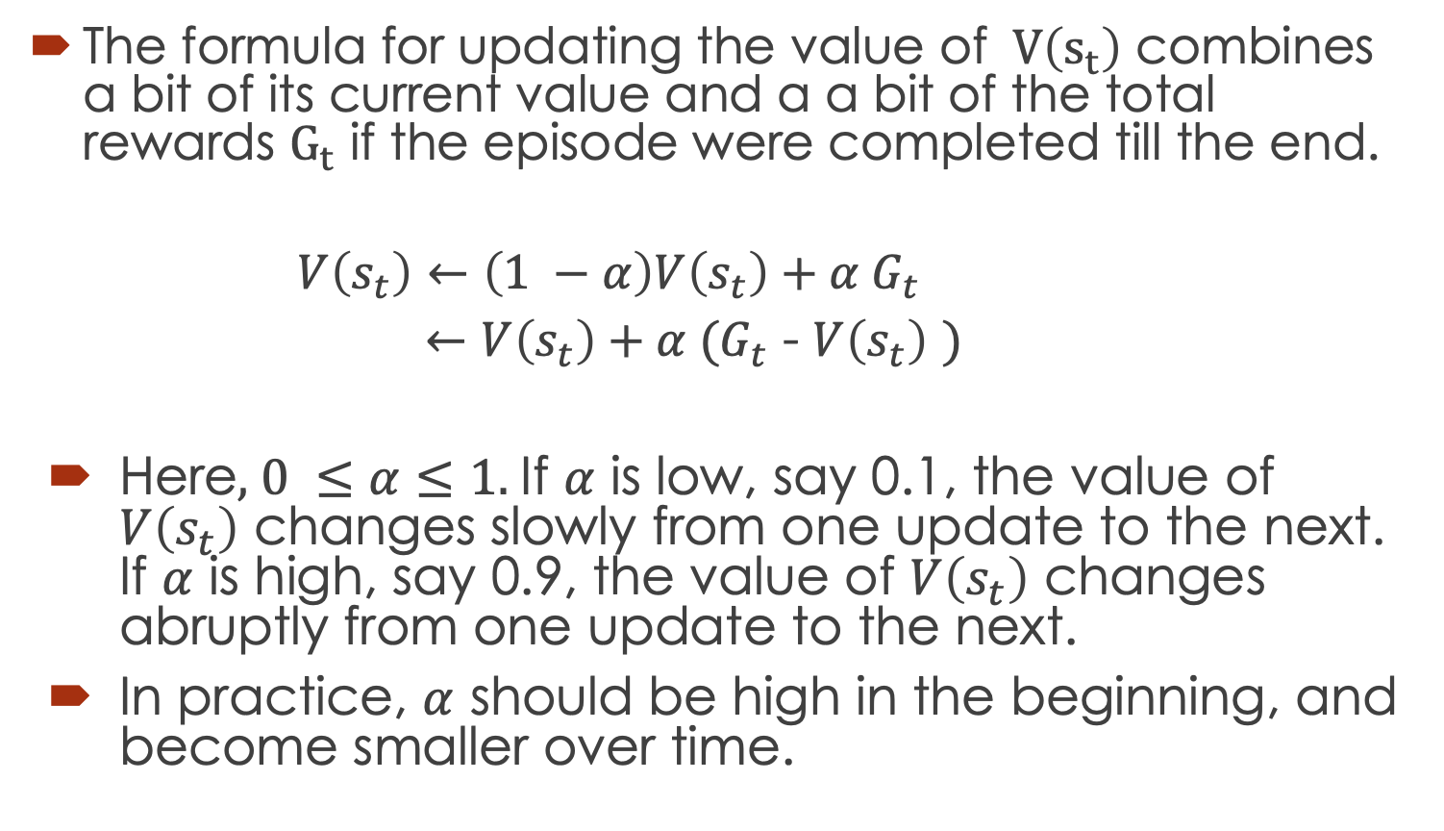

Formula for Updating $v_{π}\left(s\right)$
The formula for updating the value of $V\left(s_{t}\right)$ combines a bit of its current value and a a bit of the total rewards $G_{t}$ if the episode were completed till the end.
$$V\left(s_{t}\right)←\left(1 −α\right)V\left(s_{t}\right)+α G_{t}$$
$←V\left(s_{t}\right)+α {(G}_{t}$ - $V\left(s_{t}\right)$ $)$
Here, $0 ≤α≤1.$If $α$ is low, say 0.1, the value of $V\left(s_{t}\right)$ changes slowly from one update to the next. If $α$ is high, say 0.9, the value of $V\left(s_{t}\right)$ changes abruptly from one update to the next.
In practice, $α$ should be high in the beginning, and become smaller over time.

Slide 4
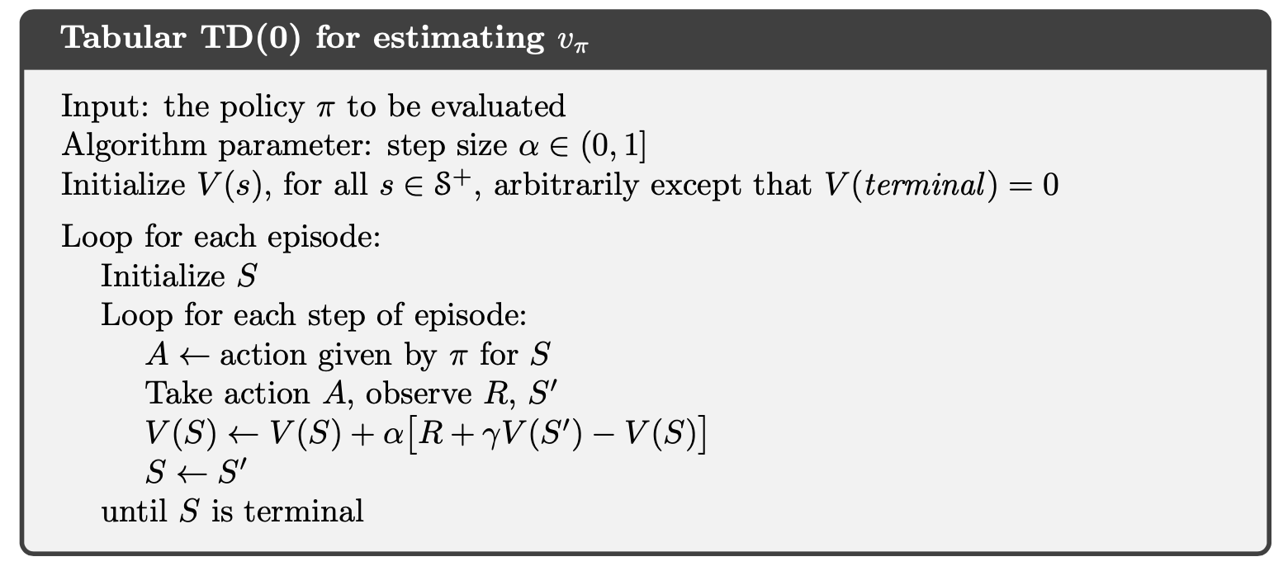

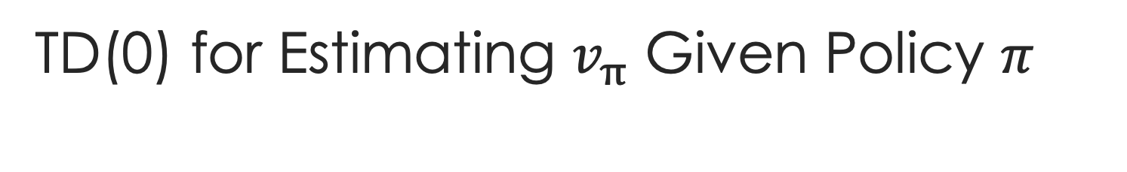

TD(0) for Estimating $v_{π}$ Given Policy $π$
This is often called the TD Error

Slide 5
Advantages of TD Learning
TD methods learn a guess from a guess: This is called Bootstrapping.
Are TD methods better than MC methods in terms of estimation or learning? The answer is not clear cut although often TD does a better job quicker.
TD as well as MC methods do not need a full model, i.e., all details of the probabilities of rewards and transitions.
TD methods are online in the sense that an episode does not have to end before learning.
TD Learning can be used for long episodes and/or continuous learning environments where the episodes do not end.
TD Learning often converges earlier.

Slide 6
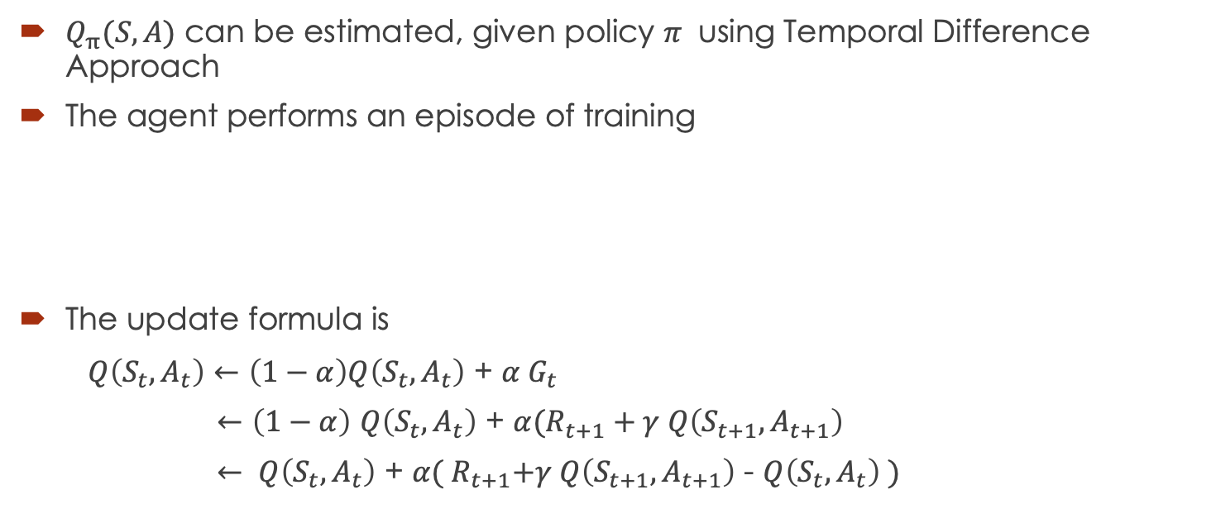
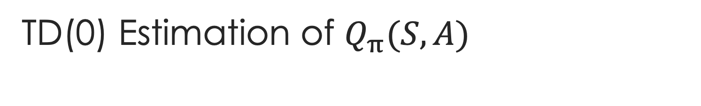
TD(0) Estimation of $Q_{π}(S,A)$
$Q_{π}(S,A)$ can be estimated, given policy $π$ using Temporal Difference Approach
The agent performs an episode of training
The update formula is
$Q\left(S_{t}, A_{t}\right)←\left(1−α\right)Q\left(S_{t},A_{t}\right)$ + ${α G}_{t}$
$←\left(1−α\right)$ $Q\left(S_{t},A_{t}\right)$ + $α(R_{t+1}+γ Q\left(S_{t+1},A_{t+1}\right)$
$← Q\left(S_{t},A_{t}\right)$ + $α({ R}_{t+1}+γ Q\left(S_{t+1},A_{t+1}\right)$ - $Q\left(S_{t},A_{t}\right) )$

Slide 7
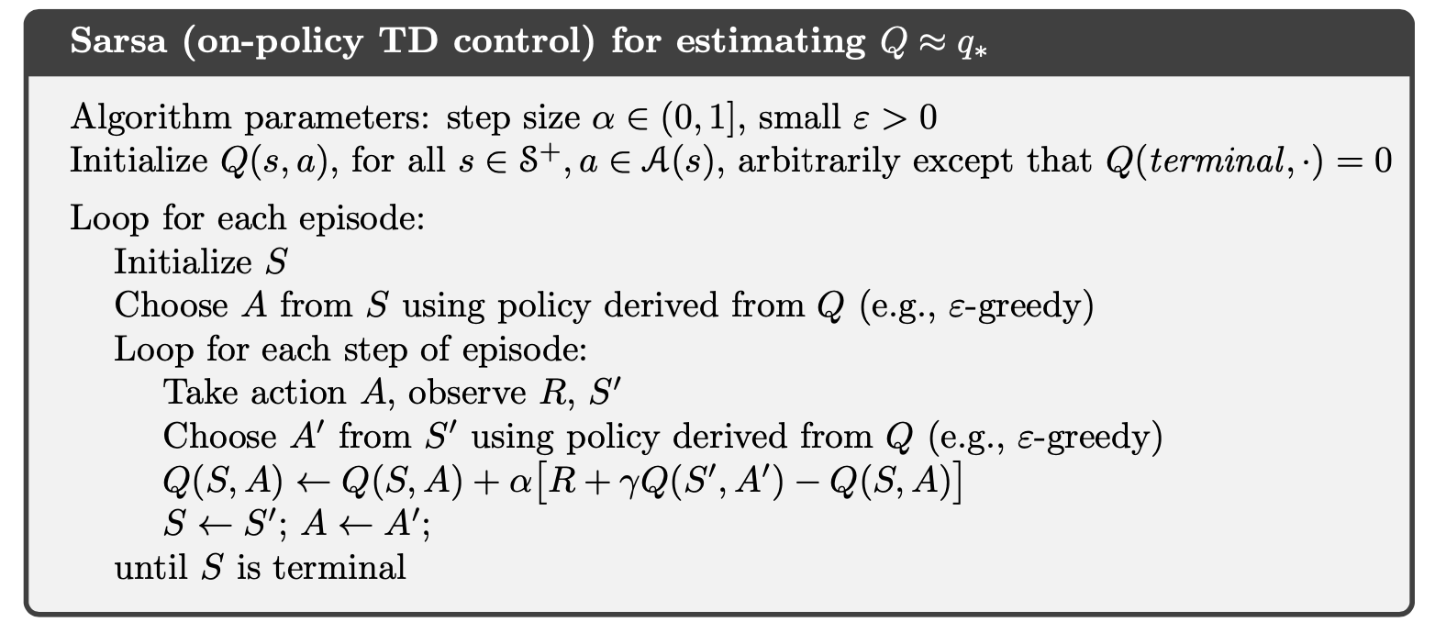
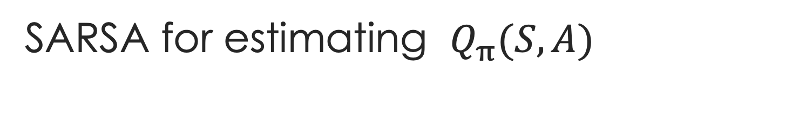
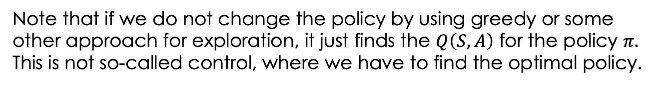
SARSA for estimating $Q_{π}(S,A)$
SARSA-like algorithms for estimating $Q_{π}(S,A)$
Note that if we do not change the policy by using greedy or some other approach for exploration, it just finds the $Q\left(S,A\right)$ for the policy $π.$
This is not so-called control, where we have to find the optimal policy.

Slide 8
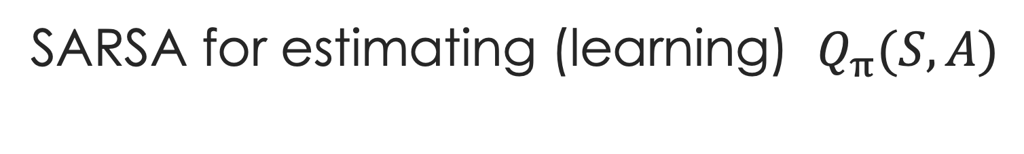
SARSA for estimating (learning) $Q_{π}(S,A)$
To make it an algorithm for control, we introduce exploration using greedy approach to choosing an action. In other words, the algorithm does not always choose the optimal action in a state; it chooses non-optimal actions with non-0 probability so that it can explore.

Slide 9
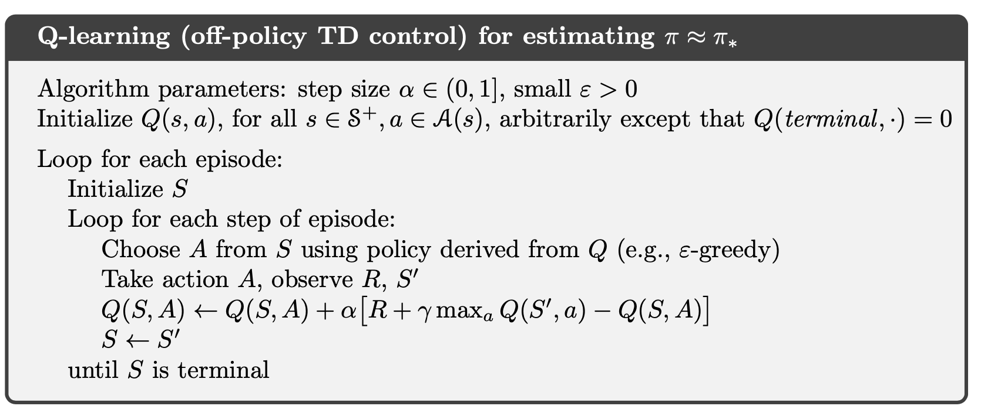

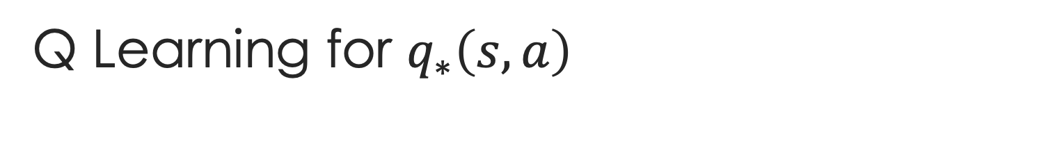

Q Learning for ${q_{∗}\left(s,a\right)}_{}$
Behavior policy is a minor variation of the policy derived from Q
The update policy is considered very different from the policy given at any time by Q, since the best action at any state is chosen.
Q-learning is an Off-Policy learning since the learned/update policy is different from the behavior policy. In Q-learning, a policy derived from the current values of Q(s,a) is considered the current policy.

Slide 10
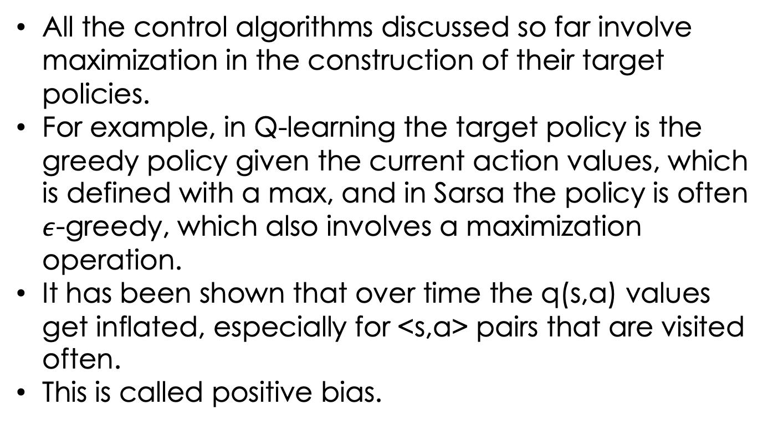
Double Q Learning
All the control algorithms discussed so far involve maximization in the construction of their target policies.
For example, in Q-learning the target policy is the greedy policy given the current action values, which is defined with a max, and in Sarsa the policy is often $ε$-greedy, which also involves a maximization operation.
It has been shown that over time the q(s,a) values get inflated, especially for <s,a> pairs that are visited often.
This is called positive bias.

Slide 11
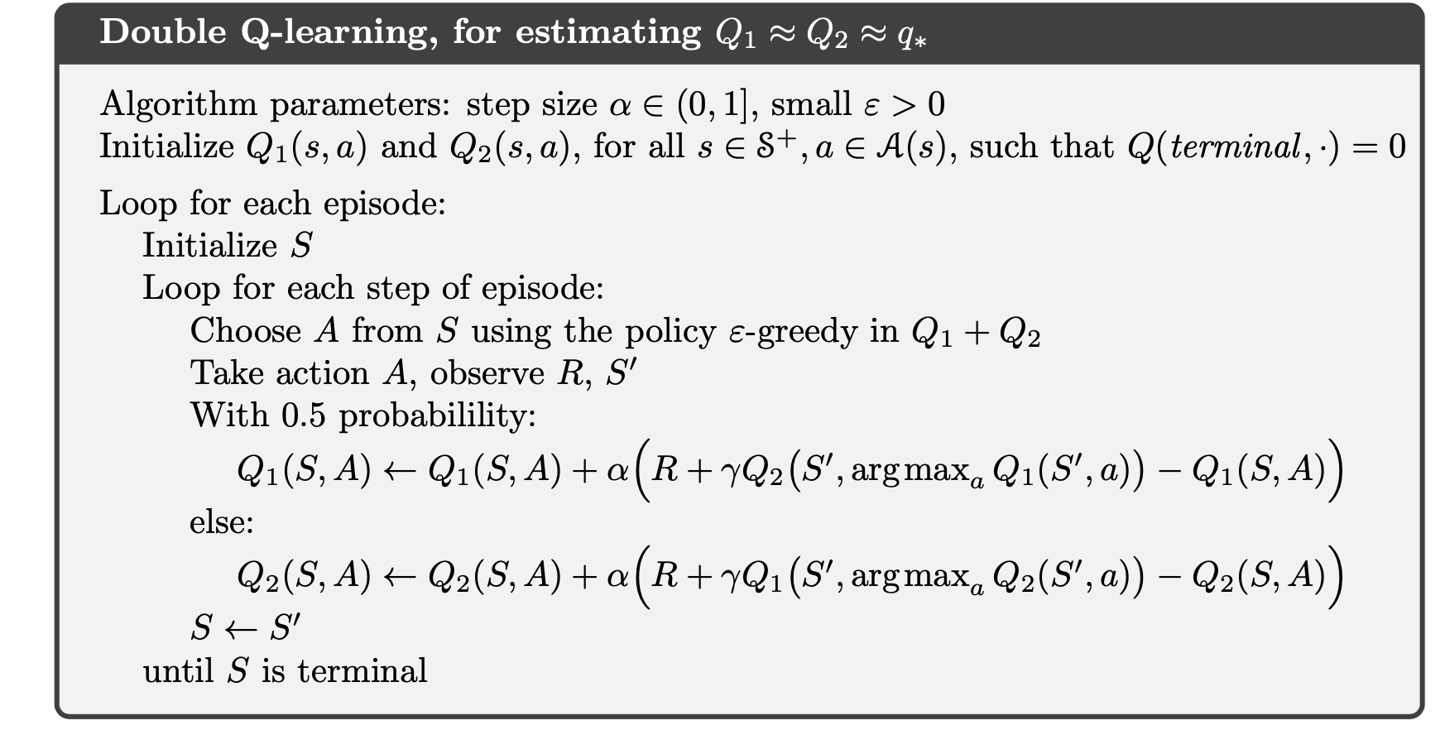
Double Q Learning
It has been shown in statistics in general that when estimating values, if a single estimator/function is used to estimate the maximum of a set of random values, it leads to positive bias.
Using more than one estimator reduces this bias.
The actual value learned for Q(S,A) is the average of the two.

