Slide 1
N-step RL

Slide 2
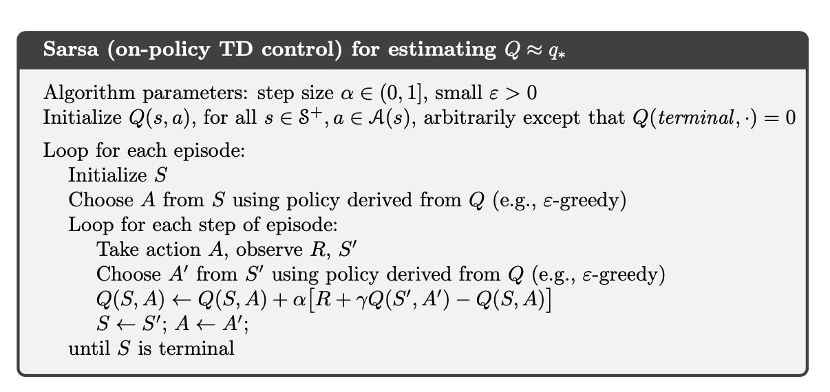

SARSA
Think of this is Return from one State-Action step

Slide 3
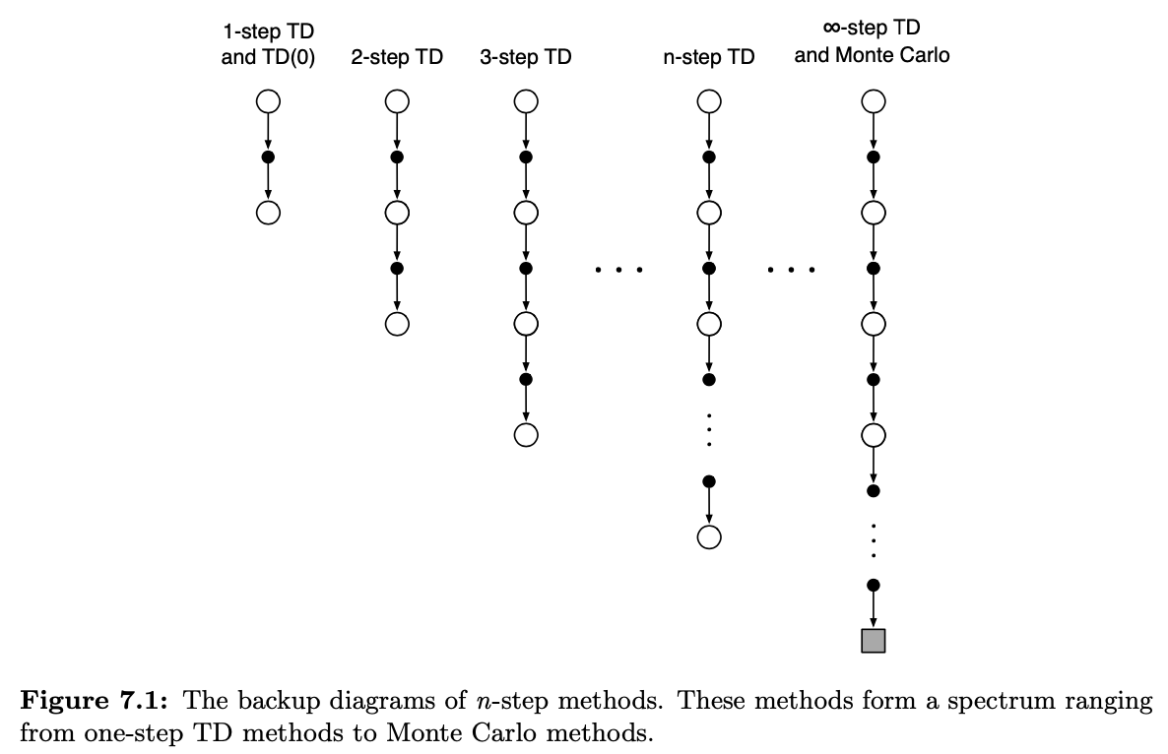
N-Step Prediction

Slide 4


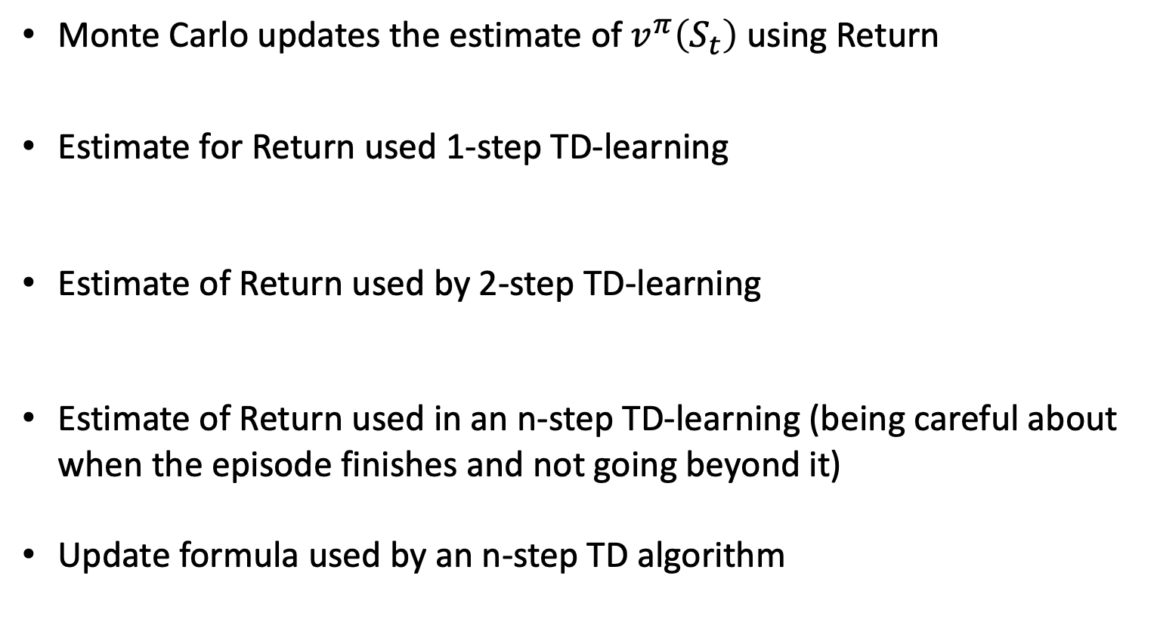
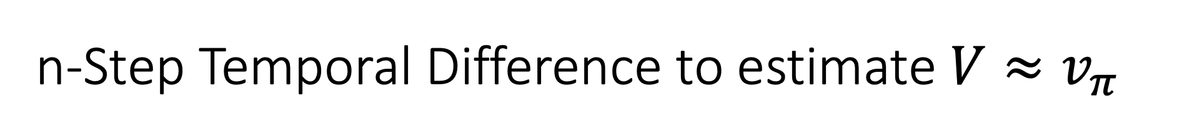
n-Step Temporal Difference to estimate $V≈v_{π}$
Monte Carlo updates the estimate of $v^{π}\left(S_{t}\right)$ using Return
Estimate for Return used 1-step TD-learning
Estimate of Return used by 2-step TD-learning
Estimate of Return used in an n-step TD-learning (being careful about when the episode finishes and not going beyond it)
Update formula used by an n-step TD algorithm

Slide 5
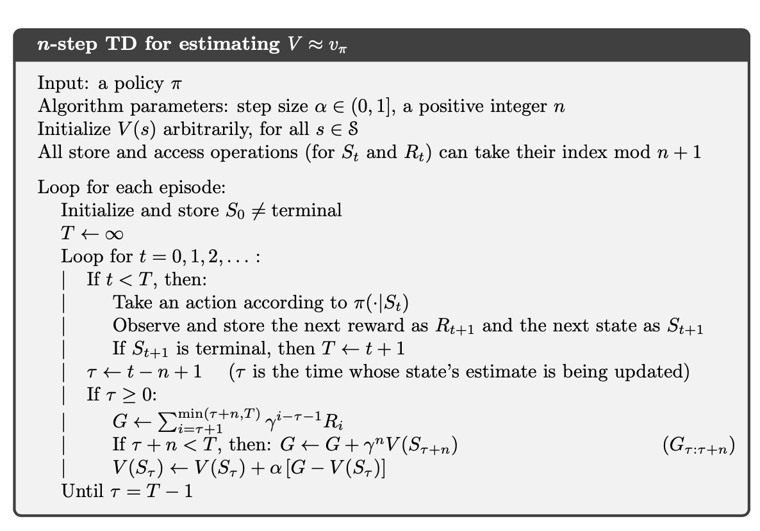
n-Step Temporal Difference to estimate $V≈v_{π}$

Slide 6
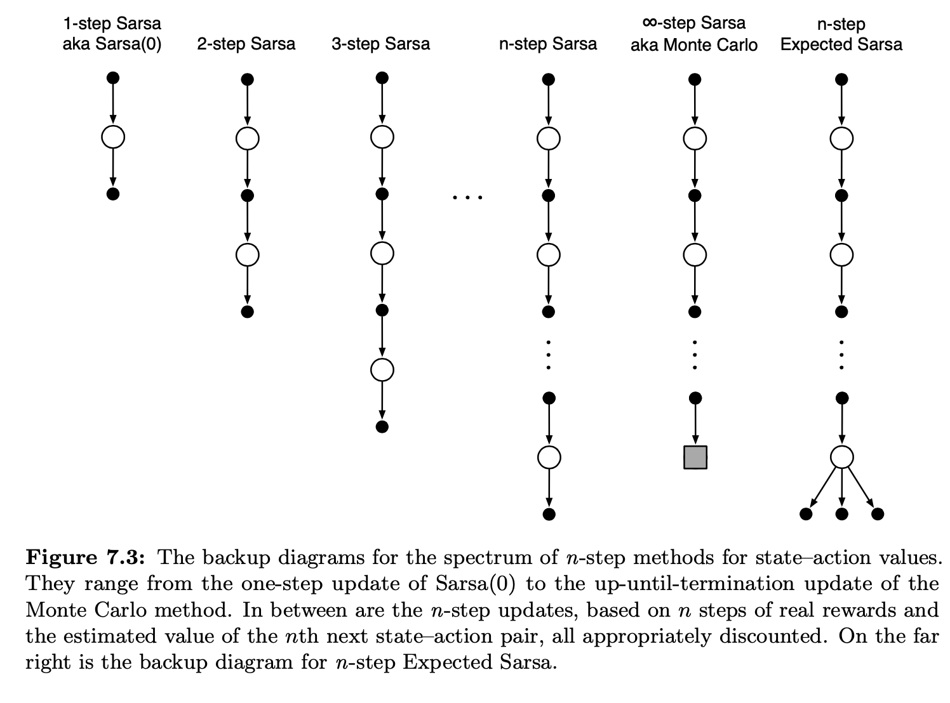
n-Step SARSA

Slide 7

n-Step SARSA
n-step returns (update targets) can be defined in terms of estimated action values:
with
The update formula used is:

Slide 8
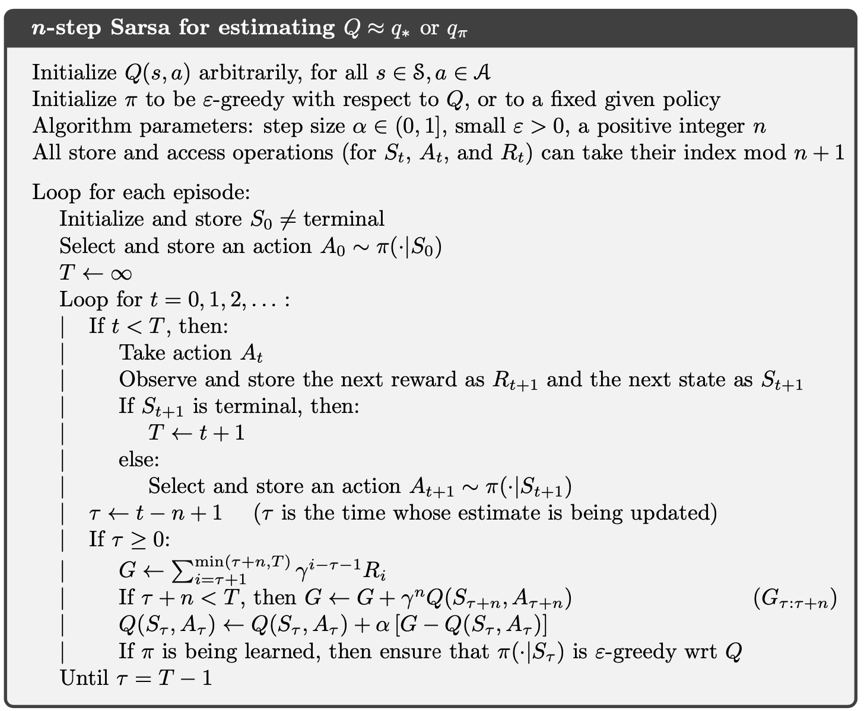
n-Step SARSA

Slide 9
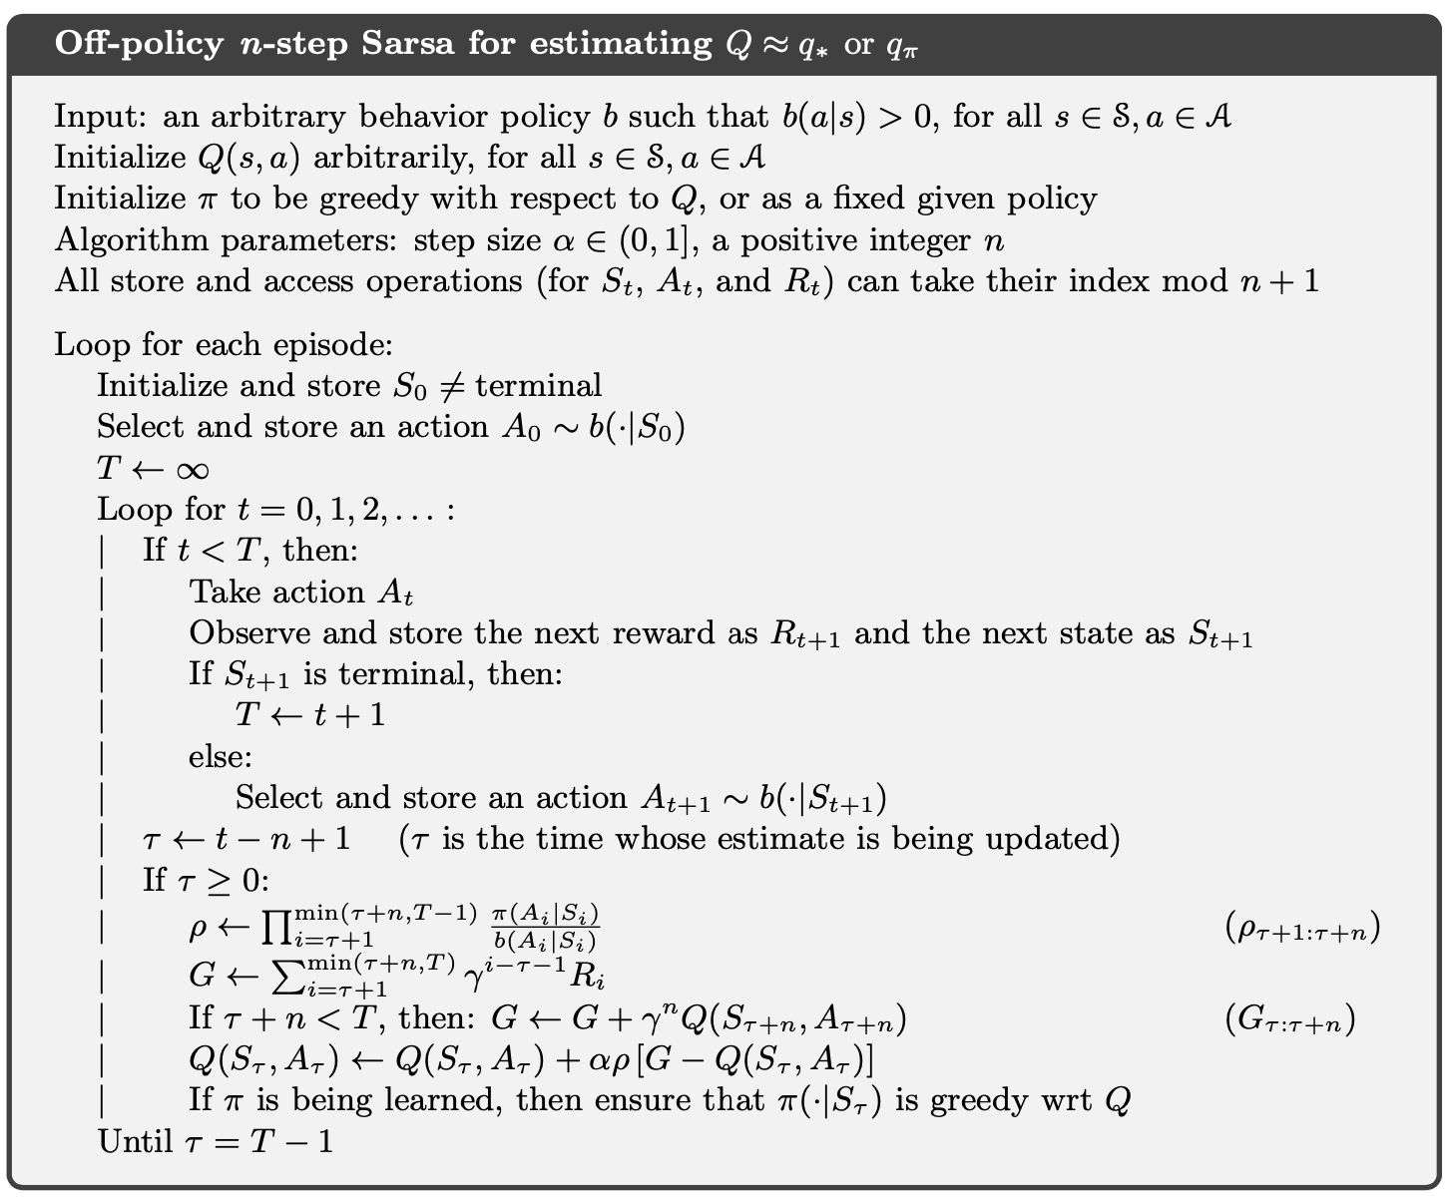
n-Step Off-Policy SARSA

Slide 10
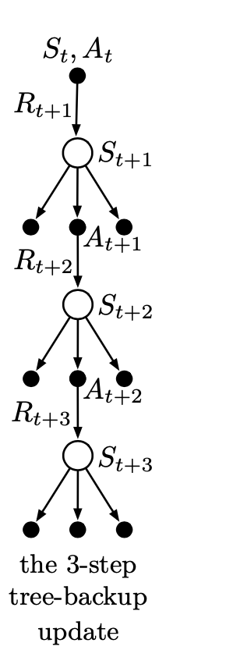
The n-step Tree Backup Algorithm
Down the central spine and labeled in the diagram are three sample states and rewards, and two sample actions.
Hanging to the sides of each state are the actions that were not selected.
Because we have no sample data for the unselected actions, we bootstrap and use the estimates of their values in forming the target for the update.
In the tree-backup update, the target includes all these things plus the estimated values of the dangling action nodes hanging on the sides, at all levels.
This is why it is called a tree- backup update; it is an update from the entire tree of estimated action values.

Slide 11
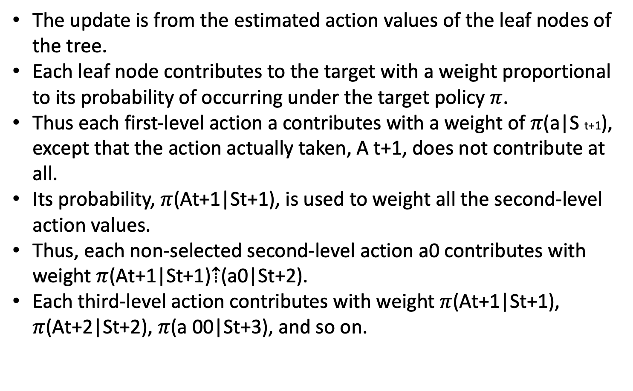
The n-step Tree Backup Algorithm
The update is from the estimated action values of the leaf nodes of the tree.
Each leaf node contributes to the target with a weight proportional to its probability of occurring under the target policy $π$.
Thus each first-level action a contributes with a weight of $π$(a|S t+1), except that the action actually taken, A t+1, does not contribute at all.
Its probability, $π$(At+1|St+1), is used to weight all the second-level action values.
Thus, each non-selected second-level action a0 contributes with weight $π$(At+1|St+1)⇡(a0|St+2).
Each third-level action contributes with weight $π$(At+1|St+1), $π$(At+2|St+2), $π$(a 00|St+3), and so on.

Slide 12
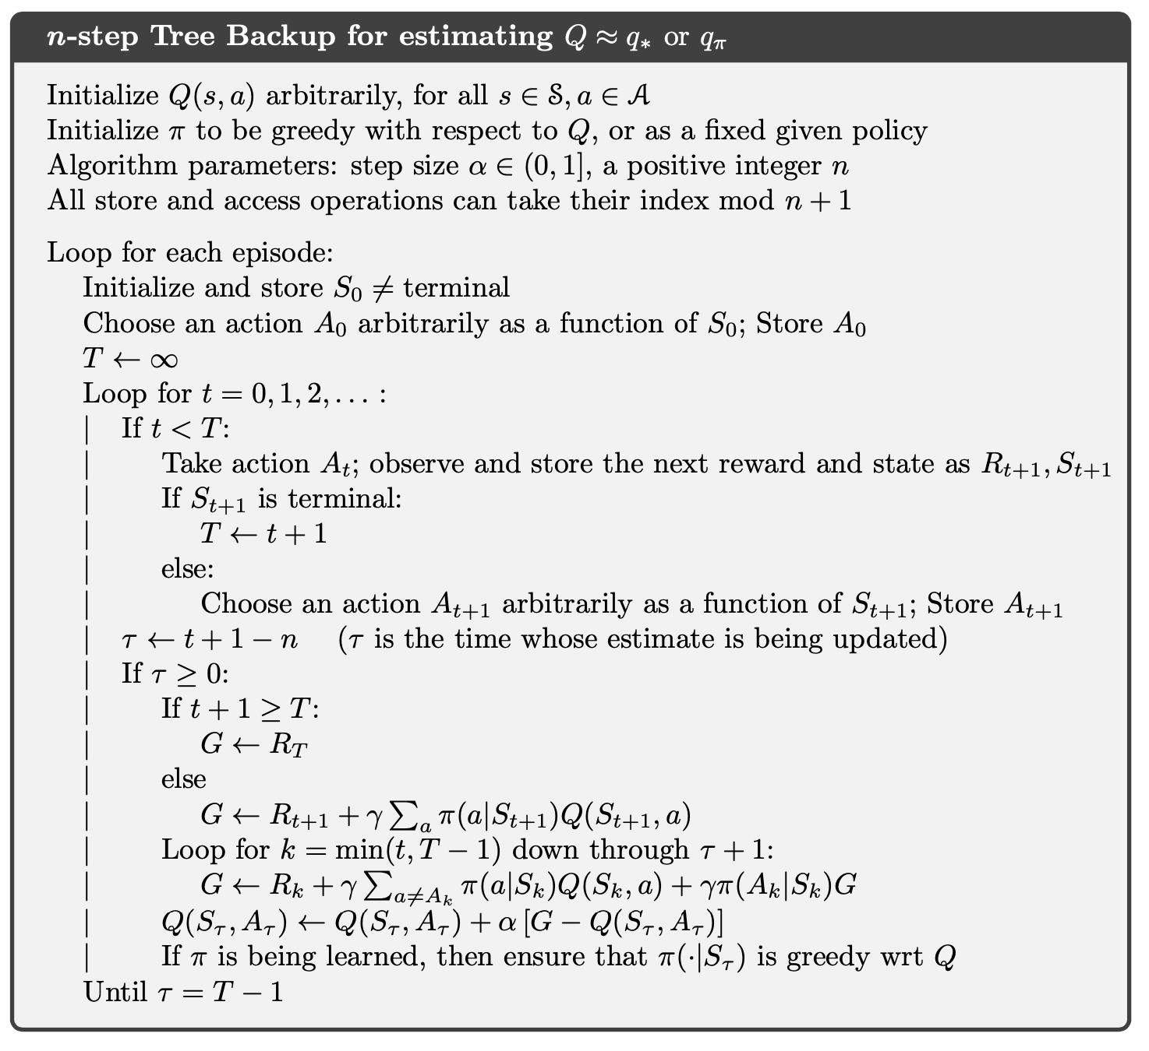
The n-step Tree Backup Algorithm

Slide 13
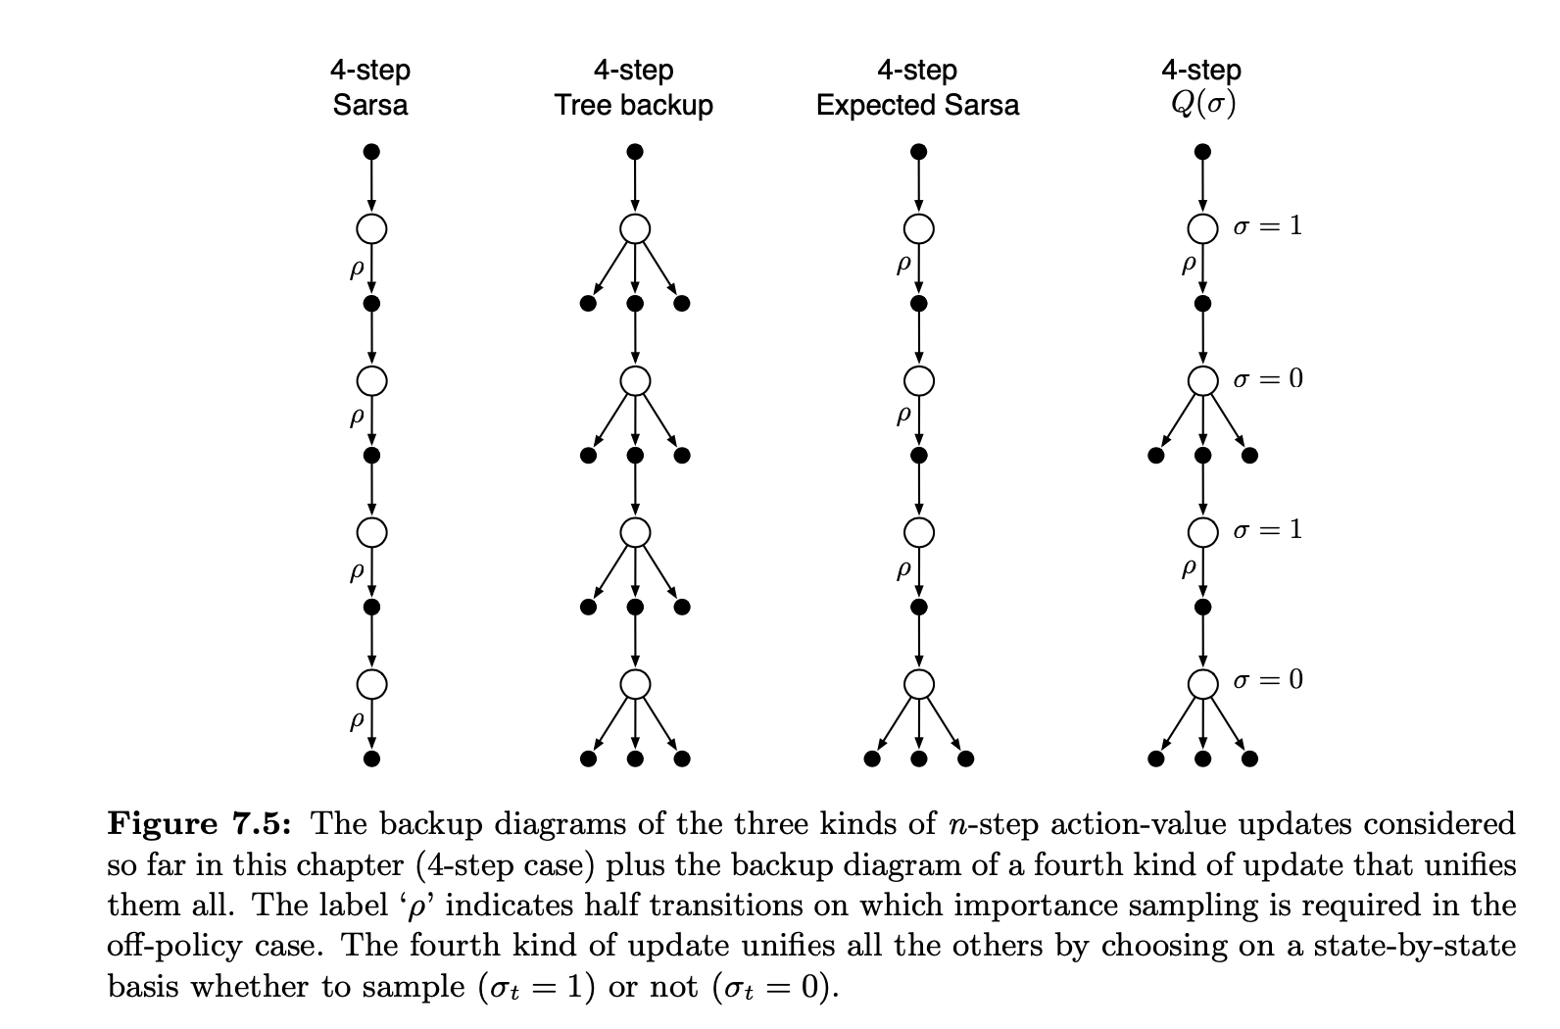

$Q\left(σ\right)$Algorithm

Slide 14
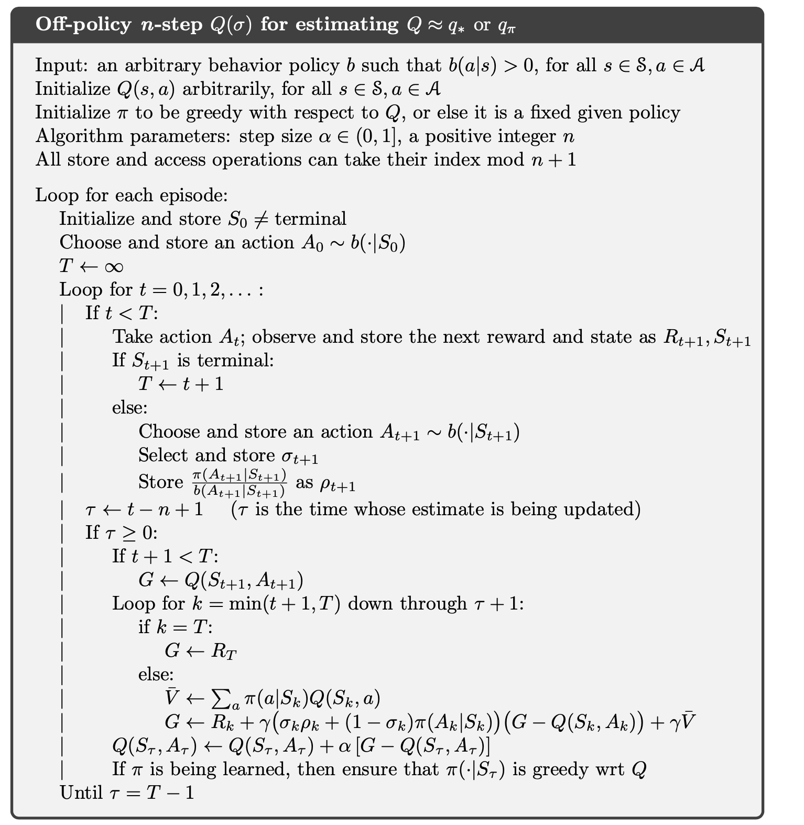
$Q\left(σ\right)$Algorithm

