Slide 1
Atari Games
Played by Deep Q Learning
Mnih et al., 2013

Slide 2
Atari Pong
Pong is a 1972 sports video game developed and published by Atari, Inc., for arcades.
Pong was the first commercially successful video game, helping to establish the video game industry.
Pong is a two-dimensional sports game that simulates table tennis.
The player controls a paddle by moving it vertically across the left or right side of the screen.
They can compete against another player controlling a second paddle on the opposing side. Players use the paddles to hit a ball back and forth.
The goal is for each player to reach eleven points before the opponent; points are earned when one fails to return the ball to the other.
https://www.youtube.com/watch?v=fiShX2pTz9A

Slide 3
Atari Breakout
Breakout is a 1976 action video game developed and published by Atari, Inc. for arcades.
Breakout begins with eight rows of bricks, with two rows each of a different color.
Using a single ball, the player must knock down as many bricks as possible by using the walls and the paddle below to hit the ball against the bricks and eliminate them.
https://www.youtube.com/watch?v=sxzGhG_38pc

Slide 4
Atari Space Invaders
Space Invaders is a 1980 fixed shooter video game developed and published by Atari, Inc. for the Atari 2600 as a port of Taito's 1978 arcade game of the same name.
Space Invaders has the player at war with enemies from outer space.
The player uses the joystick to move left and right and presses the red button to fire a laser cannon.
The goal is to earn as many points as possible by destroying the enemies with a laser cannon and to eliminate them before they reach the bottom of the screen.
https://www.youtube.com/watch?v=opru6qPsPa4

Slide 5
Atari Seaquest
Seaquest is an Atari 2600 video game published by Activision in 1983.
The game is an underwater shooter in which the player controls a submarine on a mission to rescue divers.
The player uses a submarine to shoot at enemies and rescue divers. Hazards include sharks which attack divers and the player and enemy submarines, which can shoot torpedoes at the player's submarine.
The player must ward off the enemies by firing an unlimited supply of torpedoes while trying to rescue divers swimming through the water.
https://www.youtube.com/watch?v=Ir1t57ItCpw&t=236s

Slide 6
Atari Beam Rider
Beamrider is a 1983 fixed shooter video game published by Intellivision. The game was ported to the Atari 2600 (with a slightly reduced feature set).
Beamrider takes place above Earth's atmosphere, where a large alien shield called the Restrictor Shield surrounds the Earth.
The player's objective is to clear the Shield's 99 sectors of alien craft while piloting the Beamrider ship.
The Beamrider is equipped with a short-range laser lariat and a limited supply of torpedoes. The player is given three at the start of each sector.
https://www.youtube.com/watch?v=dgTxca0pdac

Slide 7
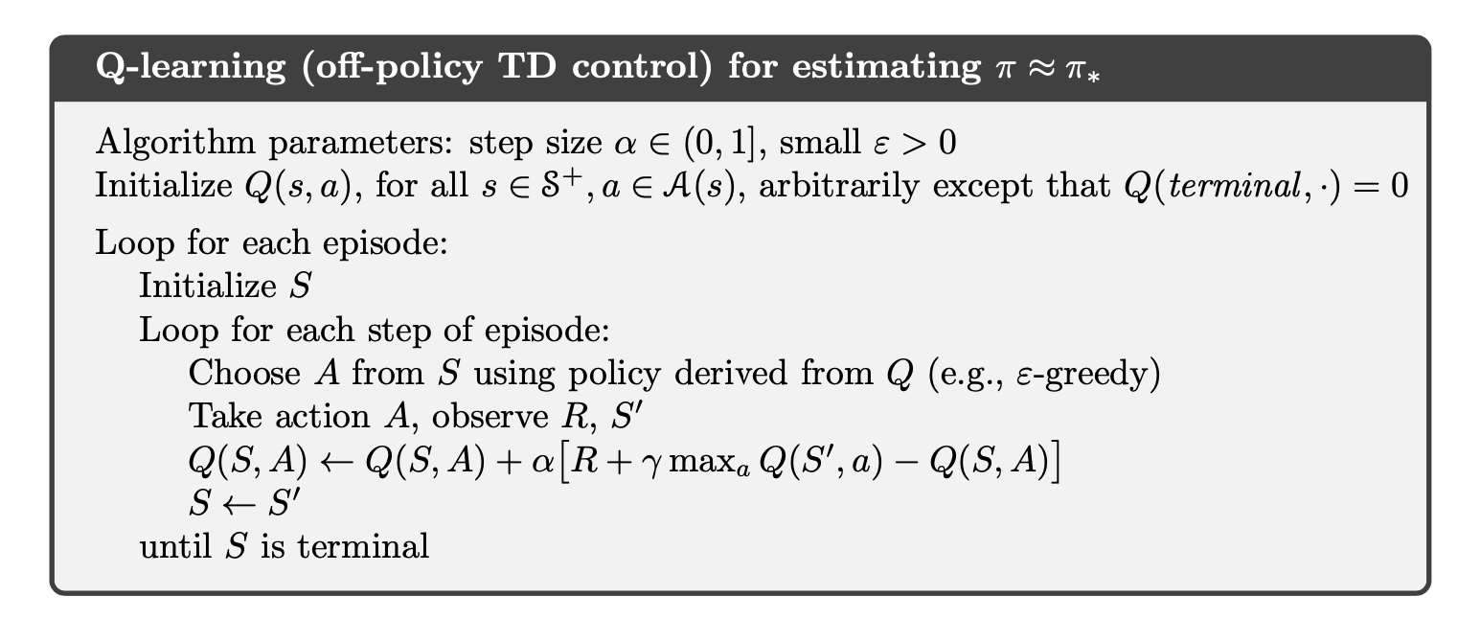
Tabular Q-Learning
The Q table is used in two places:
To choose an action:
To update Q table ie., learn new values:

Slide 8
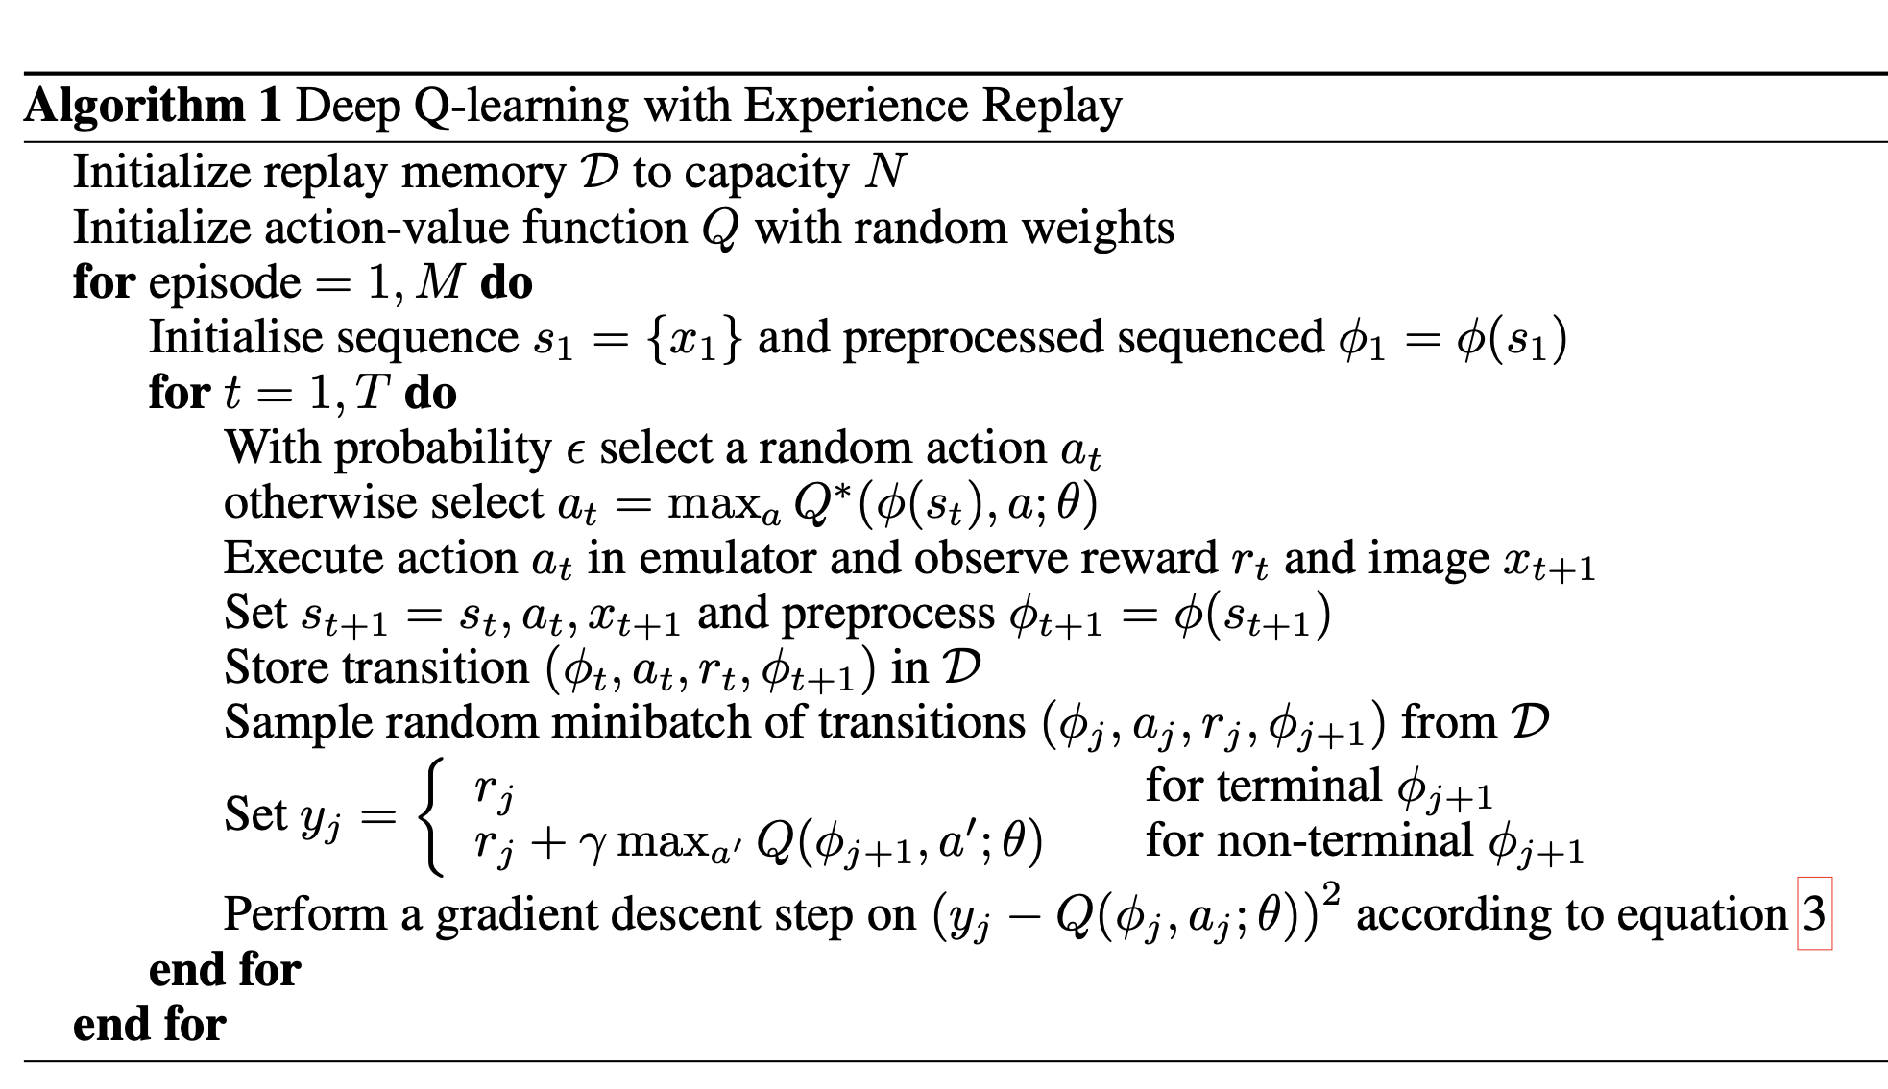
Deep Q-learning
The Q-table is replaced by a neural network in the same two places

