Slide 1
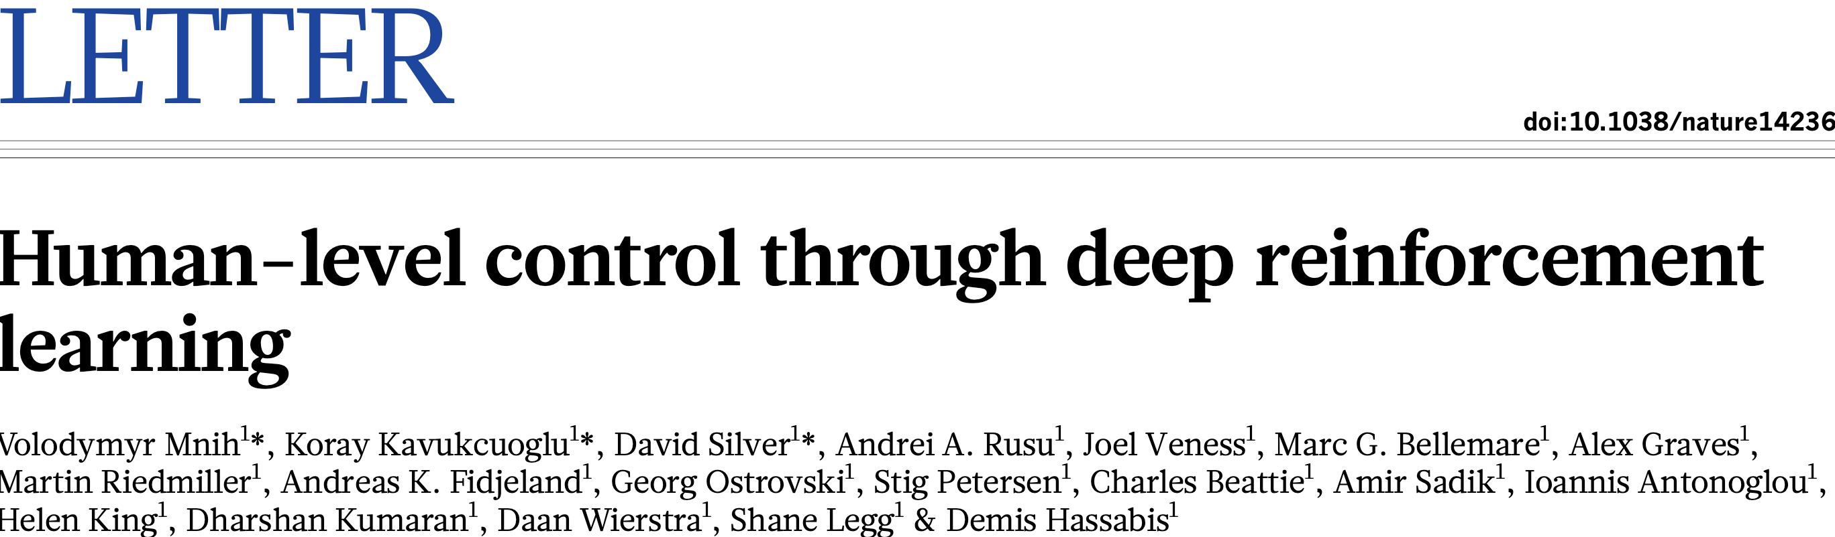
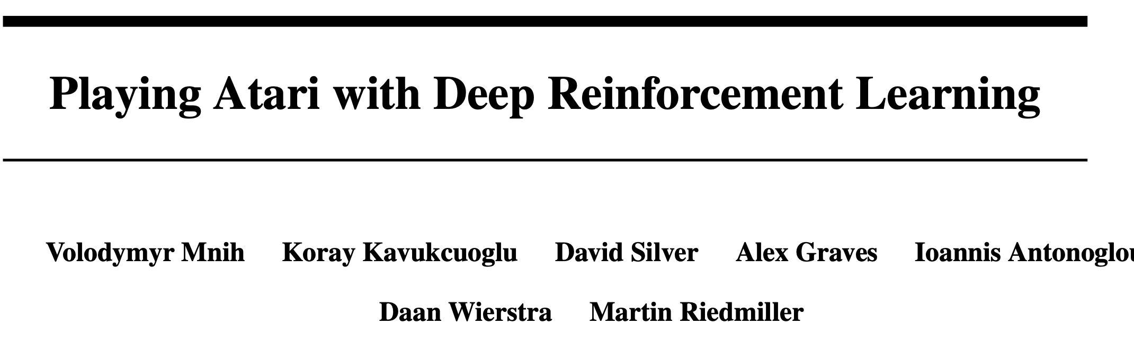
Deep Q-Learning and Atari Games
Mnih et al., 2013
Cited 40,745 times, 3/19/2026
Cited 20,260 times, 3/19/2026

Slide 2
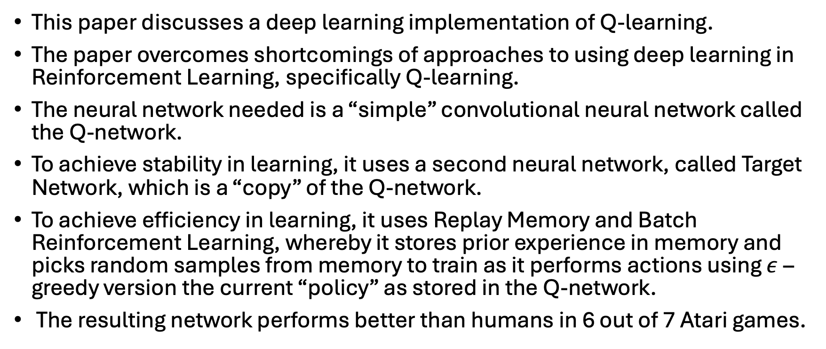
Deep Q-Learning
This paper discusses a deep learning implementation of Q-learning.
The paper overcomes shortcomings of approaches to using deep learning in Reinforcement Learning, specifically Q-learning.
The neural network needed is a “simple” convolutional neural network called the Q-network.
To achieve stability in learning, it uses a second neural network, called Target Network, which is a “copy” of the Q-network.
To achieve efficiency in learning, it uses Replay Memory and Batch Reinforcement Learning, whereby it stores prior experience in memory and picks random samples from memory to train as it performs actions using $ε$–greedy version the current “policy” as stored in the Q-network.
The resulting network performs better than humans in 6 out of 7 Atari games.

Slide 3
Atari Pong
Pong is a 1972 sports video game developed and published by Atari, Inc., for arcades.
Pong was the first commercially successful video game, helping to establish the video game industry.
Pong is a two-dimensional sports game that simulates table tennis.
The player controls a paddle by moving it vertically across the left or right side of the screen.
They can compete against another player controlling a second paddle on the opposing side. Players use the paddles to hit a ball back and forth.
The goal is for each player to reach eleven points before the opponent; points are earned when one fails to return the ball to the other.
https://www.youtube.com/watch?v=fiShX2pTz9A

Slide 4
Atari Breakout
Breakout is a 1976 action video game developed and published by Atari, Inc. for arcades.
Breakout begins with eight rows of bricks, with two rows each of a different color.
Using a single ball, the player must knock down as many bricks as possible by using the walls and the paddle below to hit the ball against the bricks and eliminate them.
https://www.youtube.com/watch?v=sxzGhG_38pc

Slide 5
Atari Space Invaders
Space Invaders is a 1980 fixed shooter video game developed and published by Atari, Inc. for the Atari 2600 as a port of Taito's 1978 arcade game of the same name.
Space Invaders has the player at war with enemies from outer space.
The player uses the joystick to move left and right and presses the red button to fire a laser cannon.
The goal is to earn as many points as possible by destroying the enemies with a laser cannon and to eliminate them before they reach the bottom of the screen.
https://www.youtube.com/watch?v=opru6qPsPa4

Slide 6
Atari Seaquest
Seaquest is an Atari 2600 video game published by Activision in 1983.
The game is an underwater shooter in which the player controls a submarine on a mission to rescue divers.
The player uses a submarine to shoot at enemies and rescue divers. Hazards include sharks which attack divers and the player and enemy submarines, which can shoot torpedoes at the player's submarine.
The player must ward off the enemies by firing an unlimited supply of torpedoes while trying to rescue divers swimming through the water.
https://www.youtube.com/watch?v=Ir1t57ItCpw&t=236s

Slide 7
Atari Beam Rider
Beamrider is a 1983 fixed shooter video game published by Intellivision. The game was ported to the Atari 2600 (with a slightly reduced feature set).
Beamrider takes place above Earth's atmosphere, where a large alien shield called the Restrictor Shield surrounds the Earth.
The player's objective is to clear the Shield's 99 sectors of alien craft while piloting the Beamrider ship.
The Beamrider is equipped with a short-range laser lariat and a limited supply of torpedoes. The player is given three at the start of each sector.
https://www.youtube.com/watch?v=dgTxca0pdac

Slide 8
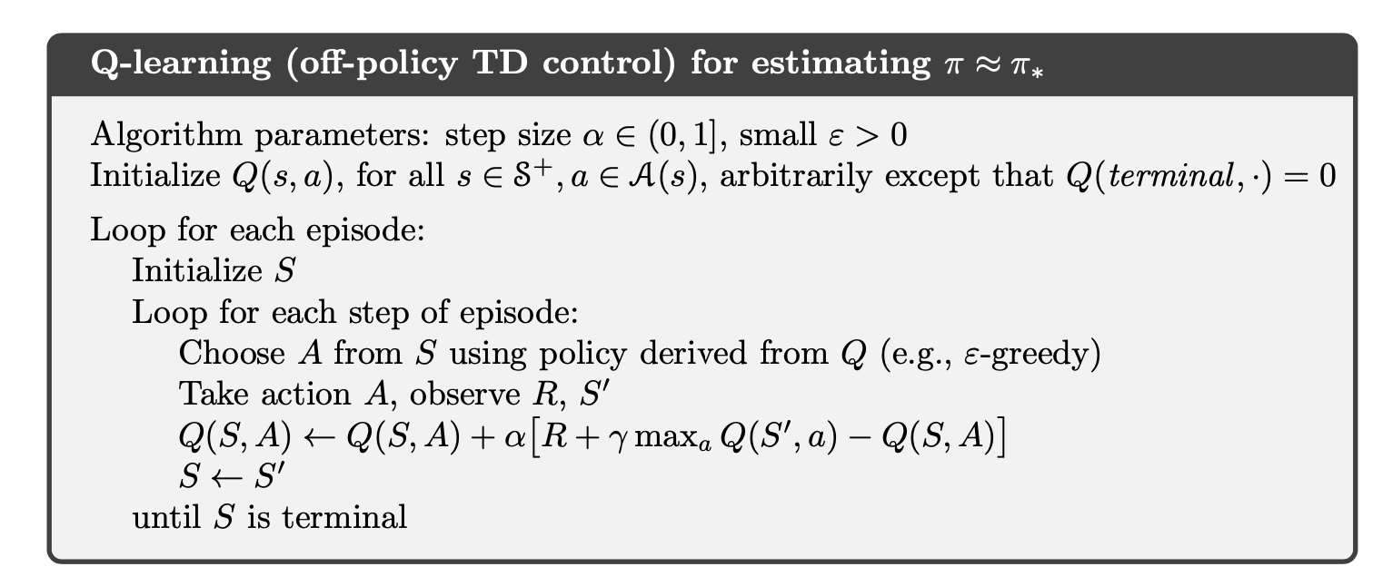
Tabular Q-Learning
The Q table is used in two places:
To choose an action:
To update Q table ie., learn new values:

Slide 9
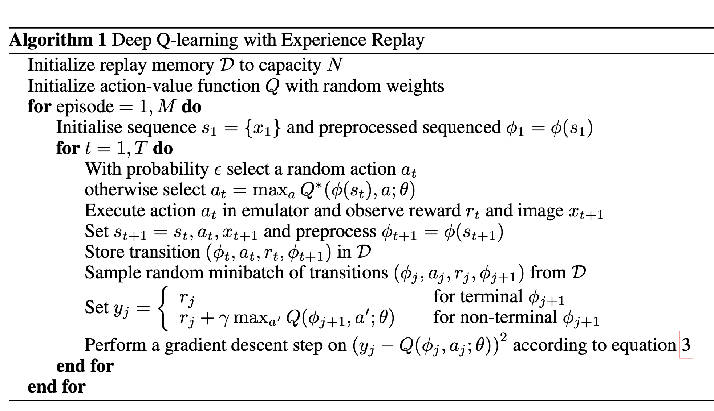
Deep Q-learning
The Q-table is replaced by a neural network in the same two places582q w34567p;’;p[;’.

Slide 10
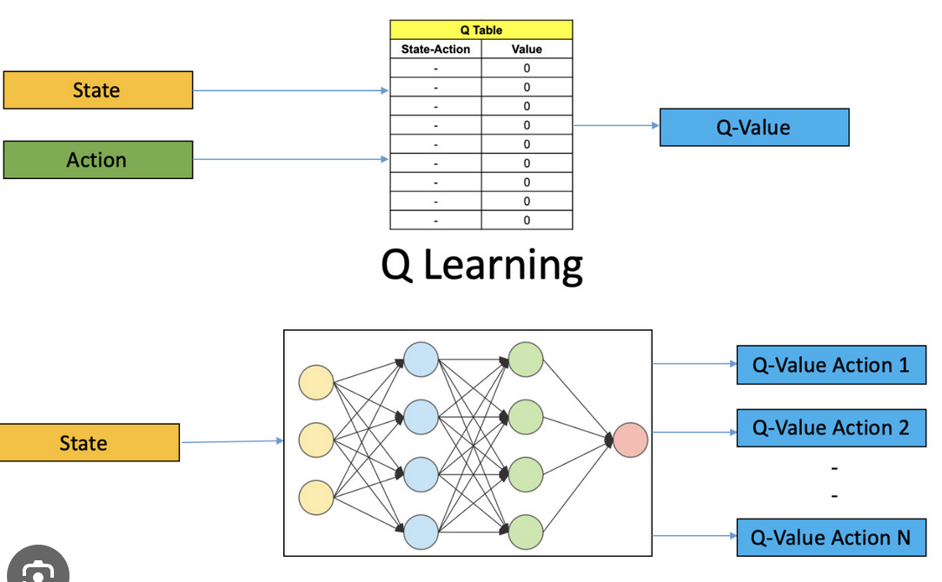
Tabular Q-learning Vs. DQN
https://thesequence.substack.com/p/edge95

Slide 11
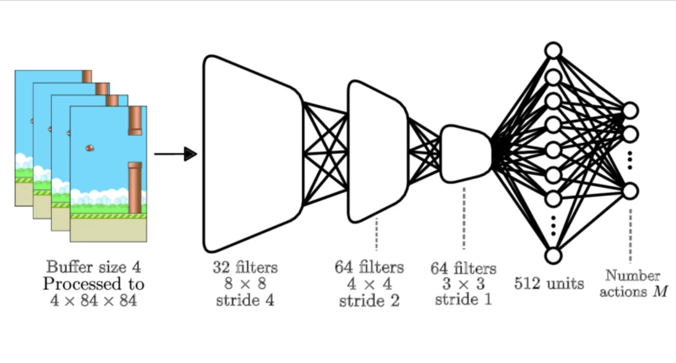
DQN Architecture
https://www.researchgate.net/figure/A-standard-DQN-architecture-with-convolutional-layers-allows-comparisons-between-buffer_fig4_321962850

Slide 12
Challenges that DQN addressed and “solved”
Handle Complex State Descriptions: The state descriptions are not simple integer indices any longer. The states are complex descriptions of the input-–may be unfiltered input like a game’s frames, or embeddings obtained from the inputs. Generally, the state descriptions are high dimensional.
Generalize to Large Numbers of States: The Q-table in tabular formulation can store only a limited number of states, indexed by integer indices. However, in a complex problem where the input is described by an image or an embedding, the number of states is potentially “infinite.” The deep learning approach generalizes the input to previously unseen states on which the Q-learning approach has not been trained; this is because neural networks can provide an output based on a “similar” state that may have been seen in actual learning. Tabular Q-learning requires “infinitely often” visits of states and state-action pairs.
Perform End-to-end Learning: Neural networks are end-to-end learners. DQN was able to solve the problem of true hand-eye coordination in an end-to-end fashion from pixel to joystick. This had not been achieved by any computer program before.

Slide 13
Challenges that DQN addressed and “solved”
Correlations among Consecutive States in an Episode: In a complex state space, the states (e.g., frames of a video game) change in a simple way from one to the next. Thus, learning from consecutive states is inefficient.
Solution to Slow Learning: Learn from random training experiences , with smaller samples or batches of samples. Save agent experiences from episodes in a limited sized memory database. Randomly sample mini-experiences and train the neural network on these experiences. This breaks the problem of correlations.

Slide 14
Challenges that DQN addressed and “solved”
Address Instability in Deep RL: When DQN was published, there were theoretical papers that showed the Deep RL is unstable, and the instability problem cannot be overcome. The instability comes because the Q-network’s values (target values) keep on changing when loss is computed.
Reason for Instability: Distinction from Supervised Learning: This is unlike supervised learning, where the target value is fixed. For example, the class an example belongs to (in classification problems), and the value that should a regression problem should try to achieve, remain constant.
Solution to Address Instability: Use replay buffer and perform batch reinforcement learning.

Slide 15
Replay Memory
Replay Memory saves prior SARS tuples in a small-sized memory and learns from it, instead of learning from actions based on the agent’s current policy.
Picking random SARS samples from Replay Buffer seems to break the correlation problem adequately.
The use of Replay Memory decouples learning from immediate prior acting, and jumbles learning and acting.
In addition, each SARS sample can be used multiple times during training, making learning possibly more resource/episode efficient.

Slide 16
Replay Memory
Replay Memory size used in DQN is limited, and prior SARS samples are overwritten by newer samples.
DQN picks samples from Replay Memory uniformly. Some samples may be more important from a learning perspective than others; DQN does not know how to handle this situation.
Other papers have discussed picking samples by some notion of “importance.”

Slide 17
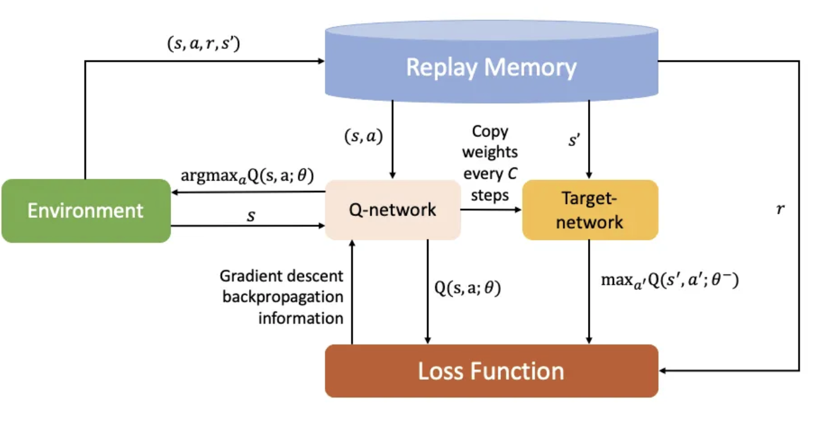
Use of Target Network: Another solution to Instability of Learning
Theoretically, a single Q-network is enough for DQN.
However, in practice it it was found that the use of one network to act and to learn caused instability in learning because the target value to learn for loss computation was changing too quickly.
An innovation in Q-learning is to use to two networks: Q-network and Target network.
The Target network is the same as the Q-network, but the Q-network’s parameter values are copied over to the Target network after a few cycles. Thus, the Target network’s values were more stable/less changing that the values in the Q-network.
https://medium.com/@mcomeshernandez/reinforcement-learning-diving-into-deep-q-networks-dqn-92f237f448ec

Slide 18
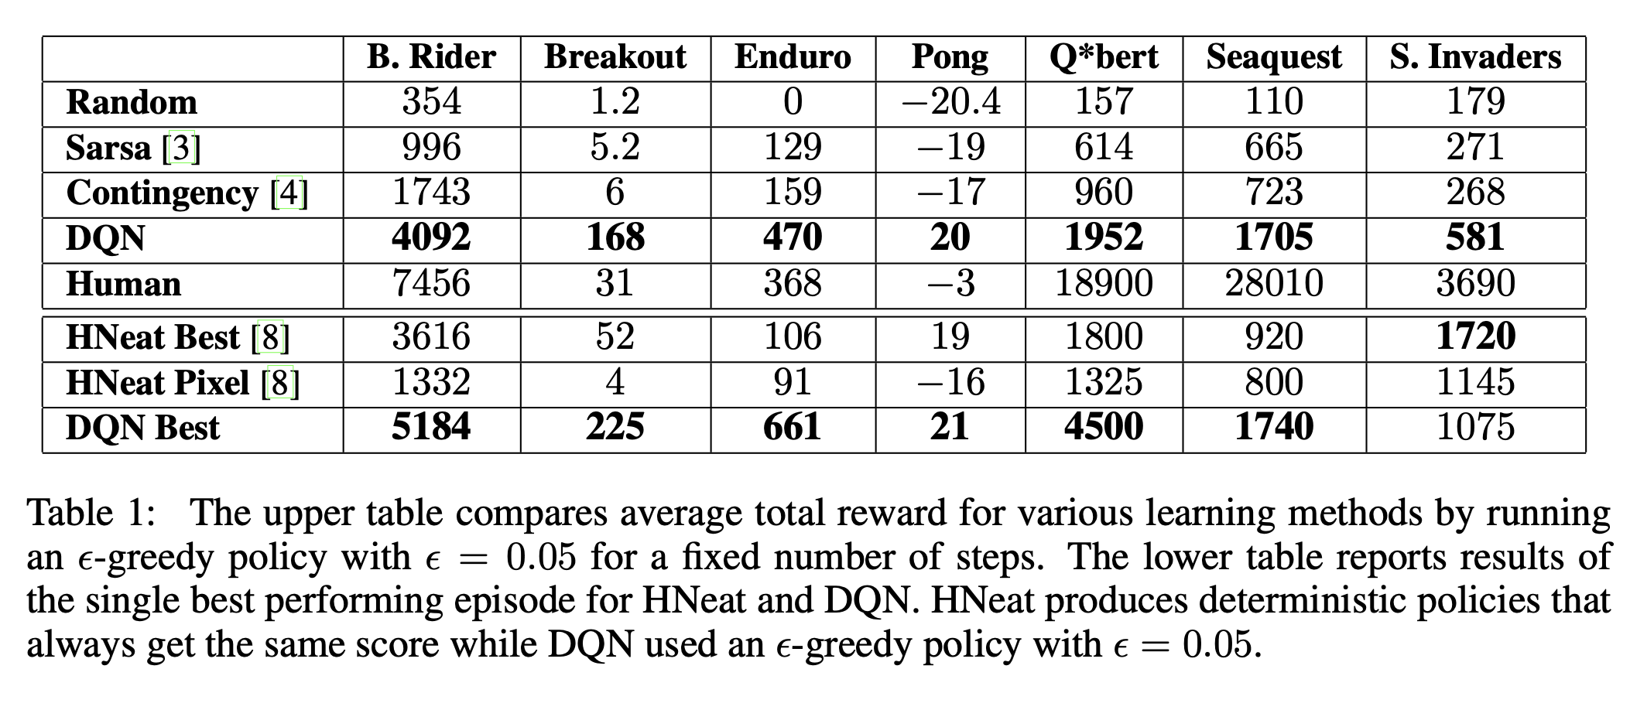
Results of DQN Experiments
DQN performed better than all other SOTA approaches at the time.
DQN performed better than human best players at the time in 6 of 7 Atari games.
Mnih et al., Playing Atari with Deep Reinforcement Learning, 2013

Slide 19
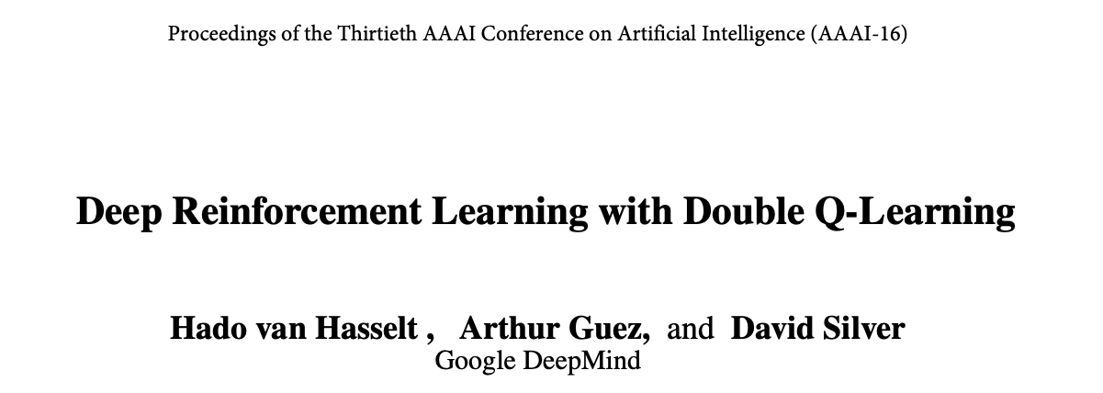
Double Deep Q-Learning
Cited 12,972 times, 3/19/2026

Slide 20
Summary of DDQN
Q-learning algorithm is known to overestimate action values.
It was not previously known whether, such overestimations are common, whether they harm performance, and whether they can generally be prevented.
In this paper, the authors answer all these questions affirmatively.
In particular, the authors first show that the DQN algorithm, suffers from substantial overestimations in some games in the Atari 2600 domain.
The paper proposes an adaptation to the DQN algorithm with two Q-networks and shows that the resulting algorithm reduces overestimations, and performs much better in several games.

Slide 21
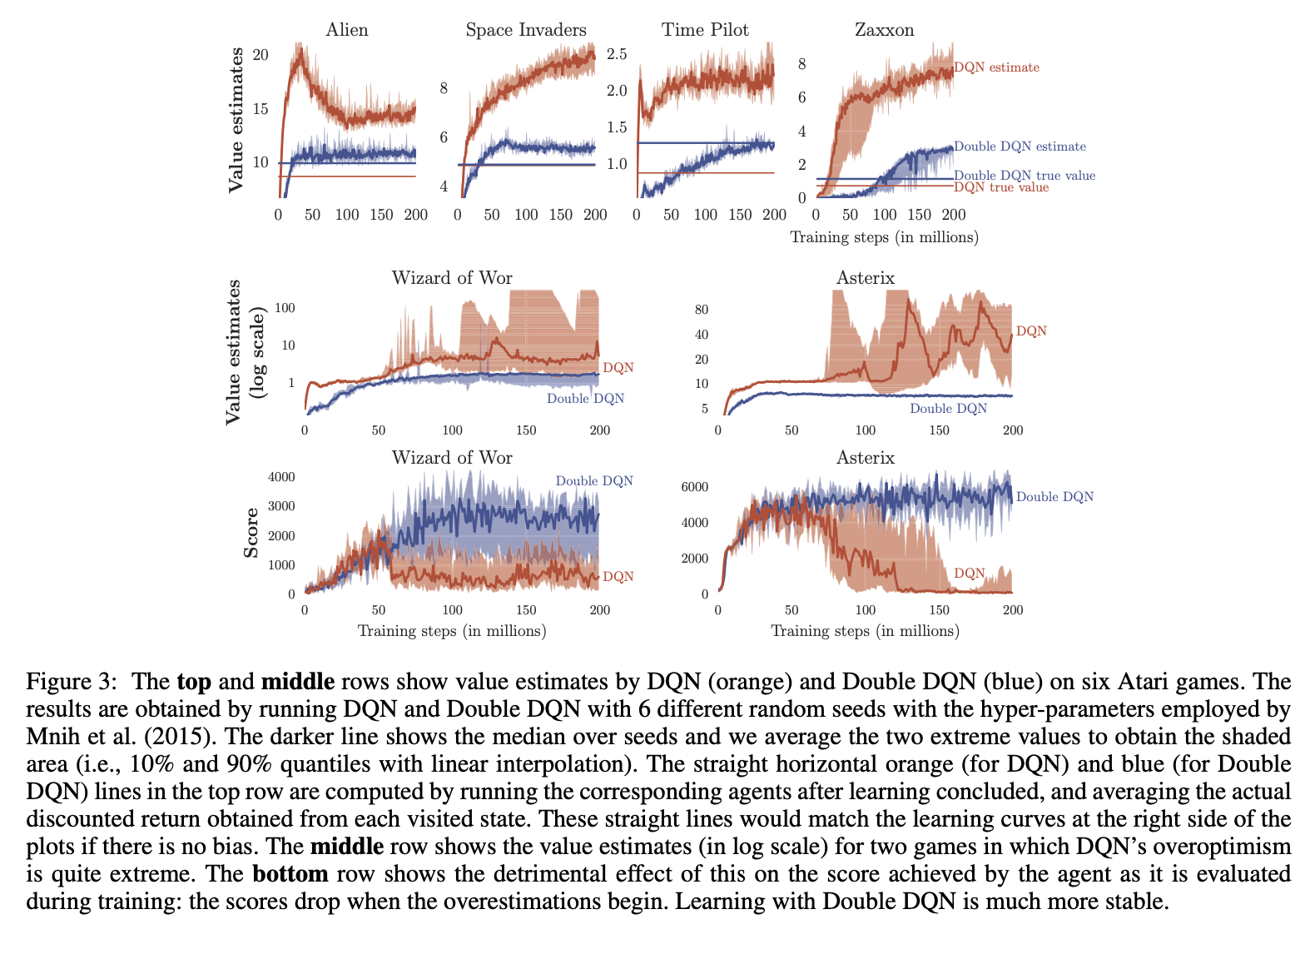
Overestimation by DQN
Top Row: Orange graph shows range of Q-values obtained by DQN in several game plays. Blue shows Q-values obtained by DDQN
Middle Row: The same as top row. Moreover, DQN’s Q-values are unstable often.
Bottom Row: Shows that the actual game scores fall when overestimation of Q-values happen.

Slide 22
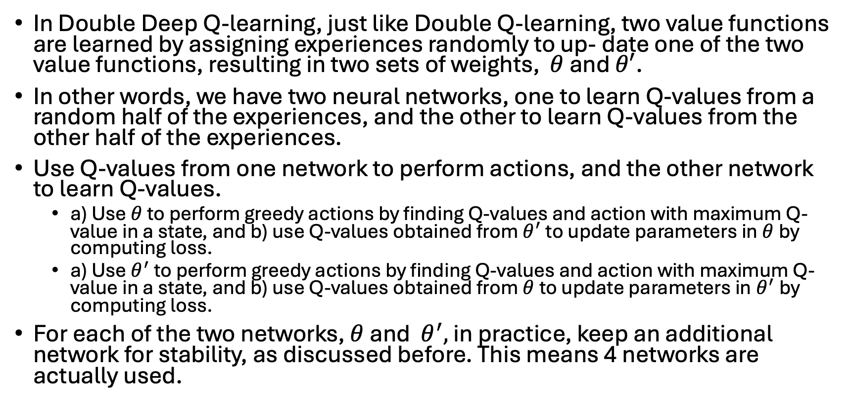
DDQN
In Double Deep Q-learning, just like Double Q-learning, two value functions are learned by assigning experiences randomly to up- date one of the two value functions, resulting in two sets of weights, $θ$ and $θ′$.
In other words, we have two neural networks, one to learn Q-values from a random half of the experiences, and the other to learn Q-values from the other half of the experiences.
Use Q-values from one network to perform actions, and the other network to learn Q-values.
a) Use $θ$ to perform greedy actions by finding Q-values and action with maximum Q-value in a state, and b) use Q-values obtained from $θ^{′}$ to update parameters in $θ$by computing loss.
a) Use${ θ}^{′}$ to perform greedy actions by finding Q-values and action with maximum Q-value in a state, and b) use Q-values obtained from $θ$to update parameters in${ θ}^{′}$by computing loss.
For each of the two networks, $θ$ and ${ θ}^{′},$ in practice, keep an additional network for stability, as discussed before. This means 4 networks are actually used.

Slide 23
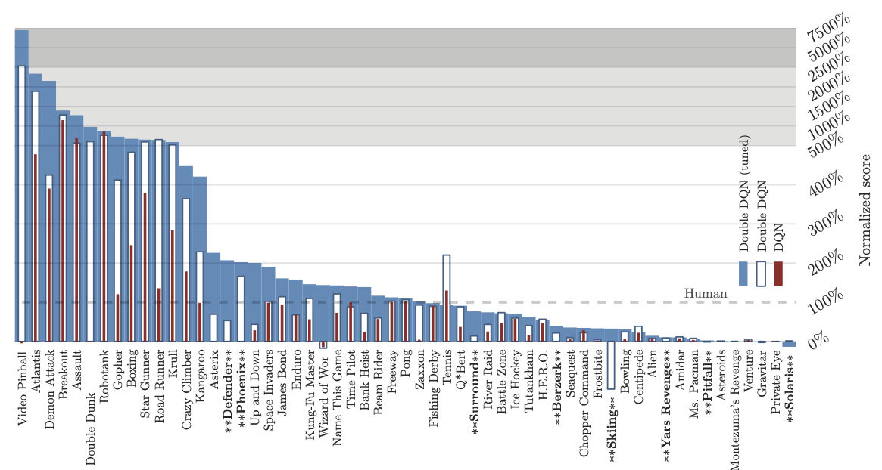
DDQN Results
Figure 4: Normalized scores on 57 Atari games, tested for 100 episodes per game with human starts. Compared to Mnih et al. (2015), eight additional games were tested. These are indicated with stars and a bold font.
DDQN obtains better scores than DQN for almost every game.

Slide 24
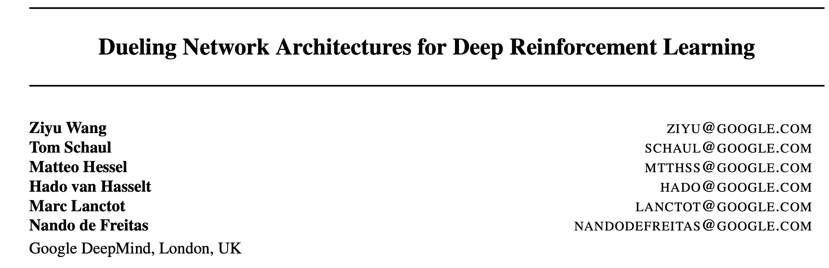
Dueling Deep Q-Learning
Published 2016, Cited 6,732 times, 3/19/2026

Slide 25
Summary of Dueling DQN
The dueling network contains two separate estimators: one for the state value function and one for the state-dependent action advantage function.
This factoring generalizes learning across actions without imposing any change to the underlying reinforcement learning algorithm.
Results showed that the architecture leads to better policy evaluation in the presence of many similar-valued actions.
The dueling architecture enables our RL agent to outperform the state-of-the-art on the Atari 2600 domain.

Slide 26
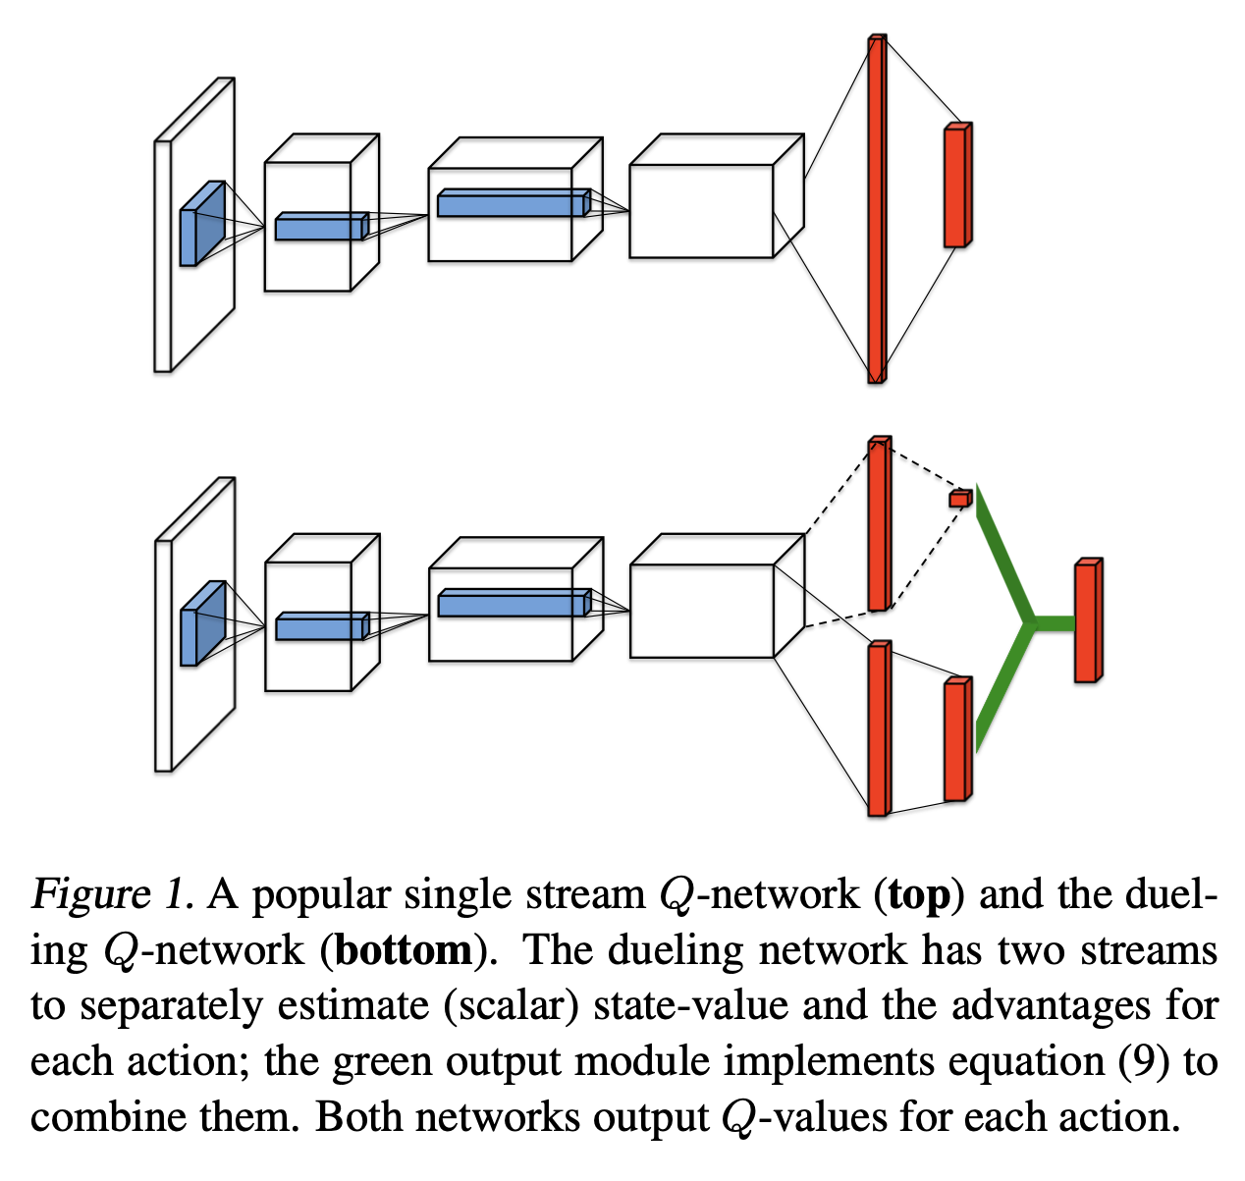
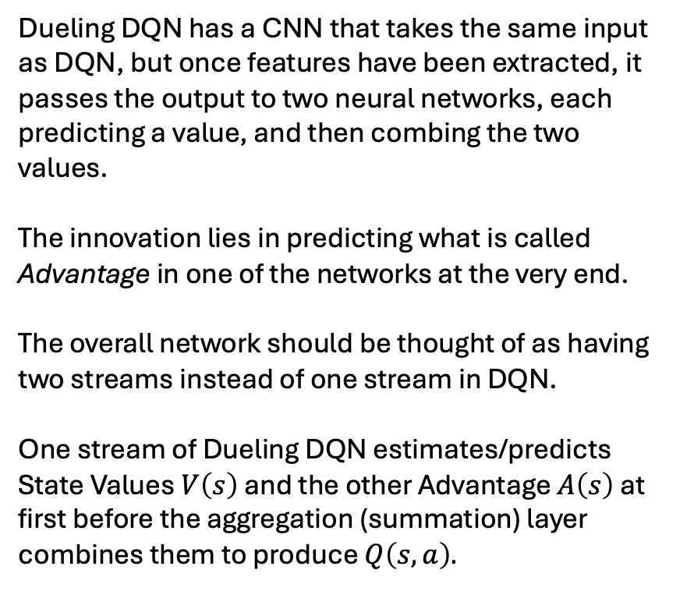
DQN vs. Dueling DQN
Dueling DQN has a CNN that takes the same input as DQN, but once features have been extracted, it passes the output to two neural networks, each predicting a value, and then combing the two values.
The innovation lies in predicting what is called Advantage in one of the networks at the very end.
The overall network should be thought of as having two streams instead of one stream in DQN.
One stream of Dueling DQN estimates/predicts State Values $V\left(s\right)$ and the other Advantage $A\left(s\right)$ at first before the aggregation (summation) layer combines them to produce $Q\left(s,a\right).$

Slide 27
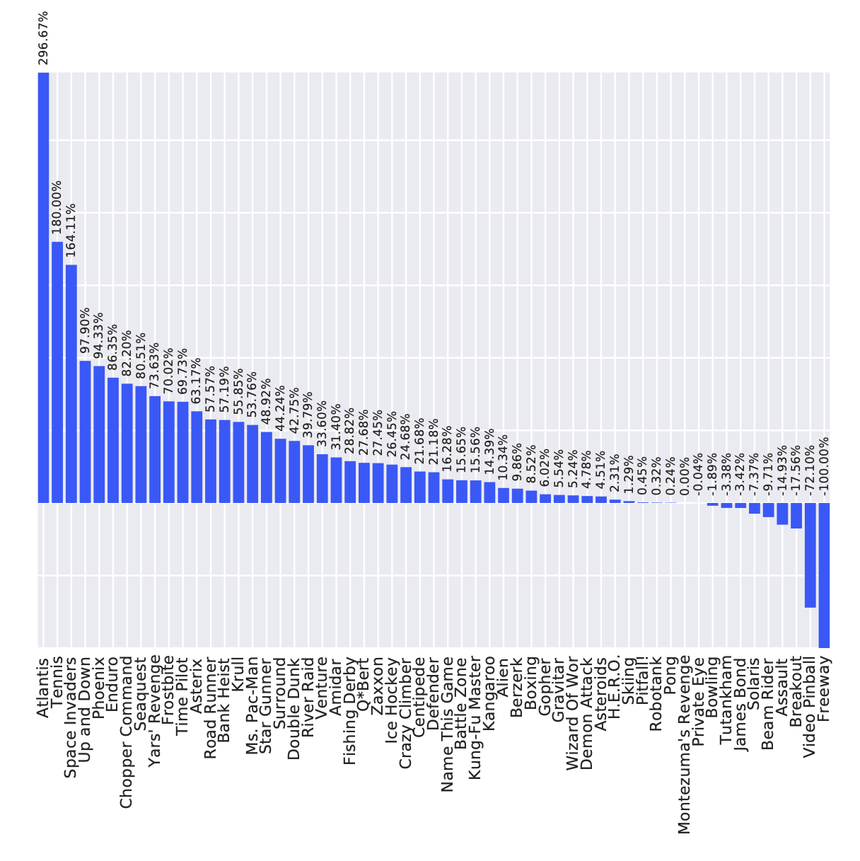
Dueling DQN produces better game players
Figure 4. Improvements of dueling architecture over the baseline Single network of van Hasselt et al. (2015), using the metric de- scribed in Equation (10). Bars to the right indicate by how much the dueling network outperforms the single-stream network.

Slide 28
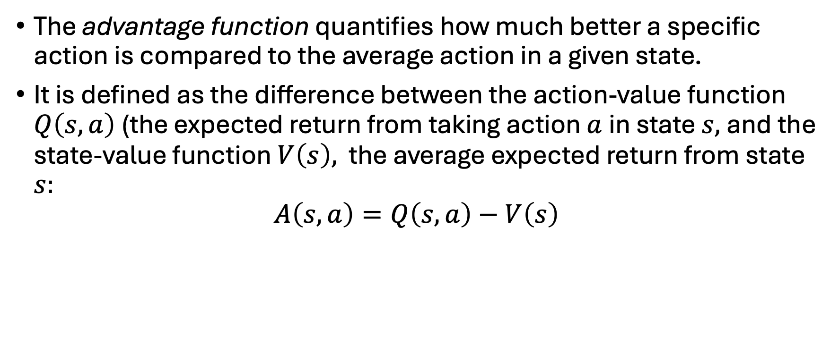

Advantage $A(s,a)$ of an Action over the State
The advantage function quantifies how much better a specific action is compared to the average action in a given state.
It is defined as the difference between the action-value function $Q\left(s,a\right)$(the expected return from taking action $a$in state $s,$and the state-value function $V\left(s\right),$ the average expected return from state $s:$
$$A\left(s,a\right)=Q\left(s,a\right)−V\left(s\right)$$

