Slide 1
Reinforcement Learning for Intelligent Tutoring System
BY
Abin Acharya
University of Colorado Colorado Springs
CS 4885/5885 Project
Instructor: Jugal Kalita
Date: Feb 17, 2026

Slide 2
Agenda
Problem & Objective
Intelligent Tutoring System
Problem Formulation as Reinforcement Learning
Related Work
Proposed RL Tutor Framework
Methods
Evaluation Plan
Project Timeline

Slide 3
Problem & Objective
Problem
Traditional Tutoring systems rely on rigid, rule-based sequencing, does not adapt to learning pace or engagement state
They optimize short-term correctness rather than long-term mastery
Objective
Develop an adaptive Reinforcement learning tutor – selecting problems and hint levels to maximize long term mastery and student engagement
Notes:
Most tutoring systems follow fixed rules. For eg: If a student gets a qsn wrong , the system might show easier qsn or always give a hint. But the real student don’t learn at same pace. Some get bored if its too easy and other gets frustrated if its too hard. And these systems often optimize short term correctness i.e just focusing on next qsn right instead of focusing on long term mastery across skills. So the goal of this project is to build adaptive RL tutor that learns how to choose problems and hint levels automatically

Slide 4
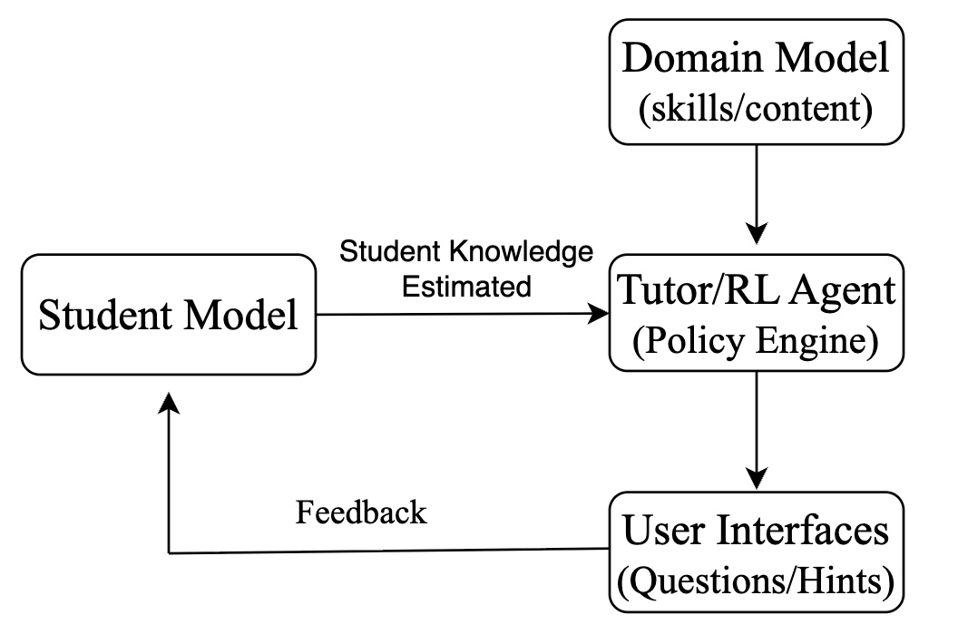
Intelligent Tutoring Systems
AI systems that personalize instruction for each learner
Track student knowledge and learning progress
Adapt problem selection and feedback
Used in math , science , and online educational platforms
Goal: Maximize learning efficiency and engagement
Notes:
ITS is built around a feedback loop between student and tutor. The domain model contains the skills or content being taught. For eg: math , science, English. The student model estimate what the student currently knows . After each interaction, the system update this estimate. The tutor or policy engine uses estimate to decide what to do next for eg; which qsn to show or whether to give hint or not. The user interface presents this qsn to student and the student’s response becomes feedback and updates the student model. So the ITS system continuously observe, decide and adapts.

Slide 5
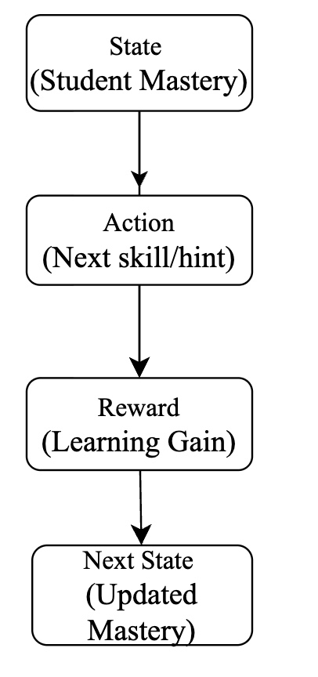
Tutoring as Sequential Decision-Making
Each Tutoring decision affects future learning
Immediate correctness ≠ long term mastery
Need to balance
Skill coverage
Difficulty progression
Hint usage
Engagement
Tutoring can be formulated as a Markov Decision Process
Notes:
We can model tutoring process as Markov Decision Process. The state represents what the student currently knows, their mastery across skills. The action is what the tutor chooses next, such as which problem to give or whether to give a hint. After the student responds , the system receives a reward. This lead to the next state , which is the updated estimate of student mastery.

Slide 6
Literature Review
Paper | Problem Addressed | Method | Key Contribution
Towards Goal-oriented Intelligent Tutoring Systems in Online Education [1] | Traditional tutors select exercises greedily without explicit learning goals | Graph-based RL with cognitive prerequisite modeling | Introduces goal-driven tutoring where the agent learns when to teach vs assess, using prerequisite graphs to structure long-horizon learning plans
Integrating Reinforcement Learning with Dynamic Knowledge Tracing for Personalized Learning Path Optimization [2] | Knowledge tracing predicts mastery but does not optimize next-step decisions | Dynamic Knowledge Tracing combined with reward-shaped RL | Integrates neural student state estimation with RL sequencing to optimize personalized learning paths beyond binary correctness
Dynamic Adaptation in an Intelligent Multi-Tutoring System: A Multi-Agent Approach [3] | Single-agent tutors lack adaptive intervention strategies and human support integration | MDP-based multi-agent tutoring framework | Models intervention selection as a decision problem coordinating automated, peer, and teacher support to reduce dropout and increase engagement
Notes:
The first paper treats tutoring as a goal driven planning problem. Instead of just picking next exercise, the system learns when to teach and when to assess, using prerequisite structure.
The second paper combines knowledge tracing with RL. It estimate what the student knows and used RL to optimize learning path.
The third paper extends tutoring to multi-agent strategies- it decides when automated help , peer support or teacher intervention is needed.

Slide 7
Dataset
Source
Public dataset from the ASSISTments online tutoring system
Real student Math algebra problem-solving sessions
Structure
Each row represents one student-problem interaction
Student ID
Problem/skill ID
Correctness (0/1)
Hint usage
Attempt count
Response time
Affect/confidence signals and many more
Role in this project
Select top-k skills for tutoring domain
offline trajectories for Decision Transformer
Notes:
For this project, I will use a real educational dataset from ASSISTment online tutoring system. It is a platform where students solves math qsns , and the system logs every interactions.

Slide 8
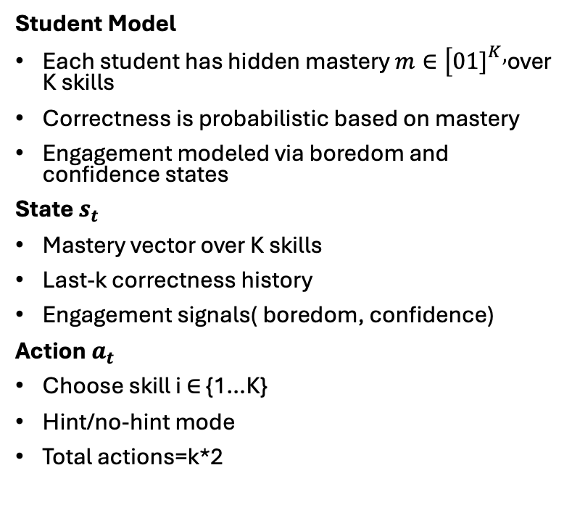
Environment Design
Student Model
Each student has hidden mastery $m∈[01{\left.]\right.}^{K},$over K skills
Correctness is probabilistic based on mastery
Engagement modeled via boredom and confidence states
State $s_{t}$
Mastery vector over K skills
Last-k correctness history
Engagement signals( boredom, confidence)
Action $a_{t}$
Choose skill i ∈ {1…K}
Hint/no-hint mode
Total actions=k*2
Transition
Succes probability increase with mastery
Correct answers increase with mastery
Engagement updates dynamically
Reward rt
Correctness reward
Mastery improvement bonus
-hint and boredom penalties
Notes:
This slide shows how the tutoring process is modeled as a reinforcement learning environment.
Each student is represented by a hidden mastery vector across K skills. Mastery values range from low to high and determine the probability of answering correctly.
In addition to knowledge, there wil be model engagement using boredom and confidence. This allows the tutor to react not only to correctness, but also to student state.
The environment state includes the mastery vector, recent correctness history, and engagement signals. So the agent sees both learning progress and behavioral context.
The action is selecting a skill and deciding whether to give a hint.
Transitions are probabilistic. If mastery is high, success is more likely. Correct answers increase mastery, while engagement evolves dynamically.
The reward combines correctness, improvement in mastery, and penalties for excessive hints or boredom. This encourages effective and balanced teaching strategies.

Slide 9
Methods
Baselines
Random Policy
Greedy Heuristics
Online RL (simulator Training)
Vanilla DQN
Double DQN + Dueling architecture
PPO (actor–critic with GAE)
Offline Extension
Decision Transformer
Train on trajectory dataset
Condition on return-to-go
Notes:
A random policy is the simplest. It chooses skill randomly without looking student's state.
A greedy Heuristic is rule based tutor. It always select weakest skill and gives hint when mastery is low.
Vanilla DQN learns to score tutoring actions. For each student state, it predicts how good is to teach skill. Over many simulated sessions, it discovers which sequences of problems lead to long term mastery.
Double DQN + Dueling : It separates the state value and action advantage. It estimate 2 things: 1) How good is the student state overall and 2) which action is best inside that state.
PPO(Proximal Policy Optimization) : It is an actor-critic method. It has 2 parts: the actor decides which tutoring action to take and the critic which evaluate how good that decision was. Here GAE is Generalized Advantage Estimation which measure how much better an action was compared to expectations
DT is offline RL that learns from the datsets or trajectories. Given a sequence od state , action and Return to go , it predicts the optimal action to take.

Slide 10
Evaluation Metrics
Episode Total Reward
Overall teaching quality measured by the environment’s reward signal, combining correctness, learning progress, fairness, and engagement
Accuracy (Correctness Rate)
Percentage of questions answered correctly within an episode
Final Mean Mastery
Average skill mastery at the end of an episode, representing overall learning progress
Final Minimum Mastery
Mastery level of the weakest skill at episode end, measuring fairness across skills
Skill Coverage Entropy
How evenly the tutor teaches different skills; higher values mean more balanced curriculum coverage
Hint Usage Rate
How often the tutor provides hints during an episode
Notes:
Episode total reward: It is the overall score from the environment. It combines correctness, engagement and fairness.
Final Mean Mastery: it measures how much student improved overall by the end of episode.

Slide 11
Project Timeline
Week(s) | Tasks
Week 1 | Dataset preprocessing, skill analysis, Top-K selection, simulator calibration
Week 2 | Environment validation, baseline policies, reward sanity checks
Week 3 | Train online RL agents (DQN, DDQN, PPO)
Week 4 | Midterm presentation + progress report
Week 5 | RL evaluation, ablation studies, metric analysis
Week 6 | Trajectory collection, Decision Transformer dataset construction
Week 7 | Train Decision Transformer, offline comparison, final analysis

Slide 12
References
Deng, Y., Ren, Z., Zhang, A., & Chua, T. S. (2025). Towards goal-oriented intelligent tutoring systems in online education. ACM Transactions on Information Systems, 43(6), 1–26.
Fu, Z. (2025). Integrating reinforcement learning with dynamic knowledge tracing for personalized learning path optimization. Scientific Reports, 15(1), 40202.
Zakaria, R., Hadhoum, B., Mourad, E., & Mustapha, M. (2025). Dynamic adaptation in an intelligent multi-tutoring system: A multi-agent approach. IEEE Access.

