Slide 1
Proposal Presentation
Presented by Kaleb Chanza

Slide 2
Presenter Introduction
My name is Kaleb Chanza
I am a Graduate Student Attending for Software Engineering
I have not had any experience with AI development or Machine Learning concepts

Slide 3
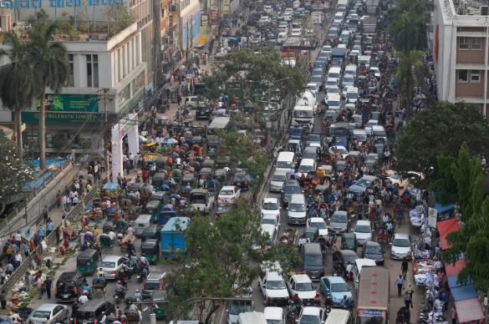
Introduction
As the modern world has continued to develop, traffic and issues stemming from it remain a persistent issue.[2]
While better design for future infrastructure is able to address these problems, it is difficult to address severe traffic in current urban areas.[3]
Image Taken From Source 1

Slide 4
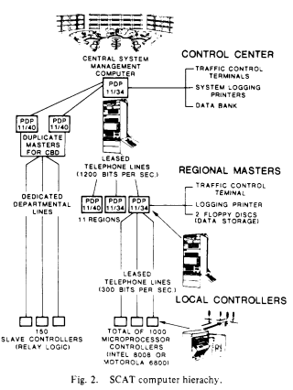
Traffic Congestion Solution
One avenue for solving this problem has been the incorporation of Adaptive Traffic Signal Control (ATSC).
This concept has seen a variety of different implementations with great success.[4]
Older implementations of ATSC are limited in how much they can assist, so research has turned to using AI.[5]
Image Taken From Source 4

Slide 5
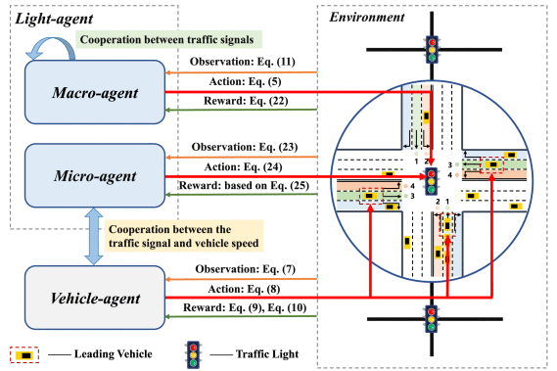
Related Work
Reinforcement Learning has served as the basis for a large number of ATSC projects.
Recent research utilizes Deep Reinforcement Learning concepts and/or Multi-Agent Design. [6]
A potentially effective idea suggested by recent papers has been the incorporation of information given by vehicles. [7] [8]
Image Taken From Source 7

Slide 6
Project Proposal
The goal of this project will be the development of a Multi-Agent Deep Reinforcement Learning method that is capable of consistently reducing traffic congestion.
I want to develop a method where multiple traffic light agents are capable of communicating with each other to learn more effectively.
I want to use the idea of utilizing information from vehicles to improve how the traffic lights function.

Slide 7
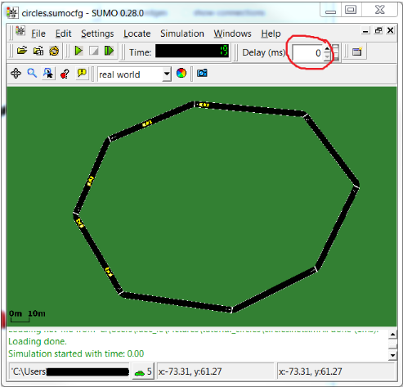
Implementation Environment
Most papers related to the concept of ATSC used the “Simulation of Urban Mobility” (SUMO) to conduct experiments. [9]
This application will allow me to easily test implementations of my algorithms on both simple and real world implementations.
Image Taken From Source 10

Slide 8
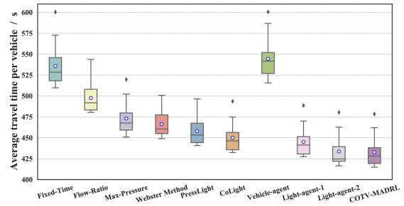
Agent Implementation
When looking at how to implement the ATSC method, it will be necessary to create an agent that can be duplicated for each traffic light.
These agents will need to learn about average traffic across different times of day and be able to adapt to create more efficient patterns.
An element of utilizing average vehicle speed will be used to understand how this affects an agent’s learning and development.
There are several different existing methods that can be either learned from or expanded upon. [7][8][11]-[18]
Image Taken From Source 7

Slide 9
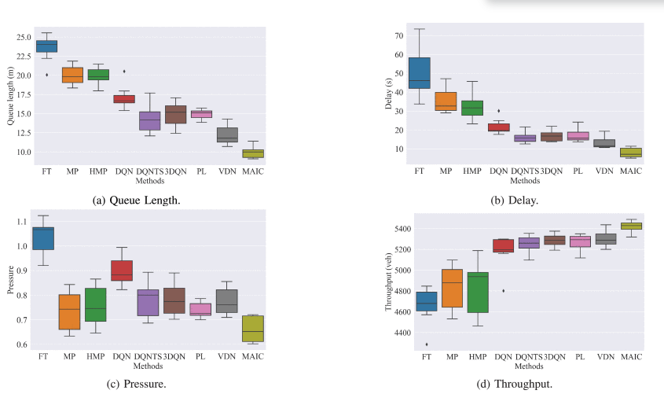
Evaluation
When looking at current research, there are a few metrics that are commonly measured:
Queue Length
Average Wait Time
Pressure
Throughput
Image Taken From Source 8

Slide 10
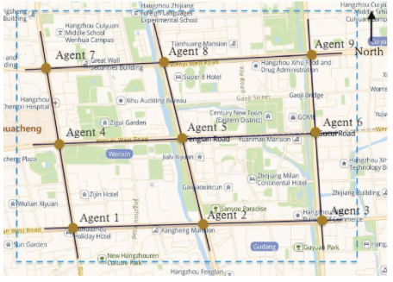
Real World Data
Previous research has indicated that utilizing real world data is both possible and necessary for accurate performance metrics. [7]
If available, I want to use the data used in previous research papers as well as information for Colorado Springs.
Image Taken From Source 8

Slide 11
Potential Issues
One of the main issues is my own inexperience with reinforcement learning concepts and the tools for this project.
It is consistently mentioned in the research that traditional reinforcement learning struggles with high-dimensional environments like this.
Acquiring the necessary data for real world testing needs to be done early since I don’t know what steps are required.

Slide 12
Questions
?

Slide 13
Works Cited
[1] “TIME,” 2023. [Online]. Available: https://time.com/6318377/traffic-by-city/
[2] “INRIX,” 2025. [Online]. Available: https://inrix.com/scorecard/
[3] J. Wang, D. Wei, K. He, H. Gong, and P. Wang, “Encapsulating urban traffic rhythms into road networks,” Sci. Rep., vol. 4, no. 1, pp. 1–7, Feb. 2014.
[4] Sims, A.; and Dobinson, K. 1980. The Sydney coordinated adaptive traffic (SCAT) system philosophy and benefits. IEEE Transactions on Vehicular Technology, 29(2): 130–137.
[5] Tan, T.; Bao, F.; Deng, Y.; Jin, A.; Dai, Q.; and Wang, J. 2020. Cooperative Deep Reinforcement Learning for Large-Scale Traffic Grid Signal Control. IEEE Transactions on Cybernetics, 50(6): 2687–2700.
[6] Mao, F.; Li, Z.; and Li, L. 2023. A Comparison of Deep Reinforcement Learning Models for Isolated Traffic Signal Control. IEEE Intelligent Transportation Systems Magazine, 15(1): 160–180.
[7] Huang, H.; Hu, Z.; Li, M.; Lu, Z.; and Wen, X. 2024. Co-operative Optimization of Traffic Signals and Vehicle Speed Using a Novel Multi-Agent Deep Reinforcement Learning. IEEE Transactions on Vehicular Technology, 73(6): 7785–7798.
[8] Zhou, B.; Zhou, Q.; Hu, S.; Ma, D.; Jin, S.; and Lee, D.H. 2024. Cooperative Traffic Signal Control Using a Distributed Agent-Based Deep Reinforcement Learning With Incentive Communication. IEEE Transactions on Intelligent Transportation Systems, 25(8): 10147–10160.
[9] Lopez, P. A.; Behrisch, M.; Bieker-Walz, L.; Erdmann, J.; Fl¨otter¨od, Y.-P.; Hilbrich, R.; L¨ucken, L.; Rummel, J.; Wagner, P.; and Wiessner, E. 2018. Microscopic Traffic Simulation using SUMO. In 2018 21st International Conference on Intelligent Transportation Systems (ITSC), 2575–2582.
[10] “SUMO,” 2026. [Online]. Available: https://sumo.sourceforge.net/docs/index.htmll
[11] Agarwal, I.; Singh, A.; Agarwal, A.; Mishra, S.; Satapathy, S. K.; Cho, S.-B.; Prusty, M. R.; and Mohanty, S. N. 2024. Enhancing Road Safety and Cybersecurity in Traffic Management Systems: Leveraging the Potential of Reinforcement Learning. IEEE Access, 12: 9963–9975.
[12] Zhu, R.; Wu, S.; Li, L.; Ding, W.; Lv, P.; and Sui, L. 2024. Adaptive Broad Deep Reinforcement Learning for Intelligent Traffic Light Control. IEEE Internet of Things Journal,
11(17): 28496–28507.
[13] Ei Mon, E.; Ochiai, H.; and Aswakul, C. 2024. Application of Traffic Light Control in Oversaturated Urban Network Using Multi-Agent Deep Reinforcement Learning. IEEE Access, 12: 82384–82395.
[14] Han, G.; Han, Y.; Wang, H.; Ruan, T.; and Li, C. 2024. Coordinated Control of Urban Expressway Integrating Adjacent Signalized Intersections Using Adversarial Network Based
Reinforcement Learning Method. IEEE Transactions on Intelligent Transportation Systems, 25(2): 1857–1871.
[15] Xu, D.; Yu, Z.; Liao, X.; and Guo, H. 2024. A Graph Deep Reinforcement Learning Traffic Signal Control for Multiple Intersections Considering Missing Data. IEEE Transactions on Vehicular Technology, 73(12): 18307–18319.
[16] Jiang, Q.; Qin, M.; Zhang, H.; Zhang, X.; and Sun, W. 2024. BlindLight: High Robustness Reinforcement Learning Method to Solve Partially Blinded Traffic Signal Control Problem. IEEE Transactions on Intelligent Transportation Systems, 25(11): 16625–16641
[17] Lee, D. 2024. Transfer Learning-Based Deep Reinforcement Learning Approach for Robust Route Guidance in Mixed Traffic Environment. IEEE Access, 12: 61667– 61680.
[18] Fereidooni, Z.; Palesi, L. A. I.; and Nesi, P. 2025. Multi-Agent Optimizing Traffic Light Signals Using Deep Reinforcement Learning. IEEE Access, 13: 106974–106988.

