Slide 1
Using Historical Financial Data and Sentiment Analysis with Reinforcement Learning for Day Trading
Carlos R Guerra
Department of Computer Science
University of Colorado Colorado Springs

Slide 2
Agenda
Inspiration and Sentiment Analysis
Data Sets and Tools
Goals and Reinforcement Learning
States, Actions, and Rewards
Plan and Expectations

Slide 3
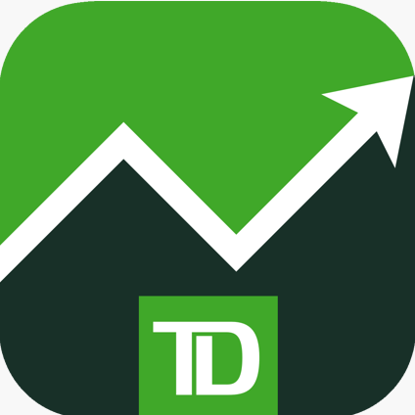




Inspiration
The influence of social media
Information availability and ease of trade
The Efficient Market Hypothesis
Prices of trade assets reflect ALL the publicly available information of the market

Slide 4
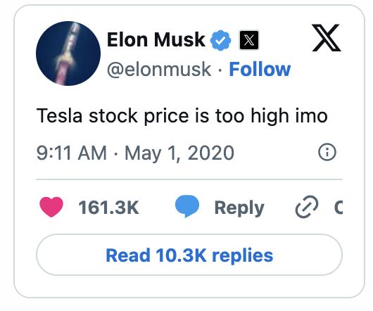
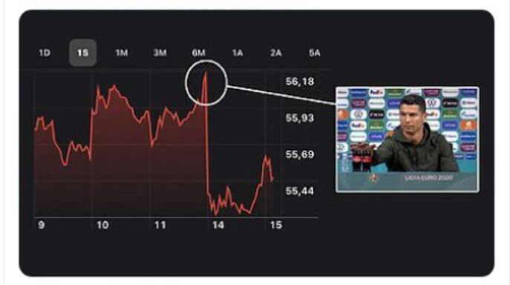

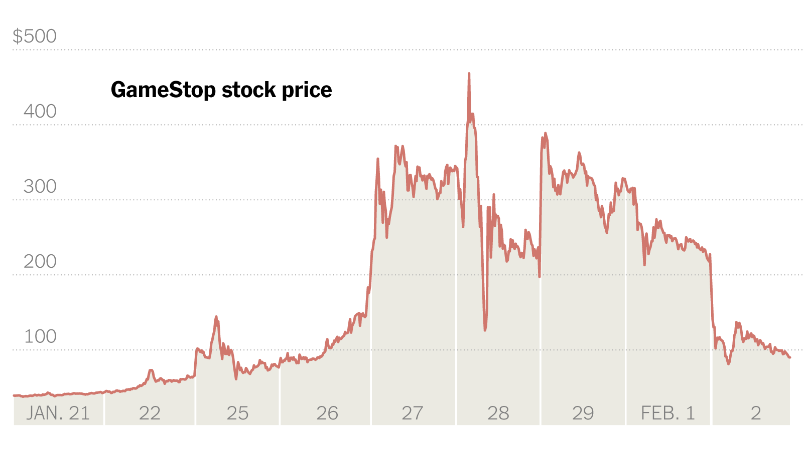
Examples
$14B
$4B
$17B?

Slide 5
Sentiment Analysis
“Sentiment analysis, or opinion mining, is the process of analyzing large volumes of text to determine whether it expresses a positive sentiment, a negative sentiment or a neutral sentiment” – IBM
Can be gathered from many sources
News articles, blogs, financial reports, interview transcripts, product reviews, social media interactions, etc.
Natural Language libraries trained on financial scenarios specifically

Slide 6
Data Sets
Sources of stock market data
End-of-Day Historical Data API
Yahoo Finance API
Finviz
FinnHub
Alpaca
Sources of sentiment analysis
Yahoo Finance API
BBC news API
Other news feeds

Slide 7
Goals and Reinforcement Learning
Get a consistent set of data
Simplify the complexity of the market info; Focus on a small subset of markers
Make the sentiment analysis a part of a state
Will the resulting policy be beneficial and actionable?

Slide 8
States, Actions, and Rewards Keeping it simple
States
What combination of data points would yield the best policy
Defining the scope will be critical
Large data volume; historical, current, and sentiment data
Actions
Limit the time: days or even hours
Buy vs Sell vs Hold
Defining what would indicate a good time to buy a stock vs selling it
If holding a stock, the time needs to be limited, this is not for portfolio management.
Rewards
Positive or negative
When all trades are done and not holding any stocks

Slide 9
Challenges
Narrowing down the datapoints from such large data sets
Historical price, returns, price changes, inventory information, volume, relative strength index, moving averages, P/E ratio, dividends, market capitalizations, bid-ask indicators, order limits, volatility, time indexes, etc.
Defining the scope of states
How do you define the initial state
If the end state is defined as having nothing to trade, how do you stop it from ending early
How long is an episode
Simulations and using tools like Gymnasium

Slide 10
Resources
Reinforcement Learning, second edition: An Introduction
Grokking Deep Reinforcement Learning
Deep Reinforcement Learning Hands-On: A practical and easy-to-follow guide to RL from Q-learning and DQNs to PPO and RLHF 3rd ed. Edition
Machine Learning for Algorithmic Trading: Predictive models to extract signals from market and alternative data for systematic trading strategies with Python 2nd ed. Edition
Artificial Intelligence in Finance: A Python-Based Guide 1st Edition
Python for Algorithmic Trading: From Idea to Cloud Deployment 1st Edition
Reinforcement Learning for Finance: A Python-Based Introduction 1st Edition
Liu, Xiao-Yang, et al. "Dynamic datasets and market environments for financial reinforcement learning." Machine Learning 113.5 (2024): 2795-2839.
﻿Millea, Adrian. "Deep reinforcement learning for trading—A critical survey." Data 6.11 (2021): 119.
Pricope, Tidor-Vlad. "Deep reinforcement learning in quantitative algorithmic trading: A review." arXiv preprint arXiv:2106.00123 (2021).
﻿Zhang, Zihao, Stefan Zohren, and Stephen Roberts. "Deep reinforcement learning for trading." arXiv preprint arXiv:1911.10107 (2019).
﻿Goluža, Sven, et al. "Deep reinforcement learning with positional context for intraday trading." Evolving systems 15.5 (2024): 1865-1880.
﻿Conegundes, Leonardo, and Adriano C. Machado Pereira. "Beating the stock market with a deep reinforcement learning day trading system." 2020 International Joint Conference on Neural Networks (IJCNN). IEEE, 2020.
﻿Li, Daifeng, et al. "Analyzing stock market trends using social media user moods and social influence." Journal of the Association for Information Science and Technology 70.9 (2019): 1000-1013.
﻿Théate, Thibaut, and Damien Ernst. "An application of deep reinforcement learning to algorithmic trading." Expert systems with applications 173 (2021): 114632.
﻿Wu, Xing, et al. "Adaptive stock trading strategies with deep reinforcement learning methods." Information Sciences 538 (2020): 142-158.
Liu, Yang, et al. "Adaptive quantitative trading: An imitative deep reinforcement learning approach." Proceedings of the AAAI conference on artificial intelligence. Vol. 34. No. 02. 2020.
﻿Bai, Yahui, et al. "A review of reinforcement learning in financial applications." Annual Review of Statistics and Its Application 12.1 (2025): 209-232.

Slide 11
Questions?

