Slide 1
Reinforcement Learning for Fast and Secure Circuit Selection in Tor
Presented by
Amanul Islam
Course: Reinforcement Learning (CS 5080)
February 17, 2026

Slide 2
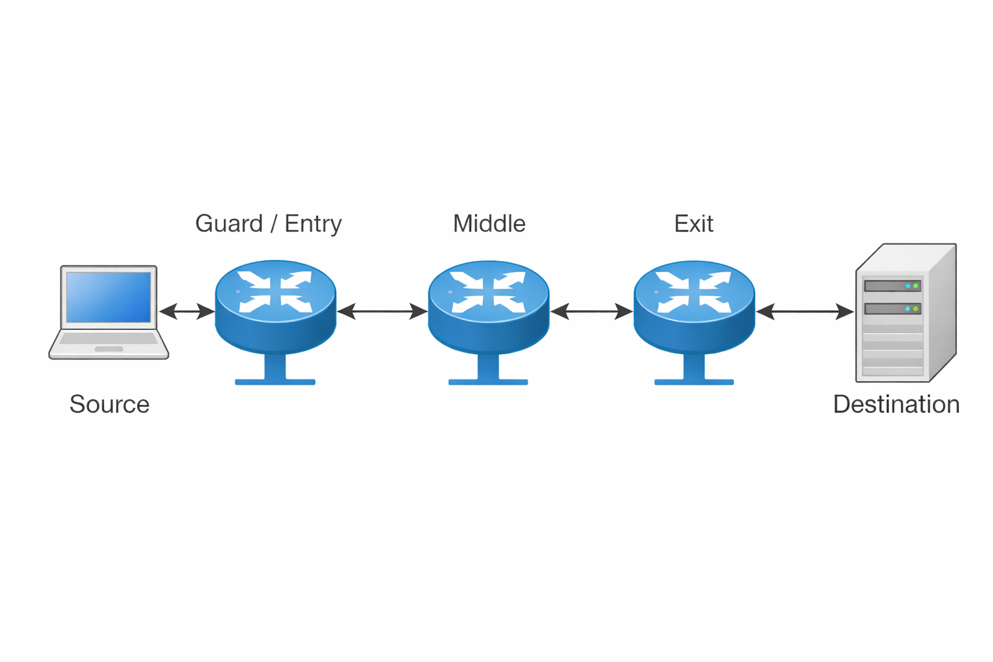
How Tor works
TOR networks consist of multiple relays circuits:
Entry Relay
Middle Relay
Exit Relay
Fig : Architecture of TOR Network

Slide 3
Motivation
Tor keeps users anonymous but often makes connections slow.
Tor currently picks relays randomly, which adds extra delay.
Our aim is to keep users anonymous and make Tor faster.

Slide 4
Research Objectives
Develop an RL-based model for optimal circuit selection in the Tor network.
Evaluate the performance of the proposed model against traditional heuristic-based methods.
Analyze the trade-offs between latency, anonymity, and bandwidth utilization.

Slide 5
EXISTING WORKS
Previous research such as Basyoni et al.[1] investigated the integration of the QUIC protocol to shorten the Tor handshake process and improve latency performance.
Rochet et al.[2] focused on securing user’s location information without compromising anonymity.
Zhang and Chang[3] analyzes the trade-off between performance and anonymity in the TOR network proposing source-driven relay selection method. Zhang et al.[4] also applied Reinforcement Learning in Tor but they priories the Tor performance and compromised anonymity.
Our study is to explore whether reinforcement learning can be effectively used in Tor’s circuit selection.
[Basyoni, L., Erbad, A., Alsabah, M., Fetais, N., Mohamed, A., & Guizani, M. (2021). QuicTor: Enhancing tor for real-time communication using QUIC transport protocol. IEEE Access, 9, 28769-28784.
Rochet, F., Wails, R., Johnson, A., Mittal, P., & Pereira, O. (2020, October). CLAPS: Client-location-aware path selection in Tor. In Proceedings of the 2020 ACM SIGSAC Conference on Computer and Communications Security (pp. 17-34).
Zhang, K., & Chang, S. Y. (2024, July). Performance or anonymity? source-driven tor relay selection for performance enhancement. In 2024 33rd International Conference on Computer Communications and Networks (ICCCN) (pp. 1-9). IEEECommunications and Networks (ICCCN), Kailua-Kona, HI, USA, 2024, pp. 1-9, doi: 10.1109/ICCCN61486.2024.10637542.
Zhang, K., Islam, A., & Chang, S. Y. (2025, June). Reinforcement Learning on Tor: Prioritizing Performance Compromises Anonymity. In 2025 Silicon Valley Cybersecurity Conference (SVCC) (pp. 1-3). IEEE.

Slide 6
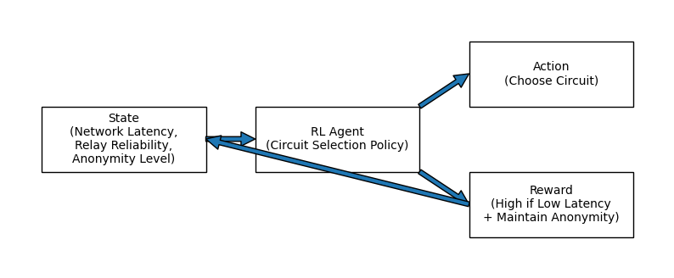
RL-Based Scheme
Agent: RL agent selects a Tor circuit
State: Network conditions (latency, relay reliability, anonymity level)Action: Choose one circuit from candidate circuits
Reward: Higher reward for lower latency while maintaining anonymity
Goal: Learn a policy that balances latency and anonymity
Figure 1: Reinforcement learning framework for adaptive Tor circuit selection, where the agent observes network state, selects a circuit, and receives rewards based on latency and anonymity to learn an optimal policy.

Slide 7
CONCLUSION
Improve Tor performance.
Maintain anonymity guarantees.
Introduce adaptive learning-based routing.

Slide 8
Thank you

