Slide 1
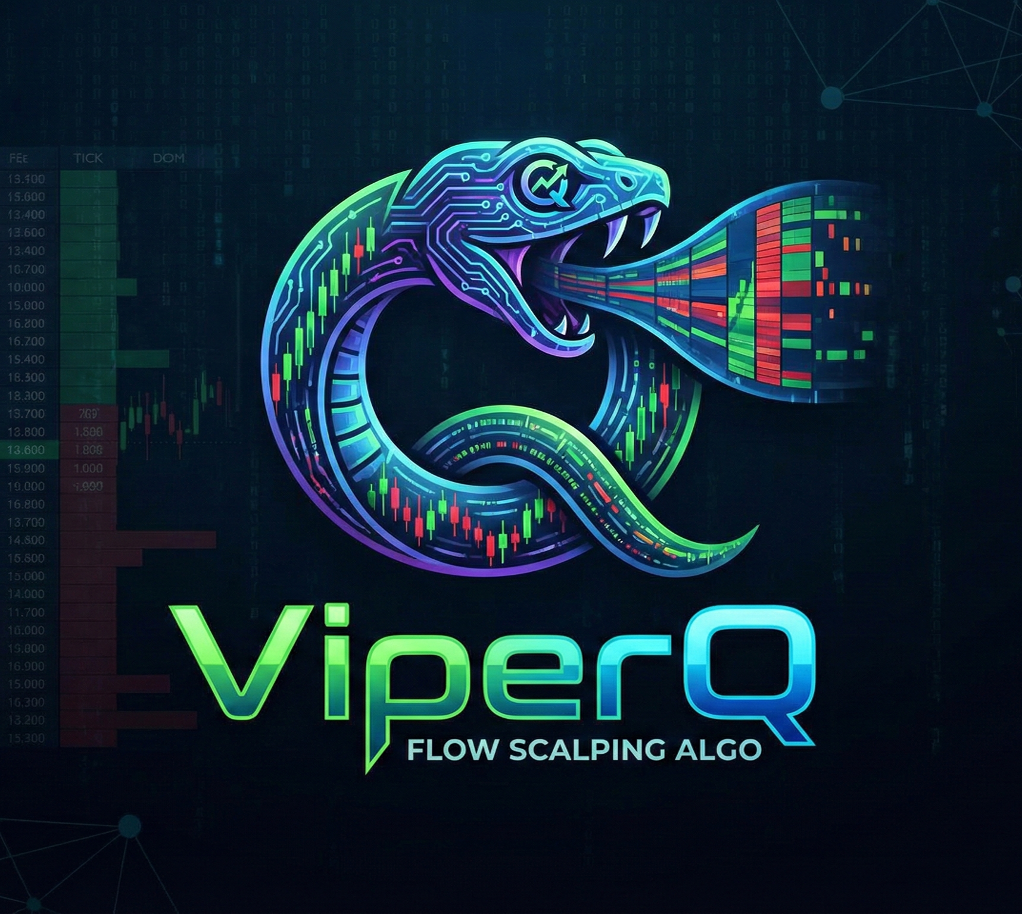
ViperQ: Order Flow & Auction Market Theory Trading via Reinforcement Learning
By: Asser Moustafa
Notes:
Good evening, everyone. Today’s Project, I named it ViperQ. I am building an automated trading agent that uses Reinforcement Learning to trade the stock market. But unlike traditional algorithms that try to predict price using historical charts, my system will use 'Order Flow’, which is the actual mechanics of supply and demand, to make decisions on a minute-by-minute basis.

Slide 2
Agenda
Motivation & Related Work: Why this?
The Logic: Market Micro-Structure & Auction Theory.
The Strategy: How we trade "Imbalance.”
System Architecture: Data & Training Setup.
The RL Agent: Algorithm, Actions, Reward Function
Performance Goals: The Math of Compounding
Evaluation: How we measure success.
Conclusion & End Goal
Notes:
Here is our agenda. I will start with the motivation behind the project and why no one has solved this problem yet. Then, I will explain the 'Physics' of the market, how orders actually move price. We will look at the specific strategy I am teaching the AI, and the data architecture using Nvidia and Tesla, and finally, the performance targets we aim to hit. And some evaluation metrics.

Slide 3
Motivation & Related Work
The Inspiration: Based on the manual strategy of Fabio Valentini, a 3-time World Trading Champion.
His Record: ~80% average annual returns.
His Edge: He does not use charts. He reads the "Tape" (Order Flow).
The Gap in Research:
Most RL papers use simple "Price History" (OHLC data). This is like driving using only the rear-view mirror.
Real "Order Flow" RL is mostly proprietary (Hedge Funds/HFTs).
My Goal: Bridge this gap by automating Fabio's logic using a PPO Agent.
Notes:
My motivation comes from a trader named Fabio, who has won the World Trading Championship three times. He usually achieves 80% annual returns. He doesn't look at charts; he looks at the raw stream of buy and sell orders. In the academic world, most Reinforcement Learning projects fail because they train on simple price history. No one has successfully published a working agent that trades pure Order Flow logic like Fabio. That is what I aim to do. Most probably, this RL agent trading on order flow is a proprietary software for Hedge funds and Quant companies.

Slide 4
Market Physics (Order Flow 101)
The Reality of Price: Price is just an advertisement.
The Matching Engine: Traders send orders into a central engine.
The Order Book (Level 2):
Group #1: Passive Orders: People waiting to buy/sell (The "Liquidity").
Group #2: Aggressive Orders: People buying/selling now (The "Flow").
The Edge: Level 1 data (Price) is laggy. Level 2 data (Order Flow) shows the pressure before the price moves.
Notes:
To understand our advantage, we need to understand how the market actually works. Most people just look at the 'Last Price,' but that is old news. Think of the market as a battle between two groups. Group 1 is Passive. These are sellers saying, 'I will sell, but only at $100.' They form a line, waiting, so they are not the ones moving the price much. On the other hand, Group 2 is the Aggressive. These are buyers saying, 'I need to buy right now, at any price.’ The price only goes up when the Aggressive buyers eat up all the orders from the Passive sellers. Normal traders wait for the price to move. Our AI watches the Aggressive buyers eating the supply. We can see when the supply is about to run out, so we can jump in before the price moves.

Slide 5
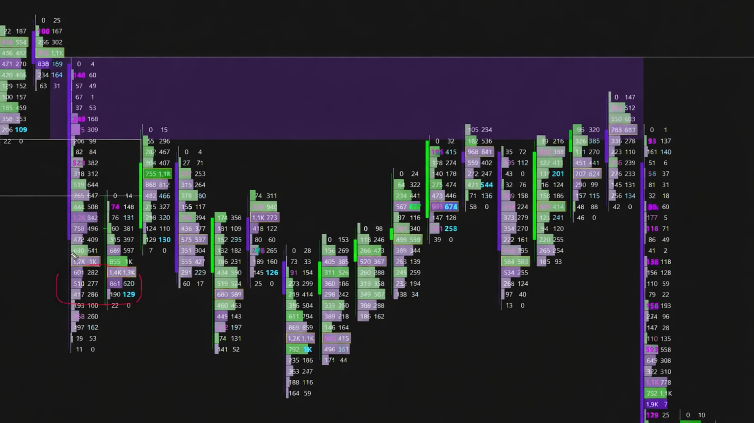
Notes:
We can see here at the bottom that there were aggressive buyers who moved the demand and price up, which dramatically increased the price. And at the very end, we see there were aggressive sellers who moved the price down.

Slide 6
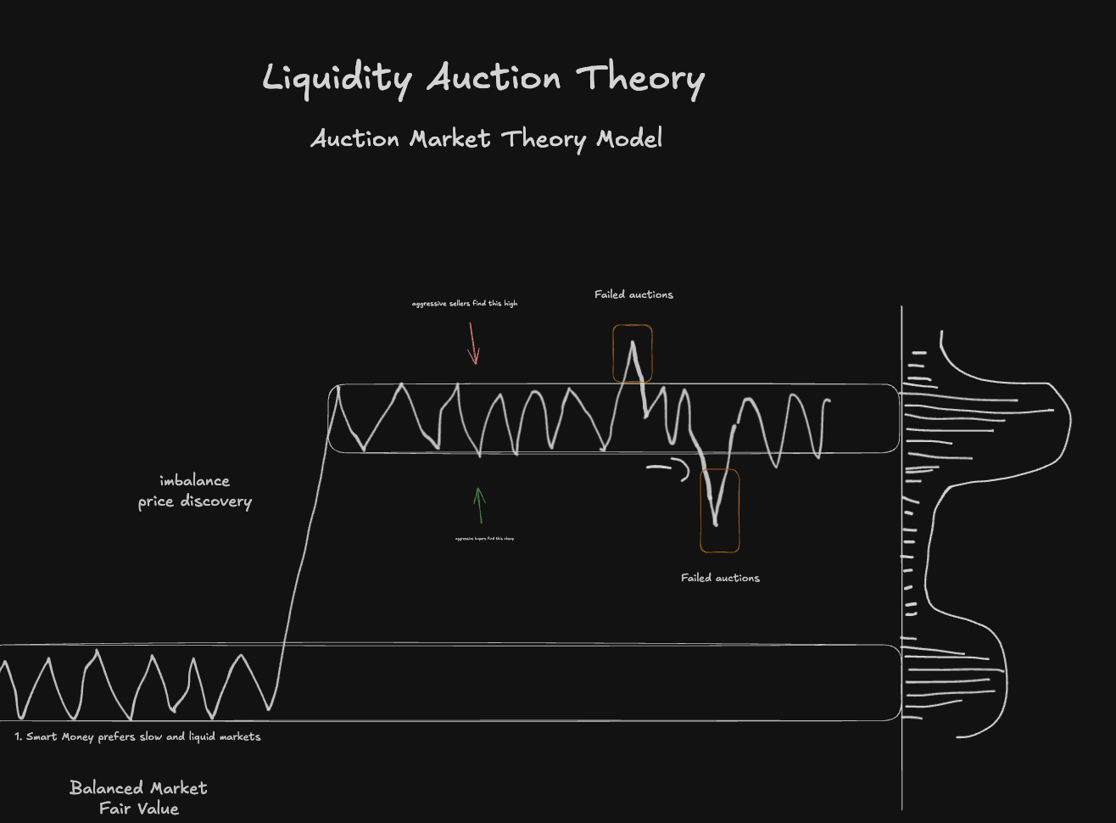
The Strategy (Auction Market Theory)
Market State A: Balanced Market.
Price moves sideways. Buyers and Sellers agree on value.
Action: DO NOT TRADE.
Market State B: Imbalance (Price Discovery).
Aggressive buyers overwhelm sellers. Price "sprints" to find a new value.
Action: ENTER HERE. Ride the imbalance.
Market State C: Failed Auction.
Price tries to go higher but finds no buyers.
Action: EXIT immediately.
Notes:
So how do we trade this? We use 'Auction Market Theory.' The market spends most of its time in 'Balance', just chopping sideways. We do not trade there. We train the Agent to identify the moment of 'Imbalance', when the price breaks out to find a new fair value. So we will want the agent to buy low and sell after it spikes. We ride that wave, and on the other hand, as soon as we see a 'Failed Auction', where the momentum stops, we exit. We simply want to capture the easy middle part of the move. And as we can see in the image on the very right, this is considered the volume, and in balanced areas, the volume traded is the highest.

Slide 7
System Architecture & Data
Assets: NVDA (Nvidia) and TSLA (Tesla) Only.
Why? Massive liquidity and high volatility ("Embedded Leverage"). They respect institutional technical levels.
Data Source: Nasdaq TotalView (ITCH).
Timeline: Jan 1, 2020 – Present.
Why 2020? Captures the modern volatility regime (COVID crash, AI boom, Inflation). Old data is irrelevant.
Training Split:
80% Train: Learning the physics.
20% Test: "Out of Sample" backtesting (Live Simulation).
Notes:
For the system architecture, we are focusing exclusively on Nvidia and Tesla. These two stocks have the highest volume and volatility in the world right now, making them perfect for this strategy. We are acquiring Nasdaq TotalView data from 2020 to today. We rely on modern data because the market structure changed completely after 2020 also from 2020 until today the data it will capture the covid crash and the AI boom as well. We will use 80% of this data to train the brain, and the final 20% to test it as if we were trading live over the last year.

Slide 8
The RL Agent (PPO)
Algorithm: PPO (Proximal Policy Optimization).
Why? Stable, robust, and industry standard for continuous problems.
Action (Output): Discrete Actions (0 Flat, 1 Long, 2 Sell).
Reward Function:
Profit: Scaled PnL (Directly proportional to dollar return)
Profit $100 -> Reward +1.0
Profit $500 -> Reward +5.0
Profit $5,000 -> Reward +50.0
Pain Penalty: -0.3 points per minute for holding a losing trade
Goal: Force the Agent to "Cut Losers Fast" and "Let Winners Run”
Notes:
We use an algorithm called PPO. Every minute, the Agent sees 20 different data points describing the market's physics and chooses to Buy, Sell, or Hold. The secret sauce is our Reward Function. We don't just reward profit; we actively punish 'Failure.' If the Agent holds a losing position, it loses 0.3 points every single second. This forces it to cut losers instantly. On the other hand, we let it hold winning trades without penalty, teaching it the discipline to ride the trend.

Slide 9

Performance Goals
Strategy | Monthly Return | Annual Return (Reinvested)
S&P 500 (Benchmark) | ~0.8% | ~10%
ViperQ Target | 5% | +80%
ViperQ Target (Ideal) | 10% | +213%
The Power of ViperQ: We don't need home runs. We need consistent 5% monthly growth.
Compounding: Reinvesting profits triples the account size in one year at 5%/month.
Notes:
This is why we are doing this. The S&P 500 returns about 10% per year. That is our benchmark. However, with our high-velocity strategy, our goal is to generate 5% per month. And the ideal scenario as you can see in the table, if we can consistently hit just 10% a month and reinvest the profits, we don't just beat the market, we generate over 200% annual returns. The math of compounding is our biggest edge. But our target is just to do 5% profit per month for now.

Slide 10
Evaluation Metrics
1. Sharpe Ratio:
Measures Return vs. Risk.
Goal: Sharpe > 2.0 (Indicates skill, not luck).
2. Maximum Drawdown:
The worst peak-to-trough drop.
Hard Rule: If Drawdown > 20%, the model fails.
3. Win Rate vs. Risk/Reward:
We don't need a 90% win rate.
We need small losses and big wins (Asymmetric Returns).
Notes:
How will we know if we succeeded? We aren't just looking at total profit, which can be lucky, you know, it can be random. But instead, we are looking at the Sharpe Ratio to measure risk-adjusted return. For example, we have 2 people, both did at the end of the month $10000 in returns, but one person's account went down to 50% losses and the other his account went down during the month to only 5% loss. The second person off course is better and will have a higher Sharpe ratio. So the Sharpe Ratio penalizes the trader who had high volatility and rewards the one who was stable. Also We are strictly monitoring Maximum Drawdown, if the Agent loses more than 20% of the account at any point, it fails. Finally, we look at the Risk/Reward ratio to ensure it is taking professional, asymmetric bets, cutting losses fast and letting winners run.

Slide 11
Conclusion & Goal
Summary: ViperQ removes emotion from the "Casino."
Method: Combining Domain Knowledge (Auction Theory) + Modern AI (PPO).
Goal: A Stable, Autonomous Agent that beats market returns. (Beat the S&P 500 using Order Flow)
Notes:
In conclusion, the goal of Project ViperQ is not to build a magic money printer. It is to prove that by combining deep domain knowledge, the Market Physics and Market Auction Theory, with modern AI, we can create a system that navigates uncertainty better than a human. We are taking the emotion out of the casino and replacing it with physics. My goal is to beat the S&P 500, and I look forward to showing you the results soon. Thank you.

Slide 12

Questions

Slide 13
These represent the "state" of the market at any given second, mostly normalized as Z-Scores or ratios so the model can read them easily across any price range:
z_price_vwap (How far the current price is from VWAP, normalized)
z_price_vpoc (How far the price is from the Volume Point of Control)
dist_to_wall (Distance to the nearest large resting limit order / liquidity wall)
cvd_slope (The trajectory/slope of the Cumulative Volume Delta) (tells us if that aggression is increasing or decreasing right now.)
cvd_divergence (Difference between price trend and CVD trend) (This happens when Price goes UP, but the CVD (Aggressive Buying) goes DOWN. It means the price move is fake.)
tape_velocity (Speed of incoming market orders) (Speedometer)
trade_size_z (Normalized size of recent trades to spot institutional activity) (Whales Activity)
imbalance_ratio (Order book pressure: Bid size vs Ask size)
in_lvn_zone (Is price currently in a Low Volume Node / fast moving zone)
unrealized_pnl (The agent's current open profit/loss, so it knows when to hold or fold)
time_in_trade (Seconds elapsed since the trade was opened)
lag_1 (The previous second's price/feature state)
lag_2 (State from 2 seconds ago)
lag_3 (State from 3 seconds ago)
lag_4 (State from 4 seconds ago)
lag_5 (State from 5 seconds ago) 17. lag_6 (State from 6 seconds ago) 18. lag_7 (State from 7 seconds ago)
19. lag_8 (State from 8 seconds ago) 20. lag_9 (State from 9 seconds ago)

