Slide 1
Appraisal-Based Intrinsic Reward Functions for Multi-Agent Reinforcement Learning (MARL)
A Proposal by
Himon Thakur
As Part of Class Project for
CS 5080: Reinforcement Learning – Spring 2026
Instructor
Dr. Jugal Kalita
Date of Presentation
Feb 19, 2026
CC BY-NC-SA 4.0; Himon Thakur, hthakur@uccs.edu;

Slide 2
Agenda
What? | 1. Preamble 2. Background 3. Problem Statement
Why? | 4. Related Works 5. Research Gap
How? | 6. Research Contribution 7. Methods, Dataset, Evaluation 8. Timeline
Conclusion | 9. Limitations 10. Summery

Slide 3
Preamble
Multi-Agent Reinforcement Learning (MARL) It takes a village to raise a child Adaptive Intelligence You sycophant! Multi-Agent Architecture Down with the hierarchy! | Reward Engineering Beyond the binary Appraisal Theory Emotions are not random qualia[^{1]} – Scherer’s Component Process Model (CPM) (Model-Agnostic) Meta-Learning (MAML) Learn to learn to learn
Notes:
single point of failure

Slide 4
Background
LLMs
reasoning
agentic
“intelligence”
scaling
exponential
Manifold-Constrained Hyper-Connections (mHC)
Mixture-of-Experts (MoE)
Attention
Gated DeltaNet
ChatGPT et al.^{[2]}
DeepSeek et al.^{[3]}
2. The internet, The Web
3. The Chinese, for some reason

Slide 5
Problem Statement
Better Rewards?
Collaboration?
Reinforcement Learning?
Better Agents?

Slide 6
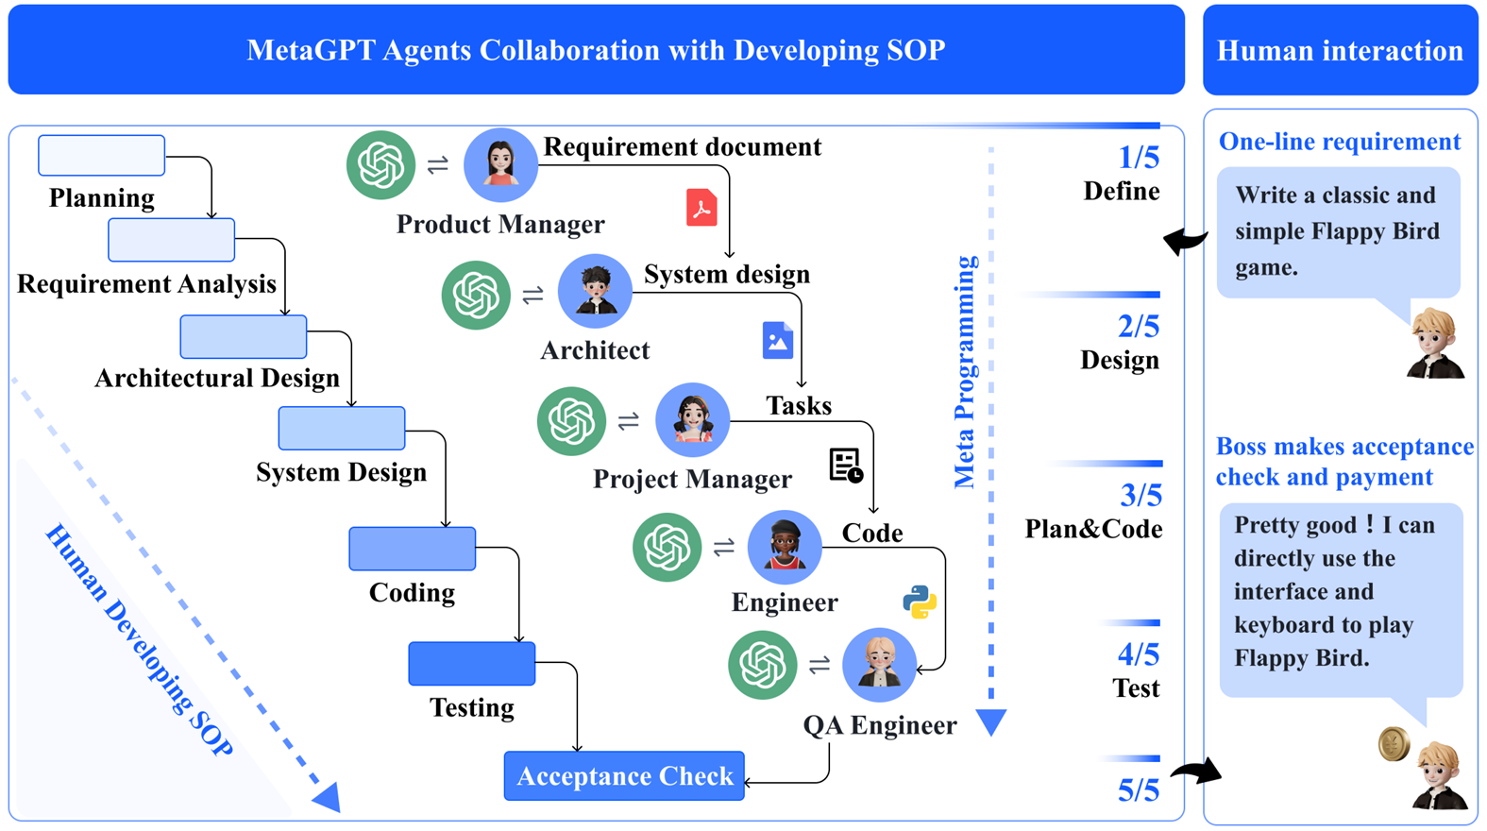
Related Work #1: MetaGPT^{[4]}
[4] Hong, Sirui, et al. "MetaGPT: Meta programming for a multi-agent collaborative framework." The twelfth international conference on learning representations. 2023.

Slide 7
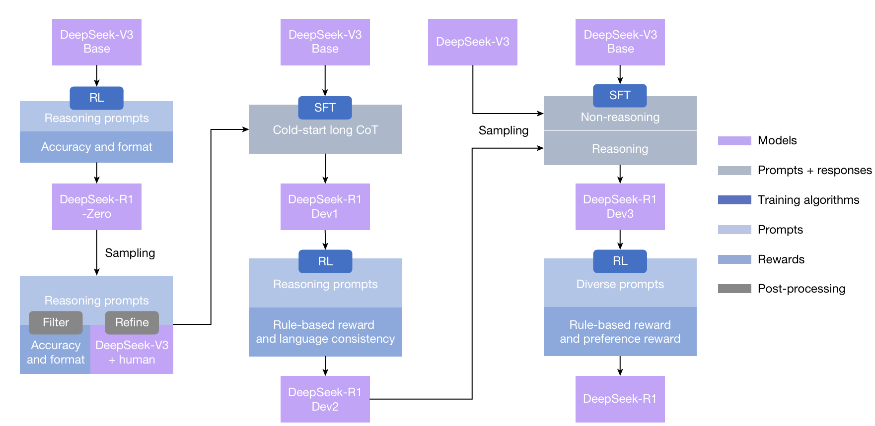
Related Work #2: DeepSeek-R1^{[5]}
[5] Guo, Daya, et al. "Deepseek-r1: Incentivizing reasoning capability in llms via reinforcement learning." arXiv preprint arXiv:2501.12948 (2025).

Slide 8
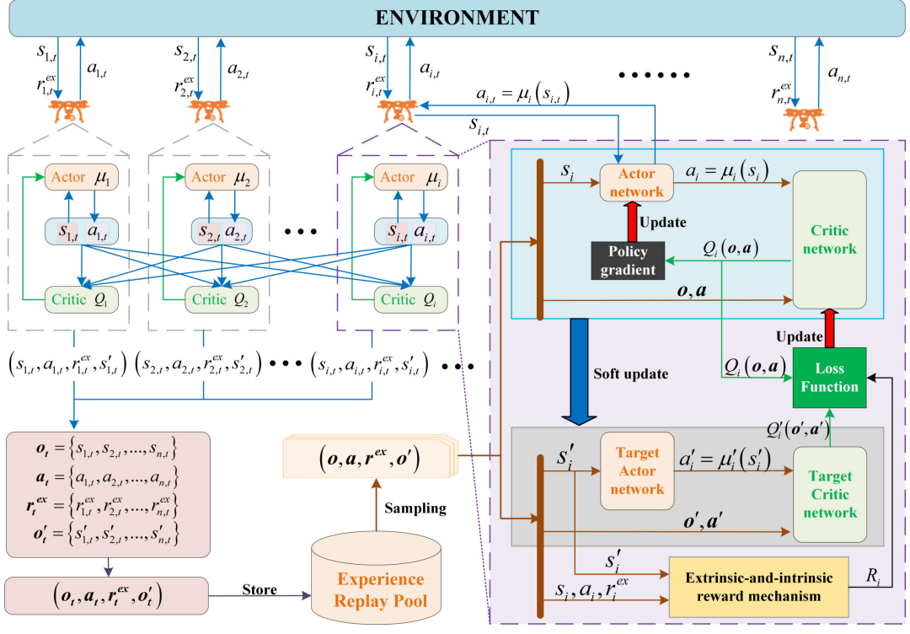
Related Work #3: Extrinsic-and-Intrinsic Reward⁶
[6] J. Chen, Y. Wang, Y. Zhang, Y. Lu, Q. Shu and Y. Hu, "Extrinsic-and-Intrinsic Reward-Based Multi-Agent Reinforcement Learning for Multi-UAV Cooperative Target Encirclement," in IEEE Transactions on Intelligent Transportation Systems, vol. 26, no. 10, pp. 17653-17665, Oct. 2025, doi: 10.1109/TITS.2024.3524562.

Slide 9
Research Gap
Surface level pattern recognition is not AI
Hierarchical systems have ‘single point of failure’, and are non-optimal
Emotions are intrinsic and deterministic
Agents don’t ‘retain’ learning or memory
Binary reward-penalty, win-lose is naïve and narrow

Slide 10


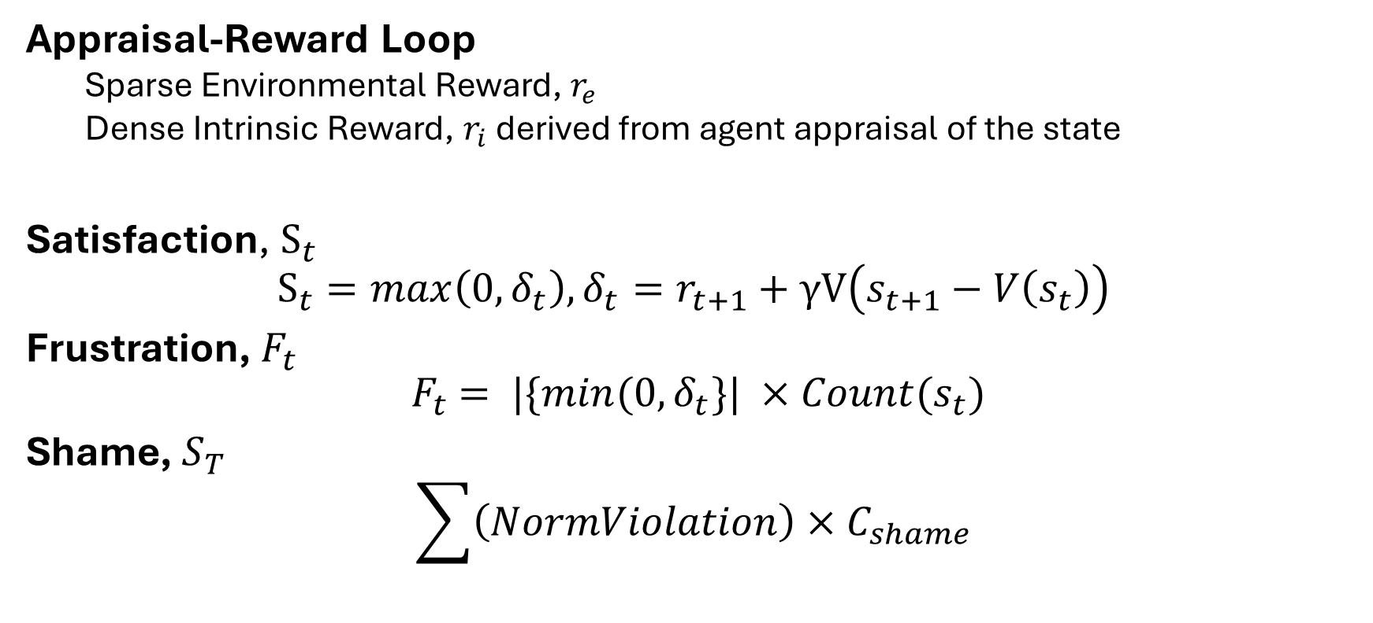
Research Contribution
Appraisal-Reward Loop
Sparse Environmental Reward, $r_{e}$
Dense Intrinsic Reward, $r_{i}$ derived from agent appraisal of the state
Satisfaction, $S_{t}$
$$S_{t}=max\left(0,δ_{t}\right),δ_{t}=r_{t+1}+γV\left(s_{t+1}−V\left(s_{t}\right)\right)$$
Frustration,${ F}_{t}$
$${ F}_{t} = |\{min(0,δ_{t}\}| ×Count(s_{t})$$
Shame, $S_{T}$
$$\sum{\left(NormViolation\right)}×C_{shame}$$

Slide 11

Method, Dataset, Evaluation
Agent Architecture:
Non-hierarchical (dynamic?)
Proximal Policy Optimization (PPO)
OpenAI Gym
HumanEval
$$R_{total}=R_{ext}+w_{j}J_{t}−W_{f}F_{t}−W_{s}S_{t}$$
[7] Schulman, John, et al. "Proximal policy optimization algorithms." arXiv preprint arXiv:1707.06347 (2017).

Slide 12
Timeline
Month | Task
February | Topic Formulation
March | Finalize Methodology
April | Complete Multi-Agent Structure
May | Complete and Evaluate Reward System

Slide 13
Limitations
LLMs are computationally (local models) and monetarily(API) expensive
Reinforcement Learning is hard
Reward functions might be unstable
AI is moving too fast

Slide 14
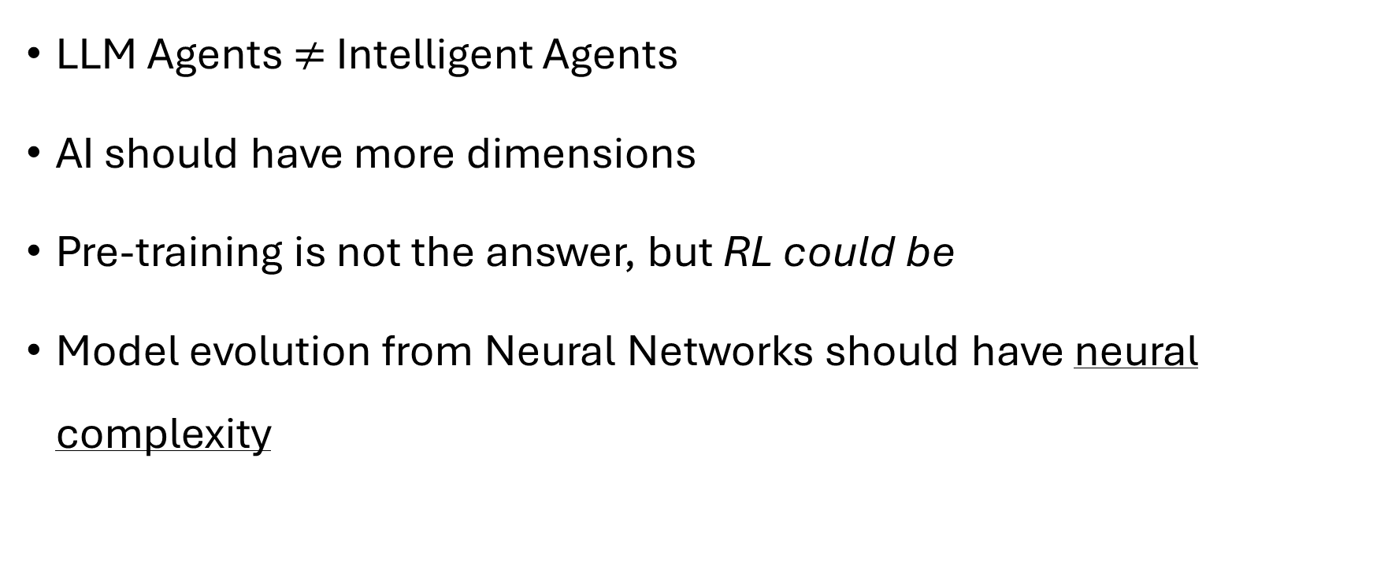
Summery
LLM Agents $≠$ Intelligent Agents
AI should have more dimensions
Pre-training is not the answer, but RL could be
Model evolution from Neural Networks should have neural complexity

Slide 15
Fin.
Questions?

