Slide 1
Finetuning Large Language Models with Proprietary Data
Joe Weibel

Slide 2
Background
Large Language Model (LLM) – Neural network that has been training on large amounts of data to predict the next token value
Reinforcement Learning from Human Feedback (RLHF) – Training paradigm that will assist with aligning what the model outputs with desired output using a feedback reward structure
Proximal Policy Optimization (PPO) – A reinforcement learning algorithm that uses controlled updates to the policy based on the reward signals without making drastic changes
Low-Rank Adaptation (LoRA) – Freezes the original model’s weights and adds new matrices to the model. Instead of tuning the entire model, I only tune the low rank matrices added to increase efficiency

Slide 3
Problem Statement
Most large language models are training on broad and any accessible public data that can not align with what is being done in an air gapped network or just doesn’t align with proprietary business practices
Finetuning an entire model is computationally expensive and can have issues such as overfitting and forgetting what it was initially trained on
Using LoRA is more efficient at fine tuning that a complete retrain of the model and using reinforcement learning will help build trust in the agent's responses
What is the best way to adapt pretrained models that don’t align with an organization, to proprietary data to increase efficiencies across the organization?

Slide 4
Objectives
Can LoRA compete with a model that has been fully fine-tuned? Is the efficiency in finetuning a good trade off?
Quantify the difference between how different models perform
Base model
PPO aligned model with LoRA
I want to gain experience with this project so I can implement a solution in a professional setting at my current job to gain efficiencies across the software development lifecycle

Slide 5
Related Work – arxiv 2017
Design a policy gradient algorithm that is as stable and reliable as trust region policy optimization, simpler to implement, more sample efficient
Results showed PPO was comparable or outperformed all algorithms it was tested against while keeping the reward feedback loops to remain stable
Baseline Algorithm | Environment | Result
Vanilla Gradient Policy | MuJoCo Continuous control: Walker2d | Vanilla PG: -0.39 PPO: 0.82
TRPO | MuJoCo Continuous control | PPO achieved comparable results or outperformed TRPO
Fixed KL penalty PG | MuJoCo Continuous control | KL: 0.62-0.72 PPO: 0.82
Schulman, John, et al. "Proximal policy optimization algorithms." arXiv preprint arXiv:1707.06347 (2017).

Slide 6
Related Work – ICLR 2022
Retraining all parameters in a large language model is unnecessary and you can achieve optimal results by training less than 0.1% of all parameters
Used GPT-3 175B, GPT-2 medium and large
LoRA demonstrates only training a few low rank parameters can achieve the same performance of full finetuning
Training method | Parameters | WikiSQL accuracy | MNLI accuracy
Full fine-tuning | 175B | 73.0% | 89.5%
LoRA | 4.7M-37.7M | 73.4% - 73.8% | 91.3% - 91.7%
Hu, Edward J., et al. "Lora: Low-rank adaptation of large language models." ICLR 1.2 (2022): 3.

Slide 7
Related Work – NeurIPS 2023
Wanted to prove LLMs can be fine tuned at a low precision without losing performance
Full fine tuning of LlaMA 65B required over 780GB of GPU memory while full fine tuning with QLoRA reduced this to less than 48GB
The best QLoRA model, Guanaco 65B, achieved 99.3% of ChatGPTs performance on the Vicuna benchmark
Guanaco 33B was training on a single GPU and achieved 97.8% of ChatGPTs performance in less than 12 hours
Dettmers, Tim, et al. "Qlora: Efficient finetuning of quantized llms." Advances in neural information processing systems 36 (2023): 10088-10115.

Slide 8
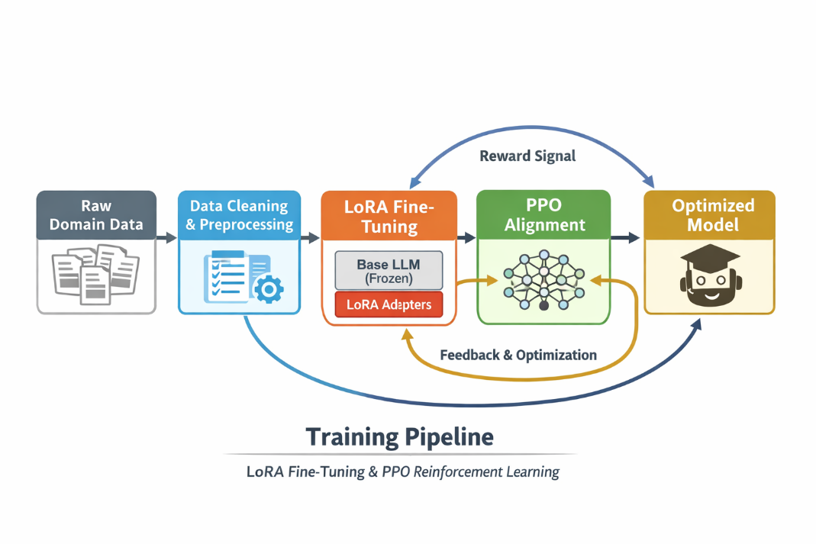
Methodology / Reward Design
Intake raw data
Clean and preprocess data
One policy model with LoRA adapters is iteratively updated by PPO
Optimized model is the starting point of each iteration; samples get generated and rewards calculated and then the policy model will be updated and produce a new optimized model

Slide 9
Goals / Milestones
19FEB | Proposal
03MAR | Setup baseline model and get initial metrics
10MAR | Create automated pipeline for data cleaning, injecting, training
24MAR | Efficiently adapting baseline model to data using LoRA
14APR | Tweak reward structure and integrate PPO
01MAY | Compare base model vs LoRA vs PPO
14MAY | Final Presentation and demo

Slide 10
Questions?

