Slide 1
Machine Learning for Exoplanet Detection: Identifying Exoplanets in Light Curves
Tristan Moffett
Josh Manchester
Brianne Leatherman

Slide 2
General background of Exoplanet discovery
Kepler/K2 mission
2009-2018
Continuously monitored one section of sky for 4 years
More than 4000 potential planets, and 2700 are confirmed
TESS (Transiting Exoplanet Survey Satellite) mission
2018-present
Monitors a different segment of sky every 27 days
Over 7000 potential planets, and almost 700 confirmed
Exoplanets often found by analyzing light curve data
Looking for periodic threshold crossing events, or dips in intensity of the light coming from the star

Slide 3
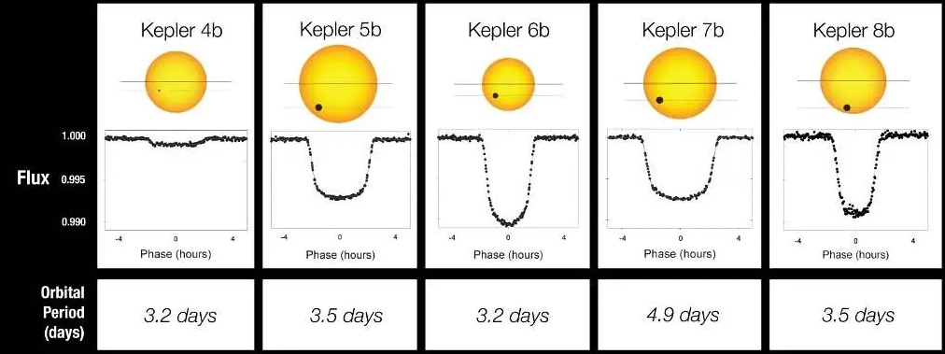
What are Threshold Crossing Events?
NASA. (2010, January 4). Light curves of Kepler’s first 5 discoveries [Image]. NASA. https://www.nasa.gov/image-article/light-curves-of-keplers-first-5-discoveries/

Slide 4
Problem Statement and Method
There is currently way more data than can be analyzed by hand, and Machine Learning (ML) is the logical solution.
We will compare the performance of the following ML methods after training and testing on the same sets of data:
Convolutional Neural Network (CNN)
Transformers
Recursive Neural Network (RNN)
We will use these deep learning methods to analyze light curve data for threshold crossing events (TCEs) which may indicate the transit of an exoplanet

Slide 5
Data sets
Simulated K2 data (free data sets available from NASA Exoplanet Archive)
Labeled TESS light curves (list of confirmed planets and false positives from NASA Exoplanet Archive, light curves available from MAST)
Reserve 20% of each data set for testing
If models are accurate, compare results when looking at unlabeled Kepler/K2/TESS data

Slide 6
CNN Research Papers
Shallue, C. J., & Vanderburg, A. (2018). Identifying exoplanets with deep learning: A five-planet resonant chain around Kepler-80 and an eighth planet around Kepler-90. The Astronomical Journal, 155(2), 94. https://doi.org/10.3847/1538-3881/aa9e09
Dattilo, A., Vanderburg, A., Shallue, C. J., Mayo, A. W., Berlind, P., Bieryla, A., Calkins, M. L., Esquerdo, G. A., Everett, M. E., Howell, S. B., Latham, D. W., Scott, N. J., & Yu, L. (2019). Identifying exoplanets with deep learning II: Two new super-Earths uncovered by a neural network in K2 data. The Astronomical Journal, 157(5), 169. https://doi.org/10.3847/1538-3881/ab0e12
Osborn, H. P., Ansdell, M., Ioannou, Y., Sasdelli, M., Angerhausen, D., Caldwell, D., Jenkins, J. M., Räissi, C., & Smith, J. C. (2020). Rapid classification of TESS planet candidates with convolutional neural networks. Astronomy & Astrophysics, 633, A53. https://doi.org/10.1051/0004-6361/201935345

Slide 7
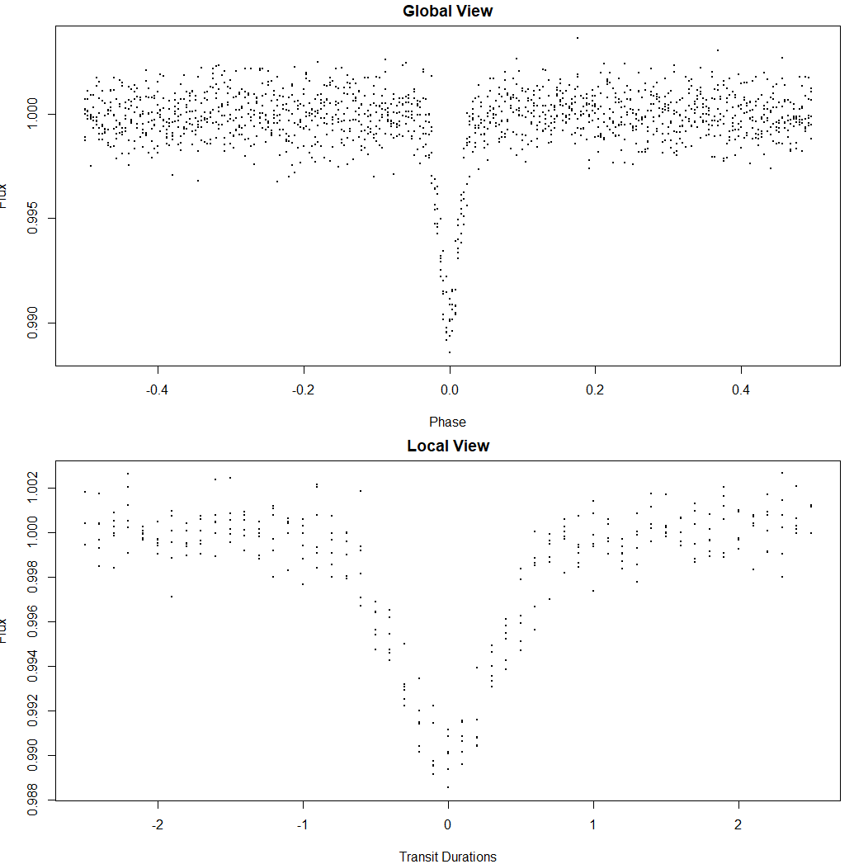
Identifying Exoplanets with Deep Learning (The Astronomical Journal, 2018)
Goal: Find and build a classifier for Kepler data
Approach: Compared linear, fully connected, and 1-D CNN models using Kepler and DR24 data. Best results from CNN using global and local views of light cure sequences.
Techniques: Phase-folding, spline detrending, augmentation, dropout, ensemble learning.
Model (AstroNet): 1-D CNN with 4/10 Convolutional layers, Max Pooling, Dense FC-512 layer with a sigmoid probability output.
Results Observational: 96% Accuracy, 98.8% AUC, 96% precision, 95% recall.
Results Simulated: 81% recovery of true planets, misclassified 90% background planets, and misclassified 65% of eclipsing binaries.
Findings: Kepler-80g and Kepler-90i
Takeaways: Models limited by generalization. Extend to simulated data and centroid features.

Slide 8
Identifying Exoplanets with Deep Learning II (The Astronomical Journal, 2019)
Goal: Build a CNN classifier for K2 data
Approach: Extended AstroNet architecture to handle K2 dataset. Trained on K2 TCEs and ran validation and tuning on simulated TCEs. Used local and global views.
Techniques: Phase-folding, spline detrending, data augmentation, ensemble learning, scalar features (Rp/R* and impact).
Model (AstroNet-K2): 1-D CNN with 4/8 Convolutional layers, Max Pooling, Dense FC-512 layer with a sigmoid probability output.
Results Observational: Accuracy 97.8%, AUC 98.8%, 94% in capturing planets.
Findings: K2-293B and K2-294B
Takeaways: Shows CNNs can work on noisier light curve sequences and that scalar features may help in improving classification.

Slide 9
Rapid Classification of TESS Planet Candidates with Convolutional Neural Networks (Astronomy & Astrophysics, 2019)
Goal: Build a CNN classifier for TESS data
Approach: Adapted AstroNet/ExoNet CNN. Trained on TSOP-301 (simulated). Used local and global views with centroids.
Techniques: Phase-folding, normalization, balanced batches, augmentation, cross-validation
Model: 1-D CNN with 4/8 Convolutional layers, Max Pooling, Dense FC-256 layer into both a sigmoid (binary) and softmax(multi-class) output
Results Simulated: AP(Acc/Prec) of 97.3%
Results Observational: Planet Precision of 91.8% and 61% recovery on real TESS exoplanets
Takeaways: Proof that CNNs can reduce human vetting and classify planets though possibly limited in generalization.

Slide 10
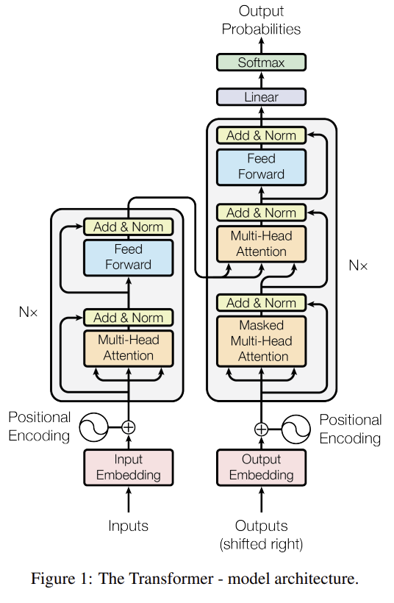
Transformer model
Input/output embedding
Creates tokens and encodes positional data
Encoder/decoder
Creates relationships between tokens
Multi-Head Attention
Weights the relationships between tokens
Each token is compared to every other token
Each head compares the tokens in a different way
Relationship weights are determined by the query, key, and value vectors
Add & Norm
Keeps important information distinct and appropriately scaled
Feed Forward
Creates new token vectors by applying learned weights for the next step
Good for sequential data (text or time series)
Initially used in Large Language Models
Parallelization makes training more efficient
Figure 1 reproduced with permission by Google for scholarly use, from Vaswani et al. (2017).
Vaswani, A., Shazeer, N., Parmar, N., Uszkoreit, J., Jones, L., Gomez, A. N., Kaiser, Ł., & Polosukhin, I. (2017). Attention is all you need. In Proceedings of the 31st International Conference on Neural Information Processing Systems (NIPS 2017) (pp. 6000–6010). Curran Associates Inc. https://arxiv.org/pdf/1706.03762
Notes:
"Attention is all you need" Nature ranks it as 7th most-cited paper in 21st century, presents the Transformer architecture, brings parallelization to ML, allows faster training with GPUs GPT – Generative Pre-trained Transformer

Slide 11
Transformer Research Papers
Morvan, M., Nikolaou, N., Yip, K. H., & Waldmann, I. (2022). Don't pay attention to the noise: Learning self-supervised representations of light curves with a denoising time series transformer. Proceedings of the Thirty-ninth International Conference on Machine Learning (ICML 2022). https://arxiv.org/abs/2206.08447
Salinas, H., Pichara, K., Brahm, R., Pérez-Galarce, F., & Mery, D. (2023). Distinguishing a planetary transit from false positives: A Transformer-based classification for planetary transit signals. Monthly Notices of the Royal Astronomical Society, 522(3), 3201–3216. https://doi.org/10.1093/mnras/stad1173
Salinas, H., Brahm, R., Olmschenk, G., Barry, R. K., Pichara, K., Silva, S. I., & Araujo, V. (2025). Exoplanet transit candidate identification in TESS full-frame images via a transformer-based algorithm. Monthly Notices of the Royal Astronomical Society, 538(3), 2031–2049. https://doi.org/10.1093/mnras/staf347

Slide 12
Don’t pay attention to the noise: Learning self-supervised representations of light curves with a denoising time series transformer
Goal: To create a self-supervised framework that remove noises and repopulates data gaps (imputation) from raw light curves
Data set: TESS (raw light curve data)
Method: Denoising Time Series Transformer (DTST)
​​Used 30% masking ratio on light curve data
Encoder-only, with three layers and eight heads each
Results: Lowest residual noise (IQR 0.385%) and lowest error (MAE 0.235%) compared to two other methods
Impact: Does not need a fixed sliding window size, greater adaptability to data
Morvan, M., Nikolaou, N., Yip, K. H., & Waldmann, I. (2022). Don't pay attention to the noise: Learning self-supervised representations of light curves with a denoising time series transformer. Proceedings of the Thirty-ninth International Conference on Machine Learning (ICML 2022). https://arxiv.org/abs/2206.08447

Slide 13
Distinguishing a planetary transit from false positives: A Transformer-based classification for planetary transit signals
Goal: Classify Threshold Crossing Events (TCEs) as either true exoplanet transits or false positives
Data set: TESS phase-folded light curves, centroid data
Method: CNN tokenization, then positional data embedding, then three encoder layers, each containing four multi-head self-attention layers, with four heads each
Results: Achieved competitive performance with CNNs with average precision, recall, and F1 ≈ 0.88
Impact: Transformers can match CNN accuracy
Salinas, H., Pichara, K., Brahm, R., Pérez-Galarce, F., & Mery, D. (2023). Distinguishing a planetary transit from false positives: A Transformer-based classification for planetary transit signals. Monthly Notices of the Royal Astronomical Society, 522(3), 3201–3216. https://doi.org/10.1093/mnras/stad1173

Slide 14
Exoplanet transit candidate identification in TESS full-frame images via a transformer-based algorithm
Goal: Identify exoplanet candidates in TESS Full Frame Images (FFIs) without relying on phase folding or periodicity assumptions
Data set: TESS raw full-frame images, centroid data, background flux time series, artificially injected light curves
Method: 2-layer CNN data tokenization, then positional embedding, then one encoder with four multi-head layers, each with four heads
Results: Average AUC of 0.88 and F1 score of 0.82. Then observed more than 4 million light curves, indicating 0.1% were possible candidates, 25% of which were valid candidates
Impact: Successfully identified 214 new planetary candidates, including 88 single-transit candidates, indicates high ability to generalize
Salinas, H., Brahm, R., Olmschenk, G., Barry, R. K., Pichara, K., Silva, S. I., & Araujo, V. (2025). Exoplanet transit candidate identification in TESS full-frame images via a transformer-based algorithm. Monthly Notices of the Royal Astronomical Society, 538(3), 2031–2049. https://doi.org/10.1093/mnras/staf347

Slide 15
RNN Research Papers
Vida, K., Bódi, A., Szklenár, T., & Seli, B. (2021). Finding flares in Kepler and TESS data with recurrent deep neural networks. Astronomy & Astrophysics, 652, A107.
Kügler, S. D., Gianniotis, N., & Polsterer, K. L. (2016). An explorative approach for inspecting Kepler data. Monthly Notices of the Royal Astronomical Society, 455(4), 4399–4405.
Du, N., Dai, H., Trivedi, R., Upadhyay, U., Gomez-Rodriguez, M., & Song, L. (2016). Recurrent marked temporal point processes: Embedding event history to vector. In Proceedings of the 22nd ACM SIGKDD International Conference on Knowledge Discovery and Data Mining (pp. 1555–1564). New York, NY: ACM.

Slide 16
Finding flares in Kepler and TESS data with recurrent deep neural networks Why RNN: Long, noisy light curves → need memory of past context.
Data / tools: Kepler (train) → TESS (test); automated flare detection..
RNN used: Stacked LSTM + dropout; sigmoid output (binary).
Why this RNN: LSTM > GRU/CNN here for temporal dependencies.
Success: ≈80–90% precision/recall for strong flares; Kepler→TESS transfer. My takeaway: Start with 2–3×LSTM (128–256), class weighting, dropout, early stopping; include hard negatives.

Slide 17
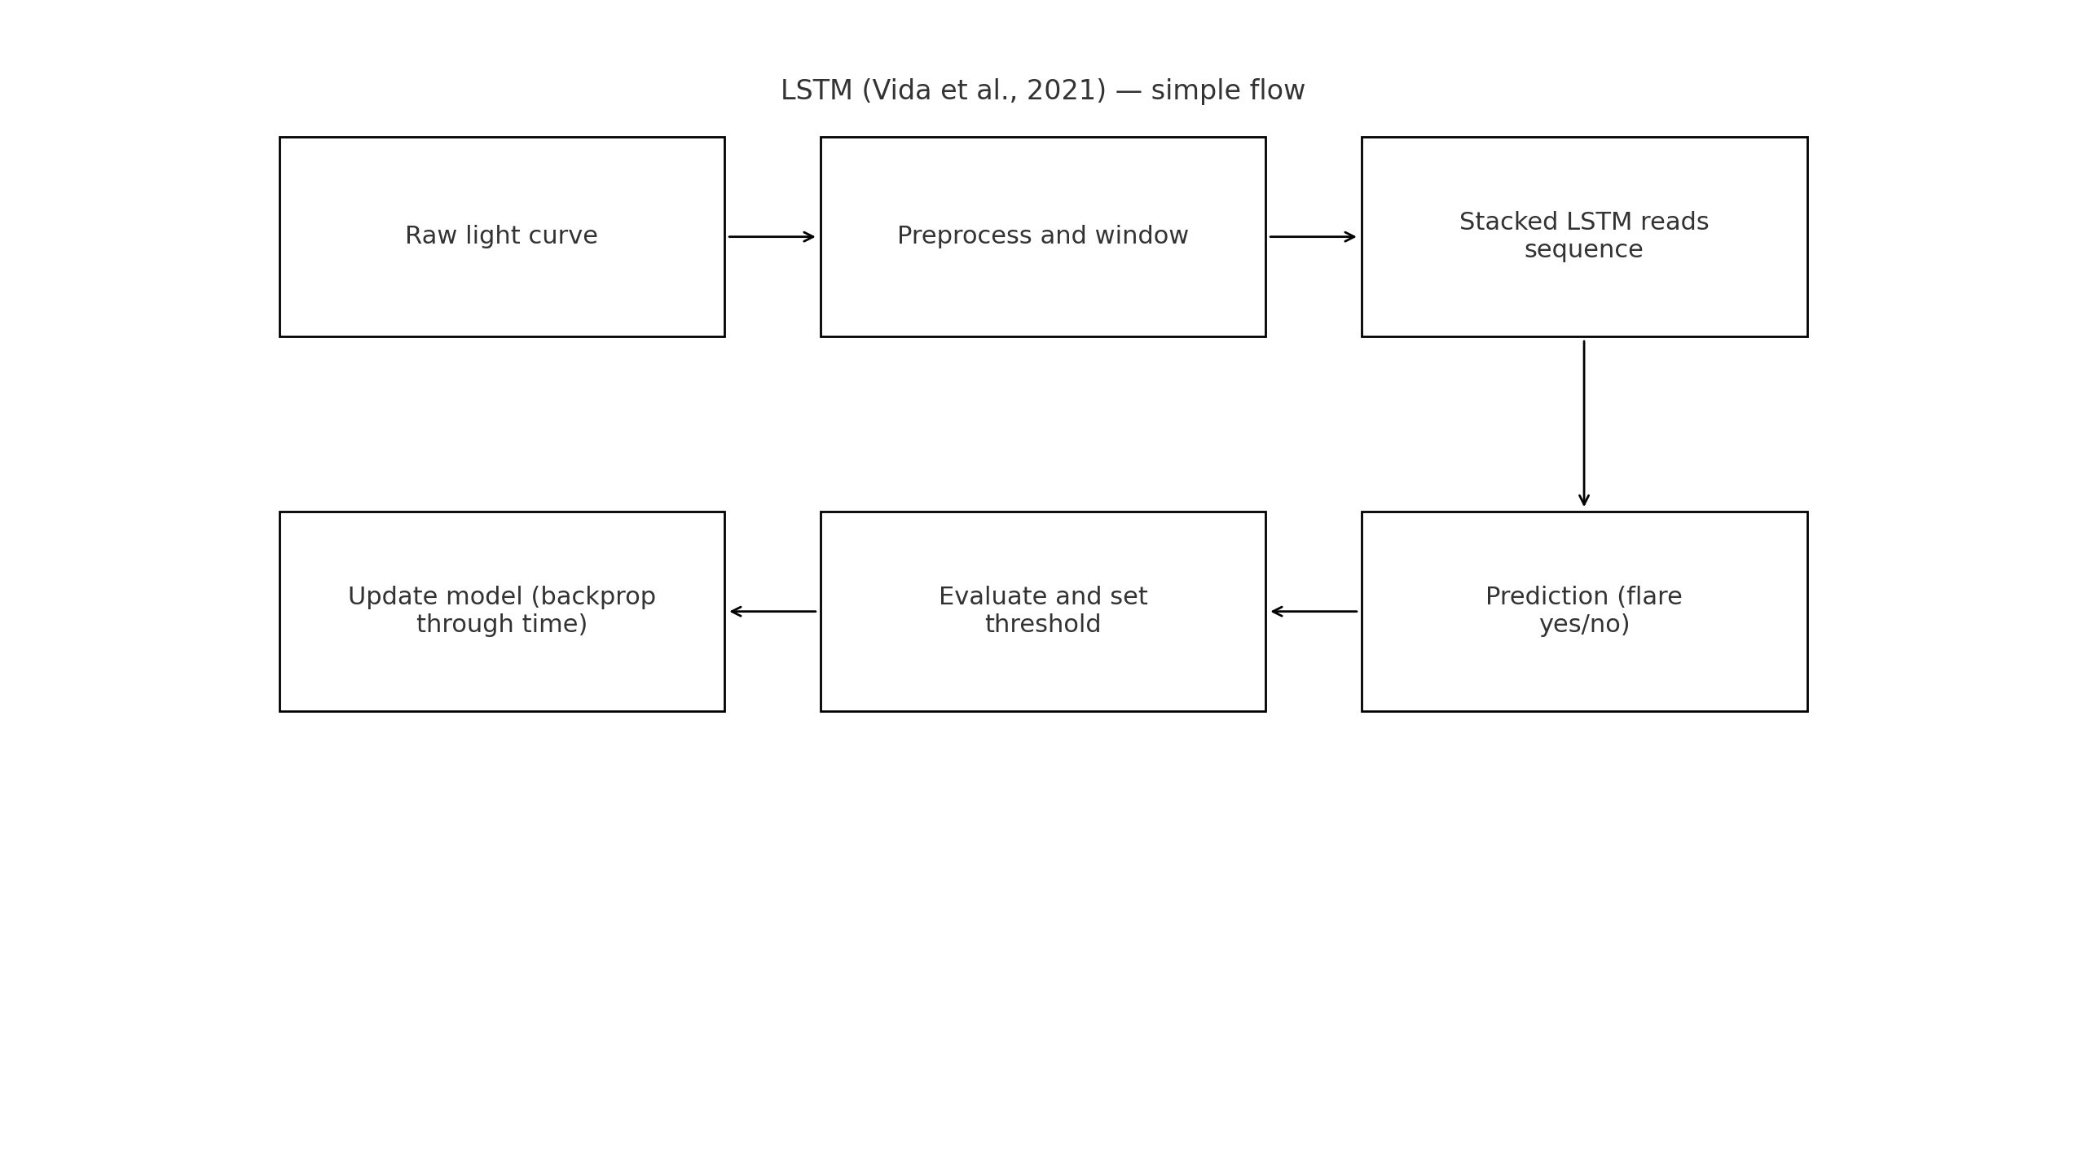

Slide 18
An explorative approach for inspecting Kepler data Why RNN/seq model: Capture full sequence dynamics of Kepler curves.
Data / tools: Kepler; ESN reservoir + autoencoder (sequence-aware).
Success: Better clustering/visualization of dynamics than PCA/plain AE.
RNN used: Echo State Network (ESN) reservoir + autoencoder (ESN-AE). Why this RNN: ESN gives fast recurrent state; optimize in sequence space. Success: Clearer clustering/visualization vs. PCA/plain AE (qualitative SOTA). My takeaway: Use sequence-aware diagnostics/objectives; inspect scores over time, not just final embeddings.

Slide 19
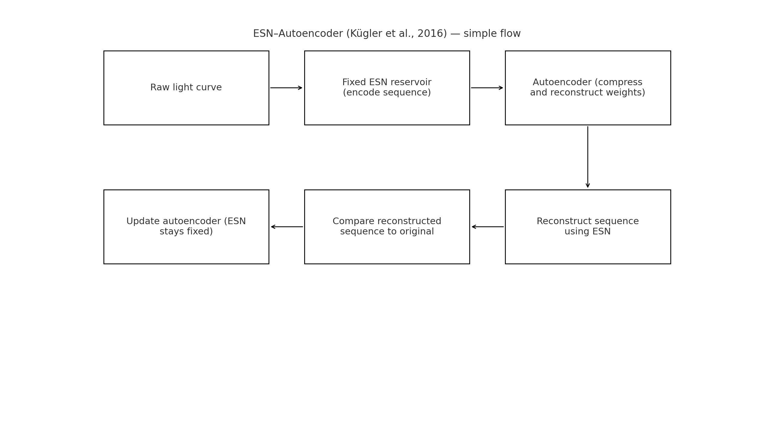

Slide 20
Recurrent marked temporal point processes: Embedding event history to vector Why RNN: Need model of event timing + type, not just labels.
Data / tools: General event streams; RMTPP with RNN history encoder.
RNN used (specific): RMTPP with an RNN history encoder (tanh-RNN in the formulation) to parametrize intensity.
Why this RNN: Non-parametric timing from history; flexible vs. fixed forms.
Success: Better next-event time/type prediction across domains. My takeaway: Add timing helper (intervals / rough period) as feature or tiny aux loss to favor periodic transits.

Slide 21
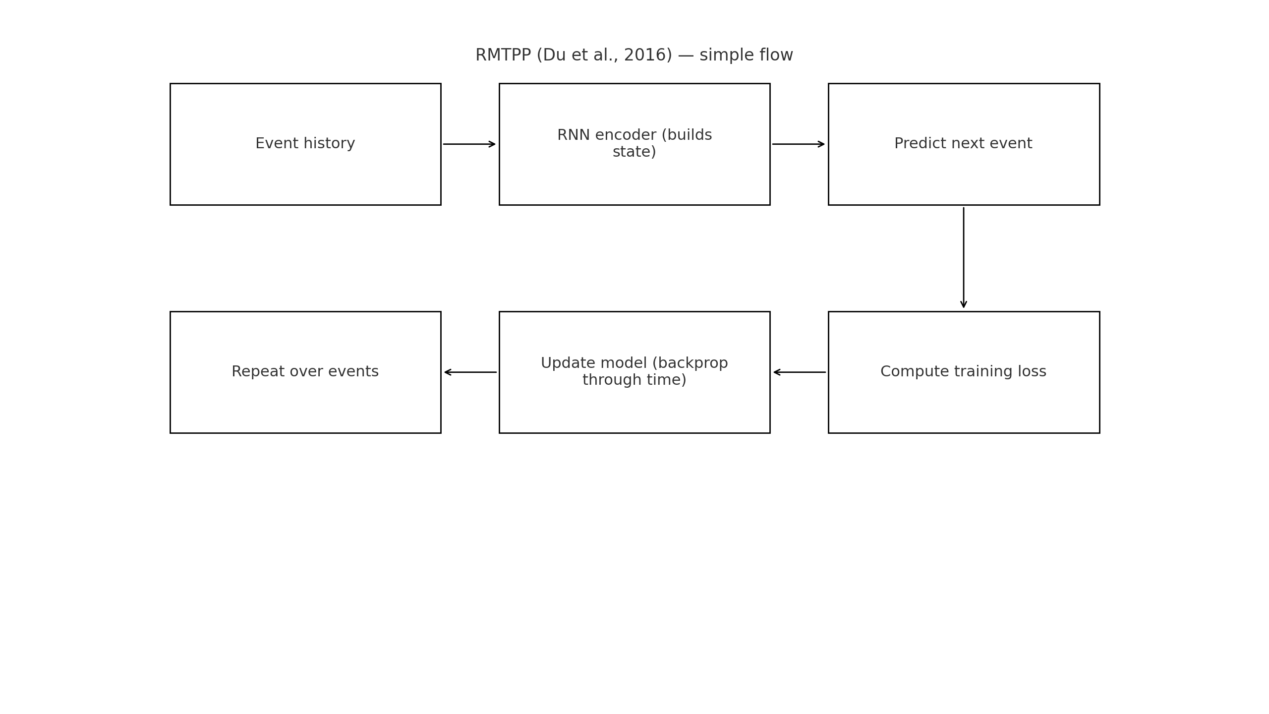

Slide 22
Considerations in achieving goals
Determining sky sector?
Preprocessing data
Standardization and normalization
Creating test data
Ruling out false positives
Finding uniform analysis metric to compare methods

Slide 23
Project Plan
Goal: Identify Kepler/TESS TCEs
Data: Kepler/TESS/Simulated light curves
Metrics: Accuracy, Precision, Recall, F1, and AUC (Area Under Curve)
Milestones:
Week 1-2: Preprocess light curves
Week 3-4: Train model
Week 5-6: Evaluate using precision, recall, AUC
Week 7-8: Compare models and present findings

