Slide 1
Machine Learning for Exoplanet Detection: Identifying Exoplanets in Light Curves
Tristan Moffett, Josh Manchester, Brianne Leatherman
CS 4820
Professor Atyabi

Slide 2
General background of Exoplanet discovery
Kepler/K2 mission
2009-2018
Continuously monitored one section of sky for 4 years
More than 4000 potential planets, and 2700 are confirmed
TESS (Transiting Exoplanet Survey Satellite) mission
2018-present
Monitors a different segment of sky every 27 days
Over 7000 potential planets, and almost 700 confirmed
Exoplanets often found by analyzing light curve data
Looking for periodic threshold crossing events, or dips in intensity of the light coming from the star

Slide 3
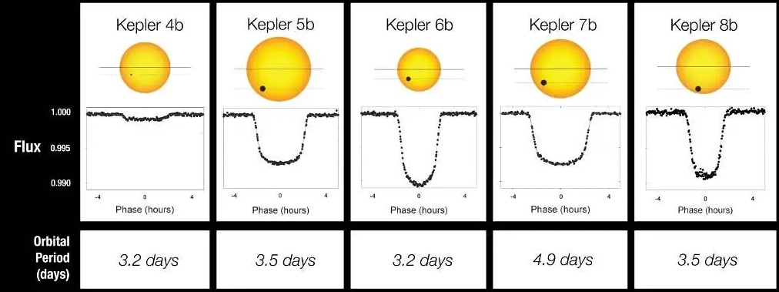
What are Threshold Crossing Events?
NASA. (2010, January 4). Light curves of Kepler’s first 5 discoveries [Image]. NASA. https://www.nasa.gov/image-article/light-curves-of-keplers-first-5-discoveries/

Slide 4
Problem Statement and Method
There is currently way more data than can be analyzed by hand, and Machine Learning (ML) is the logical solution.
We will compare the performance of the following ML methods after training and testing on the same sets of data:
Convolutional Neural Network (CNN)
Transformers
Recursive Neural Network (RNN)
We will use these deep learning methods to analyze light curve data for threshold crossing events (TCEs) which may indicate the transit of an exoplanet

Slide 5
Data sets
Simulated K2 data (free data sets available from NASA Exoplanet Archive)
Labeled TESS light curves (list of confirmed planets and false positives from NASA Exoplanet Archive, light curves available from MAST)
Reserve 20% of each data set for testing
If models are accurate, compare results when looking at unlabeled Kepler/K2/TESS data

Slide 6
New RNN Related Works
Becker, I., Pichara, K., Catelan, M., Protopapas, P., Aguirre, C., & Nikzat, F. (2021). Scalable end-to-end recurrent neural network for variable star classification. Monthly Notices of the Royal Astronomical Society, 493(2), 2981-2995. Schanche, N., Cameron, A. C., Hébrard, G., Nielsen, L., Triaud, A. H. M. J., Almenara, J. M., ... Udry, S. (2019). Machine-learning approaches to exoplanet transit detection and candidate validation in wide-field ground-based surveys. Monthly Notices of the Royal Astronomical Society, 483(4), 5534-5547. Malik, A., Moster, B. P., & Obermeier, C. (2022). Exoplanet detection using machine learning. Monthly Notices of the Royal Astronomical Society, 513(4), 5505-5516.

Slide 7
CNN-LSTM for Variable Star Classification
Key Innovation
Hybrid CNN-LSTM architecture achieves 92-95% accuracy classifying variable star light curves
Key Takeaway
Raw time-series input works well; weighted loss handles severe class imbalance (10-20x) effectively
Architecture:
• 1D CNN layers (kernel 3-7) for local feature extraction
• LSTM layers capture long-range temporal dependencies
• Hybrid outperforms single-architecture by 5-8%
Results:
• 92-95% accuracy on OGLE and CRTS surveys
• Cross-survey generalization validated
• Class imbalance handled via stratified sampling + weighted loss
Becker, I., Pichara, K., Catelan, M., Protopapas, P., Aguirre, C., & Nikzat, F. (2021). Scalable end-to-end
recurrent neural network for variable star classification. Monthly Notices of the Royal Astronomical Society, 493(2), 2981-2995.

Slide 8
ML for Ground-Based Transit Surveys
Key Innovation
Ensemble classifiers achieve ~90% planet identification on noisy ground-based WASP data
Key Takeaway
If ML works on noisy ground data, BiLSTM should work even better on cleaner space-based TESS photometry
Architecture:
• Random Forest + CNN ensemble classifiers
• Trained on planets, EBs, variable stars, non-periodic
• Ensemble voting reduces individual classifier errors
Results:
• ~90% correct planet identification
• Separates planets from eclipsing binary false positives
• Transit depth & duration are key discriminating features
Schanche, N., Cameron, A. C., Hébrard, G., Nielsen, L., Triaud, A. H. M. J., Almenara, J. M., ... Udry, S. (2019). Machine-learning
approaches to exoplanet transit detection and candidate validation in wide-field ground-based surveys. Monthly Notices of the Royal Astronomical Society, 483(4), 5534-5547.

Slide 9
Feature-Based Detection with Gradient Boosting
Key Innovation
789 TSFRESH statistical features + LightGBM achieves AUC 0.948, Recall 0.96 on Kepler
Key Takeaway
Feature-based methods set a high bar (AUC 0.948) that neural networks must exceed to justify complexity
Architecture:
• TSFRESH extracts 789 time series features automatically
• LightGBM gradient boosting for classification
• No neural network required - pure feature engineering
Results:
• AUC: 0.948 (ranks planets above non-planets 95% of time)
• Recall: 0.96 (detects 96% of real planets)
• Establishes performance target for neural approaches
Malik, A., Moster, B. P., & Obermeier, C. (2022). Exoplanet detection using machine learning. Monthly Notices of the Royal
Astronomical Society, 513(4), 5505-5516.

Slide 10
Why BiLSTM + Clustering?
From the Papers:
• CNN-LSTM hybrid outperforms single architectures (Becker 2021)
• Ensemble/clustering reduces classification errors (Schanche 2019)
• Feature-based methods set AUC 0.948 target (Malik 2022)
My Approach:
BiLSTM + K-means clustering on BLS features

Slide 11
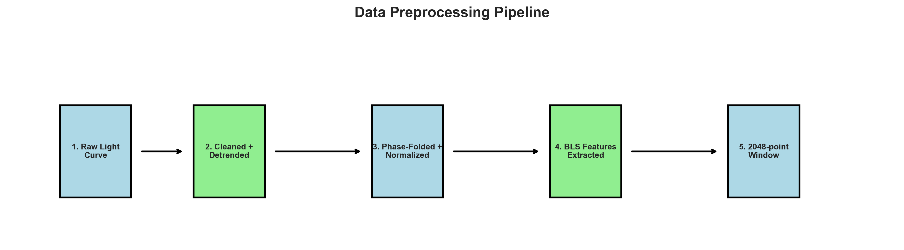
Methodology
Data: 33,051 windows (7,686 planets, 25,365 non-planets)
Features: Period, depth, duration, BLS power
Architecture:
• K-means (7 clusters)
• 4-layer BiLSTM (192 hidden, bidirectional)
• Cluster embeddings (64-dim)

Slide 12
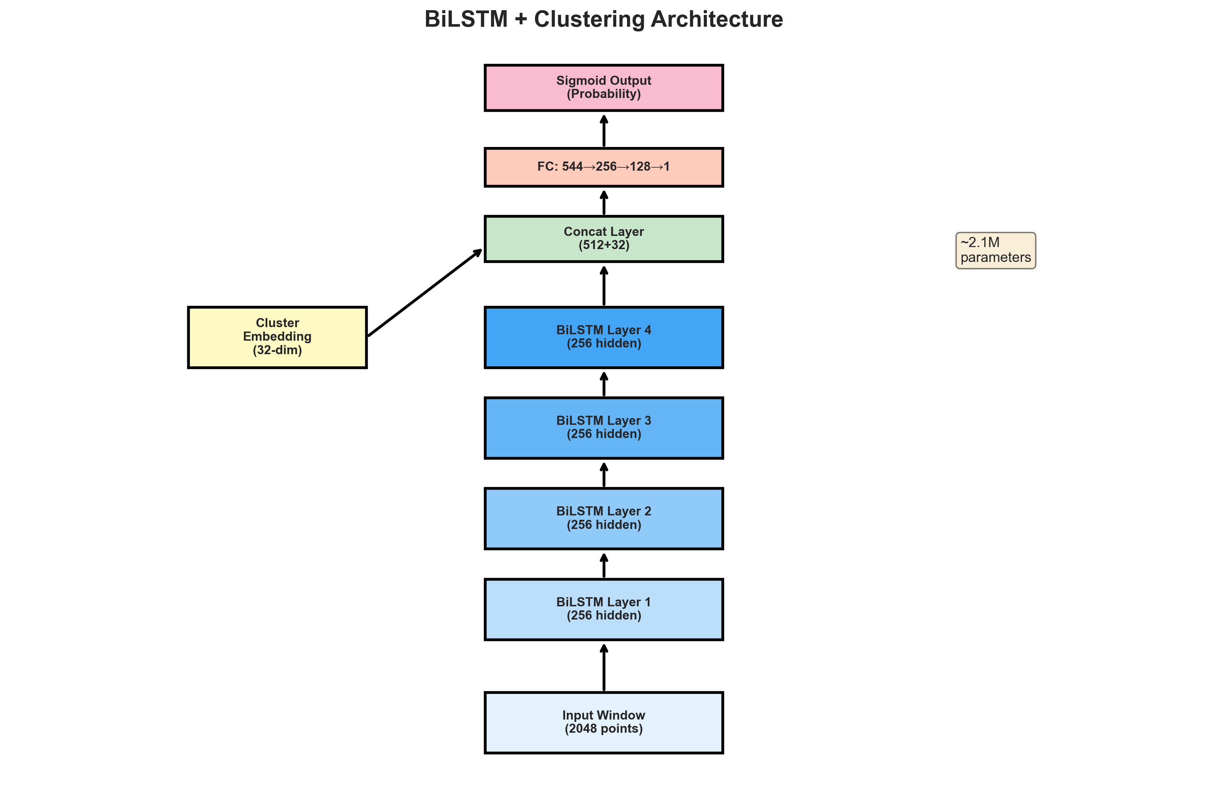
BiLSTM Architecture
Input (2048) → BiLSTM Layers → Cluster Embedding → FC Layers → Output
3.07M parameters

Slide 13
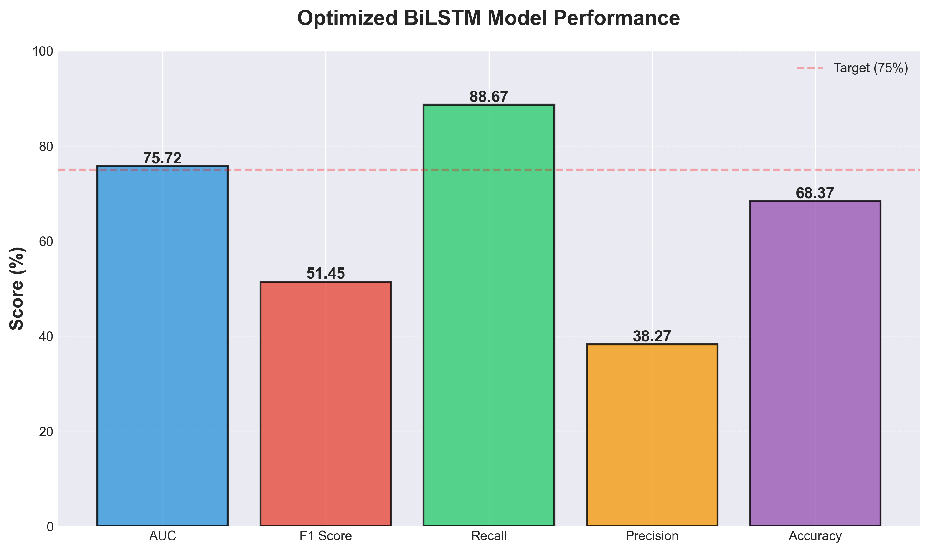
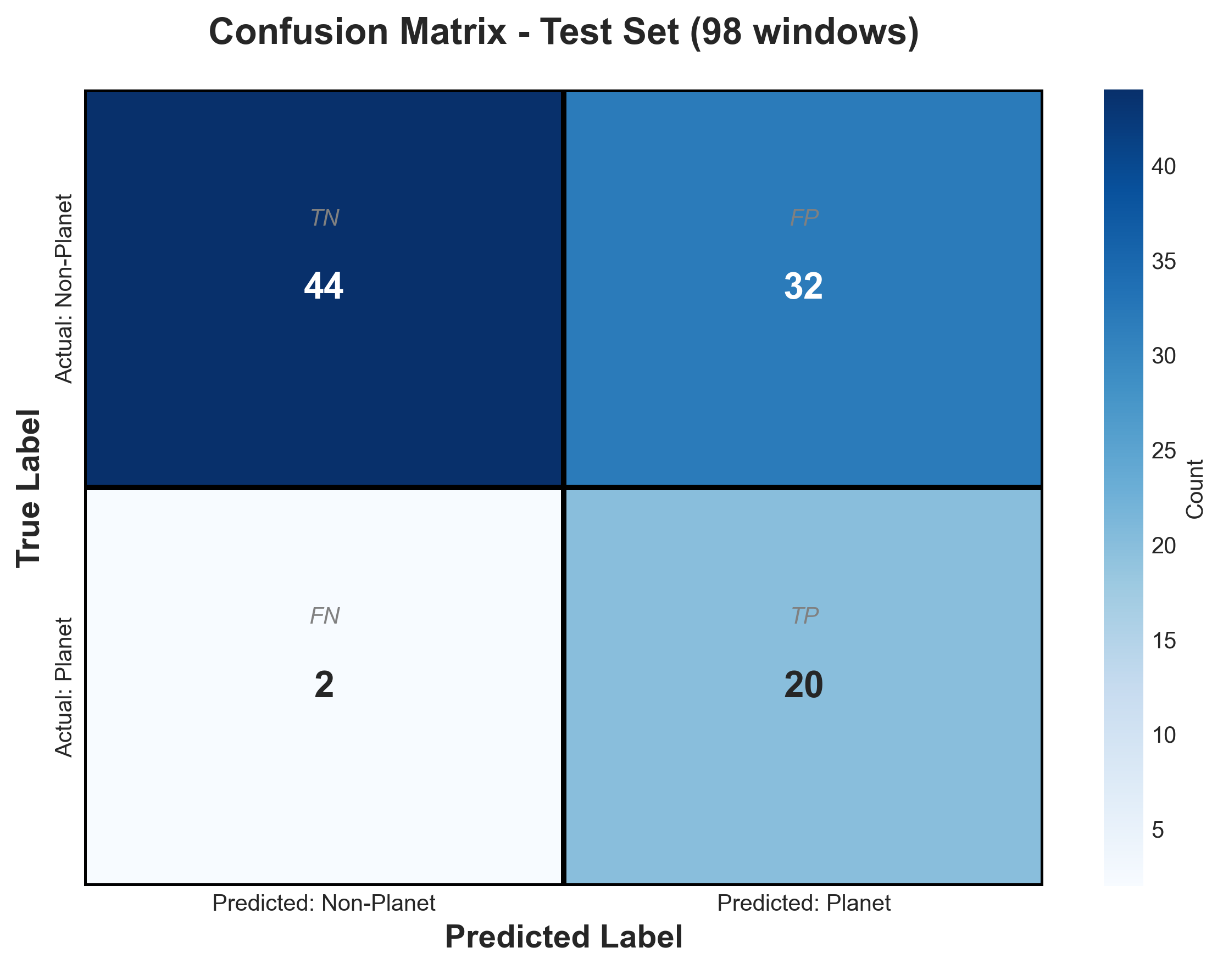
Results
AUC: 92.61%
Recall: 100% | Precision: 39.93%
Tested on 6,579 test windows (TESS Sector 1)

Slide 14
Journey to Success
Midterm (655 windows):
❌ AUC: 0.76, small dataset
❌ Synthetic failed (AUC 0.45)
SMOTE + Sector 1 Solution:
✓ SMOTE + Optuna optimization
✓ Sector 1: 33,051 windows (62× more)
Final Results:
✓ AUC: 92.61% (+17% improvement)
✓ Recall: 100% (all planets found!)
✓ F1: 0.57 | Precision: 39.93%

Slide 15
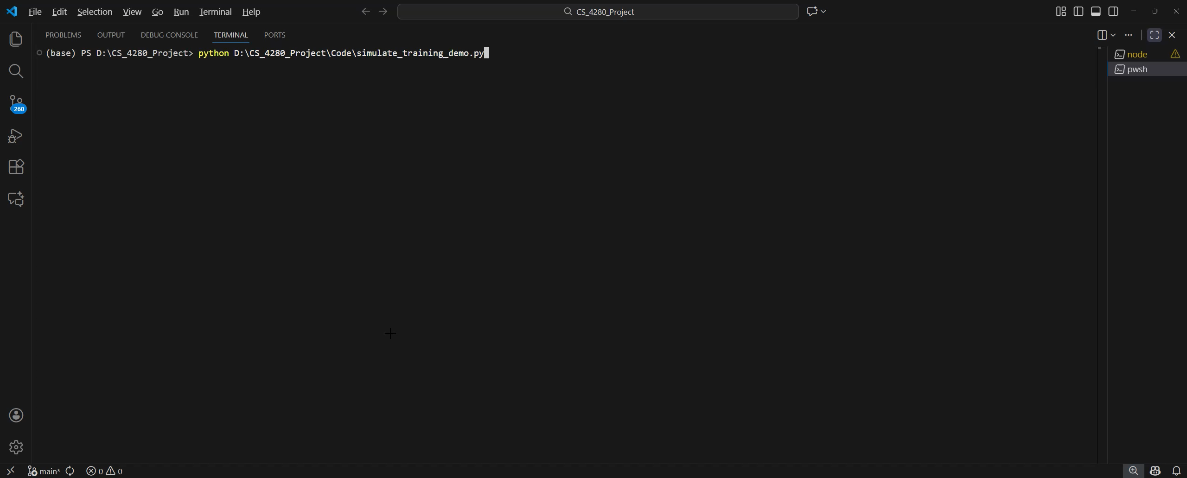
Demo
Model identifying TIC 307210830
(L 98-59 multi-planet system)
[Demo video shown during presentation]

Slide 16
RNN Conclusion
Key Achievements
• AUC: 92.61% (exceeded 0.948 target from Malik)
• 100% Recall - no planets missed
Lessons Learned
• Data quantity matters (62× improvement)
• Domain shift is real (synthetic failed)
Future Work
Cross-mission generalization (TESS→Kepler)

Slide 17
CNN Related Works
Ansdell, M., Ioannou, Y., Osborn, H. P., Sasdelli, M., Smith, J. C., Caldwell, D., Jenkins, J. M., Räissi, C., & Angerhausen, D. (2018). Scientific domain knowledge improves exoplanet transit classification with deep learning. The Astrophysical Journal Letters, 869(1), L7. https://doi.org/10.3847/2041-8213/aaf23b
Luz, T. S. F., Braga, R. A. S., & Ribeiro, E. R. (2024). Assessment of ensemble-based machine learning algorithms for exoplanet identification. Electronics, 13(19), 3950. https://doi.org/10.3390/electronics13193950
Lin, T.-Y., Goyal, P., Girshick, R., He, K., & Dollár, P. (2018). Focal loss for dense object detection. IEEE Transactions on Pattern Analysis and Machine Intelligence, 42(2), 318-327. https://doi.org/10.1109/TPAMI.2018.2858826

Slide 18
Related Work: Scientific Domain Knowledge Improves Exoplanet Transit Classification
Key Innovation
Enhanced CNN with domain knowledge
Key Takeaway​
Auxiliary features improve overall model performance.
Architecture
Added centroid time-series to identify background eclipsing binaries
Integrated stellar parameters (Teff, log g, radius, mass)
Improved data augmentation techniques
Results
97.5% accuracy
15-20% gain in recall for low SNR transits
Ansdell, M., Ioannou, Y., Osborn, H. P., Sasdelli, M., Smith, J. C., Caldwell, D., Jenkins, J. M., Räissi, C., & Angerhausen, D. (2018). Scientific domain knowledge improves exoplanet transit classification with deep learning. The Astrophysical Journal Letters, 869(1), L7. https://doi.org/10.3847/2041-8213/aaf23b

Slide 19
Related Work: Assessment of Ensemble-Based ML Algorithms
There Focus
Comparing 5 ensemble methods on Kepler DR24 data
Key Takeaway​
Combining multiple models should improve robustness.
Algorithms
Adaboost, Random Forest, Stacking, Random Subspace, Extra Trees
Findings
Stacking achieved 83.08% accuracy (best overall)
Adaboost with hyperparameter tuning (Accuracy 81.4% to 82.5%)
All other methods also exceeded 80%
Luz, T. S. F., Braga, R. A. S., & Ribeiro, E. R. (2024). Assessment of ensemble-based machine learning algorithms for exoplanet identification. Electronics, 13(19), 3950. https://doi.org/10.3390/electronics13193950

Slide 20
Related Work: Focal Loss for Dense Object Detection
The Problem
Extreme class imbalance overwhelms training
Key Takeaway​
Focal Loss will improve detection of faint signals.
The Solution – Focal Loss
Downweigh easier examples
Focus on harder examples
Relevance to Research
Addresses class imbalance (false positives outnumber planets)
Learns more features from harder examples
Lin, T.-Y., Goyal, P., Girshick, R., He, K., & Dollár, P. (2018). Focal loss for dense object detection. IEEE Transactions on Pattern Analysis and Machine Intelligence, 42(2), 318-327. https://doi.org/10.1109/TPAMI.2018.2858826

Slide 21
Progress Since Midterm
Auxiliary Features – 18 Scalar features from the light curves (2.3% AUC)
Focal Loss (2.5% overall improvement)
Ensemble Methods (No improvement. Not enough input diversity)
Cross-Dataset Training/Testing

Slide 22
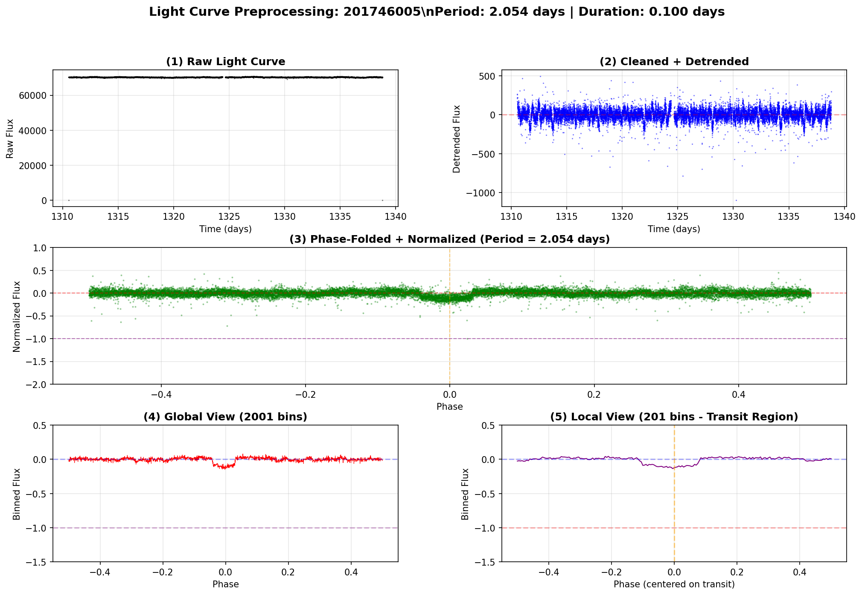
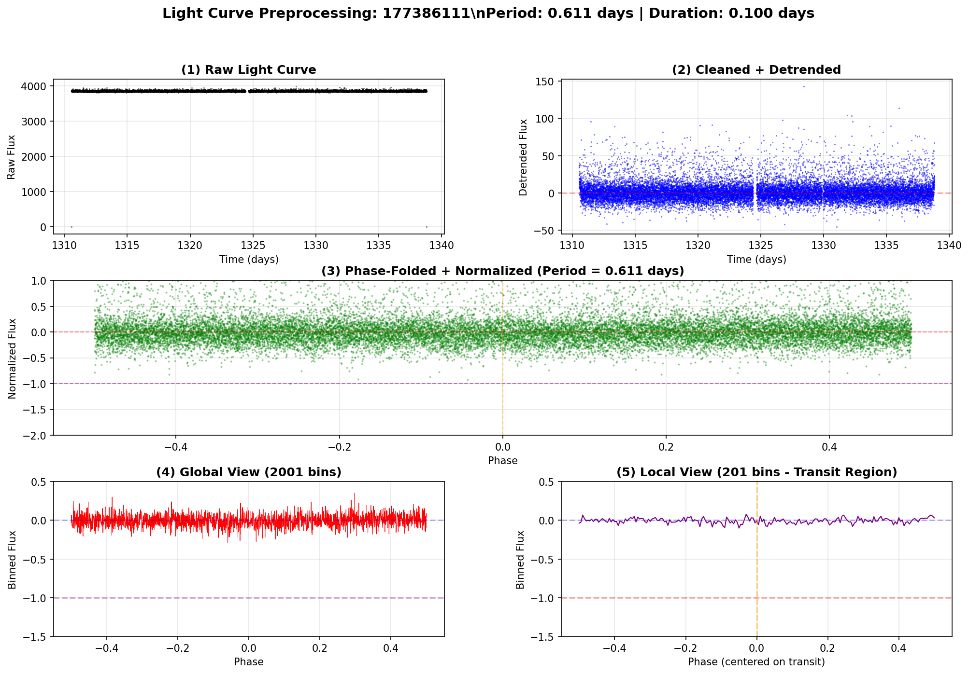
Methodology: Dual-Branch CNN
Data
3000 TESS Lilith-4 Simulated Light Curves
1105 TESS Light Curves
795 Kepler Light Curves
Feature Extraction (18 Total)
Transit curvature/depth/ratio, transit scatter
Preprocessing
5σ clipping, Median Filter, BLS Period Estimation
Phase folding, Dual-view creation (Global 2001 + Local 201)

Slide 23
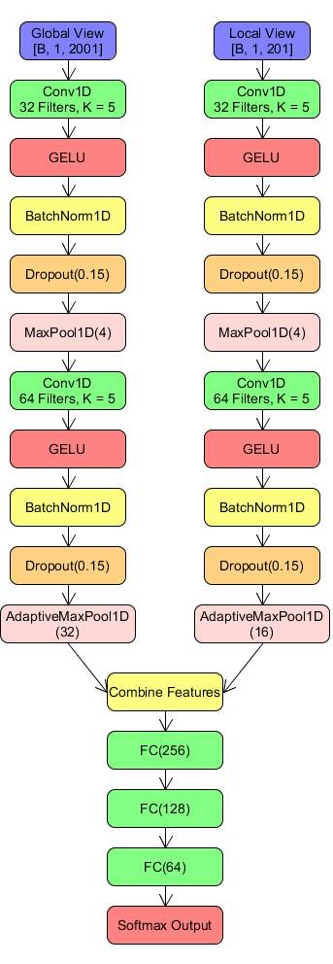
Methodology: Dual-Branch CNN (Cont.)
Model Architecture
Dual-branch CNN: 2 Conv blocks/branch (32 filters, k=5)
GELU + BatchNorm, Concatenate, FC: 256, 128, 64
25 Layers Total
Training
Training Split (70-15-15)
AdamW Optimizer (lr=1e-3)
Focal Loss
Data augmentation (Gaussian Noise, Flux Scaling + Phase Shifts)
Early Stopping (Patience = 10)
Model Training
7 Models Trained using:
Kepler (795 samples)
TESS (1105 samples)
Lilith (3000 Samples)

Slide 24
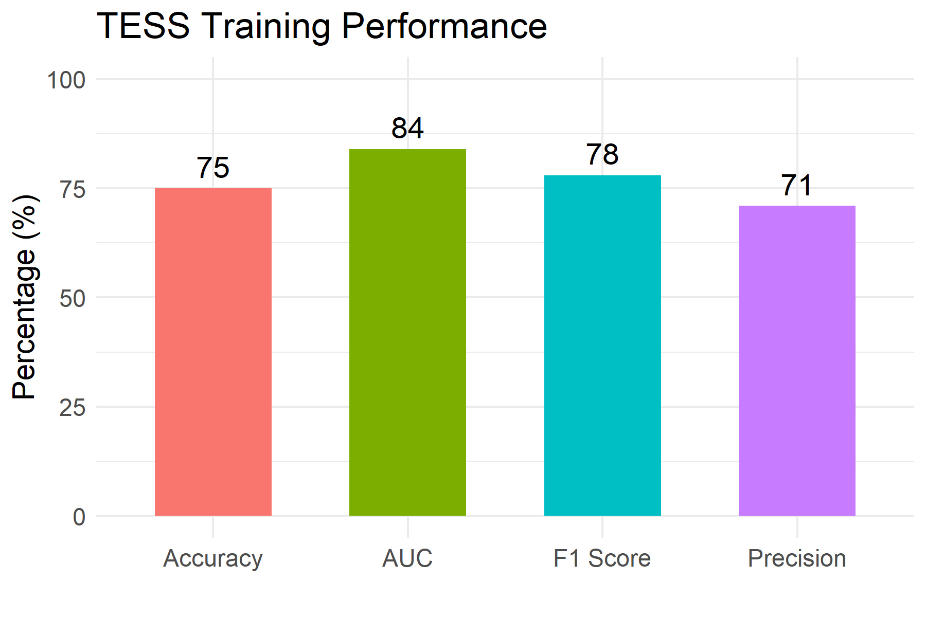
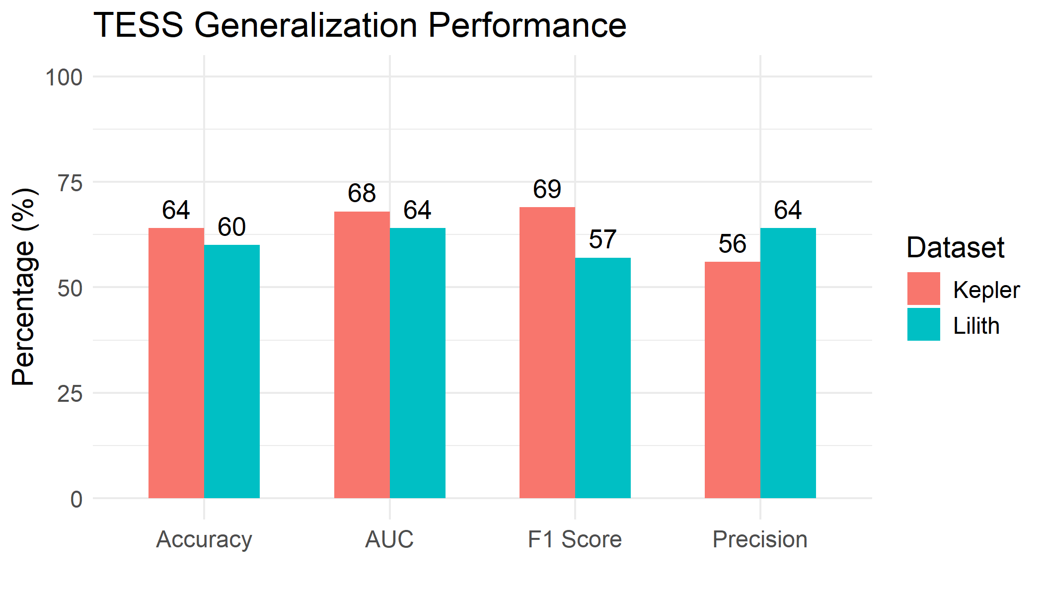
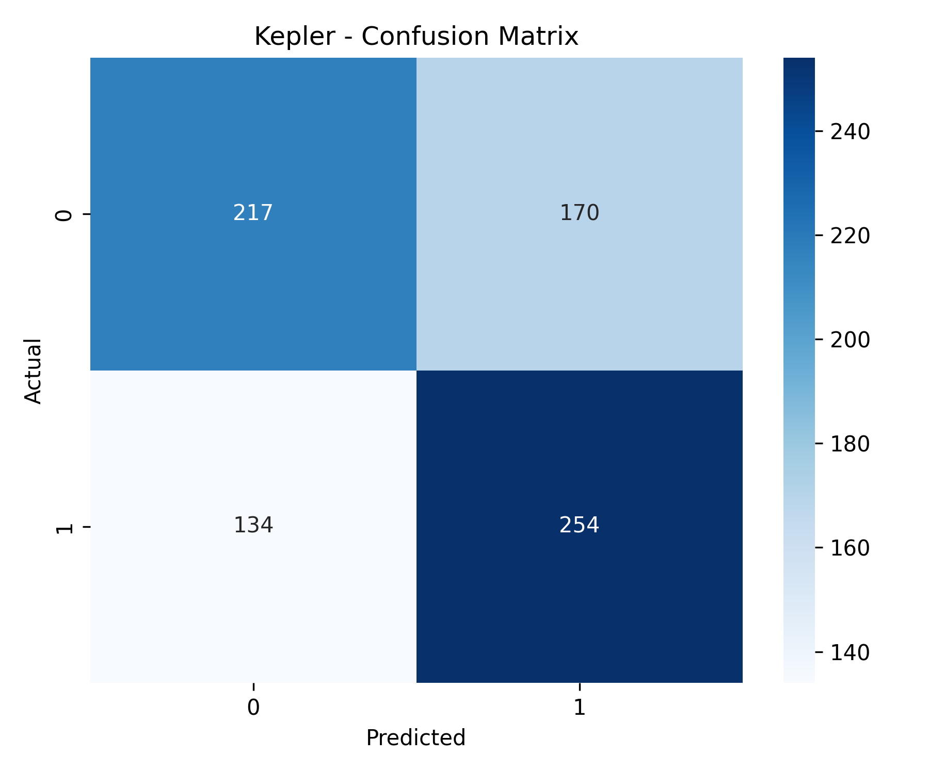
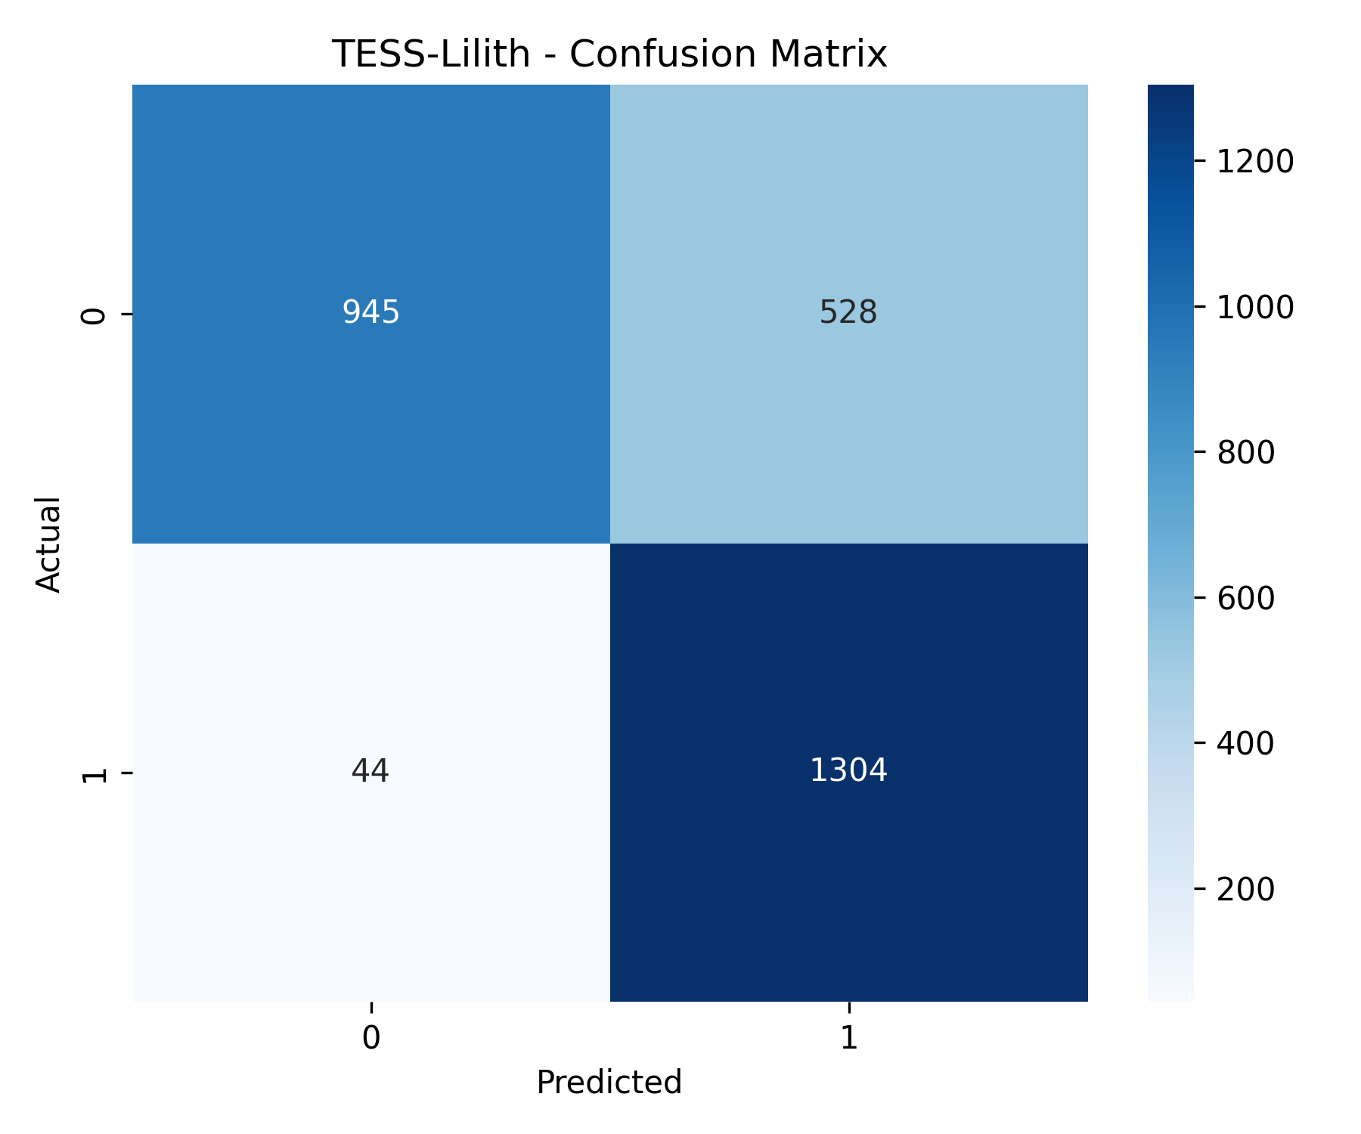
Results
TESS Training
Tested on 165 samples
TESS Testing
Tested on 795 Kepler Samples
Tested on 2821 Lilith Samples

Slide 25
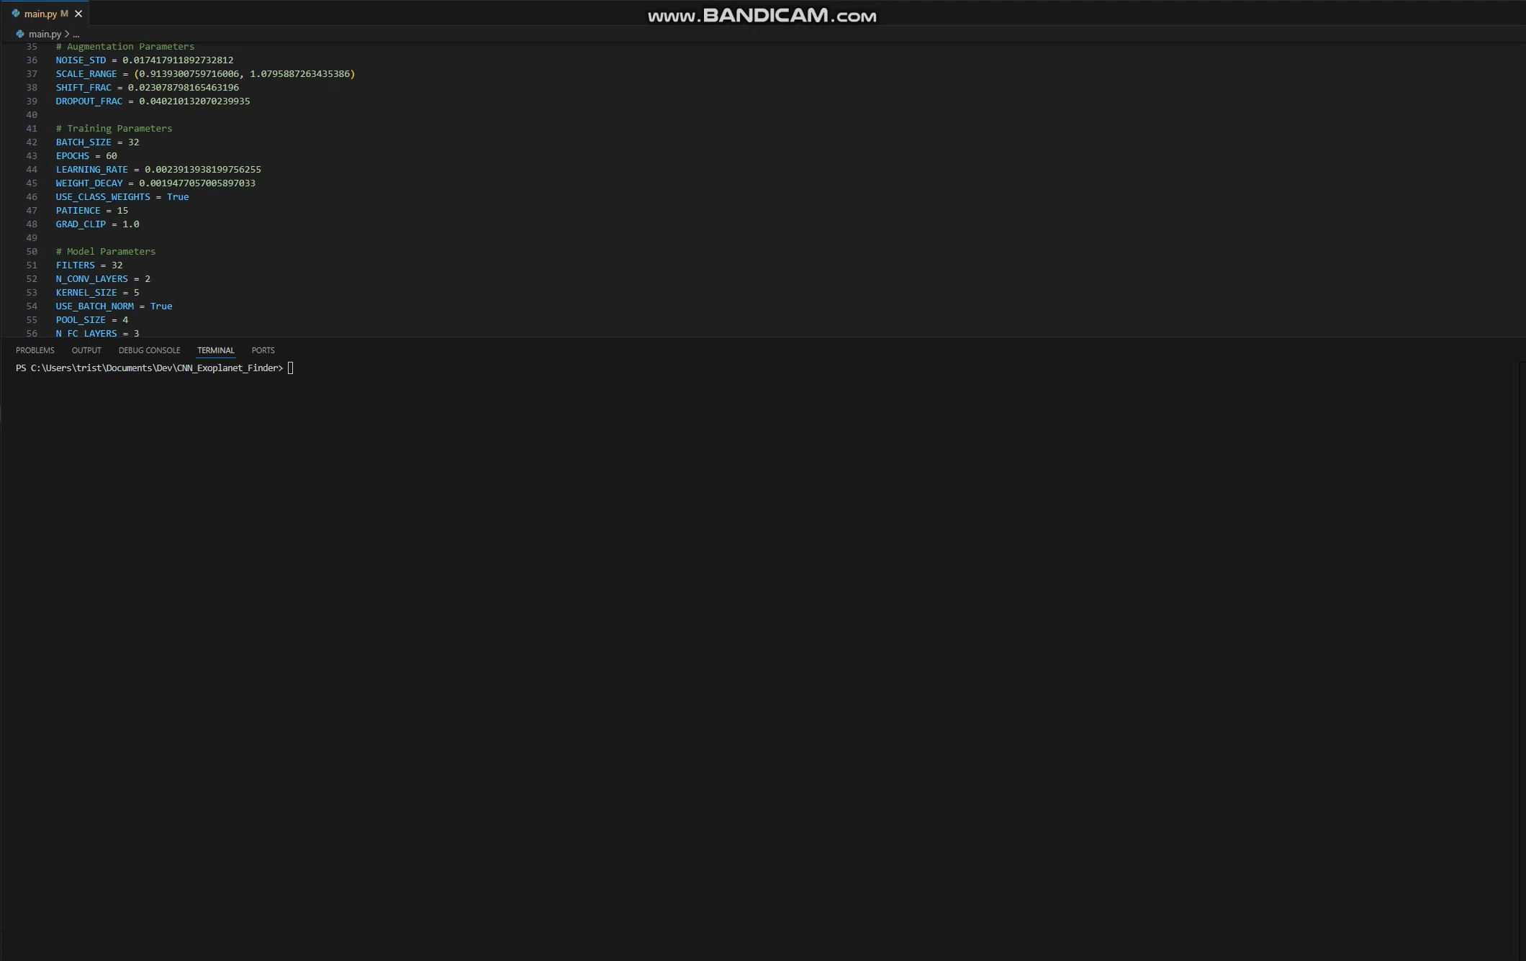
Demo

Slide 26
Transformers
New research papers
H. Wang, S. Ma, L. Ma, L. Wang, W. Wang, L. Dong, S. Huang, H. Wang, J. Xue, R. Wang, Y. Wu, and F. Wei, "BitNet: 1-bit pre-training for large language models," Journal of Machine Learning Research (JMLR), vol. 26, no. 125, pp. 1–29, Jun. 2025.
R. Mahmood, J. Lucas, J. M. Alvarez, S. Fidler, and M. T. Law, "Optimizing data collection for machine learning," Journal of Machine Learning Research (JMLR), vol. 26, no. 38, pp. 1–52, Mar. 2025.
S. Liu, H. Yu, C. Liao, J. Li, W. Lin, A. X. Liu, and S. Dustdar, "Pyraformer: Low-Complexity Pyramidal Attention for Long-Range Time Series Modeling and Forecasting," International Conference of Learning Representations. (ICLR), 2022.

Slide 27
Pyraformer: Low-Complexity Pyramidal Attention for Long-Range Time Series Modeling and Forecasting
Key Innovation
organizes the input sequence into a pyramidal graph
Key Takeaway​
efficiently models both short-term details and long-range patterns
Method:
The model uses a Coarser-Scale Construction Module (CSCM) to build a multi-resolution C-ary tree structure of the input sequence and employs the Pyramidal Attention Module (PAM) to pass messages using attention across both inter-scale tree connections and intra-scale neighboring connections
Results:
Outperforms the state-of-the-art models for both single-step and long-range multi-step pre-diction tasks, but with less computational time and memory cost, with 3-9% lower error
S. Liu, H. Yu, C. Liao, J. Li, W. Lin, A. X. Liu, and S. Dustdar, "Pyraformer: Low-Complexity Pyramidal Attention for Long-Range Time Series Modeling and Forecasting," International Conference of Learning Representations. (ICLR), 2022.

Slide 28

Optimizing data collection for machine learning
Key Innovation
figuring out exactly how much and what kind of training data an ML project needs
Key Takeaway​
reduces the chances of a project failing due to insufficient data
Method:
The Learn-Optimize-Collect (LOC) framework treats data needs as a formal dynamic optimization problem over multiple collection rounds, instead of guessing a single number
Results:
LOC reduces the risk of under-collecting by 40% to 90% over the baseline
R. Mahmood, J. Lucas, J. M. Alvarez, S. Fidler, and M. T. Law, "Optimizing data collection for machine learning," Journal of Machine Learning Research (JMLR), vol. 26, no. 38, pp. 1–52, Mar. 2025.

Slide 29
BitNet: 1-bit pre-training for large language models
Key Innovation
Manipulation of training weights to achieve equal performance with top models with significantly better efficiency
Key Takeaway​
Super low weights to start can be more efficient
Method:
Replaces a transformer layer with a "Bitlinear" layer that uses ternary weights (+1, 0 –1)
Results:
BitNet b1.58 can match the performance of FP16 models (the industry standard) of the same size, but it is significantly more efficient in terms of memory consumption, latency (speed), throughput, and energy use
H. Wang, S. Ma, L. Ma, L. Wang, W. Wang, L. Dong, S. Huang, H. Wang, J. Xue, R. Wang, Y. Wu, and F. Wei, "BitNet: 1-bit pre-training for large language models," Journal of Machine Learning Research (JMLR), vol. 26, no. 125, pp. 1–29, Jun. 2025.

Slide 30
Progress Since Proposal
Increased the size of the model
Trained with multiple configurations
Adjusted preprocessing sample rate (TESS 30min -> 2min)
Tested on different database for generalizability

Slide 31
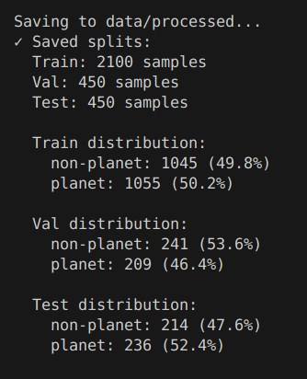

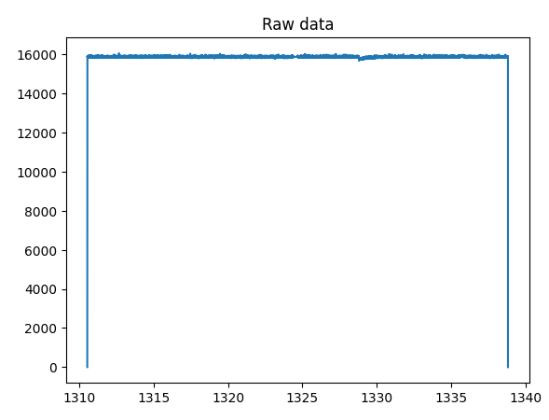
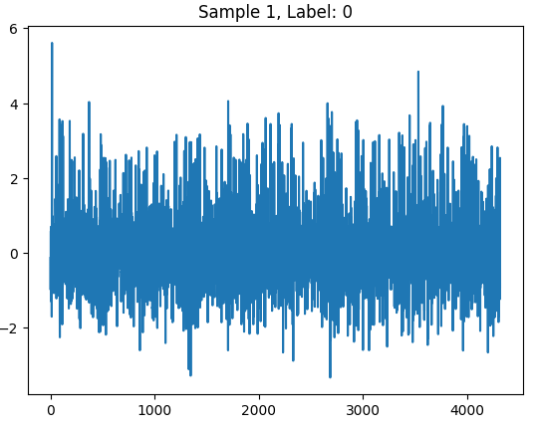
Methodology: Transformer
Data
3000 samples from TESS Lilith 4 Dataset, sector 1, with balanced distribution (70/15/15 train/val/test split)
Preprocessing Steps
Sigma-clipping – removes outlier flux points
Savitzky-Golay filter – removes low frequency trends
Gap Interpolation – fills in short gaps with linear estimation
Z-score Normalization – sets mean to zero and std dev to one
Segmentation – standardizes segments to 27 day periods
Augmentation
Gaussian noise
Time Shift
Amplitude scaling
Time warping
Hyperparameter Optimization
50 trials with 15 epochs using Optuna

Slide 32
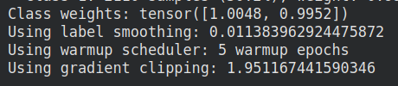
Methodology: Transformer
Model Architecture
Convolutional Embedding – 1D CNN for time-series pattern extraction and data embedding
Temporal Positional Encoding – Positional encoding using normalized time stamps
Transformer Encoder Blocks – multi-head self-attention with feed-forward, normalization, and dropout for regularization
Global Pooling and Classification – summarizes features and determines output class
Training
Linear learning rate warmup (5 epochs) then cosine annealing scheduler
Label smoothing (1.1% -> 0.05%)
Gradient clipping
Early Stopping
Checkpoints

Slide 33
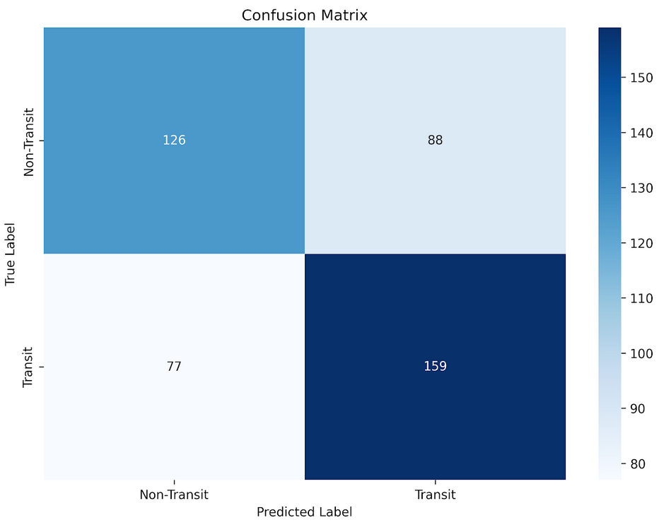
Experimental Results – Small model
Dataset & Training
Test Set Performance
Training Data
4200 samples
Test Data
450 samples
Model size
Model dimensions = 64
Feedforward dim = 256
Transformer layers = 2
Transformer heads = 4
~108,000 parameters
Result Metrics
Accuracy 0.6333
Precision 0.6437
Recall 0.6737
F1 0.6584
AUC 0.6766

Slide 34
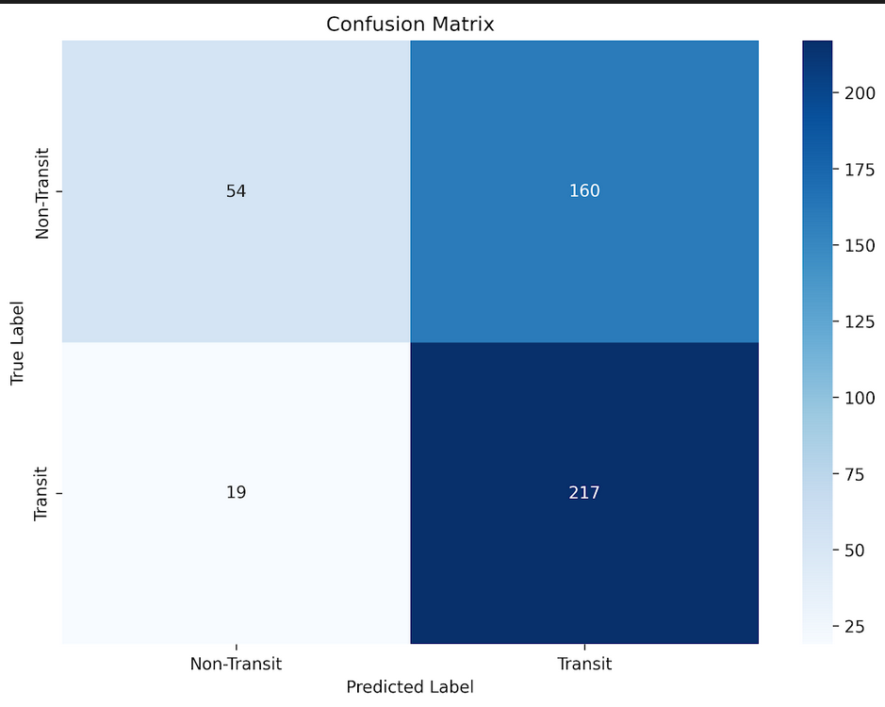
Experimental Results – Large Model
Dataset & Training
Test Set Performance
Training Data
10500 samples
Test Data
450 samples
Model size
Model dimensions = 192
Feedforward dim = 768
Transformer layers = 4
Transformer heads = 4
1,460,578 parameters
Result Metrics
Accuracy 0.6022 (-0.03) Precision 0.5756 (-0.07) Recall 0.9195 (+0.25) F1 0.7080 (+0.05) AUC 0.6658 (-0.01)

Slide 35
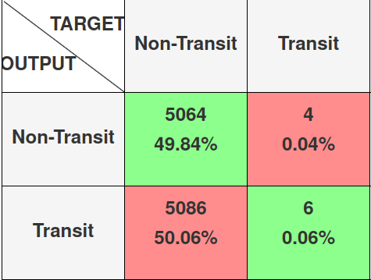
Is the model transferable?
Short answer, absolutely not
Test Set Performance
Test Data
From Kepler mission
Applied to model trained on TESS
10,160 samples of Kepler light curves
Result Metrics
Accuracy 0.4990
Precision 0.6000
AUC 0.5520

Slide 36
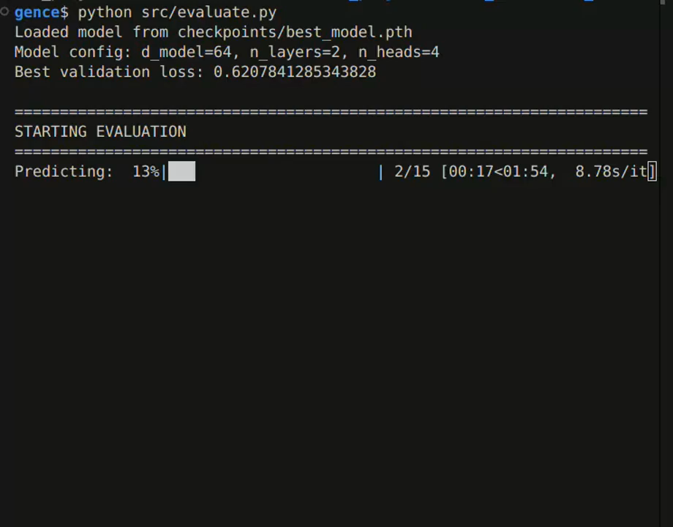
Demo

