Slide 1
Related Work - Three NEW Papers
Speiser, A., Müller, L. R., Matti, U., Obholzer, N. D., Legant, W. R., Kreshuk, A., ... & Hufnagel, L. (2020). Machine learning for cluster analysis of localization microscopy data. Nature Communications, 11(1), 1493. (H5 index: 399)
Vu, M. T., Vo, N. D., Ngo, T. D., Pham, T. D., Huynh, T. T. M., Nguyen, N. T., ... & Ly, H. B. (2024). Harnessing LSTM and XGBoost algorithms for storm prediction. Scientific Reports, 14(1), 11516. (H5 index: 234)
Ding, Y., Ji, K., Xiao, M., Zheng, X., Chen, Y., Liang, J., ... & Qi, Y. (2024). Photometric redshift estimation for CSST survey with LSTM neural networks. Monthly Notices of the Royal Astronomical Society, 535(2), 1844-1858. (H5 index: 151)

Slide 2
Why BiLSTM + Clustering?
From the Papers:
• Clustering improves ML on large datasets (Speiser 2020)
• LSTM captures long-term dependencies (Vu 2024)
• LSTM reduces outliers in astronomy (Ding 2024)
My Approach:
BiLSTM + K-means clustering on BLS features

Slide 3
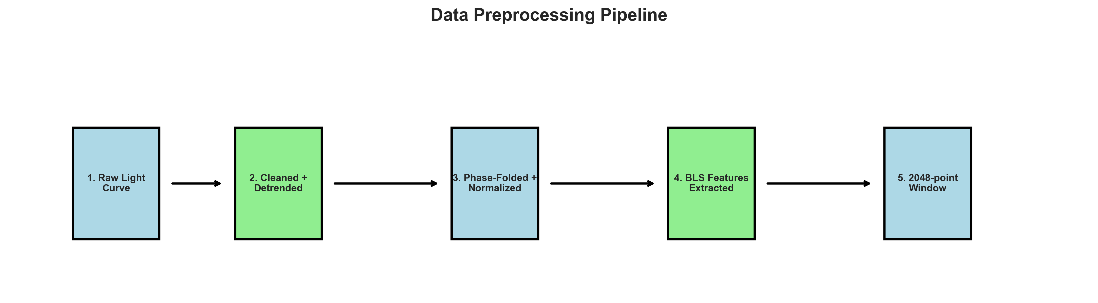
Methodology
Data: 655 windows (150 planets, 505 non-planets)
Features: Period, depth, duration, BLS power
Architecture:
• K-means (5 clusters)
• 4-layer BiLSTM (256 hidden, bidirectional)
• Cluster embeddings (32-dim)

Slide 4
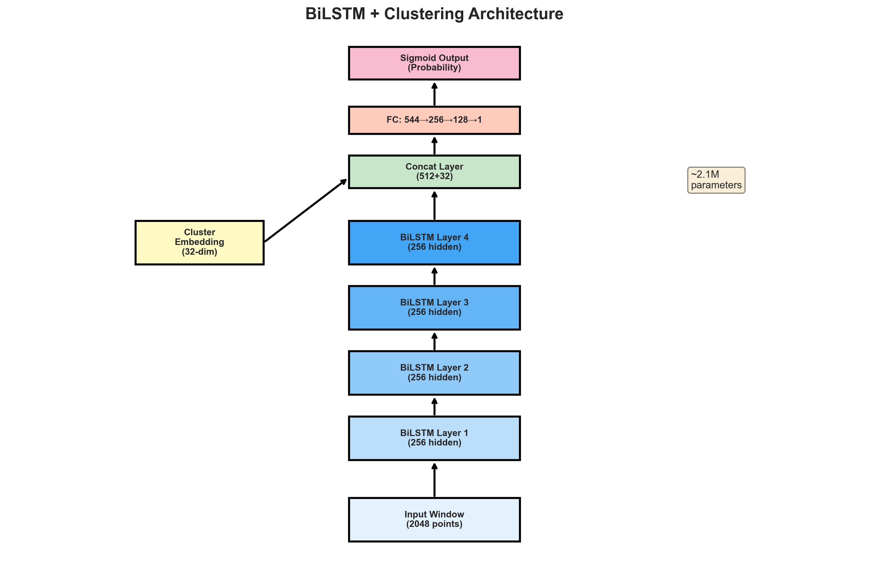
BiLSTM Architecture
Input (2048) → BiLSTM Layers → Cluster Embedding → FC Layers → Output
~2.1M parameters

Slide 5
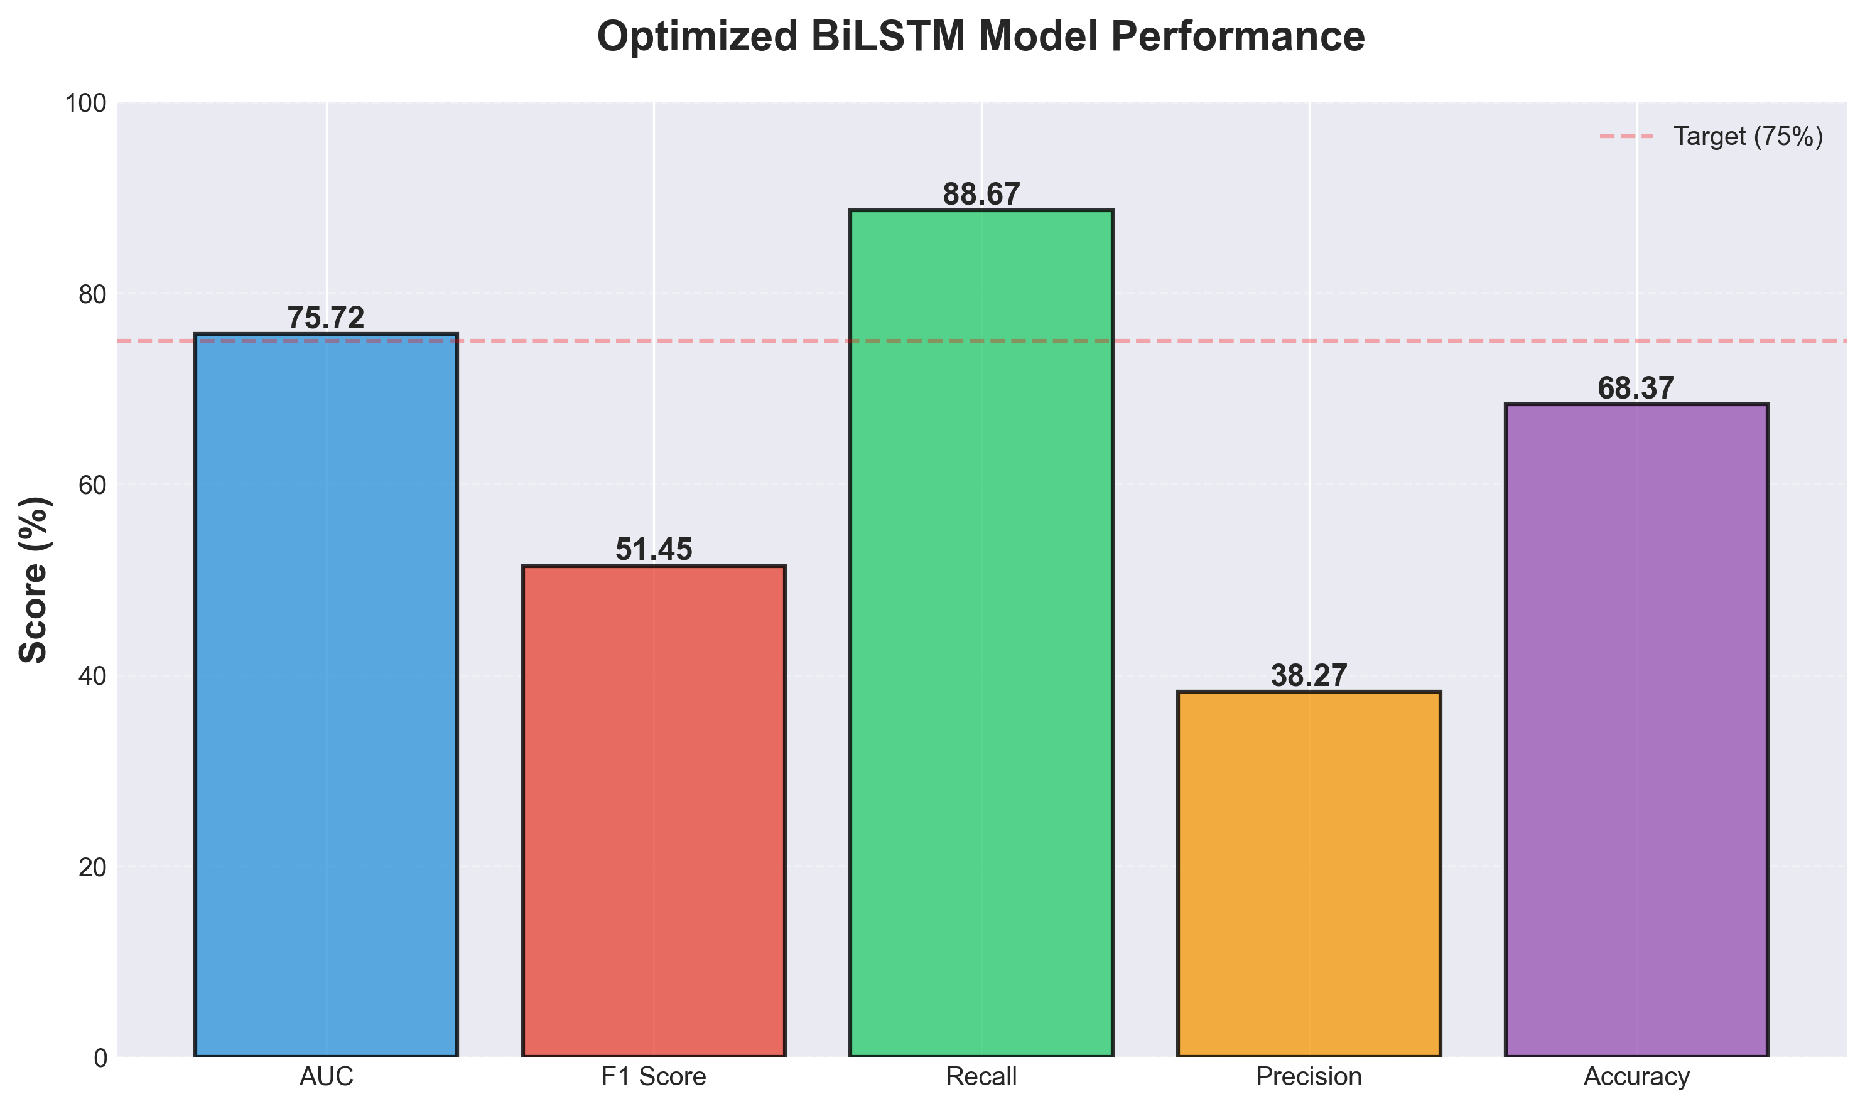
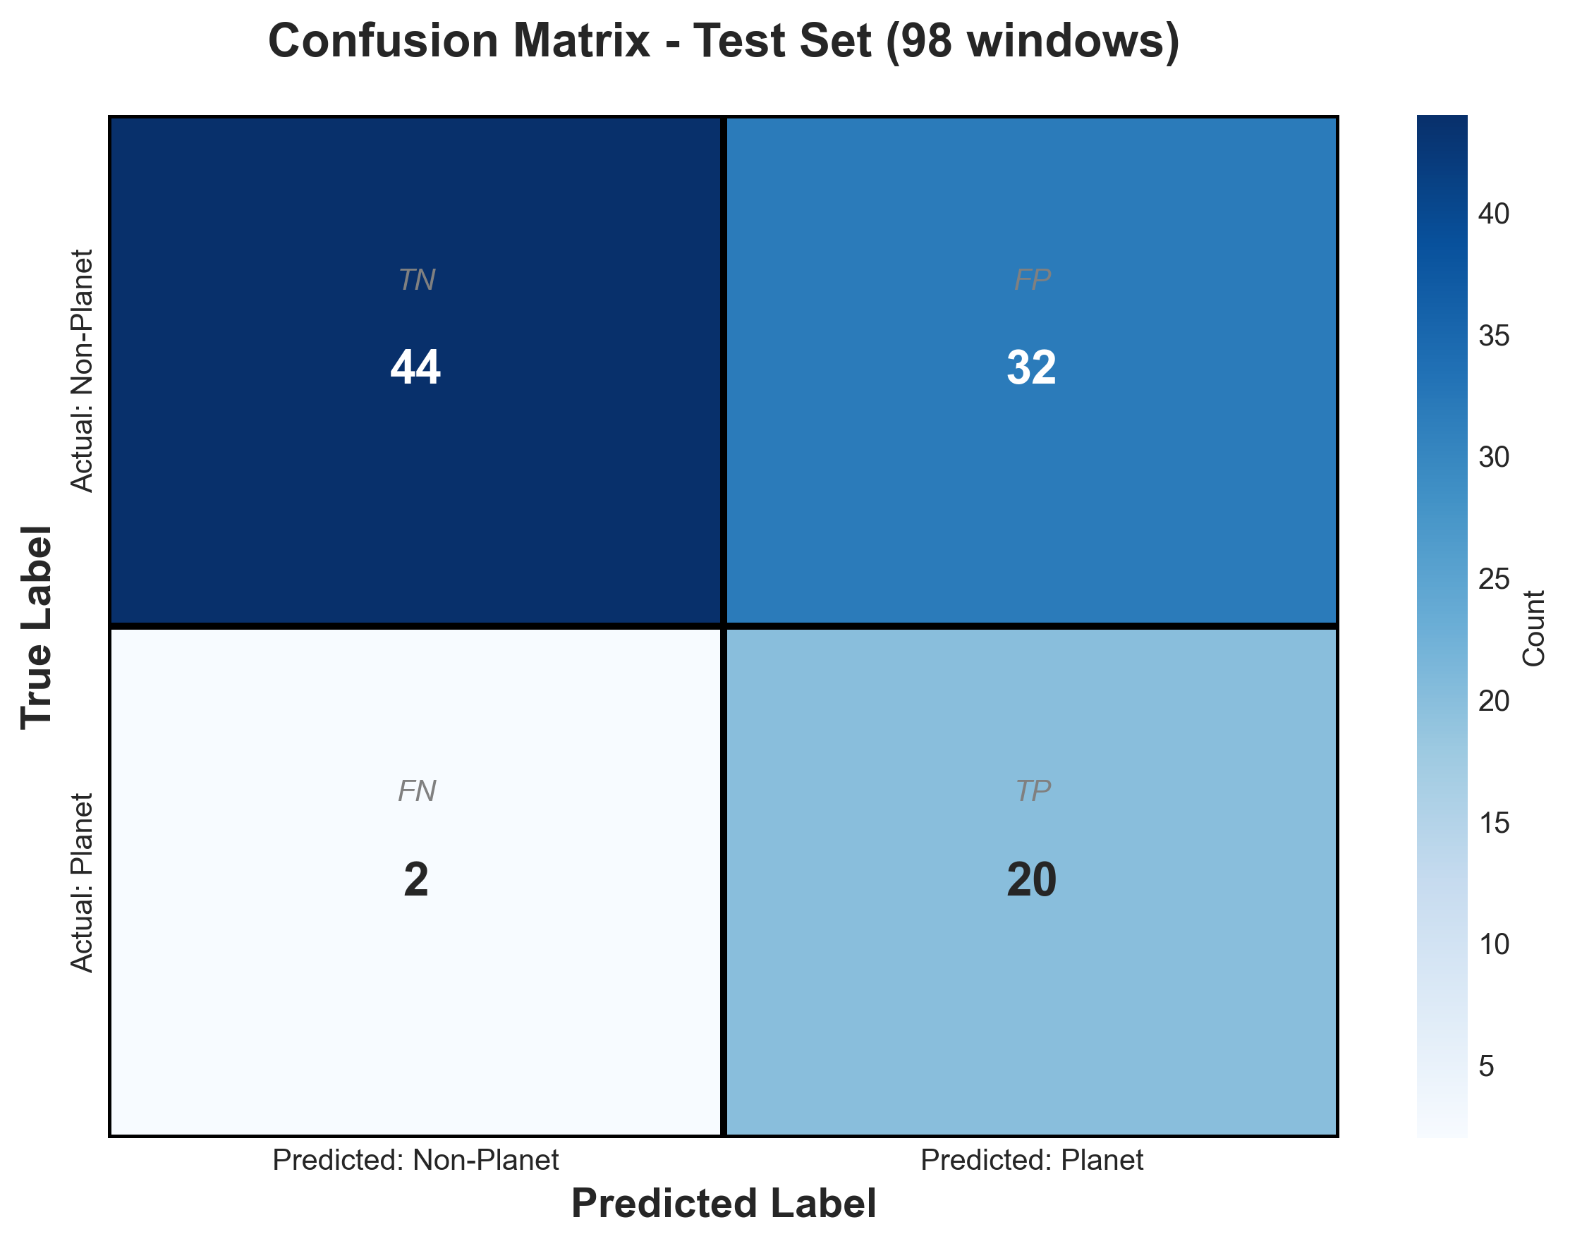
Results
AUC: 75.72%
Recall: 88.67% | Precision: 38.27%
Tested on 100 confirmed exoplanet systems

Slide 6
Learning from Failure
100 Planets Only:
❌ Predicted everything as planet
❌ 100% false positives
Solution: Add Non-Planets
✓ 100 planets + 300 non-planets → AUC: 0.69
✓ Real TESS: Identified TIC 307210830 (prob: 0.5959)
But: Imbalanced Data Problem
❌ 150 planets vs 505 non-planets (23% positive)
❌ High recall (88.67%) but low precision (38.27%)
❌ Too many false positives → Model biased toward negatives

Slide 7
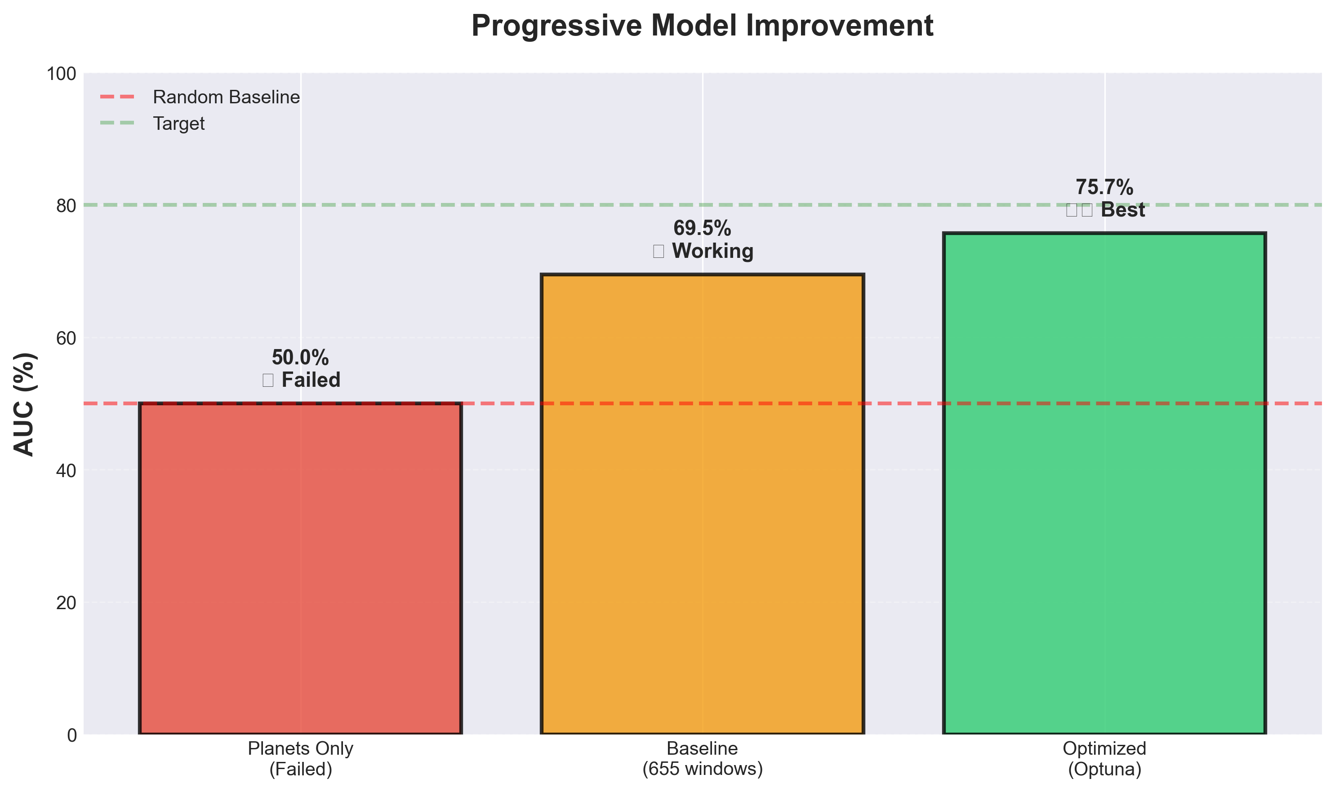
Optuna Optimization
Parameter changes:
• Layers: 3 → 4
• Batch size: 64 → 128
• Learning rate: 1e-4 → 2.25e-4
Result: AUC 0.69 → 0.76 (+9%)

Slide 8
Demo
Model identifying TIC 307210830
(L 98-59 multi-planet system)
[Demo video shown during presentation]

Slide 9
What's Next?
Balanced Data Attempt Failed
• Tried 50/50 balanced synthetic data (200 planets + 200 non-planets)
• AUC dropped to 0.45 on real TESS data (domain shift)
Solution: Hybrid Training
• Mix real TESS + synthetic (90/10 ratio)
• Better balance than 23% but maintains domain fidelity
Cross-Mission Testing
Train on TESS → Test on Kepler to verify generalization

