Slide 1
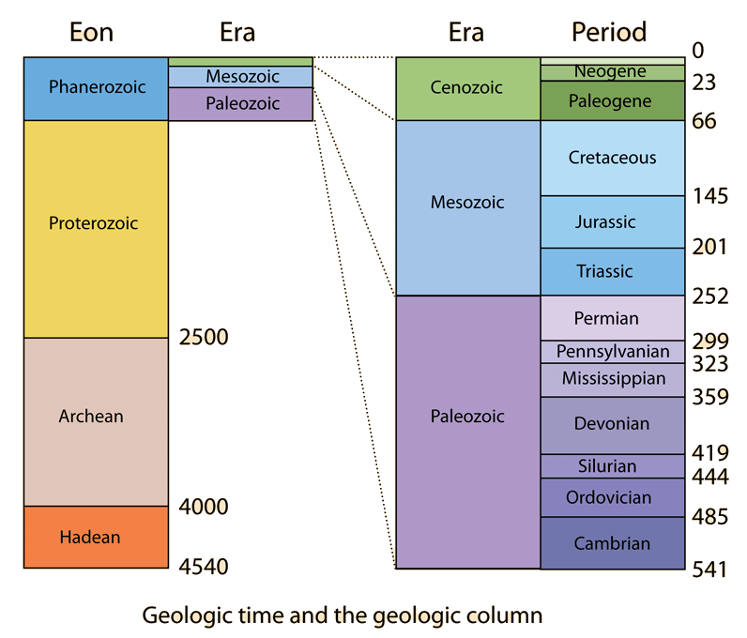
Stratigraphic Age Determination
AKA. Geologic Sequences
A self-study in geologic sequences…
Pre Lab/Lab

Slide 2
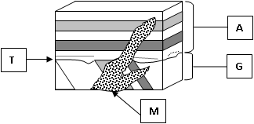
You will use the following to put these Geologic Events in order:
Superposition
Cross cutting relationships
How to go about putting Geologic sequences in order:
Work from the bottom of the sequence to the top.
Work from the top of the sequence downward
Do both of the above and meet in the middle!

Slide 3
You will use the following to put these Geologic Events in order:
Superposition
The tilted layers are oldest (G)
The horizontal layers “A” are youngest.
Cross cutting relationships
“M” cuts across all of the other layers so it is the “youngest” or last to occur.
“T” cuts across “G” so it is younger than “G” but older than “A”

Slide 4
So…
Youngest Event (Last to happen) M – cuts across all other events
A – On top of T, and G
T – Cuts across G, T is an Angular Unconformity
Oldest Event (First to happen) G – Layers deposited, uplifted then eroded.

Slide 5
Deposition “G”

Slide 6
Uplift of “G”
Uplift

Slide 7
Erosion of “G,” formation of unconformity “T”
Erosion of layers “G” after uplift.
This is the unconformity (angular unconformity) “T"

Slide 8
Deposition “A” superposed on “G”
Deposition of layers on top of “T”

Slide 9
Igneous intrusion “M,” cuts across G, T, and A
Intrusion of magma into fracture “M”
Cuts across other events. Is youngest

Slide 10
M - Youngest
A
T
G - Oldest

Slide 11
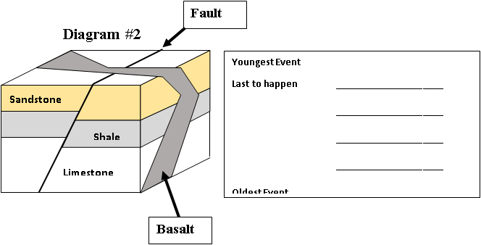
Youngest Event (Last) ______________________
______________________
______________________
______________________
Oldest Event (First) ______________________

Slide 12
Youngest Event (Last) BASALT
FAULT
SANDSTONE
SHALE
Oldest Event (First) LIMESTONE

Slide 13
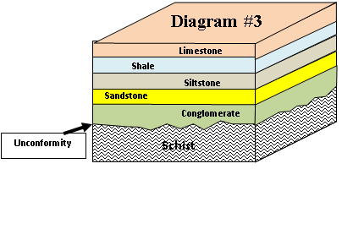
Youngest Event (Last) ______________________
______________________
______________________
______________________
______________________
______________________
Oldest Event (First) ______________________

Slide 14
Youngest Event (Last) LIMESTONE
SHALE
SILTSTONE
SANDSTONE
CONGLOMERATE
NONCONFORMITY
Oldest Event (First) SCHIST (Metamorphic)

Slide 15
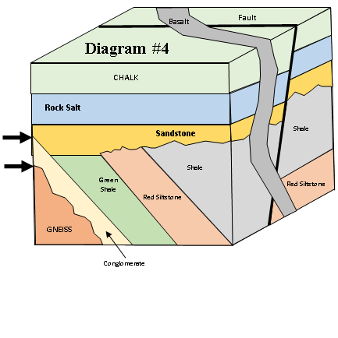
Youngest Event (Last) ______________________
______________________
_____________________
______________________
______________________
______________________
______________________
______________________
______________________
______________________
______________________
Oldest Event (First) ______________________
Two Arrows are locations of the Unconformities which are also events.

Slide 16
Youngest Event (Last) BASALT
FAULT
CHALK
ROCK SALT
SANDSTONE
ANGULAR UNCONFORMITY_
SHALE
RED SANDSTONE_
GREEN SHALE
CONGLOMERATE
NONCONFORMITY
Oldest Event (First) GNEISS_
Two Arrows are locations of the Unconformities which are also events.

Slide 17
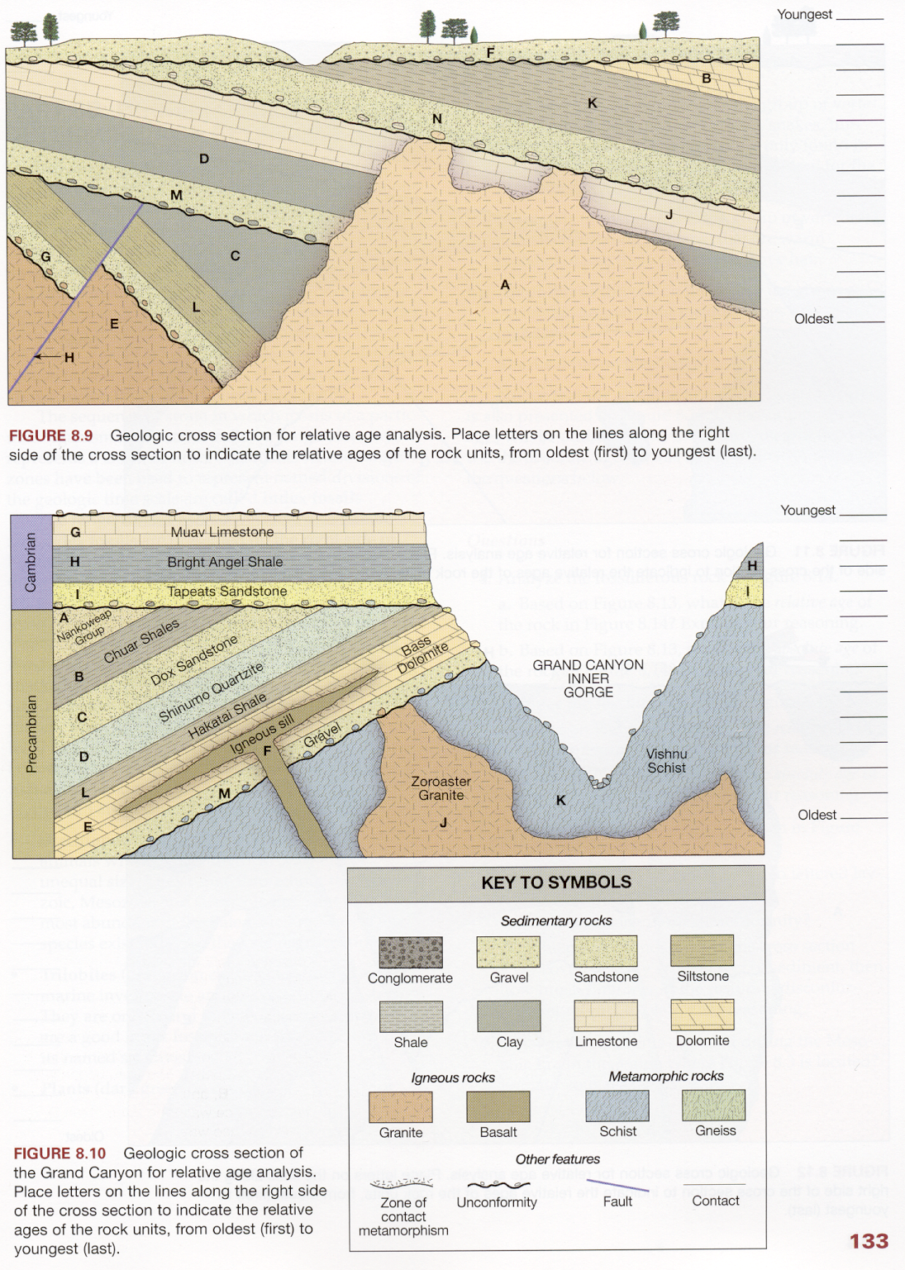
These are the rock symbols for the next 4 diagrams
Sedimentary Rocks: The top 8, these are deposited horizontally or flat.
Igneous Rocks: Granite, Basalt.
Granite is intruded into other rocks below the surface.
Basalt is very close to the surface OR deposited as a lava flow ON the surface.
Metamorphic Rocks: Shist, Gneiss. These both form at least 6 miles beneath the crust.

Slide 18
Determine the order of the labelled events
Determine the order of the labelled events
See if you can identify the unconformities

Slide 19
Determine the order of the labelled events
F
B
K
N
A
J
D
M
H
C
L
G
E
Angular Unconformity
Disconformity
Angular Unconformity
Disconformity
Nonconformity
Nonconformity
INTRUSION
FAULT
INTRUSION
Determine the order of the labelled events
See if you can identify the unconformities

Slide 20
Determine the order of the labelled events
Determine the order of the labelled events
See if you can identify the unconformities

Slide 21
Determine the order of the labelled events
G
H
I
A
B
C
D
L
F
E
M
J
K
Angular Unconformity
Nonconformity
INTRUSION
INTRUSION
Determine the order of the labelled events
See if you can identify the unconformities

Slide 22
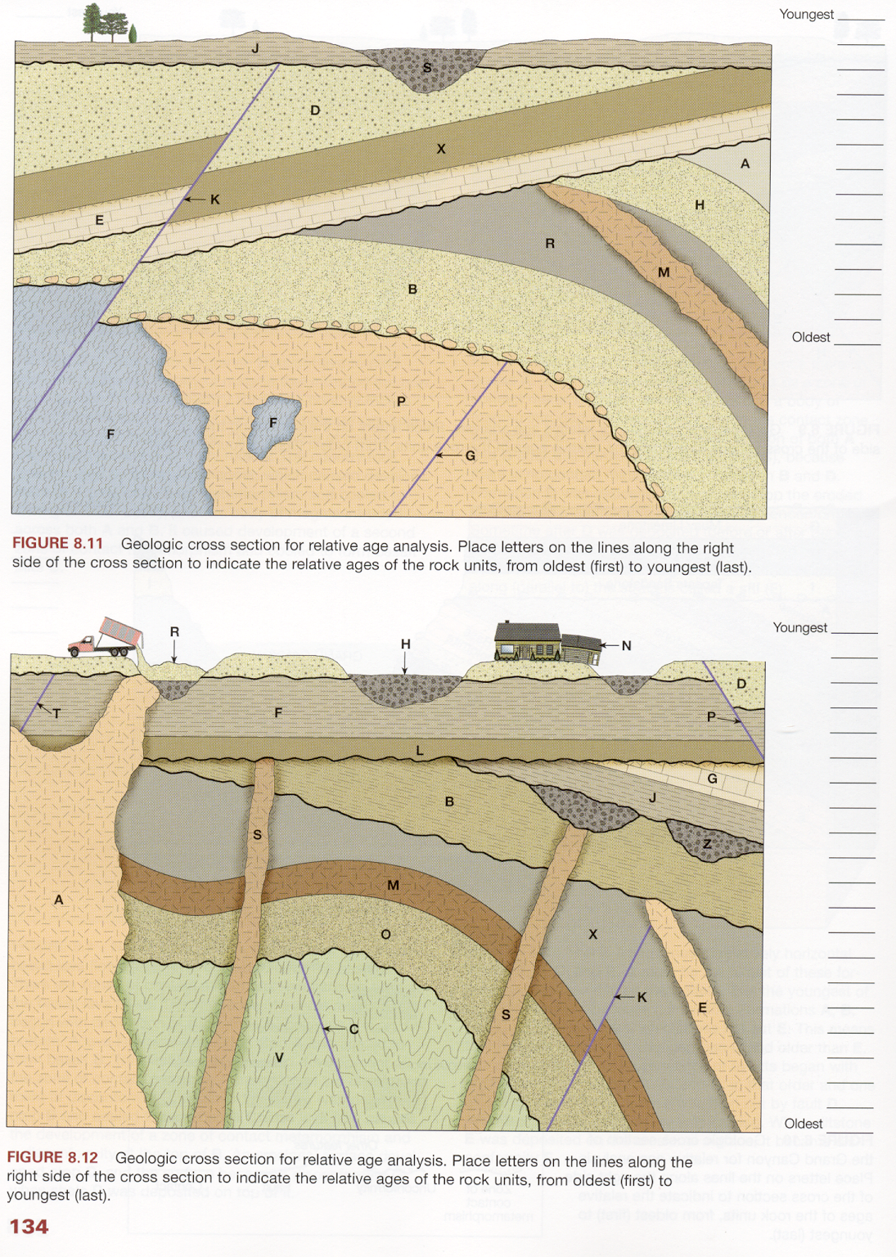
Determine the order of the labelled events
Determine the order of the labelled events
See if you can identify the unconformities

Slide 23
Determine the order of the labelled events
S
J
K
D
X
E
A
H
M
R
B
G
F
P
Angular Unconformity
Angular Unconformity
Disconformity
Angular Unconformity
Disconformity
Nonconformity
INTRUSION
FAULT
Determine the order of the labelled events
See if you can identify the unconformities
FAULT
INTRUSION

Slide 24
Determine the order of the labelled events

Slide 25
Determine the order of the labelled events
FAULT
Nonconformity
R
N
P – fault
H
D
A - intrusion
T - fault
F
L
G
J
Z
S - intrusion
B
E - intrusion
K - fault
X
M
O
C – fault
V – Meta Rxs
Disconformity
Disconformity
Angular Unconformity
FAULT
Angular Unconformity
Disconformities
INTRUSION
Nonconformity
INTRUSION
FAULT
FAULT

Slide 26
Geologic Age Determination From Index Fossils
Index Fossils and Geologic Time – BIOSTRATIGRAPHY (Post Lab)

Slide 27
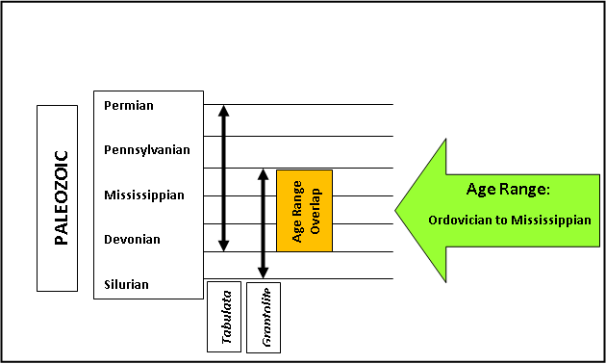
Example: Tabulata (Ordovician to Permian); Graptolite/Graptolithina (Cambrian – Mississippian), these OVERLAP from the Ordovician to Mississippian. So Rocks containing both of these fossils represent this Geologic Age Range.

Slide 28
Phylum/Class/Order Age Range
Porifera Proterozoic to Recent
Cnidaria
Rugosa Ordovician to Permian
Scleractinia Triassic to Recent
Tabulata Ordovician to Permian
Bryozoa Ordovician to Recent
Brachiopoda Cambrian to Recent
Mollusca
Gastropoda Cambrian to Recent
Bivalvia (pelecypoda) Cambrian to Recent
Cephalopoda
    Ammonoidea Devonian to Cretaceous
    Nautiloidea Cambrian to Recent
Arthropoda
Trilobita Cambrian to Permian
Crustacea
  Ostracoda Cambrian to Recent
Insecta (uniramia) Devonian to Recent
FOSSIL GEOLOGIC AGE RANGES
TABLE #1

Slide 29
Phylum/Class/Order Age Range
Echinodermata
Crinoidea Cambrian to Recent
Blastoidea Ordovician to Permian
Echinoidea Ordovician to Recent
Hemichordata
Graptolithina Cambrian to Mississippian (Early Carboniferous)
Chordata
Vertebrata
  Pisces (fish) Ordovician to Recent
  Amphibia Devonian to Recent
  Reptilia Pennsylvanian (Late Carboniferous) to Recent
  Mammalia Triassic to Recent
  Aves Jurassic to Recent
FOSSIL GEOLOGIC AGE RANGES
TABLE #2

Slide 30
Please provide the geologic age range for the following assemblages, note that a fossil assemblage is a group of fossils found together in the same layer(s):
Assemblage One: Graptolite (Hemichordata), Trilobites, Ammonoids.
Assemblage Two: Articulate Brachiopods, Pelecypods (bivalves), Bryozoans, Rugose Corals.
Assemblage Three: Gastropods, Pelecypods, Scleractinian Corals, Fish (Pisces).
Assemblage Four: Blastoidea, Ammonoidea, Reptile Skull, Tabulate Corals.
INSTRUCTIONS: Determine the age range of the fossils found in each assemblage, from “Fossil Geologic Age Ranges Tables #1 & #1. Use the Geologic Time Scale to determine where the ages OVERLAP. The place where they overlap in geologic time is the age of the assemblage.

Slide 31
Assemblage One:
Graptolite (Hemichordata), Trilobites, Ammonoids.
Hemichordata – Cambrian to Mississippian (Early Carboniferous)
Trilobites - Cambrian to Permian
Ammonoids – Devonian to Cretaceous

Slide 32
Assemblage One:
Hemichordata – Cambrian to Mississippian (Early Carboniferous)
Trilobites - Cambrian to Permian
Ammonoids – Devonian to Cretaceous
Ammonoids
Where all three fossils occur together
Trilobites - Cambrian to Permian
Hemichordata
Top of Mississippian to the bottom of the Devonian
RANGE: DEVONIAN TO MISSISSIPPIAN

Slide 33
Assemblage One:
Hemichordata – Cambrian to Mississippian (Early Carboniferous)
Trilobites - Cambrian to Permian
Ammonoids – Devonian to Cretaceous
The three fossils occur together from the Devonian to Mississippian

Slide 34
Assemblage Two:
Articulate Brachiopods – Cambrian to Recent
Pelecypods (bivalves) – Cambrian to Recent
Bryozoans – Ordovician to Recent
Rugose Corals – Ordovician to Permian

Slide 35
Assemblage Two:
Articulate Brachiopods – Cambrian to Recent
Pelecypods (bivalves) – Cambrian to Recent
Bryozoans – Ordovician to Recent
Rugose Corals – Ordovician to Permian
RANGE: ORDOVICIAN TO PERMIAN
Bryozoans
Articulate Brachiopods & BIvalves
Rugose Corals
Where all four fossils occur together

Slide 36
Assemblage Three:
Gastropods - Cambrian to Recent
Pelecypods (bivalves) – Cambrian to Recent
Scleractinian Corals – Triassic to Recent
Fish (Pisces) – Ordovician to Recent

Slide 37
Where all four fossils occur together
Scleractinian Corals
Fish
Gastropods & BIvalves
Assemblage Three:
Gastropods - Cambrian to Recent
Pelecypods (bivalves) – Cambrian to Recent
Scleractinian Corals – Triassic to Recent
Fish (Pisces) – Ordovician to Recent
RANGE: TRIASSIC TO RECENT

Slide 38
Assemblage Four:
Blastoidea – Ordovician to Permian
Ammonoidea – Devonian to Cretaceous
Reptile Skull – Pennsylvanian (late Carboniferous) to Recent
Tabulate Corals – Ordovician to Permian

Slide 39
Reptile
Ammonoids
Where all four fossils occur together
Blastoids & Tabulate Coral
Assemblage Four:
Blastoidea – Ordovician to Permian
Ammonoidea – Devonian to Cretaceous
Reptile Skull – Pennsylvanian (late Carboniferous) to Recent
Tabulate Corals – Ordovician to Permian
RANGE: PENNSYLVANIAN TO PERMIAN

