Slide 1
Language translation service
By:
Group 11

Slide 2
Introduction
Advanced Tech: State-of-the-art machine learning for accurate, context-aware translations.
Languages Galore: Extensive range, from popular to rare languages.
Human Expertise: Skilled linguists ensure culturally nuanced translations.
Versatile Use: Ideal for emails, legal documents, websites, and more.
Easy Access: User-friendly interface for hassle-free translations.
Applications:
Business expansion
Travel ease
Educational access
Legal document accuracy

Slide 3
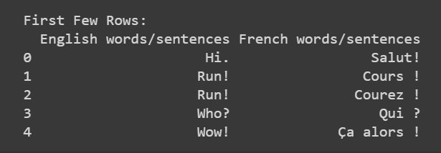
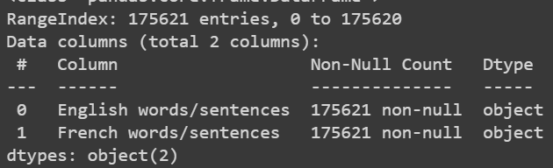
Dataset

Slide 4
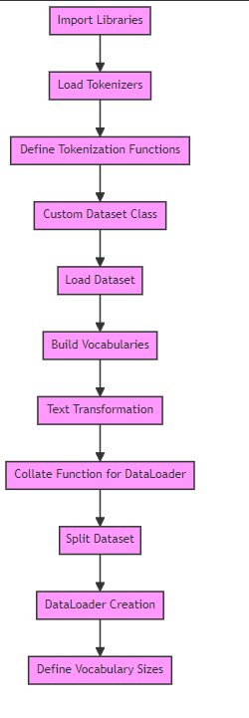
Preprocessing
Library Import: Imports Python libraries for data handling (Pandas), neural networks (PyTorch), tokenization (Spacy), and plotting (matplotlib).
Tokenizer Setup: Initializes English and French tokenizers using Spacy for text processing.
Custom Dataset: Defines a dataset class for English-French text pairs, handling reading and tokenizing data from a CSV file.
Vocabulary Construction: Builds vocabularies for both languages, mapping tokens to indices for model input.
Text Transformation: Adds special tokens and converts text to numerical format using the created vocabularies.
DataLoader Creation: Splits dataset into training and testing and prepares DataLoaders for batch processing with padding.
Model Setup: Calculates the sizes of source and target vocabularies, crucial for defining the translation model architecture.

Slide 5
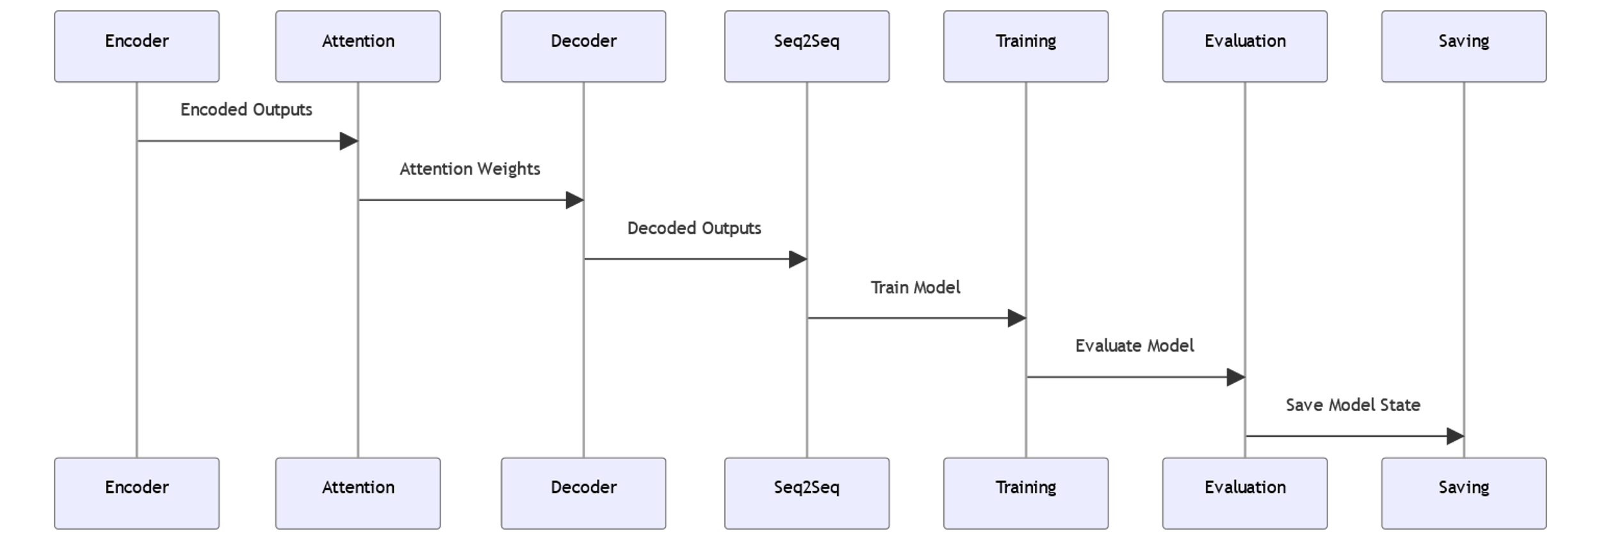
Bidirectional LSTM with Attention mechanism

Slide 6
Architecture
Encoder: Processes input data into encoded outputs.
Attention Mechanism: Calculates attention weights from Encoder's outputs.
Decoder: Decodes information using attention weights.
Seq2Seq Model: Integrates Encoder and Decoder for processing.
Training: Seq2Seq model learns from data.
Evaluation: Assesses model's performance post-training.
Saving: Stores the trained model for future use.

Slide 7
Attention Mechanism:
Bahdanau Attention:
Research paper referred:
Neural Machine Translation by Jointly Learning to Align and Translate

Slide 8
Why Bleu score is used
Accuracy as a metric often implies exact matches between the predicted and actual sequences. In language translation, however, there can be multiple correct ways to translate the same sentence. Therefore, a translation could be contextually accurate and semantically appropriate without being a word-for-word match with the reference translation.
Referred Research Paper
Bleu: a Method for Automatic Evaluation of Machine Translation" by Kishore Papineni, Salim Roukos, Todd Ward, and Wei-Jing Zhu, published in 2002

Slide 9
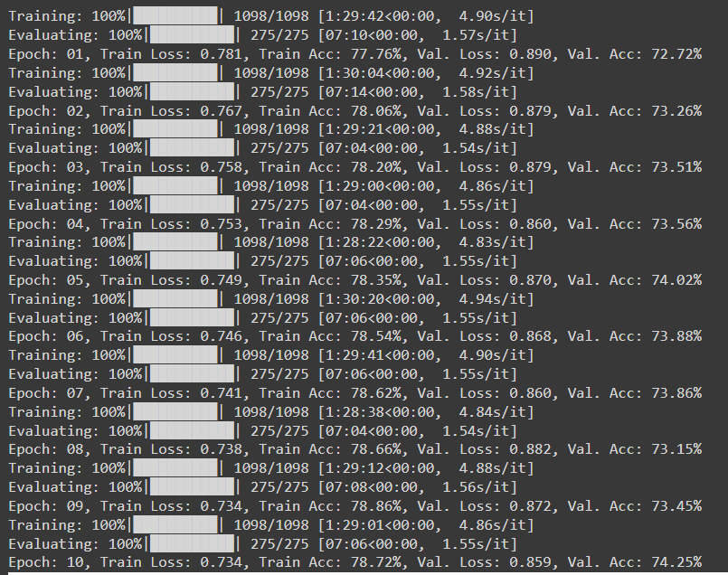
Criterion: CrossEntropyLoss
Optimizer: Adam

Slide 10
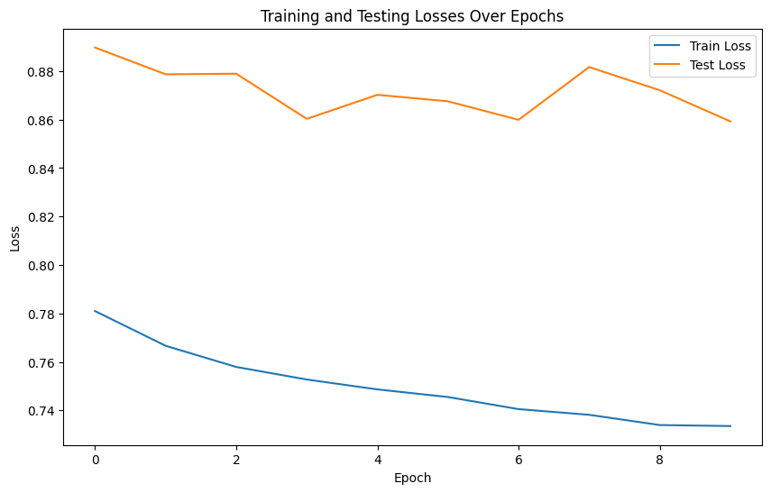
Criterion: CrossEntropyLoss
Optimizer: Adam

Slide 11
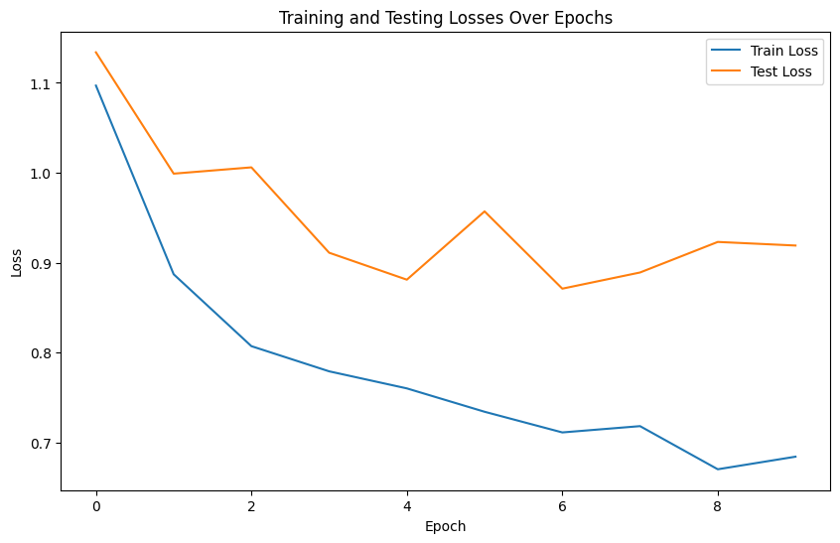
Criterion: NLLLoss
Optimizer: SGD

Slide 12
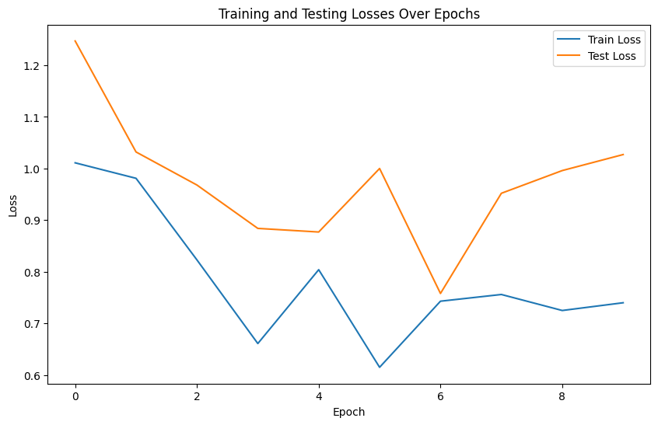
Criterion: CrossEntropyLoss
Optimizer: RMSprop

Slide 13
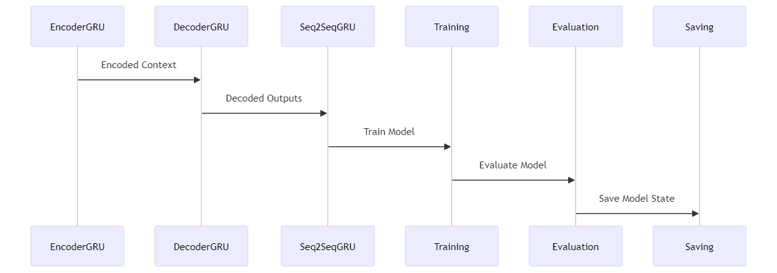
Gated Recurrent Unit

Slide 14
Architecture
The EncoderGRU processes the input data and generates a context vector.
This context vector is then passed to the DecoderGRU.
The DecoderGRU uses the context to generate decoded outputs.
The Seq2SeqGRU model, which integrates the EncoderGRU and DecoderGRU, is then trained.
The Training process involves adjusting the model's parameters based on the training data.
After training, the model is Evaluated to assess its performance.
Finally, the trained model's state is Saved for future use.

Slide 15
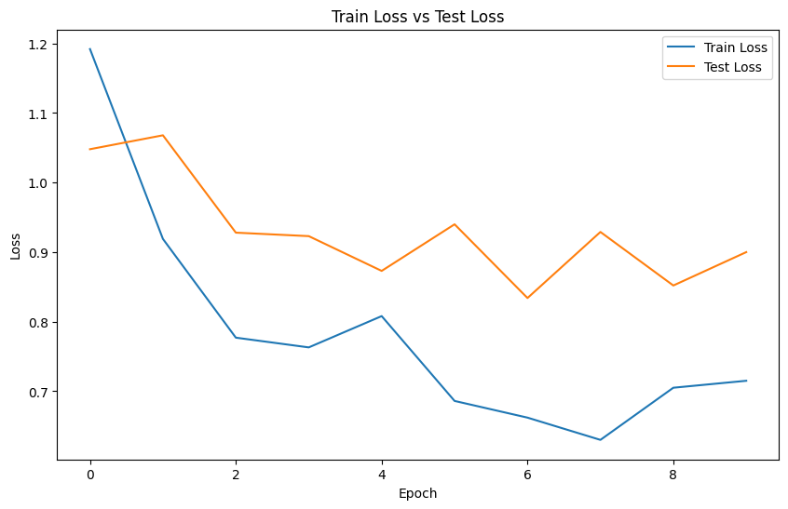
Criterion: NLLLoss
Optimizer: SGD

Slide 16
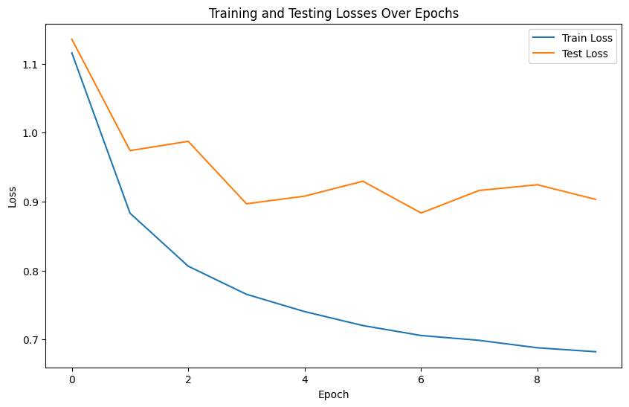
Criterion: CrossEntropyLoss
Optimizer: Adam

Slide 17
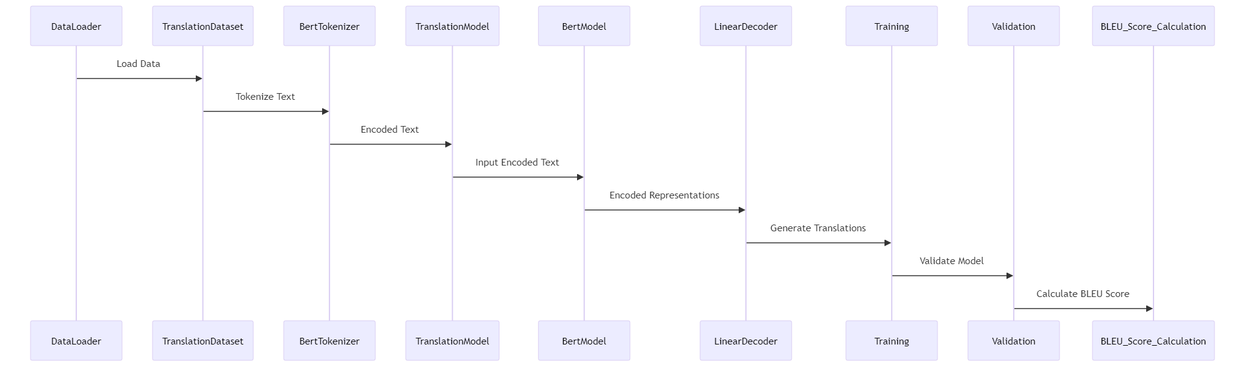
BERT

Slide 18
DataLoader: Loads the dataset and passes it to the TranslationDataset.
TranslationDataset: Prepares the data for processing. It sends text data to the BertTokenizer.
BertTokenizer: Tokenizes the text data (both English and French). The tokenized text is then sent to the TranslationModel.
TranslationModel: Receives the encoded text. It consists of two main components:
BertModel: Processes the input encoded text and generates encoded representations.
LinearDecoder: Takes the encoded representations from the BertModel and generates translations.
Training: The model is trained on these translations. The training process involves adjusting the model's parameters to improve translation accuracy.
Validation: After training, the model is validated to assess its performance on unseen data.
BLEU Score Calculation: Finally, the BLEU score is calculated to quantitatively evaluate the quality of the translations produced by the model.

Slide 19
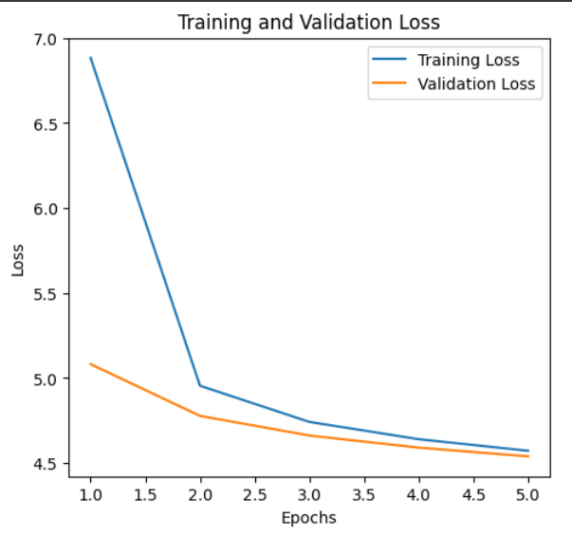
Criterion: CrossEntropyLoss
Optimizer: AdamW

Slide 20
Results
Model | Loss | Bleu Score
Bi-LSTM with Attention CrossEntropyLoss, Adam | 0.859 | 27.56
Bi-LSTM with Attention NLLLoss, SGD | 0.755 | 26.21
Bi-LSTM with Attention CrossEntropyLoss, RMSprop | 0.758 | 16.45
GRU CrossEntropyLoss, Adam | 0.903 | 20.7
GRU NLLLoss, SGD | 0.900 | 18.37
BERT CrossEntropyLoss, AdamW | 0.93 | 23.8

Slide 21
Conclusion:
Bi-LSTM with Attention model using CrossEntropyLoss and Adam optimizer appears to be the most effective setup among the tested configurations

Slide 22
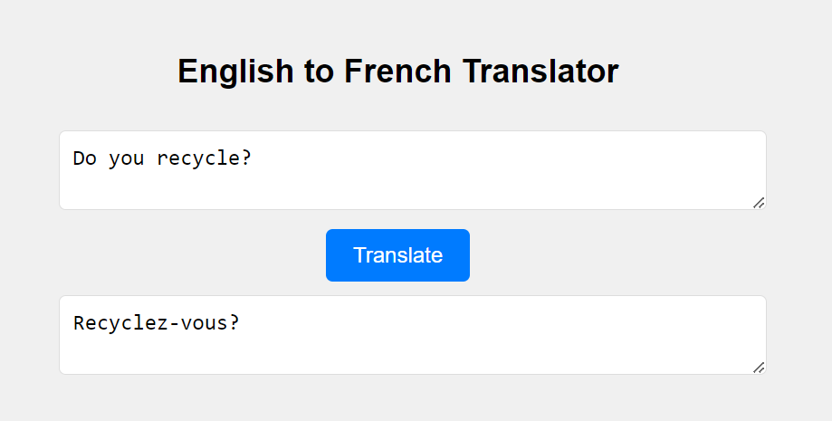
Front-end

Slide 23
THANK YOU

