Slide 1
Sentiment Analysis
Team : 16
Group Members : Vikas Manchikanti
Priyanka Chakraborty
Pragathi Makkena

Slide 2
Abstract
An overview of a sentiment analysis model developed for evaluating customer feedback on musical instruments using the Amazon review dataset.
The model identifies positive and negative sentiments in individual reviews and predicts overall ratings based on textual feedback.
In this study, we compare three deep learning architectures (LSTM, GRU, and CNN) with various optimizers and loss functions and identifies LSTM and GRU models with the Adam optimizer and BCEWithLogitsLoss.
The model's success in categorizing customer feedback and predicting overall ratings offers valuable insights to businesses seeking to understand customer insights, which further help business to improve their products and services.

Slide 3
What is Sentiment Analysis?
Sentiment analysis is the most common text classification tool that analyses the input such as customer feedback and tells us whether it is Positive, Negative.
The main goal of sentiment analysis is to understand the opinions of individuals or group towards the products, services or an event.
By understanding the sentiment of the customers, companies can improve their products, services according to the issues raised.

Slide 4
Dataset
We have used "Amazon Musical Instruments Reviews" dataset from Kaggle, which contains customer feedback and reviews for various musical instruments available on Amazon.
The dataset contains many important columns, such as reviewerID, asin, reviewername, helpful, reviewtext, overall, summary, unixReviewTime, and reviewTime.

Slide 5
Dataset Preprocessing
Text Preprocessing: The reviewText column, which contained the textual feedback, underwent essential preprocessing steps, such as:
Tokenization
Stop Word Removal
Lemmatization
Numerical Encoding
Model-Specific Data Formatting

Slide 6
Model Building
In this model, the ratio of training and testing data is 80:20
The input to the model is the textual feedback in the form of word sequences, and the expected output is the sentiment label (positive or negative) for each review.
LSTM ( Long Short-Term Memory ) : The reason why we chose LSTM is because of its ability to effectively model sequential data such as text. This type of model is well-suited to capture the context and dependencies between words
GRU ( Gated Recurrent Unit ) : In sentiment Analysis GRU can be used because of its ability to capture dependencies and patterns in sequential data. This is the most Computationally efficient alternative to LSTM.
CNN ( Convolutional Neural Network) : Though CNN’s are known for their image processing tasks, we can use it for Sentiment Analysis with some modifications. For example, when CNN’s are combined with other techniques like pre-trained word embeddings, they have shown promising results.

Slide 7
Loss Function:
Loss Function plays a very important role as they are used to evaluate the difference between the predicted output and the actual target values during the training process.
The most commonly used loss functions in the context of the models mentioned,
Binary Cross-Entropy Loss
Mean Squared Error (MSELoss)
L1 Loss (L1Loss)
But, for binary classification tasks like sentiment analysis, the Binary Cross-Entropy Loss is the most commonly used loss function.

Slide 8
Optimizer :
Basically, the optimization process involves iteratively updating the model's parameters based on the feedback from a defined loss function, which measures the discrepancy between model predictions and true target values.
There are variations of gradient descent, such as Stochastic Gradient Descent (SGD), Mini-Batch Gradient Descent, and more advanced methods like Adam, RMSprop, and Adagrad.
Adam is a great optimizer for LSTM model training due to its adaptive learning rates, momentum, robustness to noisy data, and efficient memory usage.

Slide 9
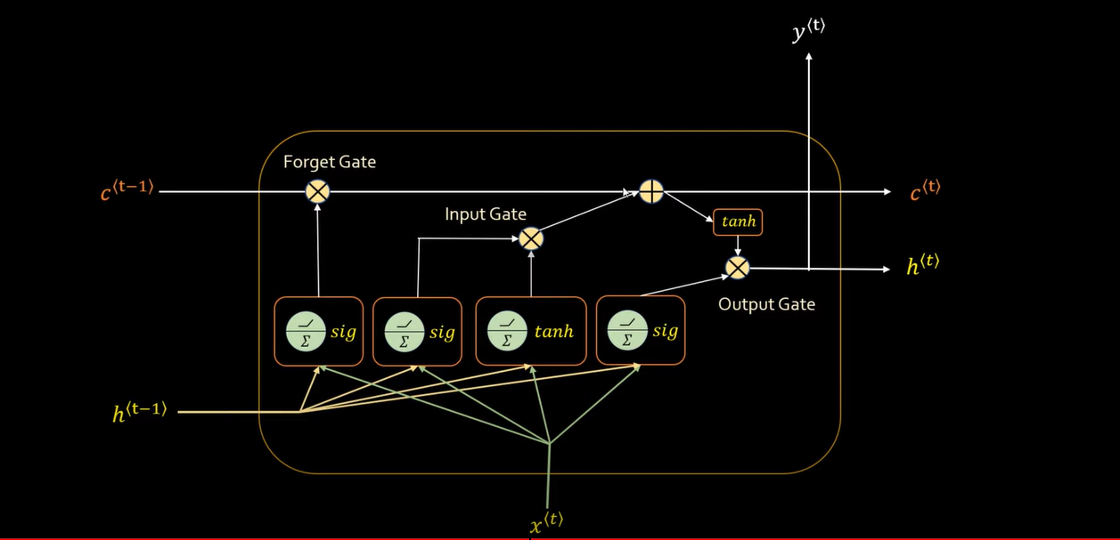
LSTM :
Long Short-Term Memory(LSTM) is unit of Recurrent Neural Network(RNN). Commonly, an LSTM unit is composed of a Candidate Cell State, an input gate, an output gate and a forget gate.
Our LSTM architecture consists of 4 components,
Embedding layer
LSTM Layer
Linear Layer
Sigmoid Function

Slide 10
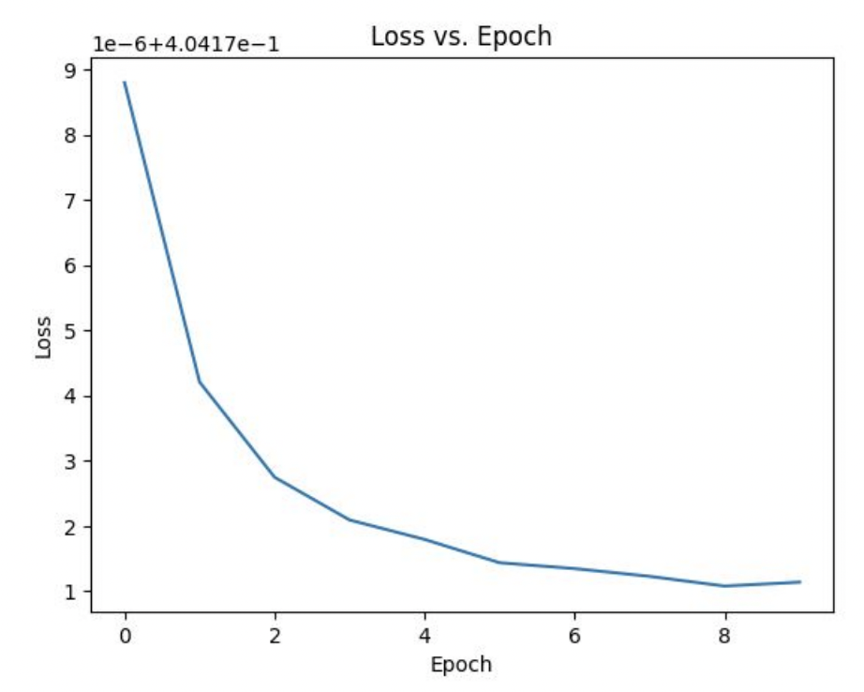
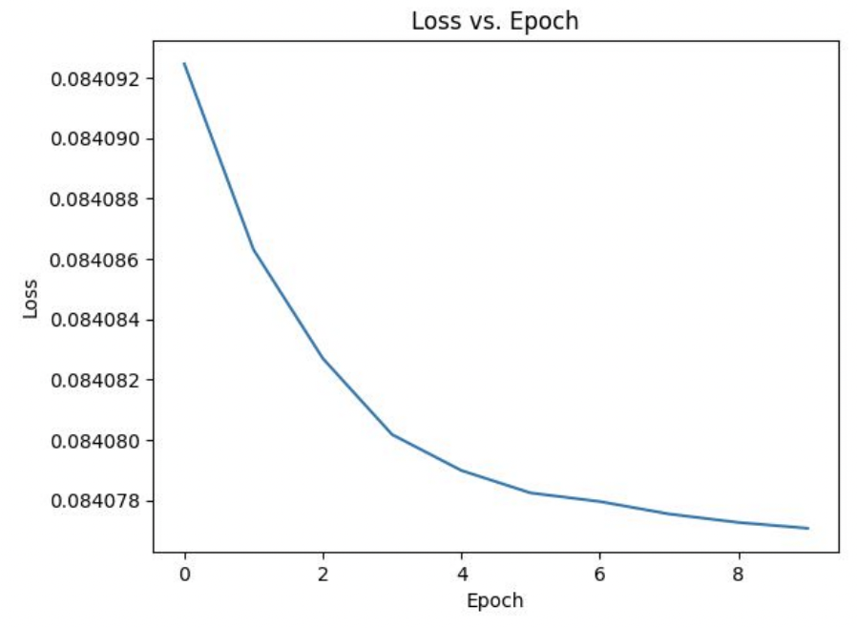
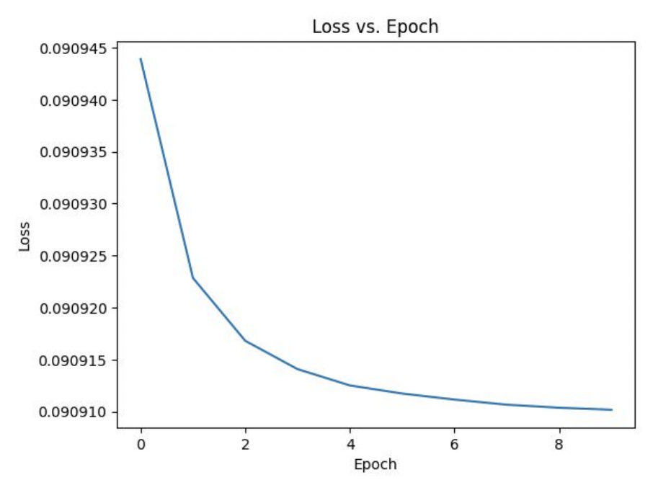
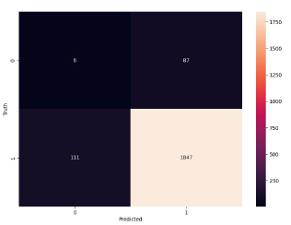
LSTM Experimental Results:
LSTM model with Adam optimizer and BCEWithLogitsLoss
LSTM model with SGD optimizer and MSELoss
LSTM model with Adam optimizer and L1Loss

Slide 11
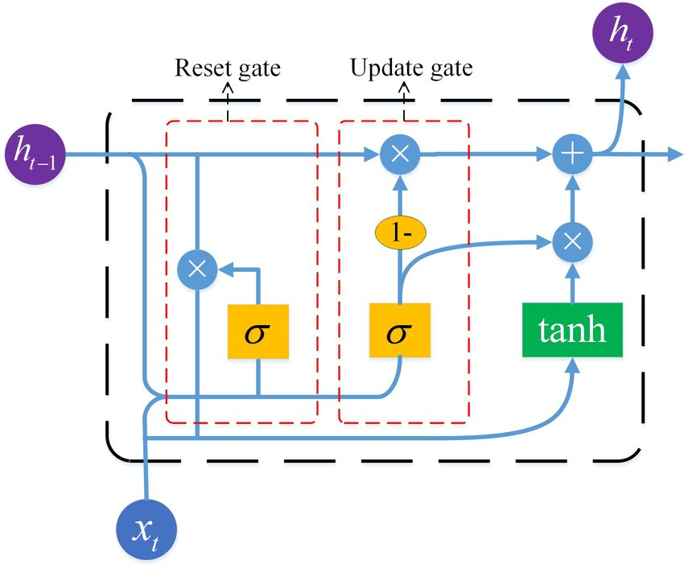
GRU :
GRU is also a type of recurrent neural network (RNN) unit, which is similar to LSTM and the most common GRU unit consists of Candidate Hidden State, New Hidden State and two gates i.e., an update gate and a reset gate. These gates regulate the flow of information in and out of the cell.
Our GRU model architecture consists of the following,
Embedding Layer
GRU Layer
Linear Layer
Sigmoid Function

Slide 12
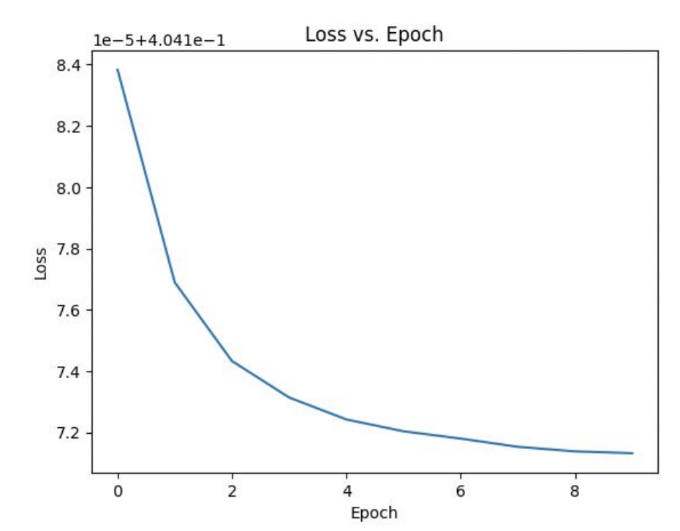
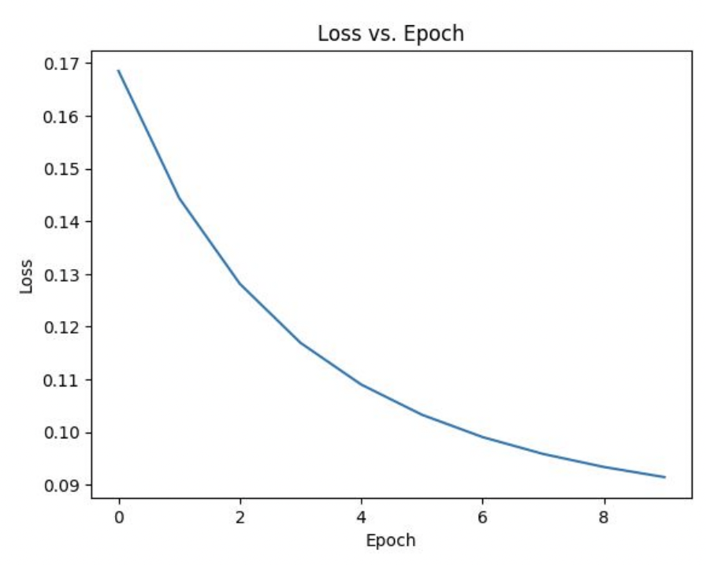
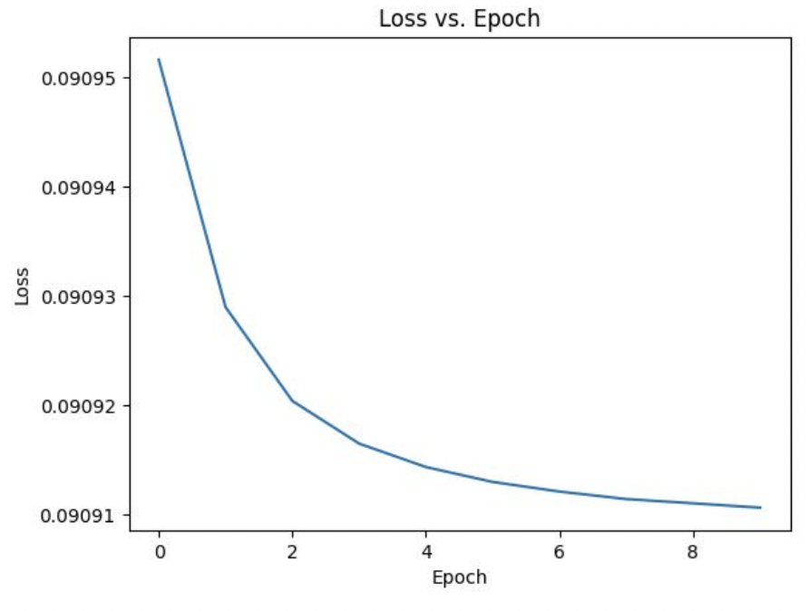
GRU Experimental Results:
GRU model with Adam optimizer and BCEWithLogitsLoss
GRU model with SGD optimizer and MSELoss
GRU model with Adam optimizer and L1Loss

Slide 13
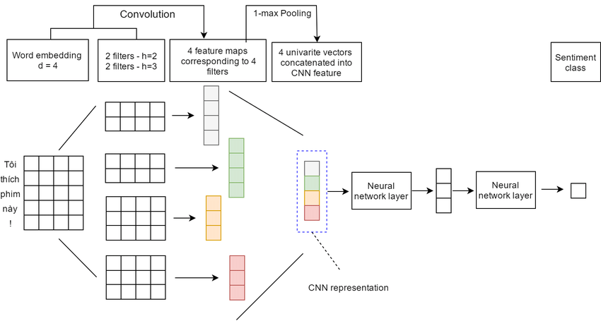
CNN :
Convolutional Neural Networks (CNNs) are primarily known for their application in image processing tasks, but they can be adapted for Natural Language Processing (NLP) tasks like sentiment analysis.
Our CNN architecture consists of 6 components,
Embedding Layer
Convolutional Layer
Max Pooling
Dropout
Fully Connected Layer
Sigmoid Activation Function

Slide 14
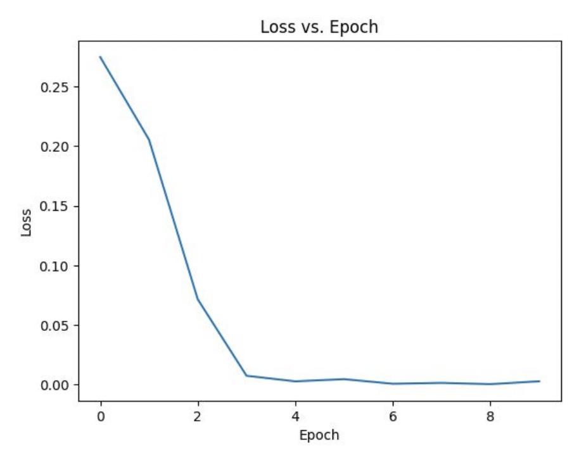
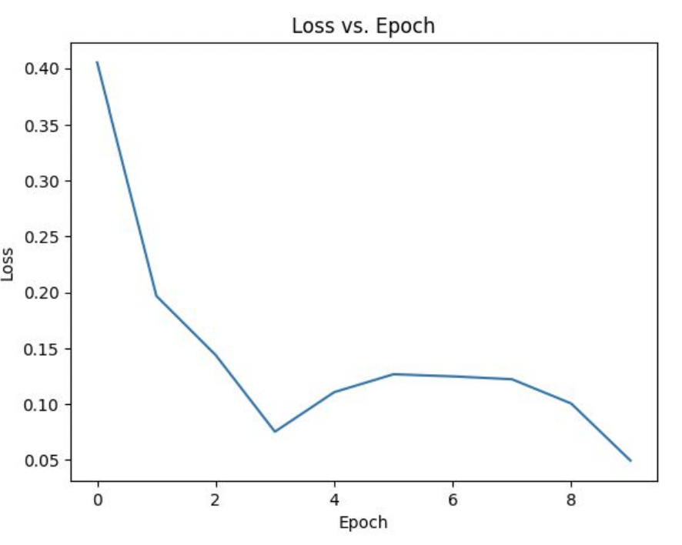
CNN Experimental Results:
CNN model with Adam optimizer and BCEWithLogitsLoss
CNN model with SGD optimizer and MSELoss

Slide 15
Conclusion :
We can finally conclude that for this dataset that the LSTM model with the Adam optimizer and the BCELoss, GRU model with the Adam optimizer and the BCELoss function are the most suitable for sentiment analysis using the Amazon review dataset
These insights provided by the customers will help the businesses to improve their product and services, increasing the customer satisfaction which further may result in market success.
To improve results, future work could optimize and fine-tune the models and possibly investigate other deep learning architectures for sentiment analysis tasks.

Slide 16
THANK YOU

