Slide 1

Khaled Rasheed
Computer Science Dept.
University of Georgia
http://www.cs.uga.edu/~khaled

Slide 2

Genetic algorithms
Genetic programming
Evolution strategies
Classifier systems
Evolution programming
Conclusion

Slide 3

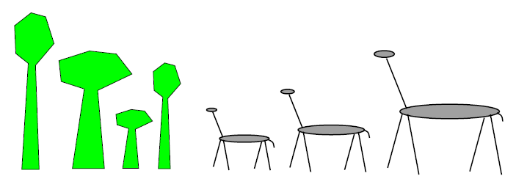
Fitness = Height
Survival of the fittest

Slide 4

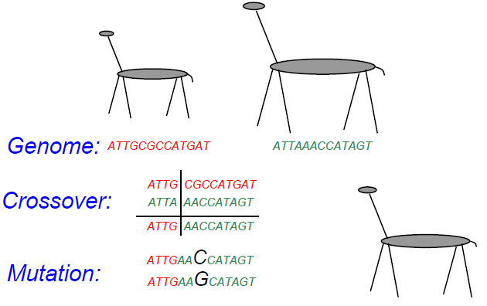

Slide 5

Maintain a population of potential solutions
New solutions are generated by selecting, combining and modifying existing solutions
  Crossover
  Mutation
Objective function = Fitness function
  Better solutions favored for parenthood
  Worse solutions favored for replacement

Slide 6

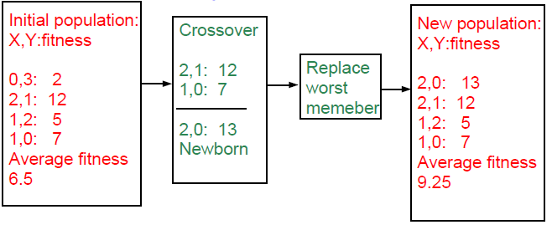
maximize 2X^2-y+5 where X:[0,3],Y:[0,3]

Slide 7

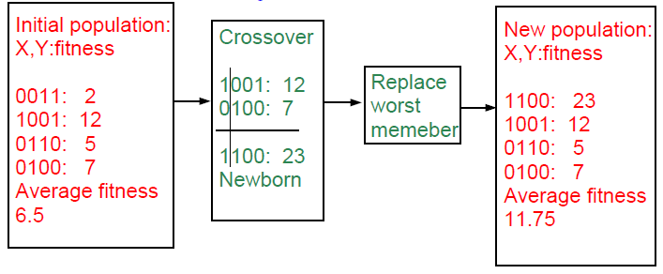
maximize 2X^2-y+5 where X:[0,3],Y:[0,3]

Slide 8
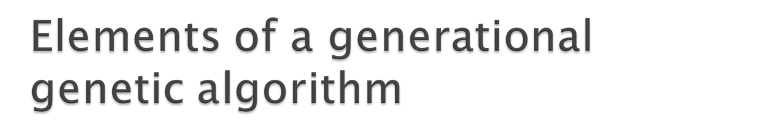
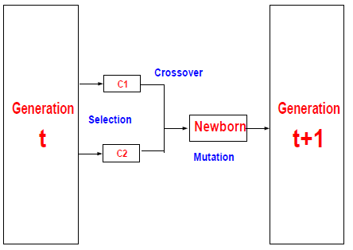
Representation
Fitness function
Initialization strategy
Selection strategy
Crossover operators
Mutation operators

Slide 9
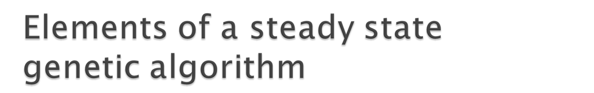
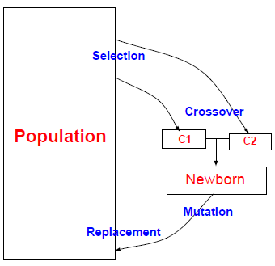
Representation
Fitness function
Initialization strategy
Selection strategy
Crossover operators
Mutation operators
Replacement strategy

Slide 10

Proportional selection (roulette wheel)
  selection probability of individual=fitness/sum of fitnesses
Rank based selection
  Example: decreasing arithmetic/geometric series
  better when fitness range is very large
Tournament selection
  Virtual tournament between randomly selected individuals using fitness

Slide 11

Point crossover (classical)
  Parent1=x1,x2,x3,x4,x5,x6
  Parent2=y1,y2,y3,y4,y5,y6
  Child =x1,x2,x3,x4,y5,y6
Uniform (random) crossover
  Parent1=x1,x2,x3,x4,x5,x6
  Parent2=y1,y2,y3,y4,y5,y6
  Child =x1,x2,y3,x4,y5,y6
Arithmetic crossover
  Parent1=x1,x2,x3
  Parent2=y1,y2,y3
  Child =(x1+y1)/2,(x2+y2)/2,(x3+y3)/2

Slide 12

change one or more components
Let Child=x1,x2,P,x3,x4...
Gaussian mutation:
  P ¬ P ± ∆p
  ∆ p: (small) random normal value
Uniform mutation:
  P ¬ P new
  p new : random uniform value
boundary mutation:
  P ¬ Pmin OR Pmax
Binary mutation=bit flip

Slide 13
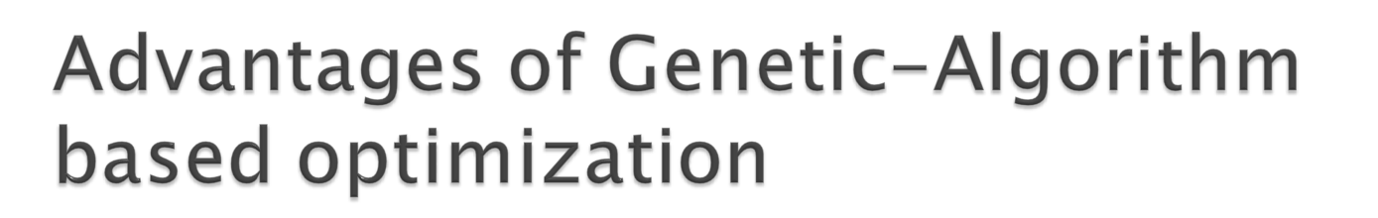
Finds global optima
Can handle discrete, continuous and mixed variable spaces
Easy to use (short programs)
Robust (less sensitive to noise, ill conditions)

Slide 14

Relatively slower than other methods (not suitable for easy problems)
Theory lags behind applications

Slide 15

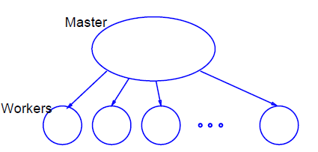

Slide 16

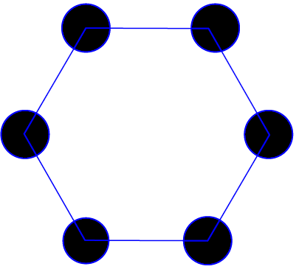

Slide 17

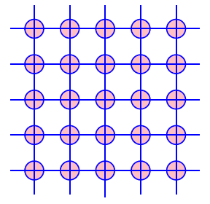

Slide 18

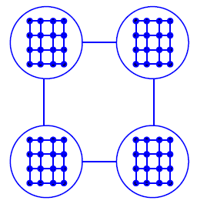
Coarse-grained GA at high level
Fine-grained GA at low level

Slide 19
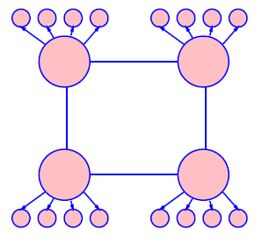
Coarse-grained GA at high level
Global parallel GA at low level

Slide 20
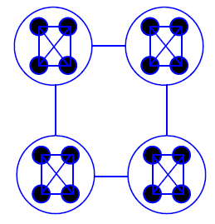
Coarse-grained GA at high level
Coarse-grained GA at low level

Slide 21

Introduced (officially) by John Koza in his book (genetic programming, 1992)
Early attempts date back to the 50s (evolving populations of binary object codes)
Idea is to evolve computer programs
Declarative programming languages usually used (Lisp)
Programs are represented as trees

Slide 22

A population of trees representing programs
The programs are composed of elements from the FUNCTION SET and the TERMINAL SET
These sets are usually fixed sets of symbols
The function set forms "non-leaf" nodes. (e.g. +,-,*,sin,cos)
The terminal set forms leaf nodes. (e.g. x,3.7, random())

Slide 23

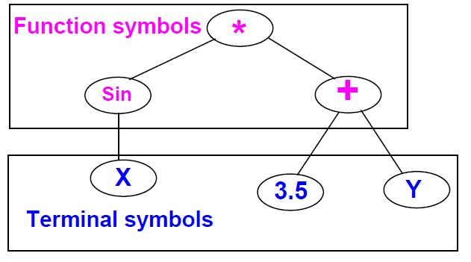

Slide 24

Fitness is usually based on I/O traces
Crossover is implemented by randomly swapping subtrees between individuals
GP usually does not extensively rely on mutation (random nodes or subtrees)
GPs are usually generational (sometimes with a generation gap)
GP usually uses huge populations (1M individuals)

Slide 25

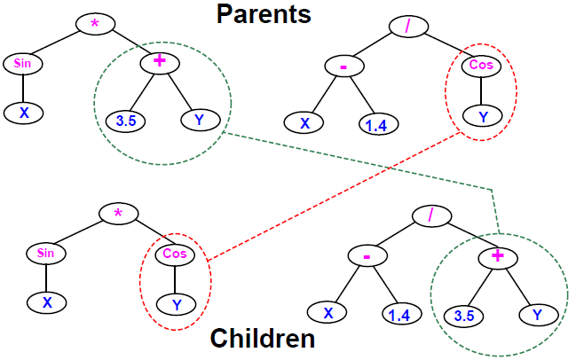

Slide 26

More flexible representation
Greater application spectrum
If tractable, evolving a way to make “things” is more useful than evolving the “things”.
Example: evolving a learning rule for neural networks (Amr Radi, GP98) vs. evolving the weights of a particular NN.

Slide 27

Extremely slow
Very poor handling of numbers
Very large populations needed
Criticism from classical GA community: no schema theory or any theory!

Slide 28

Genetic programming with linear genomes (Wolfgang Banzaf)
  Kind of going back to the evolution of binary program codes
Hybrids of GP and other methods that better handle numbers:
  Least squares methods
  Gradient based optimizers
  Genetic algorithms, other evolutionary computation methods
Evolving things other than programs
  Example: electric circuits represented as trees (Koza, AI in design 1996)

Slide 29

Were invented to solve numerical optimization problems
Originated in Europe in the 1960s
Initially: two-member or (1+1) ES:
  one PARENT generates one OFFSPRING per GENERATION
  by applying normally distributed (Gaussian) mutations
  until offspring is better and replaces parent
  This simple structure allowed theoretical results to be obtained (speed of convergence, mutation size)
Later: enhanced to a (μ+1) strategy which incorporated crossover

Slide 30

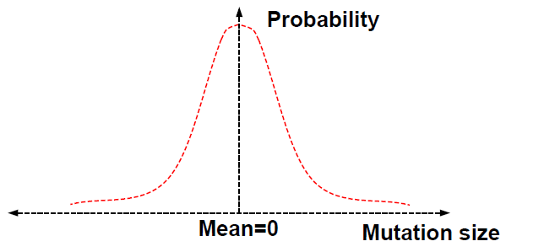

Slide 31

Schwefel introduced the multi-membered ESs now denoted by (μ +λ) and (μ, λ)
(μ, λ) ES: The parent generation is disjoint from the child generation
(μ + λ) ES: Some of the parents may be selected to "propagate" to the child generation

Slide 32

Real valued vectors consisting of two parts:
  Object variable: just like real-valued GA individual
  Strategy variable: a set of standard deviations for the Gaussian mutation
This structure allows for "Self-adaptation“ of the mutation size
  Excellent feature for dynamically changing fitness landscape

Slide 33

In machine learning we seek a good hypothesis
The hypothesis may be a rule, a neural network, a program ... etc.
GAs and other EC methods can evolve rules, NNs, programs ...etc.
Classifier systems (CFS) are the most explicit GA based machine learning tool.

Slide 34

Rule and message system
  if <condition> then <action>
Apportionment of credit system
  Based on a set of training examples
  Credit (fitness) given to rules that match the example
  Example: Bucket brigade (auctions for examples, winner takes all, existence taxes)
Genetic algorithm
  evolves a population of rules or a population of entire rule systems

Slide 35

Evolves a population of rules, the final population is used as the rule and message system
Diversity maintenance among rules is hard
If done well converges faster
Need to specify how to use the rules to classify
  what if multiple rules match example?
  exact matching only or inexact matching allowed?

Slide 36

Each individual is a complete set of rules or complete solution
Avoids the hard credit assignment problem
Slow because of complexity of space

Slide 37

Evolves finite state machines (or similar structures)
Relies on mutation (no crossover)
Fitness based on training sequence(s)
Uses rank based selection
Good for sequence problems (DNA) and prediction in time series

Slide 38

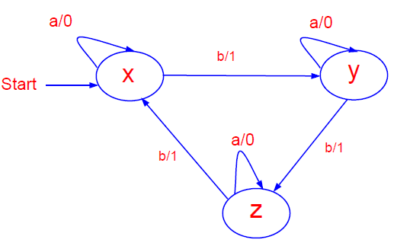

Slide 39

Add a state (with random transitions)
Delete a state (reassign state transitions)
Change an output symbol
Change a state transition
Change the start state

Slide 40
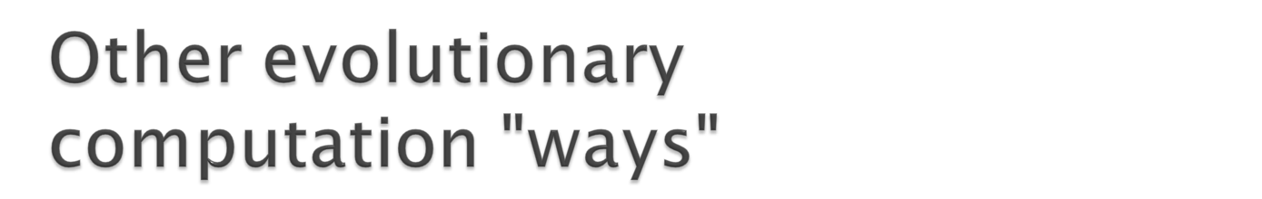
Variable complexity representations (Peter Gage, AI in design 96)
Representations based on description of transformations
  instead of enumerating the parameters of the individual, describe how to change another (nominal) individual to be it.
  Good for dimension reduction, at the expense of optimality
Response surface methods (alvarez, GP 98)
  Good when objective function is very expensive
  fit a surface to some points and optimize the surface

Slide 41

Artificial life
  An individual’s fitness depends on genes + lifetime experience
  An individual can pass the experience to offspring
Co-evolution
  Several populations of different types of individuals co-evolve
  Interaction between populations changes fitness measures

Slide 42

All evolutionary computation models are getting closer to each other
The choice of method is important for success
EC provides a very flexible architecture
  easy to combine with other paradigms
  easy to inject domain knowledge

Slide 43

Evolutionary Computation
IEEE transactions on evolutionary computation
Genetic programming
other: AIEDAM, AIENG ...

Slide 44

Genetic and evolutionary computation conference (GECCO)
Congress on evolutionary computation (CEC)
evolutionary programming (EP)
Parallel problem solving from nature (PPSN)
other: AI in design, IJCAI, AAAI ...

