Slide 1

GitHub Copilot Hackathon
Team Name- Hexaware Copilots
Team Leader Name- Manju kalyanasundaram
Team Leader Email Address-Manjuk2@hexaware.com

Slide 2
Python - Weather Forecasting Tool
Create a command-line tool that accepts a city's name and returns the current weather forecast. Leverage OpenWeatherMap API to fetch weather data and parse it using Python. Your solution should demonstrate how GitHub Copilot can help you with API usage, data parsing, and error handling.

Slide 3
Proposed solution
Subscribe to OpenWeatherMap API
Get help of GitHub copilot for requesting data from API and parsing the response from API

Slide 4
Technology/Stack used
Python, Visual studio 2022
OpenWeatherMap API
GithubCopilot extensions for Visual Studio 2022

Slide 5
Usage of GitHub Copilot
This is my first time coding in Python
Since it is using GitHub copilot, I chose to compete in Python category instead of c#.
I did not stuck up anywhere with the help of Github Copilot.
I have used Visual Studio 2022 IDE since I am comfortable with.
GitHub copilot is suggesting the syntax and helped me in parsing data back from response

Slide 6

Source code in zip file / Github link :
manchprady/PythonLearning (github.com)

Slide 7
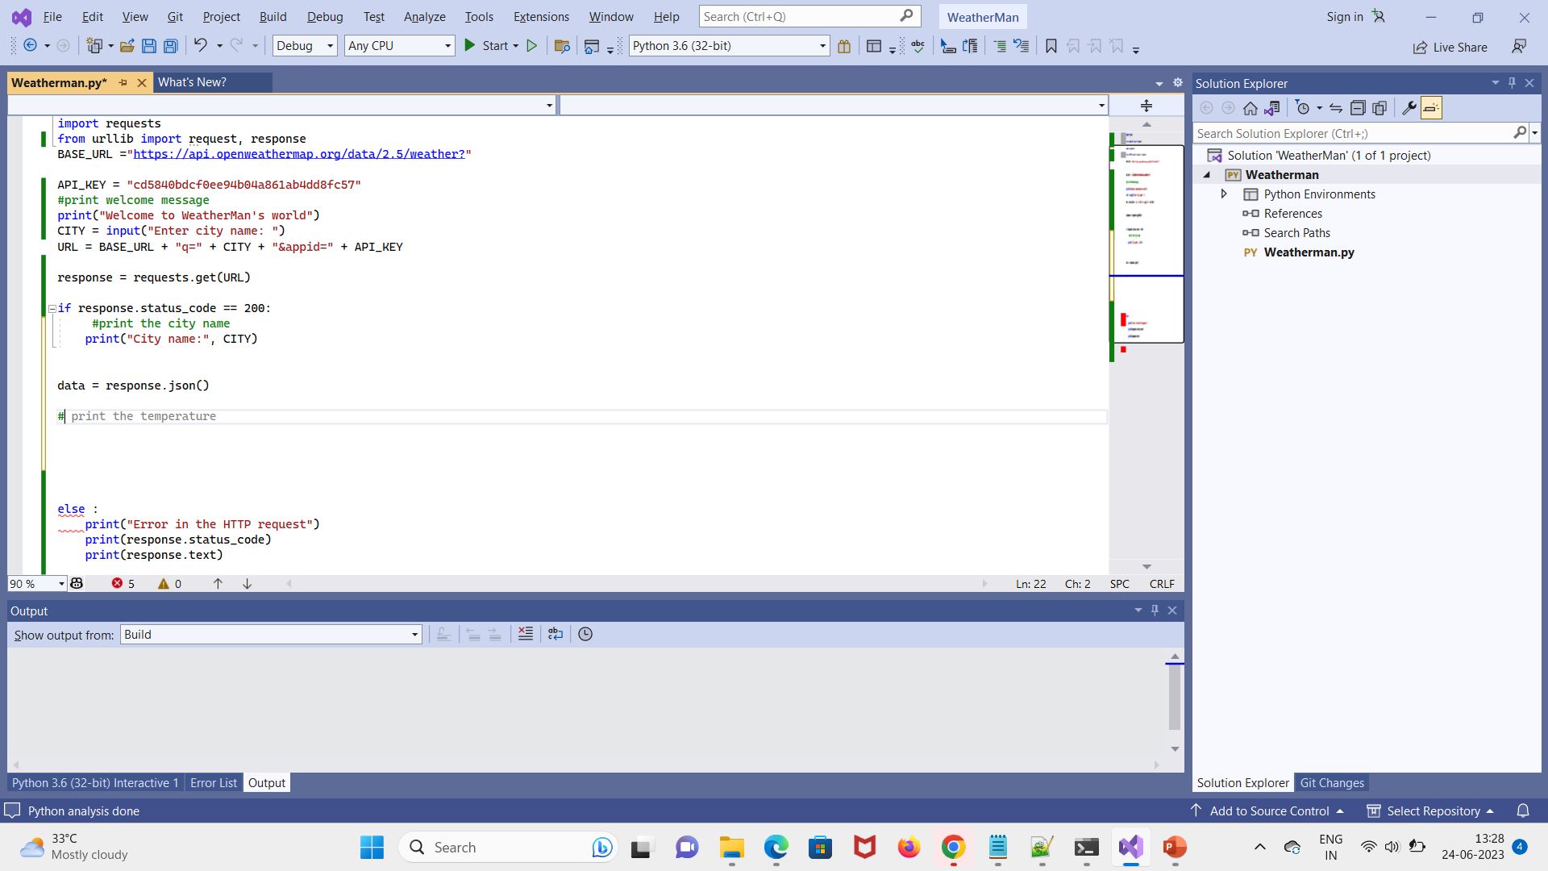

Screenshot of Github copilot suggesting code in greyed:

Slide 8
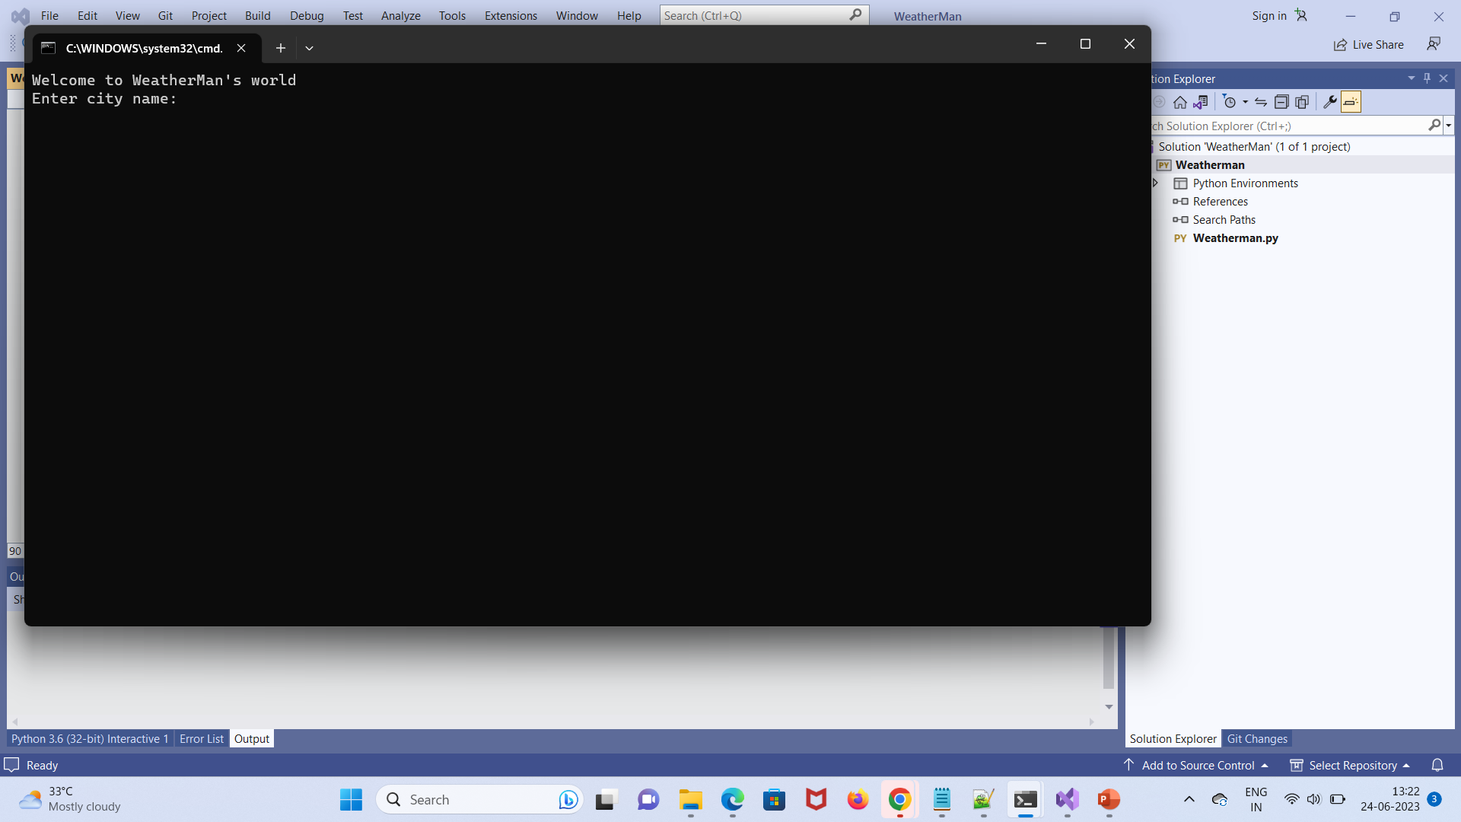
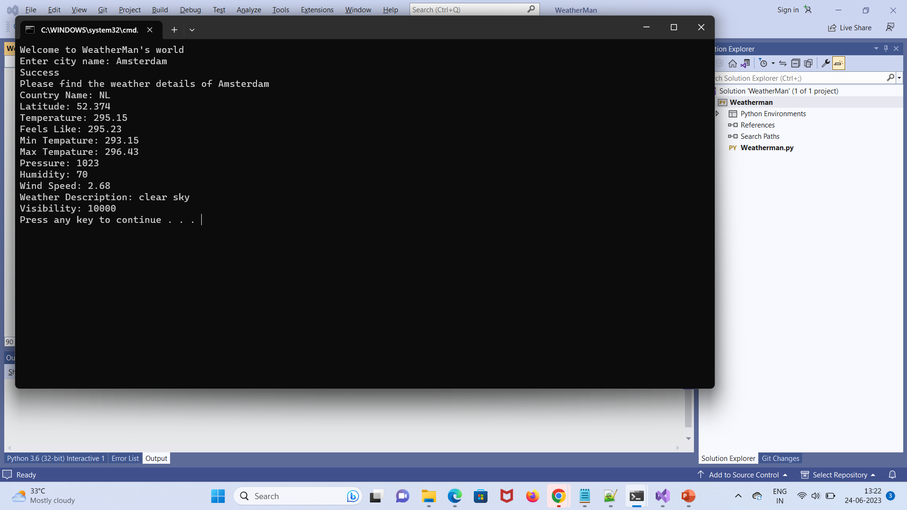
Execution Demo(Video/Screenshots) showing usage of the GitHub Copilot Platform :

Slide 9
THANK YOU

