Slide 1

by Team Four of a Kind

Slide 2
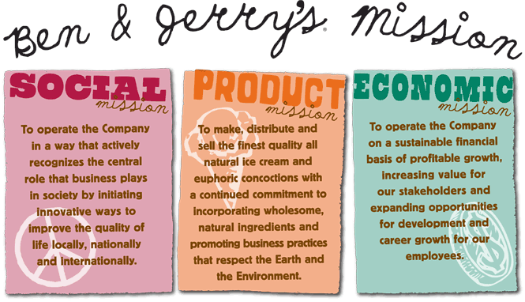
Notes:
Sound freezers
HC freezers
Occupy wall street
Livable Wages – Twice min wage
Partner shops – non profit shops with no franchize fees

Slide 3
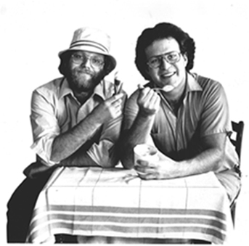
Slogan
Be One In A Million!
Notes:
Over one million free cones are given away each year, prompting the company's ad slogan "Be One In A Million." Charitable organizations are often present at the stores each year and enjoy a significant amount of fundraising success. Oftentimes, local celebrities show up at various stores, promoting the day and the charities there.[21] Sometimes the event is scheduled to coincide with Earth Day and sometimes volunteers are on hand with clipboards and voter registration forms to help those who would like to register to vote.

Slide 4
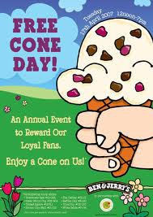
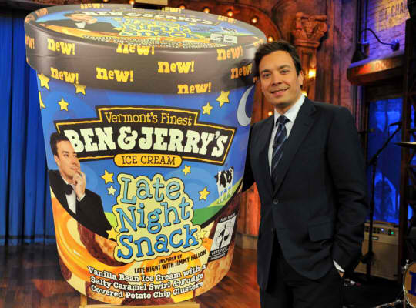
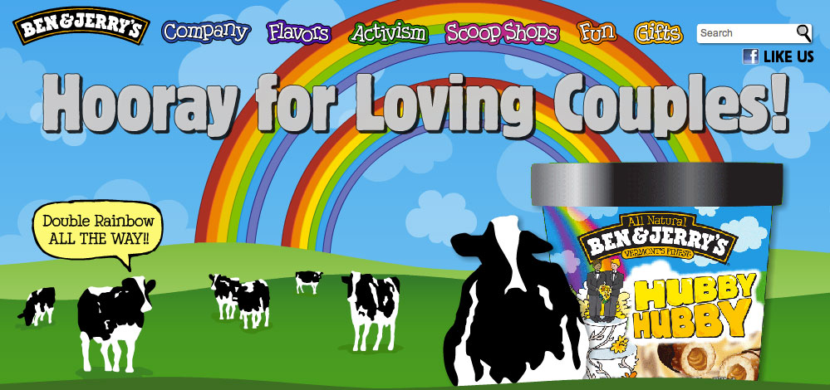
Ben & Jerry’s Ceremonies ~
Notes:
Free cone day :
Started 1979
Celebrates founding
Jimmy Fallon – Flavor

Slide 5
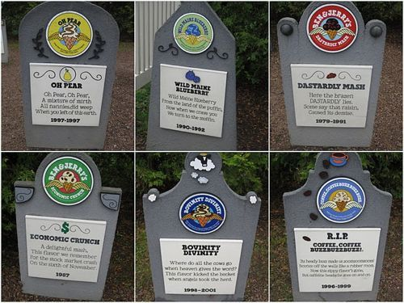
Ben & Jerry’s Ceremonies ~
Notes:
Peanut Butter & Jelly (1998-1999)
Miz Jelena's Sweet Potato Pie(1992-1993)
Bovinity Divinity(1998-2001)
Coffee! Coffee! Buzz Buzz Buzz (1996-1999)

Slide 6
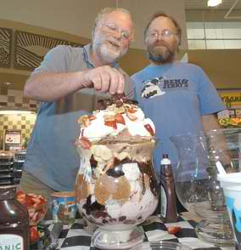
Hero’s
Notes:
Ben Cohen
Jerry Greenfield

Slide 7
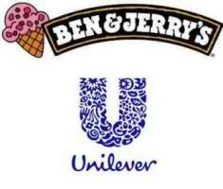
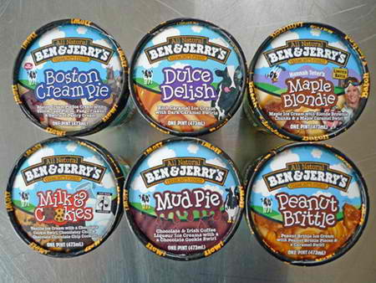
Stories
Notes:
In April 2000, Ben & Jerry's sold the company to British-Dutch multinational food giant Unilever. Unilever said it hopes to carry on the tradition of engaging "in these critical, global economic and social missions." Although the founders' names are still attached to the product, they do not hold any board or management position and are not involved in day-to-day management of the company, a new CEO took hold of the company to transition the values and socials needs in the company.
In 2001, Ben & Jerry's U.S. completed transition to "Eco-Pint" packaging, which packaged all pint flavors in environmentally friendly unbleached paperboard Eco-Pint containers, a decision it later reversed, However, due to what they described as increasing supply, quality, and cost challenges, Ben & Jerry's discontinued their use of the Eco-Pint in 2006.

Slide 8
Images:
Logo: http://www.frugallivingnw.com/wp-content/uploads/2011/02/ben-and-jerry-logo1.jpg
Background Image: http://www.benjerry.com/assets/images/bg/clouds_company.gif
Jimmy Fallon: forums.penny-arcade.com/discussion/148355/theyre-made-from-a-secret-schweddy-family-recipe/p2
Hubby Hubby: http://blog.guerrillacomm.com/2010/08/hubby-hubby.html
Occupy wall street: http://gothamist.com/2011/10/09/ben_and_jerrys_lend_delicious_suppo.php
Unilever: http://topnews.co.uk/22369-hefty-price-cuts-helped-unilever-deliver-growing-sales
Packaging: http://popsop.com/53425
Ben and Jerry: http://muppet.wikia.com/wiki/Ben_and_Jerry
Flavor Graveyard: http://www.dogonews.com/2010/9/17/at-ben-jerrys-flavors-rip-in-style

