Slide 1
Start a business in San Francisco

Slide 2
Business Problem
In this project, we are going to help our boss to decide what and where should we open our new business in San Francisco. To consider whether is suitable place and type of business for opening, we look into population and also the competitors in such areas.
Firstly, we need to identify the highest population areas (by clustering) in San Francisco.
Secondly, we then check for the most popular types of shop in that certain area
Finally, we can have a high level view by creating a word cloud to see which type of shops is most popular in that area. and we can have our suggestion to our boss.

Slide 3
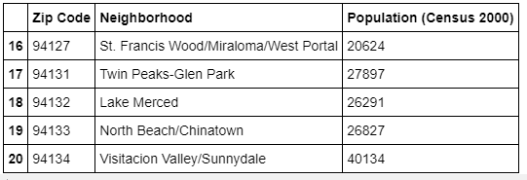
Data Preparation (1)
Zipcode and Neighborhood info for San Francisco

Slide 4
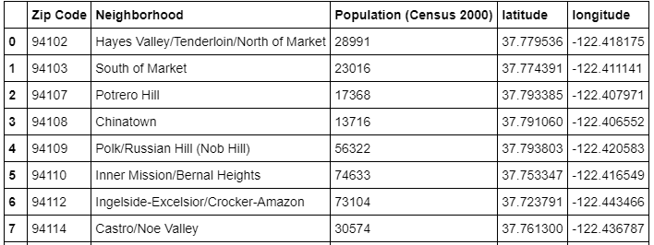
Data Preparation (2)
Geographical Coordinates of Neighborhoods

Slide 5
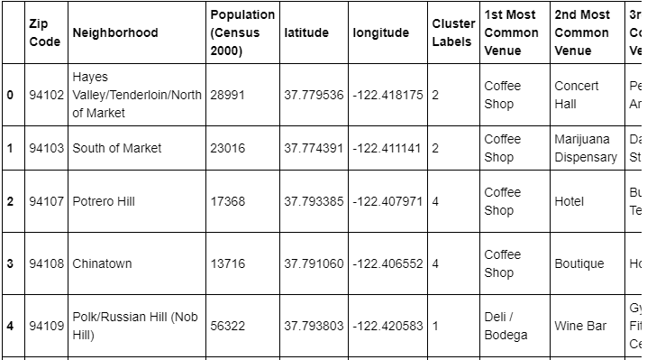
Data Analysis(1)
Combine population data to geodata

Slide 6
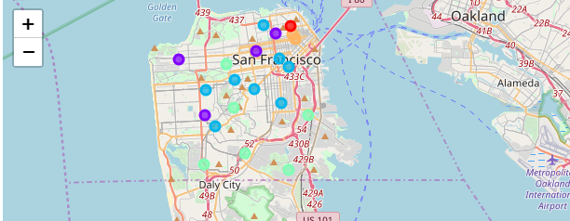
Data Analysis(2)
Create clusters for areas that is simlar

Slide 7
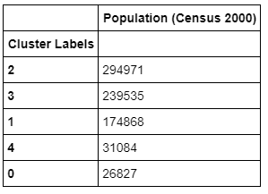
Data Analysis(3)
Population Distribution of each clusters

Slide 8
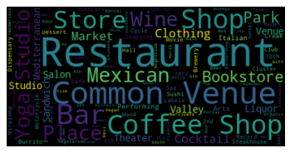
Data Analysis(4)
We do word cloud for cluster 2

Slide 9
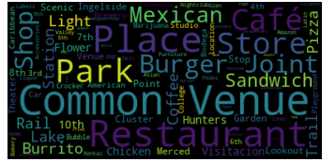
Data Analysis(5)
We do word cloud for cluster 3

Slide 10
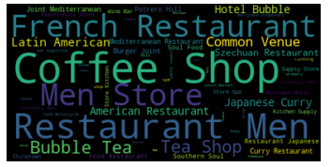
Data Analysis(4)
We do word cloud for ALL clusters

Slide 11
Conclusion
the overall popular shops in San Francisco, seems people in here are enjoy Coffee/Cafe and restaurant (especially French).
Almond the clusters, cluster 3 is with the least popular Coffee shop/café, especially in the area of “Ingelside-Excelsior/Crocker-Amazon”.
We suggest open a
Coffee Shop/ Café in area of “Ingelside-Excelsior/Crocker-Amazon”.

