Slide 1

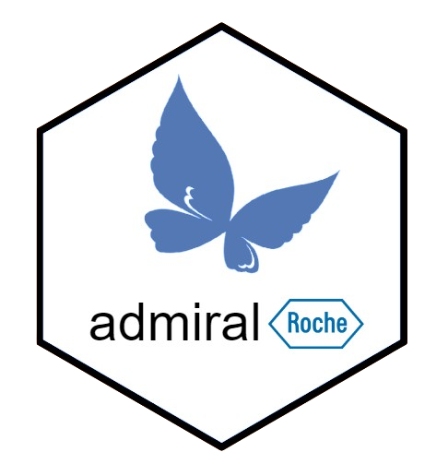
SM11 - Code that writes code that writes code?! Creating ADaMs in R with {admiralroche}
Gordon Miller and Edoardo Mancini
17th November 2026 | For public use

Slide 2
Table of contents
Background: Why {admiralroche}, and why ADaM Templates?
Stage 1: Code - Initial intro to ADaM templates
Stage 2: Code that writes code - “Abstracting away” our ADaM templates
Stage 3: Code that writes code that writes code - Creating dynamic ADaM templates
Conclusion: Reflections, Further work, Recommendations

Slide 3
Background

Slide 4
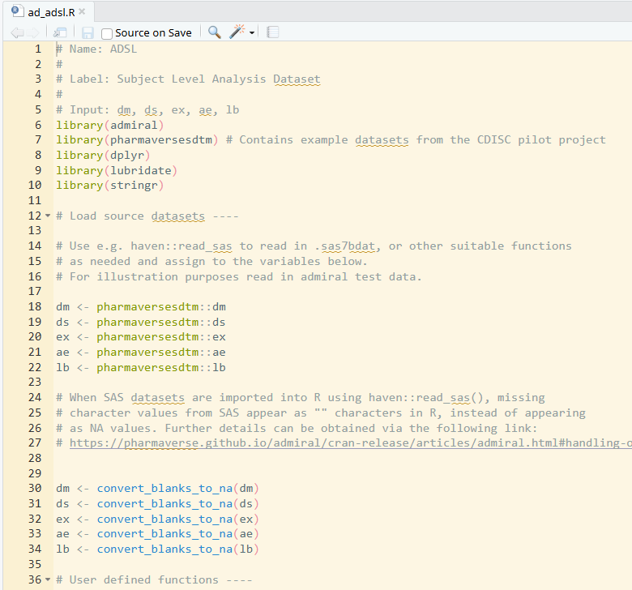
The open source {admiral} framework makes it very easy to get simple ADaM template programs…
In console:
library(admiral)
admiral::use_ad_template(
“adsl”,
package = “admiral”
)

Slide 5
…but are these templates really that close to Roche’s interpretation of the ADaM standards?
Short answer:
Not really - you should probably make your own templates.
Long answer:
Any sponsor who implements ADaM (Roche included) makes choices in the areas where ADaM is flexible, e.g.:
Conventions to follow (imputation techniques, visit mapping, period assignment, etc.)
Sponsor-specific variables, parameters (custom age groups, population flags, etc.)
Additionally each sponsor’s templates should include:
Custom helper code catered to interact smoothly with their chosen SCE
Hand-picked code to interact with dataset specs (perhaps using other pharmaverse packages such as metatools, metacore xportr...)
So, we set up the {admiralroche} package to provide ADaM templates that are as close as possible to the datasets that we routinely create at Roche.
Notes:
Mention:
Any company could create their own admiral extension package
Existing PHUSE US presentation and paper about admiralroche https://phuse.s3.eu-central-1.amazonaws.com/Archive/2024/Connect/US/Bethesda/PAP_OS05.pdf

Slide 6
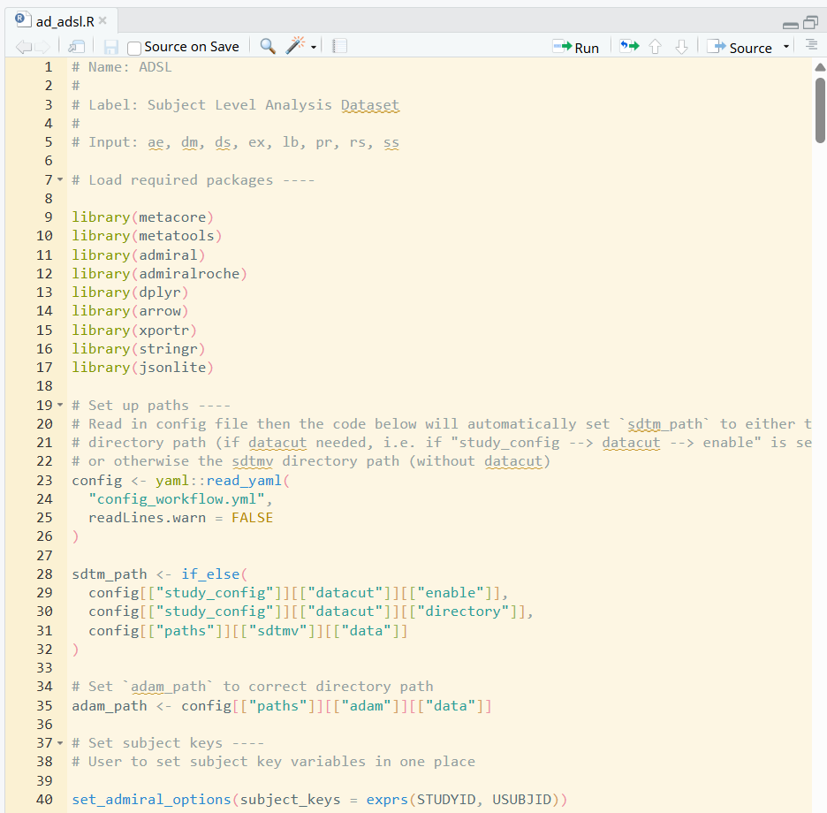
Now we can provide our own custom Roche ADaM templates!
In console:
library(admiral)
library(admiralroche)
admiral::use_ad_template(
“adsl”,
package = “admiralroche”
)
Note that {admiralroche} provides both the ADaM templates themselves and some R functions to derive Roche-specific variables in ADaM datasets.

Slide 7
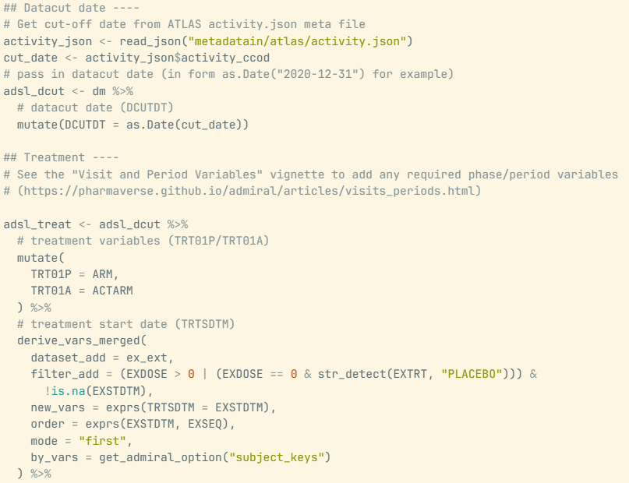
Example: (portions of) an {admiralroche} template
Code to pull data cut date from Roche-specific metadata file
Study-specific code to derive treatment arms (expect user to edit this)
Standard {admiral} function (possibly still using Roche-specific choice or arguments)
…
Custom {admiralroche} functions to derive AGEGR1 and AGEGR2 as per Roche standards

Slide 8

Stage 1: Code

Slide 9
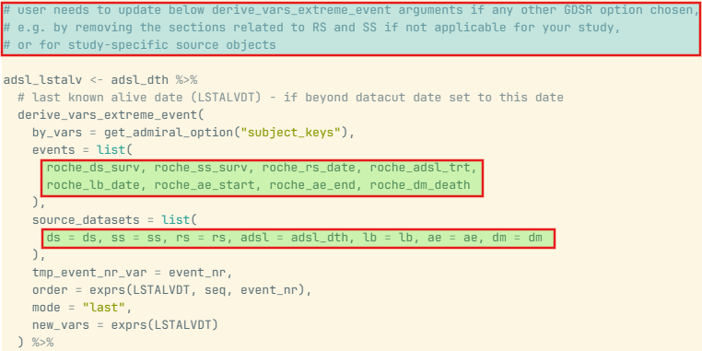
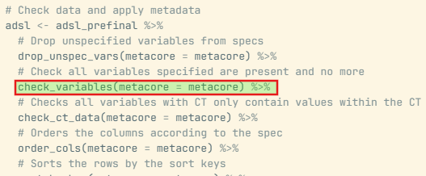
{admiralroche}’s initial (static) ADaM templates
Throughout its first releases, {admiralroche} provided static ADaM templates, accessible through use_ad_template(package = “admiralroche”) matching the specifications of the datasets in our Roche standards (ADSL, ADAE, ADVS, etc.)
Pros
Simple to maintain for devs
Simple for users to access and use
Easiest way to initially set up {admiralroche}
Cons
Difficult to cater for many different options, especially if complex
Duplication of code for sections common to all templates
Users required to update green portions if not using most common option
An update to this function would require updating every template

Slide 10
Summary: where are we at so far?
Stage | How is a typical template (e.g. ADSL) generated and served to the user?
Stage 1: Code | Static ad_adsl.R template program is directly provided by {admiralroche}

Slide 11
Stage 2: Code that writes code?!

Slide 12
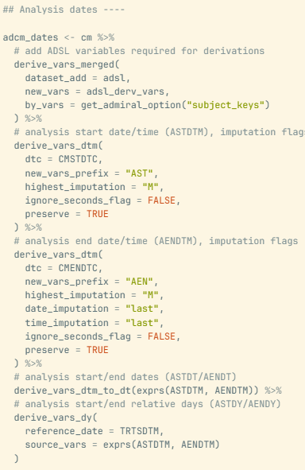
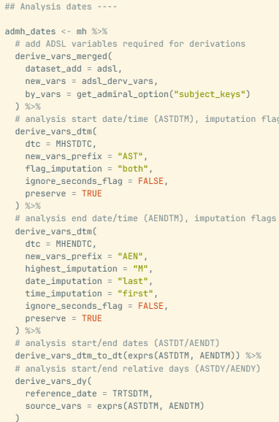
Abstracting away common chunks of the templates (1/3)
😤Issue: After a while, {admiralroche} contained >20 ADaM templates, with many common or similar sections. Updating one of those meant potentially having to identically edit 20 files.
Eg: ADCM and ADMH templates contain almost identical sequence of 5 {admiral} code blocks to set up analysis dates, with some key differences.
For just the blue AENDTM block, we see:
Different source variable names (CMENDTC vs MHENDTC)
Different time imputation (“first” vs “last”)
🤔Can we do better than just duplicating this code? 🤔

Slide 13
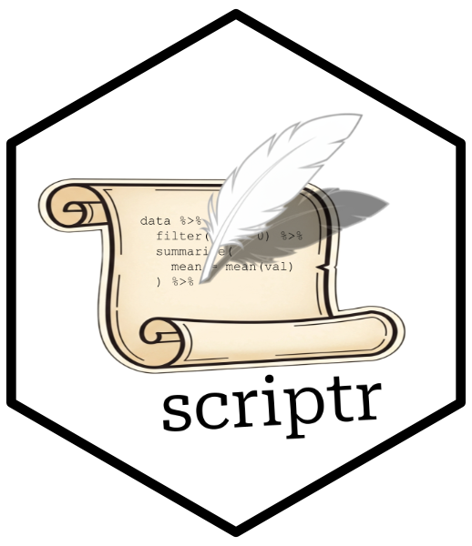
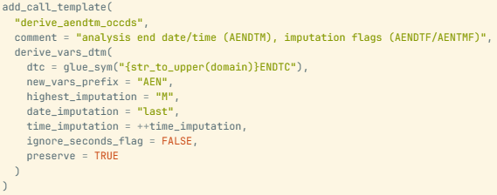
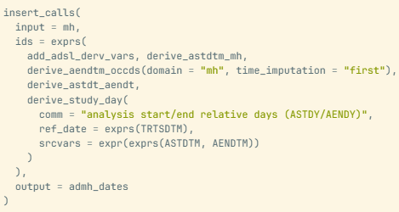
Abstracting away common chunks of the templates (2/3)
💡Solution: What if we abstracted away the common sections, to dynamically build and maintain ADaM templates using a combination of common and dataset-specific chunks?
….enter the {scriptr} package! {scriptr} is an internal Roche package built to store code in a central place and use it to generate scripts.
Example:
…and then use the abstracted chunks to construct the ACDM/ADMH templates. The call below constructs the 5 ADMH blocks from the previous slide.
We can abstract away each block (e.g. the blue AENDTM block from before) using {scriptr}...

Slide 14
Abstracting away common chunks of the templates (3/3)
In summary:
{admiralroche} was refactored internally to create a “library” of generic code chunks (powered by {scriptr} that were used to construct our ~20 ADaM template scripts (code that writes code!)
Now, any update to an {admiral}/{admiralroche} function requires updating each chunk rather than each template. The chunks also ensure consistency across datasets (same derivation in two datasets → same chunk used → identical code generated)
Importantly, this had no impact to our users, who could still access the templates using:
use_ad_template(“<adam_name>”, package = “admiralroche”)
🤔But why stop here?🤔
Now that we had this library of code chunks, why not just ask our users which chunks they want (i.e. which standards they are following) to build them a template which is closer to their end goal?

Slide 15
Summary: where are we at so far?
Stage | How is a typical template (e.g. ADSL) generated and served to the user?
Stage 1: Code | ad_adsl.R template programs provided by {admiralroche}
Stage 2: Code that writes code | Internal create_ad_adsl.R script combines generic chunks to construct ad_adsl.R template - still provided to users through {admiralroche}

Slide 16
Stage 3: Code that writes code that writes code!

Slide 17
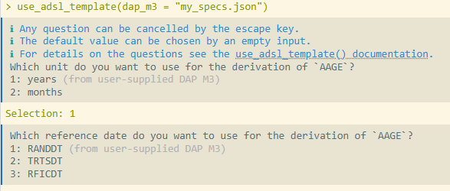
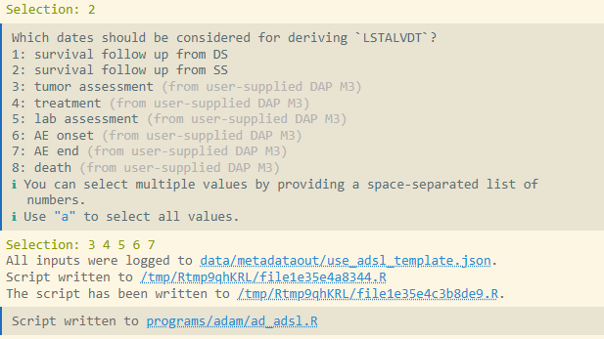
Building “dynamic” ADaM templates (1/2)
🆕In the latest {admiralroche} releases, we:
Expanded our “library of chunks” to create options and/or variants for all possible choices mentioned in our global standards - not just the most popular ones!
Created dynamic use_<adam>_template() functions which identify user preferences through the CLI and then pick the right chunks to use to construct their ADaM templates (code that writes code that writes code!)
  Users can also feed in their specifications so that the function may attempt to identify a choice by default (by scanning the derivation text and looking for keywords).
<...>
Defaults from specs
Notice ss, ds, death not required

Slide 18
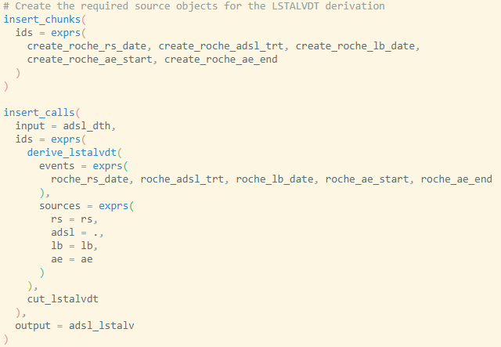
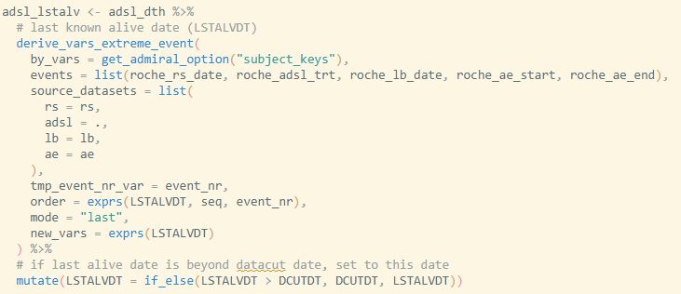
Building “dynamic” ADaM templates (2/2)
➡️Let’s follow through the selection for LSTALVDT:
Internally, the correct chunks are identified and set up for the last alive date derivation (excluding ds, ss)...
…to end up with the correct LSTALVDT block in the ADSL template!

Slide 19
Summary: where did we get to?
Stage | How are templates generated and served to the user?
Stage 1: Code | ad_adsl.R template programs provided by {admiralroche}
Stage 2: Code that writes code | Internal create_ad_adsl.R script combines generic chunks to construct ad_adsl.R template - still provided to users through {admiralroche}
Stage 3: Code that writes code that writes code | use_adsl_template() functions dynamically generates custom create_adsl.R script by choosing chunks based on user input, then create_adsl.R scripts is automatically executed to serve custom ad_adsl.R to the user

Slide 20
Conclusion: Reflections and Further Work, Recommendations

Slide 21
Reflections and Further Work
🤔Looking back…
It would have been difficult to jump straight to stage 3 (code that writes code that writes code) because our learnings from previous stages influenced design decisions.
The end product is a great example of a case where deterministic automation trumps probabilistic AI: we don’t have AI guessing what the ADaM code should be, rather we have a chunk library and use it to automatically build fit-for-purpose templates.
<Maybe add some metric to measure success?>
💡Looking forward…
AI agents should be able to read specifications and make selections for users.
Exposing statistical programmers to some of this infrastructure, allowing them to make their own chunks, to maintain study-specifics at higher level such as across-molecule or TA - maybe this is Stage 4 😮
Notes:
Mention:
Chunks could be unit-tested

Slide 22
Recommendations
You can easily set up your own {admiral<company>} package to begin with, at the very least to provide your users with templates that are a close starting point for their ADaMs.
These templates should be allowed to grow organically and stabilise before you attempt to abstract further.
Don’t underestimate the importance of setting up a package like {scriptr} as the automation engine.
A set of mature and stable company ADaM implementation standards is just as important as your R package.

Slide 23

Thank you for listening!
Special thank you to Stefan Bundfuss for his invaluable expertise and leadership as lead developer on {admiralroche} and {scriptr}
Thank you to Roche for allowing us to deliver this talk.

