Slide 1
Development and characterization of an atmospheric plasma source for non-thermal blood coagulation
Davide Mancini
1108971

Slide 2
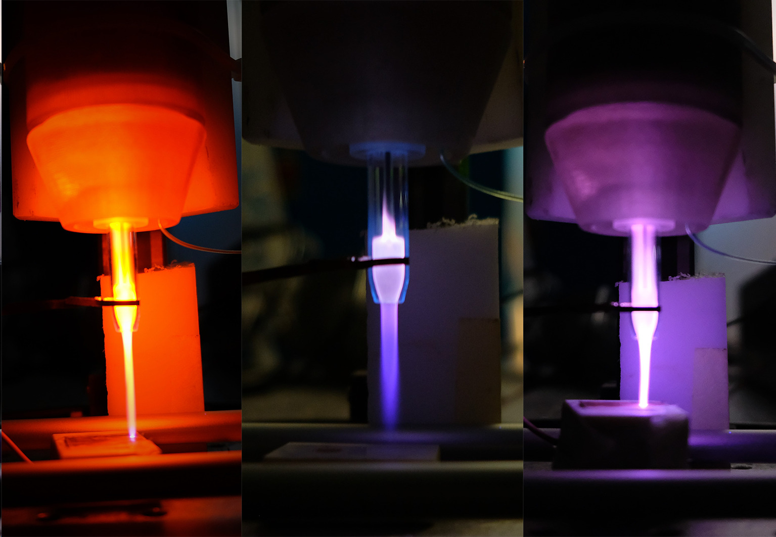
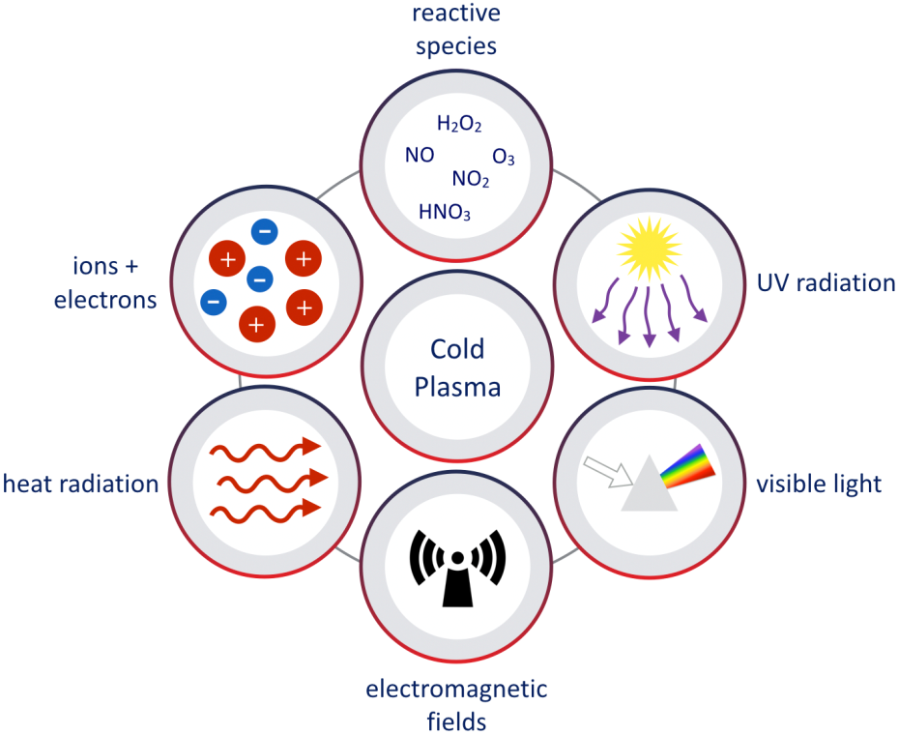
Cold Atmospheric Plasma for Plasma Medicine
Source realized by a specialized research group in Consorzio RFX Laboratories, in collaboration with Università Magna Graecia di Catanzaro
Plasma applied on biological tissues interacts through:
Reactive chemical species
UV radiation
Electromagnetic field
Plasma Medicine
Sterilization and decontamination
Wound disinfection and healing
Cancer cell treatment
Blood coagulation

Slide 3
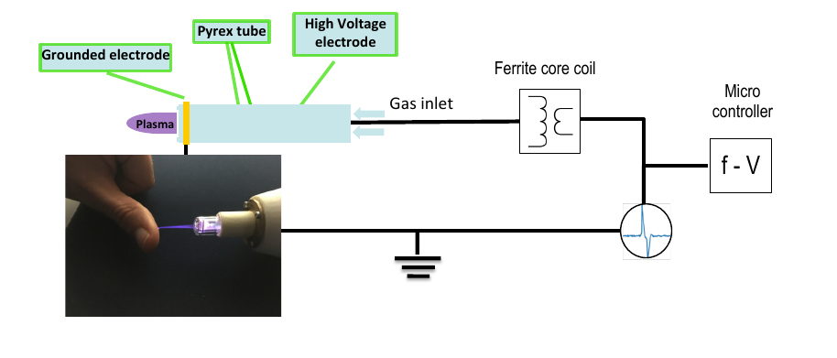
Plasma Coagulation Controller
Voltage pulse on electrode covered in dielectric = Dielectric Barrier Discharge
Neutral gas:
Helium
Neon
Argon
Pulse Repetition Rate
1 kHz < f < 40 kHz
Low current density on target
Low power deposition on target = low target temperature
Presence of Reactive Oxygen Species and Reactive Nitrogen Species = therapeutic effects

Slide 4
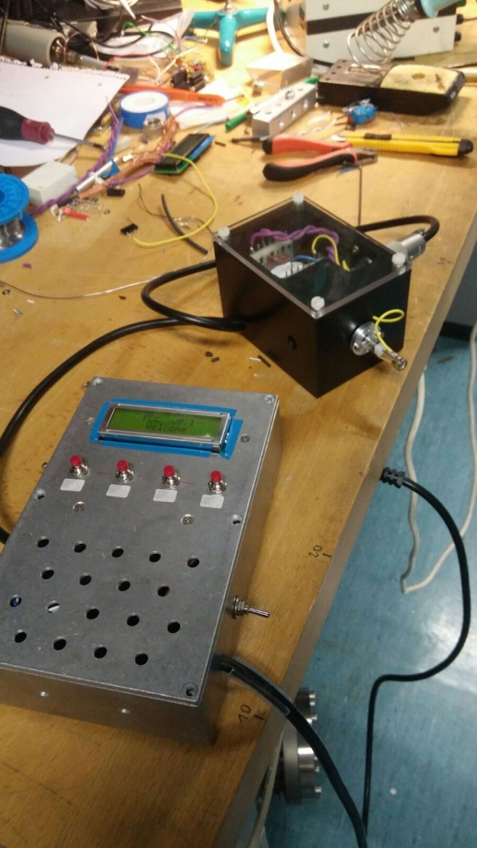
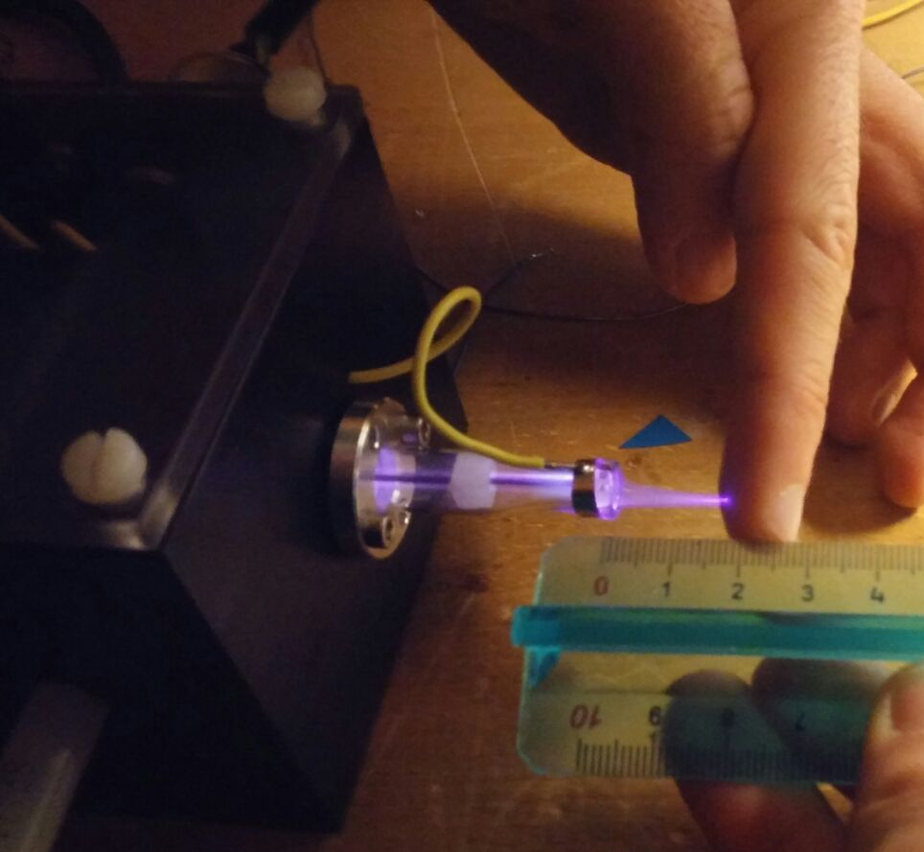
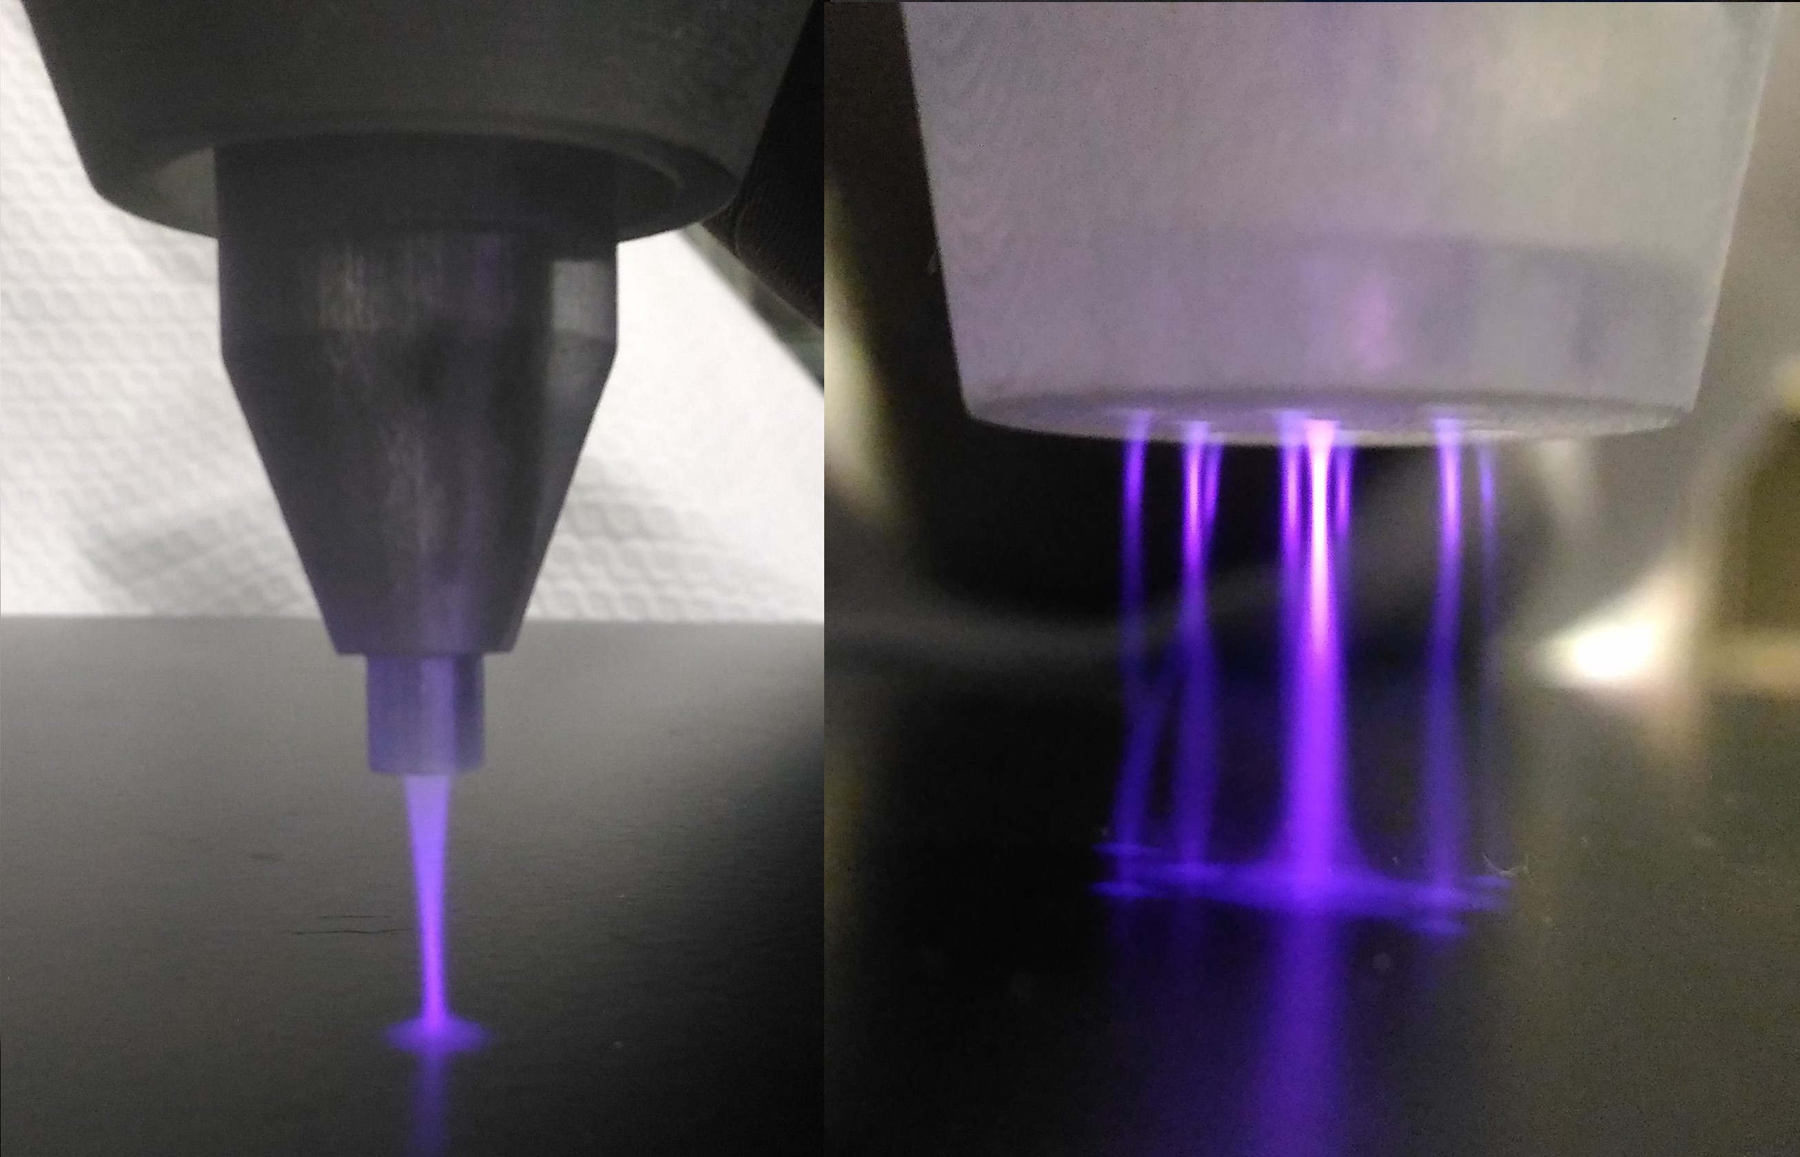
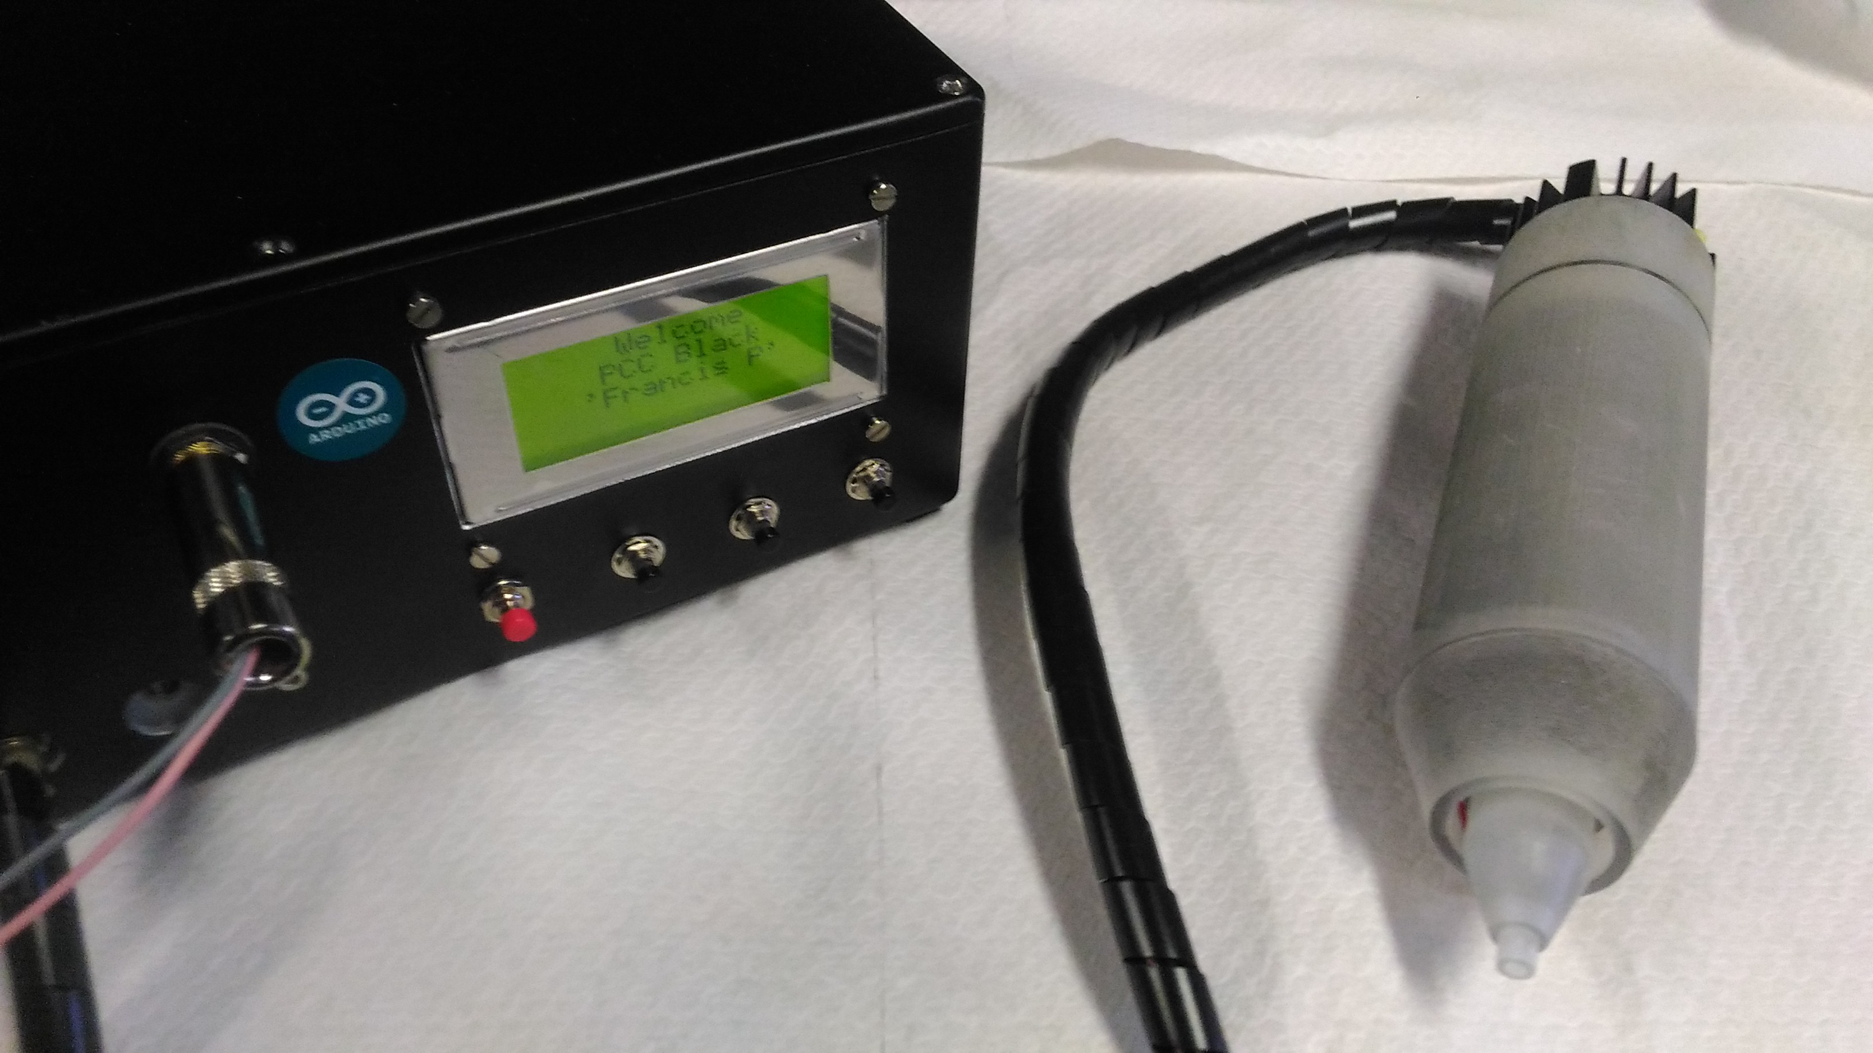
PCC development
From the first prototype:
Main improvements:
Higher ionization capabilities
Resolution of gas diffusion problems
Removal of high voltage signal reflection
Different geometry for higher maneuverability
Possibility of different nozzles
to the third:

Slide 5

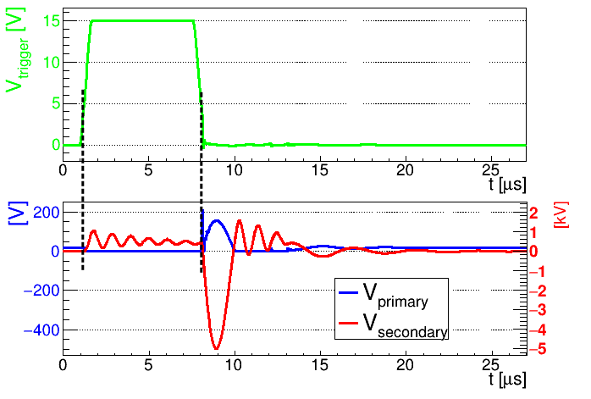
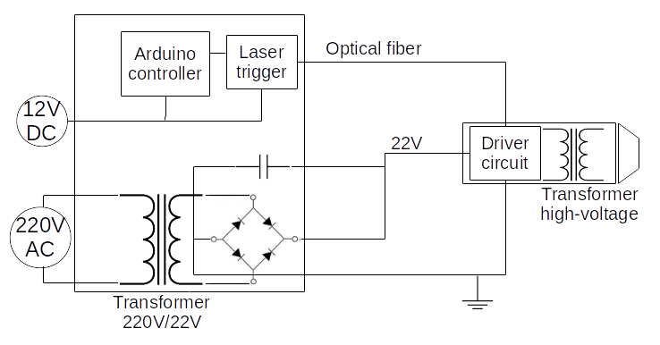
Electric characterization
Head module
Controller module
Plasma formation
Discharge trigger

Slide 6
Electric characterization
Δt
V_{p}
Head module
Controller module
Plasma formation
Discharge trigger

Slide 7
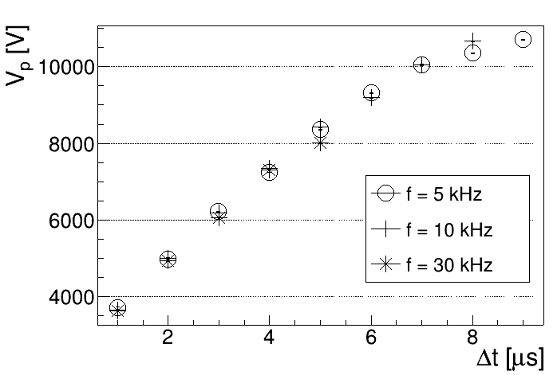
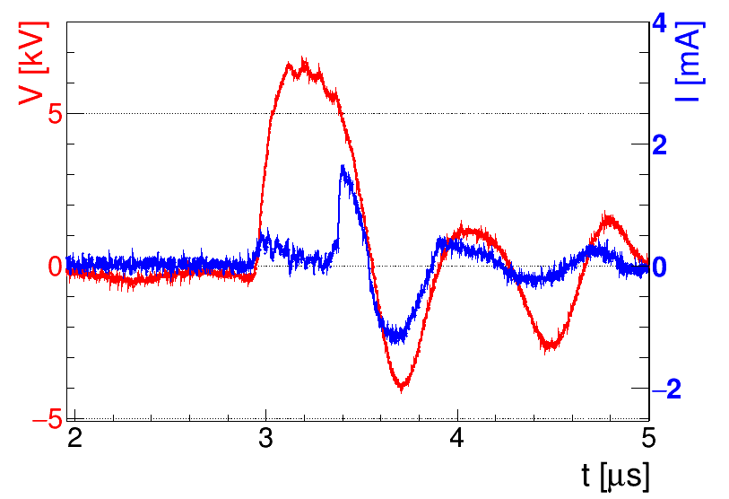
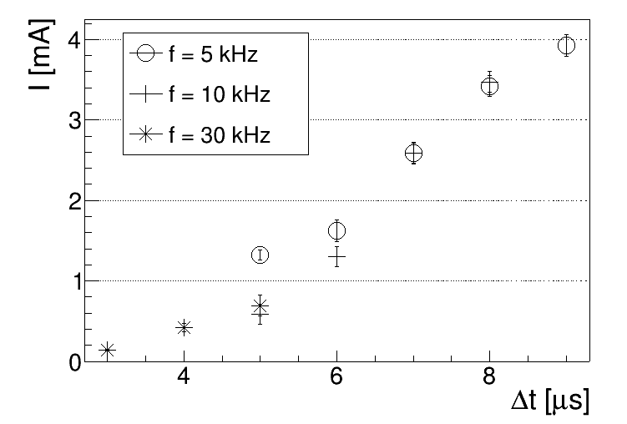
Electric characterization voltage and current measurements
Voltage
Linearity 4 < V_{p} < 10 kV
V_{p} independent from f
Pulse width ≈ 1 μs
Measurements of:
Voltage pulse amplitude
Current flowing in a copper target at 1cm from the nozzle
Current
Always < 10 mA

Slide 8
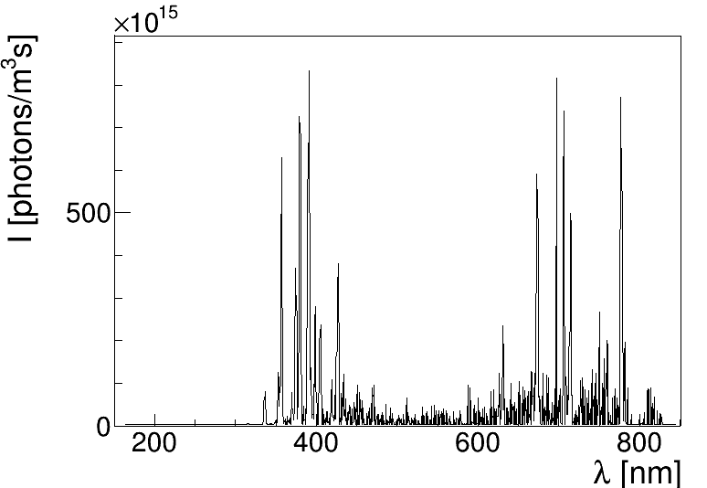
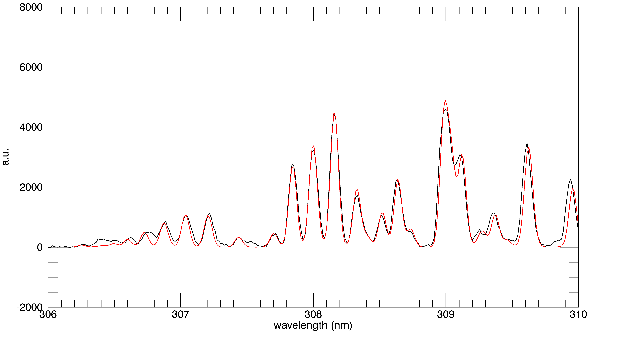
Optical Emission Spectroscopy
Example with helium flux
N₂⁺
He
O
Spectrometer range 150-850 nm
Emission spectrum of Helium, Neon, Argon or mixed flux.
N₂
Observed lines:
N₂ , N₂⁺ 320-480 nm (1st, 2nd order)
OH 300-310 nm (1st, 2nd order)
O 777 nm
He 706 nm (only with Helium)
Ne 410-780 nm (only with Neon)
Ar 660-850 nm (only with Argon)
OH
I [arb.u.]
308 - 310 nm

Slide 9
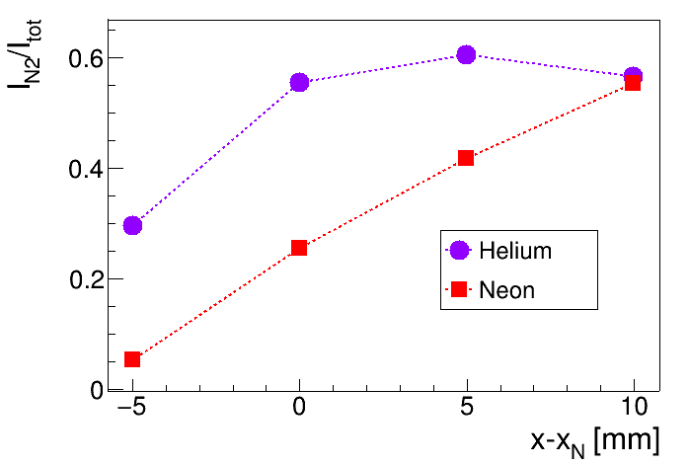
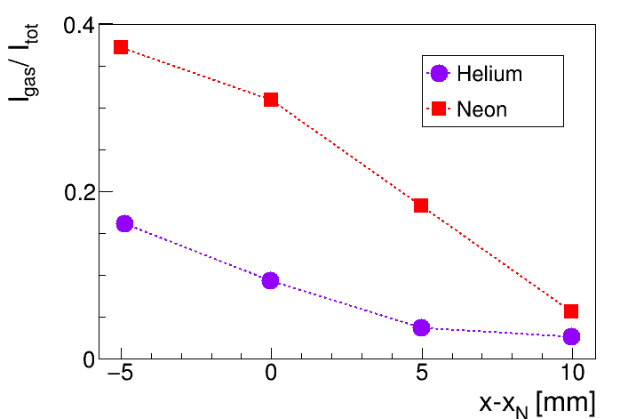
Optical Emission Spectroscopy emission intensity
N₂
Ne
He
Spectrometer
-5
0
5
10
From inside the nozzle to the outside:
N₂ emission increase
Gas (He or Ne) emission decrease
Gas
Grounded conductive target

Slide 10
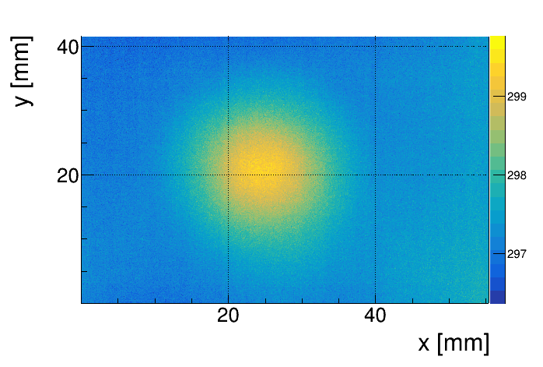
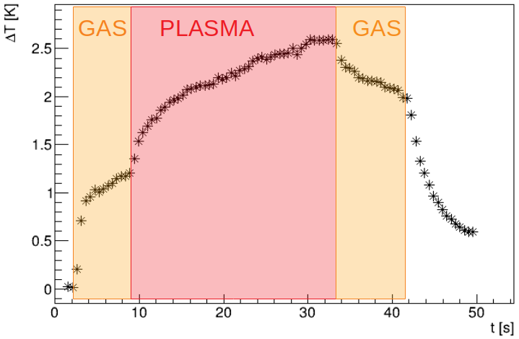
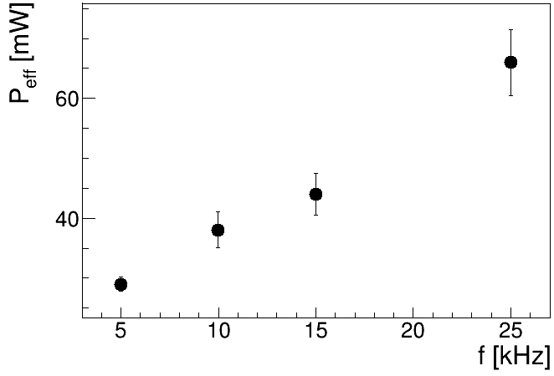
Target temperature and power estimate
Thermal camera measurements of aluminium target during plasma application with set discharge parameters and source-target distance.
Always ΔT_{MAX} < 3 K
for Δt ≈ 30 s

Slide 11
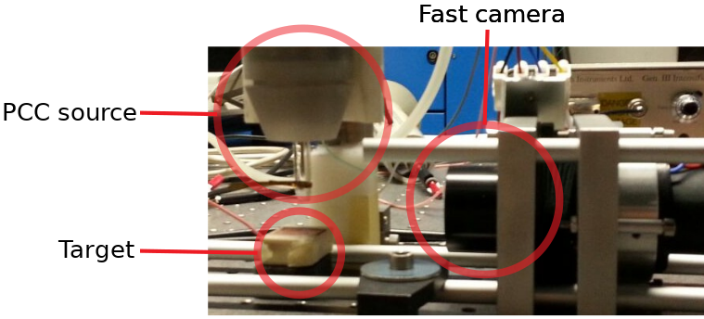
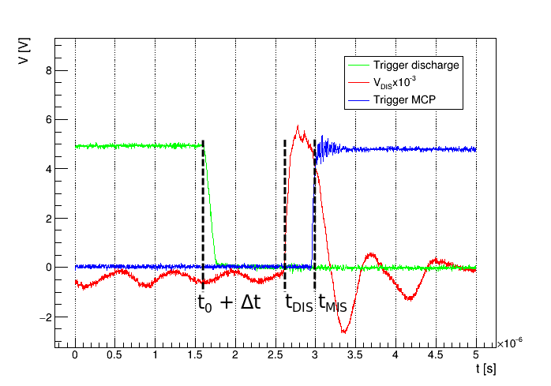
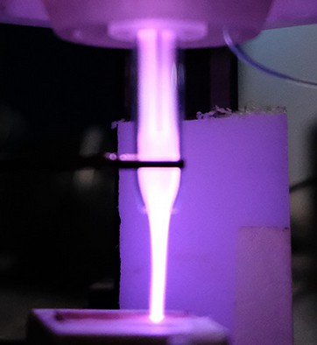

Fast camera measurements
Fast imaging allows us to see plasma formation and propagation.
Fast camera lens
Synchronization between discharge and camera allows us to see the evolution of the discharge.
Standard camera
integration time > 10ms
Fast camera
integration time = 15ns

Slide 12
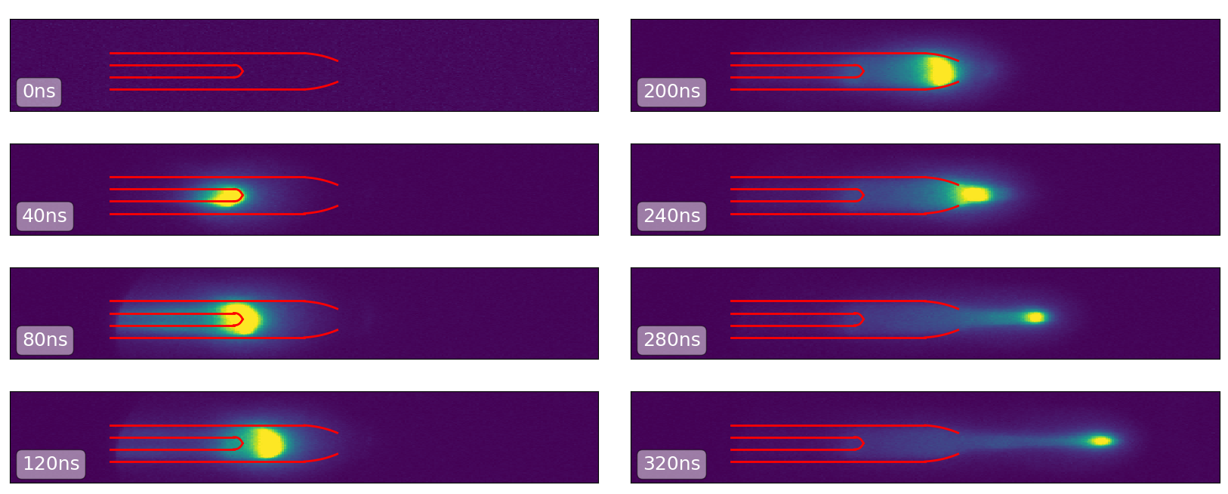
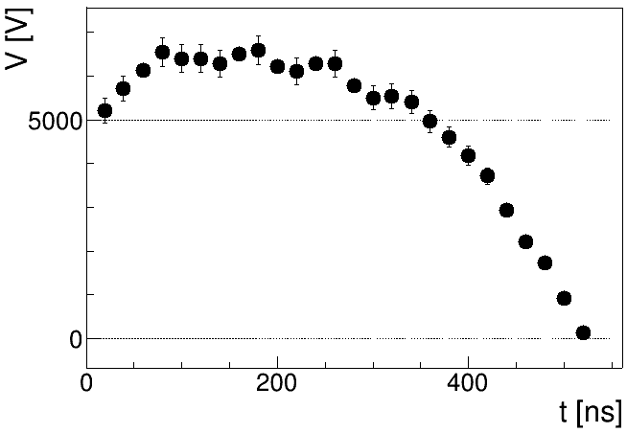
Helium and Neon plasma Bullets
b
a
c
d
Plasma propagates as bullets : a ionization front that moves from the electrode to the air outside.
Plasma forms first near the electrode (a), then the ionization continues inside the nozzle covering its entire area (b) and propagates in air with decreasing luminosity (c-d).
b
c
a
d

Slide 13
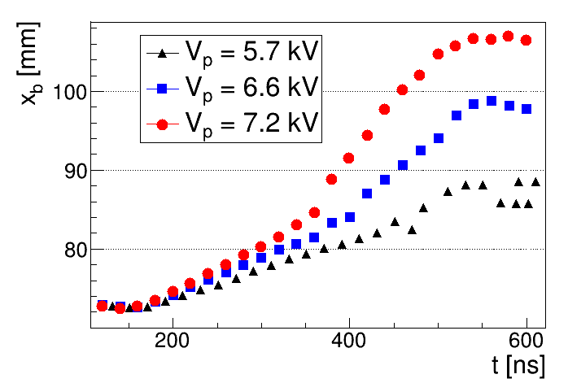
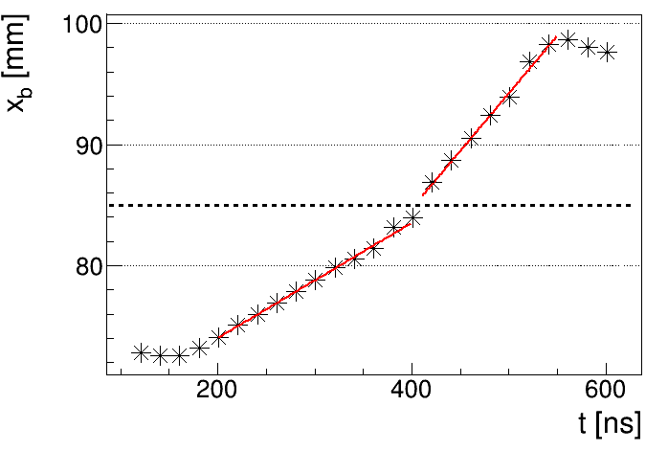
Bullet position and velocity
Plasma propagates from the electrode to the air.
Increasing voltage peak amplitude:
different distances
different velocities
v_{A}
a
v_{N} = velocity inside the nozzle
v_{A} = velocity in air
v_{N}

Slide 14
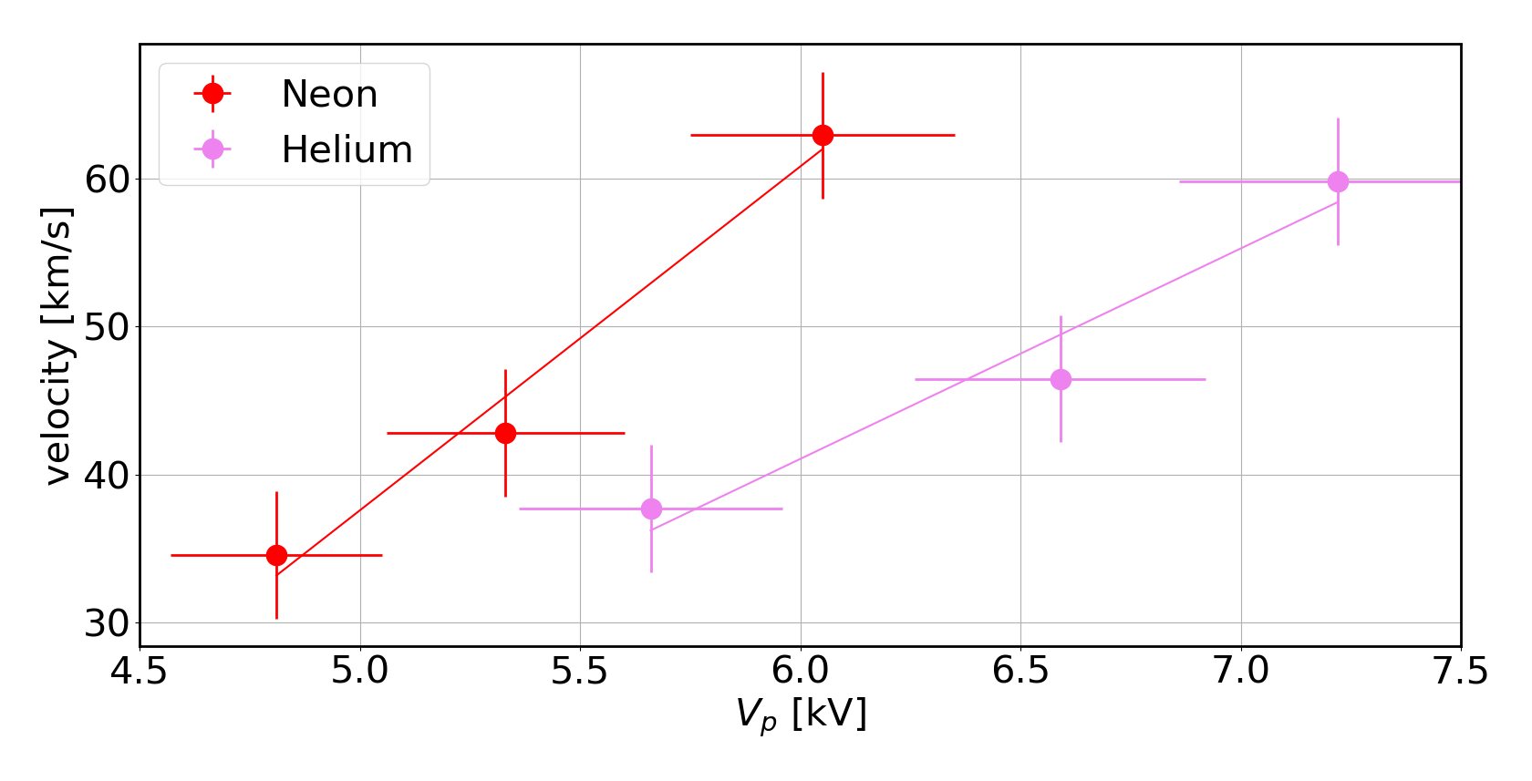
Bullet position and velocity
Gas | V_{p} [kV] | Δx_{MAX} [mm] | v_{N} [km/s] | v_{A} [km/s]
Helium | 5.7 ± 0.3 | 16.0 ± 0.8 | 37.7 ± 3.2 | -
 | 6.6 ± 0.3 | 26.1 ± 0.5 | 46.5 ± 4.0 | 95.2 ± 6.3
 | 7.2 ± 0.4 | 34.6 ± 0.5 | 59.8 ± 4.3 | 149.5 ± 11.9
Neon | 4.8 ± 0.2 | 18.1 ± 0.9 | 34.6 ± 3.0 | 43.2 ± 7.2
 | 5.3 ± 0.3 | 22.4 ± 0.8 | 42.8 ± 4.6 | 61.2 ± 6.8
 | 6.1 ± 0.3 | 26.6 ± 0.9 | 62.9 ± 5.1 | 160.3 ± 15.7
v_{A}
a
v_{N,Ne}
v_{N}
v_{N,He}
d

Slide 15
Electronic motion equations
Electron energy distribution f in 6-dim phase space, without magnetic field :
Boltzmann eq
Where C[f] is given by collisions.
First two moments:
Continuity eq
Drift diffusion eq
Where:
n is the electron density
S is the source term given by reactions
Γ is the electron flux
μ is the electron mobility
D is the electron diffusion coefficient

Slide 16
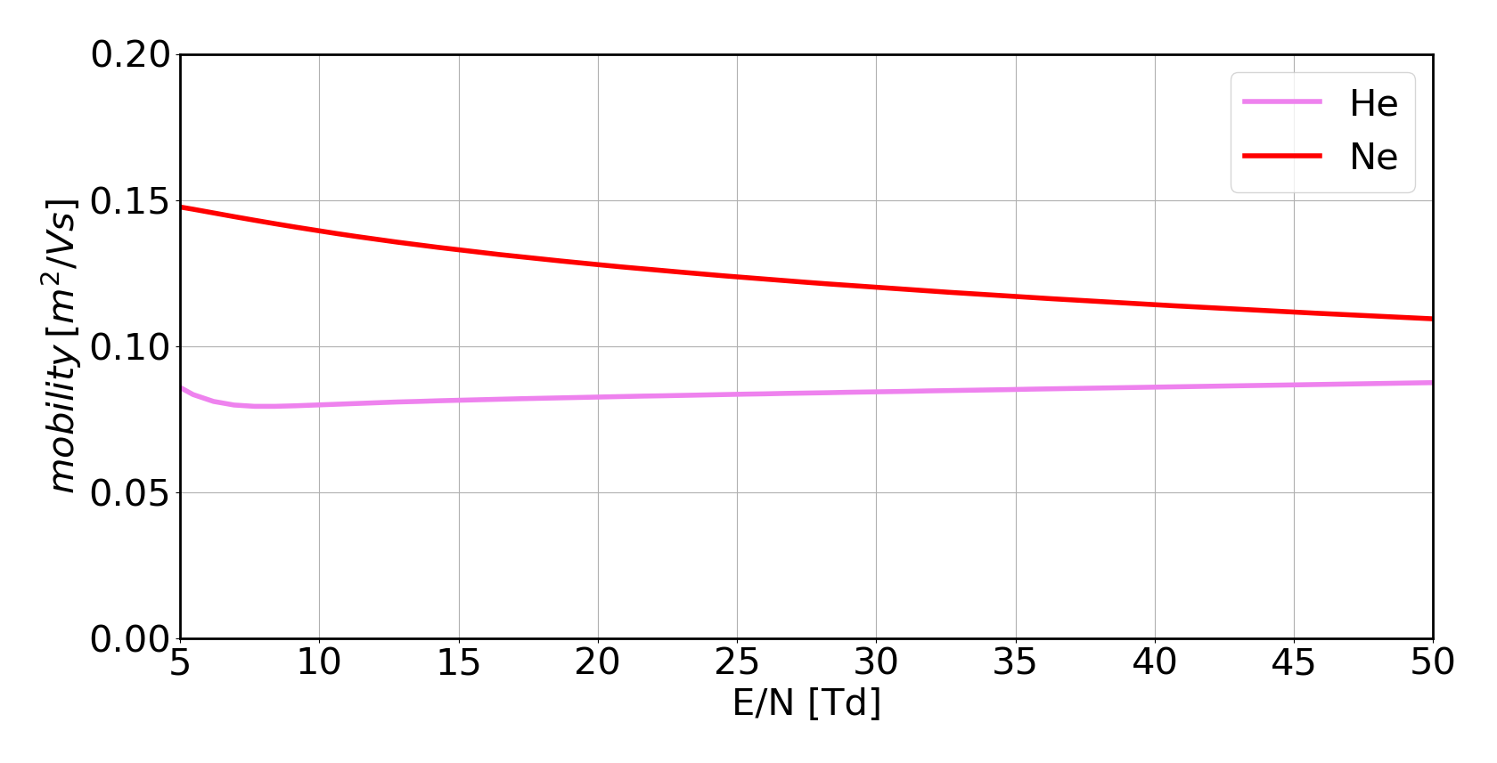
Electronic parameters
Previous equations can be solved by Bolsig+, a Boltzmann Equation solver for plasma with variable composition inside an electric field with variable intensity.
Atmospheric pressure electric fields from 130 V/mm to 1.3 kV/mm :
μ_{Ne}
μ_{He}
Bullet velocity related to electron mobility
*Submission of article “On the electrical and optical features of the PCC low temperature atmospheric plasma jet “ at Plasma

Slide 17
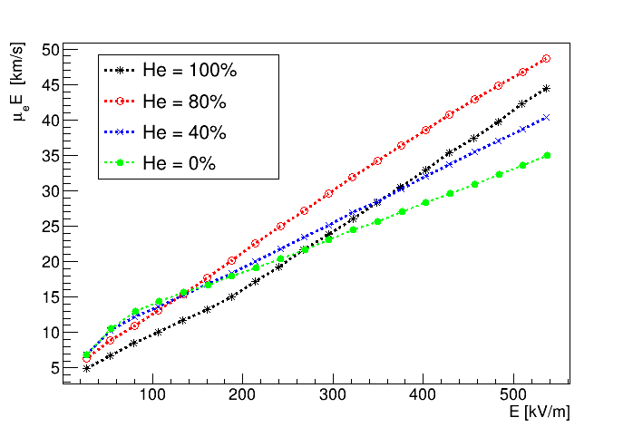
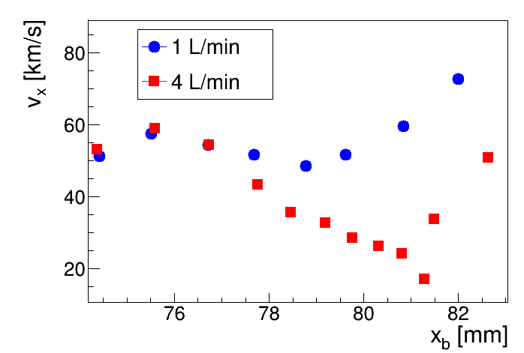
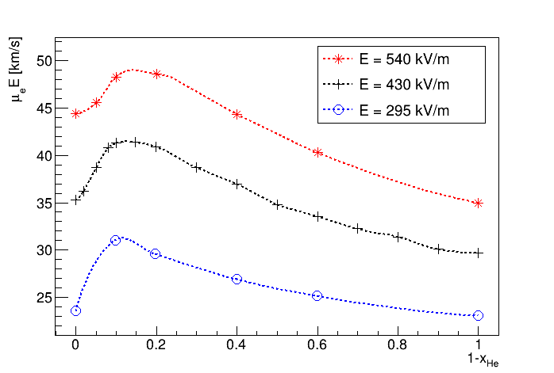
Drift velocity and bullet velocity
Drift velocity v_{D} = μ_{e}E
Bullet velocity decreases while distance from the electrode increases and increases while air concentration increases
Inside the nozzle, costant gas composition:
linearity between v and E
Outside the nozzle:
peak in v_{D} for increasing N₂ concentration

Slide 18
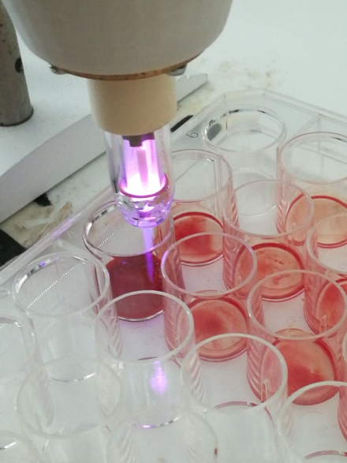
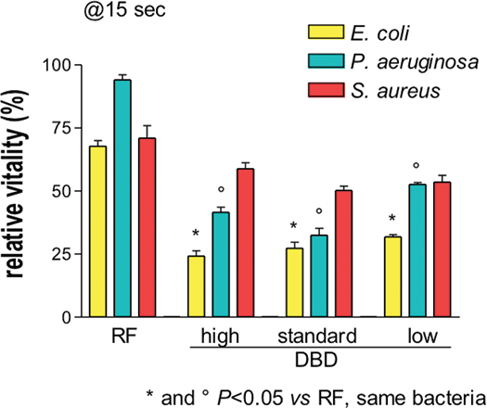
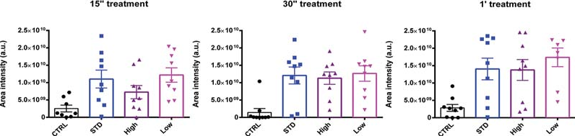
Non thermal blood coagulation
Good results for blood coagulation experiments
Good results for bactericidal experiments
Three different parameters setup

Slide 19
Conclusions and future development
In conclusion in this work was:
Developed the new PCC prototype.
Guaranteed fine control over voltage output and low current intensities.
Assured the presence of ROS and RNS, in different concentrations for different positions in plasma.
Studied plasma propagation dynamics in different conditions: changing voltage peak value, neutral gas, neutral gas flow, distance from a target, typology of target.
Plasma jet length, bullet velocity, current measurement are compared for Helium and Neon plasma, resulting that bullet velocity is correlated with electron mobility.
Future development
Formulation of a model that could explain measurements and observations collected with this work.
Further measurements, including the evaluation of the electric field around the electrode.
Start of clinical trials on human patients.
Thank you for your attention

Slide 20
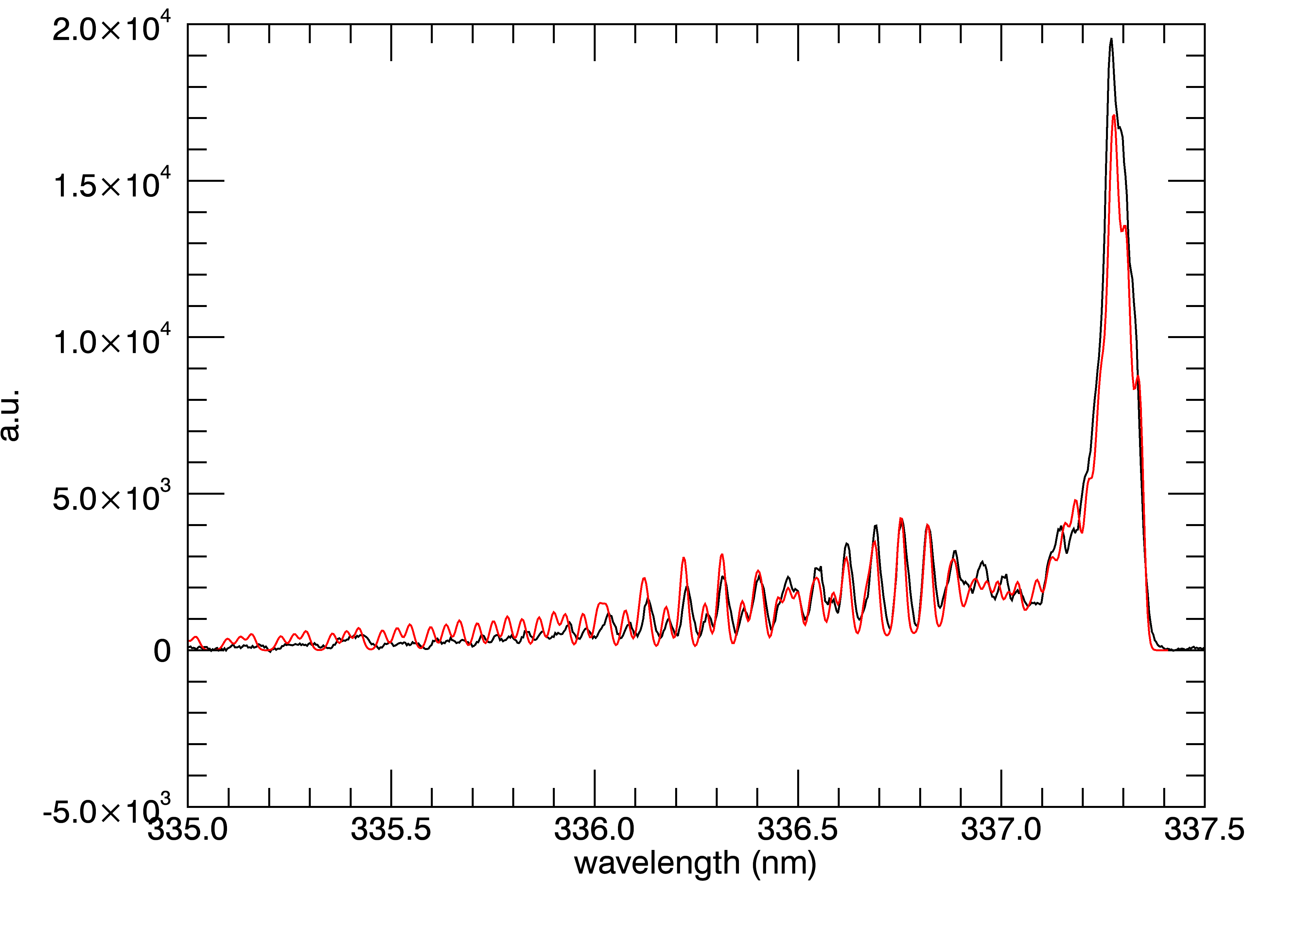
Optical Emission Spectroscopy temperature estimation
An high resolution spectrometer allows us to observe OH and N₂ rotational bands.
Through a simulation of the rotational spectrum of the molecule it is possible to estimate its rotational temperature, which is approximately the temperature of the molecule itself.
T_{rot} ≈ T_{ion}
T_{rot, OH} = 352 ± 38
T_{rot, N2} = 321 ± 41

Slide 21
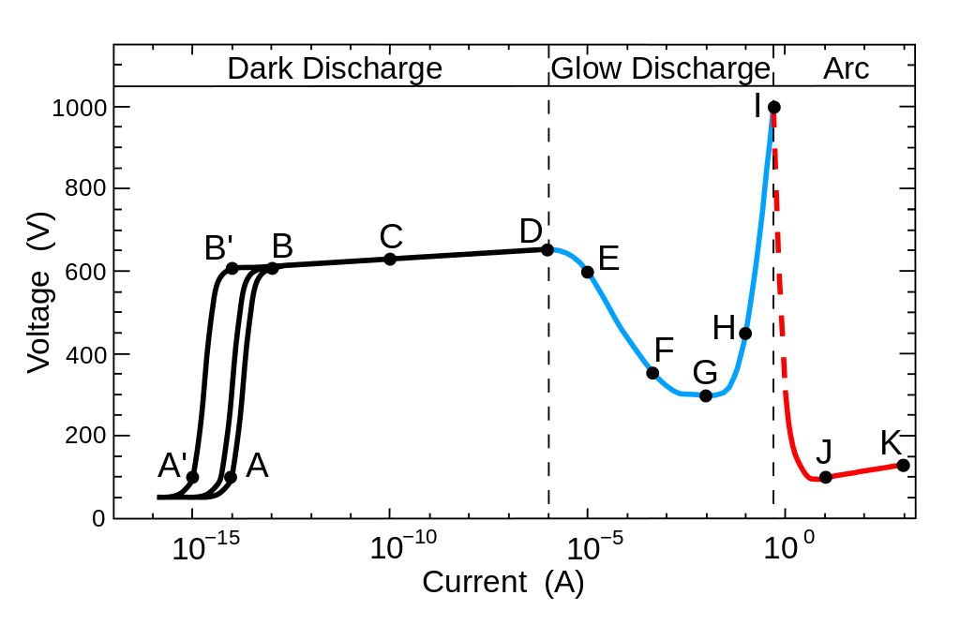
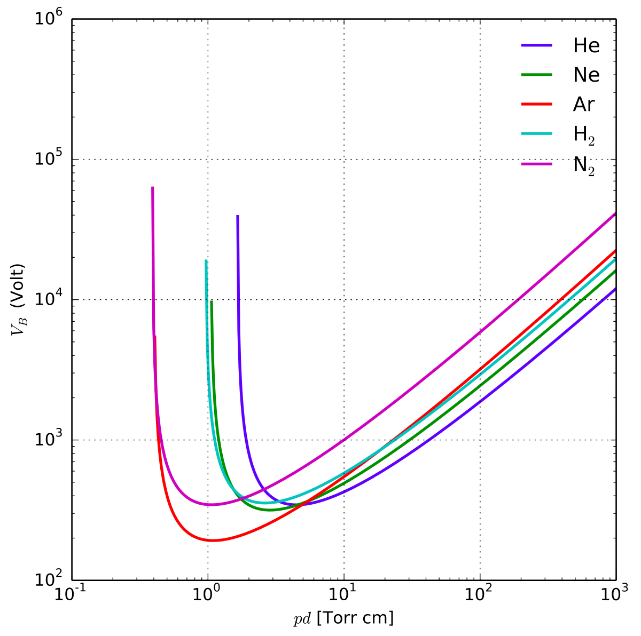
Plasma discharge
F = subnormal glow discharge
G = normal glow discharge
H = abnormal glow discharge
Paschen breakdown curve

Slide 22
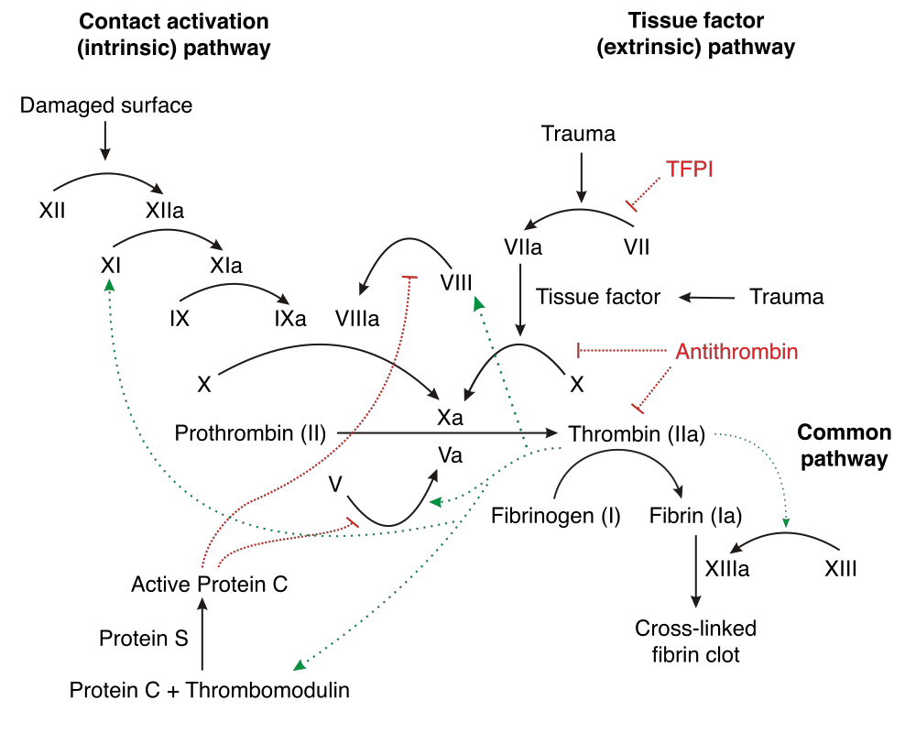
Non thermal blood coagulation
Two pathways, many tissue factors and proteins involved. PCC improves Prothtrombin and Thrombin production.

Slide 23
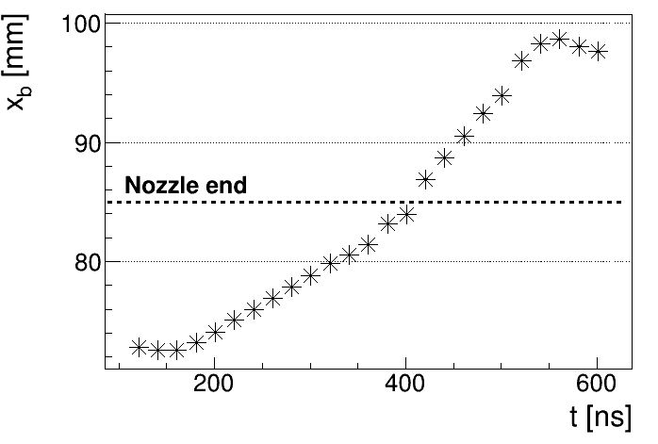
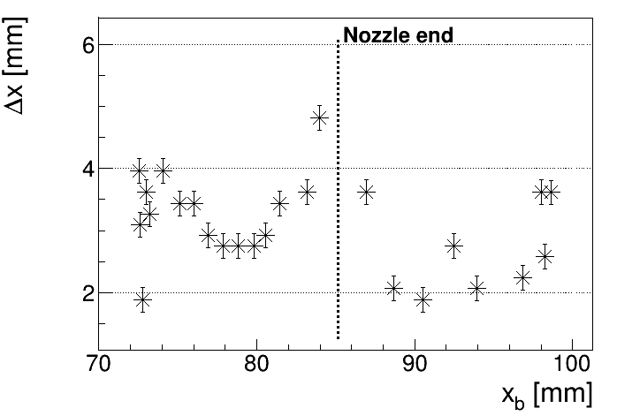
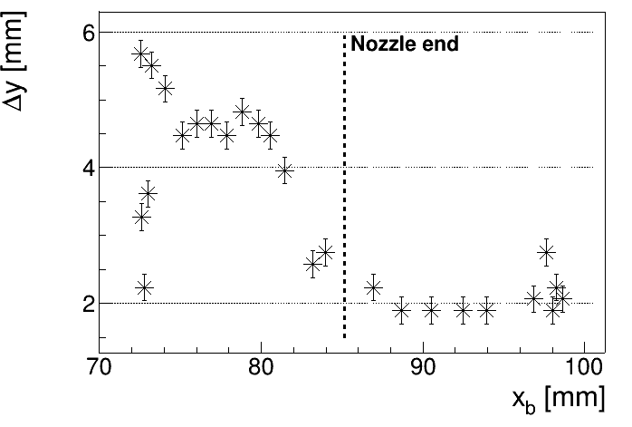
Bullet position and dimensions
The bullet propagates from the electrode to the end of the nozzle (velocity v_{N}> 40 km/s) with constant diameters.
When the bullet meets the air it speeds up (v_{A}> 80 km/s) and propagates with lower diameters until it stops.
b
a
c
d

Slide 24
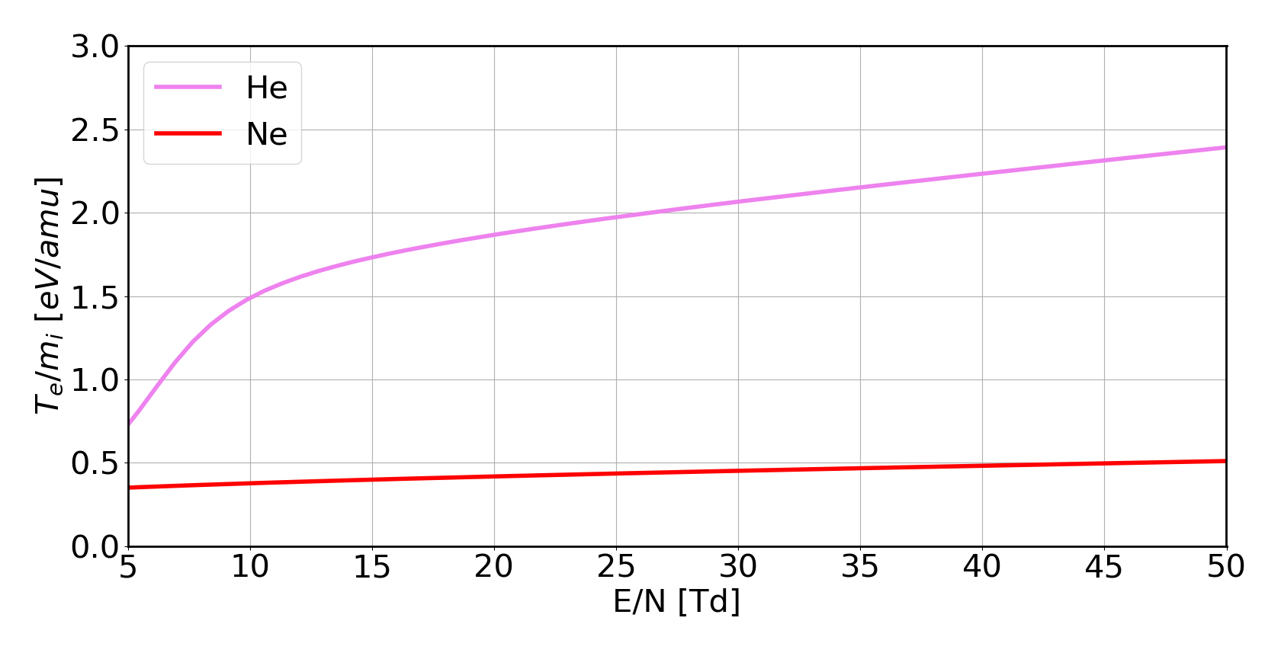
Electronic parameters
Previous equations can be solved by Bolsig+, a Boltzmann Equation solver for plasma with variable composition inside an electric field with variable intensity.
Helium and neon plasma at atmospheric pressure, electric fields from 130 V/mm to 1.3 kV/mm :
Bullet velocity not related to ion wave propagation
Bullet velocity related to electron mobility

Slide 25
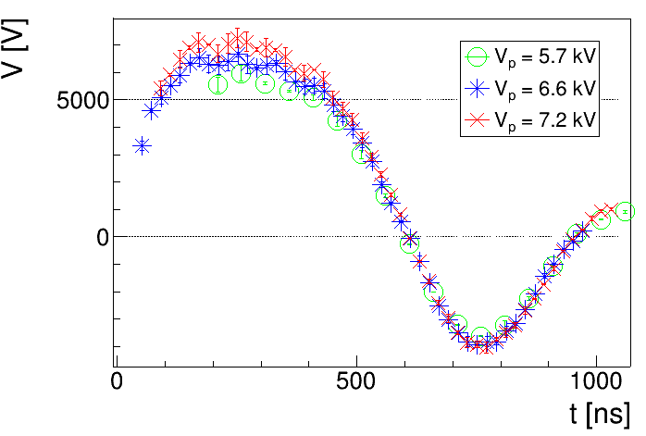
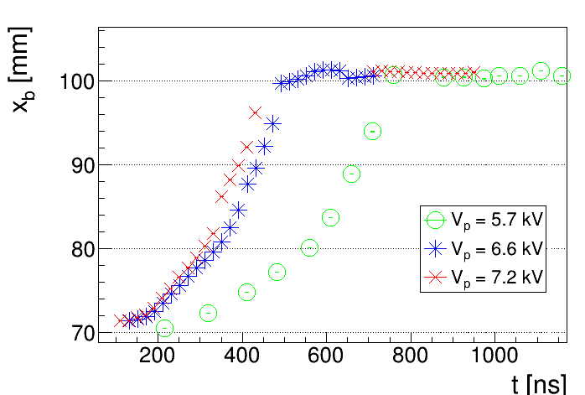
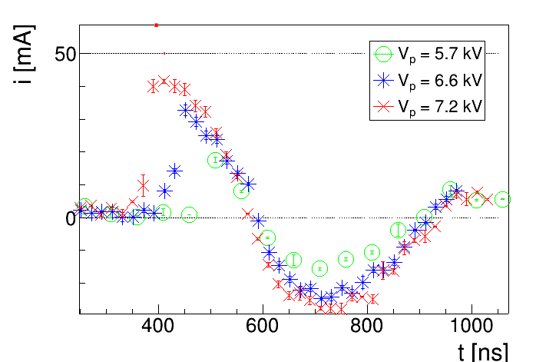

Current measurements
With a conductive target in front of the electrode: synchronization between voltage, fast camera and current measurements.
t_{0,i}
t_{imp}
Current is measured before bullet impact
t_{0,i} < t_{imp}

Slide 26
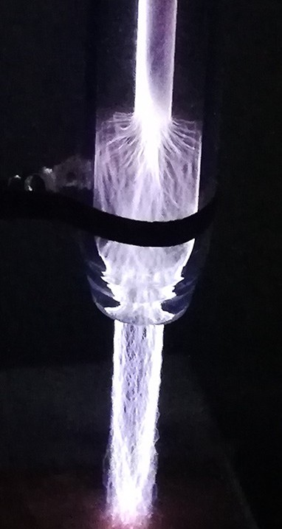
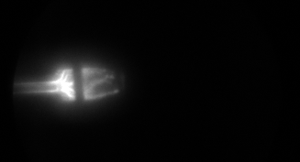
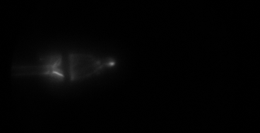
Argon plasma
Argon plasma is hard to produce, a conductive grounded ring around the nozzle helps the process.
Once ionized, Argon produces filaments instead of bullets.
t = 100ns
t = 220ns
Argon filaments goes from the electrode to the end of the nozzle.
After a certain time there are tiny round shaped plasma formations going out from the nozzle.
Is possible to study those formations as plasma bullets

Slide 27
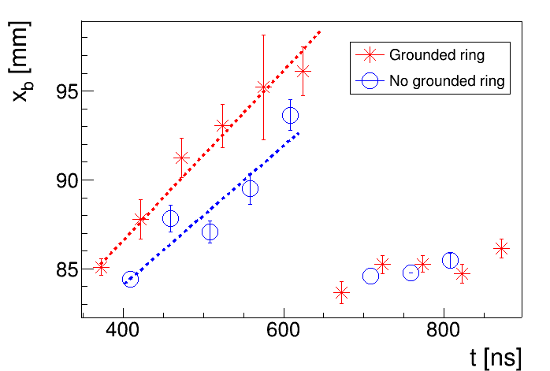
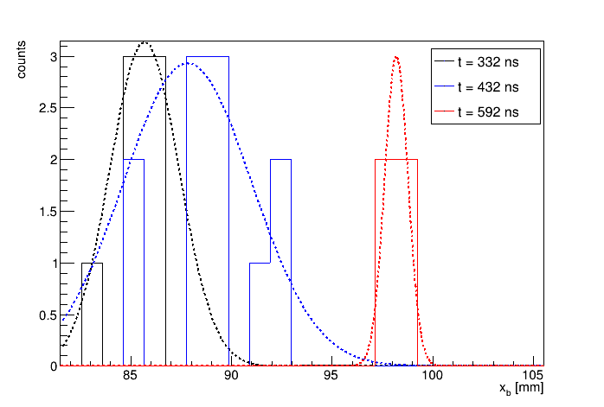

Argon plasma propagation
There is an average barycenter motion
For each time, histogram for:
positions
dimensions
and are evaluated average values
Without target
v_{A} = 47.9 ± 4.9 km/s
With target
v_{A} = 61.2 ± 2.8 km/s

