Slide 1

301 Java Microservice
How to implement a professional RESTFull API microservices application

Slide 2
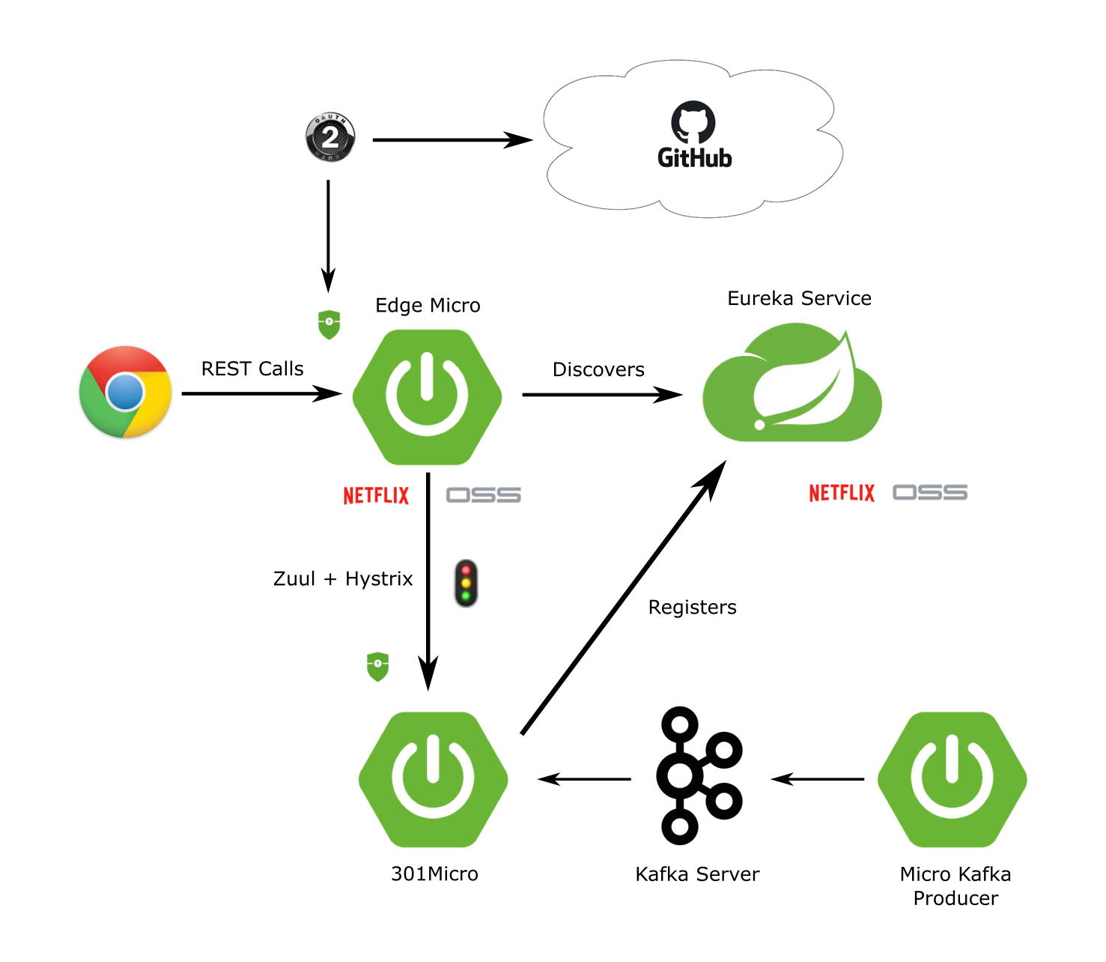
Software Architecture
Call made to the edge service
Edge service Authentication using outh2 and social log in GitHub
Calls routed to 301Micro thanks to Hystrix and Zuul
Eureka Service Discover and orchestrate communication between microservices
The producer update the employees rating
Source: https://developer.okta.com/blog/2018/02/13/secure-spring-microservices-with-oauth

Slide 3

Technology stack
Java 8
Spring Boot 2.3.1.RELEASE
Lombok
JPA
H2
Spring Cache
Javax validation
Spring Framework Cloud
Maven
Spring Security
Netflix Eureka, Hystrix and Zuul
Apache Kafka
OAuth2
GitHub
Junit

