Slide 1

301 Java Microservice
How to implement a professional RESTFull API microservices application

Slide 2
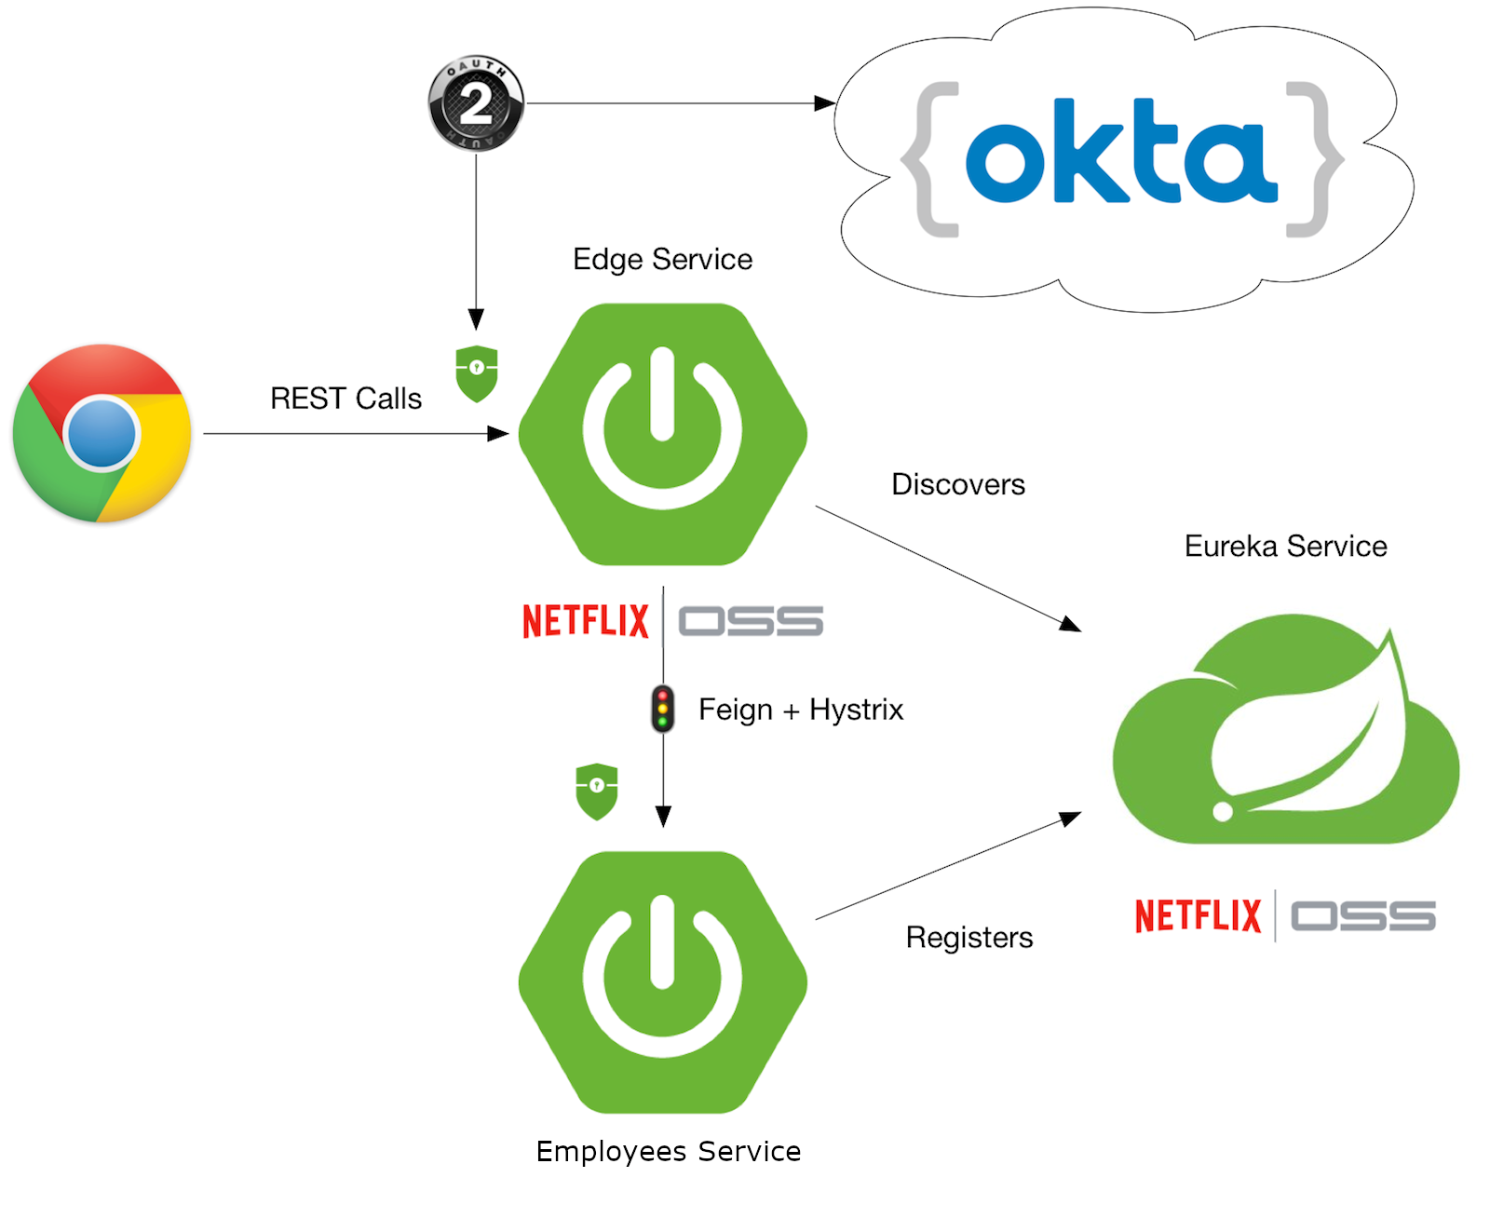
Software Architecture
Call made to the edge service
Edge service Authentication using outh2 and social log in Okta
Calls routed to Employees Service thanks to Feign Hystrix and Zuul
Eureka Service Discover and orchestrate communication between microservices
Source: https://developer.okta.com/blog/2018/02/13/secure-spring-microservices-with-oauth

Slide 3

Technology stack
Java 8
Spring Boot 2.3.1.RELEASE
Lombok
JPA
H2
Spring Cache
Javax validation
Spring Framework Cloud
Maven
Spring Security
Netflix Eureka, Hystrix and Zuul
OpenFeign
OAuth2
Okta
Junit

